Slide 1
LIVE THE WORD KIDS
23rd Sunday in Ordinary | Year C

Slide 2
GOSPEL REFLECTION
This Sunday, the church invites us to reflect on the divine community that exists in the very heart and life of God, who we praise as Father, Son and Holy Spirit. The Solemnity of the Most Holy Trinity is not a theological abstraction but a graced opportunity to contemplate the wondrous love of God who is a community of divine persons. This divine love of the Holy Trinity overflows into the world and into our lives.
The Solemnity of the Most Holy Trinity of Father, Son and Holy Spirit directs our gaze to a simple truth about who God is and who we are in relationship to God and one another. We believe in God who is a community of Father, Son and Holy Spirit and into whose life we are incorporated in baptism. We are baptized in the name of the Father, the Son and the Holy Spirit and made members of the family of God!

Slide 3
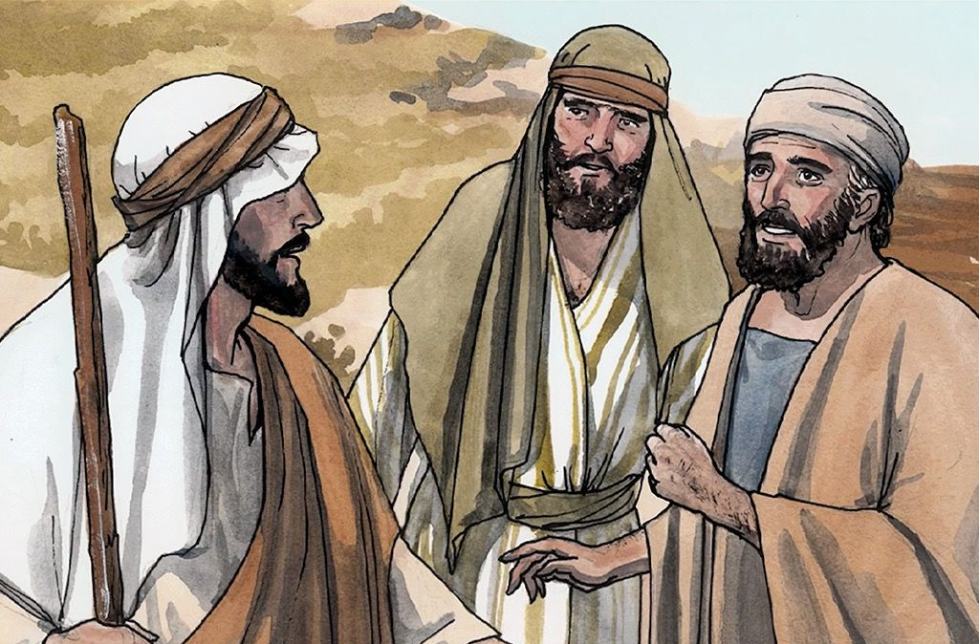
The Cost of Being a Disciple
Luke 14:25-33

Slide 4
Leader: A reading from
the Holy Gospel
according to John.
All: Glory to You, Oh Lord.

Slide 5
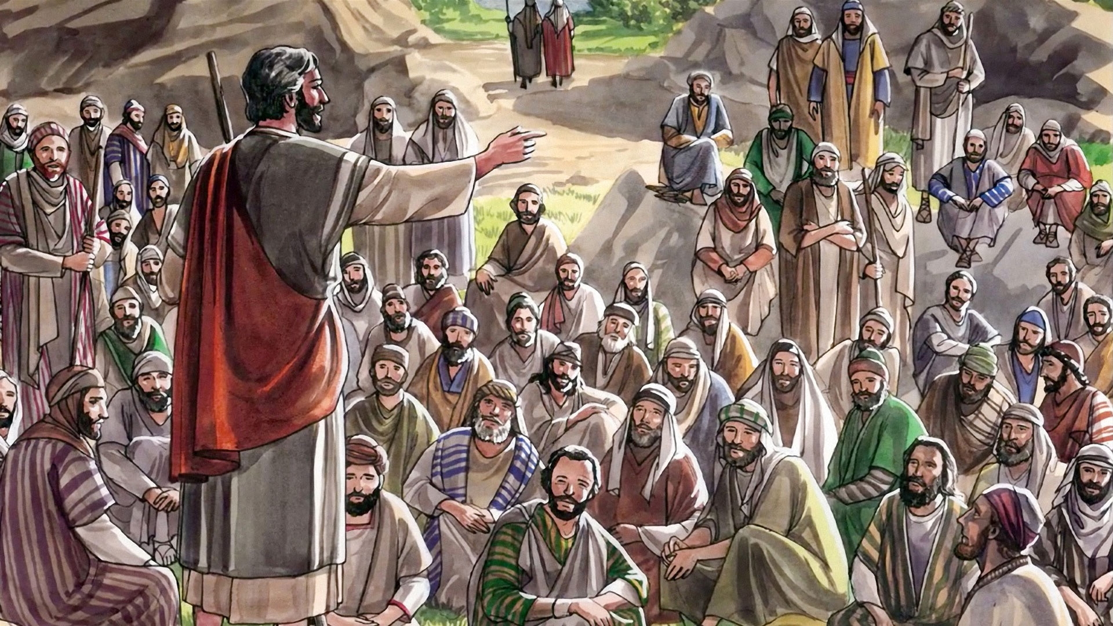
25
Once when large crowds of people were going along with Jesus, he turned and said to them
Notes:
After Jesus was baptized, he went out into the desert to pray.

Slide 6
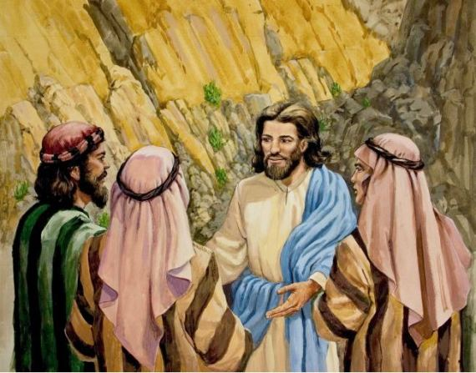
26
Those who come to me cannot be my disciples unless they love me more than they love father and mother, wife and children, brothers and sisters, and themselves as well.
Notes:
He stayed there a long time (40 days) and got very hungry. He had not eaten anything because He was trying to listen to God and do what he said.

Slide 7
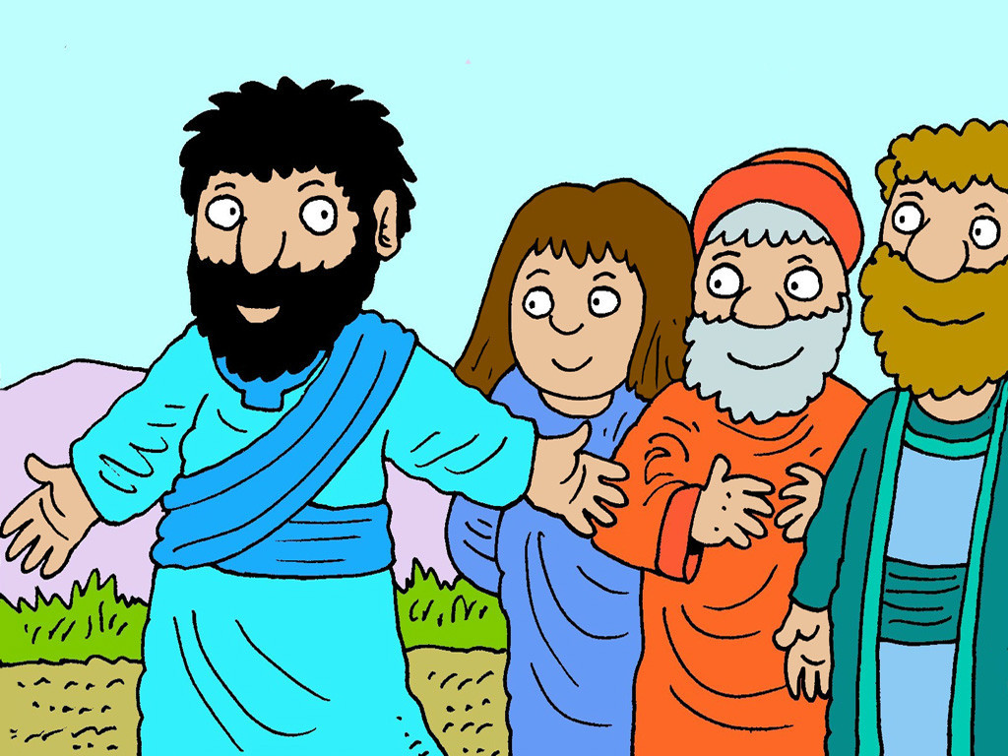
27
Those who do not carry their own cross and come after me cannot be my disciples.

Slide 8
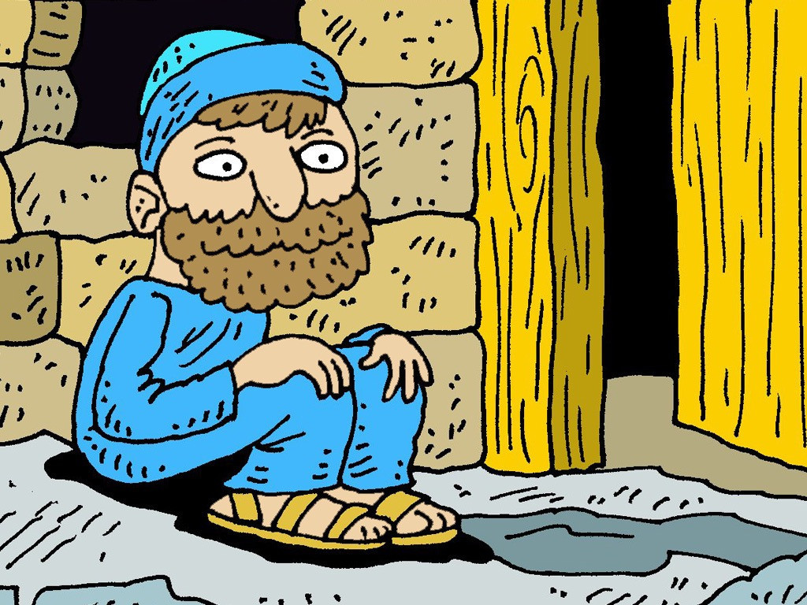
28
If one of you is planning to build a tower, you sit down first and figure out what it will cost, to see if you have enough money to finish the job.

Slide 9
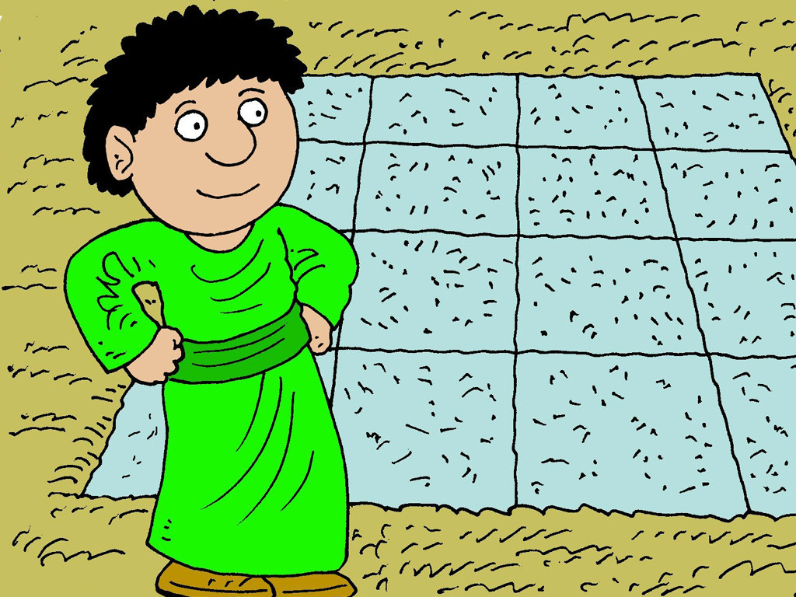
29
If you don't, you will not be able to finish the tower after laying the foundation; and all who see what happened will make fun of you.

Slide 10
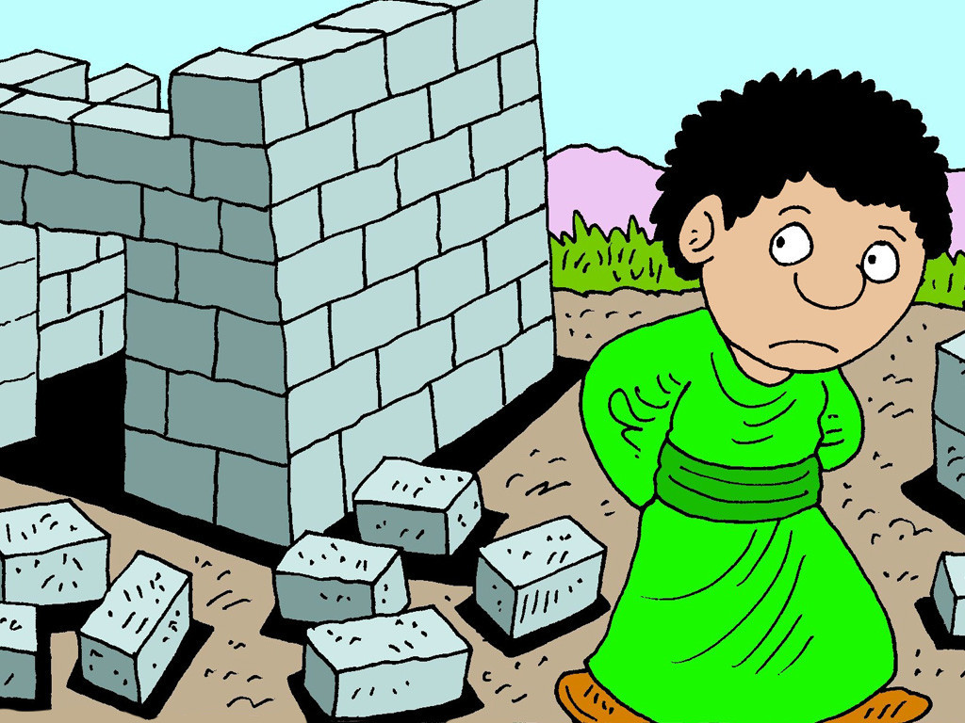
30
‘You began to build but can't finish the job!’ they will say.

Slide 11
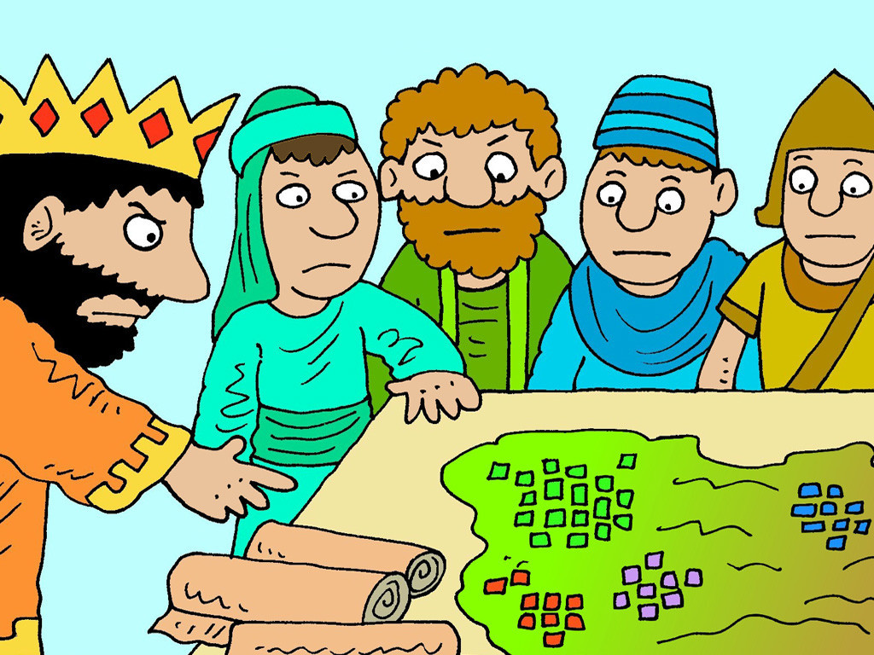
31
If a king goes out with ten thousand men to fight another king who comes against him with twenty thousand men, he will sit down first and decide if he is strong enough to face that other king.

Slide 12
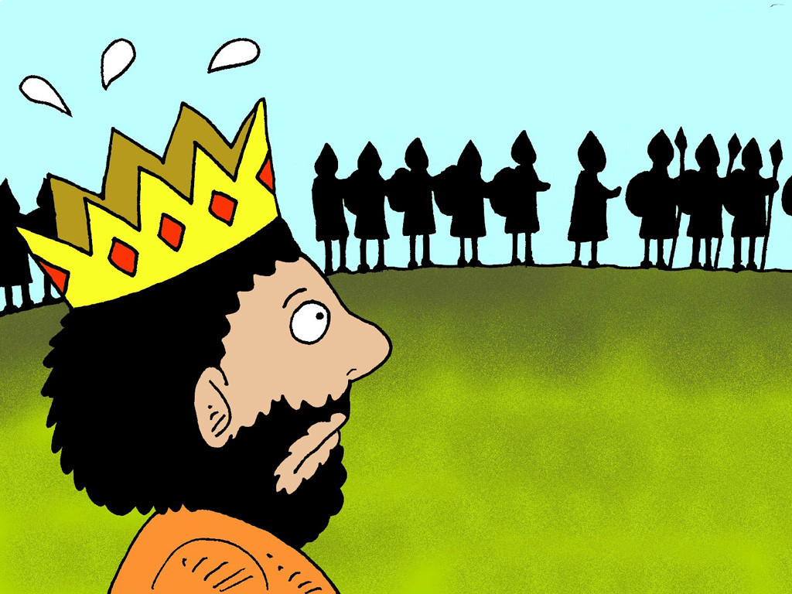
32
If he isn't, he will send messengers to meet the other king to ask for terms of peace while he is still a long way off.

Slide 13
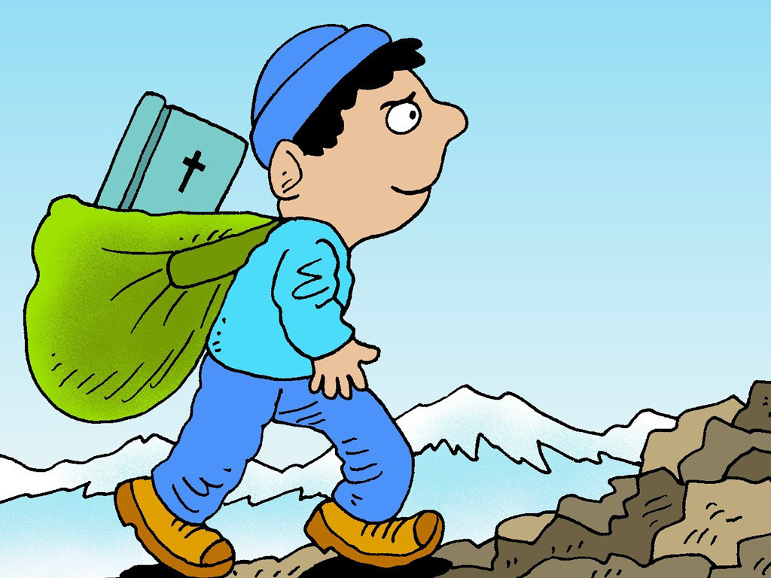
33
In the same way,” concluded Jesus, “none of you can be my disciple unless you give up everything you have.

Slide 14
Leader: The Gospel of the Lord.
All: Praise to You,
Lord Jesus Christ.

Slide 15
GOSPEL MESSAGE

Slide 16
Activity: Straw Tower
Straw
Colored Paper/ Bond Paper
Scissor
Markers
Coloring Material

Slide 17
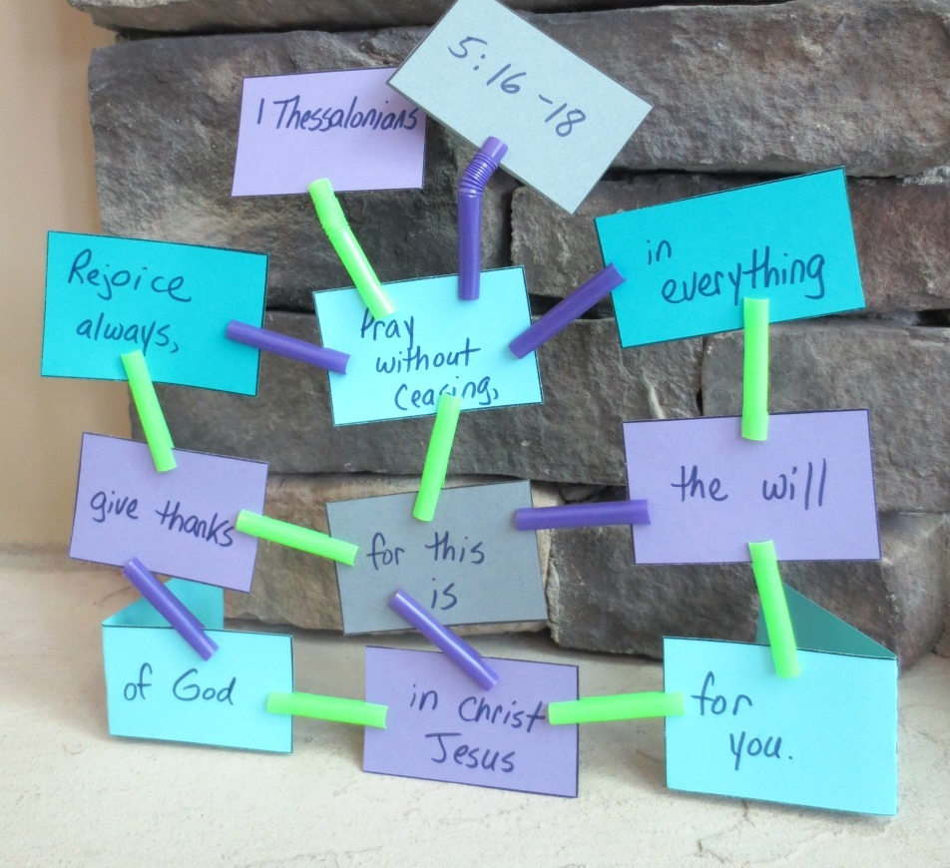
Instruction:
If age appropriate, have kids cut the colored/bond papers into a rectangle shape.
You can now write on the square on what ways you can be a good disciple of God.
Cut the straws into approximately 1.5 inch pieces. If you are using bendable straws, save that bendable part.
In each straw section, cut into the straw slightly on each side, make your cuts point toward each other. If you have kids do this, make sure they are using rounded scissors so they don’t cut themselves. This part can get a little tricky.

Slide 18
Instruction:
5. Once all of your straw sections are cut, fold the longer rectangles along the dotted line. These pieces will make your foundation corners.
6. Encourage your kids to decide what kind of a structure they would like to make.

Slide 19
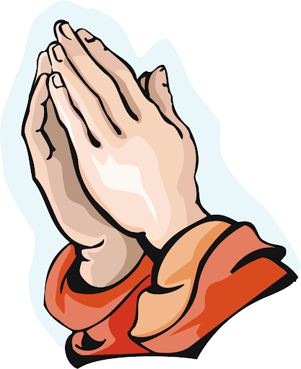
Closing Prayer
Dear God,
Thank you for always being there to guide us through the Father, Son and Holy Spirit. You never leave us in this journey of our life. Thank you for always making us happy.
In Jesus' name we pray. Amen.
Amen.

Slide 20
LIVE THE WORD KIDS
23rd Sunday in Ordinary | Year C

