Slide 1
LIVE THE WORD KIDS
31st Sunday in Ordinary | Year C

Slide 2
GOSPEL REFLECTION
The gospel reminded us that Jesus looks beyond our sins and love us despite of our imperfections. Being a tax collector during Jesus’s time were known to be a sinner for they are usually a corrupt. However, Jesus sees Zacchaeus as a son of Abraham regardless of what people entitled him to be, how good our God is to seek and to save the lost.
Jesus loved all kinds of people, and often associated with those that others did not like so much. He changed lives by this love, and transformed how people felt and behaved. Jesus offered mercy and forgiveness, and because of that we should demonstrate unconditional love to one another.

Slide 3
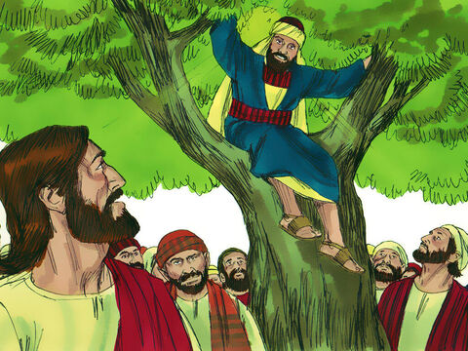
Jesus and Zacchaeus
Luke 19:1-10

Slide 4
Leader: A reading from
the Holy Gospel
according to Luke.
All: Glory to You, Oh Lord.

Slide 5
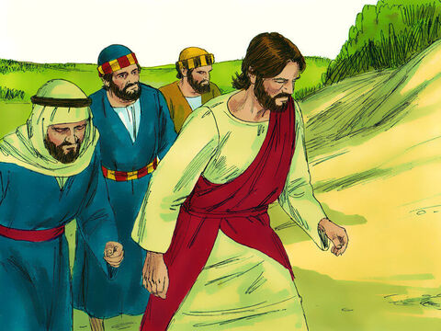
1
Jesus went on into Jericho and was passing through.

Slide 6
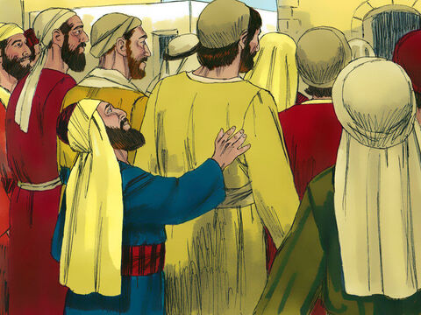
2
There was a chief tax collector there named Zacchaeus, who was rich.

Slide 7
3
He was trying to see who Jesus was, but he was a little man and could not see Jesus because of the crowd.

Slide 8
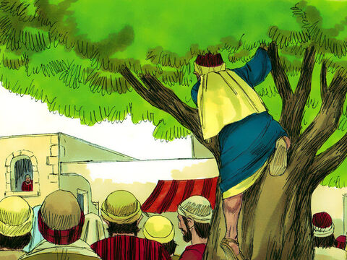
4
So he ran ahead of the crowd and climbed a sycamore tree to see Jesus, who was going to pass that way.

Slide 9
5
When Jesus came to that place, he looked up and said to Zacchaeus, “Hurry down, Zacchaeus, because I must stay in your house today.”

Slide 10
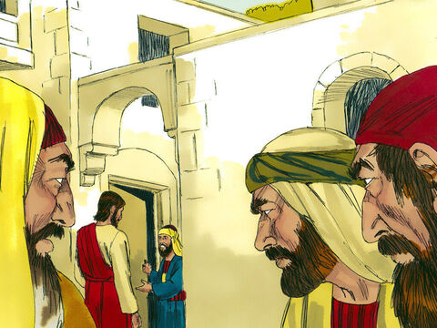
6
Zacchaeus hurried down and welcomed him with great joy.

Slide 11
7
All the people who saw it started grumbling, “This man has gone as a guest to the home of a sinner!”

Slide 12
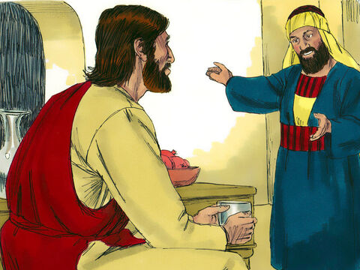
8
Zacchaeus stood up and said to the Lord, “Listen, sir! I will give half my belongings to the poor, and if I have cheated anyone, I will pay back four times as much.”

Slide 13
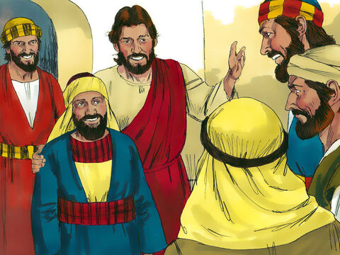
9
Jesus said to him, “Salvation has come to this house today, for this man, also, is a descendant of Abraham.

Slide 14
10
The Son of Man came to seek and to save the lost.”

Slide 15
Leader: The Gospel of the Lord.
All: Praise to You,
Lord Jesus Christ.

Slide 16
GOSPEL MESSAGE

Slide 17
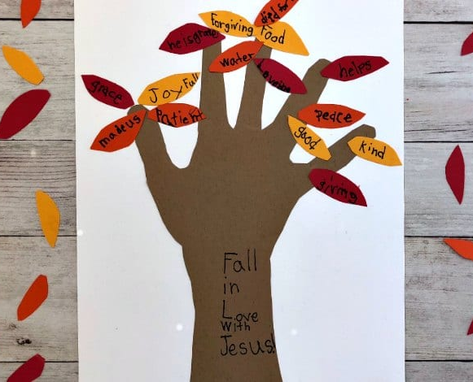
Activity: Tree of Love
Colored Paper
Coloring Materials
Pen/Marker
Scissors
Glue

Slide 18
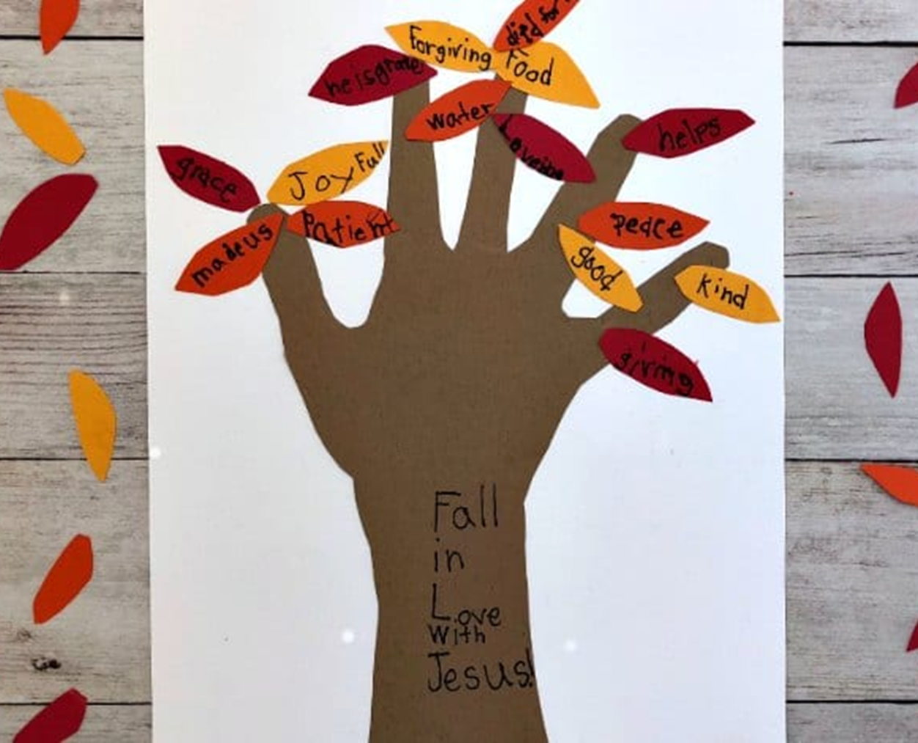
Instruction:
Trace your hand on the paper. Trace down the arm slightly so that you have a trunk of the tree.
Cut out the hands
Glue down the handprint at the bottom of the paper but centered. The Paper will be vertical.
Write “Fall in Love with Jesus” on the trunk of the tree.
Cut simple leaf shapes
On the leaves, write why you love Jesus.
These leaves will be glued to the branches of the tree.

Slide 19
Closing Prayer
Dear God,
Thank you for making us special. And for loving each and everyone of us. Help us to share that love with one another, and to let You make our hearts new. Thank you for your love. We love you, God!
In Jesus' name we pray.
Amen.

Slide 20
LIVE THE WORD KIDS
31st Sunday in Ordinary | Year C

