Slide 1
LIVE THE WORD KIDS
30th Sunday in Ordinary | Year C

Slide 2
GOSPEL REFLECTION
The Gospel reminds us a lot that what matters most to God is not what we say or do on the outside, but what’s on the inside, and the intentions of our hearts. We might act really cool, but we want to make sure we are living for the Lord. Jesus told a story about two men who were praying. One of them went into the church and gave a loud boastful prayer. He thanked God for making him better than other people, and talked about the wonderful things he did.
The other man Jesus described didn’t even want to go to church to pray. Instead, he stayed home and bowed low, full of sorrow and shame for the things he had done. He begged for mercy and felt unworthy of God’s attention. Jesus said that the man who was humble was offering a more genuine prayer than the boastful man. Humble means you don’t think too highly of yourself.
Jesus wants to teach people the importance of praying with the right attitude. And that is to be humble and admit your sins and ask for forgiveness and do not compare yourself with others.
A person’s attitude is important to God when praying.

Slide 3
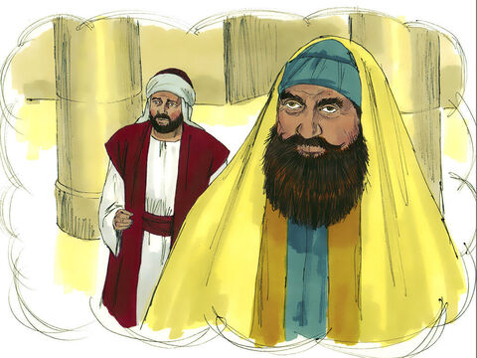
The Parable of the Pharisee and Tax Collector
Luke 18:9-14

Slide 4
Leader: A reading from
the Holy Gospel
according to Luke.
All: Glory to You, Oh Lord.

Slide 5
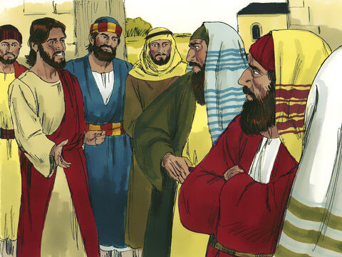
9
Jesus also told this parable to people who were sure of their own goodness and despised everybody else.

Slide 6
10
“Once there were two men who went up to the Temple to pray: one was a Pharisee, the other a tax collector.

Slide 7
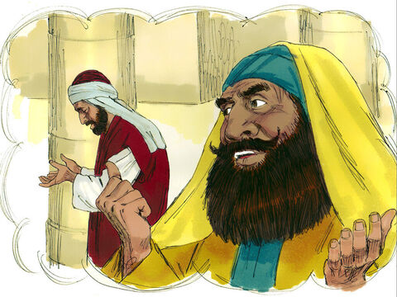
11
The Pharisee stood apart by himself and prayed,
‘I thank you, God, that I am not greedy, dishonest, or an adulterer, like everybody else. I thank you that I am not like that tax collector over there.

Slide 8
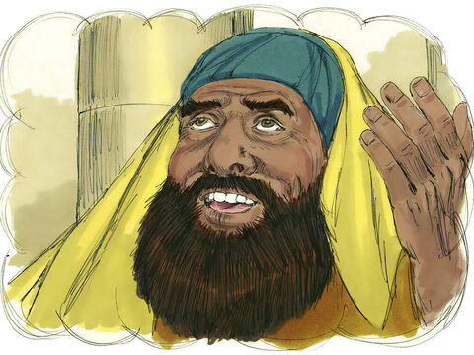
12
I fast two days a week, and I give you one tenth of all my income.

Slide 9
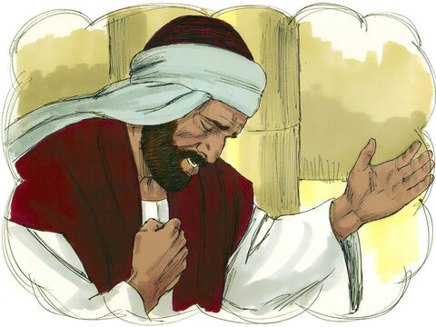
13
But the tax collector stood at a distance and would not even raise his face to heaven, but beat on his breast and said, ‘God, have pity on me, a sinner!’

Slide 10
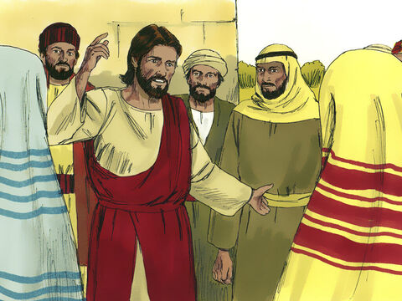
14
I tell you,” said Jesus, “the tax collector, and not the Pharisee, was in the right with God when he went home. For those who make themselves great will be humbled, and those who humble themselves will be made great.”

Slide 11
Leader: The Gospel of the Lord.
All: Praise to You,
Lord Jesus Christ.

Slide 12
GOSPEL MESSAGE

Slide 13
Activity: Humble Heart
Colored Paper
Coloring Materials
Pen/Marker
Scissors

Slide 14
Instruction:
Draw a big heart to the colored paper.
Cut the heart shape
Write your sorry prayer in the heart.
You can decorate your heart.

Slide 15
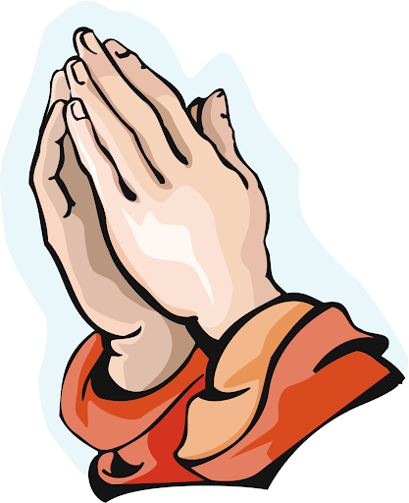
Closing Prayer
Dear God,
Thank you for teaching us the right attitude to pray. Help me to admit my sins and ask for your forgiveness. And help me not to compare my self to anyone.
In Jesus' name we pray. Amen.
Amen.

Slide 16
LIVE THE WORD KIDS
30th Sunday in Ordinary | Year C

