Slide 1
LIVE THE WORD KIDS
29th Sunday in Ordinary | Year C

Slide 2
GOSPEL REFLECTION
We can be so impatient sometimes and feel that God has not heard our prayers when they are not answered immediately. We live in a world of instant gratification, instant coffee, instant contact, and a touch of a button, and we can be anywhere in the world! But Jesus in today’s gospel, is asking us to be patient, ‘pray always and do not lose heart.’ Our prayers will be answered, maybe not in the way we are expecting, but answered in the way that is beneficial to us.

Slide 3
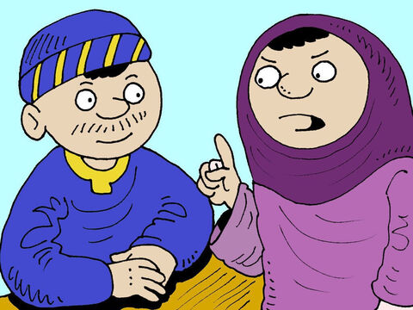
The Parable of the Widow and the Judge
Luke 18:1-8

Slide 4
Leader: A reading from
the Holy Gospel
according to Luke.
All: Glory to You, Oh Lord.

Slide 5
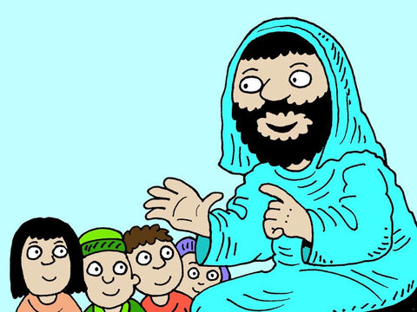
1
Then Jesus told his disciples a parable to teach them that they should always pray and never become discouraged.

Slide 6
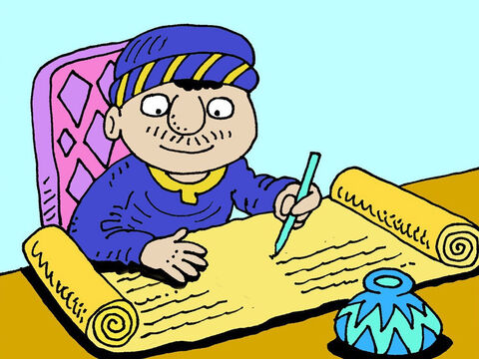
2
“In a certain town there was a judge who neither feared God nor respected people.

Slide 7
3
And there was a widow in that same town who kept coming to him and pleading for her rights, saying, ‘Help me against my opponent!’

Slide 8
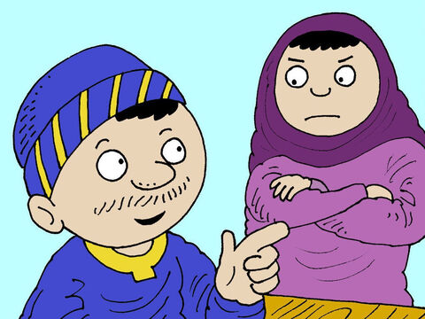
4
For a long time the judge refused to act, but at last he said to himself, ‘Even though I don't fear God or respect people,

Slide 9
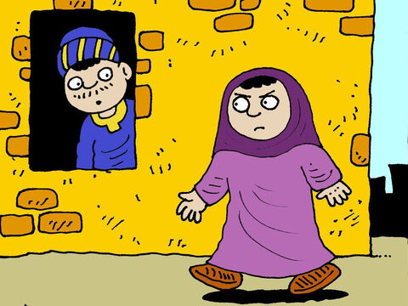
5
yet because of all the trouble this widow is giving me, I will see to it that she gets her rights. If I don't, she will keep on coming and finally wear me out!’”

Slide 10
6
And the Lord continued, “Listen to what that corrupt judge said.

Slide 11
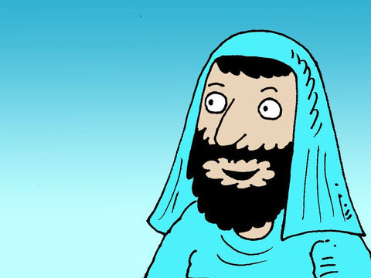
7
Now, will God not judge in favor of his own people who cry to him day and night for help? Will he be slow to help them?

Slide 12
8
I tell you, he will judge in their favor and do it quickly. But will the Son of Man find faith on earth when he comes?”

Slide 13
Leader: The Gospel of the Lord.
All: Praise to You,
Lord Jesus Christ.

Slide 14
GOSPEL MESSAGE

Slide 15
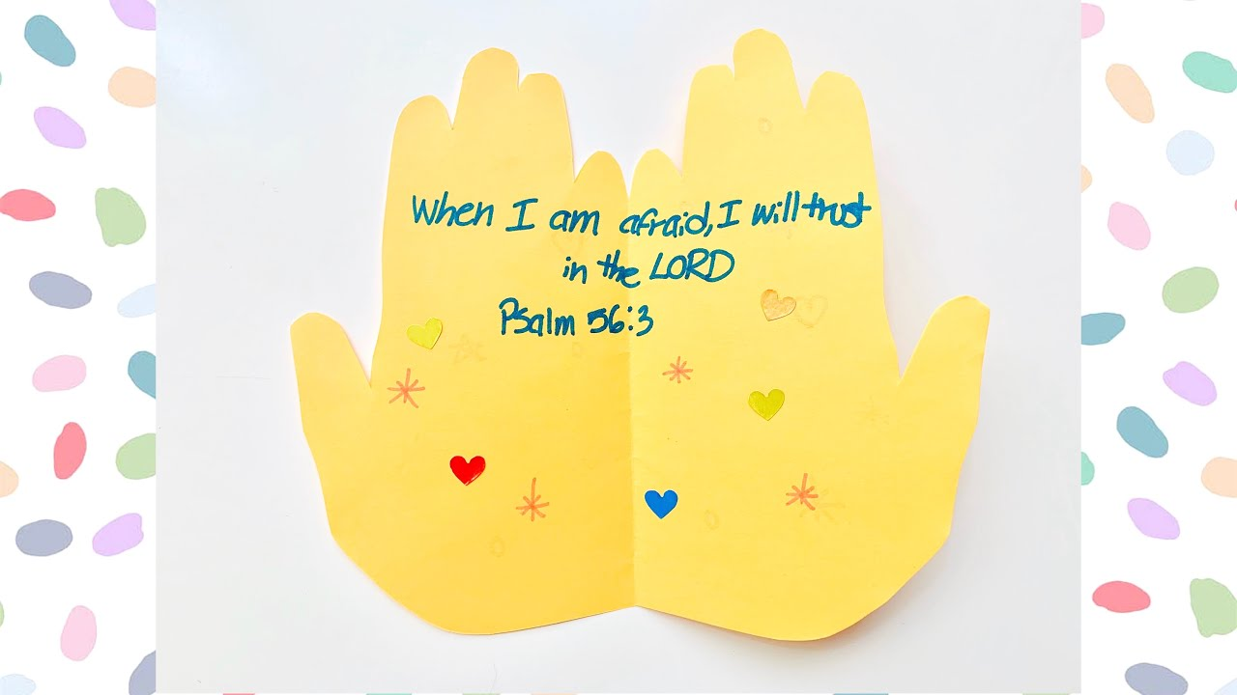
Activity: Prayer Hands
Colored Paper
Coloring Materials
Pen/Marker
Scissors

Slide 16
Instruction:
Fold the paper down the center.
Place your hand along the folded edge of the paper.
Trace you hand.
Cut along the outline of your hand.
Open your prayer hands and write what are you praying for.
Time to decorate.

Slide 17
Closing Prayer
Dear God,
Thank you for teaching us how to pray. Thank you for always listening to our prayers. May we never lose heart in praying. Jesus we trust in you.
In Jesus' name we pray. Amen.
Amen.

Slide 18
LIVE THE WORD KIDS
29th Sunday in Ordinary | Year C

