Slide 1
LIVE THE WORD KIDS
28th Sunday in Ordinary | Year C

Slide 2
GOSPEL REFLECTION
In the Bible, leprosy is a dreaded disease that is a picture of sin. And if you have that disease you are an outcast. It’s like a sin that cause as to distance from God. It is only God who can heal and cleanse us form this disease.
Everything in our lives comes from God. We often forget to offer Him thanks and praise, but we should remember to always lift our eyes to the Lord and be grateful. It’s also important to say thank you to important people in our lives who help us along the way.

Slide 3
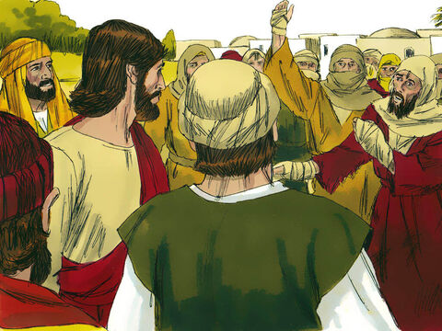
Jesus Heals Ten Men
Luke 17:11-19

Slide 4
Leader: A reading from
the Holy Gospel
according to Luke.
All: Glory to You, Oh Lord.

Slide 5
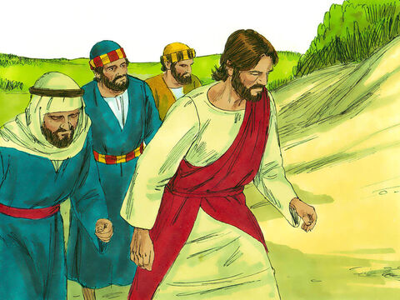
11
“As Jesus made his way to Jerusalem, he went along the border between Samaria and Galilee.

Slide 6
12
He was going into a village when he was met by ten men suffering from a dreaded skin disease. They stood at a distance

Slide 7
13
and shouted, “Jesus! Master! Have pity on us!”

Slide 8
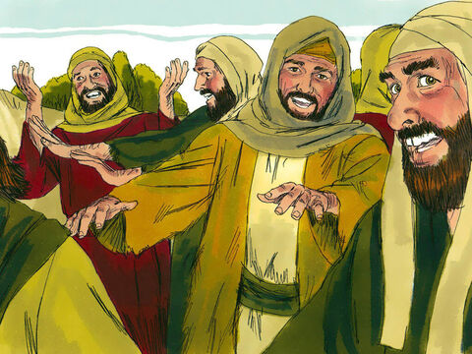
14
Jesus saw them and said to them, “Go and let the priests examine you.” On the way they were made clean.

Slide 9
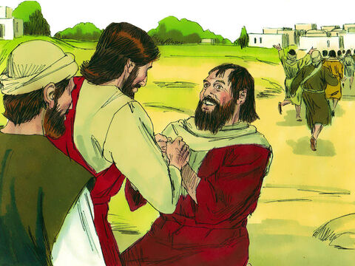
15
When one of them saw that he was healed, he came back, praising God in a loud voice.

Slide 10
16
He threw himself to the ground at Jesus' feet and thanked him. The man was a Samaritan.

Slide 11
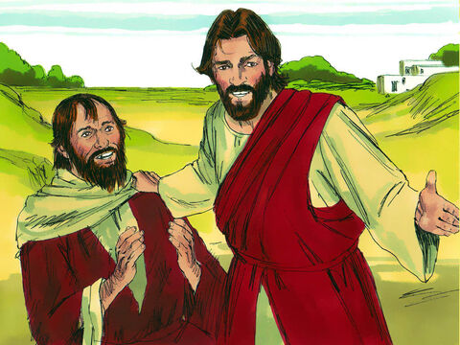
17
Jesus spoke up, “There were ten who were healed; where are the other nine?

Slide 12
18
Why is this foreigner the only one who came back to give thanks to God?”

Slide 13
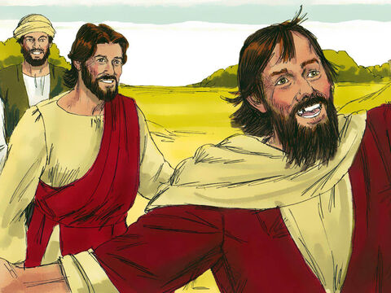
19
And Jesus said to him, “Get up and go; your faith has made you well.”

Slide 14
Leader: The Gospel of the Lord.
All: Praise to You,
Lord Jesus Christ.

Slide 15
GOSPEL MESSAGE

Slide 16
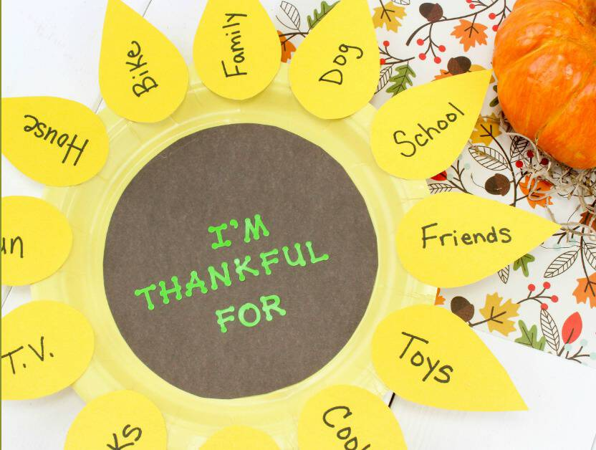
Activity: Thank You Flower
Colored Paper
Coloring Materials
Pen/Marker
Scissors
Glue

Slide 17
Instruction:
Cut a circle on colored paper.
Also cut petals shape of the flower on a colored paper.
Write in each petals the things you are thankful for to God.
Glue the petals on the circle.
Write inside the circle the “ I’m Thankful For”

Slide 18
Closing Prayer
Dear God,
Thank You for loving us. Thank you for always forgiving our sins. Lord, we pray that we may not forget to thank you everyday. Help us to be an instrument of your love and mercy.
In Jesus' name we pray. Amen.
Amen.

Slide 19
LIVE THE WORD KIDS
28th Sunday in Ordinary | Year C

