Slide 1
LIVE THE WORD KIDS
27th Sunday in Ordinary | Year C

Slide 2
GOSPEL REFLECTION
The mustard seed is one of the smallest of all seeds. Some people think of faith when they think of mustard seeds. Faith is when we believe in God and His power.
When Jesus’ friends asked Him how they could have stronger faith, Jesus said, “If you had faith even as small as a mustard seed, you could say to this mulberry tree, ‘May you be uprooted and be planted in the sea,’ and it would obey you!” (Luke 17:5-10) Jesus said that God is so powerful that if our faith is even as small as this little seed, then we can do incredible things with His power.
If Jesus said we could pray and ask God to move a tree from our front yard to the sea, then we need even smaller faith to just move this plant a little bit.
Jesus didn’t say someone with the faith of the mustard seed can move trees to the sea so that a bunch of people would start uprooting trees. That wasn’t His point. He was teaching us that it doesn't take a great faith for great things to happen. Why? Because what happens doesn’t depend on us, but instead on God. God has the power to do anything, and God is for us so we can trust whatever He does.

Slide 3
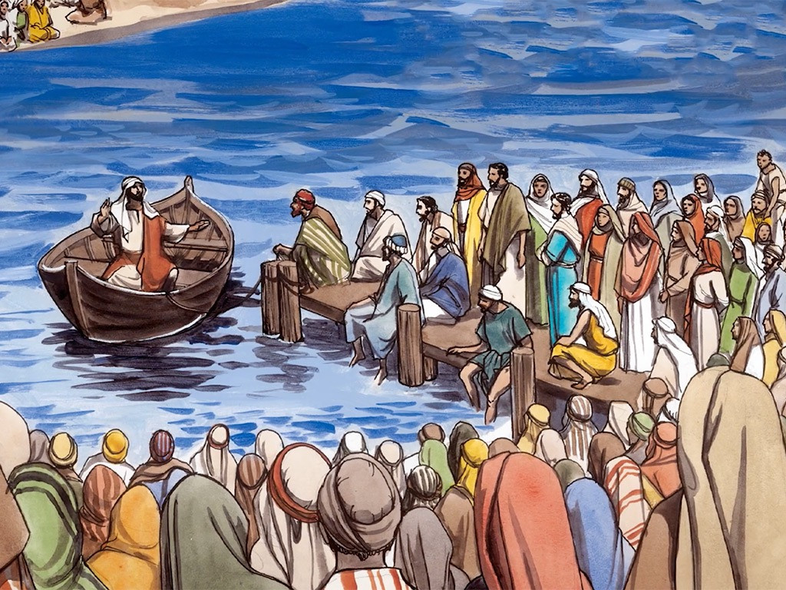
Faith and A Servant's Duty
Luke 17:5-10

Slide 4
Leader: A reading from
the Holy Gospel
according to Luke.
All: Glory to You, Oh Lord.

Slide 5
5
The apostles said to the Lord, “Make our faith greater.”

Slide 6
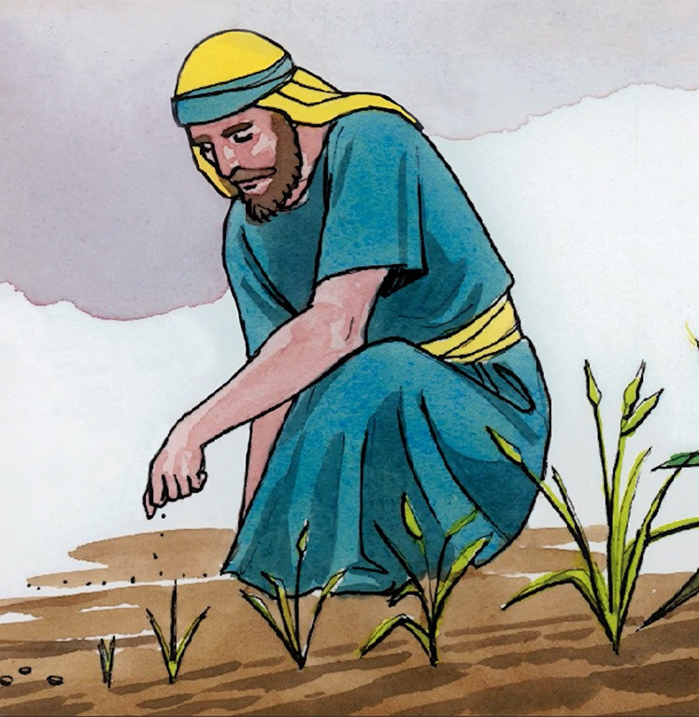
6
The Lord answered, “If you had faith as big as a mustard seed, you could say to this mulberry tree, ‘Pull yourself up by the roots and plant yourself in the sea!’ and it would obey you.

Slide 7
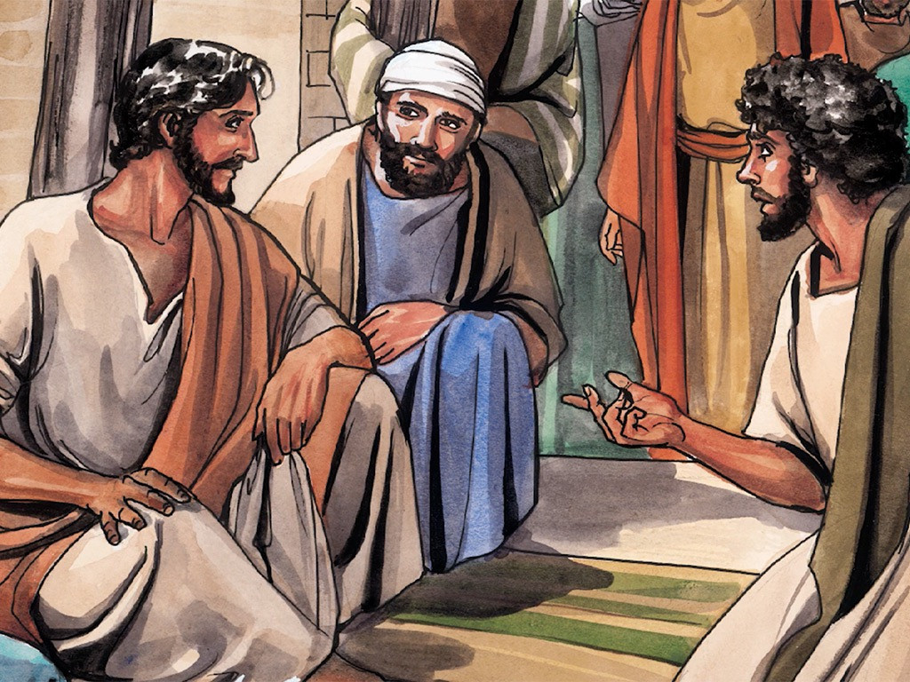
7
“Suppose one of you has a servant who is plowing or looking after the sheep. When he comes in from the field, do you tell him to hurry along and eat his meal?

Slide 8
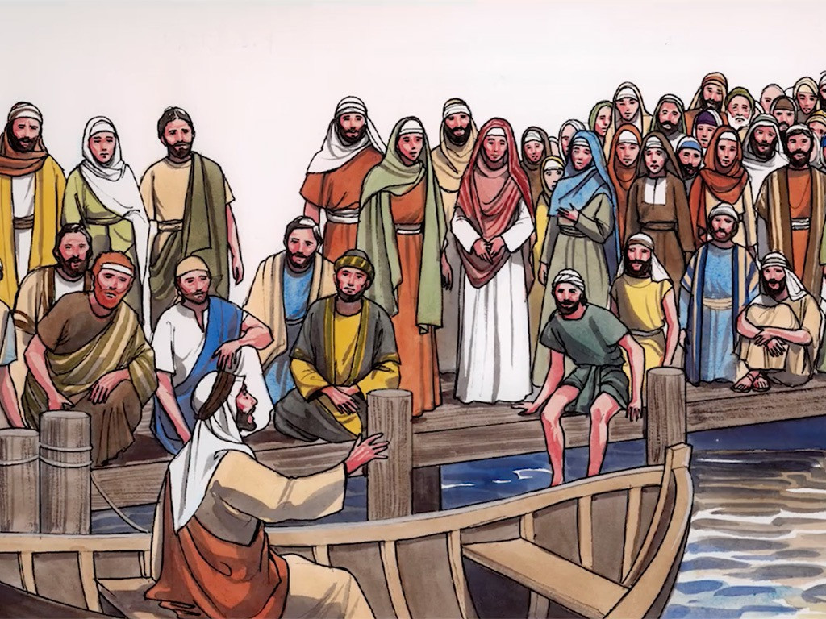
8
Of course not! Instead, you say to him, ‘Get my supper ready, then put on your apron and wait on me while I eat and drink; after that you may have your meal.’

Slide 9
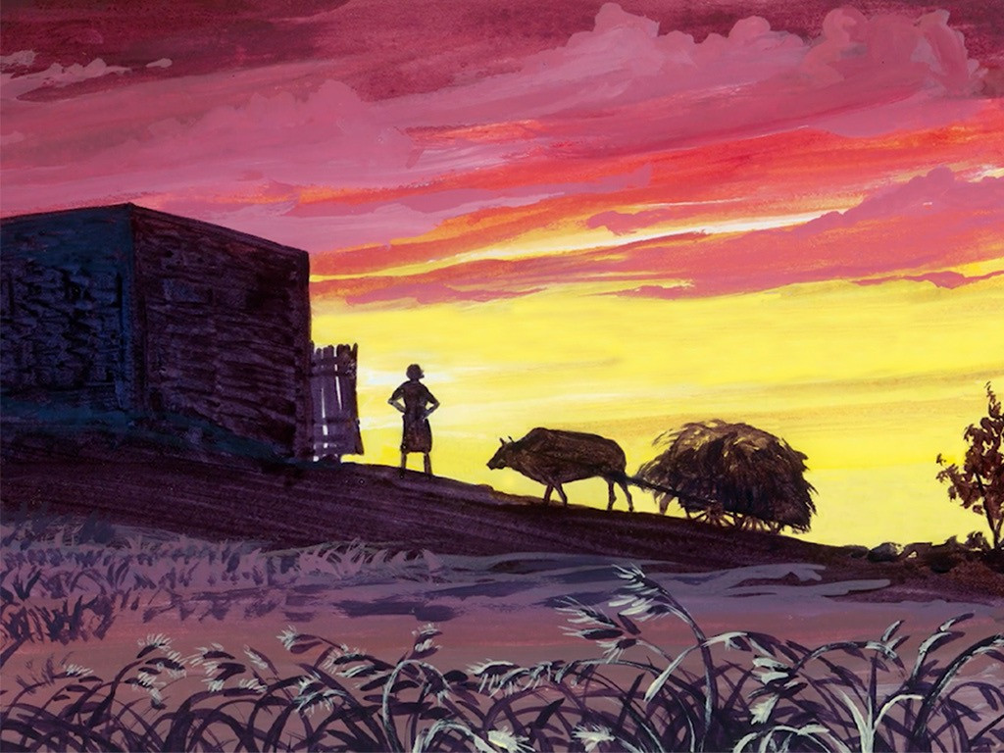
9
The servant does not deserve thanks for obeying orders, does he?

Slide 10
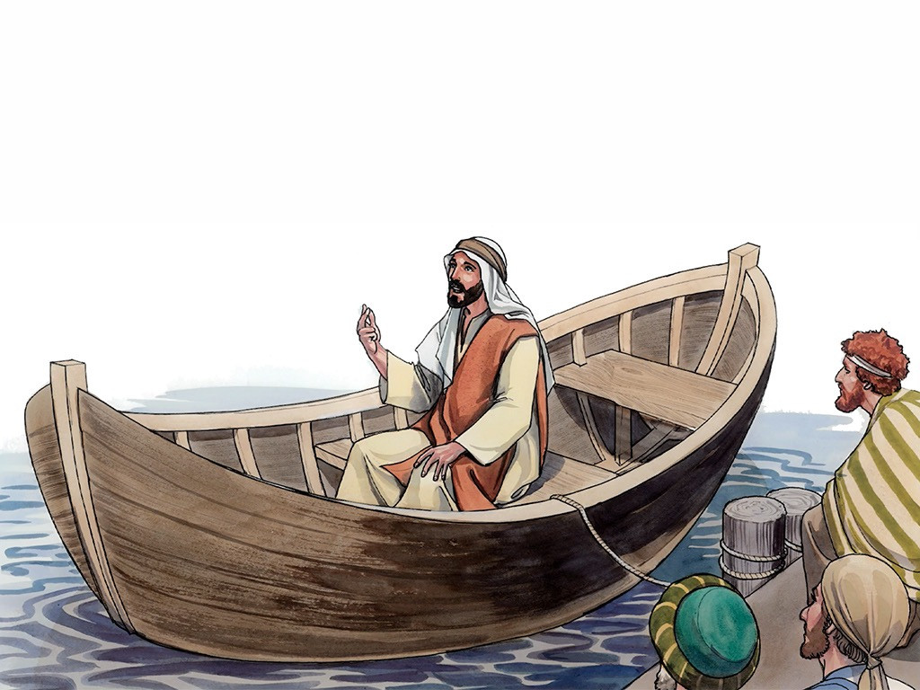
10
It is the same with you; when you have done all you have been told to do, say, ‘We are ordinary servants; we have only done our duty.’”

Slide 11
Leader: The Gospel of the Lord.
All: Praise to You,
Lord Jesus Christ.

Slide 12
GOSPEL MESSAGE

Slide 13
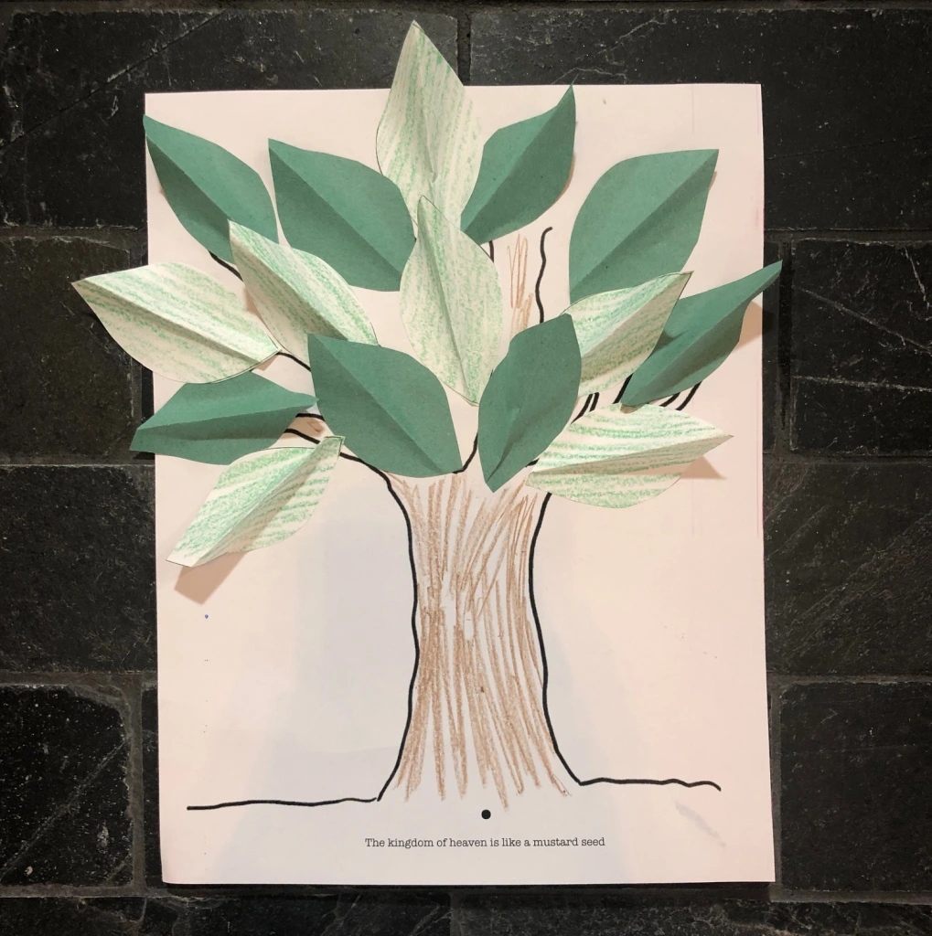
Activity: Mustard Seed Faith
Colored Paper/ Bond Paper
Scissor
Markers
Coloring Material

Slide 14
Instruction:
Draw a Tree Trunk on your bond paper.
Then draw a leaves on the colored paper and cut it.
After cutting the leaves, write on the leaves the list of things you can do and practice so that your faith can grow much deeper.
After writing down those list of yours, you can now paste the leaves on the upper part of your drawing
You may add other things, such as colors and drawings to make your tree beautiful.

Slide 15
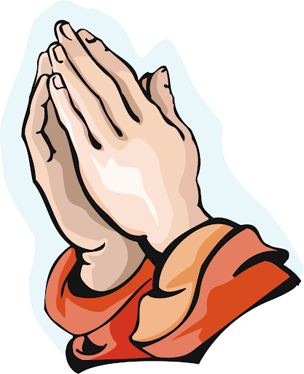
Closing Prayer
Dear God,
Thank you for reminding us how to remain and grow in our faith. God, we ask that for our mustard seed sized faith, may you help us to believe and never doubt Your mighty power in everything.
In Jesus' name we pray.
Amen.

Slide 16
LIVE THE WORD KIDS
27th Sunday in Ordinary | Year C

