Slide 1
LIVE THE WORD KIDS
First Sunday of Advent

Slide 2
GOSPEL REFLECTION
Jesus is coming again and He is coming whether we are ready or not. That is why Jesus is using the example of Noah’s time to warn us about our behavior now and what will happen to us in the future. While we still have the time, and that time is now, we must be ready to meet Him when He comes.
What does it mean exactly by being ready? It means to be holy because Jesus is holy and we all know that holiness and sinfulness can not mix. While it is true that as human beings, we always commit sin, it is also true that we can strive with all our might that we can be holy though we are sinners. And here is the application or usefulness of being awake. To be ready means to be awake. It doesn’t mean we don’t sleep. It only means that during our waking hours, we live in the present moment with God. It means that we should always be aware of His presence in our life. It means that in everything we, whether we work or rest, eat or drink, we give glory to God (1 Corinthians 10:31).
When we do this, we live in love and continuously ask for His forgiveness for our sins. Moreover, living from moment to moment with full awareness of God’s presence give us the familiarity with Him to the point that we are not afraid to meet Him and instead we have the eagerness to live in His kingdom in eternity.

Slide 3
The Day and Hour Unknown
Matthew 24: 37-44

Slide 4
Leader: A reading from
the Holy Gospel
according to Matthew.
All: Glory to You, Oh Lord.

Slide 5
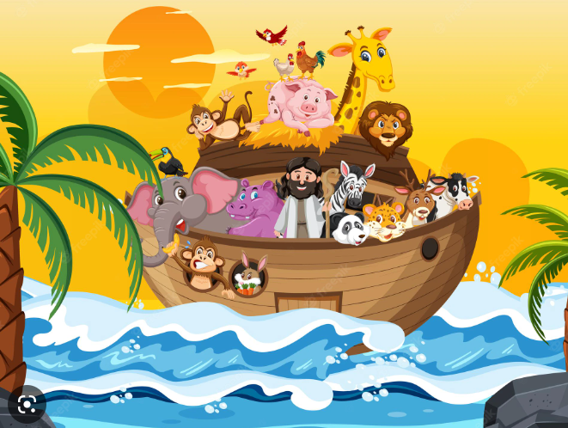
37
As it was in the days of Noah, so it will be at the coming of the Son of Man.

Slide 6
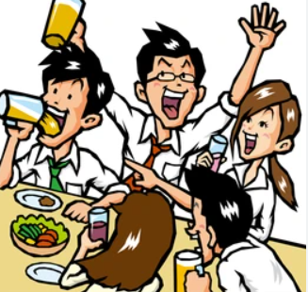
38
For in the days before the flood, people were eating and drinking, marrying and giving in marriage, up to the day Noah entered the ark;

Slide 7
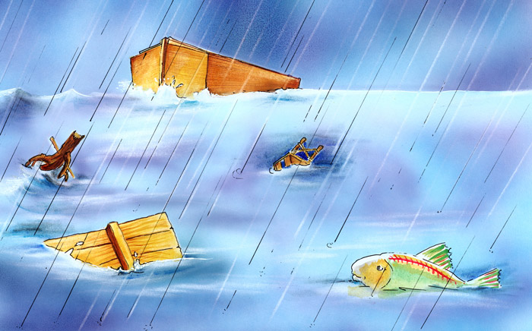
39
and they knew nothing about what would happen until the flood came and took them all away. That is how it will be at the coming of the Son of Man.

Slide 8
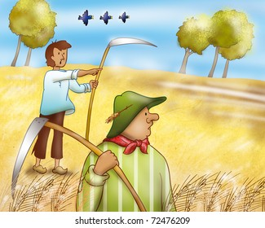
40
two men will be in the field; one will be taken and the other left.

Slide 9
41
Two women will be grinding with a hand mill; one will be taken and the other left.

Slide 10
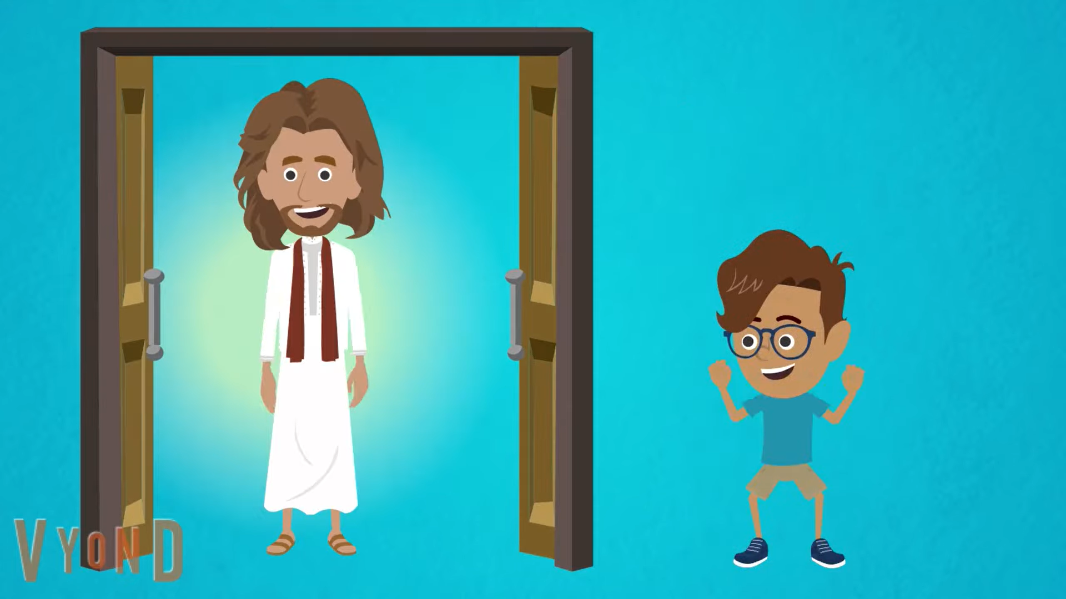
42
“Therefore keep watch, because you do not know on what day your Lord will come.

Slide 11
43
But understand this: If the owner of the house had known at what time of night the thief was coming, he would have kept watch and would not have let his house be broken into.

Slide 12
44
So you also must be ready, because the Son of Man will come at an hour when you do not expect him.

Slide 13
Leader: The Gospel of the Lord.
All: Praise to You,
Lord Jesus Christ.

Slide 14
GOSPEL MESSAGE

Slide 15
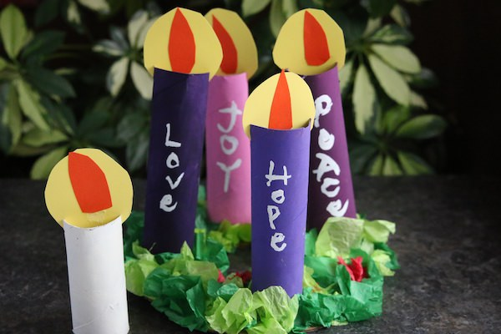
Activity: Advent Wreath
Piece of cardboard (for base of wreath)
Green and red crepe paper
5 cardboard/tissue rolls
Paint (purple, pink and white)
paintbrushes
Yellow and orange card stock or construction paper
Glue/Glue Gun
Scissor

Slide 16
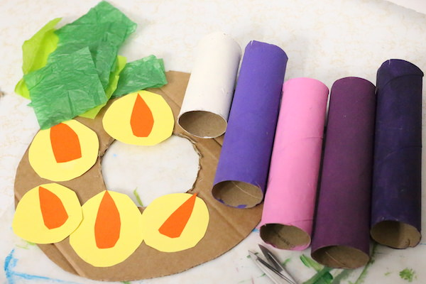
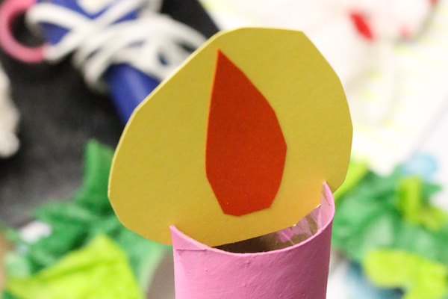
Instruction:
Make Base. Cut a “donut” out of a piece of cardboard.
Paint three cardboard rolls purple, paint one pink and one white.
Cut 5 flames out of orange card stock and 5 larger circles out of yellow card stock.
Glue the orange flames to the yellow circles.Cut 2 slits into the top of each cardboard roll. This is where you’ll insert the flames.

Slide 17
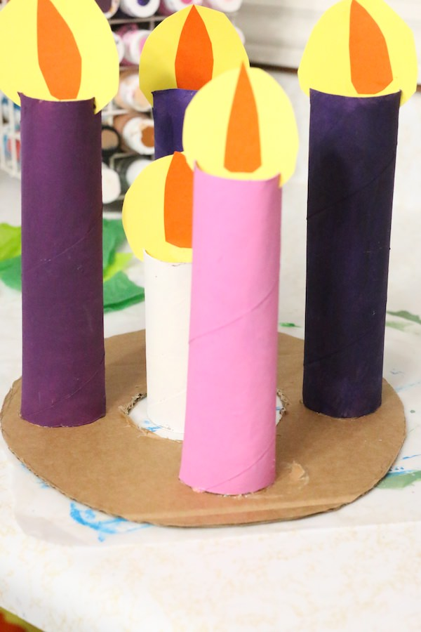
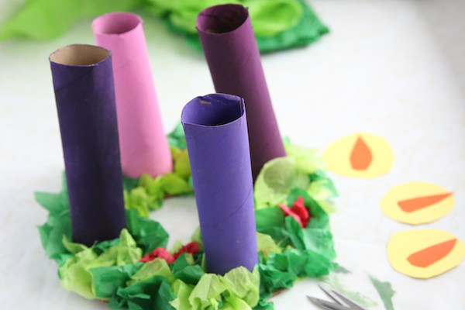
Instruction:
Squeeze a bit of hot glue to the bottoms of the cardboard rolls, and glue them to the cardboard wreath in the 12, 3, 6 and 9 o’clock positions). No glue is needed for the white candle as it will stand free in the cut out center of the wreath.
Crumple the green tissue paper squares and glue them all over the cardboard base. Add a few crumpled pieces of red tissue paper (berries) here and there.

Slide 18
Instruction:
With a fine liner brush and white paint, write the words HOPE, PEACE and LOVE on the purple candles, and JOY on the pink candle.
Place the white candle in the center and display your advent wreath on your family’s dinner table, a mantel or some other special place in your home or Sunday School classroom.

Slide 19
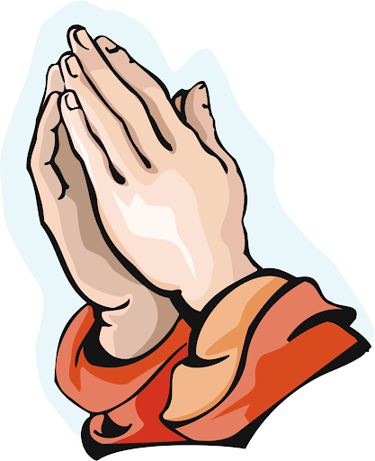
Closing Prayer
Dear God,
Thank you for coming to Earth for us. Thank you for keeping your promises to save us. Help us to live in your presence. And know what it means to prepare our hearts for You. Thank you for your love. We love you, God! Thank you for Jesus.
In Jesus' name we pray. Amen.

Slide 20
LIVE THE WORD KIDS
First Sunday of Advent

