Slide 1
LIVE THE WORD KIDS
Solemnity of Christ the King | Year C

Slide 2
GOSPEL REFLECTION
For most people, the image of royalty or kingship is power or exalted position, not crucifixion. Therefore, for Jesus to be hanging on the cross does not qualify Him to be a king. This is exactly the reason why Jesus is sneered, mocked and ridiculed as king while He is crucified. Ironically, those who were taunting Jesus were proclaiming who He is – Chosen one, King of the Jews, and Christ. In other words, these people were aware of Jesus’ identity but deliberately, on their own volition, they rejected Him.
On the other hand, the other criminal whom some writers call the “good thief” had the humility to accept Jesus as King who can dispense mercy and permission to enter paradise. Moreover, he recognized his own crime and accepted his deserved punishment. Although the gospel does not say that he was repentant or that he asked for forgiveness, Jesus proclaimed his salvation right there and then.
Indeed, Jesus is merciful. Though great are our sins, He is willing to bring us to salvation as soon as we accept Him as king of our life. Jesus is King but He is not an ordinary king who rules with guns, goons and gold. He reigns with mercy and justice. Yet His kingship is not so visible yet in this world because many people throw out His law from their heart. Still, it doesn’t mean it does not exist or that He is powerless. He has planted the seed of His kingdom some 2,000 years ago and it is growing, albeit, slowly. And Jesus reigns with patience too. He is waiting for all people to open their hearts for His kingship. May we all have the humility to enthrone Him as King in all aspect of our life.

Slide 3
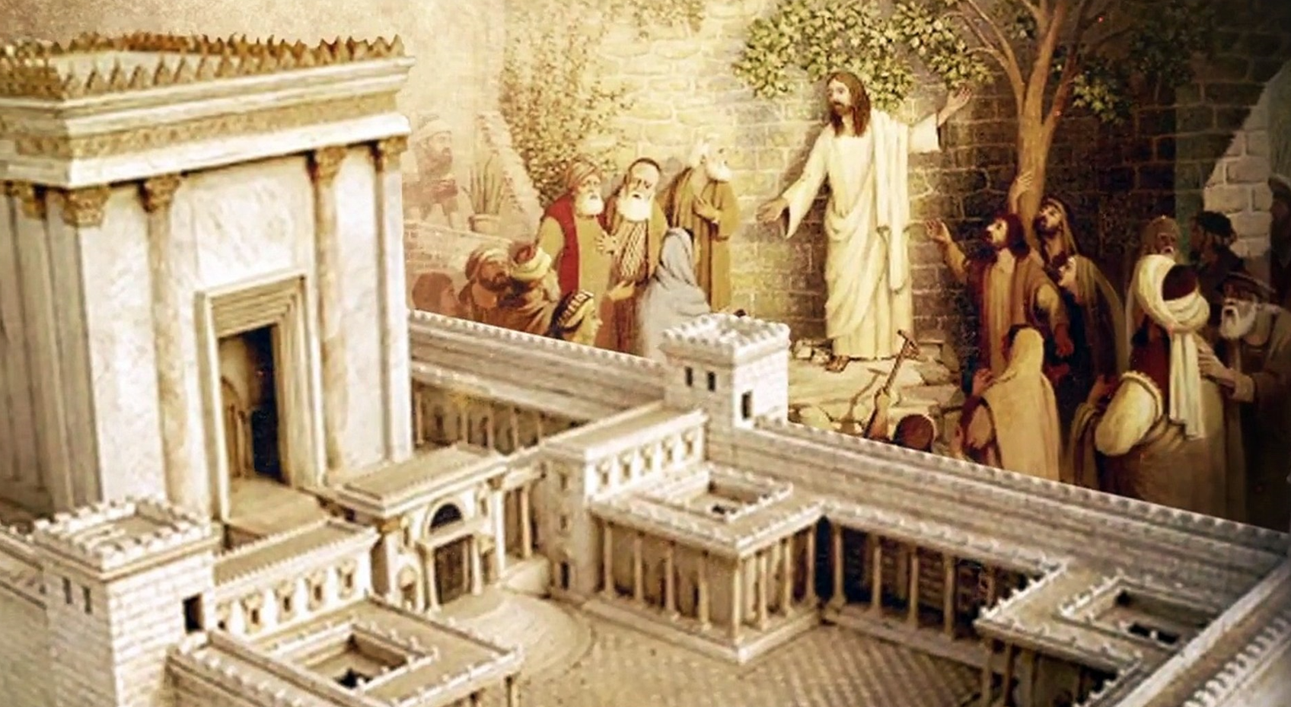
The Crucifixion
Luke 23:35-43

Slide 4
Leader: A reading from
the Holy Gospel
according to Luke.
All: Glory to You, Oh Lord.

Slide 5
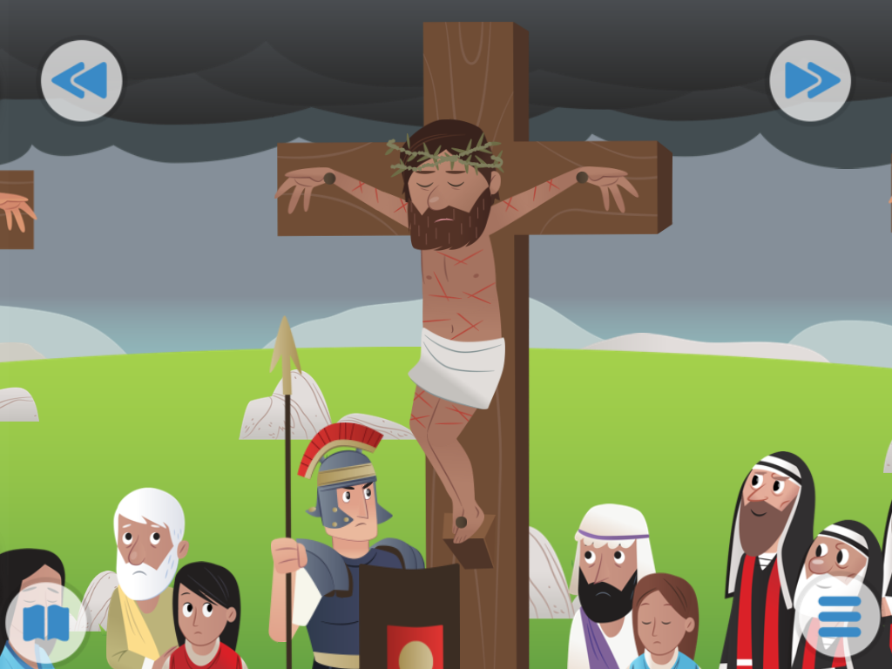
35
The people stood there watching while the Jewish leaders made fun of him:
“He saved others; let him save himself if he is the Messiah whom God has chosen!”

Slide 6
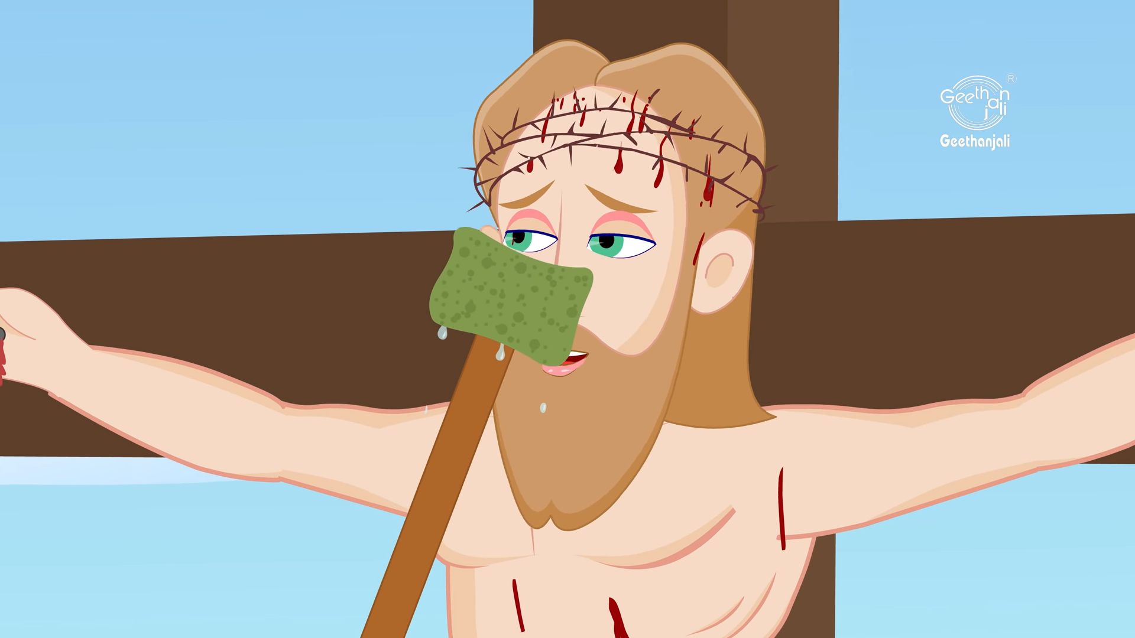
36
The soldiers also made fun of him: they came up to him and offered him cheap wine,

Slide 7
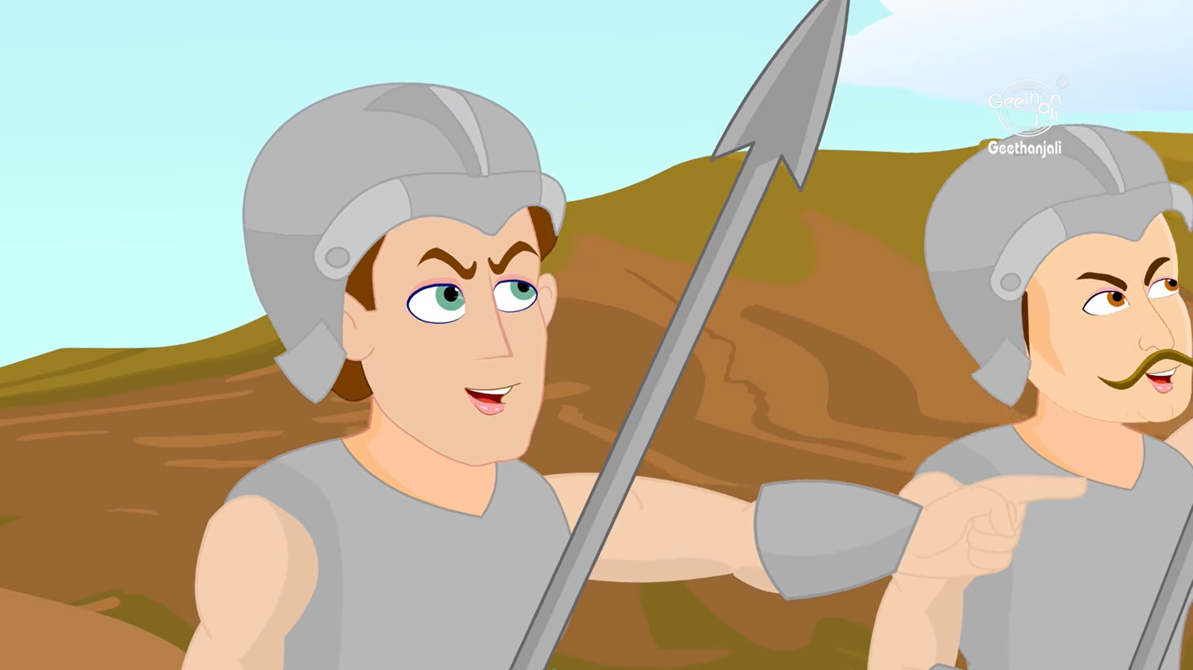
37
and said,
“Save yourself if you are the king of the Jews!”

Slide 8
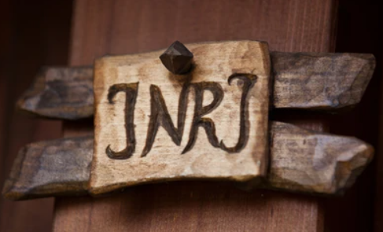
38
Above him were written these words:
“This is the King of the Jews.”

Slide 9
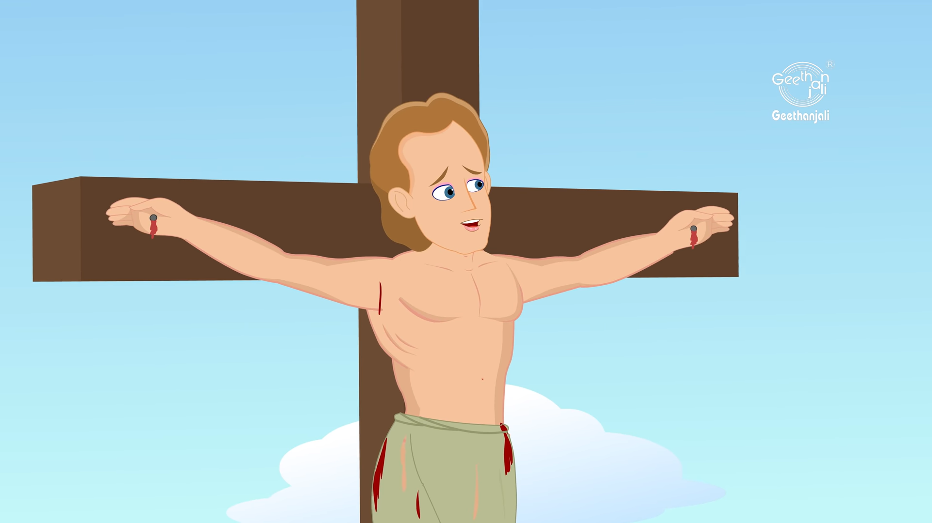
39
One of the criminals hanging there hurled insults at him:
“Aren't you the Messiah? Save yourself and us!”

Slide 10
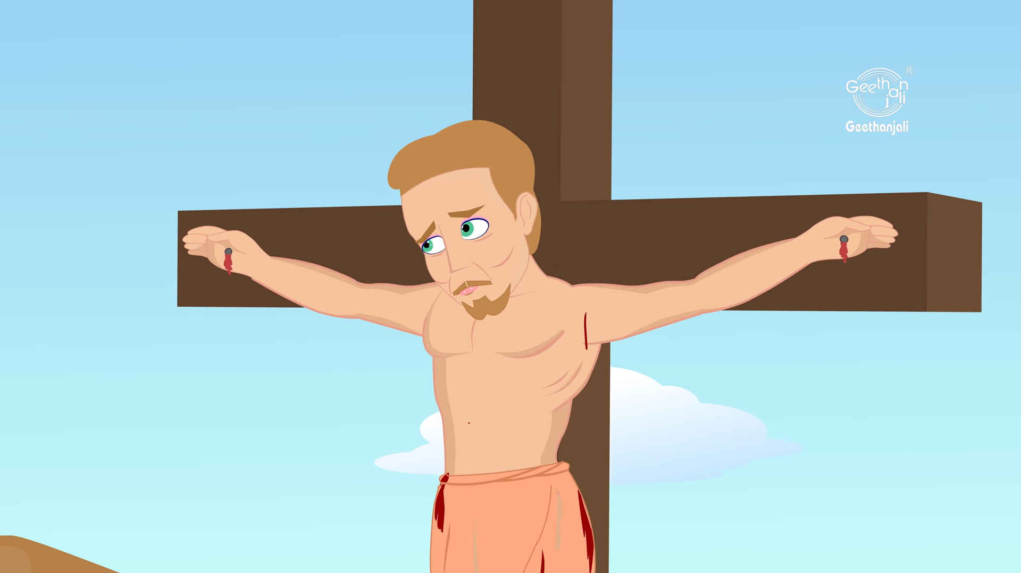
40
The other one, however, rebuked him, saying,
“Don't you fear God? You received the same sentence he did.

Slide 11
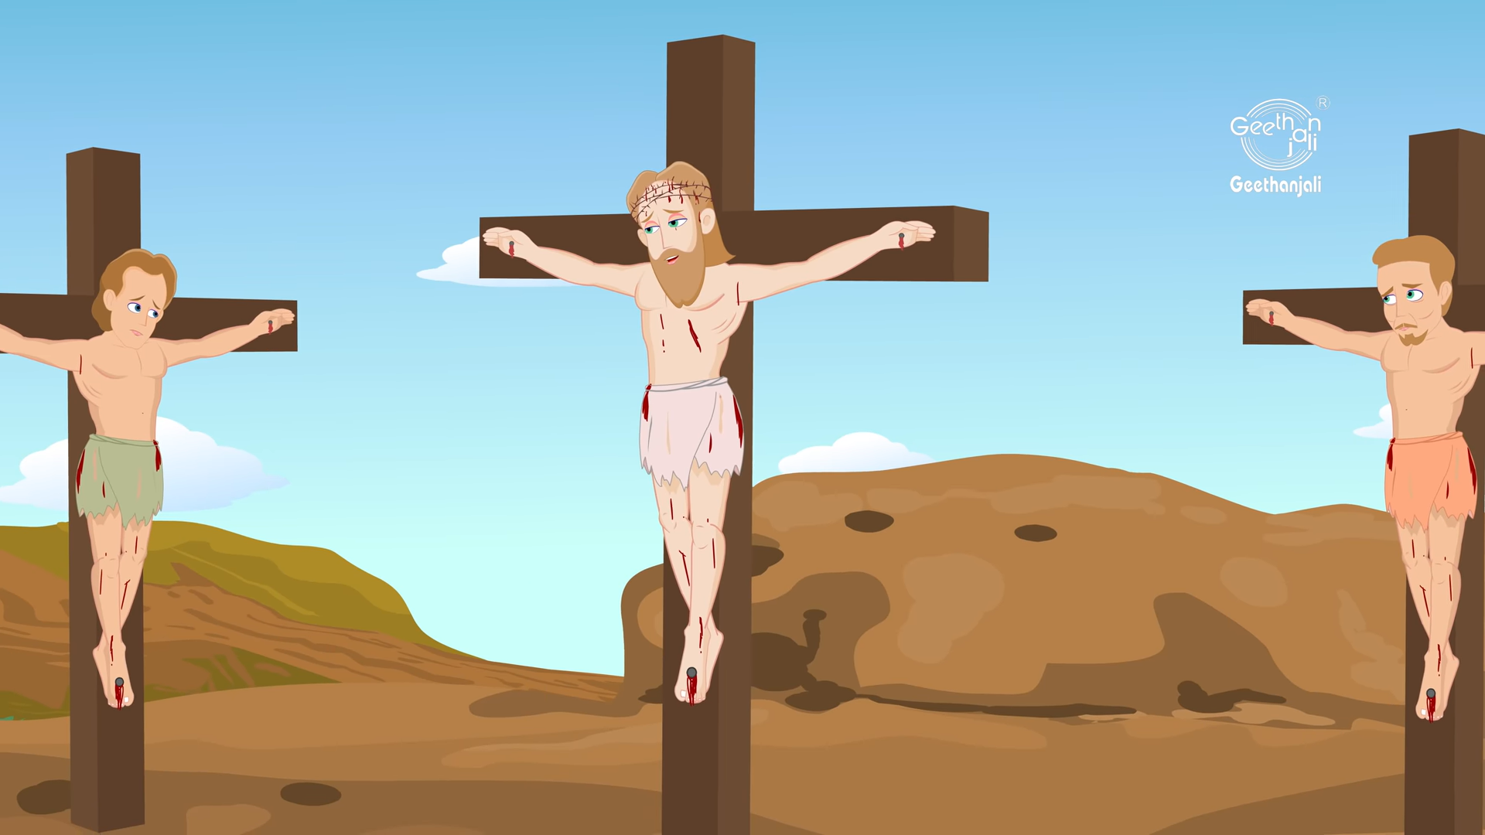
41
Ours, however, is only right, because we are getting what we deserve for what we did; but he has done no wrong.”

Slide 12
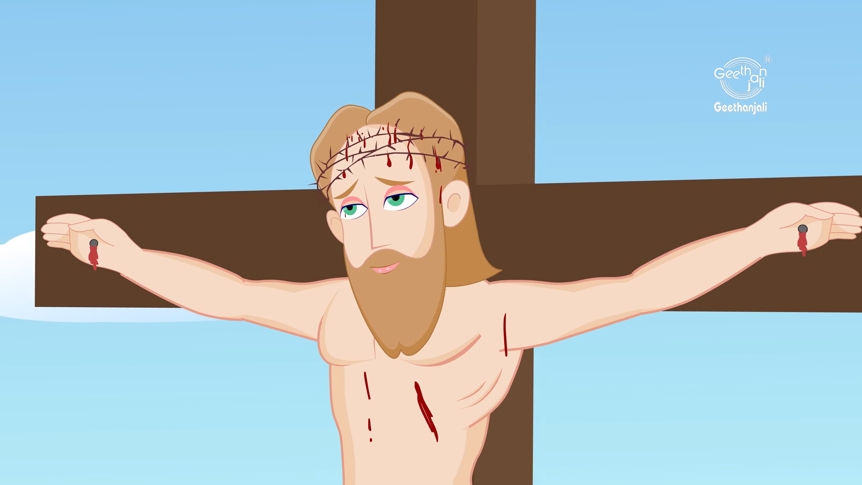
42
And he said to Jesus,
“Remember me, Jesus, when you come as King!”

Slide 13
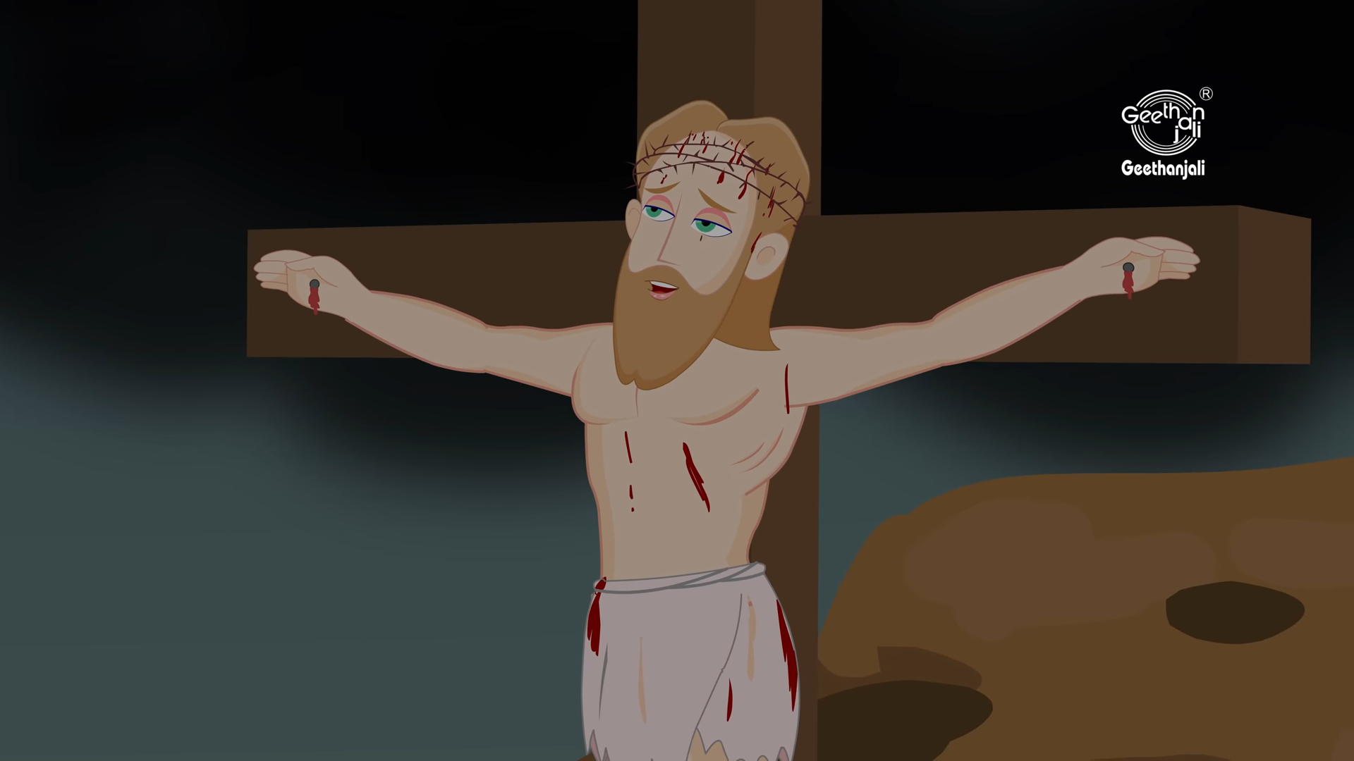
43
Jesus said to him,
“I promise you that today you will be in Paradise with me.”

Slide 14
Leader: The Gospel of the Lord.
All: Praise to You,
Lord Jesus Christ.

Slide 15
GOSPEL MESSAGE

Slide 16
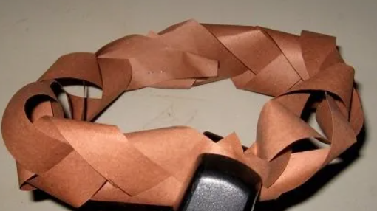
Activity:
Paper Crown of Thorns
Brown paper
Scissors
Stapler

Slide 17
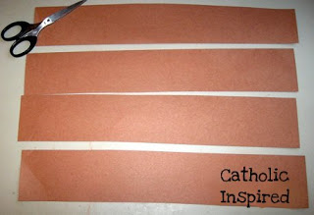
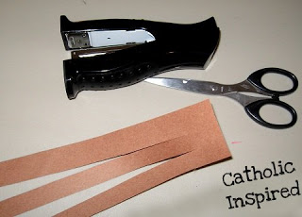
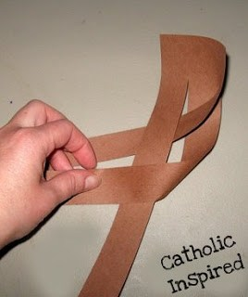
Instruction:
I cut 12 x 18-inch paper into 4 long parts.
Cut one of the sections into three parts but leave them together on one end. Now braid it!
Make as many as you need to get the size crown that you want.
Now staple the end of one to the end of another. Staple them together to make a circle

Slide 18
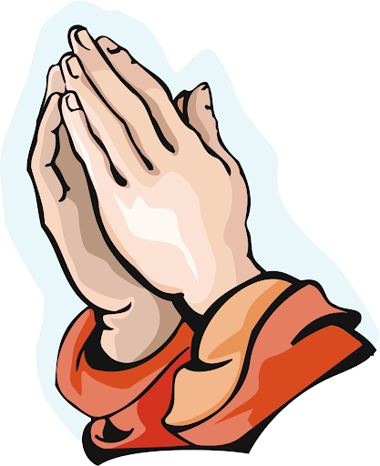
Closing Prayer
Dear God,
You sent your Son to show us how to live. Help us to listen to the truth and follow Jesus’s example in our lives.
In Jesus' name we pray. Amen.

Slide 19
LIVE THE WORD KIDS
Solemnity of Christ the King | Year C

