Slide 1
LIVE THE WORD KIDS
33rd Sunday in Ordinary | Year C

Slide 2
GOSPEL REFLECTION
In today’s scripture story, Jesus and his disciples are in Jerusalem where the Temple was located. And the disciples are excited about seeing the Temple. They think the Temple is a pretty amazing building. But even though the Temple was much prettier and better built than my little building, Jesus tells the disciples in today’s story that it was going to fall over.
This must have sounded pretty scary to the disciples because when we are told things that we think will last for a really long time (like buildings) will be gone much sooner than expected, then that can make us feel afraid. But what Jesus then teaches the disciples is that even though things like my little building and big buildings like the Temple do not last forever. God DOES last forever.
Which means when things are falling down or falling apart, God is and always will be with us while it happens. One of the ways that Jesus tells the disciples how God is always with us is by giving us words to share with others as well as wisdom about how to respond in the moment. Even in really scary situations when it feels like everything is falling apart, in today’s story, Jesus reminds his disciples (and us) that God is with us. And, because God is with us in those scary moments, then God can help us know what to do and how to respond. This is the Good News for today.

Slide 3
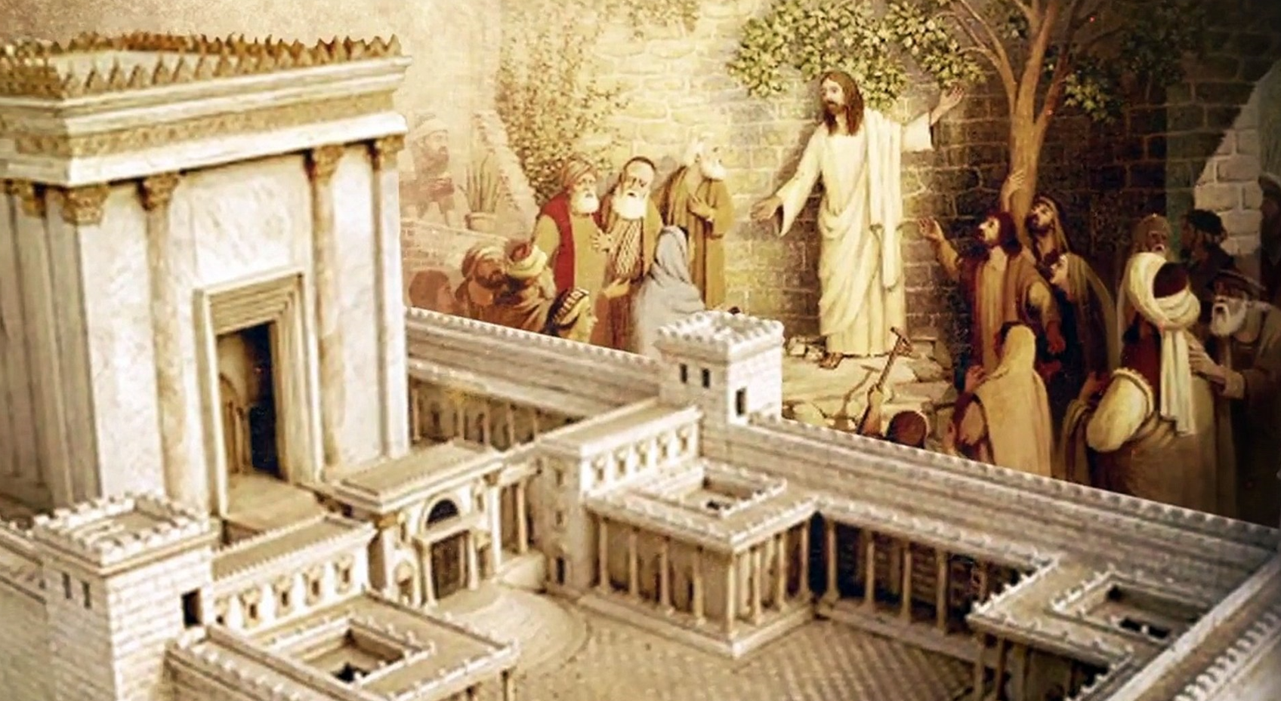
Troubles and Persecutions
Luke 21:5-19

Slide 4
Leader: A reading from
the Holy Gospel
according to Luke.
All: Glory to You, Oh Lord.

Slide 5
5
Some of the disciples were talking about the Temple, how beautiful it looked with its fine stones and the gifts offered to God.

Slide 6
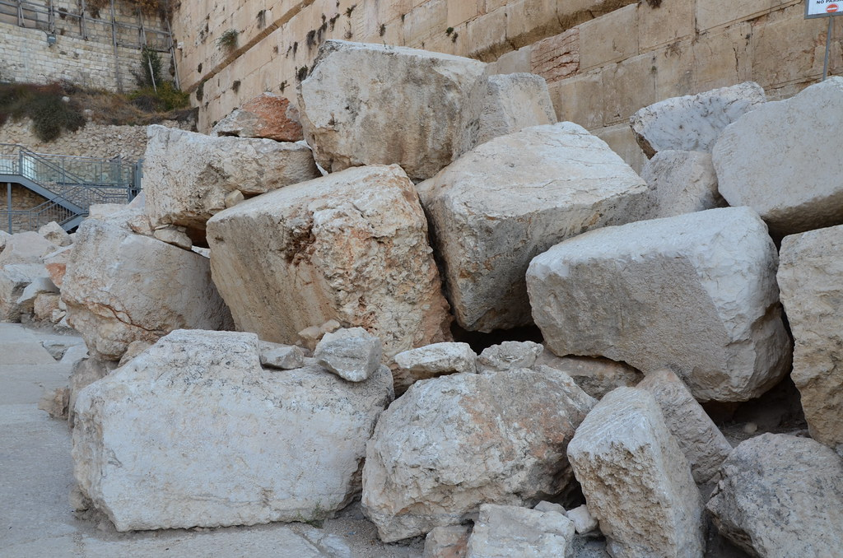
6
Jesus said,
“All this you see—the time will come when not a single stone here will be left in its place; every one will be thrown down.”

Slide 7
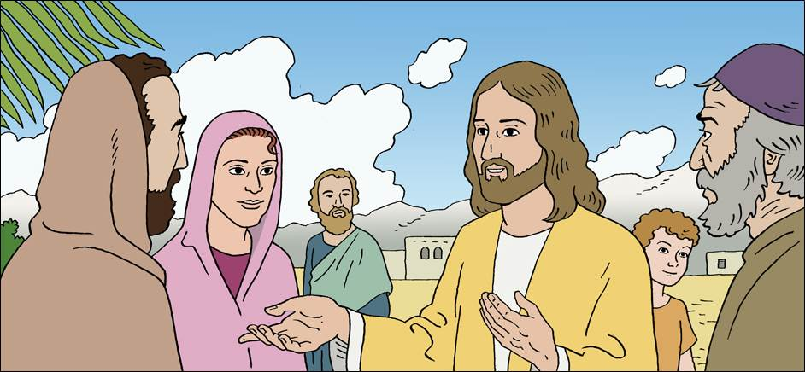
7
“Teacher,” they asked, “when will this be? And what will happen in order to show that the time has come for it to take place?”

Slide 8
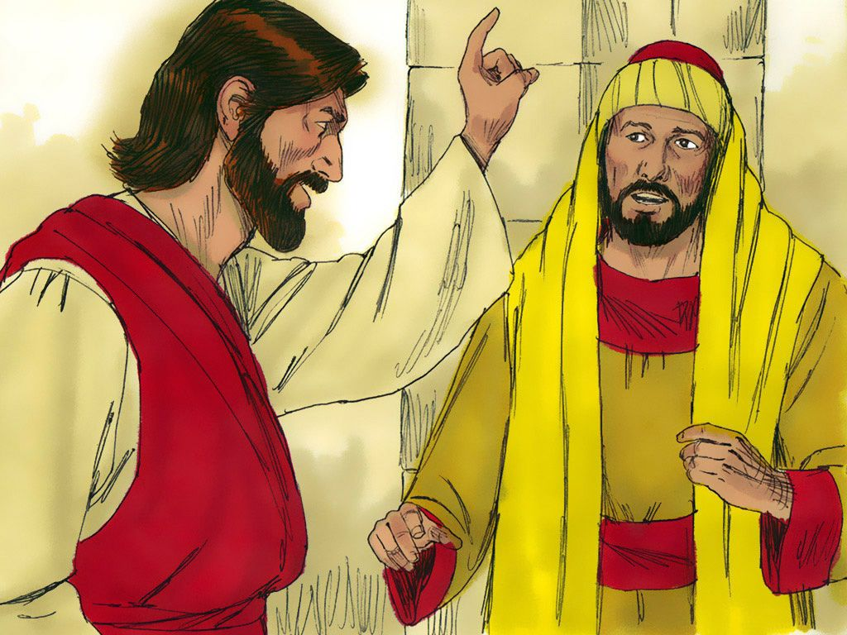
8
Jesus said,
“Watch out; don't be fooled. Many men, claiming to speak for me, will come and say, ‘I am he!’ and, ‘The time has come!’ But don't follow them.

Slide 9
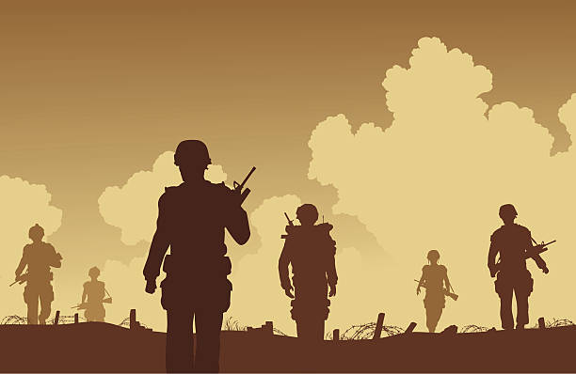
9
Don't be afraid when you hear of wars and revolutions; such things must happen first, but they do not mean that the end is near.”

Slide 10
10
He went on to say,
“Countries will fight each other; kingdoms will attack one another.

Slide 11
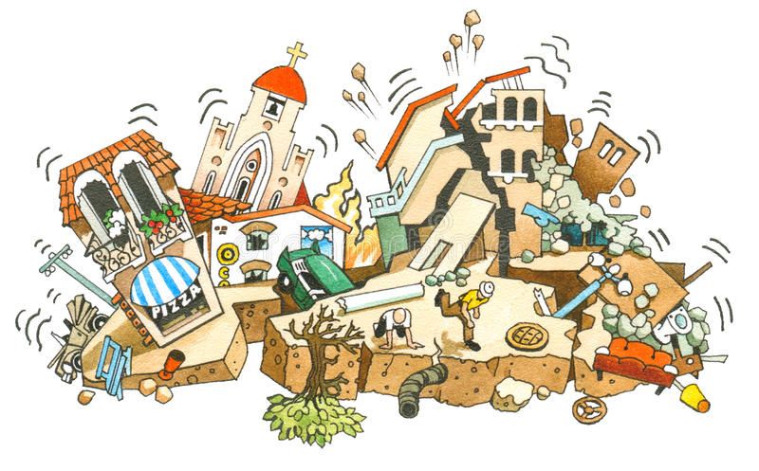
11
There will be terrible earthquakes, famines, and plagues everywhere; there will be strange and terrifying things coming from the sky.

Slide 12
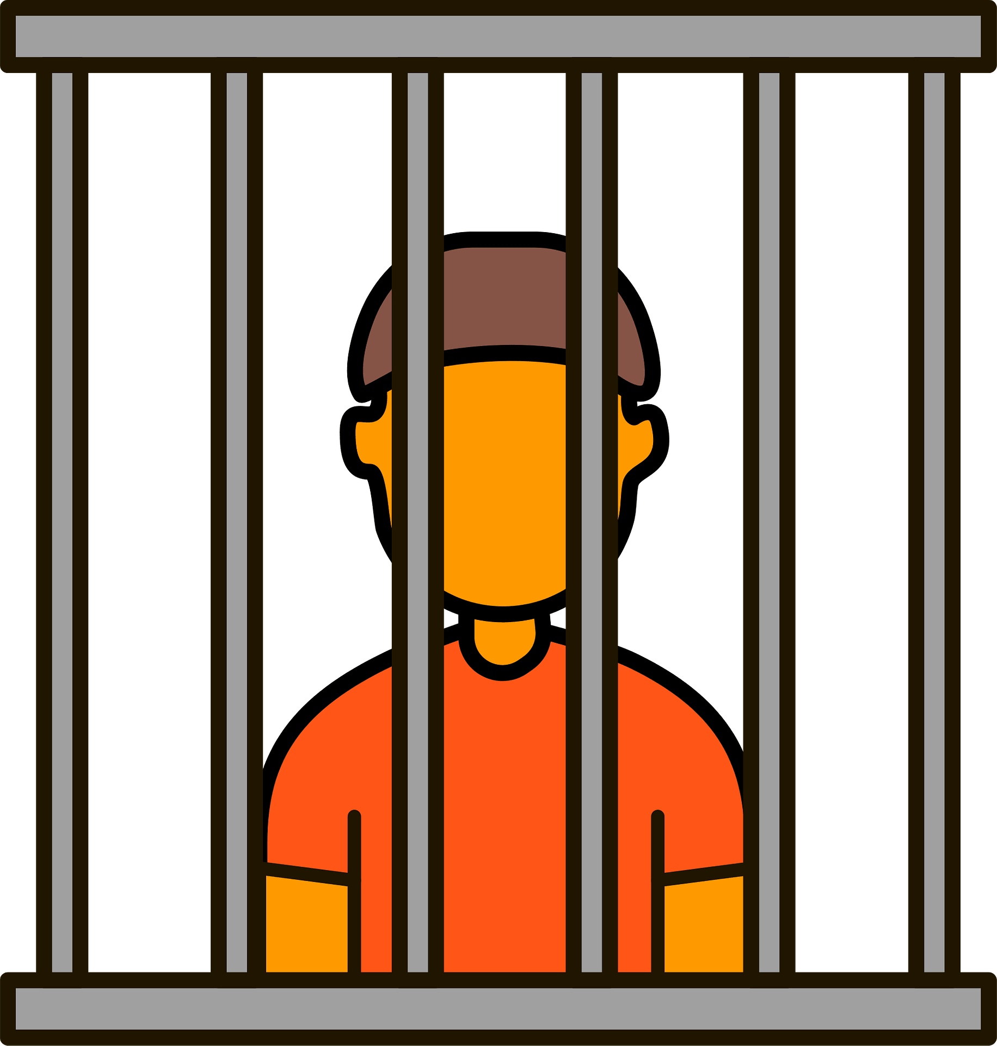
12
Before all these things take place, however, you will be arrested and persecuted; you will be handed over to be tried in synagogues and be put in prison; you will be brought before kings and rulers for my sake.

Slide 13
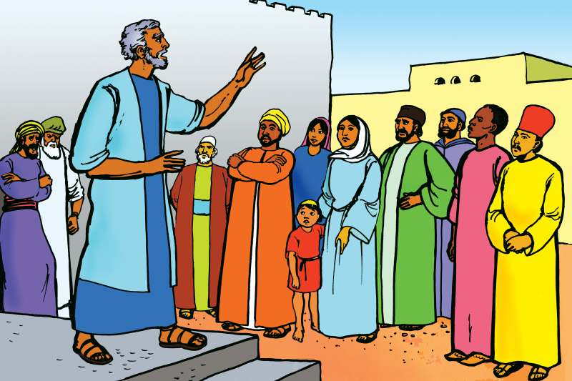
13
This will be your chance to tell the Good News.

Slide 14
14
Make up your minds ahead of time not to worry about how you will defend yourselves,

Slide 15
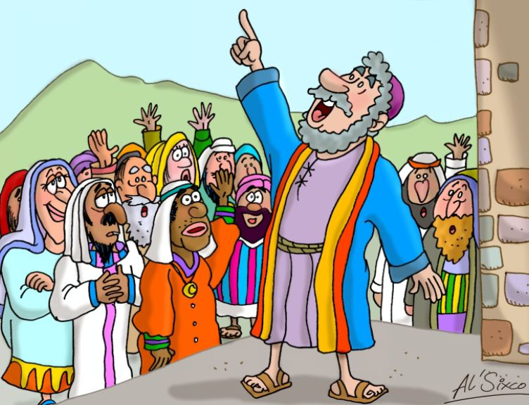
15
because I will give you such words and wisdom that none of your enemies will be able to refute or contradict what you say.

Slide 16
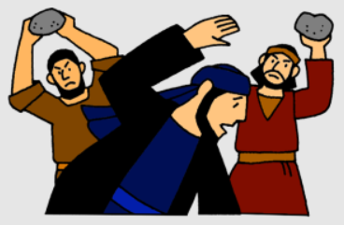
16
You will be handed over by your parents, your brothers, your relatives, and your friends; and some of you will be put to death.

Slide 17
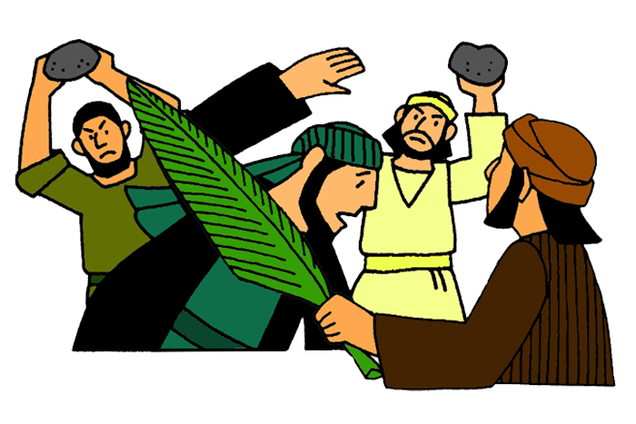
17
Everyone will hate you because of me.

Slide 18
18
But not a single hair from your heads will be lost.

Slide 19
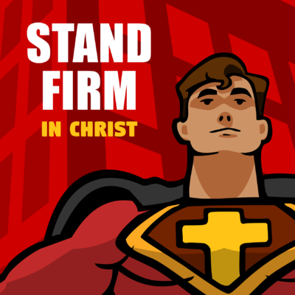
19
Stand firm, and you will save yourselves.

Slide 20
Leader: The Gospel of the Lord.
All: Praise to You,
Lord Jesus Christ.

Slide 21
GOSPEL MESSAGE

Slide 22
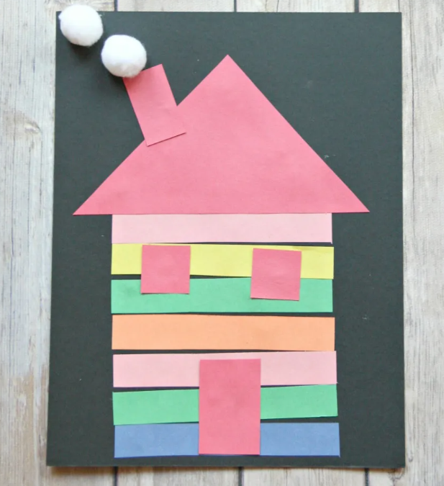
Activity:
Shape House
Multiple colors of construction paper
Scissors
White pom poms or Cotton balls
Glue

Slide 23
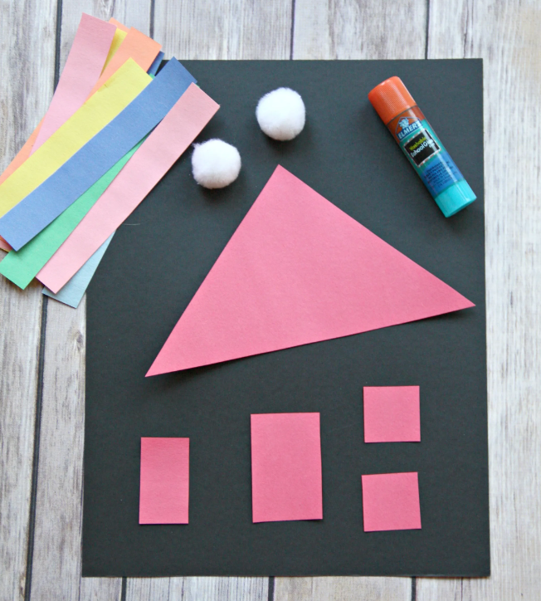
Instruction:
Cut the construction paper into 1 large triangle for the roof, 1 rectangle for the door, 1 smaller rectangle for the chimney, two squares for the window and multiple long rectangles in different colors.
Make sure those strips of paper are slightly smaller than the length of the roof.
Glue the long colorful rectangles together to make your house. Each child can choose whatever colors they want and they can decide if they want a short or tall house. Glue on the roof, door, windows and chimney. Add some puffs of smoke out of the chimney using the pom poms.

Slide 24
Closing Prayer
Dear God,
Thank you for your promises. And for being present in our lives. Thank you that we can put our hope in you even when life is scary or uncertain. Help us remember that every day. Thank you for your love. We love you, God!
In Jesus' name we pray. Amen.

Slide 25
LIVE THE WORD KIDS
33rd Sunday in Ordinary | Year C

