Slide 1
LIVE THE WORD KIDS
32nd Sunday in Ordinary | Year C

Slide 2
GOSPEL REFLECTION
In our Gospel this coming Sunday, we hear about a group of religious leaders, called the Sadducees, who were trying to trick Jesus in a very mean way – and they were trying to trick him with a question. They were asking him a question about what happens after we die. If Jesus gave a yes or a no answer, then they could make fun of him and then tell other people that they shouldn’t listen to Jesus because he wrongly answered their question. But Jesus knew they were up to no good and did not fall for their trick
Instead of talking about what happens after we die, Jesus talked about how God is with us and loves us right now because God is the God of the living, not of the dead. Jesus’ answer is important because it helps us to remember that God cares for each of us very much right now. So, instead of waiting until we die to experience God’s kingdom, we can experience God’s kingdom right now and share it with those around us – just like Jesus did!

Slide 3
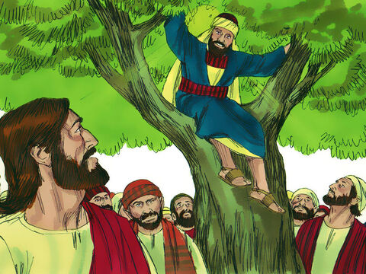
The Question about Rising from Death
Lk 20:27, 34-38

Slide 4
Leader: A reading from
the Holy Gospel
according to Luke.
All: Glory to You, Oh Lord.

Slide 5
27
Then some Sadducees, who say that people will not rise from death, came to Jesus.

Slide 6
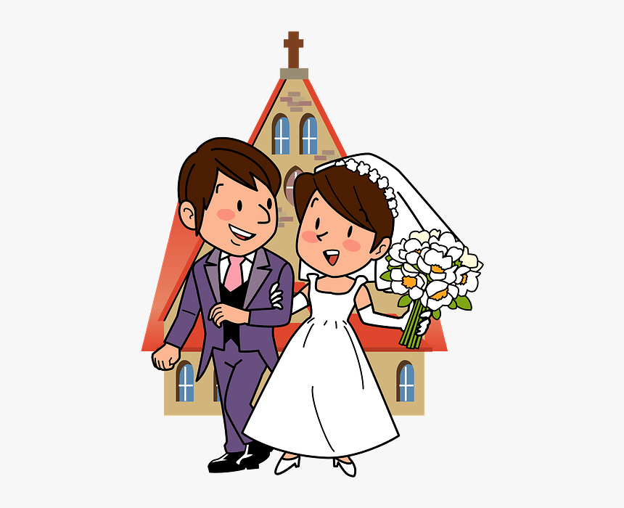
34
Jesus said to them,
“The men and women of this age marry,

Slide 7
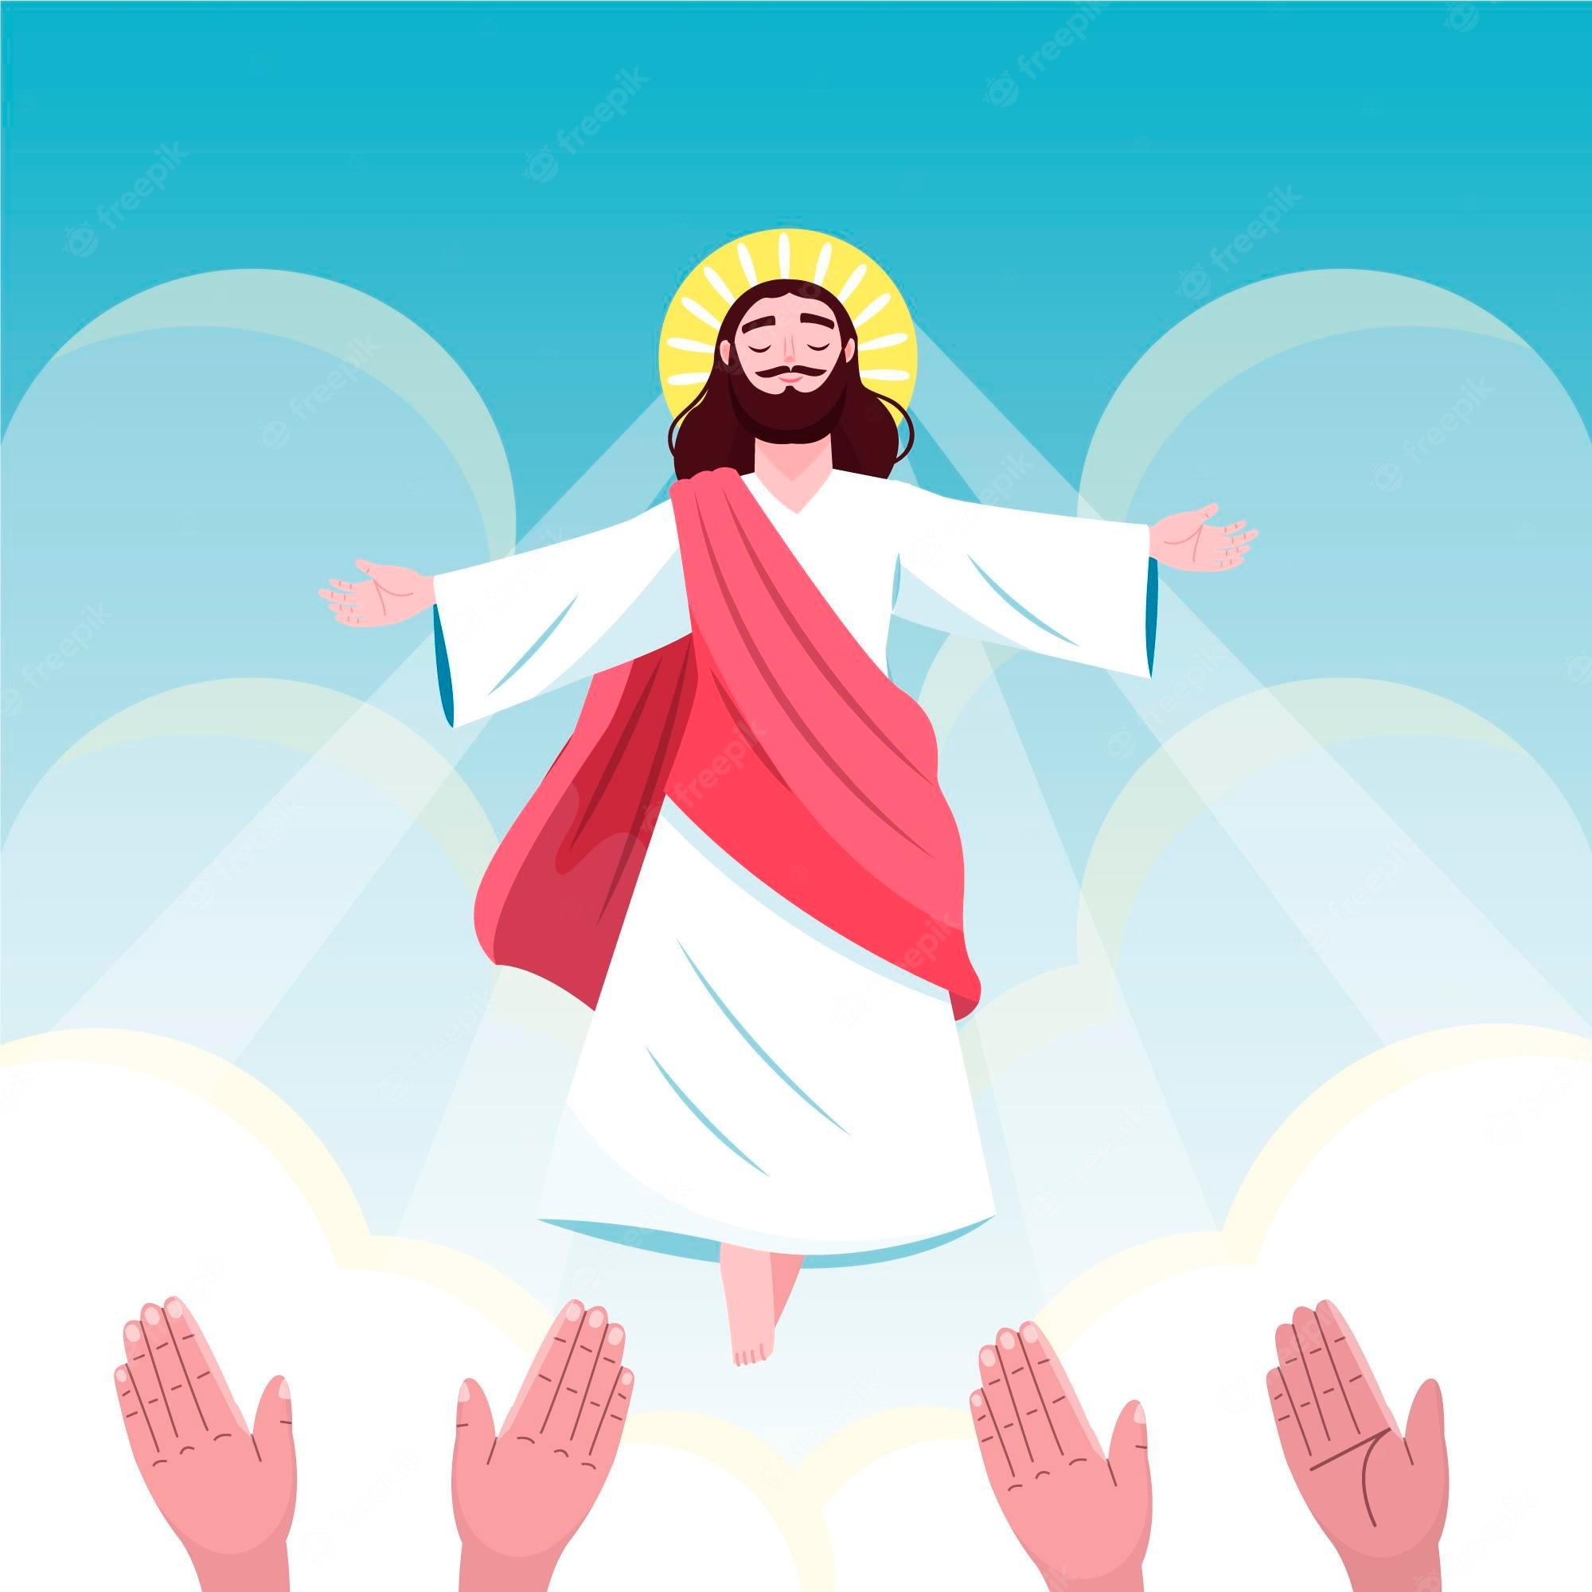
35
but the men and women who are worthy to rise from death and live in the age to come will not then marry.

Slide 8
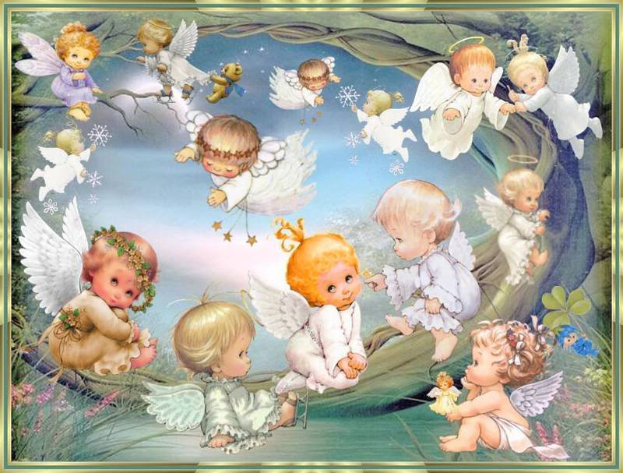
36
They will be like angels and cannot die. They are the children of God, because they have risen from death.

Slide 9
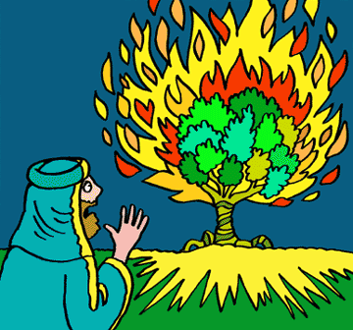
37
And Moses clearly proves that the dead are raised to life. In the passage about the burning bush he speaks of the Lord as ‘the God of Abraham, the God of Isaac, and the God of Jacob.’

Slide 10
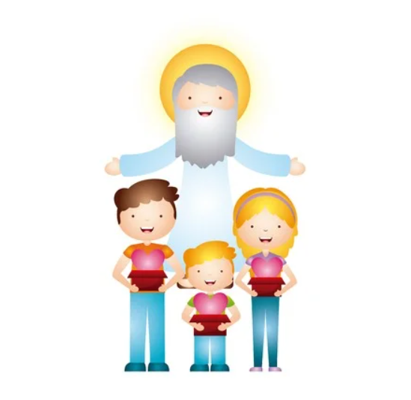
38
He is the God of the living, not of the dead, for to him all are alive.”

Slide 11
Leader: The Gospel of the Lord.
All: Praise to You,
Lord Jesus Christ.

Slide 12
GOSPEL MESSAGE

Slide 13
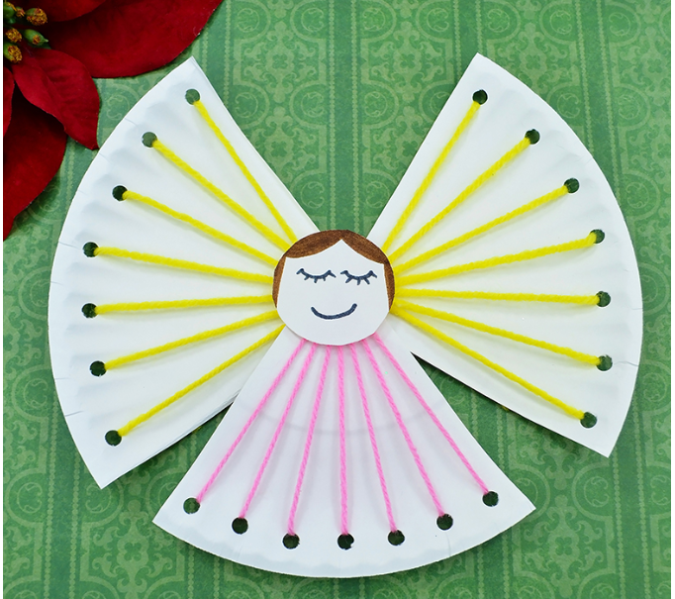
Activity: Paper Plate Angel
Paper plate
Scissors
Hole punch
Yellow and pink yarns
Glue stick
Markers
Notes:
Processing: Let us be like Angels here on earth by doing good deeds to others, by being loving and by being faitful to God always.

Slide 14
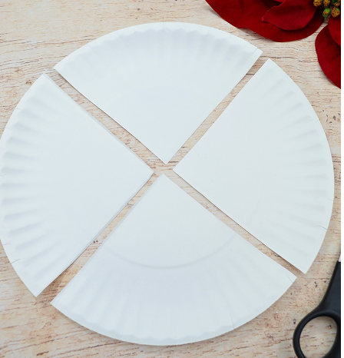
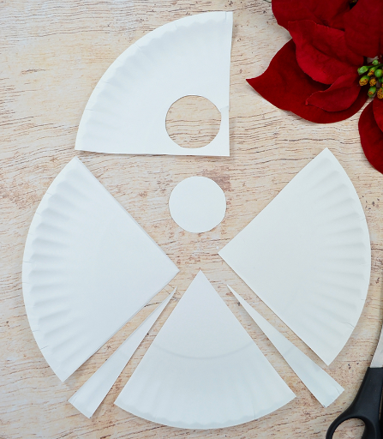
Instruction:
C. Then, trim the bottom section a little at each end for the body. The remaining pieces will be the Angel's wings.
A. Cut the plate into four even sections as seen above.
B. Cut a circle out of the top section to make the angel's head.

Slide 15
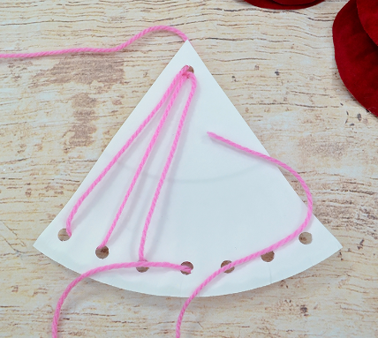
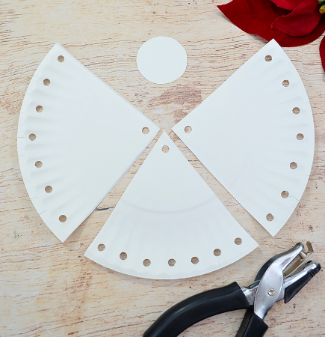
Instruction:
E. Thread the pink yarn through the top hole and into one of the bottom holes and then back through the top. Continue this pattern until you've completed the Angel's dress. Tie the loose ends together at the back.
D. Use a hole punch to make holes along the outer edges as seen above, and punch one hole at each center point.

Slide 16
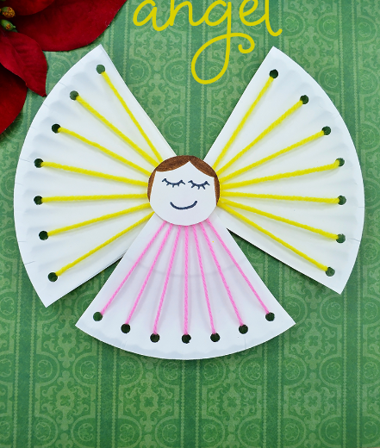
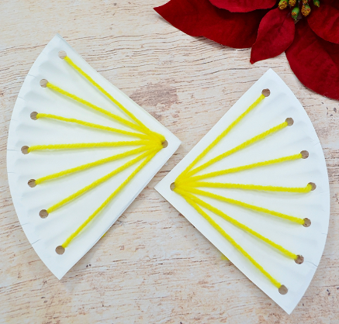
Instruction:
G. Draw a cute face and hair onto the circle piece for the Angel's head. Attach it to the body using glue or tape to complete the lacing craft.
F. Repeat the same process with the yellow yarn on the wings.

Slide 17
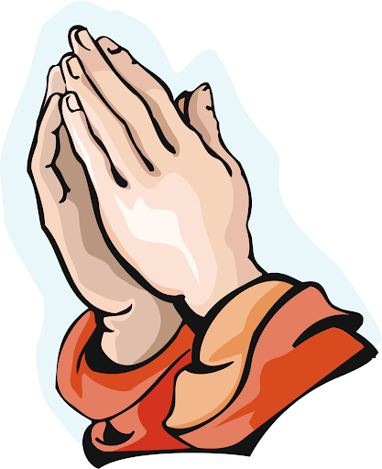
Closing Prayer
Dear God,
Thank you for being the God of the living, for loving us, and for being with us right here and now. Help us to share your love and mercy to those around us.
In Jesus' name we pray.
Amen.

Slide 18
LIVE THE WORD KIDS
32nd Sunday in Ordinary | Year C

