Slide 1
LIVE THE WORD KIDS
7th Sunday of Easter | Cycle C

Slide 2
USEFUL NOTES TO THE FACILITATOR (Don’t include this slide when you start your bible study with the kids)
The gospel talks about hope of the resurrection and the joy that is coming. The ascension of the Lord was a new beginning of His presence and for His disciples. Before He departed, He promised that he would always be with them and send the Holy Spirit who would anoint them. The disciples were not left in sorrow, but they were filled with joy and great anticipation for the coming of the Holy Spirit.
The gospel also talks about the power of God, to forgive a sinner and the power to heal, restore and make us whole again. It is to proclaim the good news of salvation. God’s love and gift of salvation was for everyone who will accept it.
The Lord ascends with a smile on His face. He smiled because of His love for us. The Lord accomplished his earthly mission and had conquered death. It is our mission to spread the good news and to proclaim that Jesus never abandoned and left us in this task, for the risen Lord is always with us through the power of Holy Spirit.

Slide 3
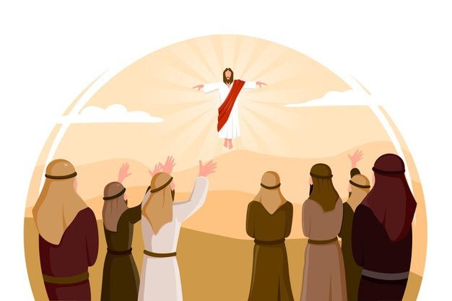
JESUS IS TAKEN UP TO HEAVEN
Luke 24:46-53

Slide 4
Leader: A reading from
the Holy Gospel
according to Luke.
All: Glory to You, Oh Lord.

Slide 5
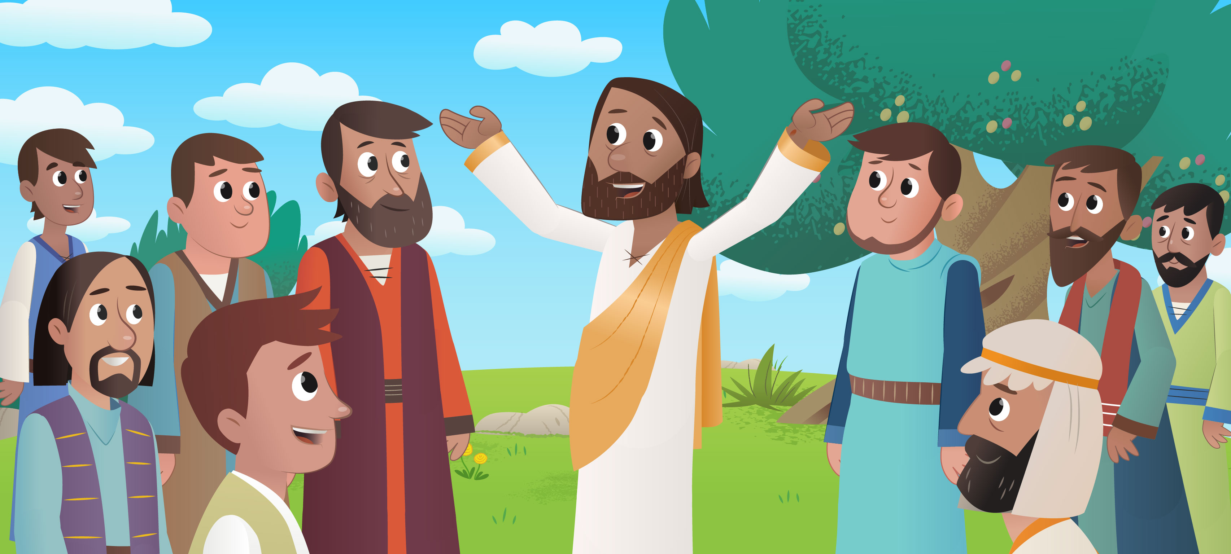
46
Jesus said to his disciples:
“This is what is written: the Messiah must suffer and must rise from death three days later,

Slide 6
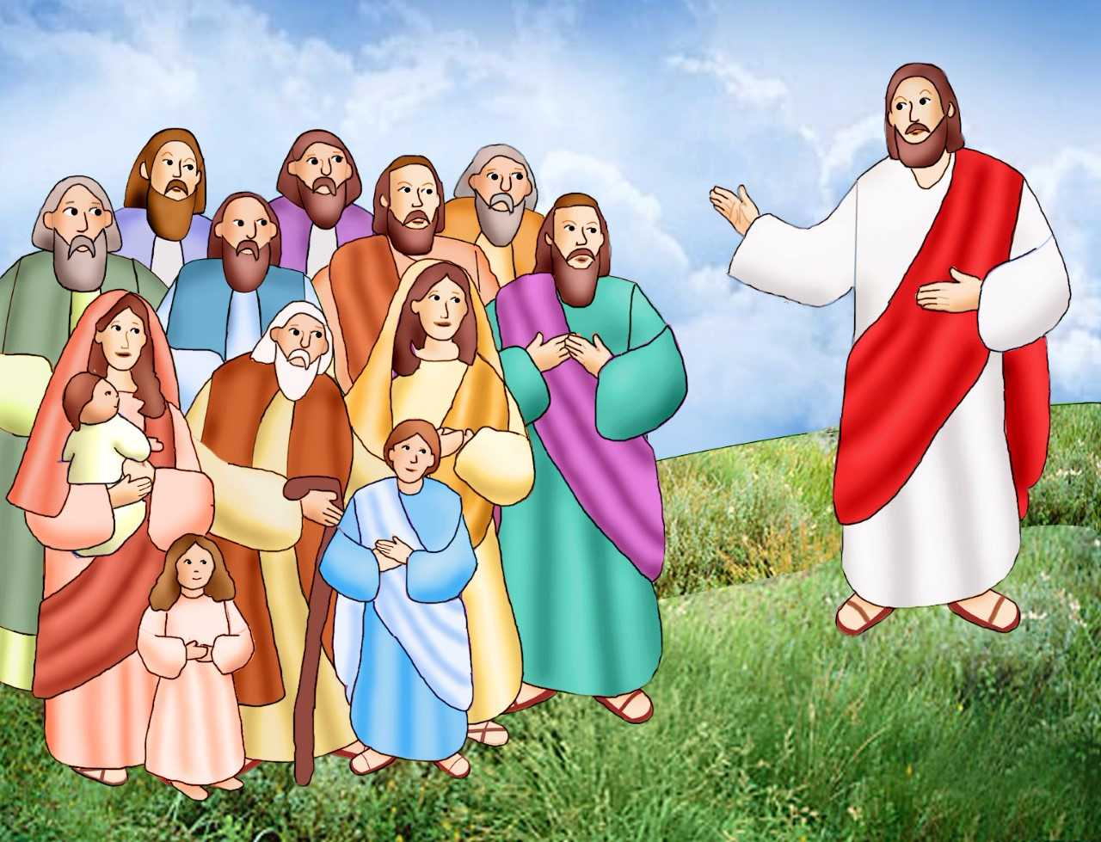
47
and in his name the message about repentance and the forgiveness of sins must be preached to all nations, beginning in Jerusalem.

Slide 7
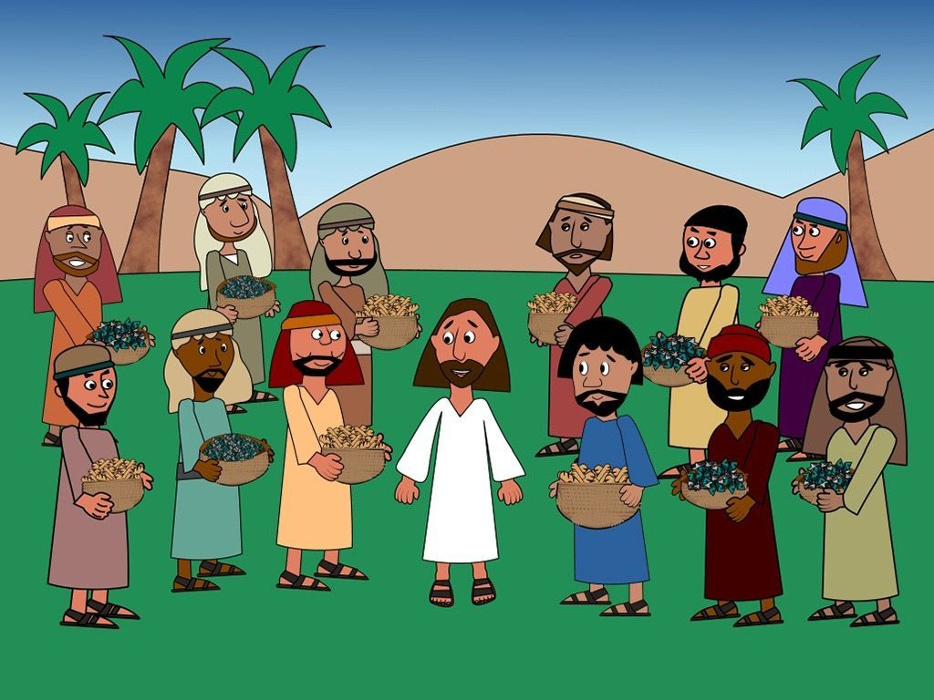
48
You are witnesses of these things.

Slide 8
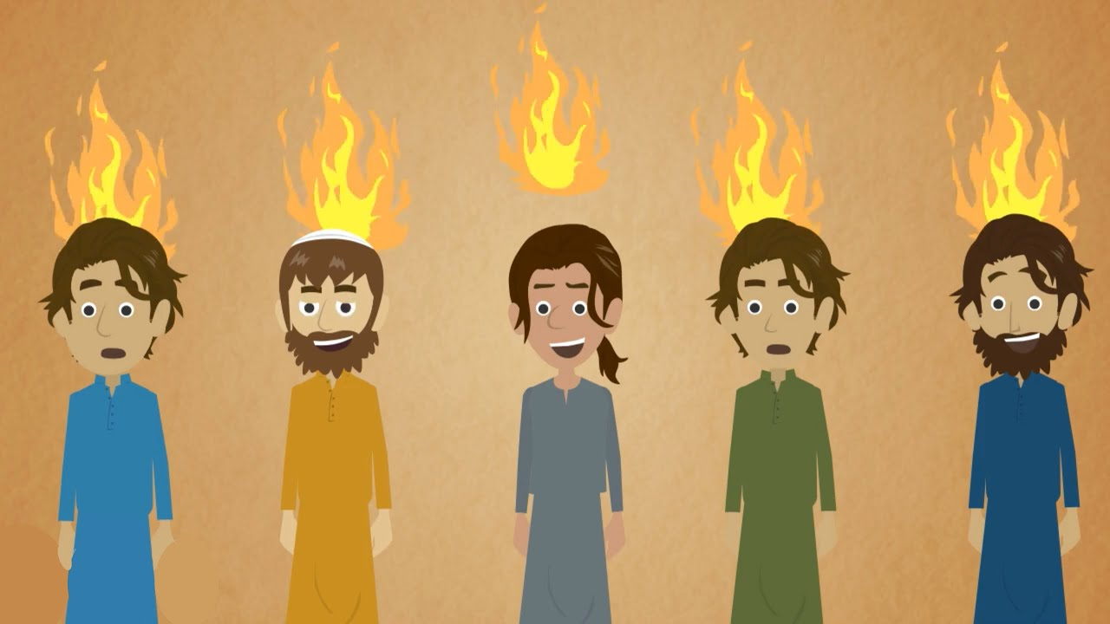
49
And I myself will send upon you what my Father has promised. But you must wait in the city until the power from above comes down upon you.”

Slide 9
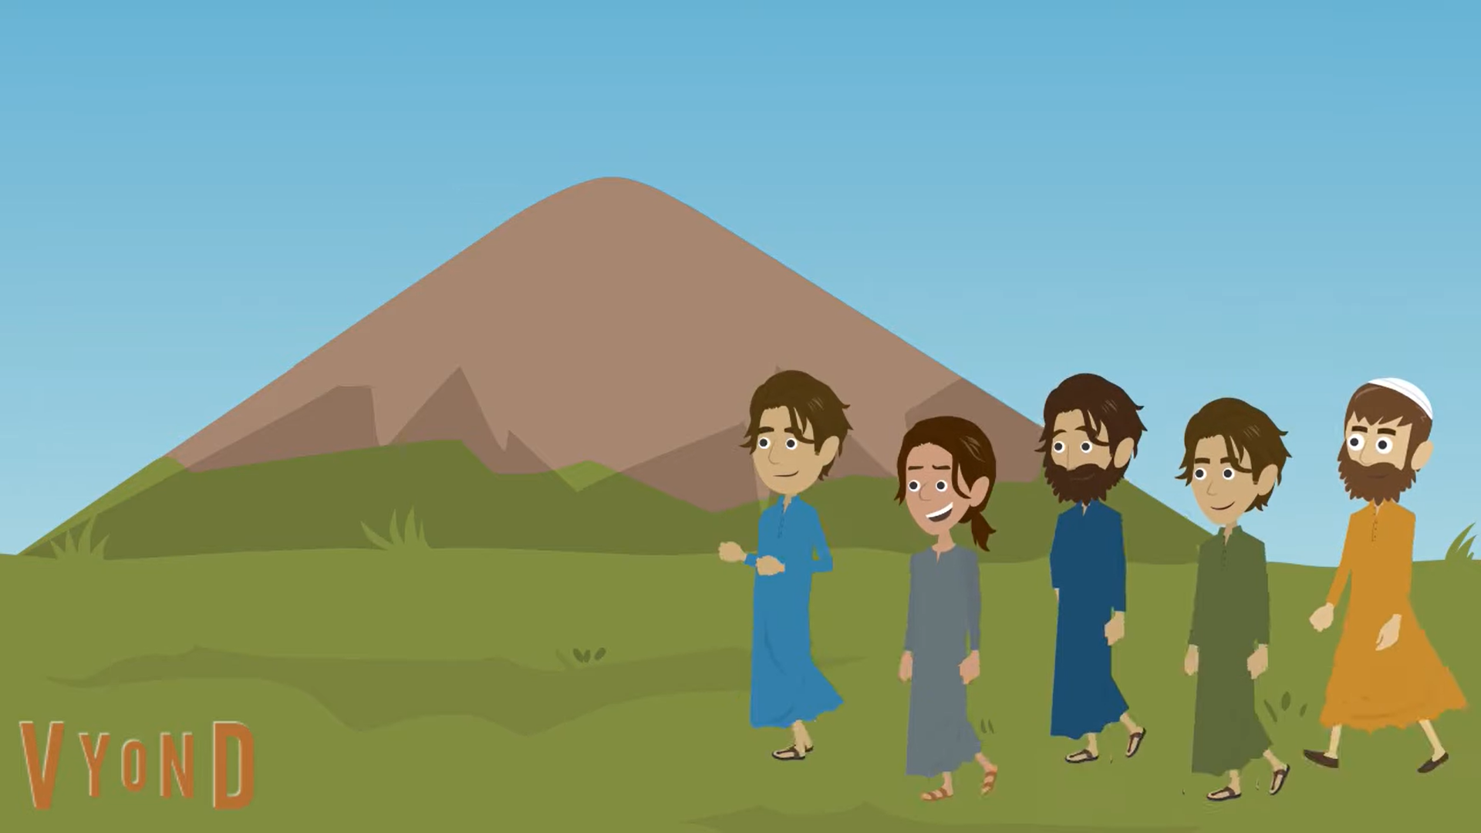
50
Then he led them out of the city as far as Bethany, where he raised his hands and blessed them.

Slide 10
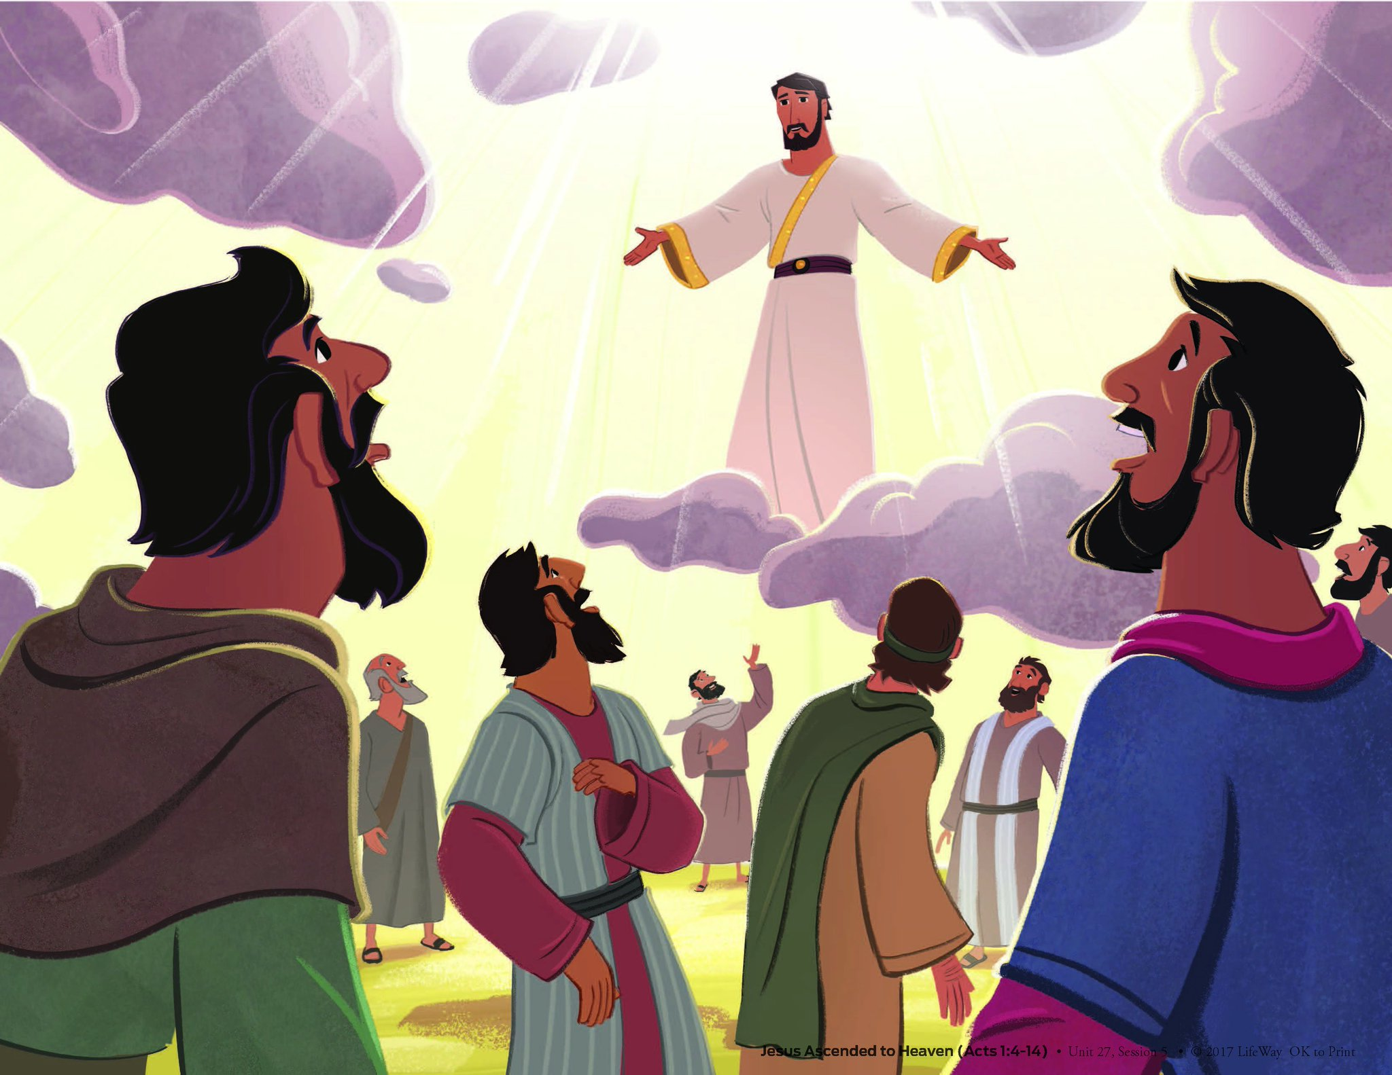
51
As he was blessing them, he departed from them and was taken up into heaven.

Slide 11
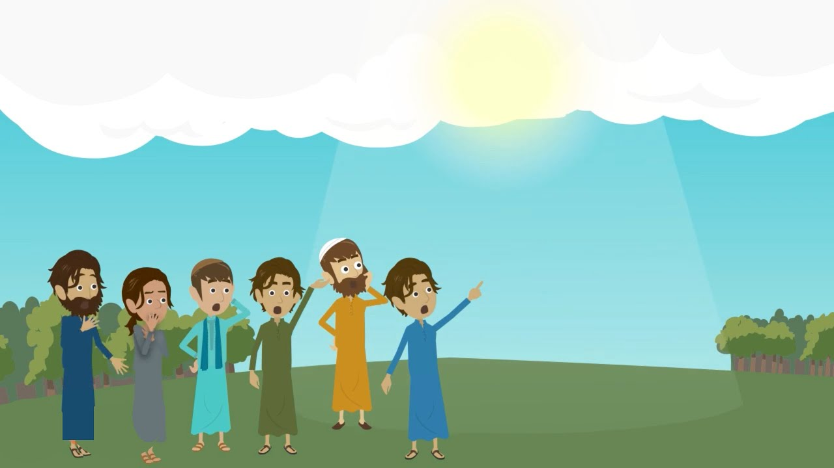
52
They worshiped him and went back into Jerusalem, filled with great joy,

Slide 12
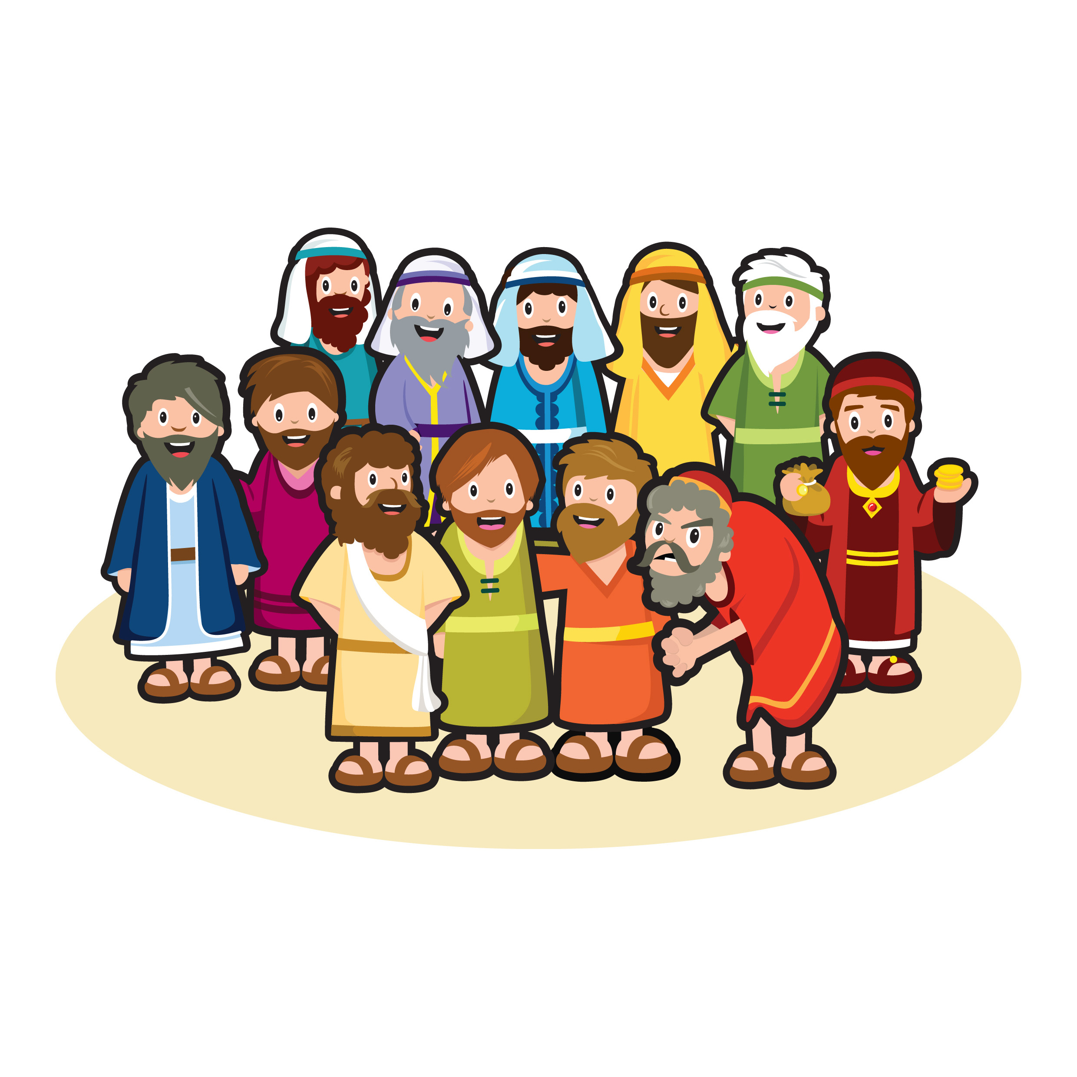
53
and spent all their time in the Temple giving thanks to God.

Slide 13
Leader: The Gospel of the Lord.
All: Praise to You,
Lord Jesus Christ.

Slide 14
GOSPEL MESSAGE

Slide 15
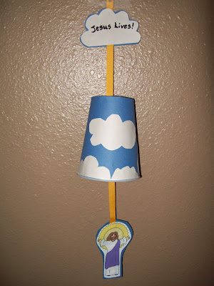
Activity:
JESUS’ ASCENSION CRAFT
1 Blue construction paper
1 Bond paper
1 ½ foot ribbon or yarn
Paper Cup
Scissor
Glue
Coloring Materials

Slide 16
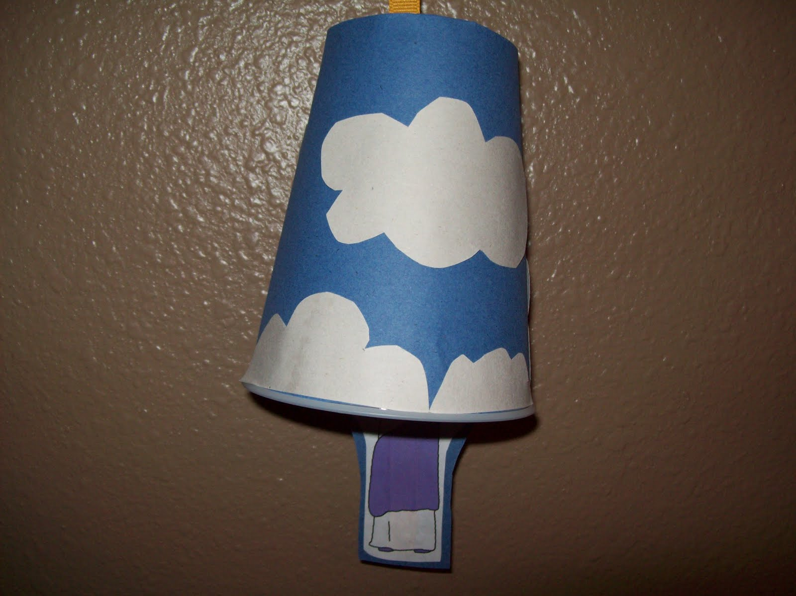
Activity: JESUS’ ASCENSION CRAFT
Cut into the bottom of a cup a small slit for the ribbon.
Flip the cup upside down, then glue blue paper on the outside of the cup.
Cut out cloud shapes from white construction paper, and glue them around the cup to represent the sky with clouds.
Then print out or draw a picture of Jesus that will fit inside the cup - used a fairly large cup.

Slide 17
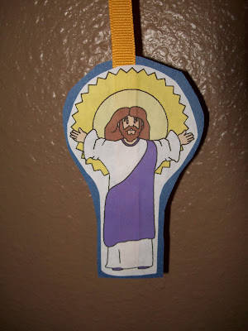
Activity: JESUS’ ASCENSION CRAFT
Cut out the picture, then put the picture on top of the blue construction paper and cut around the picture shape so you have a backing paper for Jesus' picture.
Cut out a cloud for the top piece and a slightly larger copy of the cloud in blue construction paper.
Lay the bottom end of the ribbon or yarn on the blue paper, and then glue the picture of Jesus on top of the blue paper, sandwiching the ribbon in between the two papers.

Slide 18
Activity: JESUS’ ASCENSION CRAFT
Thread the ribbon through the hole in the bottom of the cup, so that by pulling the ribbon, you can pull Jesus up into the cup.
Write on the cloud- He Lives!

Slide 19
Closing Prayer
Dear God, thank you for who you are. Thank you for resurrection joy. Help us to be excited about your story so we can share the good news with others. Thank you for loving us always.
In Jesus’ name, we pray. Amen.

Slide 20
LIVE THE WORD KIDS
7th Sunday of Easter | Cycle C

