Slide 1
LIVE THE WORD KIDS
6th Sunday of Easter | Cycle C

Slide 2
USEFUL NOTES TO THE FACILITATOR (Don’t include this slide when you start your bible study with the kids)
Jesus promises his disciples that the Father will send the Advocate, the Holy Spirit. He gives his disciples a very special gift, the gift of peace. And, though he knows their lives will be in turmoil when he is gone, he tells his disciples not to be afraid, he will still be with them through the Holy Spirit.
Jesus knew that we are in need of guidance in our lives, so he promised to send his Holy Spirit. What title does Jesus use when referring to his Holy Spirit? (Advocate). An advocate is a helper. Jesus gives us his Holy Spirit to be our advocate—our guide—so that we do not get lost on our journey to heaven.
Jesus tells us , although he is going back to his father , he will not leave us orphans. He says he will always be with us and when he comes back to us , our hearts will be full of joy.

Slide 3
THE PROMISE OF THE HOLY SPIRIT
John 14: 23-29

Slide 4
Leader: A reading from
the Holy Gospel
according to John.
All: Glory to You, Oh Lord.

Slide 5
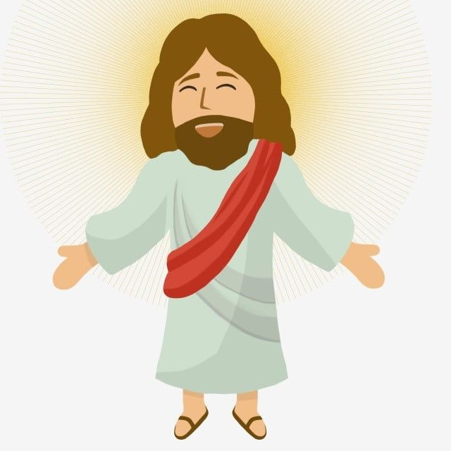
23
Jesus said to his disciples:
“Those who love me will obey my teaching. My Father will love them, and my Father and I will come to them and live with them.

Slide 6
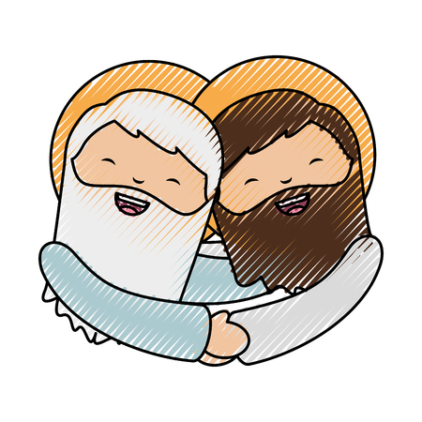
24
Those who do not love me do not obey my teaching. And the teaching you have heard is not mine, but comes from the Father, who sent me.

Slide 7
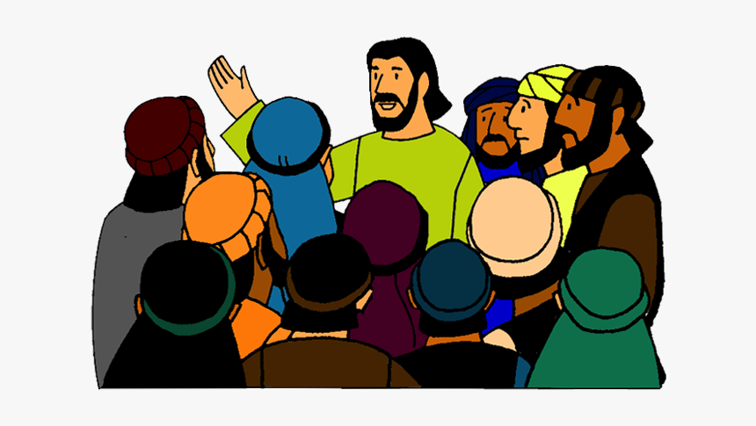
25
“I have told you this while I am still with you.

Slide 8
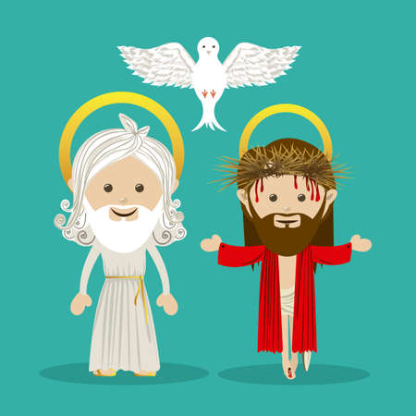
26
The Helper, the Holy Spirit, whom the Father will send in my name, will teach you everything and make you remember all that I have told you.

Slide 9
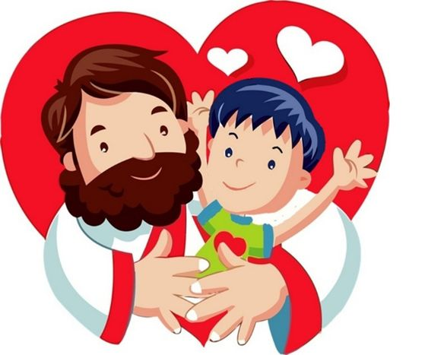
27
“Peace is what I leave with you;
it is my own peace that I give you. I do not give it as the world does. Do not be worried and upset; do not be afraid.

Slide 10
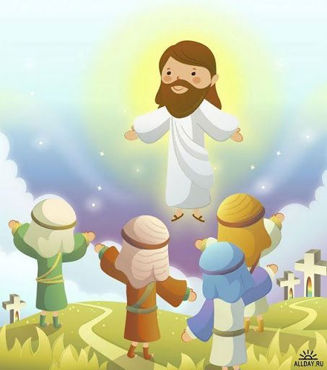
28
You heard me say to you, ‘I am leaving, but I will come back to you.’ If you loved me, you would be glad that I am going to the Father; for he is greater than I.

Slide 11
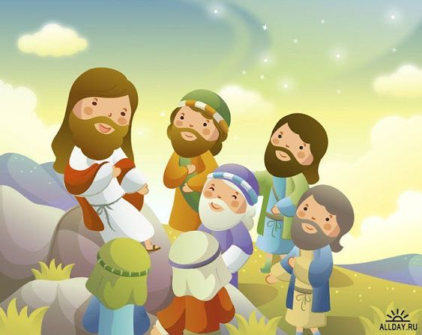
29
I have told you this now before it all happens, so that when it does happen, you will believe.

Slide 12
Leader: The Gospel of the Lord.
All: Praise to You,
Lord Jesus Christ.

Slide 13
GOSPEL MESSAGE

Slide 14
Activity:
PEACE DOVE
1 Blue construction paper
1 Bond paper
Scissor
Glue
Coloring Materials

Slide 15
Activity: PEACE DOVE
Trace your hand on a sheet of white paper.
Then cut it out and glue it down onto blue construction paper
Glue a scrap of yellow paper under for the beak.
Use a color or marker to make a dot for the eye.
Write the phrase: “Peace be with you”
Notes:
The dove represent the very special gift the Jesus gives us – the Holy Spirit. You and I have a friend. A very, very special friend. Our best friend — the Holy Spirit. The Holy Spirit is there to guide you, defend you, protect you and remind you that Jesus lived and taught “God is love.” If the Holy Spirit is alive in our lives then peace will never be taken away from us.

Slide 16
Closing Prayer
Dear Jesus, we thank you for our friends. We especially thank you for the Holy Spirit, our very best Friend. May we recognize your peace in our own lives and bring the light of that peace to those we meet.
In Jesus’ name, we pray. Amen.

Slide 17
LIVE THE WORD KIDS
6th Sunday of Easter | Cycle C

