Slide 1
LIVE THE WORD KIDS
5th Sunday of Easter | Cycle C

Slide 2
THE NEW COMMANDMENT
John 13: 31-35

Slide 3
Leader: A reading from
the Holy Gospel
according to John.
All: Glory to You, Oh Lord.

Slide 4
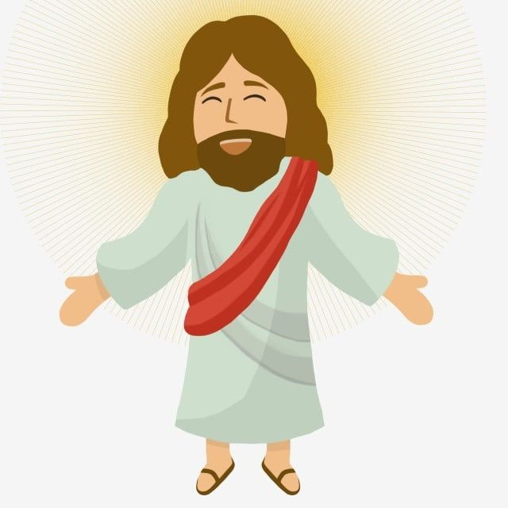
31
After Judas had left, Jesus said,
“Now the Son of Man's glory is revealed; now God's glory is revealed through him.

Slide 5
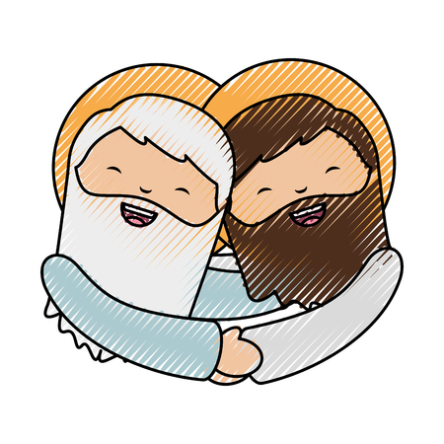
32
And if God's glory is revealed through him, then God will reveal the glory of the Son of Man in himself, and he will do so at once.

Slide 6
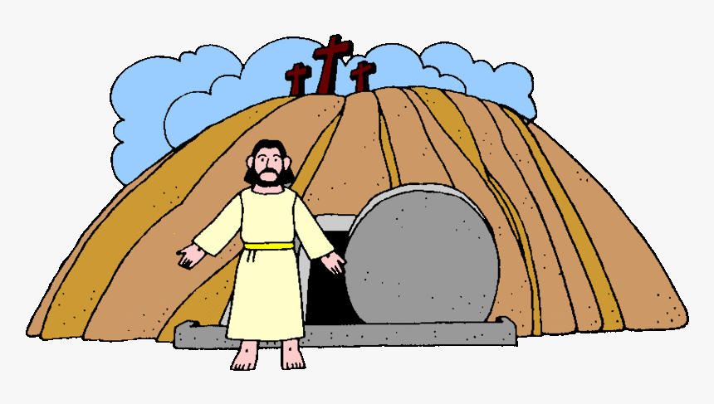
33
My children, I shall not be with you very much longer. You will look for me; but I tell you now what I told the Jewish authorities, ‘You cannot go where I am going.’

Slide 7
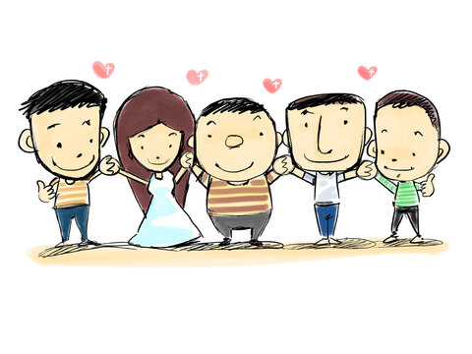
34
And now I give you a new commandment: love one another. As I have loved you, so you must love one another.

Slide 8
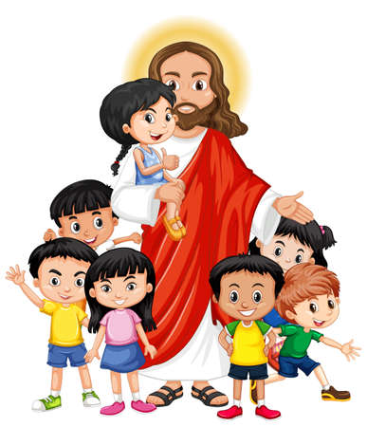
35
If you have love for one another, then everyone will know that you are my disciples.”

Slide 9
Leader: The Gospel of the Lord.
All: Praise to You,
Lord Jesus Christ.

Slide 10
GOSPEL MESSAGE

Slide 11
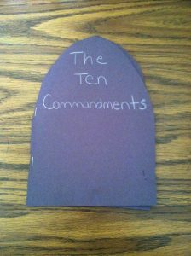
Activity:
GOD’S COMMANDMENT
Black construction paper
White construction paper
Scissors
Glue
Stapler/staples
White crayons or colored pencils

Slide 12
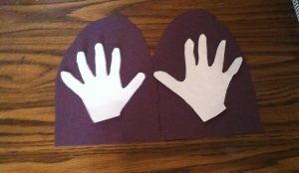
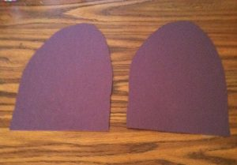
Activity: GOD’S COMMANDMENT
Pre-cut black construction paper into two large “tablet” shapes.
Trace your hand prints, both right and left hands. Cut out your handprints and glue one hand print on each tablet shape.
Write the new version of each commandment onto each handprint.

Slide 13
Activity: GOD’S COMMANDMENT
Lay the tablet shapes on top of each other and staple along the edge to create a book that opens to reveal the handprint commandments
Instruct students to give their booklet a title using white crayons or colored pencils

Slide 14
Closing Prayer
Dear Jesus, thank you for loving us unconditionally. Thank you for helping us share your good news with others. Help us understand and do that. Help us love one another. Thank you for Jesus!
In Jesus’ name, we pray. Amen.

Slide 15
LIVE THE WORD KIDS
5th Sunday of Easter | Cycle C

