Slide 1
LIVE THE WORD KIDS
4th Sunday of Easter | Cycle C

Slide 2
USEFUL NOTES FOR THE FACILITATOR
(Don’t include this slide when you start your bible study with the kids)
Jesus said, “I am the good shepherd.” A shepherd is a person who takes care of sheep. Sheep can’t take care of themselves. They need someone to watch over them and care for them. They need someone to protect them from harm. Jesus said he knows his sheep and his sheep know him. He said that he was even willing to lay down his life for his sheep. Jesus must really love his sheep!
As you might have guessed, Jesus wasn’t really talking about sheep. He was talking about you and me. We are his “sheep.” He loves us, he takes care of us, he makes sure that we have everything that we need. He was even willing to give his life so that you and I could live with him forever in heaven.
There is no doubt about it. Jesus really loves his sheep!

Slide 3
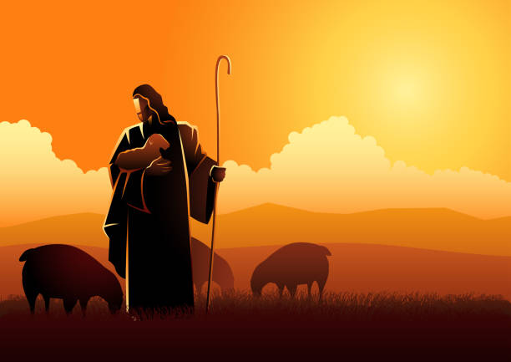
THE GOOD SHEPHERD
John 10:27-30

Slide 4
Leader: A reading from
the Holy Gospel
according to John.
All: Glory to You, Oh Lord.

Slide 5
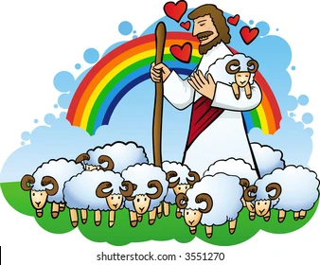
27
My sheep listen to my voice; I know them, and they follow me.

Slide 6
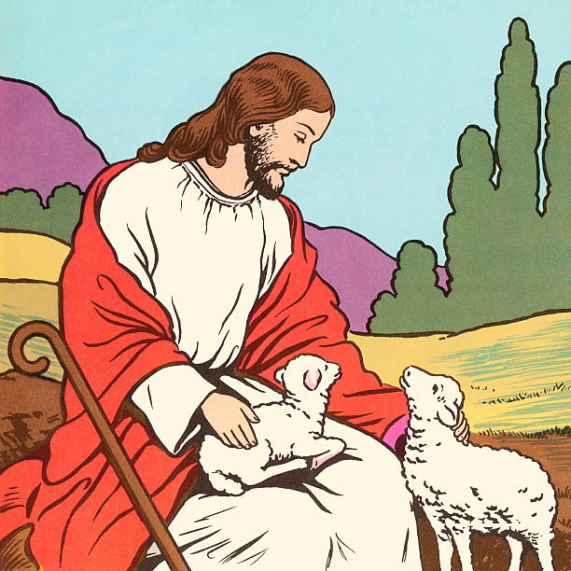
28
I give them eternal life, and they shall never die. No one can snatch them away from me.

Slide 7
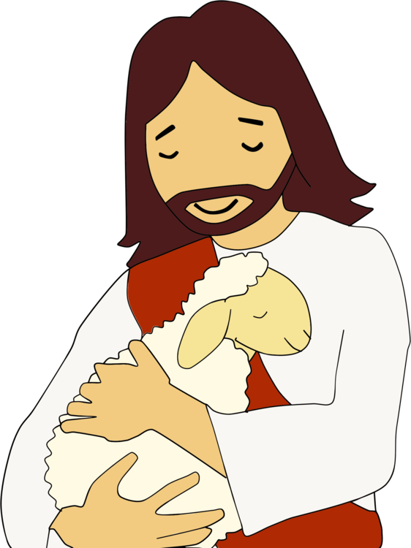
29
What my Father has given me is greater than everything,
and no one can
snatch them away
from the Father's care

Slide 8
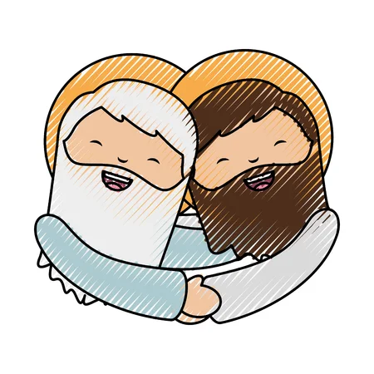
30
The Father and I are one.

Slide 9
Leader: The Gospel of the Lord.
All: Praise to You,
Lord Jesus Christ.

Slide 10
GOSPEL MESSAGE

Slide 11
Activity:
The Good Shepherd Craft
Brown construction paper
Scissors
Cotton balls
Pen or Marker
Wiggly eyes
White Glue
Baby wipes (optional)

Slide 12
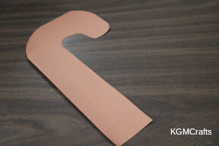
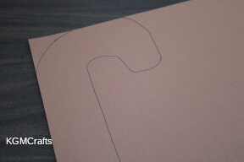
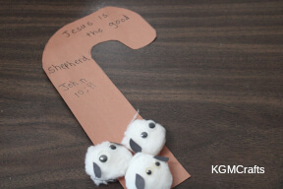
Instructions:
Draw a candy cane shape approximately 9 by 3 inches.
2. Cut the shape out.
3. Glue three cotton balls near the bottom of the staff. Add small wiggly eyes to the center of the cotton balls.

Slide 13
Instructions:
4. Cut small tear shapes from black paper to make the ears for the sheep. The tear shapes need to be really tiny, less than an inch long.
5. Glue the ears to the cotton balls near the eyes.
6. Above the sheep, on the staff with a pen or marker, write “Jesus is the good shepherd. John 10:11”.

Slide 14
Closing Prayer
Dear Jesus, thank you for your Words and its truth. Thank you for calling us yours. Help us to recognize your voice, and do what you ask
Help us to follow You more closely. Thank you for your love. Thank you for Jesus!
In Jesus’ name, we pray. Amen.

Slide 15
LIVE THE WORD KIDS
4th Sunday of Easter | Cycle C

