Slide 1
LIVE THE WORD KIDS
3rd Sunday of Easter | Cycle C

Slide 2
USEFUL NOTES FOR THE FACILITATOR
(Don’t include this slide when you start your bible study with the kids)
The Sea of Tiberias, (Galilee) is where Jesus Walked on Water, Calmed the Stormy Sea, and Fed the Five Thousand on its shores.
It was a customary practice to fish at night and to sell the fish on the morning market. However, they had fished all night without catching even one fish. When Peter announced that he was going fishing, they decided to go with him. Some of Jesus' disciples had been fishermen before becoming His disciples. These were professional fishermen, at least some of them were, so it must have been very discouraging. Though Jesus was triumphantly standing on the shore, it was not yet full daylight, and the disciples did not recognize Him. These were dark and confusing times for the disciples, but Jesus is never far away, His light is always ready to break forth.
Even in the worst of times, there is always a reason to have hope if you have Jesus.

Slide 3
Although too far away to recognize in the dim light of early morning, the miracle catch of fish caused John, "that disciple whom Jesus loved," to realize that the person on the shore was Jesus.
When Peter realized it was Jesus, he could not wait for the boat to draw closer to the shore. By obeying Jesus and finding more fish than they could have possibly caught any other way, means this was a Miracle Catch of Fish. The net not breaking was yet another miracle. The Lord can abundantly provide.
This miracle not only blessed them with a boat filled with fish, but it also restored their hope and confidence that had been lost over the recent horrible ordeal when they had thought they had lost their Master.

Slide 4
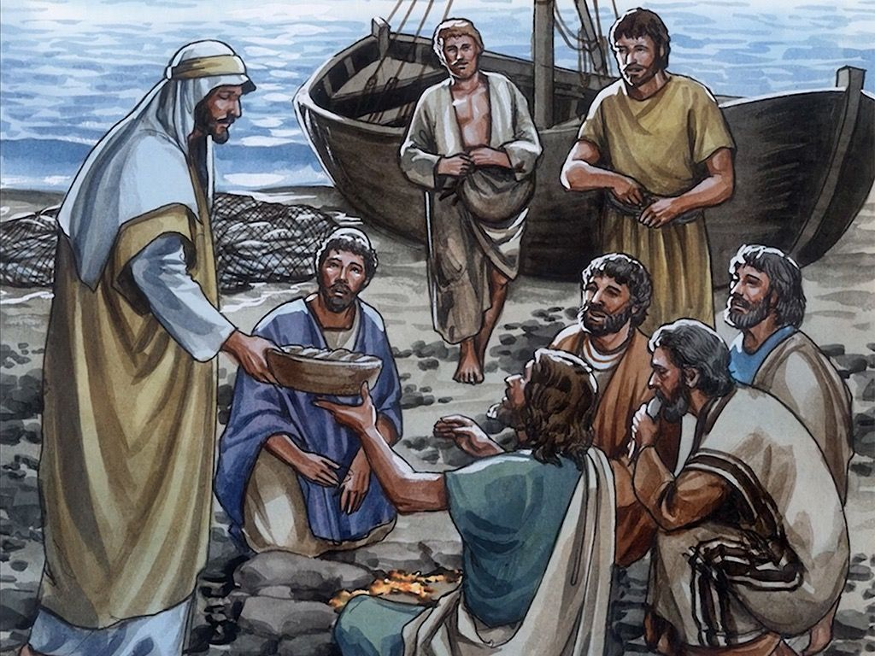
THE MIRACLE CATCH OF FISH
John 21:1-14

Slide 5
Leader: A reading from
the Holy Gospel
according to John.
All: Glory to You, Oh Lord.

Slide 6
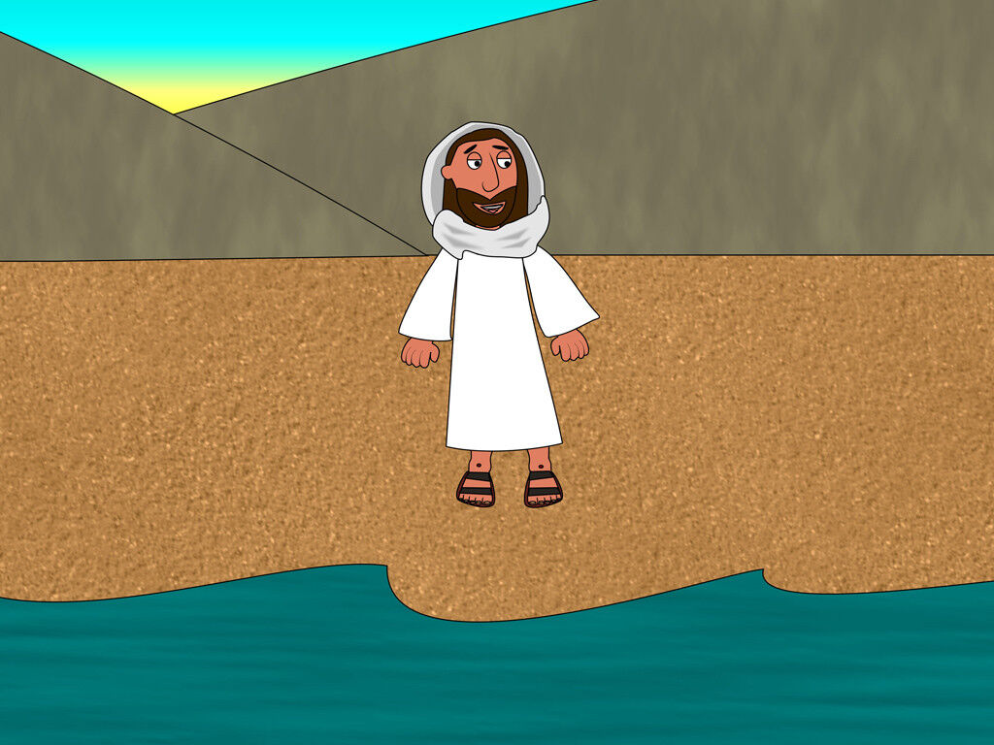
1
Jesus appeared once more to his disciples at Lake Tiberias. This is how it happened.

Slide 7
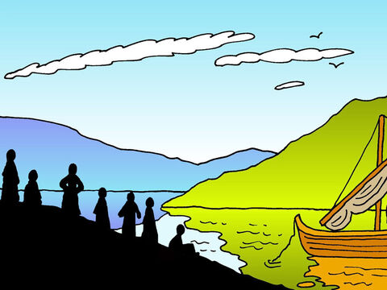
2
Simon Peter, Thomas (called the Twin), Nathanael (the one from Cana in Galilee), the sons of Zebedee, and two other disciples of Jesus were all together.

Slide 8
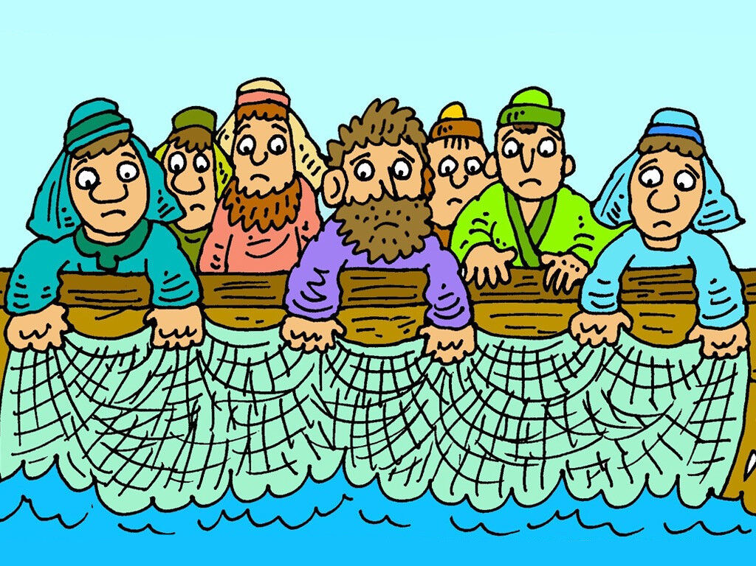
3
Simon Peter said to the others,
"I am going fishing."
"We will come with you," they told him. So they went out in a boat, but all that night they did not catch a thing.

Slide 9
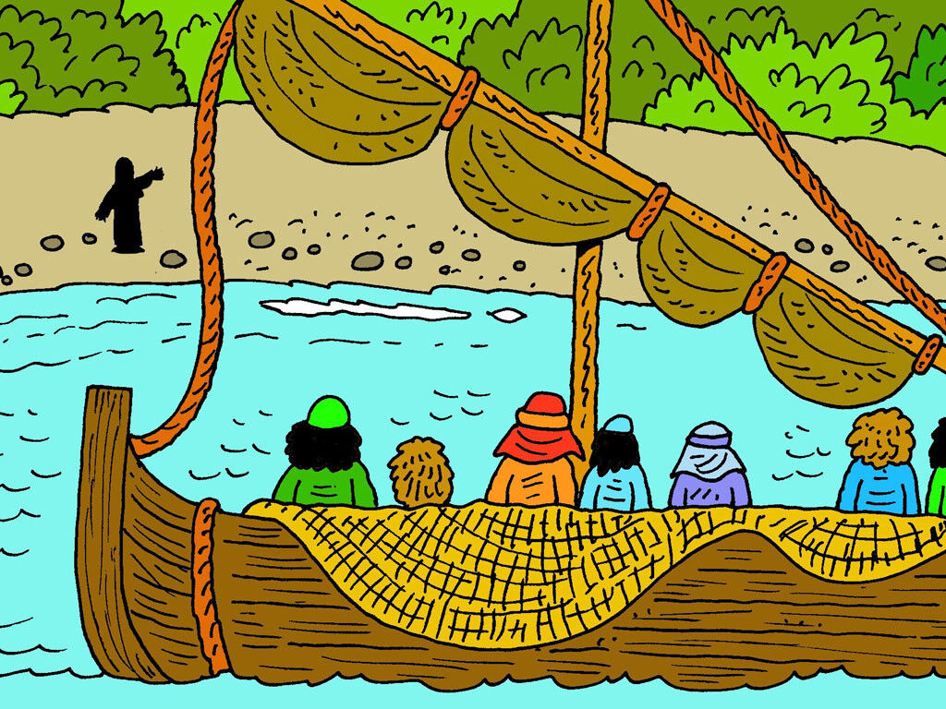
4
As the sun was rising, Jesus stood at the water's edge, but the disciples did not know that it was Jesus.

Slide 10
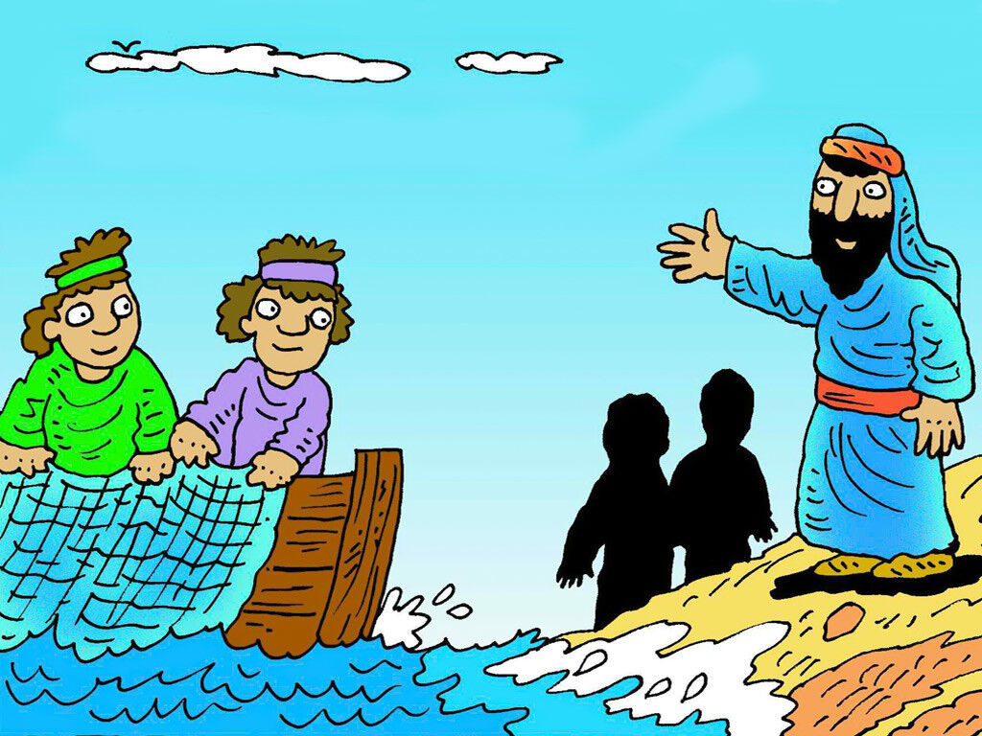
5
Then he asked them,
"Young men, haven't you caught anything?"
"Not a thing," they answered.

Slide 11
6
He said to them, "Throw your net out on the right side of the boat, and you will catch some." So they threw the net out and could not pull it back in, because they had caught so many fish.

Slide 12
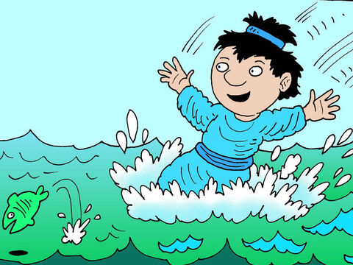
7
The disciple whom Jesus loved said to Peter, "It is the Lord!"
When Peter heard that it was the Lord, he wrapped his outer garment around him (for he had taken his clothes off) and jumped into the water.

Slide 13
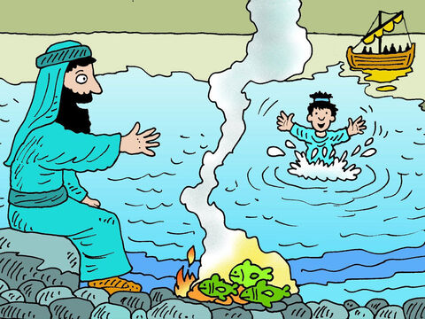
8
The other disciples came to shore in the boat, pulling the net full of fish. They were not very far from land, about a hundred yards away.

Slide 14
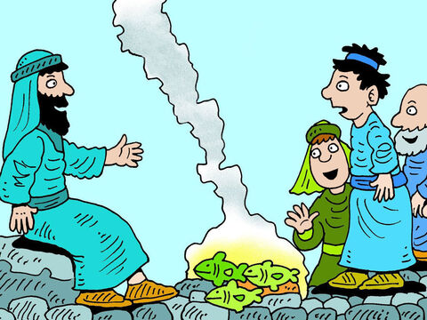
9
When they stepped ashore, they saw a charcoal fire there with fish on it and some bread.

Slide 15
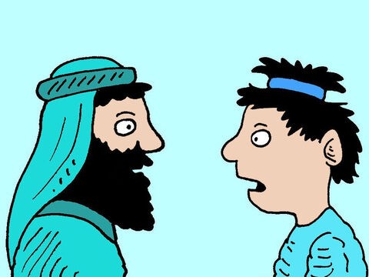
10
Then Jesus said to them,
"Bring some of the fish you have just caught."

Slide 16
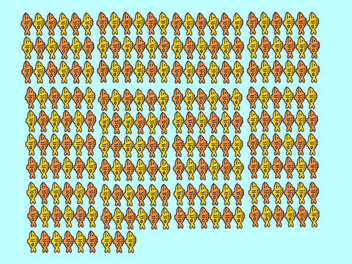
11
Simon Peter went aboard and dragged the net ashore full of big fish, a hundred and fifty-three in all; even though there were so many, still the net did not tear.

Slide 17
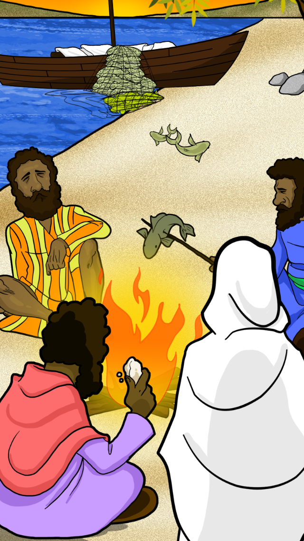
12
Jesus said to them, "Come and eat." None of the disciples dared ask him, "Who are you?" because they knew it was the Lord.

Slide 18
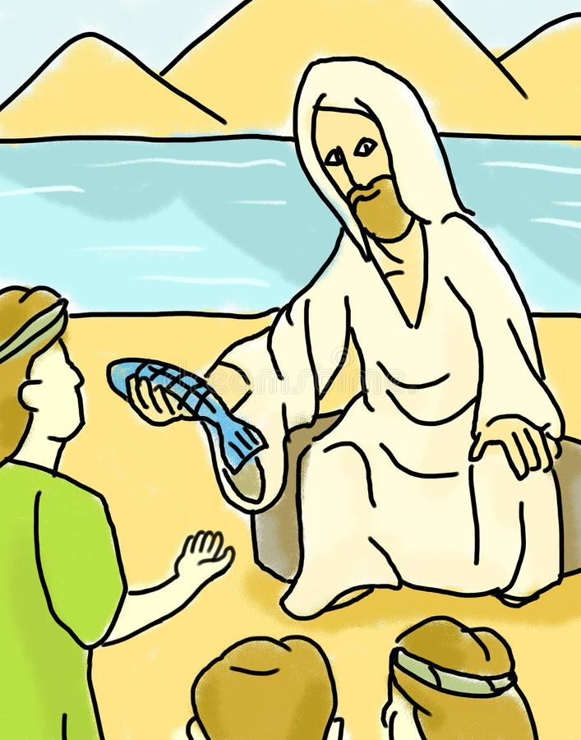
13
So Jesus went over, took the bread, and gave it to them; he did the same with the fish.

Slide 19
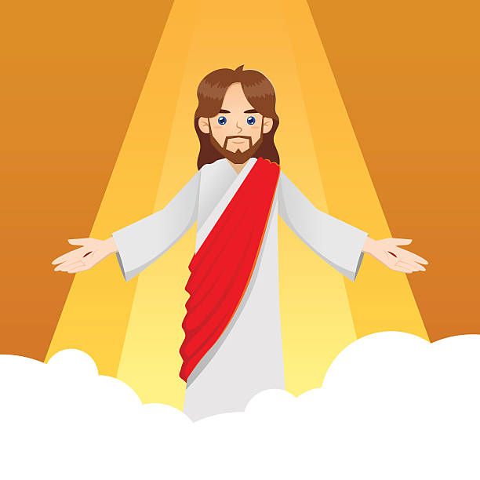
14
This, then, was the third time Jesus appeared to the disciples after he was raised from death.

Slide 20
Leader: The Gospel of the Lord.
All: Praise to You,
Lord Jesus Christ.

Slide 21
GOSPEL MESSAGE

Slide 22
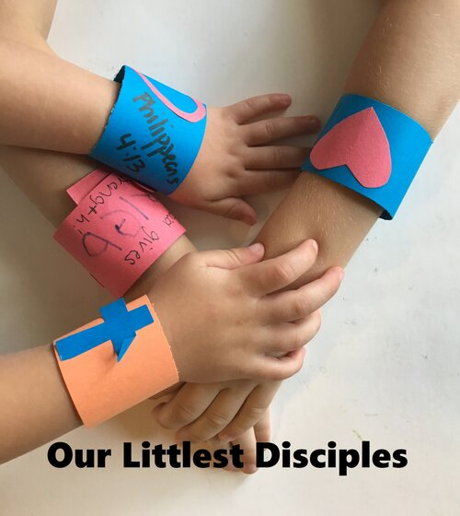
Activity:
SUPER HERO CUFF LINKS
Construction Paper/Multipurpose Paper (2 different colors)
Scissors
Pen or Markers
Glue or tape

Slide 23
Activity: I BELIEVE HAND
Make super hero cuff links, because with God’s strength we can do anything and we will never be empty.
Cut strips of paper about 1-1/2” wide. Decorate the paper with stickers, color, paper hearts/crosses, scripture.
Add the scripture or reference- I can do everything through Him who gives me strength. Philippians 4:13
Wrap the cuffs around your wrist and secure with tape.

Slide 24
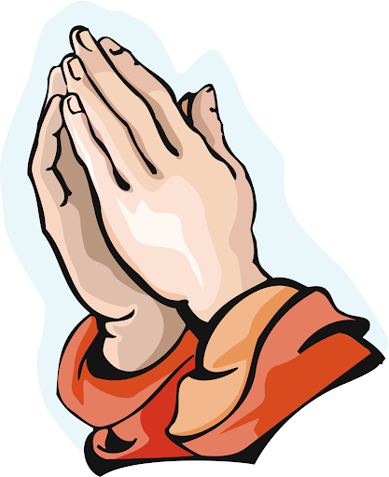
Closing Prayer
Dear Jesus, thank you for your forgiveness and for feeding us, and for reminding us of your love even when we have forgotten you. Open the eyes of our hearts so we can also recognize your presence and see the wonders you are doing in our lives.
In Jesus’ name, we pray. Amen.

Slide 25
LIVE THE WORD KIDS
3nd Sunday of Easter | Cycle C

