Slide 1
LIVE THE WORD KIDS
4th Sunday of Lent | Cycle C

Slide 2
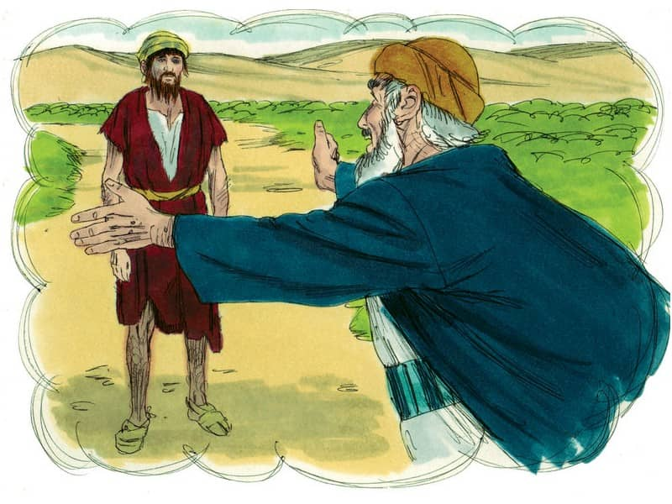
The Parable of the Lost Son
Luke 15:1-3, 11-32

Slide 3
Leader: A reading from
the Holy Gospel
according to Luke.
All: Glory to You, Oh Lord.

Slide 4
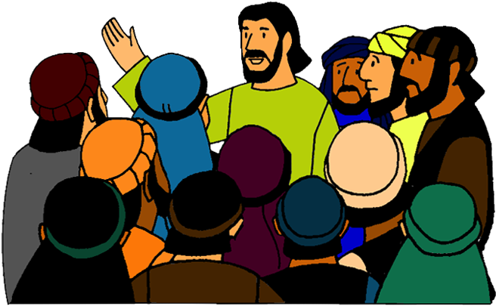
1
The tax collectors and sinners were all drawing near to listen to him,

Slide 5
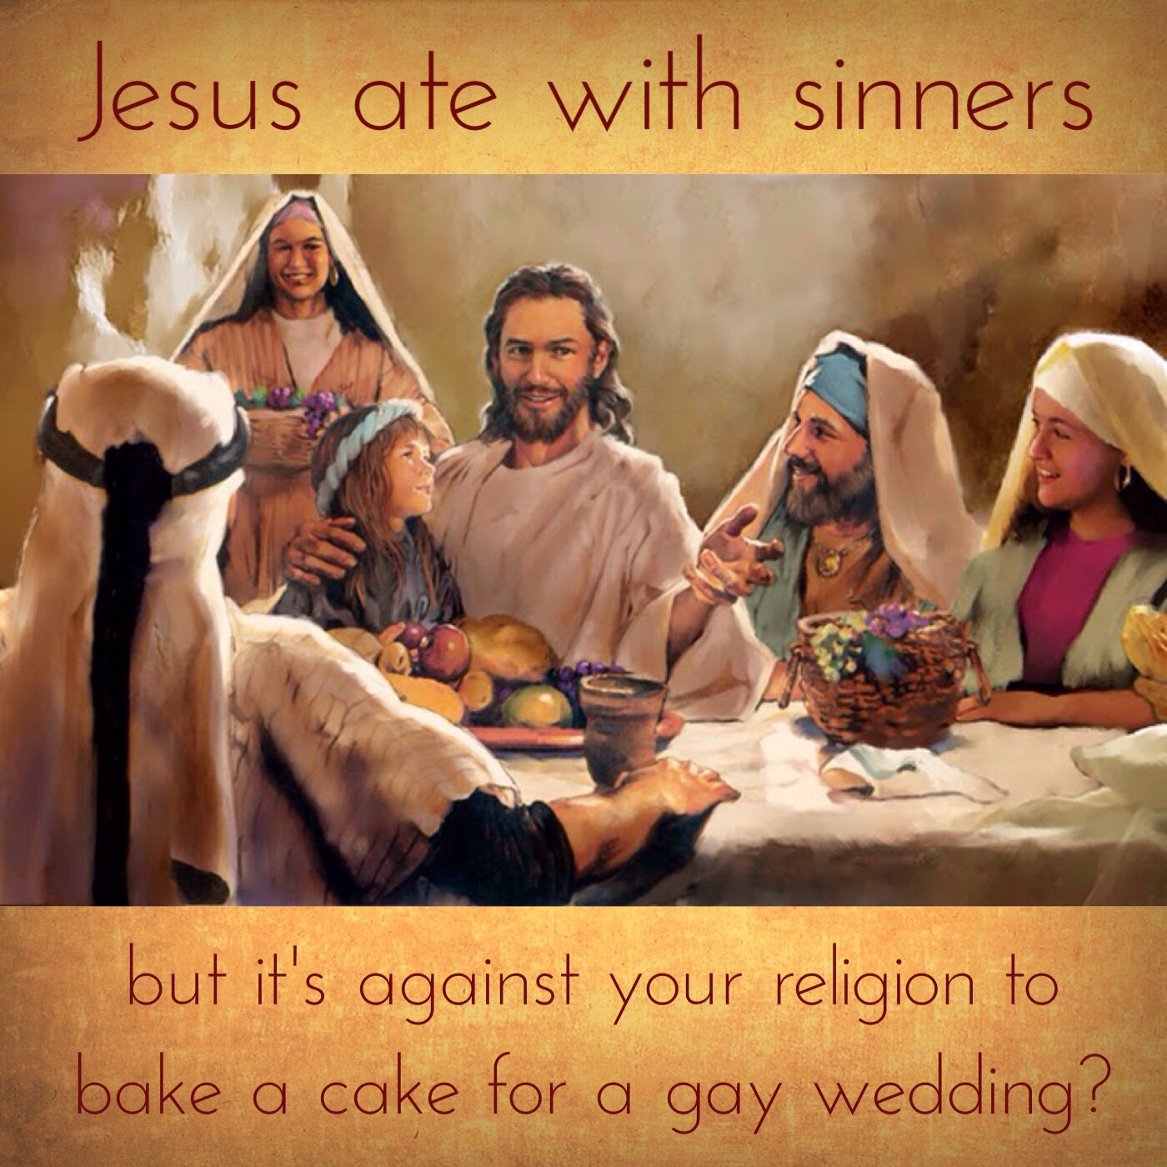
2
but the Pharisees and scribes began to complain, saying,
“This man welcomes sinners and eats with them.”

Slide 6
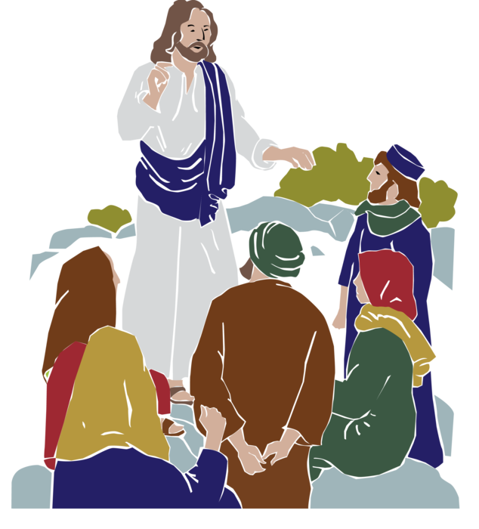
3
So to them he addressed this parable.

Slide 7
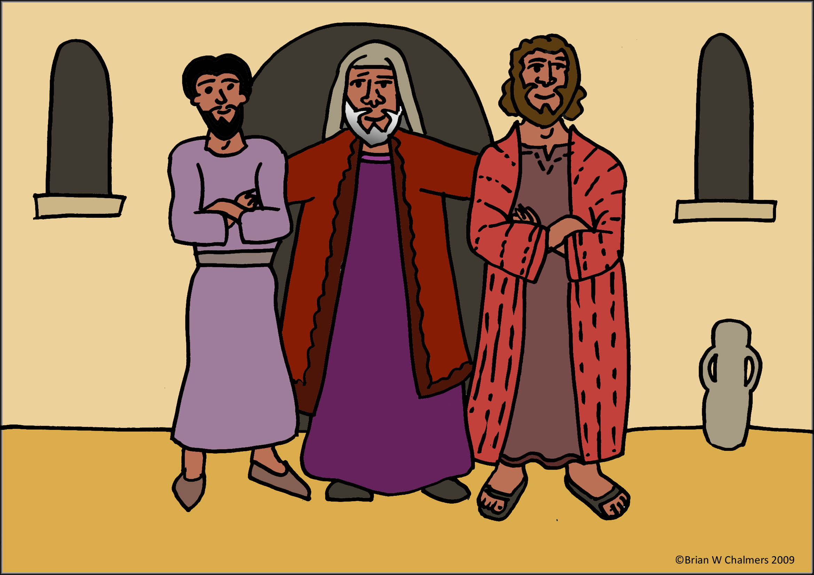
11
Then he said,
“A man had two sons,

Slide 8
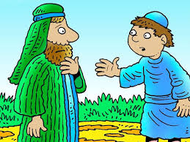
12
and the younger son said to his father, ‘Father, give me the share of your estate that should come to me.’
So the father divided the property between them.

Slide 9
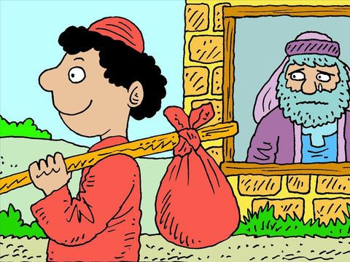
13
After a few days,
the younger son collected all his belongings and set off to a distant country where he squandered his inheritance on a life of dissipation.

Slide 10
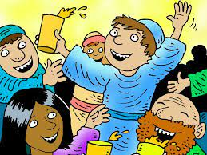
14
When he had freely spent everything,
a severe famine struck that country, and he found himself in dire need.

Slide 11
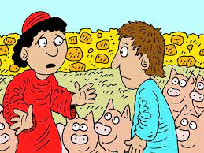
15
So he hired himself out to one of the local citizens who sent him to his farm to tend the swine.

Slide 12
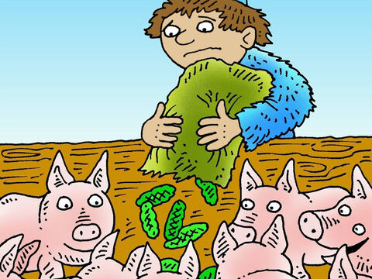
16
And he longed to eat his fill of the pods on which the swine fed, but nobody gave him any.

Slide 13
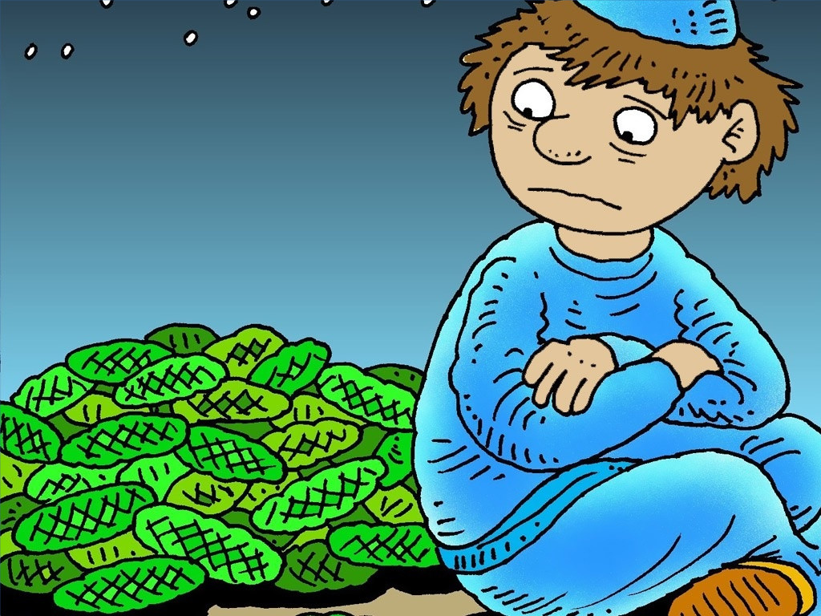
17
Coming to his senses he thought, ‘How many of my father’s hired workers have more than enough food to eat, but here am I, dying from hunger.

Slide 14
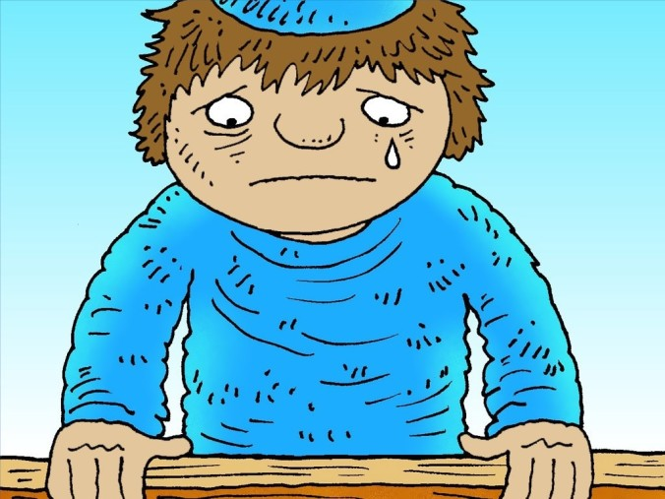
18
I shall get up and go to my father and I shall say to him,
“Father, I have sinned against heaven and against you.

Slide 15
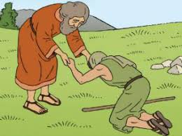
19
I no longer deserve to be called your son; treat me as you would treat one of your hired workers.”’

Slide 16
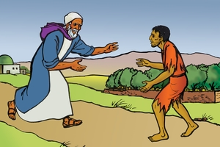
20
So he got up and went back to his father. While he was still a long way off, his father caught sight of him, and was filled with compassion. He ran to his son, embraced him and kissed him.

Slide 17
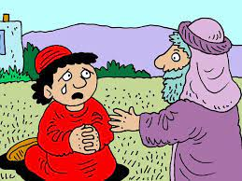
21
His son said to him,
‘Father, I have sinned against heaven and against you; I no longer deserve to be called your son.’

Slide 18
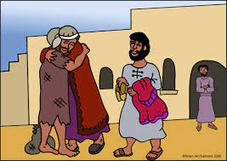
22
But his father ordered his servants,
‘Quickly bring the finest robe and put it on him; put a ring on his finger and sandals on his feet.

Slide 19
23
Take the fattened calf and slaughter it. Then let us celebrate with a feast,

Slide 20
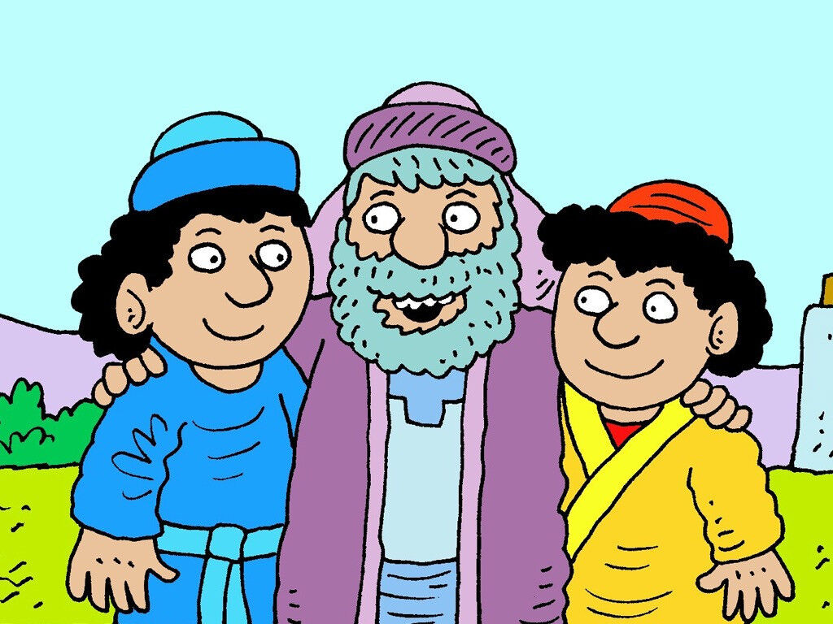
24
because this son of mine was dead, and has come to life again; he was lost, and has been found.’
Then the celebration began.

Slide 21
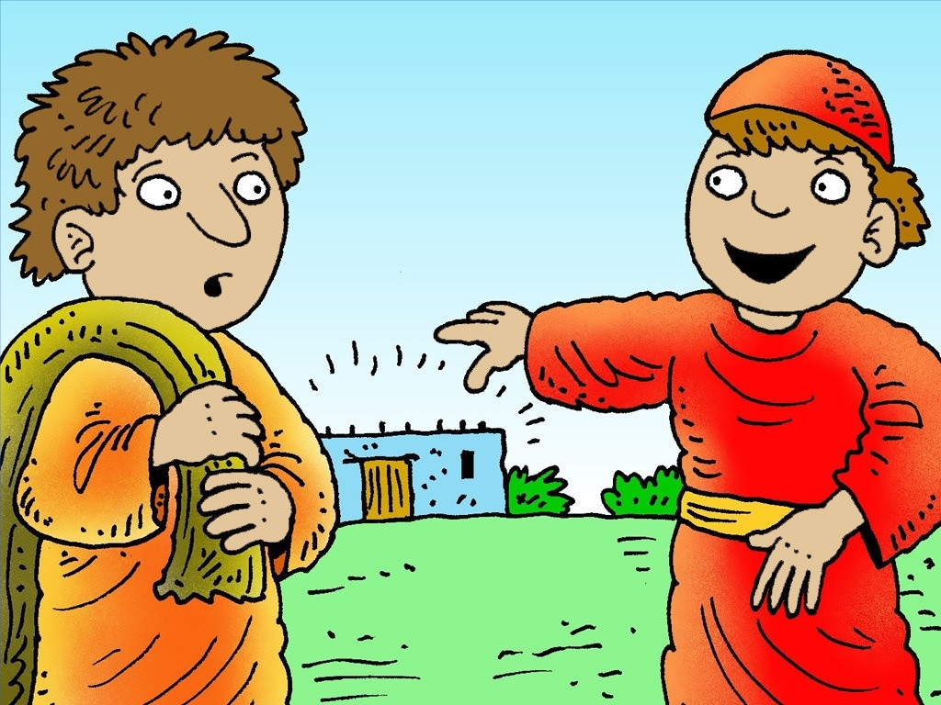
25
Now the older son had been out in the field and, on his way back, as he neared the house, he heard the sound of music and dancing.

Slide 22
26
He called one of the servants and asked what this might mean.

Slide 23
27
The servant said to him,
‘Your brother has returned and your father has slaughtered the fattened calf because he has him back safe and sound.’

Slide 24
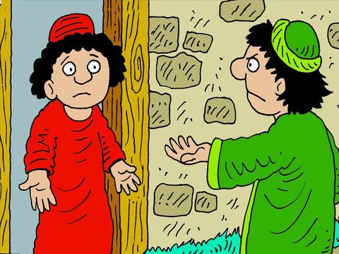
28
He became angry, and when he refused to enter the house, his father came out and pleaded with him.

Slide 25
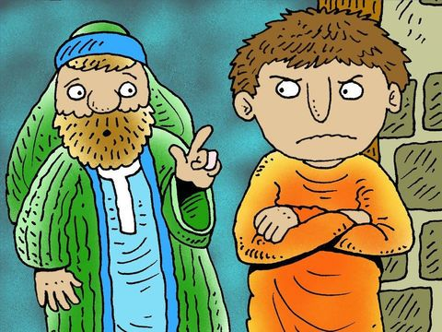
29
He said to his father in reply, ‘Look, all these years I served you and not once did I disobey your orders; yet you never gave me even a young goat to feast on with my friends.

Slide 26
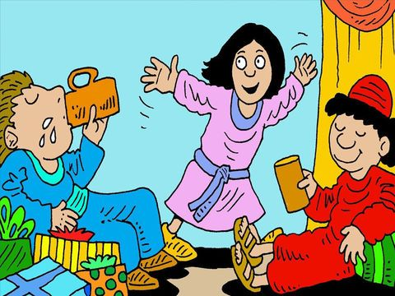
30
But when your son returns who swallowed up your property with prostitutes, for him you slaughter the fattened calf.’

Slide 27
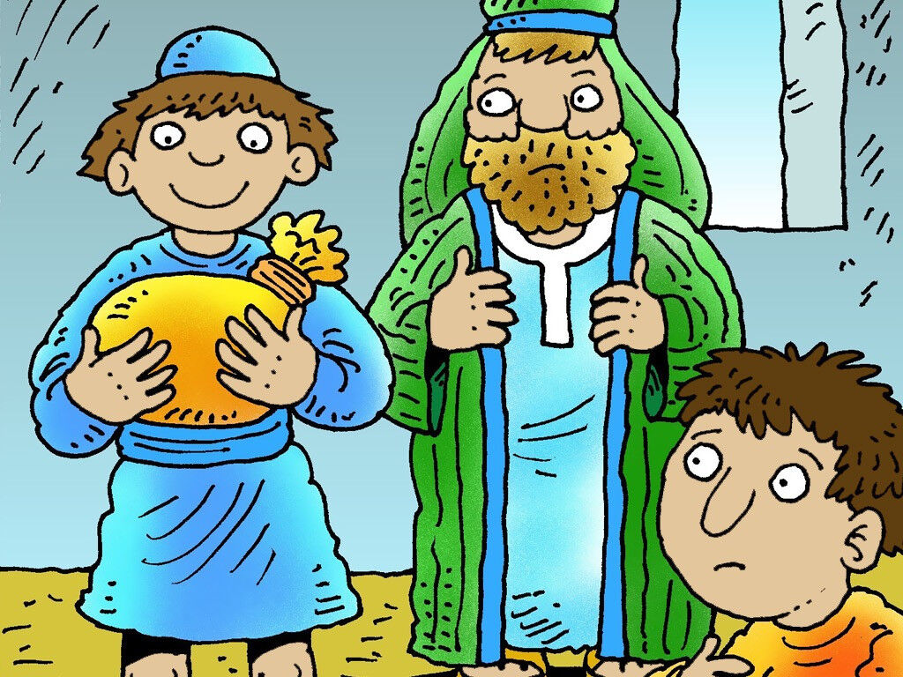
31
He said to him,
‘My son, you are here with me always; everything I have is yours.

Slide 28
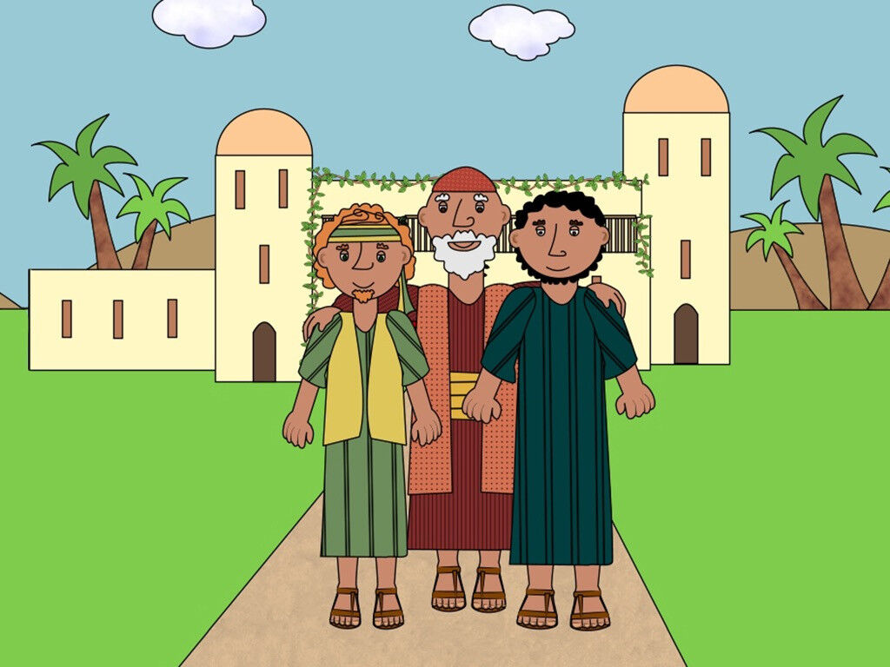
32
But now we must celebrate and rejoice, because your brother was dead and has come to life again; he was lost and has been found.’”

Slide 29
Leader: The Gospel of the Lord.
All: Praise to You,
Lord Jesus Christ.

Slide 30
GOSPEL MESSAGE

Slide 31
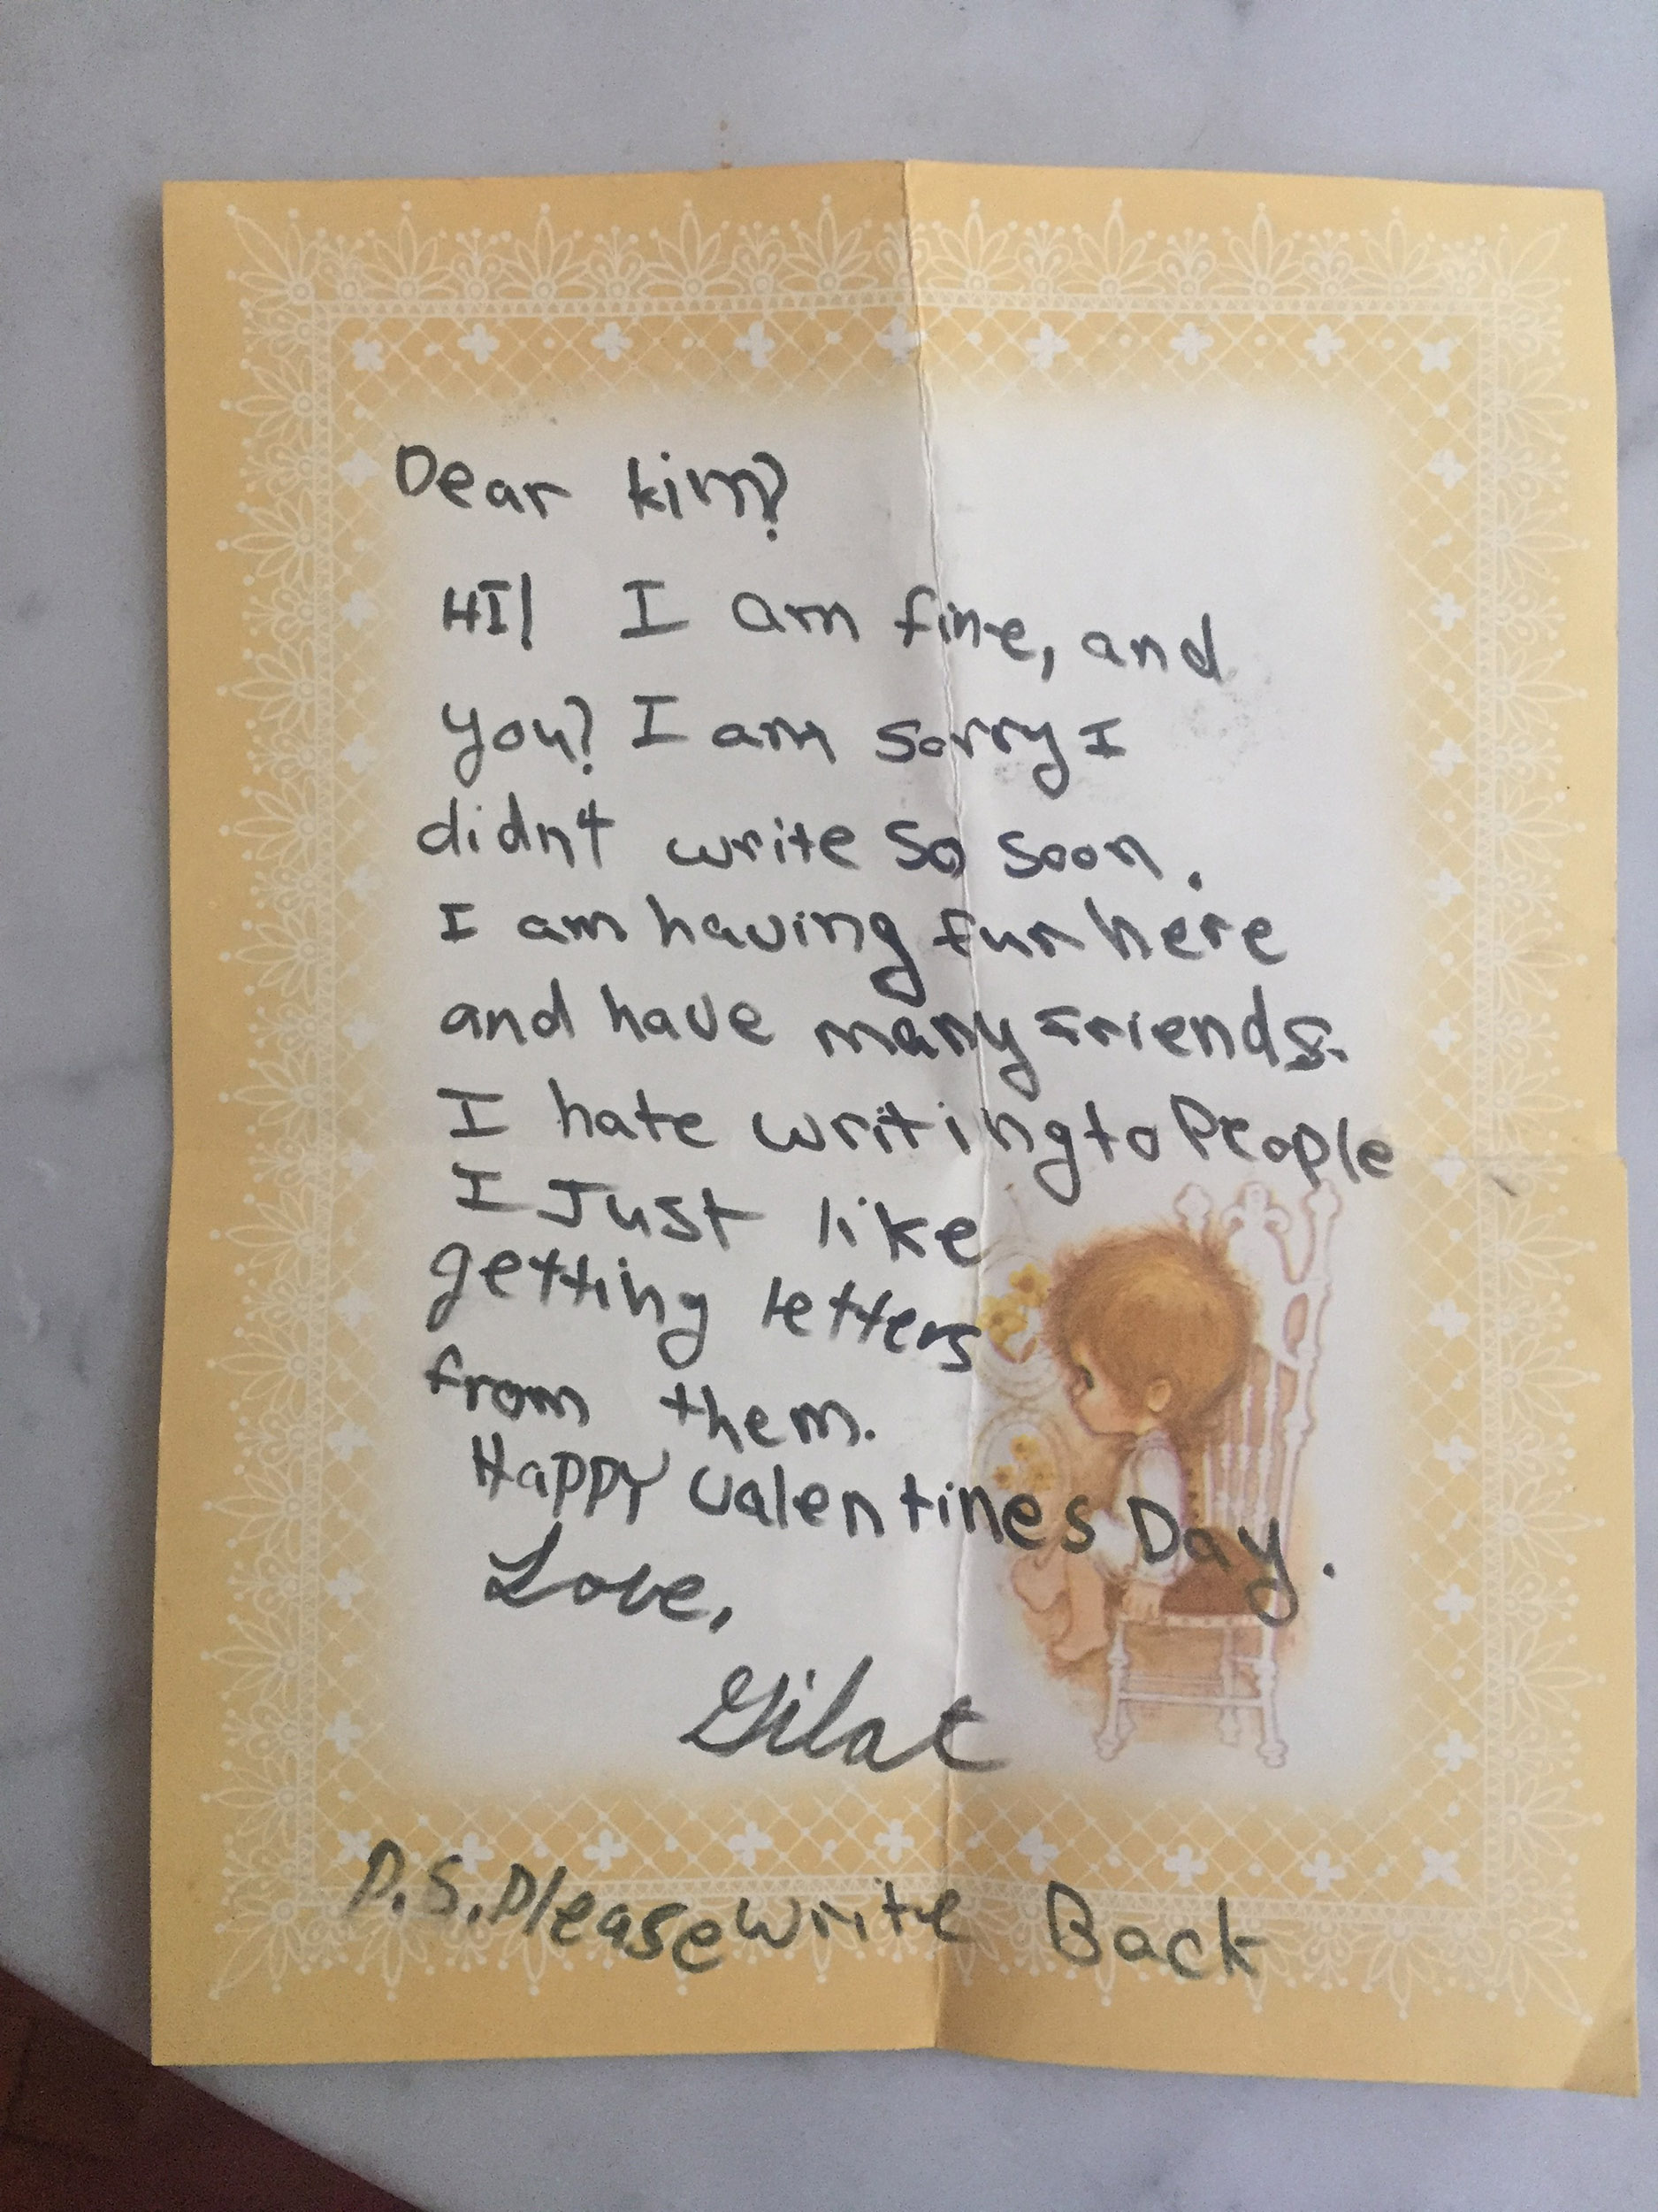
Activity:
Sorry Letter
Colored / Bond Paper
Coloring Materials
Pen / Pencil

Slide 32
Instruction:
Write a sorry letter to each member of your family
You can personalize your letter by putting pictures.
Hug and kiss them when you give them the letter.

Slide 33
Closing Prayer
Dear God,
Thank you for loving us and for being patient to us. Forgive me for the many wrongs and hurtful things that I’ve done. Help us to forgive others as You have forgiven us.
In Jesus’ name, we pray. Amen.

Slide 34
LIVE THE WORD KIDS
4th Sunday of Lent | Cycle C

