Slide 1
LIVE THE WORD KIDS
3rd Sunday of Lent | Cycle C

Slide 2
GOSPEL REFLECTION
Our Gospel talks about some things that are opposites, and it has to do with how our lives are with and without God. When fruit trees are planted in good soil and have water and sunshine, they give us tasty things to eat and enjoy. Well, the Bible tells us that when we are rooted in God’s love, when we pray and read our Bibles and trust the Lord, our lives will have good things come out of them. But if we walk away and don’t trust in Jesus, we will dry up like this shriveled plant. The first part of today’s reading says that everyone has done bad things and that bad things earn punishment. We all sin, and we are supposed to perish because of that (perish means we are supposed to die!). The great news is that because Jesus died, we get the opposite of what we deserve. We deserve punishment and death, but we get grace and life! God promises that when we accept His love and grace, and say we are sorry for the bad things we have done, He will give us new life. And that includes producing fruit! That’s why it is really important that we are connected to Christ because when we do, these fruits grow naturally, and they help others.
Suggested Game: https://www.baamboozle.com/classic/2616

Slide 3
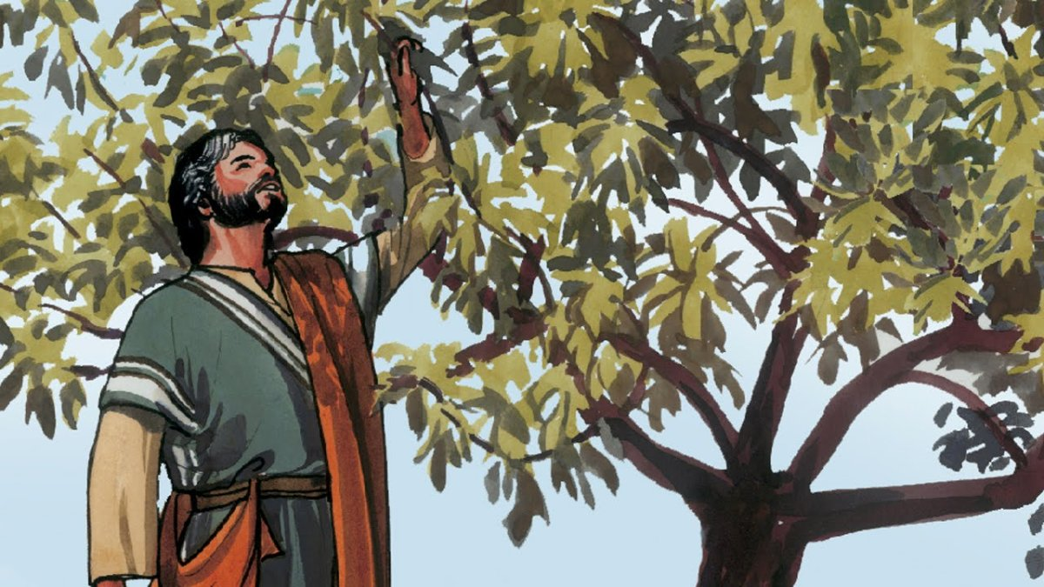
The Parable of the Unfruitful Fig Tree
Luke 13:1-9

Slide 4
Leader: A reading from
the Holy Gospel
according to Luke.
All: Glory to You, Oh Lord.

Slide 5
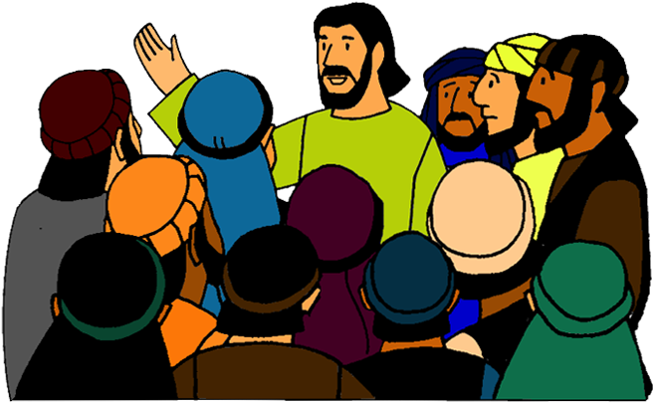
1
At that time some people were there who told Jesus about the Galileans whom Pilate had killed while they were offering sacrifices to God.

Slide 6
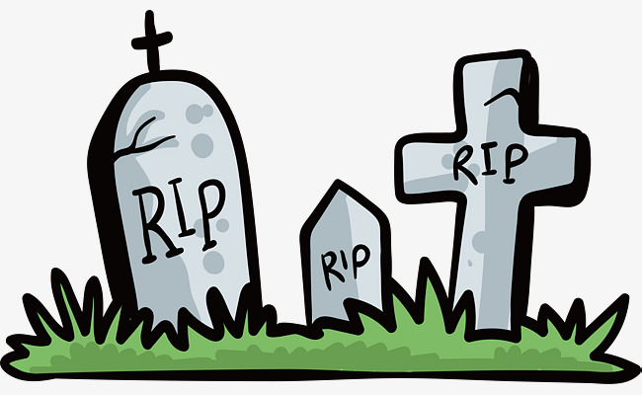
2
Jesus answered them,
“Because those Galileans were killed in that way, do you think it proves that they were worse sinners than all other Galileans?

Slide 7
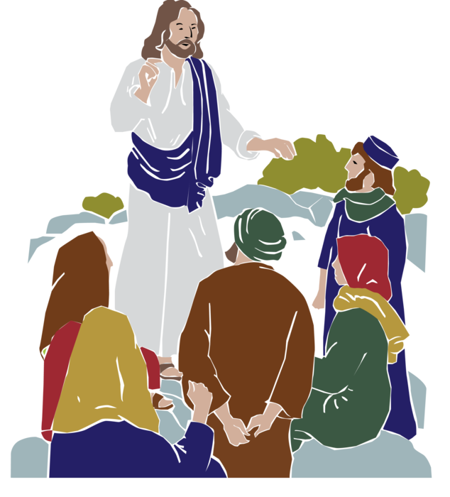
3
No indeed!
And I tell you that if you do not turn from your sins, you will all die as they did.

Slide 8
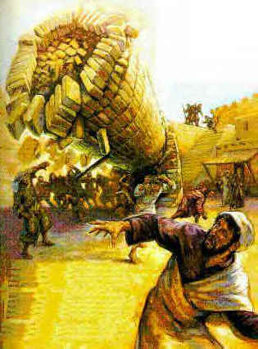
4
What about those eighteen people in Siloam who were killed when the tower fell on them? Do you suppose this proves that they were worse than all the other people living in Jerusalem?

Slide 9
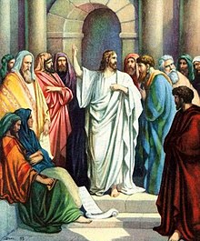
5
No indeed!
And I tell you that if you do not turn from your sins, you will all die as they did.”

Slide 10
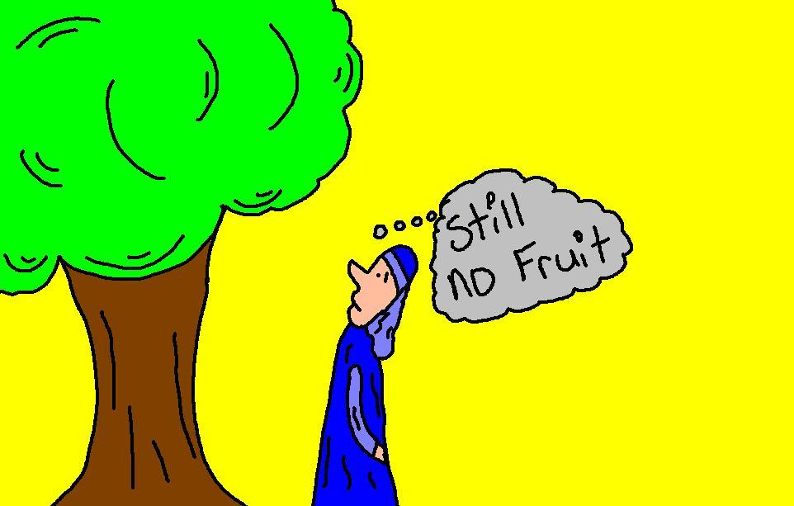
6
Then Jesus told them this parable:
“There was once a man who had a fig tree growing in his vineyard. He went looking for figs on it but found none.

Slide 11
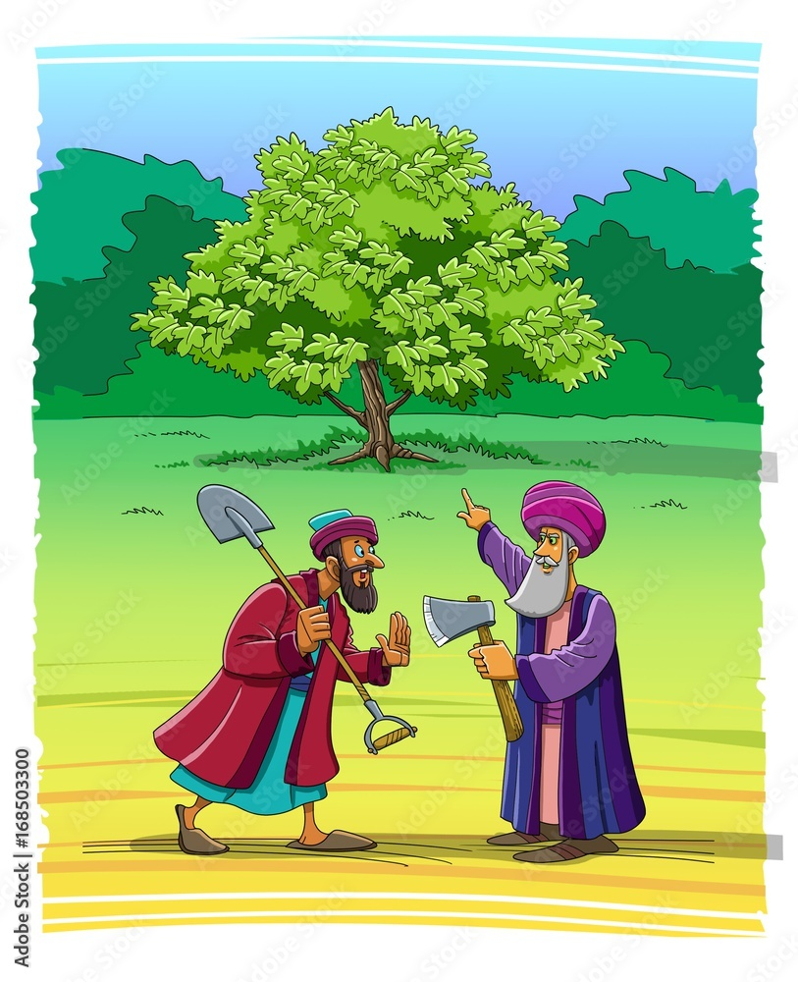
7
So he said to his gardener, ‘Look, for three years I have been coming here looking for figs on this fig tree, and I haven't found any. Cut it down! Why should it go on using up the soil?’

Slide 12
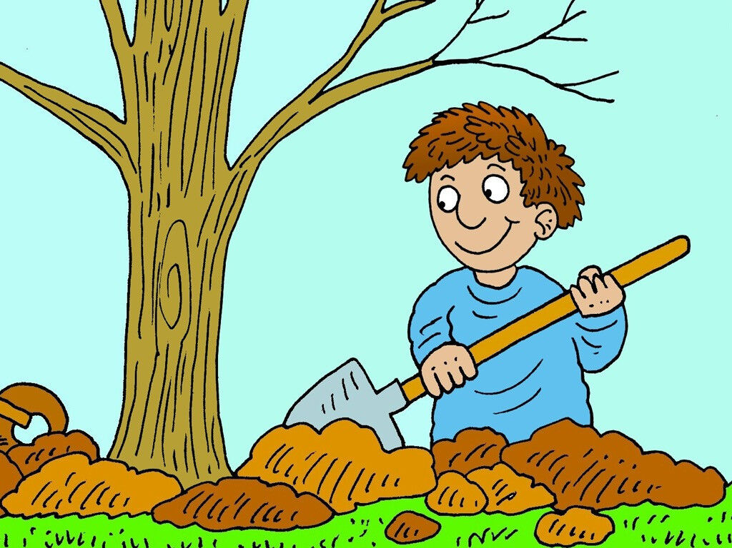
8
But the gardener answered, ‘Leave it alone, sir, just one more year; I will dig around it and put in some fertilizer.

Slide 13
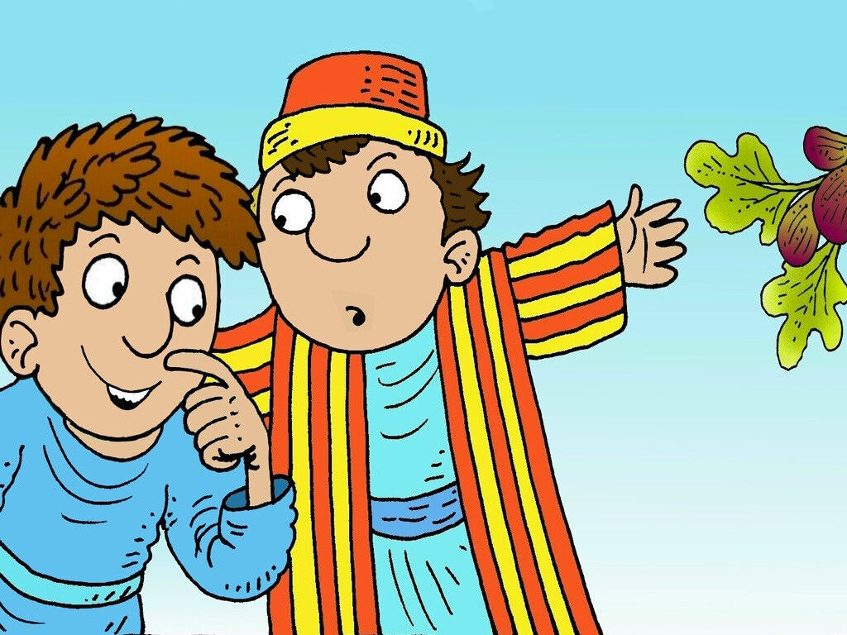
9
Then if the tree bears figs next year, so much the better; if not, then you can have it cut down.’”

Slide 14
Leader: The Gospel of the Lord.
All: Praise to You,
Lord Jesus Christ.

Slide 15
GOSPEL MESSAGE

Slide 16
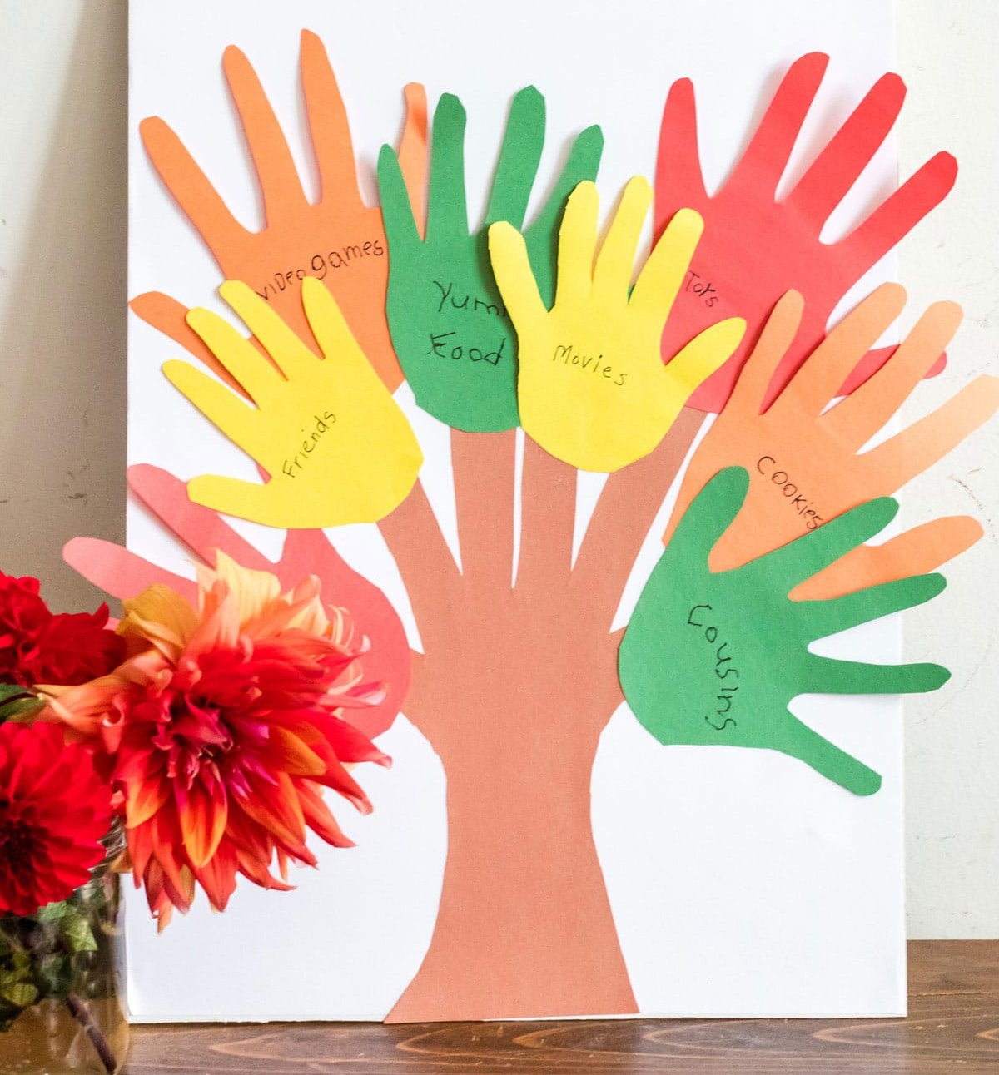
Activity:
Tree of Goodness
Bond Paper
Tree Template
Glue Stick
Scissor
Construction Paper
Pen

Slide 17
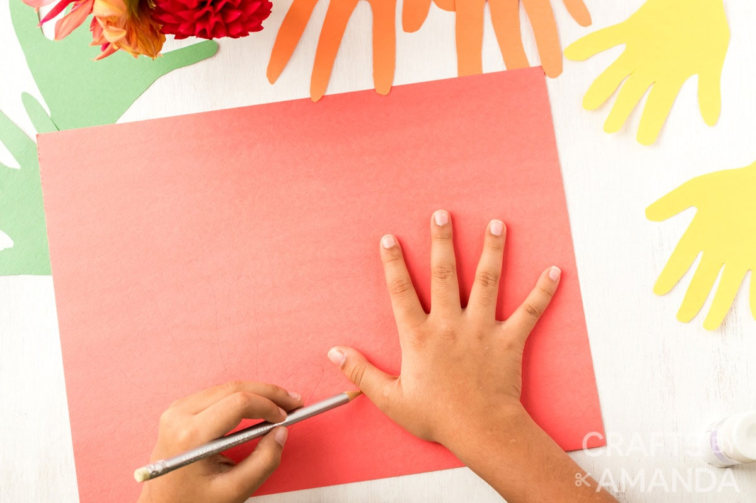
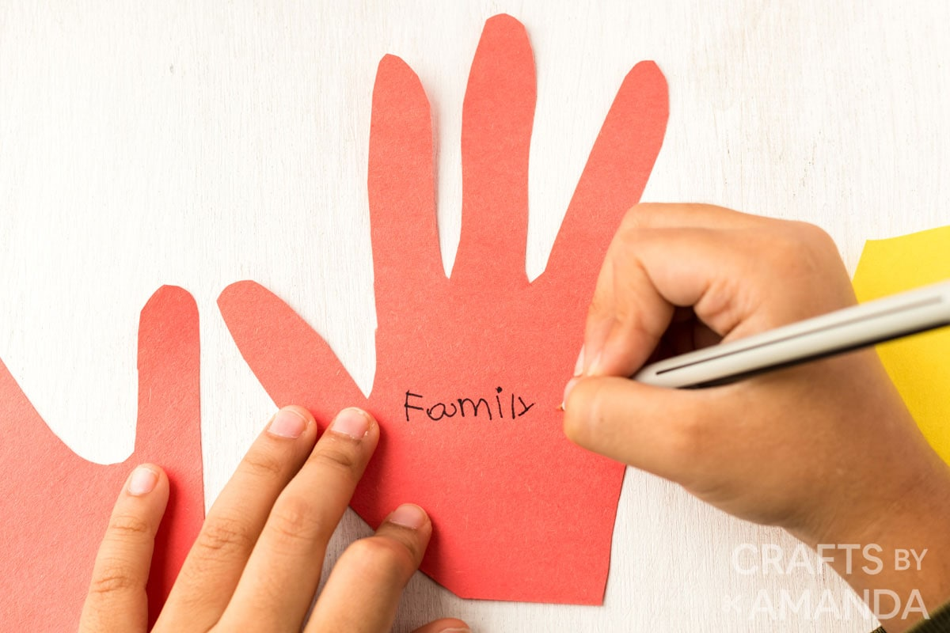
Instruction:
2. Write one good deeds that you can do to spread the love of Jesus to others on each leave.
Trace your hands on sheets of construction paper.

Slide 18
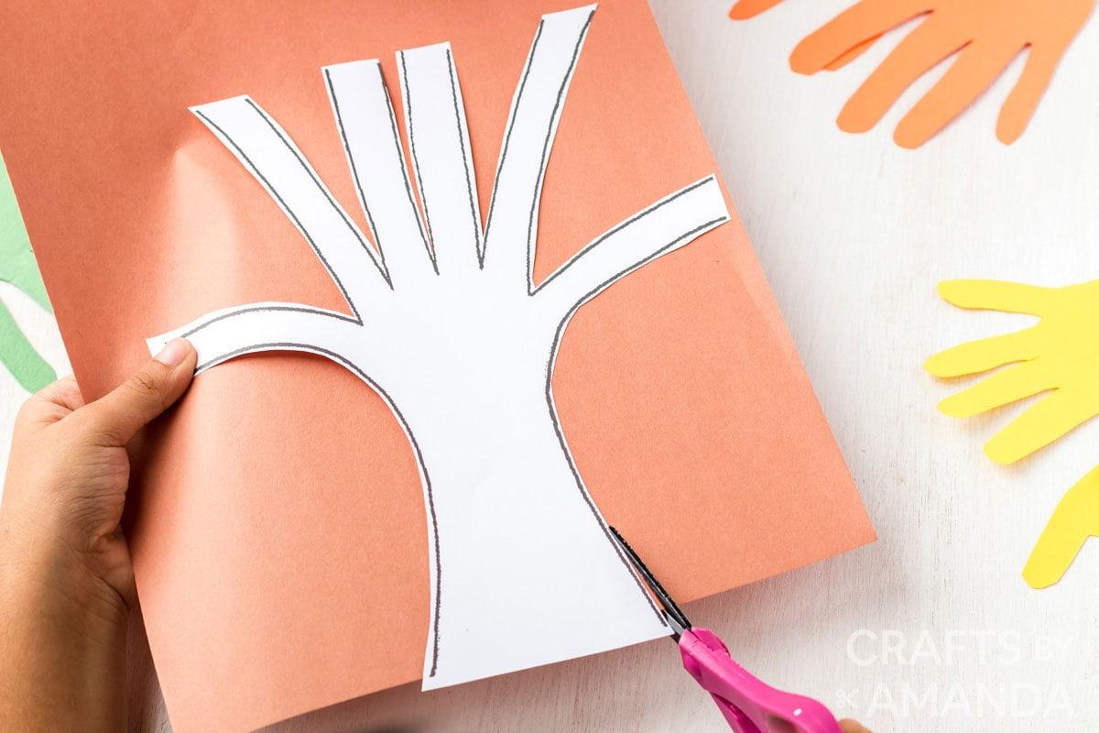
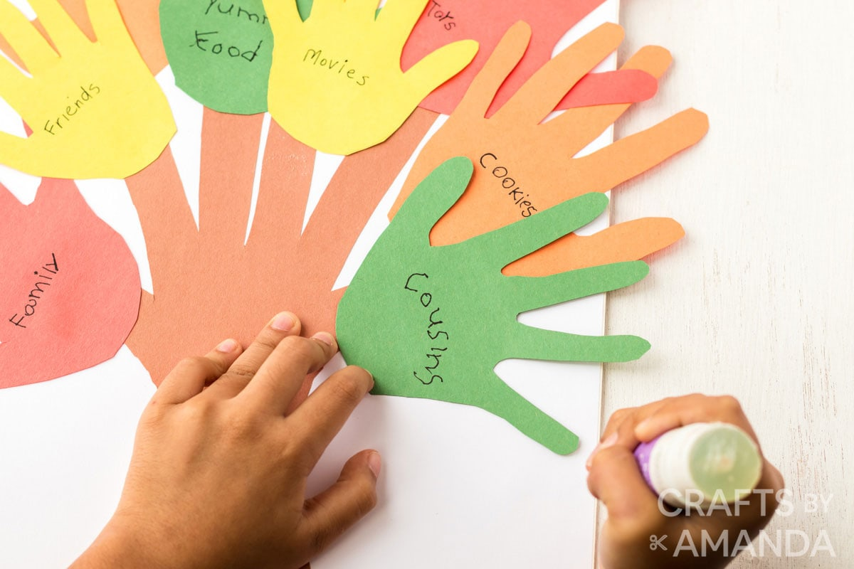
Instruction:
3. Cut the tree and use a glue stick to attach the tree to your board.
4. Use a glue stick to attach the hands to the tree.
Notes:
Remind the kids to display their Tree of Goodness craft somewhere that everyone can see! This will serve as reminder for them to always do what is good and right for them to bear fruit and be with Jesus someday.

Slide 19
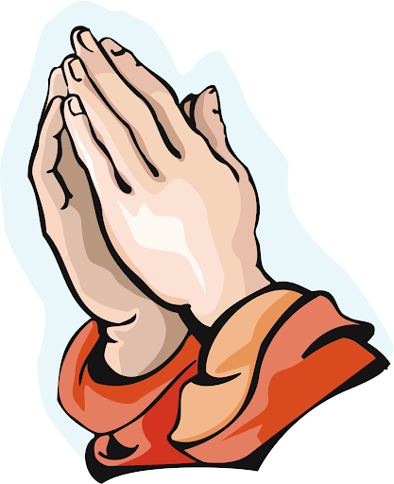
Closing Prayer
Dear God,
Thank you for your grace. Thank you for forgiving our sins. Please help us grow in you so that we can bear fruit. Thank you for your love, Lord. We love you!
In Jesus’ name, we pray. Amen.

Slide 20
LIVE THE WORD KIDS
3rd Sunday of Lent | Cycle C

