Slide 1
LIVE THE WORD KIDS
2nd Sunday of Lent | Cycle C

Slide 2
GOSPEL REFLECTION
Today’s bible reading from Luke chapter 9 is called the Transfiguration. It is about a special day when Peter, James and John went up on a mountain with Jesus to pray. When they were there two other great leaders, Elijah and Moses, miraculously appeared beside Jesus. All three of them glowed like dazzling while lights and they began to speak to the disciples. It was quite an experience! Peter didn’t know what to do. He started running around in a fluster not knowing what to do or say. Then a voice from heaven said “This is my Son, whom I have chosen, Listen to Him.” God the Father was saying that Peter needed to slow down and listen to Jesus. I think that is also pretty good advice for us today.
There are many people telling us what to do and how to live our lives. Sometimes it can get very confusing trying to listen to everyone’s advice. Sometimes everyone we talk to has a different idea of what we should do or not do. We need to remember what our Heavenly Father said to Peter up on the mountain of transfiguration when he was confused. He said to Peter, “This is my Son whom I have chosen, Listen to Him!” Listening to God’s Son Jesus is so very important. We can listen to Jesus by reading about the life of Jesus in the bible. We can read what he said and taught and we can ask the Holy Spirit to help us understand too.

Slide 3
The Transfiguration of Jesus
Luke 9:28-36

Slide 4
Leader: A reading from
the Holy Gospel
according to Luke.
All: Glory to You, Oh Lord.

Slide 5
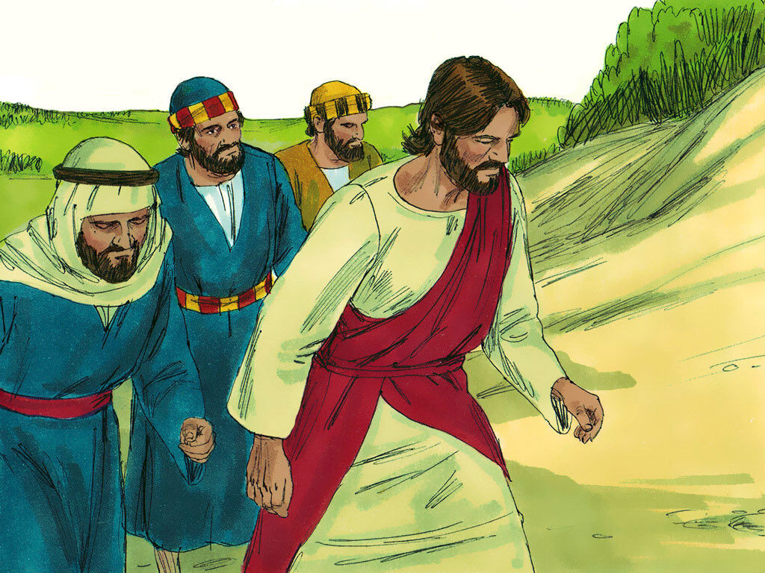
28
Jesus took Peter, John, and James with him and went up a hill to pray.

Slide 6
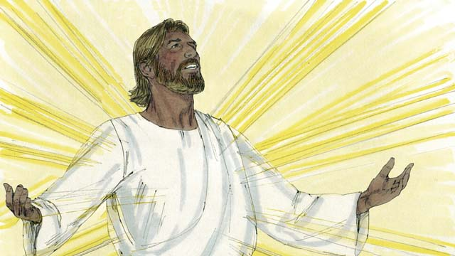
29
While he was praying, his face changed its appearance, and his clothes became dazzling white.

Slide 7
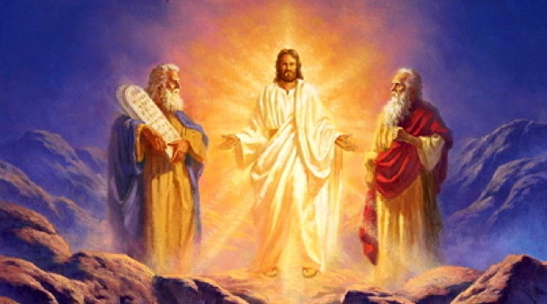
30
Suddenly two men were there talking with him. They were Moses and Elijah,

Slide 8
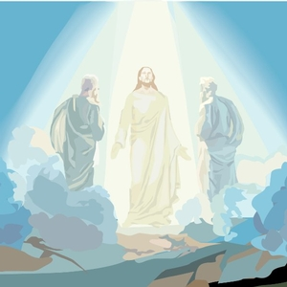
31
who appeared in heavenly glory and talked with Jesus about the way in which he would soon fulfill God's purpose by dying in Jerusalem.

Slide 9
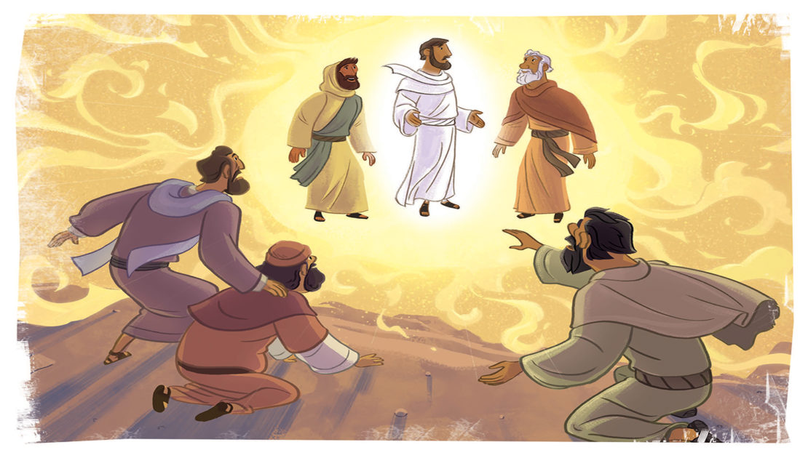
32
Peter and his companions were sound asleep, but they woke up and saw Jesus' glory and the two men who were standing with him.

Slide 10
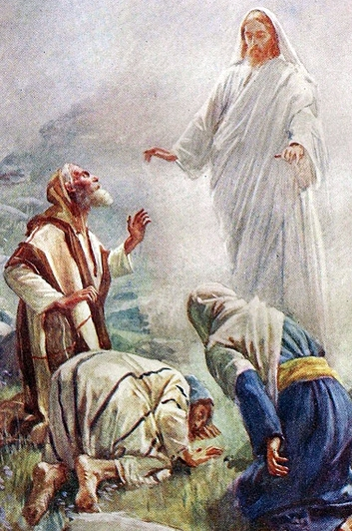
33
As the men were leaving Jesus, Peter said to him, “Master, how good it is that we are here! We will make three tents, one for you, one for Moses, and one for Elijah.” (He did not really know what he was saying.)

Slide 11
34
While he was still speaking, a cloud appeared and covered them with its shadow; and the disciples were afraid as the cloud came over them.

Slide 12
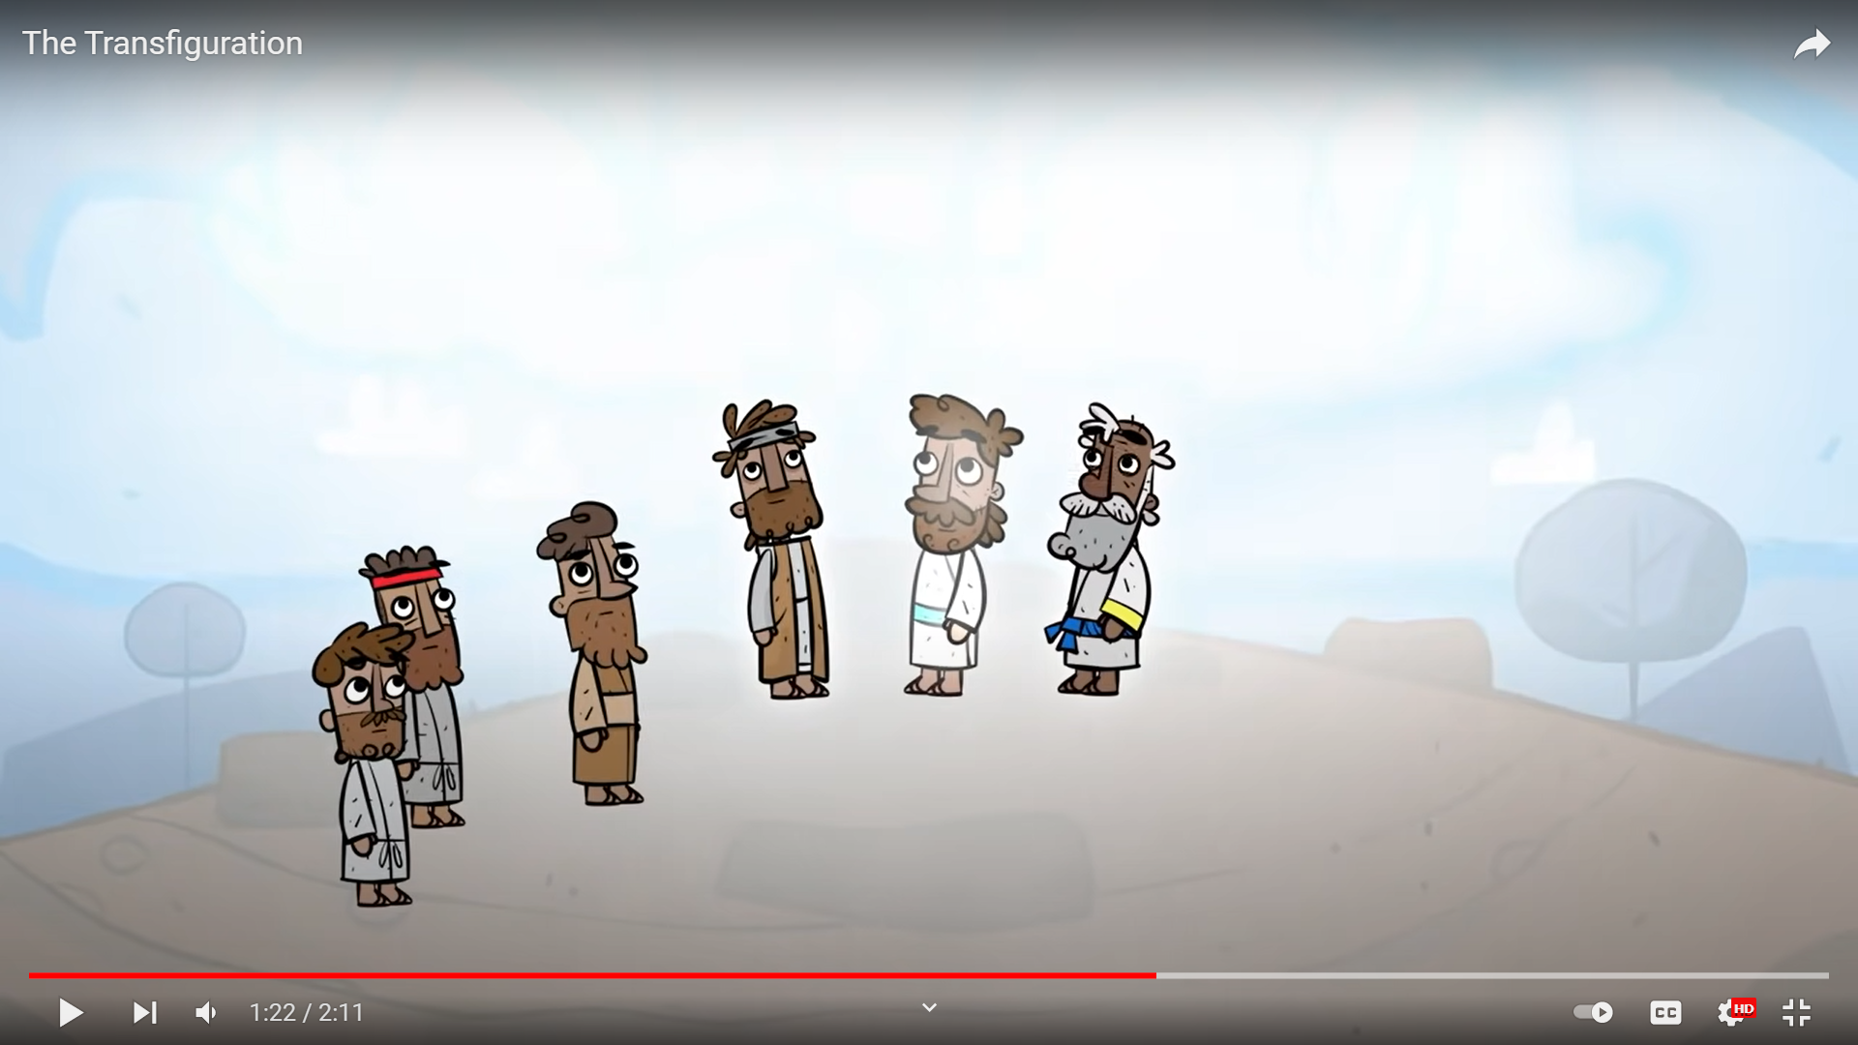
35
A voice said from the cloud,
“This is my Son, whom I have chosen—listen to him!”

Slide 13
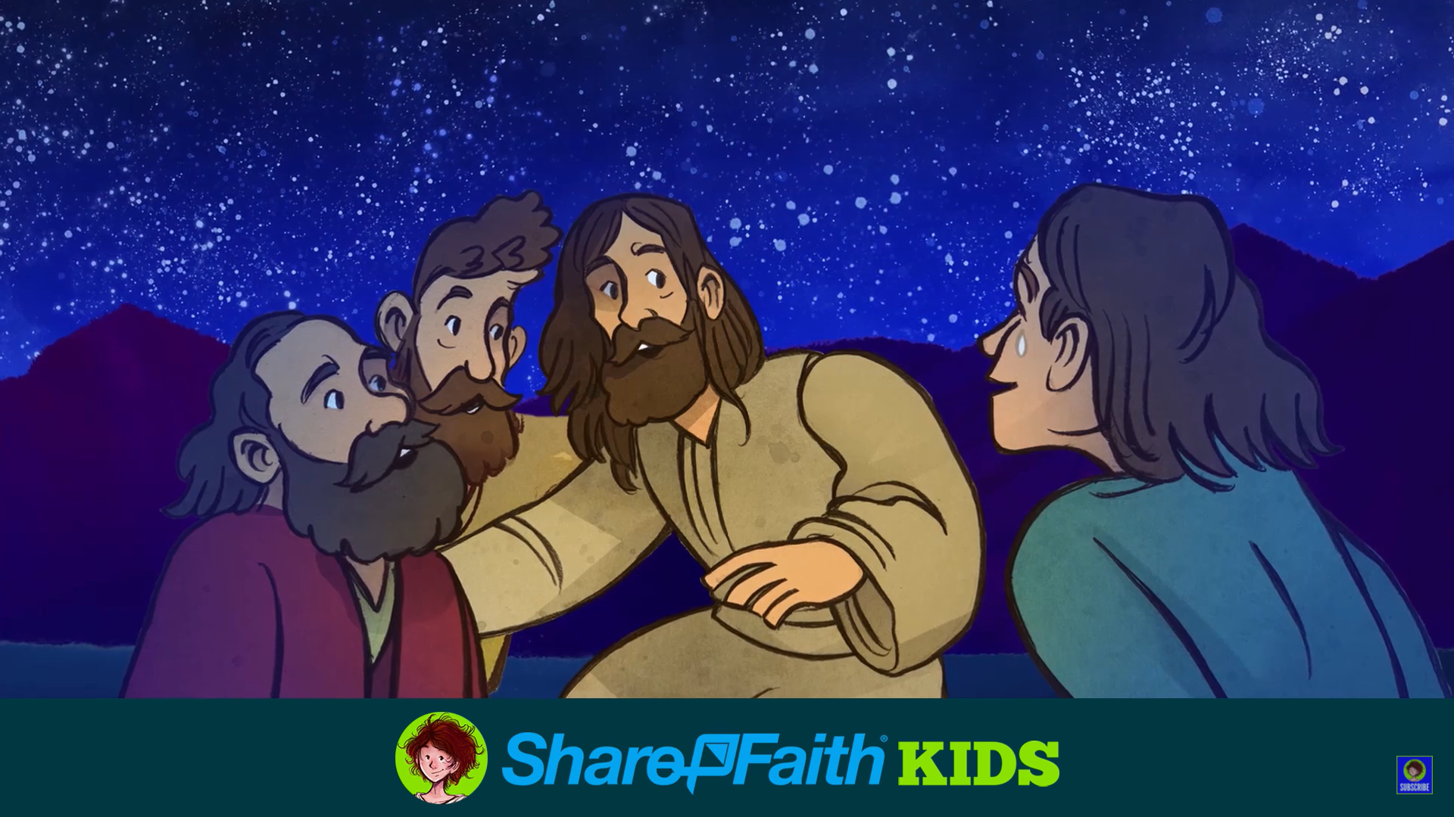
36
When the voice stopped, there was Jesus all alone. The disciples kept quiet about all this and told no one at that time anything they had seen.

Slide 14
Leader: The Gospel of the Lord.
All: Praise to You,
Lord Jesus Christ.

Slide 15
GOSPEL MESSAGE

Slide 16
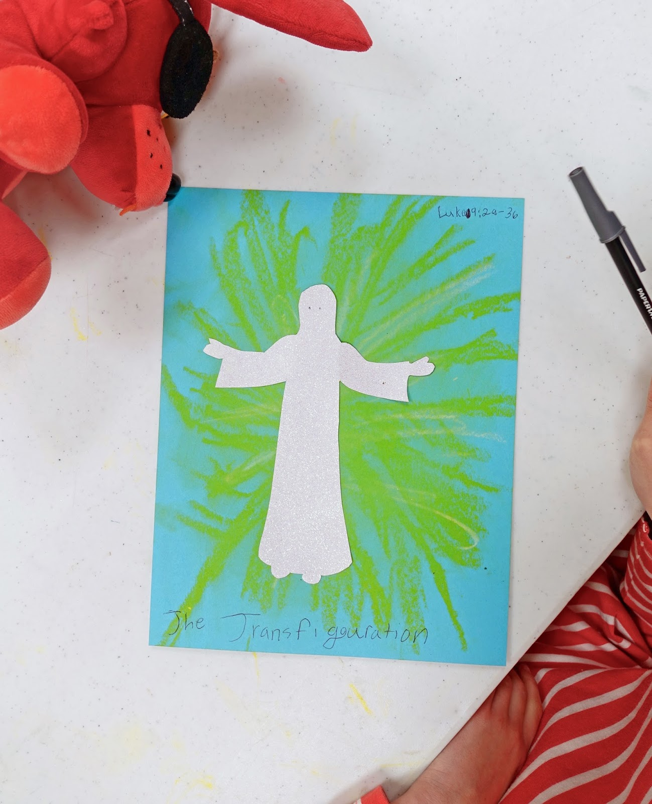
Activity:
Transfigured Jesus
Printed Image of Jesus
Bond Paper
Coloring Materials
Pen
Glue
Scissors

Slide 17
Instruction:
Print or draw an image of Jesus
Color the background behind Jesus. It can be as simple as rays of light to as detailed as a mountain scene with clouds.
Write the verse from Luke 9:35
“This is my Son, whom I have chosen—listen to him!”

Slide 18
Closing Prayer
Dear God,
thank you for all the blessings you’ve showered upon us. Thank you for guiding and protecting us. May you help us to listen to Jesus as well. Life can get pretty confusing trying to listen to everybody’s advice. Through your Holy Spirit help us to hear, know and love your son Jesus more and more each day.
In Jesus’ name, we pray. Amen.

Slide 19
LIVE THE WORD KIDS
2nd Sunday of Lent | Cycle C

