Slide 1
LIVE THE WORD KIDS
1st Sunday of Lent | Cycle C

Slide 2
GOSPEL REFLECTION
This week, Jesus is tempted by Satan in the desert. But instead of giving in, Jesus tells Satan to go away. Satan tempted Jesus three times. Satan used three things to tempt Jesus:
1. He told Jesus to turn stones into bread for food.
2. He told Jesus to show off by jumping off the temple and letting angels catch Him.
3. And he offered Jesus all of the kingdoms of the world.
The devil tempted him with food, popularity, and power. He made it seem that everything would have been easier for Jesus if he’d just give in and take what Satan offered him. We know that he did not give in. Jesus relied on God’s word to stand up to these temptations. We are tempted all the time as well. God will help us resist temptation if we ask him for it. And just like Jesus, we can rely on his word, the Bible, to give us the power to make wise choices and do the right thing. The best way that we can do to stand up against temptation is to be prepared by knowing God’s word.

Slide 3
The Temptation of Jesus
Luke 4:1-13

Slide 4
Leader: A reading from
the Holy Gospel
according to Luke.
All: Glory to You, Oh Lord.

Slide 5
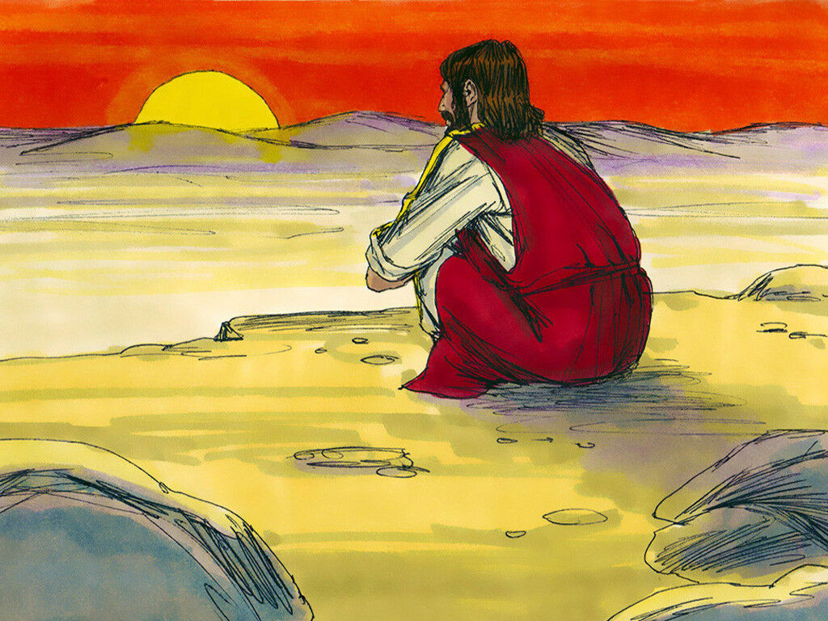
1
Jesus returned from the Jordan full of the Holy Spirit and was led by the Spirit into the desert,
Notes:
After Jesus was baptized, he went out into the desert to pray.

Slide 6
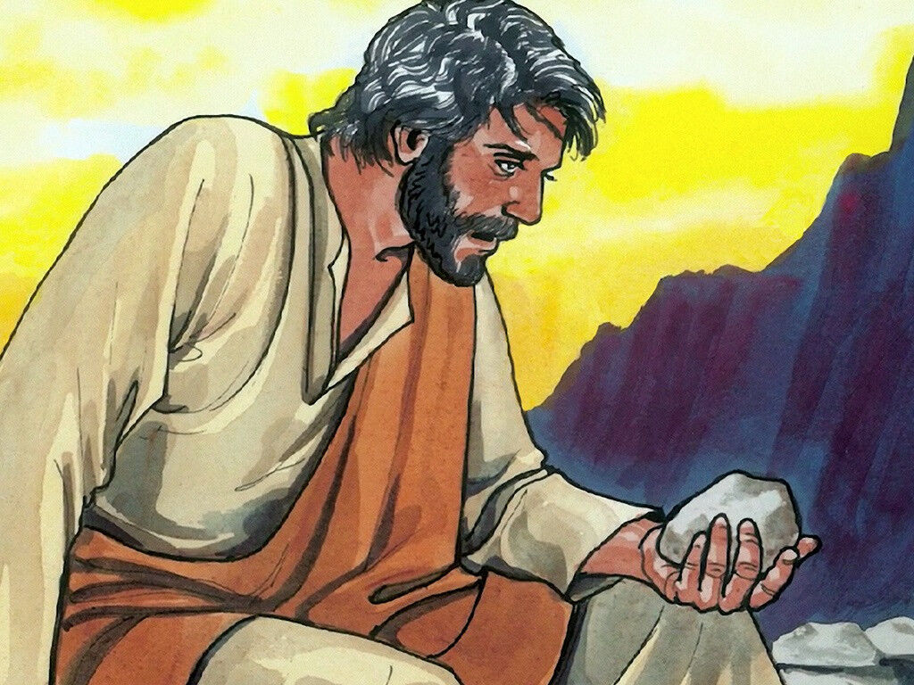
2
where he was tempted by the Devil for forty days. In all that time he ate nothing, so that he was hungry when it was over.
Notes:
He stayed there a long time (40 days) and got very hungry. He had not eaten anything because He was trying to listen to God and do what he said.

Slide 7
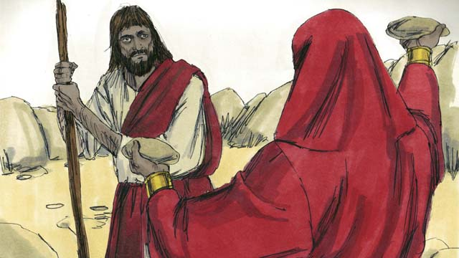
3
The Devil said to him,
“If you are God's Son, order this stone to turn into bread.”

Slide 8
4
But Jesus answered,
“The scripture says, ‘Human beings cannot live on bread alone.’”

Slide 9
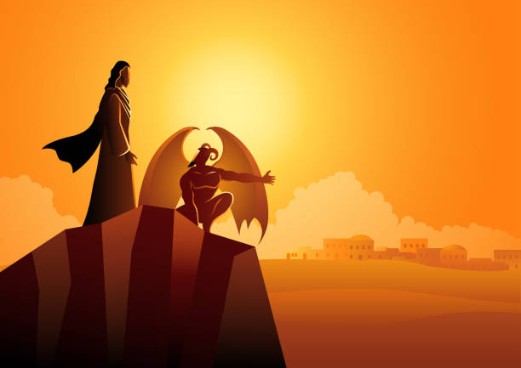
5
Then the Devil took him up and showed him in a second all the kingdoms of the world.

Slide 10
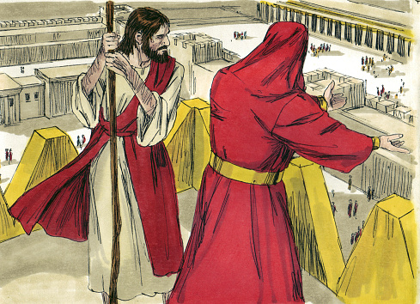
6
“I will give you all this power and all this wealth,” the Devil told him.
“It has all been handed over to me, and I can give it to anyone I choose.

Slide 11
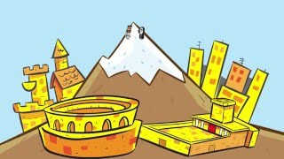
7
All this will be yours, then, if you worship me.”

Slide 12
8
Jesus answered,
“The scripture says, ‘Worship the Lord your God and serve only him!’”

Slide 13
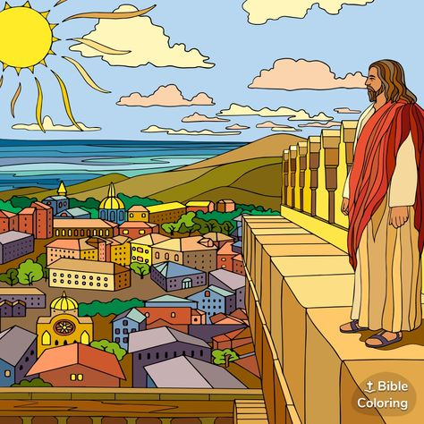
9
Then the Devil took him to Jerusalem and set him on the highest point of the Temple, and said to him, “If you are God's Son, throw yourself down from here.

Slide 14
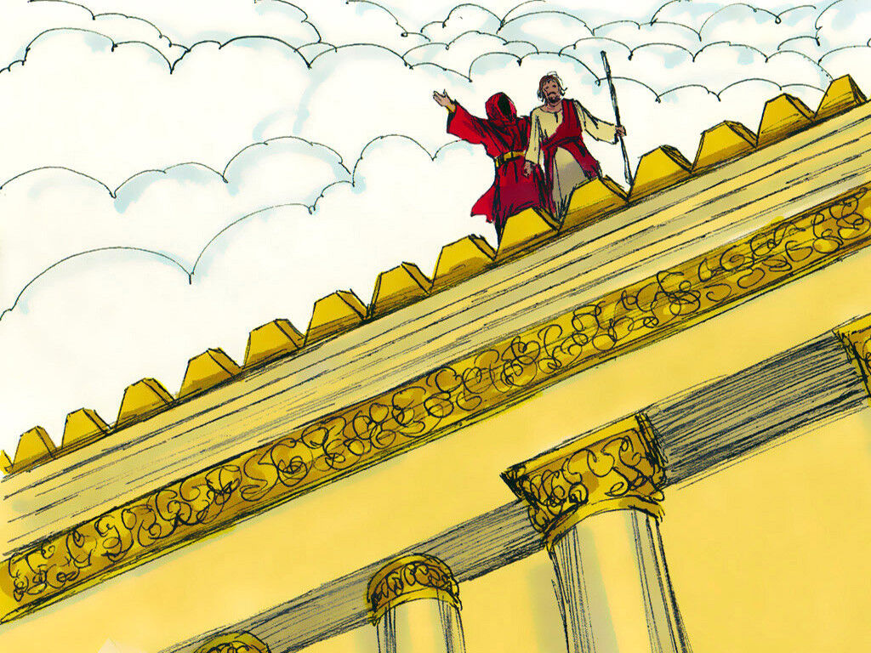
10
For the scripture says,
‘God will order his angels to take good care of you.’

Slide 15
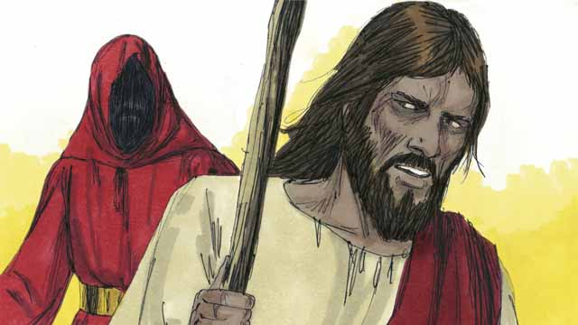
11
It also says, ‘They will hold you up with their hands so that not even your feet will be hurt on the stones.’”

Slide 16
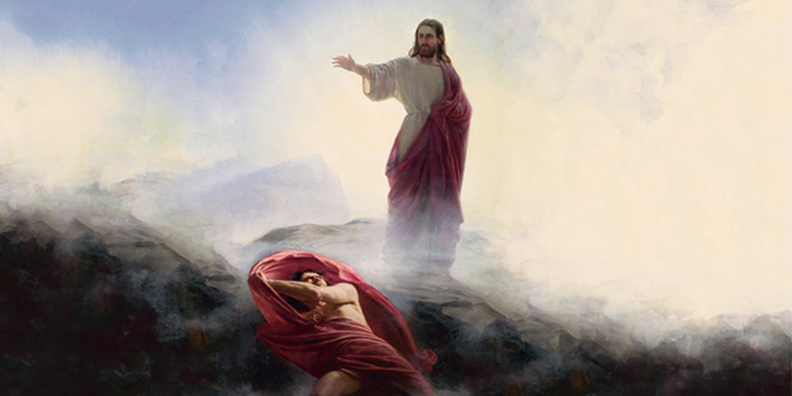
12
But Jesus answered, “The scripture says, ‘Do not put the Lord your God to the test.’”

Slide 17
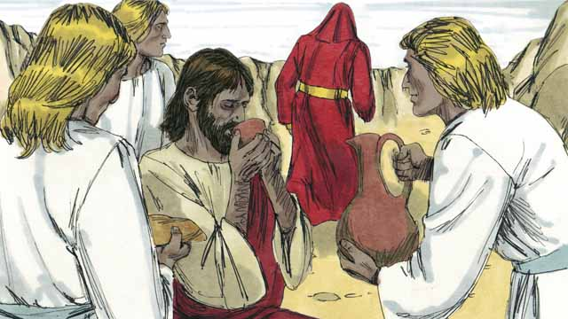
13
When the Devil finished tempting Jesus in every way, he left him for a while.

Slide 18
Leader: The Gospel of the Lord.
All: Praise to You,
Lord Jesus Christ.

Slide 19
GOSPEL MESSAGE

Slide 20
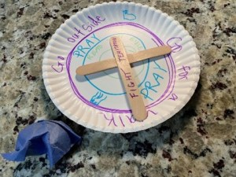
Activity:
Temptation Target
Scissors
Construction paper
Paper plates
Markers or decorating materials
Glue and/or tape
Popsicle sticks

Slide 21
Instruction:
Decorate the paper plate to look like a target. Draw several circles, one inside the other.
In each circle, write positive things to occupy time and attention. Decorate with color or stickers as desired. (Ex. Go outside, go for walk, do household chores, pray, read books)
Glue a popsicle stick cross in the “bullseye” section, to remind us to keep Christ first and foremost.
If you would like to hang the craft, attach a string or pipe cleaner to the back side.
Using construction paper, write down things that might be tricky or tempting. Crumple the paper and use as “ammunition” to throw at the target. Plan on doing one of the positive options that the target offers, according to where the “dart” hits!

Slide 22
Closing Prayer
Dear God,
We are thankful for your Holy Word. Help us to read our Bible daily and hide its words in our heart so that we might be able to resist temptations.
In Jesus' name we pray. Amen.
Amen.

Slide 23
LIVE THE WORD KIDS
1st Sunday of Lent | Cycle C

