Slide 1
LIVE THE WORD KIDS
13th Sunday in Ordinary Time | Year C

Slide 2
GOSPEL REFLECTION
it is easy to consider ourselves “followers” of Christ if we know about Him, and we might have knowledge of His life or characteristics. However, truly loving and serving Jesus requires willingness to abandon all other commitments in order to obey His commandments and serve Him wholeheartedly.
In the Gospel lesson here, Jesus talked about what it means to follow Him. He wants followers. If we really want to love and serve the Lord, it involves being more than just a “fan.” If we want to follow Him, we need to be willing to put aside everything else. Even things we really like. Even our families!
Now, it is okay to love our families, of course, and to have things we love and hobbies. But the problem is when we let those things or people get in the way of how we serve God. We don’t want anything to come between our lives and His love. That is the reason Jesus asks us to follow Him. It isn’t that He wants us to abandon our families or give up nice things. But He has a love and a plan for us that are better than anything else we could try to put our hope in. And how do we know we are following Him?
We can read His words, of course, in the Bible. We can pray, and ask for guidance in recognizing and following His instructions. When we are loving Him and acting in His will, wonderful things will result! It isn’t always easy at first, but we can rest assured that it is the best thing for us, because it is what He asked. He has our best interests in mind, whether we understand immediately or not!

Slide 3
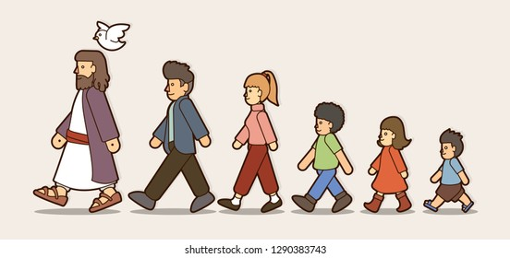
The Would-Be-Followers of Christ
Luke 9:51-62

Slide 4
Leader: A reading from
the Holy Gospel
according to Luke.
All: Glory to You, Oh Lord.

Slide 5
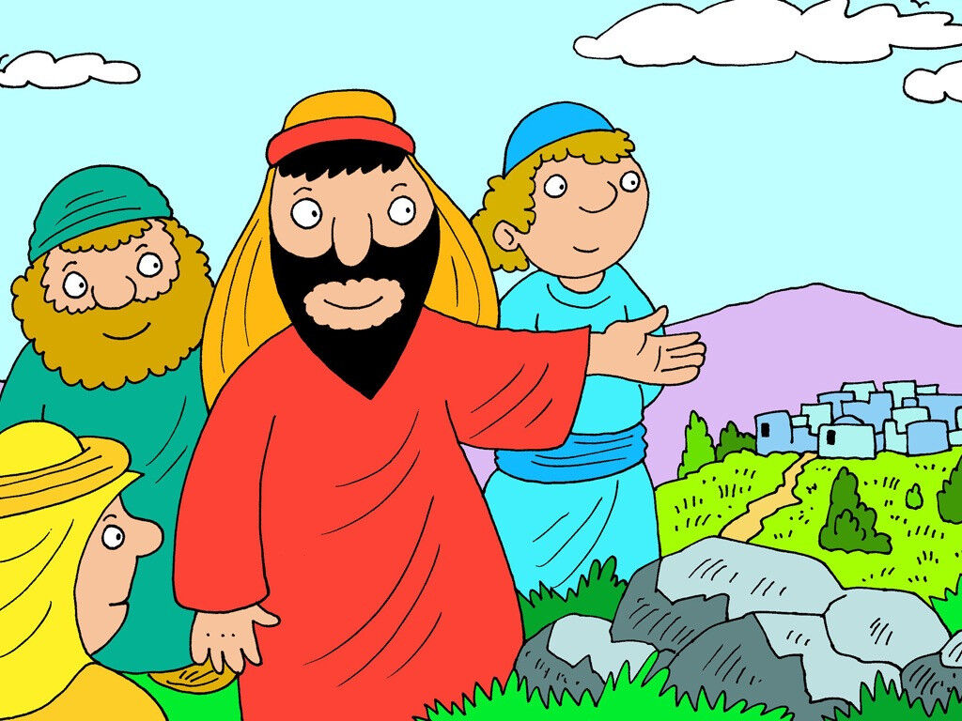
51
As the time drew near when Jesus would be taken up to heaven, he made up his mind and set out on his way to Jerusalem.

Slide 6
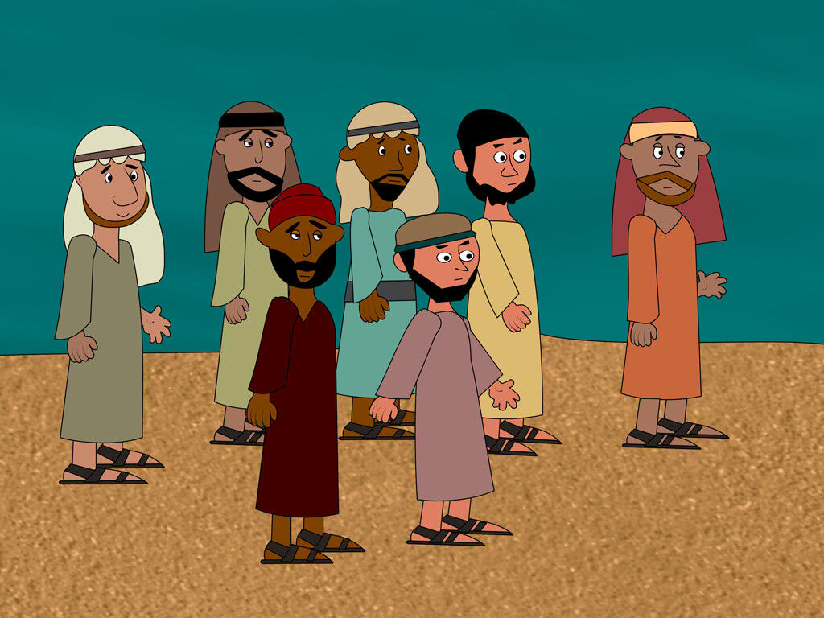
52
He sent messengers ahead of him, who went into a village in Samaria to get everything ready for him.

Slide 7
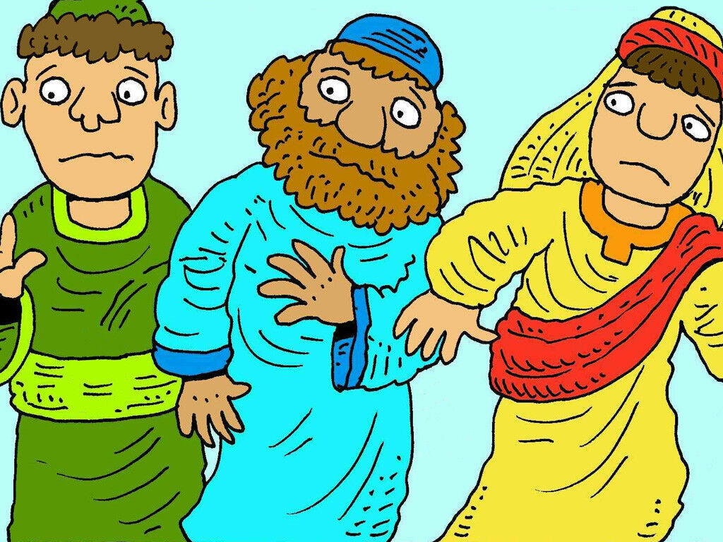
53
But the people there would not receive him, because it was clear that he was on his way to Jerusalem.

Slide 8
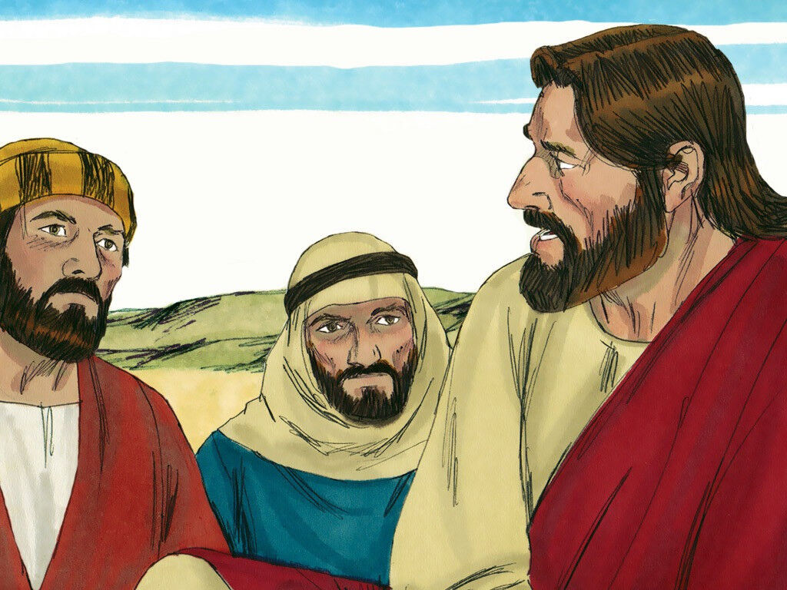
54
When the disciples James and John saw this, they said,
“Lord, do you want us to call fire down from heaven to destroy them?

Slide 9
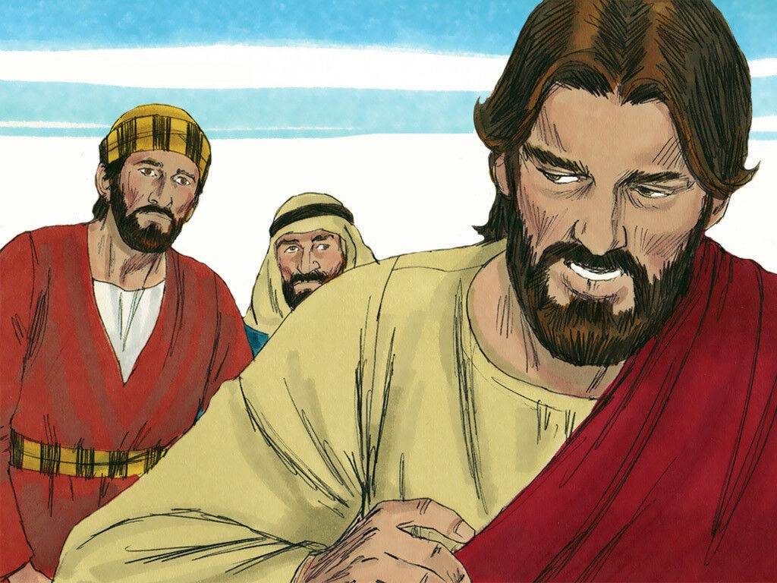
55
Jesus turned and rebuked them.

Slide 10
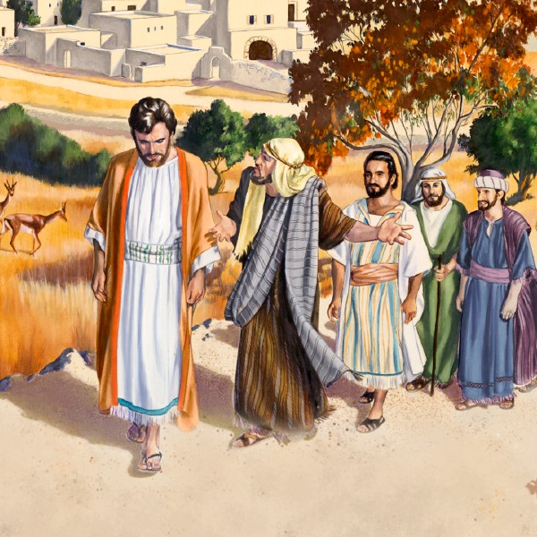
56
Then Jesus and his disciples went on to another village.

Slide 11
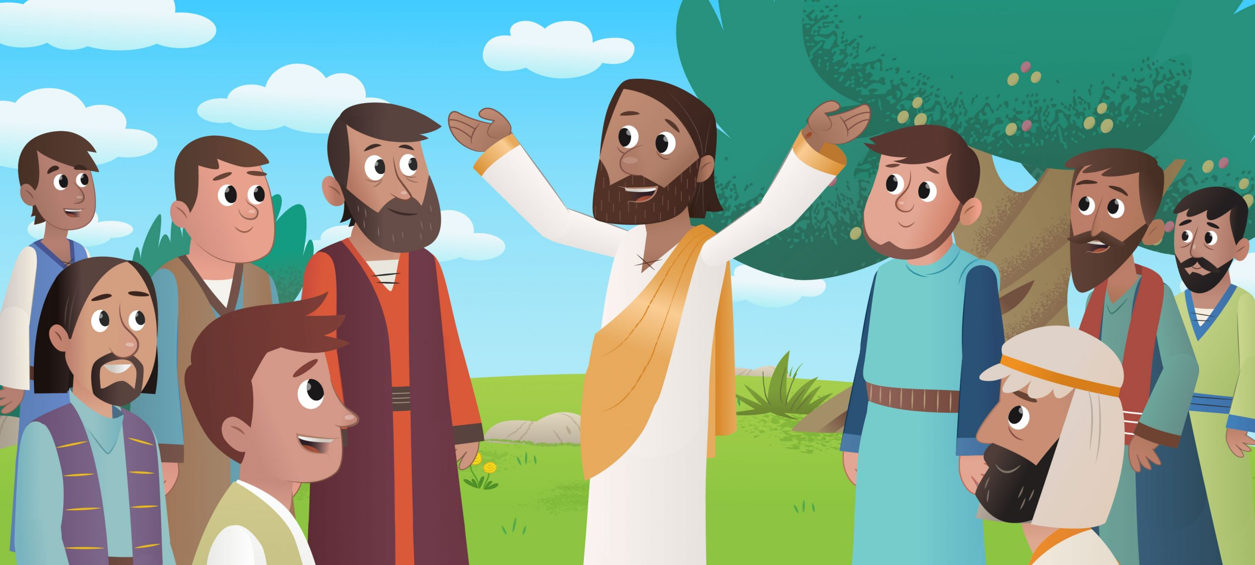
57
As they went on their way, a man said to Jesus,
“I will follow you wherever you go.”

Slide 12
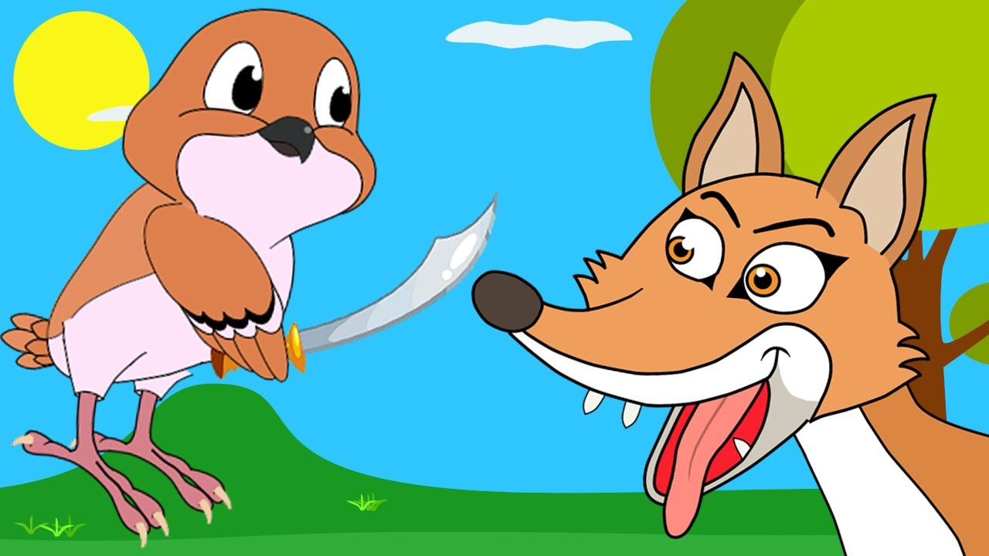
58
Jesus said to him,
“Foxes have holes, and birds have nests, but the Son of Ma n has no place to lie down and rest.”

Slide 13
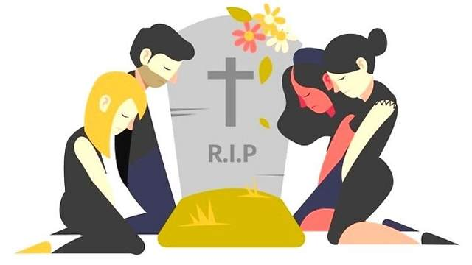
59
He said to another man, “Follow me.”
But that man said, “Sir, first let me go back and bury my father.”

Slide 14
60
Jesus answered,
“Let the dead bury their own dead. You go and proclaim the Kingdom of God.”

Slide 15
61
Someone else said,
“I will follow you, sir; but first let me go and say good-bye to my family.”

Slide 16
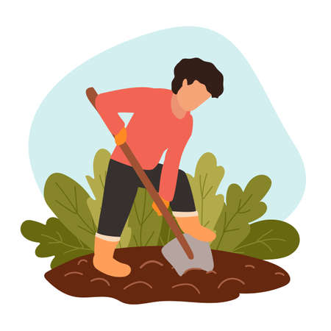
62
Jesus said to him,
“Anyone who starts to plow and then keeps looking back is of no use for the Kingdom of God.”

Slide 17
Leader: The Gospel of the Lord.
All: Praise to You,
Lord Jesus Christ.

Slide 18
GOSPEL MESSAGE

Slide 19
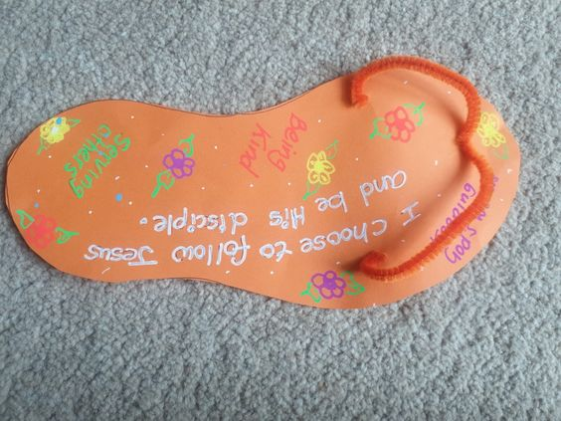
Activity:
Following Jesus Craft
Colored Paper
Scissor
Coloring Materials
Pipe cleaner
Hole punch
Marker/Pen

Slide 20
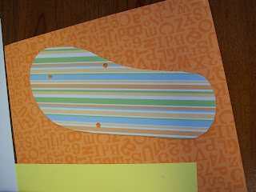
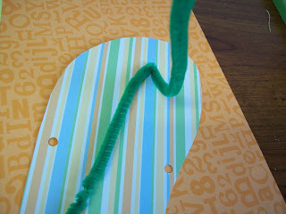
1. On construction paper or cardstock, trace around your foot then cut out.
2. Using hole puncher, punch one hole closer to the side of the flip flop where the big toe would go. Then punch two more holes directly across from one another further down.
3. Fold your pipe cleaner in half and thread the center through the top hole. Twist the pipe cleaner on the back of the shoe a bit and then fold down.
4. Now you just need to write
“I choose to follow Jesus and be his disciples”

Slide 21
Closing Prayer
Dear God, thank you for loving us unconditionally. Help us to be obedient and follow the way of your Son, Jesus. Help us to know what it means to truly follow Him.
We love you, Lord!
In Jesus' name we pray. Amen.
Amen.

Slide 22
LIVE THE WORD KIDS
13th Sunday in Ordinary Time | Year C

