Slide 1
LIVE THE WORD KIDS
Most Holy Body and Blood of Christ | Year C

Slide 2
GOSPEL REFLECTION
In the Bible, meals are seen as much more than a means of satisfying physical hunger. The Hebrew people viewed eating a meal as a way of expressing and strengthening their relationship to one another under God’s covenant.
What did the disciples want to do with the large hungry crowd? (They wanted to send them away.) What does Jesus tell the disciples to do? (He tells them to give the crowd some food to eat.) Jesus took five loaves of bread and two fish and was able to feed the entire crowd of 5,000 people until they were satisfied. What do we learn about Jesus from this story? (Jesus satisfies our spiritual hunger.)
As we celebrate the feast of the Body and Blood of Jesus, we are thankful for the gift of the Eucharist, the meal that feeds us on our spiritual journey.

Slide 3
Jesus fed the five thousand people
Luke 9:11-17

Slide 4
Leader: A reading from
the Holy Gospel
according to Luke.
All: Glory to You, Oh Lord.

Slide 5
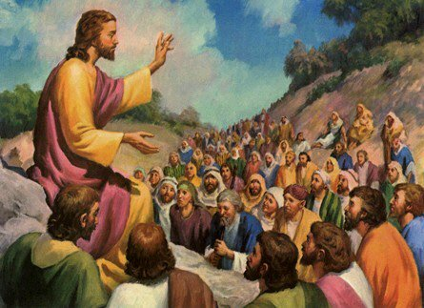
11
When the crowds heard about it, they followed him. He welcomed them, spoke to them about the Kingdom of God, and healed those who needed it.
Notes:
After Jesus was baptized, he went out into the desert to pray.

Slide 6
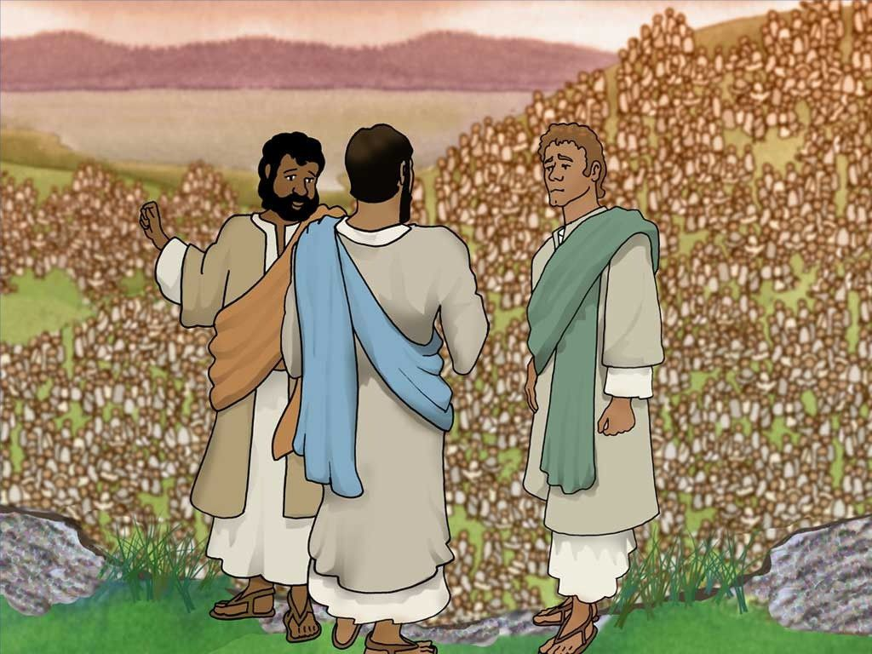
12
When the sun was beginning to set, the twelve disciples came to him and said,
“Send the people away so that they can go to the villages and farms around here and find food and lodging, because this is a lonely place.”
Notes:
He stayed there a long time (40 days) and got very hungry. He had not eaten anything because He was trying to listen to God and do what he said.

Slide 7
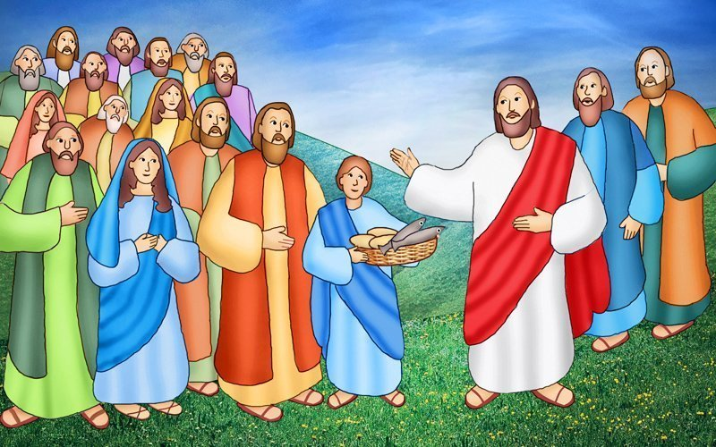
13
But Jesus said to them, “You yourselves give them something to eat.”
They answered,
“All we have are five loaves and two fish. Do you want us to go and buy food for this whole crowd?”

Slide 8
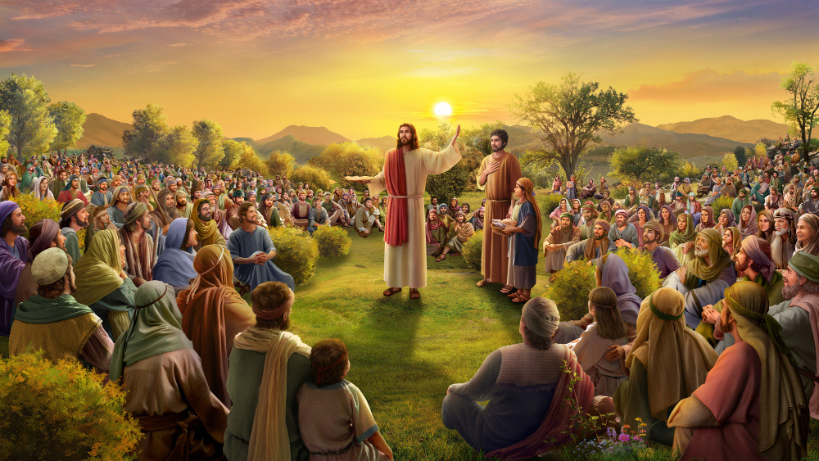
14
(There were about five thousand men there.)
Jesus said to his disciples,
“Make the people sit down in groups of about fifty each.”

Slide 9
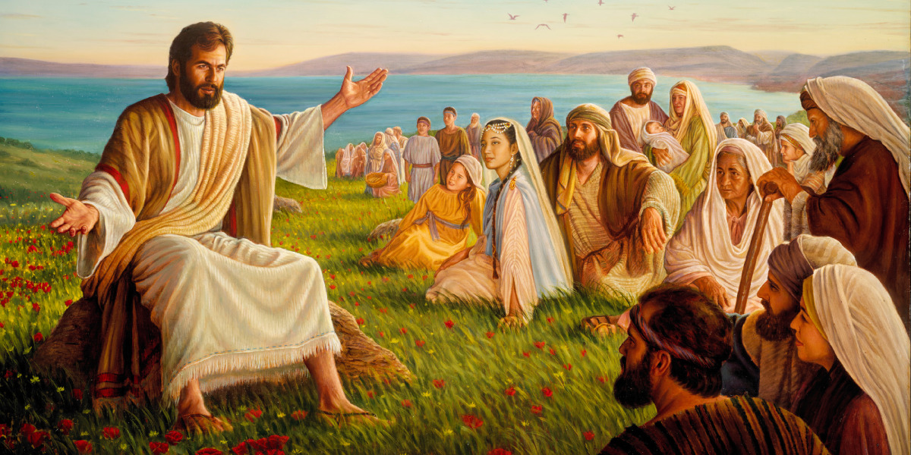
15
After the disciples had done so,
Notes:
After Jesus was baptized, he went out into the desert to pray.

Slide 10
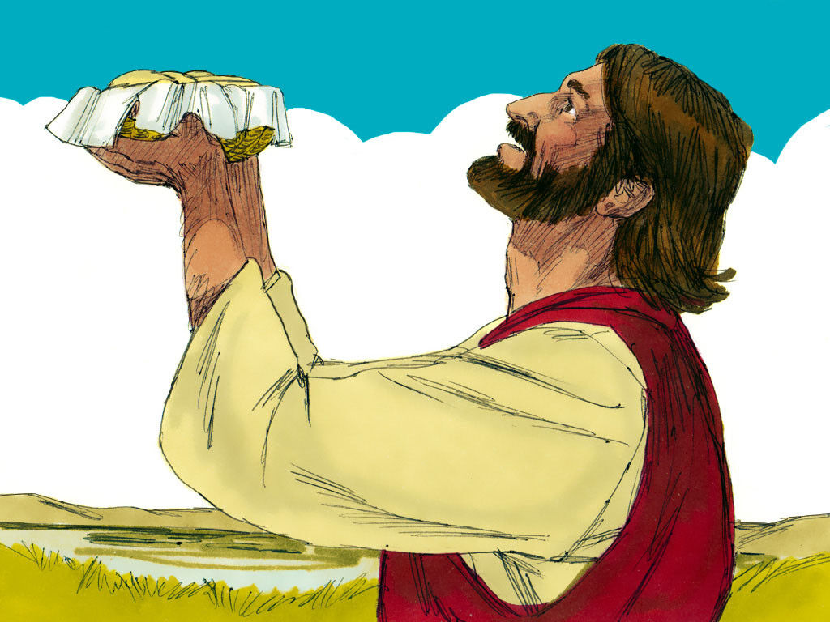
16
Jesus took the five loaves and two fish, looked up to heaven, thanked God for them, broke them, and gave them to the disciples to distribute to the people.
Notes:
He stayed there a long time (40 days) and got very hungry. He had not eaten anything because He was trying to listen to God and do what he said.

Slide 11
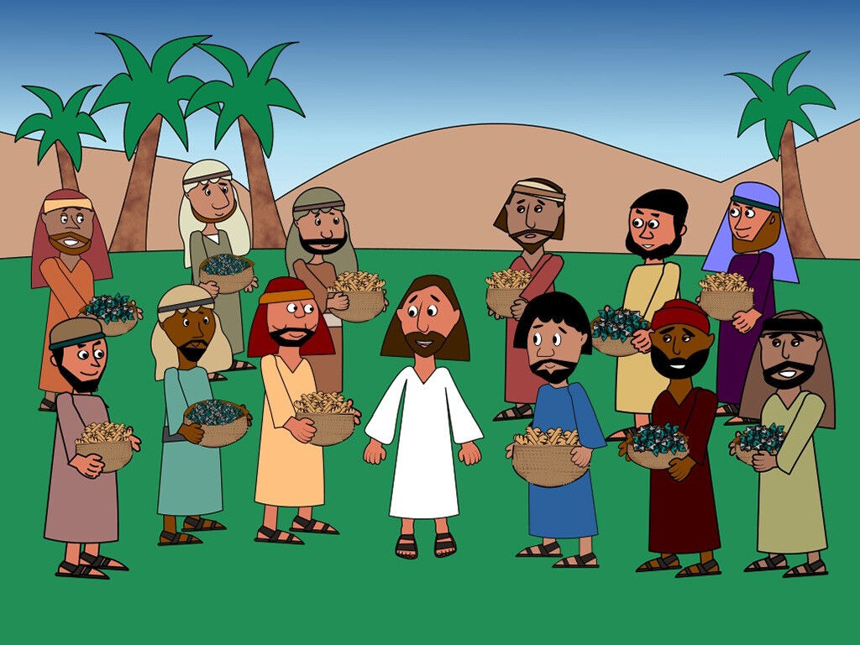
17
They all ate and had enough, and the disciples took up twelve baskets of what was left over.

Slide 12
Leader: The Gospel of the Lord.
All: Praise to You,
Lord Jesus Christ.

Slide 13
GOSPEL MESSAGE

Slide 14
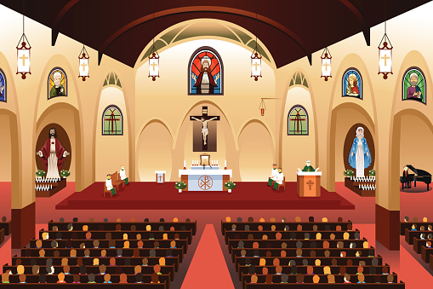
Activity:
Attend a physical mass on Sunday with your family

Slide 15
Closing Prayer
Dear God, thank you for giving us your life. We pray for people who do not have clean water to drink or enough food to eat. Help us to be generous to those in need. Help us to grow in faith and to become united in your love through our joining in the Eucharist.
In Jesus' name we pray. Amen.
Amen.

Slide 16
LIVE THE WORD KIDS
Most Holy Body and Blood of Christ | Year C

