Slide 1
LIVE THE WORD KIDS
The Solemnity of the Most Holy Trinity | Year C

Slide 2
GOSPEL REFLECTION
This Sunday, the church invites us to reflect on the divine community that exists in the very heart and life of God, who we praise as Father, Son and Holy Spirit. The Solemnity of the Most Holy Trinity is not a theological abstraction but a graced opportunity to contemplate the wondrous love of God who is a community of divine persons. This divine love of the Holy Trinity overflows into the world and into our lives.
The Solemnity of the Most Holy Trinity of Father, Son and Holy Spirit directs our gaze to a simple truth about who God is and who we are in relationship to God and one another. We believe in God who is a community of Father, Son and Holy Spirit and into whose life we are incorporated in baptism. We are baptized in the name of the Father, the Son and the Holy Spirit and made members of the family of God!

Slide 3
Solemnity of the Most Holy Trinity
John 16: 12-15

Slide 4
Leader: A reading from
the Holy Gospel
according to John.
All: Glory to You, Oh Lord.

Slide 5
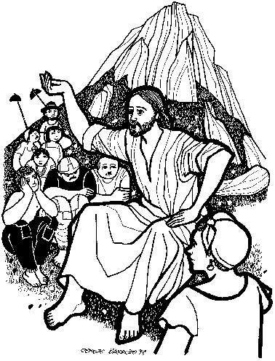
12
I have much more to tell you, but you cannot bear it now.
Notes:
After Jesus was baptized, he went out into the desert to pray.

Slide 6
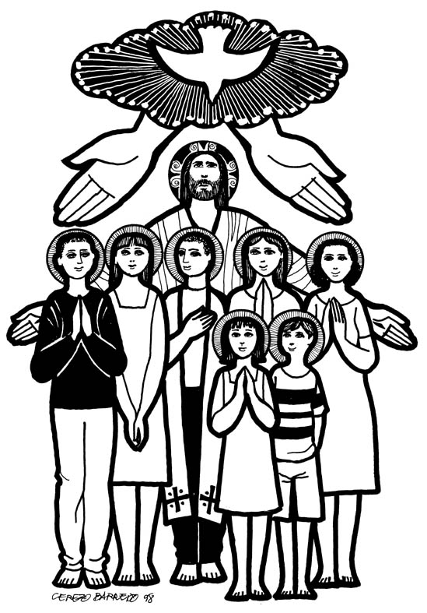
13
But when he comes, the Spirit of truth, he will guide you to all truth. He will not speak on his own, but he will speak what he hears and will declare to you the things that are coming.
Notes:
He stayed there a long time (40 days) and got very hungry. He had not eaten anything because He was trying to listen to God and do what he said.

Slide 7
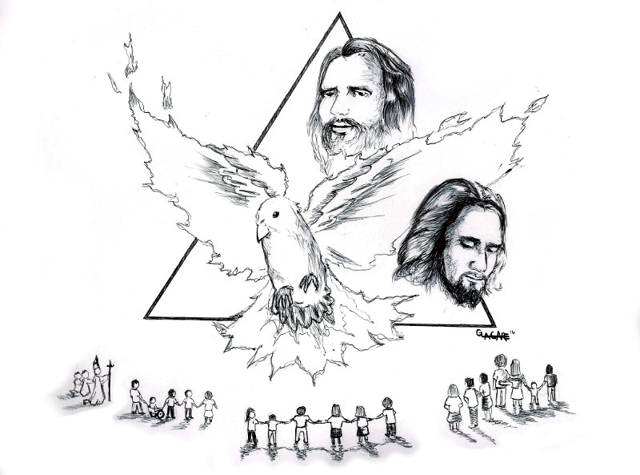
14
He will glorify me because he will take from what is mine and declare it to you.

Slide 8
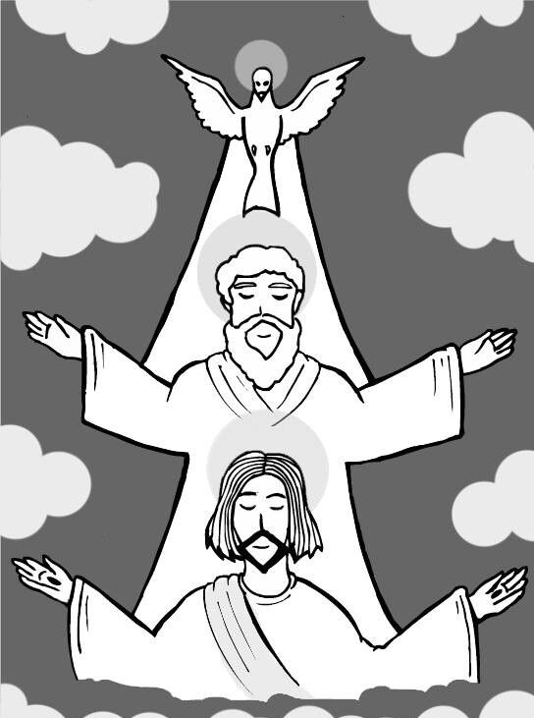
15
Everything that the Father has is mine; for this reason, I told you that he will take from what is mine and declare it to you.

Slide 9
Leader: The Gospel of the Lord.
All: Praise to You,
Lord Jesus Christ.

Slide 10
GOSPEL MESSAGE

Slide 11
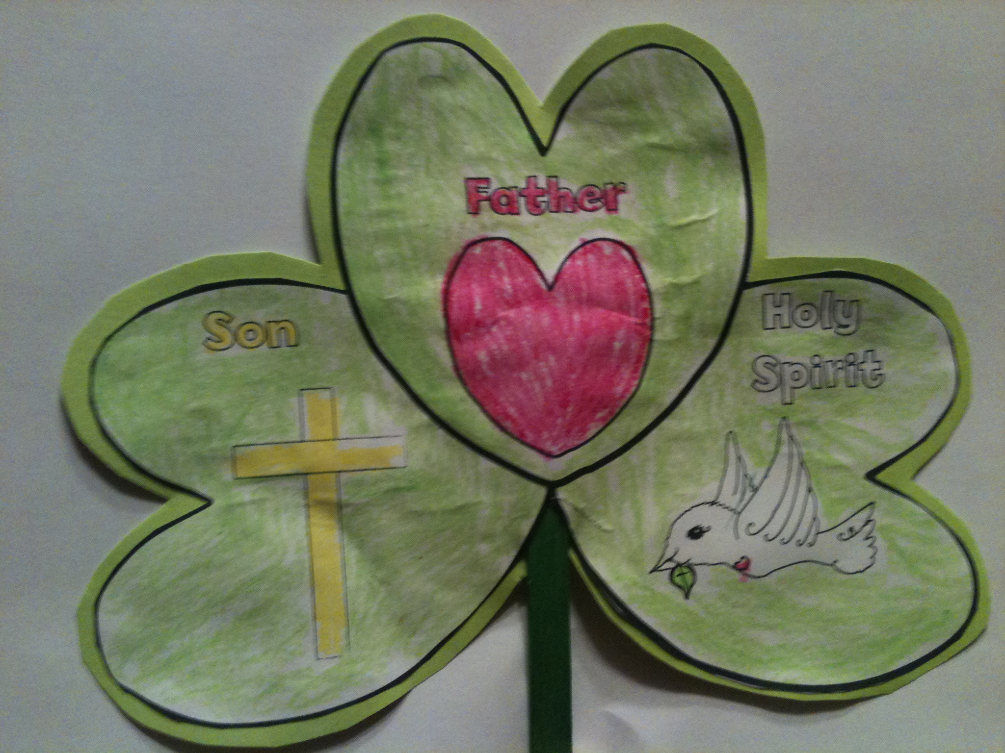
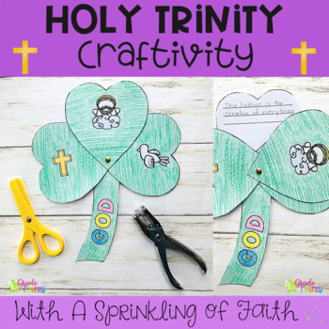
Activity:
Temptation Target
Popsicle Sticks
Colored Paper / Bond Paper
Scissor
Markers
Coloring Material
Glue / tape /

Slide 12
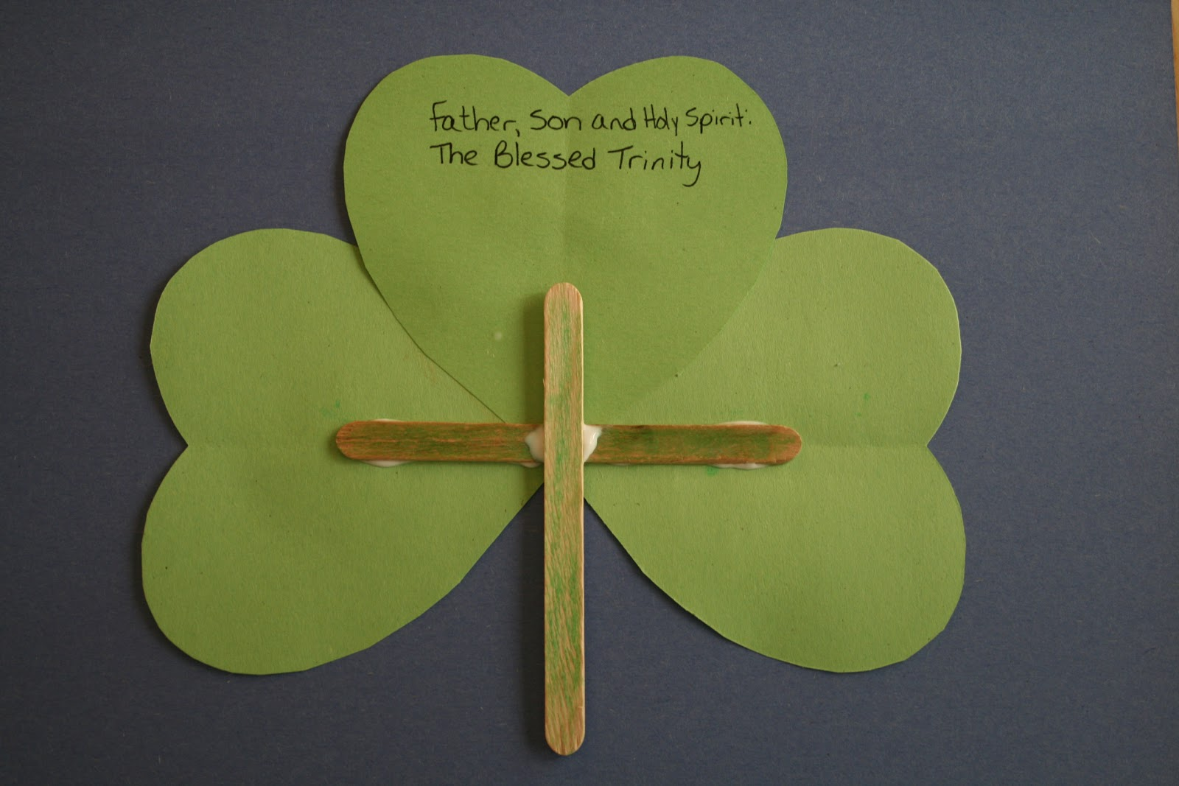
Instruction:
Put glue to the popsicle stick to form a cross to be the holder of your craft
Cut 3 heart shape on your colored paper.
On the first heart shape draw an image of a Father then color it, On the second heart shape draw an image of Son and on the last heart shape draw an image of a Holy Spirit.
Attach the 3 heart together just like the sample image
You can put additional design on it

Slide 13
Closing Prayer
Dear God,
Thank you for always being there to guide us through the Father, Son and Holy Spirit. You never leave us in this journey of our life. Thank you for always making us happy.
In Jesus' name we pray. Amen.
Amen.

Slide 14
LIVE THE WORD KIDS
The Solemnity of the Most Holy Trinity | Cycle C

