Slide 1
LIVE THE WORD KIDS
Pentecost Sunday| Cycle C

Slide 2
GOSPEL REFLECTION
Today we celebrate Pentecost when the Spirit was given to the disciples. It is the birthday of the Church, the day when the timid and uncertain apostles were transformed into bold preachers of Jesus and his resurrection. The same Spirit is still as active in the Church today, transforming it - and us - into better missionaries.
The feast of Pentecost celebrates the descent of the Holy Spirit upon Jesus’ first disciples. This same Holy Spirit is still with us. After breathing upon them and giving them the gift of the Holy Spirit, what does Jesus tell his disciples to do? (to forgive sins). Just as Jesus sent his disciples to forgive the sins of others, so too we are sent to bring peace to the world. We also have been given the gift of the Holy Spirit to help us with this task. He has given us the Holy Spirit and promises to stay with us always. He wants to take away our worries and fears and replace them with His peace as we do His work.

Slide 3
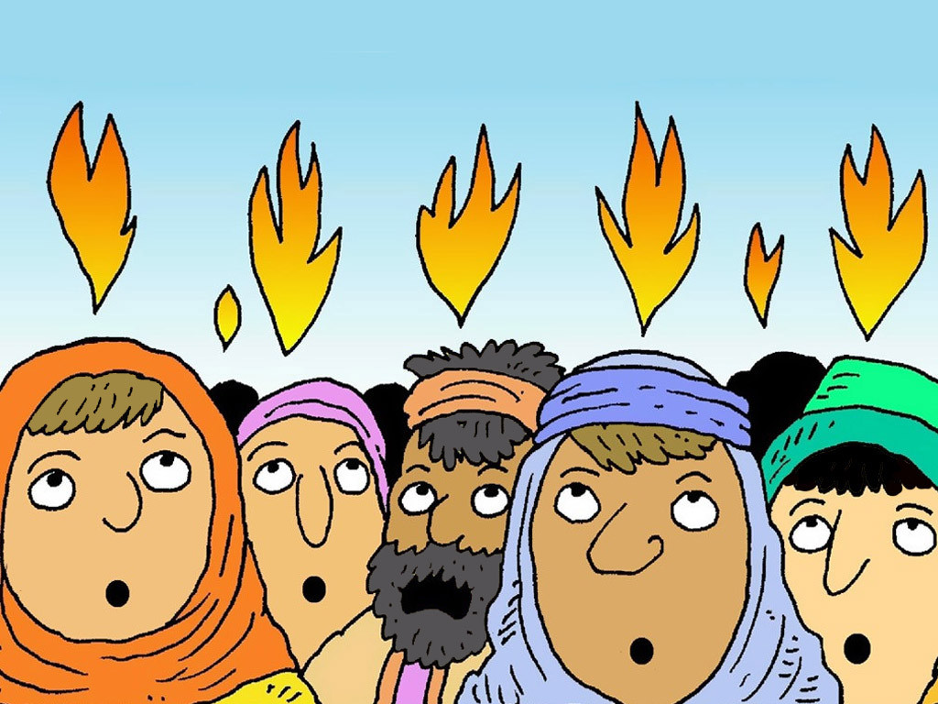
Pentecost Sunday
John 20: 19-23

Slide 4
Leader: A reading from
the Holy Gospel
according to John.
All: Glory to You, Oh Lord.

Slide 5
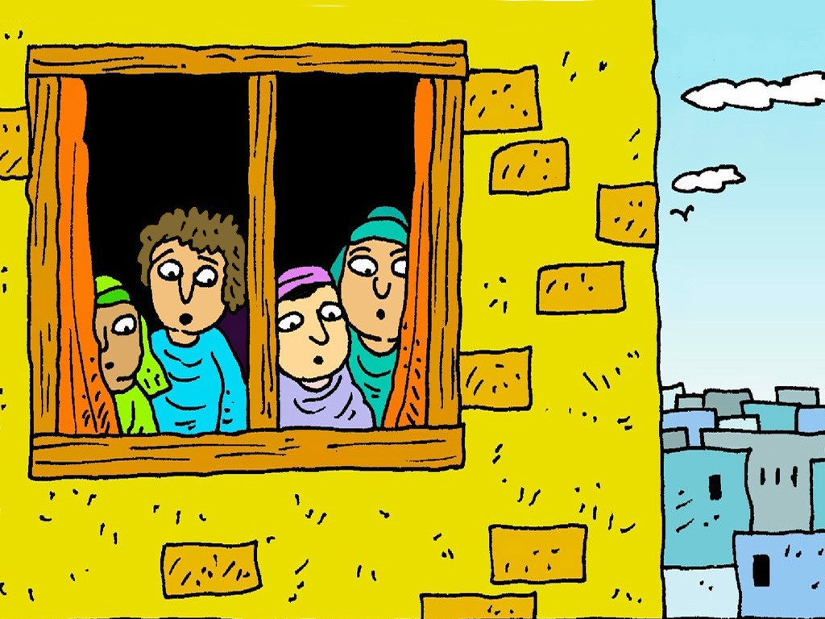
19
Now when it was late that same day, the first of the week, and the doors were shut, where the disciples were gathered together, for fear of the Jews, Jesus came and stood in the midst, and said to them: Peace be to you.
Notes:
After Jesus was baptized, he went out into the desert to pray.

Slide 6
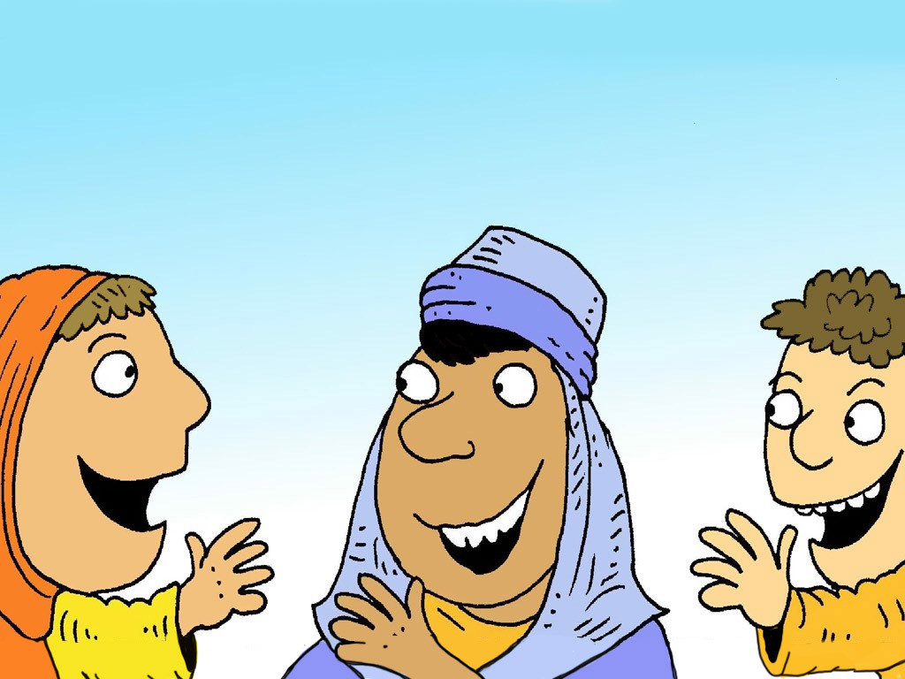
20
And when he had said this, he shewed them his hands and his side. The disciples therefore were glad, when they saw the Lord.
Notes:
He stayed there a long time (40 days) and got very hungry. He had not eaten anything because He was trying to listen to God and do what he said.

Slide 7
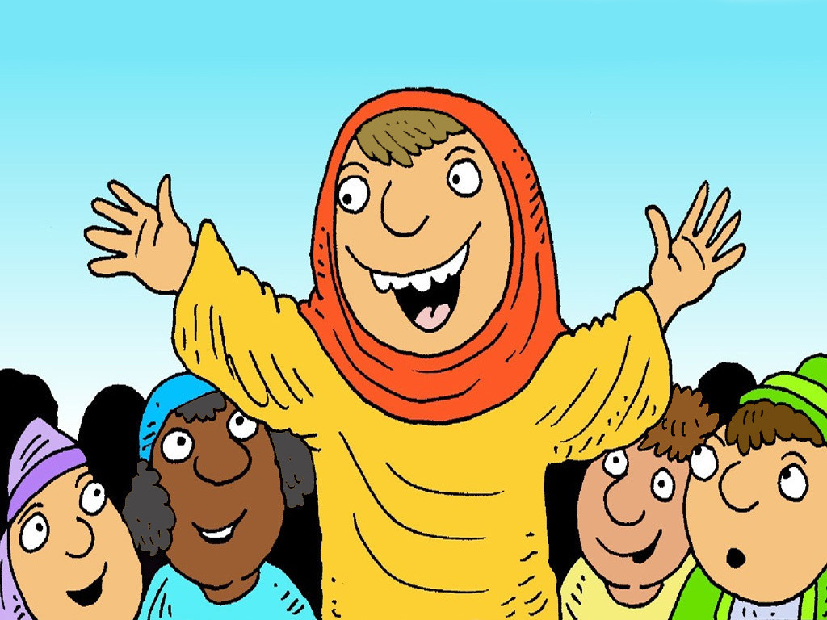
21
He said therefore to them again: Peace be to you. As the Father hath sent me, I also send you.

Slide 8
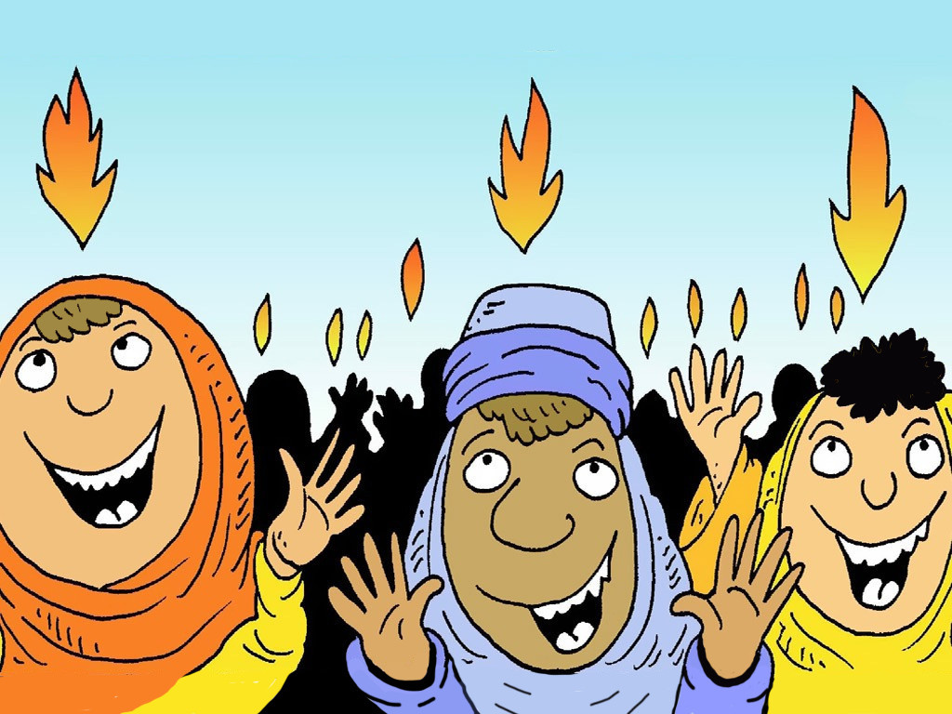
22
When he had said this, he breathed on them; and he said to them: Receive ye the Holy Ghost.

Slide 9
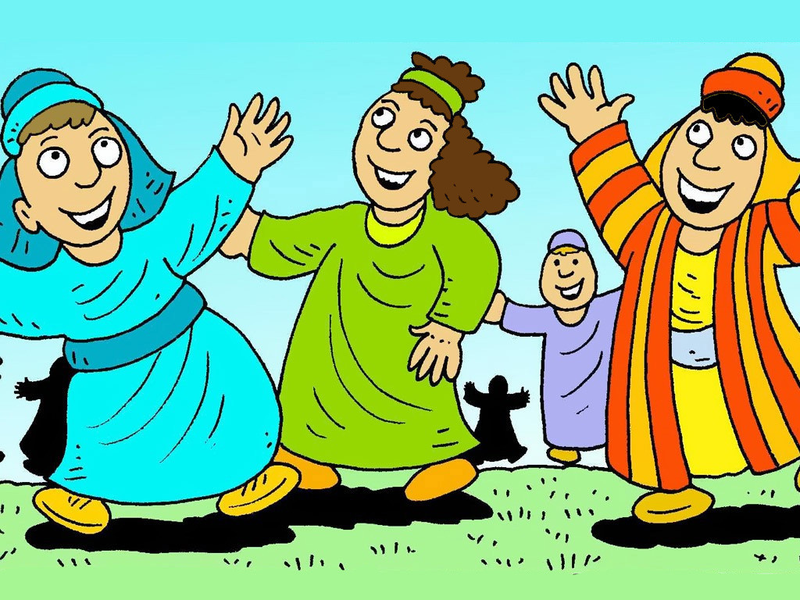
23
Whose sins you shall forgive, they are forgiven them; and whose sins you shall retain, they are retained.

Slide 10
Leader: The Gospel of the Lord.
All: Praise to You,
Lord Jesus Christ.

Slide 11
GOSPEL MESSAGE

Slide 12
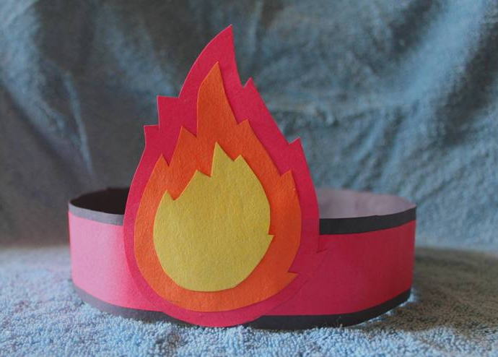
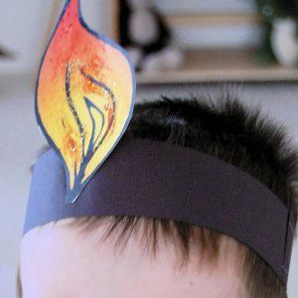
Activity:
Temptation Target
Scissors
Cardboard / Velum Board
Paper / Oslo Paper
Markers
Tissue Paper (Optional)
Glue / tape / Stapler
Coloring Material

Slide 13
Instruction:
Use card stock paper or cardboard to cut out flame shapes.
Color them with Coloring materials or glue red and orange pieces of tissue paper on it to make it look like flames.
Use a strip of paper for the headband, fitting it to each child’s head and using a stapler to secure the headband.
Attach the flames to the headband using the stapler as well.

Slide 14
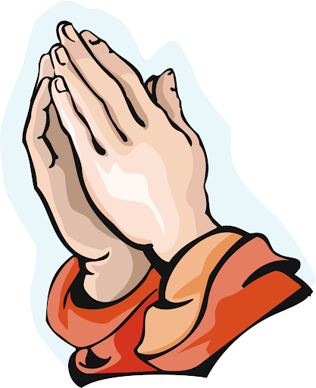
Closing Prayer
Dear God,
We are thankful for your Holy Spirit that guides us where ever we are. Always bless us with your grace so we can lead other Kids to your loving presence.
In Jesus' name we pray. Amen.
Amen.

Slide 15
LIVE THE WORD KIDS
Pentecost Sunday| Cycle C

