Slide 1
LIVE THE WORD KIDS
18th Sunday in Ordinary Time | Year C

Slide 2
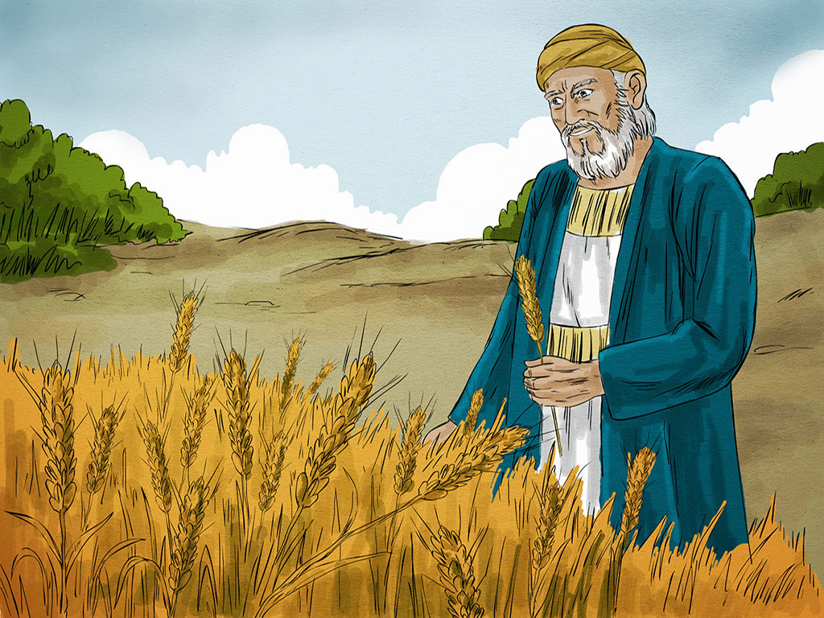
The Parable of the Rich Fool
Luke 12:13-21

Slide 3
NOTES FOR THE FACILITATOR ONLY:
Gospel Lesson:
Jesus helps his followers understand that gathering material wealth doesn’t gain you anything in the kingdom of heaven. It’s possible to have material wealthy but have a heart that is far from God. God’s intention for us is that we would be rich toward him, meaning that we don’t base our decisions purely on what we can gain, and we don’t put our confidence in material possessions. We want to communicate to the children that the things we have are a gift from God and should be used in a way that honors God.
Gospel Focus:
Being rich toward God is more important than the stuff we have.
Everything we have is a gift from God.
Notes:
Don’t include this slide when you present this to the kids

Slide 4
NOTES FOR THE FACILITATOR ONLY:
TERMS:
Inheritance
- Money or possessions left to the sons by their father. The older brother was normally responsible for sharing inheritance according to the father’s will.
Judge or arbitrator
- Someone who settles disagreements between people.
Notes:
Don’t include this slide when you present this to the kids

Slide 5
NOTES FOR THE FACILITATOR ONLY:
So how can we be generous like Jesus?
Here are a few examples:
When we have a snack or dessert and someone doesn’t have any, you could share it with them.
Do you have extra toys? Maybe you should donate them to boys or girls who don’t have toys.
Or maybe you have a great spot in line? Maybe you could let other people go ahead of you?
Notes:
Don’t include this slide when you present this to the kids

Slide 6
The Parable of the Rich Fool
Luke 12:13-21

Slide 7
Leader: A reading from
the Holy Gospel
according to Luke.
All: Glory to You, Oh Lord.

Slide 8
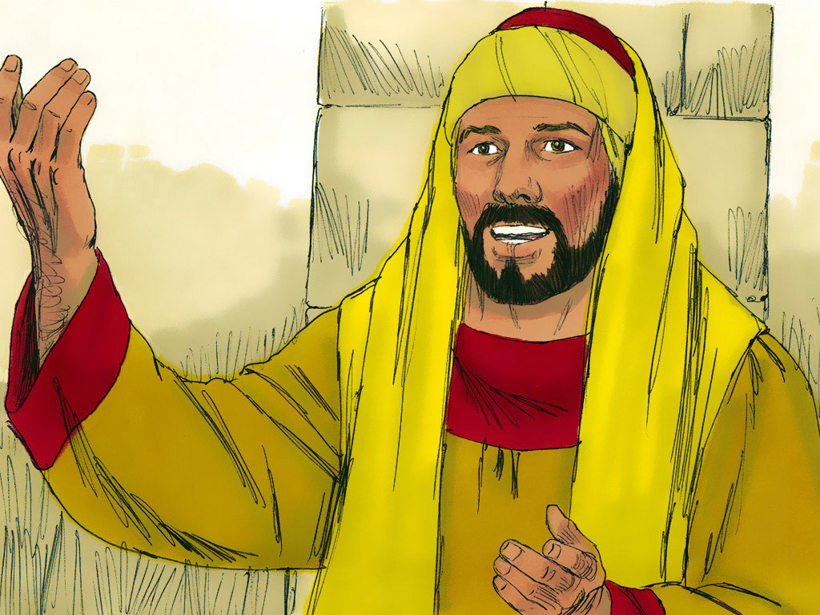
13
A man in the crowd said to Jesus, “Teacher, tell my brother to divide with me the property our father left us.”

Slide 9
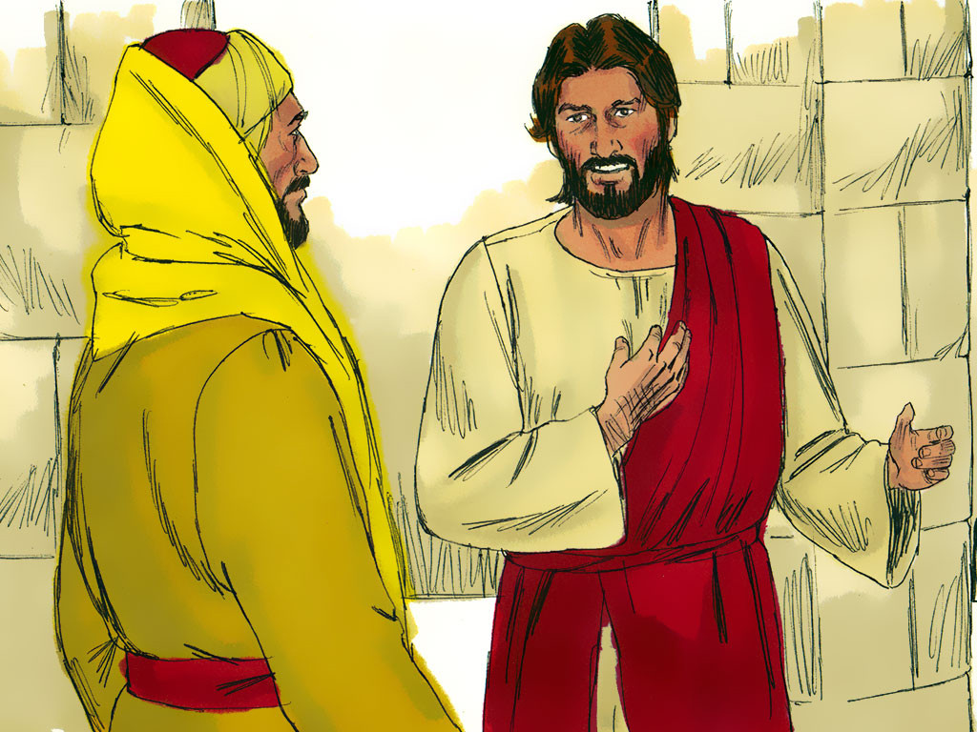
14
Jesus answered him, “Friend, who gave me the right to judge or to divide the property between you two?”

Slide 10
15
And he went on to say to them all, “Watch out and guard yourselves from every kind of greed; because your true life is not made up of the things you own, no matter how rich you may be.”

Slide 11
16
Then Jesus told them this parable: “There was once a rich man who had land which bore good crops.

Slide 12
17
He began to think to himself, ‘I don't have a place to keep all my crops. What can I do?

Slide 13
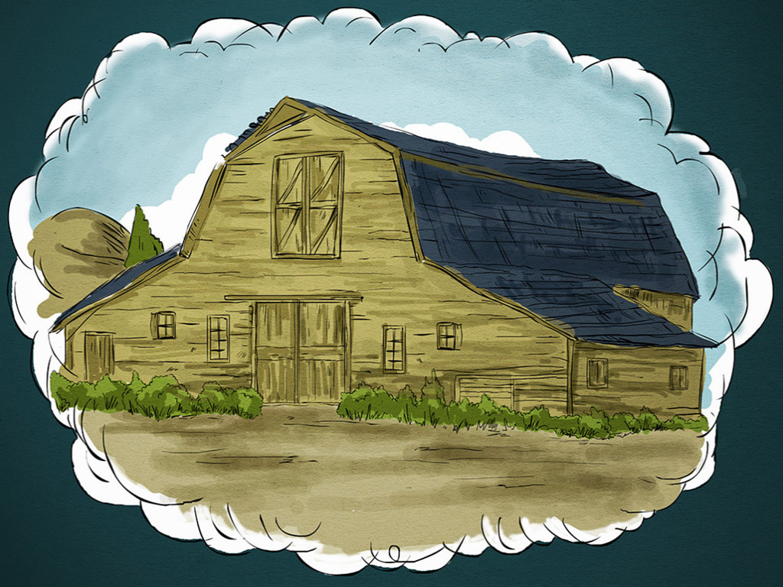
18
This is what I will do,’ he told himself; ‘I will tear down my barns and build bigger ones, where I will store the grain and all my other goods.

Slide 14
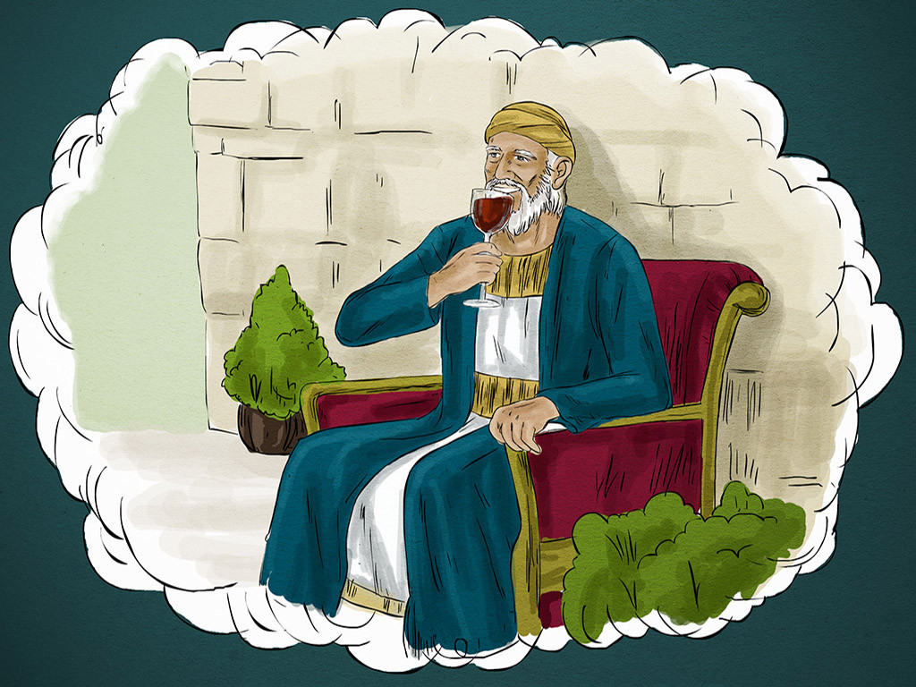
19
Then I will say to myself, Lucky man! You have all the good things you need for many years. Take life easy, eat, drink, and enjoy yourself!’

Slide 15
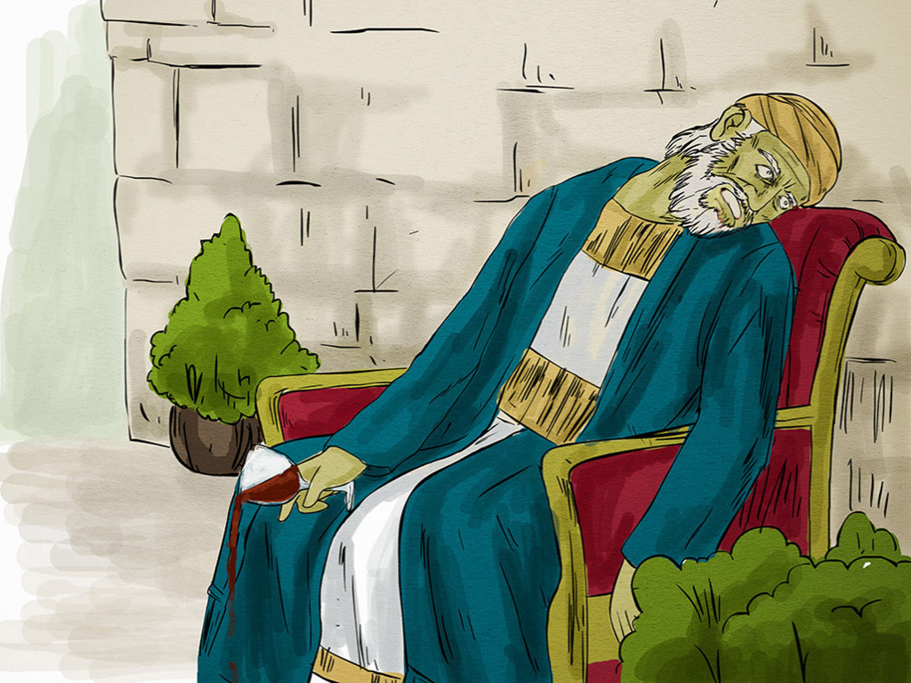
20
But God said to him, ‘You fool! This very night you will have to give up your life; then who will get all these things you have kept for yourself?’”

Slide 16
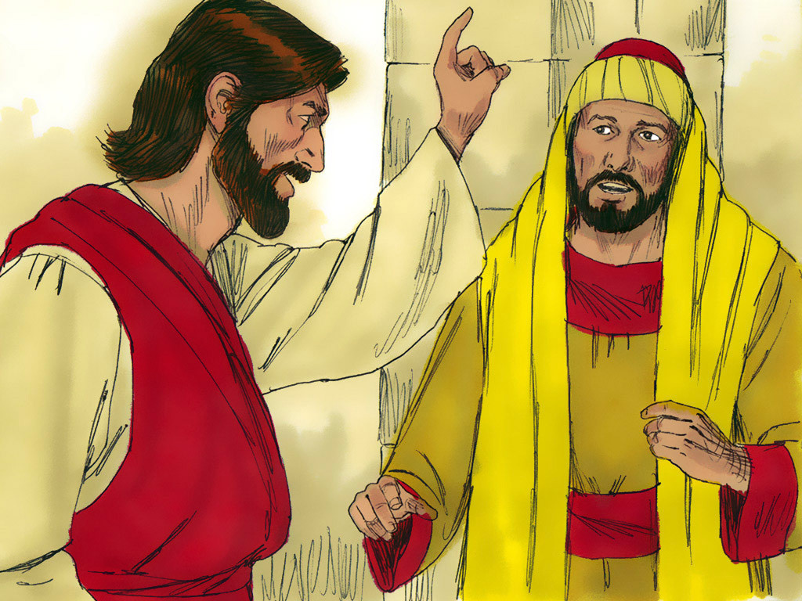
21
And Jesus concluded, “This is how it is with those who pile up riches for themselves but are not rich in God's sight.”

Slide 17
Leader: The Gospel of the Lord.
All: Praise to You,
Lord Jesus Christ.

Slide 18
GOSPEL MESSAGE

Slide 19
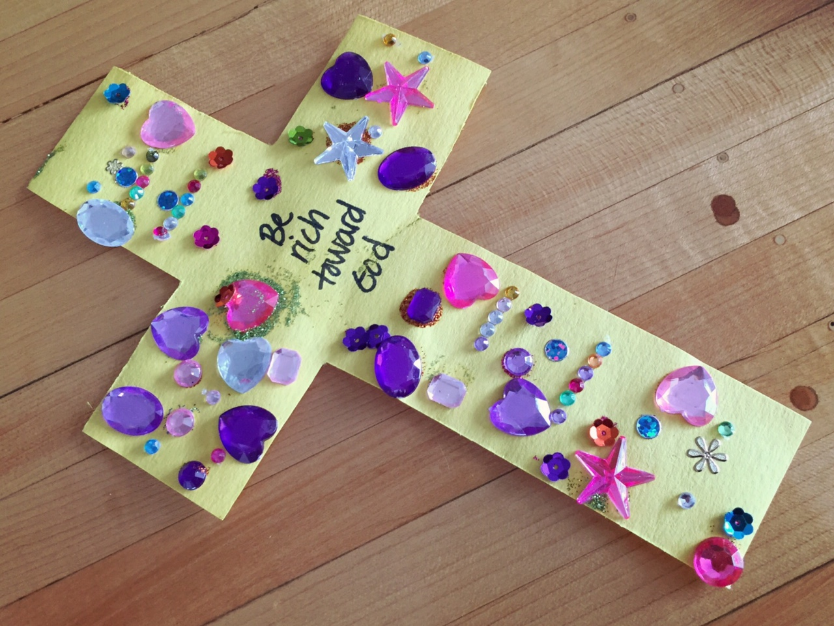
Activity:
Riches in Heaven
Cross
Materials:
Bond Paper / Colored Paper
Crayons
Markers
Glue
Plastic Jewels
Extra Stickers

Slide 20
Procedure:
1. Prepare a cut-out cross for your child (parents can assist if the kid is too young).
2. Put the words “Be rich toward God” at the center of the cross.
3. Stick plastic jewels on their cross to decorate it.
4. Let the kids go crazy with the designs using crayons, markers and even extra stickers to put on their cross.
5. Lastly, write your name at the bottom part of the cross.

Slide 21
Closing Prayer
Dear God,
Thank you for all of your blessings. Thank You for giving us everything that we need. Help us to put you first in our lives and understand what is most important. Help us to remember people who don’t have as much as we do and help us to share with others what we can. Thank you for everything!
Amen.

Slide 22
LIVE THE WORD KIDS
18th Sunday in Ordinary Time | Year C

