Slide 1
LIVE THE WORD KIDS
17th Sunday in Ordinary Time | Year C

Slide 2
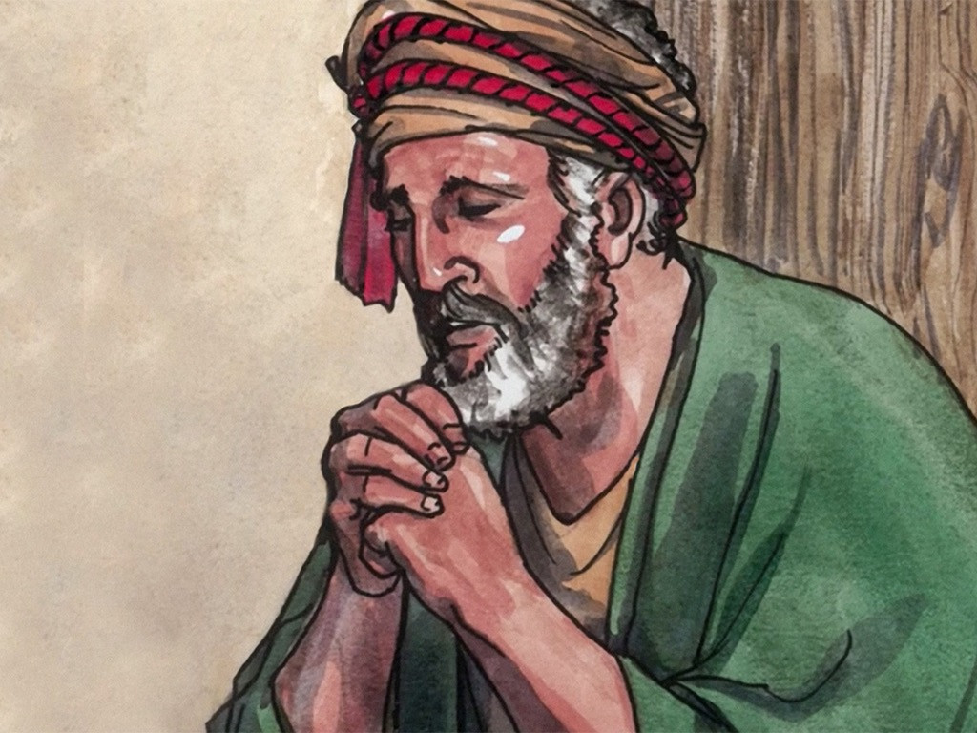
Jesus' Teaching on Prayer
Luke 11:1-13

Slide 3
Notes for the Facilitator ONLY:
Lesson Focus:
Prayer can be challenging for young ones. Some have a difficult time knowing how to pray or understanding what prayer is. This gospel should remind students that prayer does not have to be scary or complicated but is a meaningful way of talking with their Heavenly Father.
The Lord’s Prayer is a positive helper to remind kids that God wants to hear from us, and that He has given us grace and enabled us to approach Him.
This teaching concludes also with the reminder that if we seek, we will get a response. If a human father, with all his faults, knows how to give good gifts to his children, how much more will our heavenly Father give us?
Instead of good gifts, however, Luke substitutes the word Holy Spirit. This predicts the gift of the Holy Spirit, who will play an important role in the growth of the early Church after Pentecost.

Slide 4
Jesus' Teaching on Prayer
Luke 11:1-13

Slide 5
Leader: A reading from
the Holy Gospel
according to Luke.
All: Glory to You, Oh Lord.

Slide 6
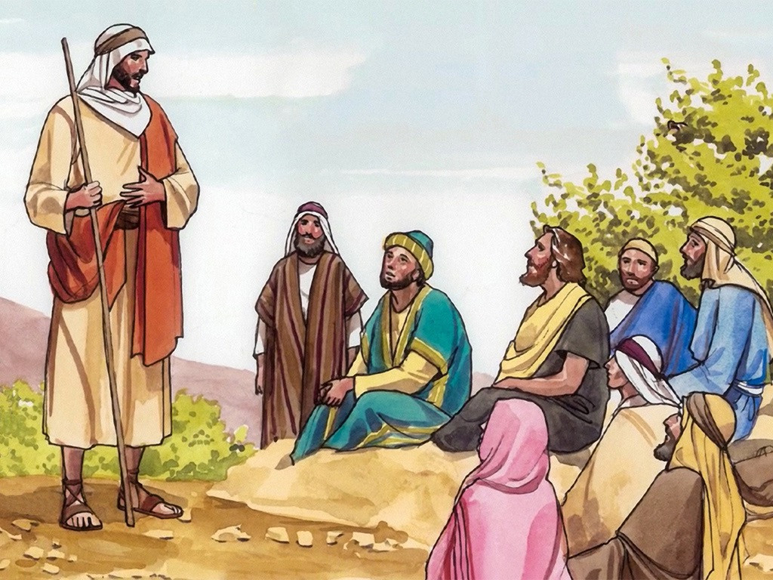
1
One day Jesus was praying in a certain place. When he had finished, one of his disciples said to him, “Lord, teach us to pray, just as John taught his disciples.”

Slide 7
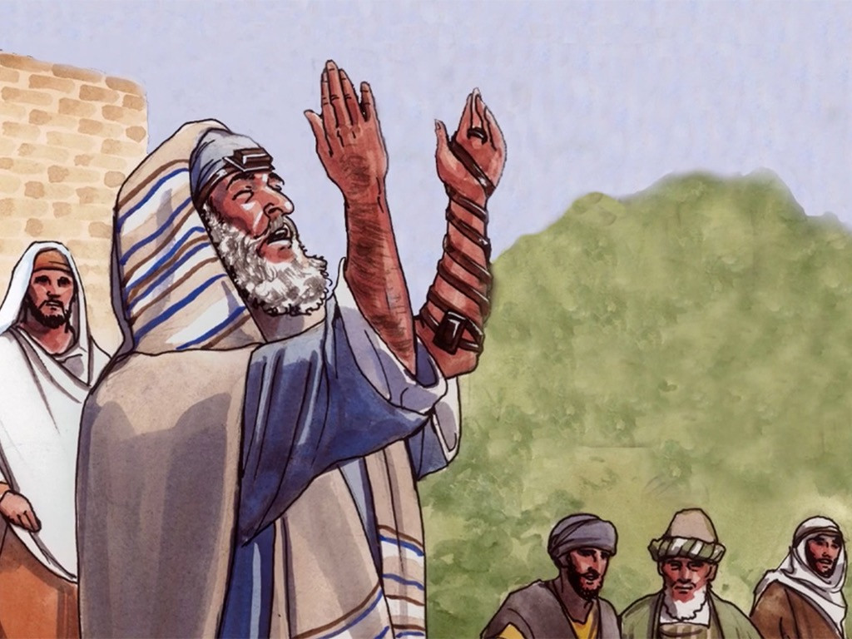
2
Jesus said to them, “When you pray, say this:
‘Father:
May your holy name be honored;
may your Kingdom come.

Slide 8
3
Give us day by day the food we need.

Slide 9
4
Forgive us our sins,
for we forgive everyone who does us wrong.
And do not bring us to hard testing.’”

Slide 10
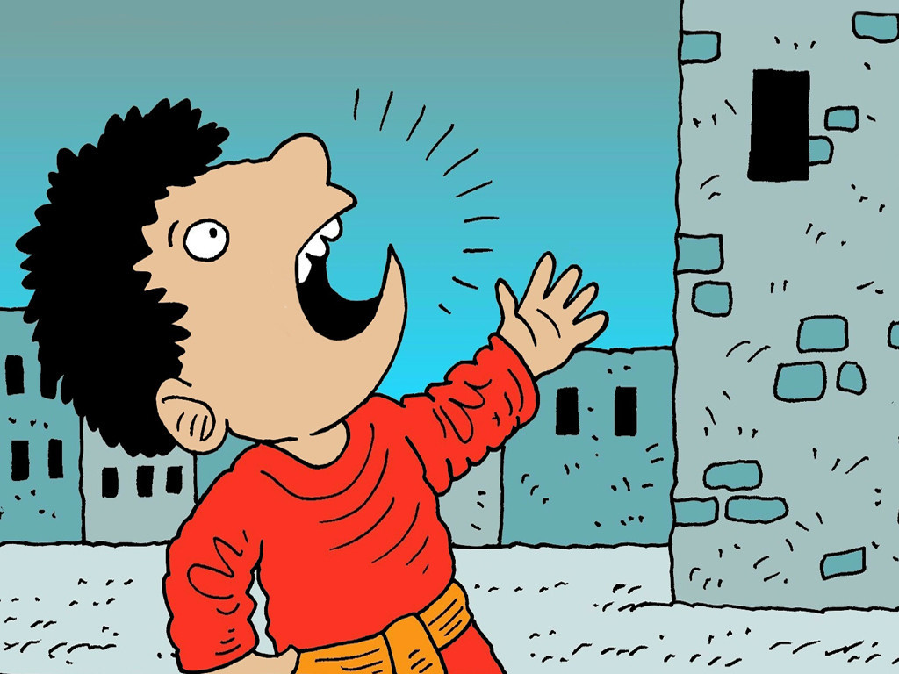
5
And Jesus said to his disciples, “Suppose one of you should go to a friend's house at midnight and say, ‘Friend, let me borrow three loaves of bread.

Slide 11
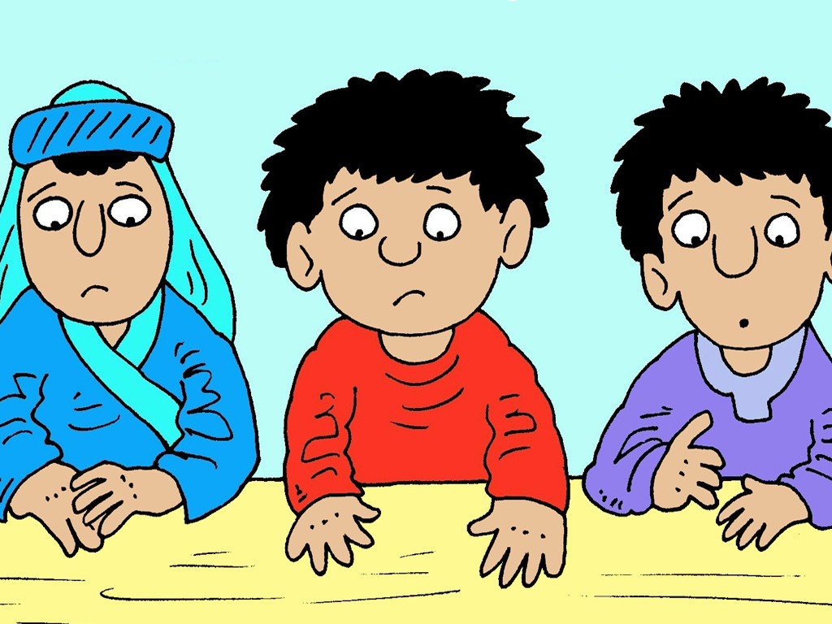
6
A friend of mine who is on a trip has just come to my house, and I don't have any food for him!’

Slide 12
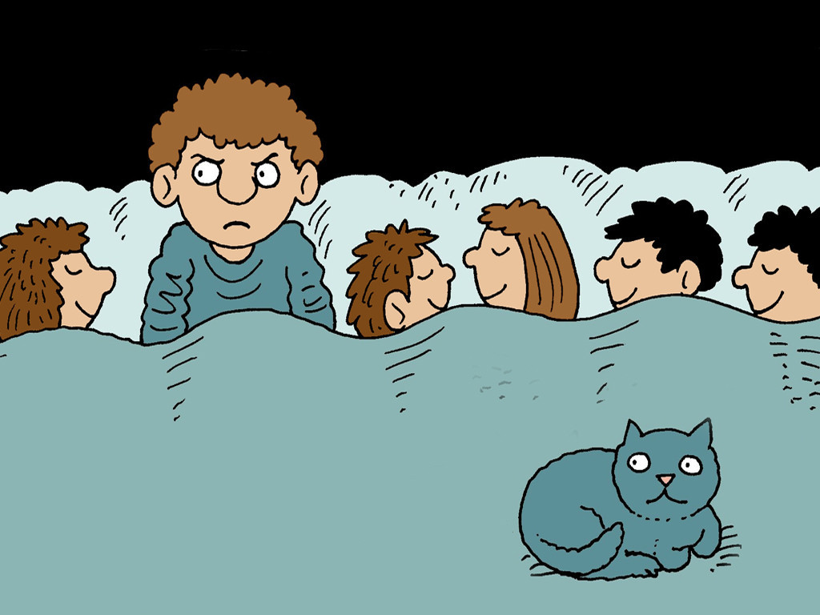
7
And suppose your friend should answer from inside, ‘Don't bother me! The door is already locked, and my children and I are in bed. I can't get up and give you anything.’

Slide 13
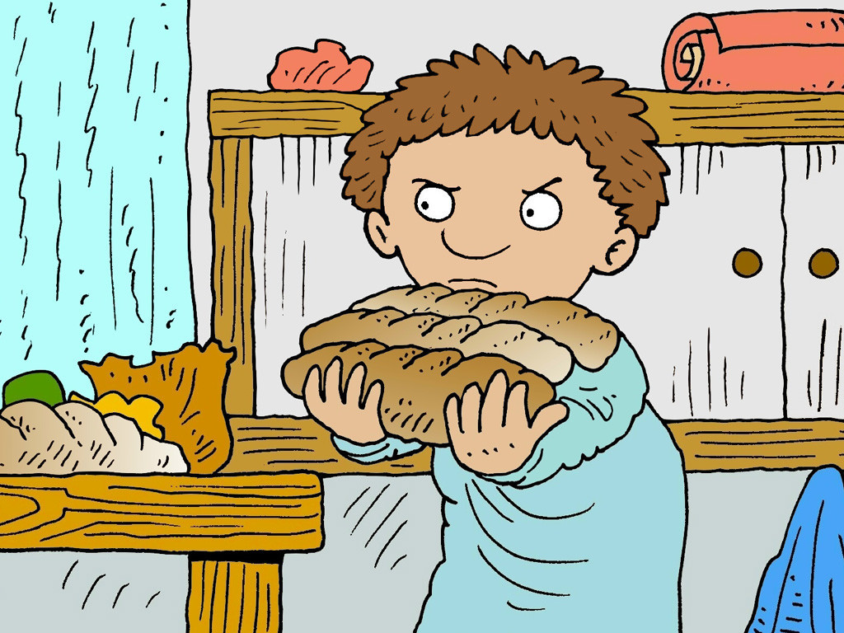
8
Well, what then? I tell you that even if he will not get up and give you the bread because you are his friend, yet he will get up and give you everything you need because you are not ashamed to keep on asking.

Slide 14
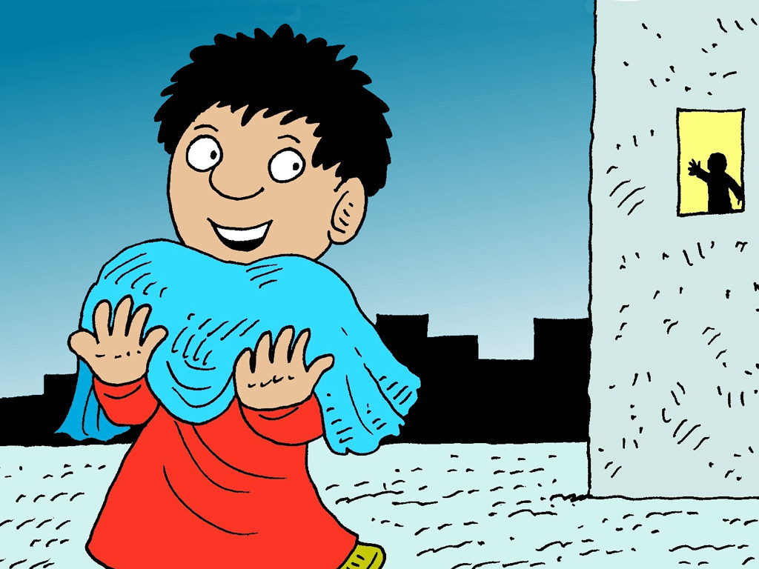
9
And so I say to you: Ask, and you will receive; seek, and you will find; knock, and the door will be opened to you.

Slide 15
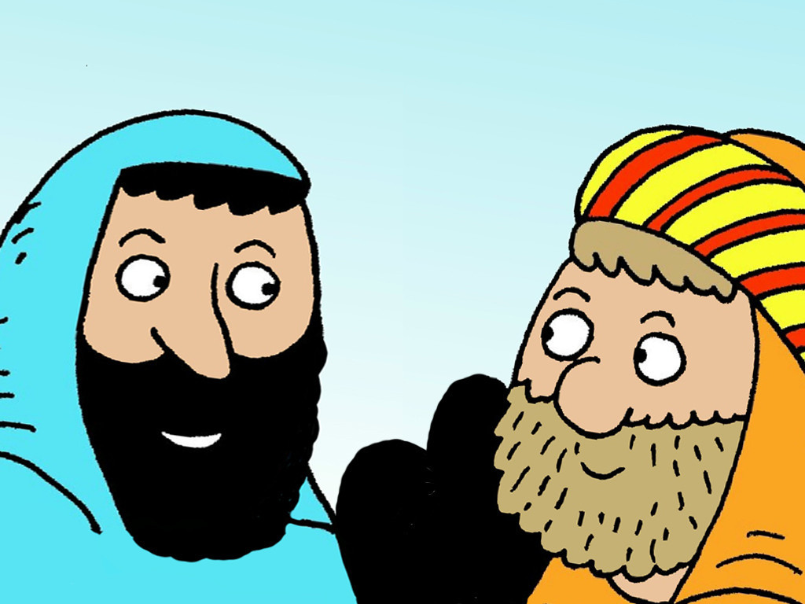
10
For those who ask will receive, and those who seek will find, and the door will be opened to anyone who knocks.

Slide 16
11
Would any of you who are fathers give your son a snake when he asks for fish?

Slide 17
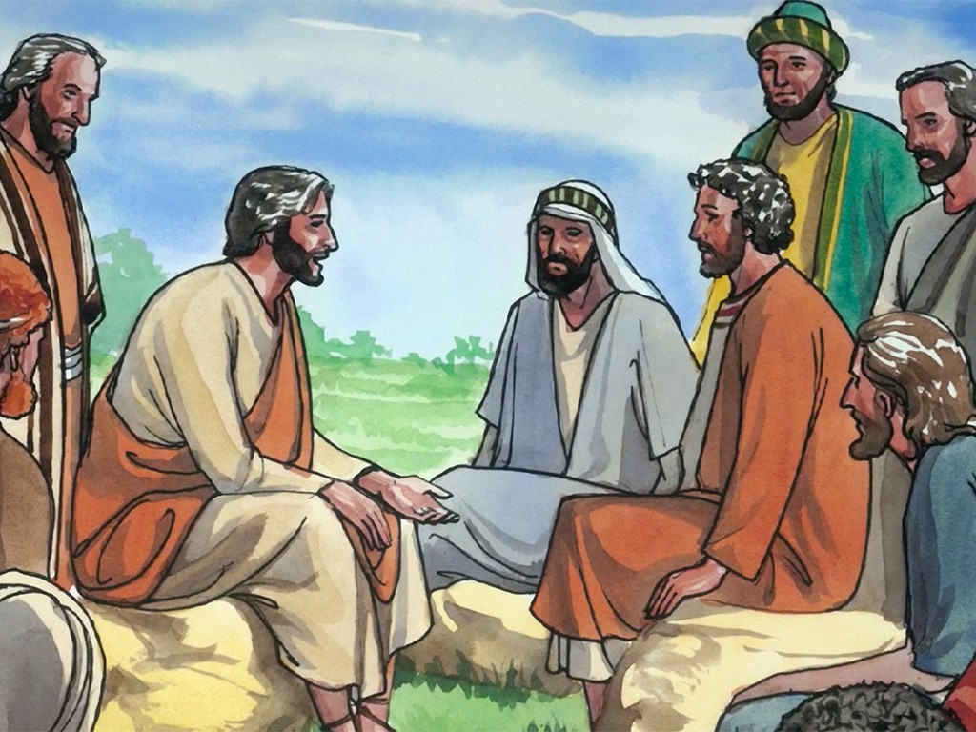
12
Or would you give him a scorpion when he asks for an egg?

Slide 18
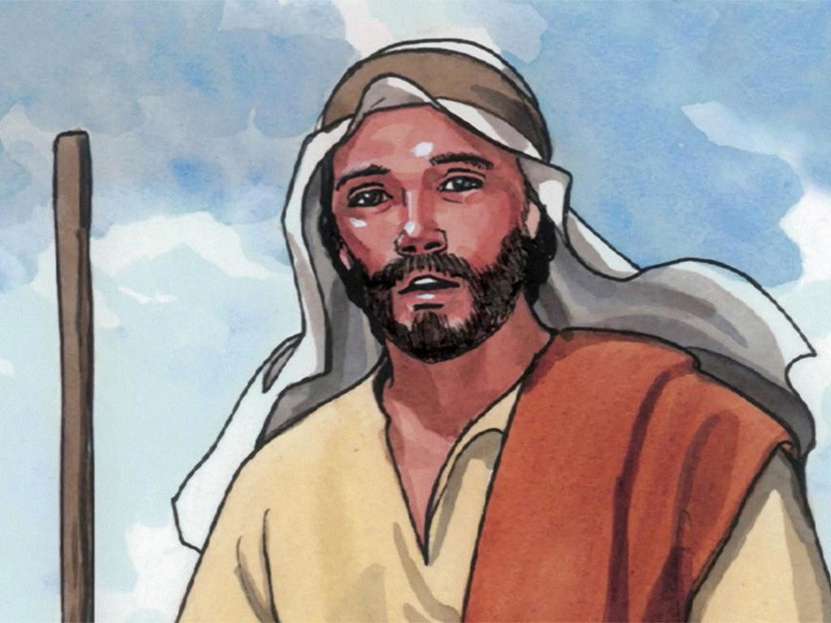
13
As bad as you are, you know how to give good things to your children. How much more, then, will the Father in heaven give the Holy Spirit to those who ask him!”

Slide 19
Leader: The Gospel of the Lord.
All: Praise to You,
Lord Jesus Christ.

Slide 20
GOSPEL MESSAGE

Slide 21
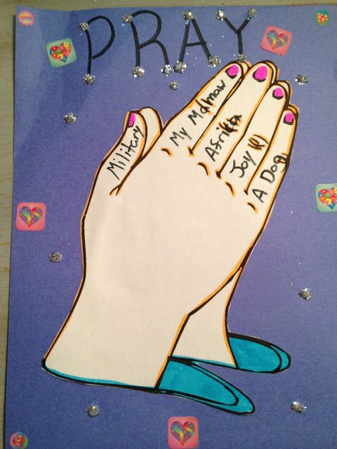
Activity:
PRAYER REMINDER POSTER
Materials:
Colored Paper / Construction Paper
Bond Paper
Markers
Crayons
Scissors
Stuff To Decorate (Glitter, Stickers, Foam Cut Outs, etc.)

Slide 22
1. Draw a 'Praying Hand' on the bond paper.
2. Have the kids write a thing to pray for on each finger. Give them 5 fields to choose from, one for each finger. (Ex. MFC Kids, A person in their life, A spiritual thing, A material thing they want, etc.).
3. Color the praying hands using markers, crayons, or colored pencils.
4. Cut out praying hands.
5. Glue hands to the piece of colored/construction paper.
6. Have the kids write "PRAY" at the top of their poster.
7. Let the kids go crazy with glitter, stickers, foam cut outs, and whatever else they have to put on their poster.

Slide 23
Closing Prayer
Our Father, Who art in heaven, Hallowed be Thy Name. Thy Kingdom come. Thy Will be done, on earth as it is in Heaven. Give us this day our daily bread. And forgive us our trespasses, as we forgive those who trespass against us. Lead us not into temptation, but deliver us from evil. Amen.

Slide 24
LIVE THE WORD KIDS
17h Sunday in Ordinary Time | Year C

