Slide 1
LIVE THE WORD KIDS
16th Sunday in Ordinary Time | Year C

Slide 2
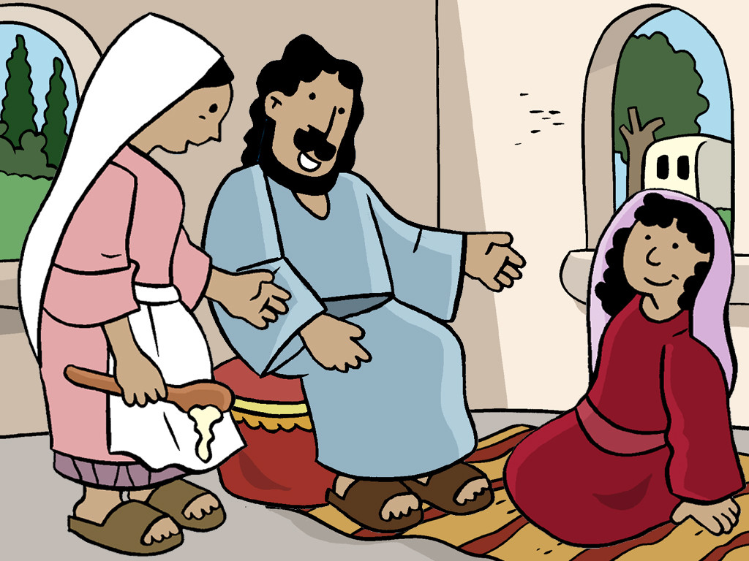
Jesus Visits Martha and Mary
Luke 10:38-42

Slide 3
Notes for the Facilitator ONLY:
Serving others is important, but we need to keep our relationship with Jesus the first priority. In this powerful event from Luke’s Gospel, Jesus explains this spiritual lesson to Martha and Mary.
What does God want from us? How much do we need to do in order to earn His favor? The truth is, there’s nothing we can or should do to please God. He loves us for who we are, and wants to spend time with us and hear from us. Children might not be as “busy” or overwhelmed as adults, but can still benefit from remembering that Jesus values our time and calls us to slow down and rest in Him.
Lesson Focus:
The kids should learn the importance of taking time to spend with Jesus and listening for His voice. This short and simple passage communicates powerful truths that children can carry with them long-term.

Slide 4
Jesus Visits Martha and Mary
Luke 10:38-42

Slide 5
Leader: A reading from
the Holy Gospel
according to Luke.
All: Glory to You, Oh Lord.

Slide 6
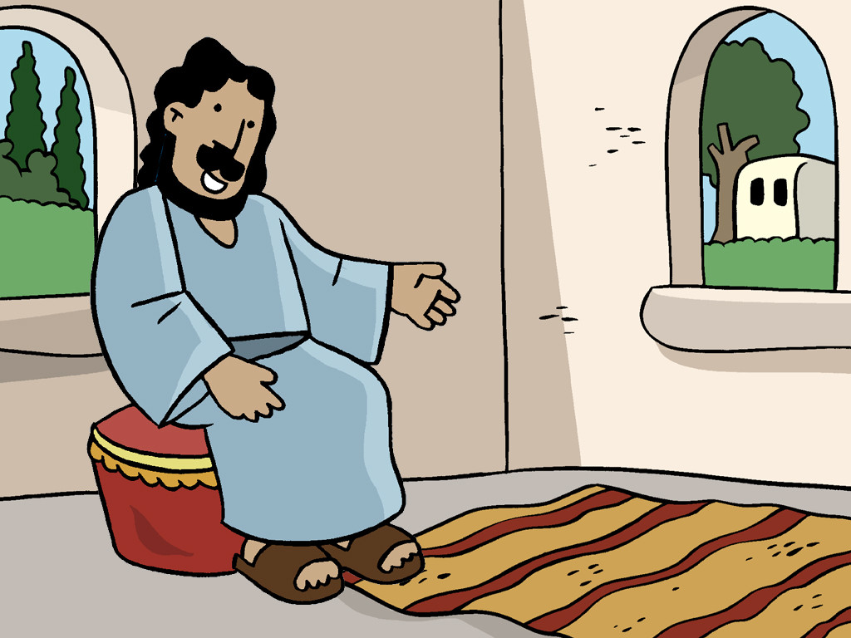
38
As Jesus and his disciples went on their way, he came to a village where a woman named Martha welcomed him in her home.

Slide 7
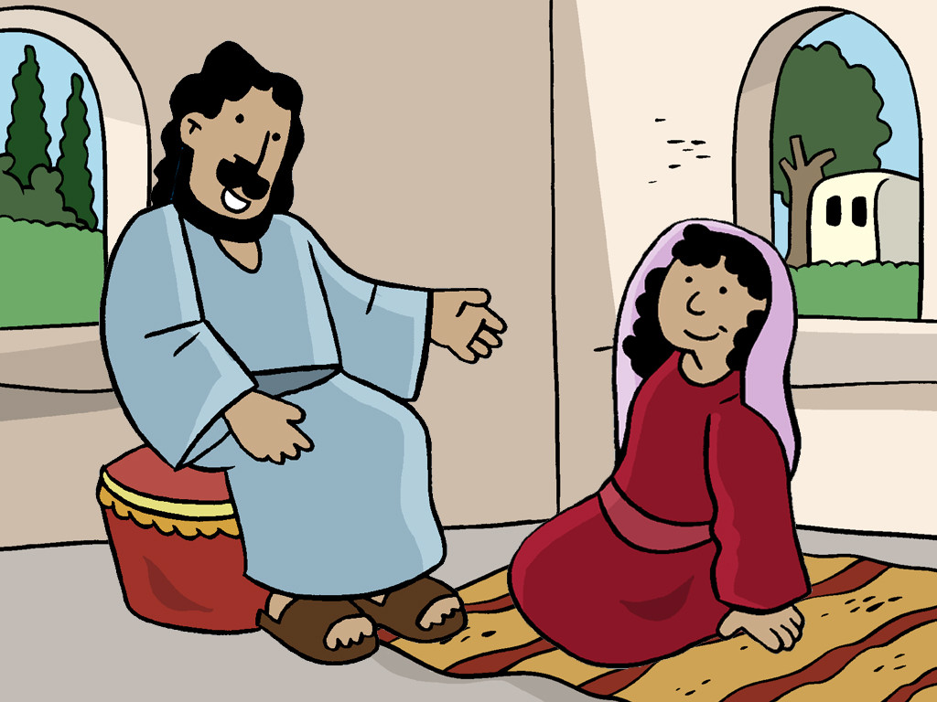
39
She had a sister named Mary, who sat down at the feet of the Lord and listened to his teaching.

Slide 8
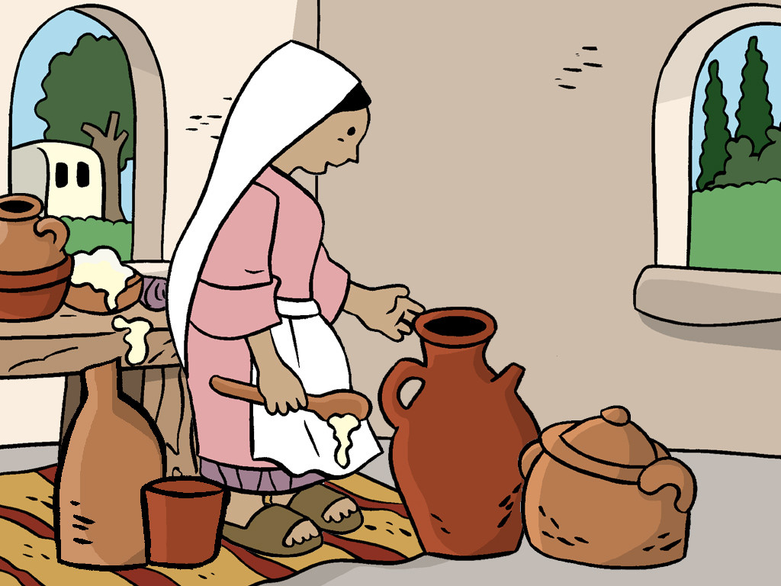
40
Martha was upset over all the work she had to do, so she came and said, “Lord, don't you care that my sister has left me to do all the work by myself? Tell her to come and help me!”

Slide 9
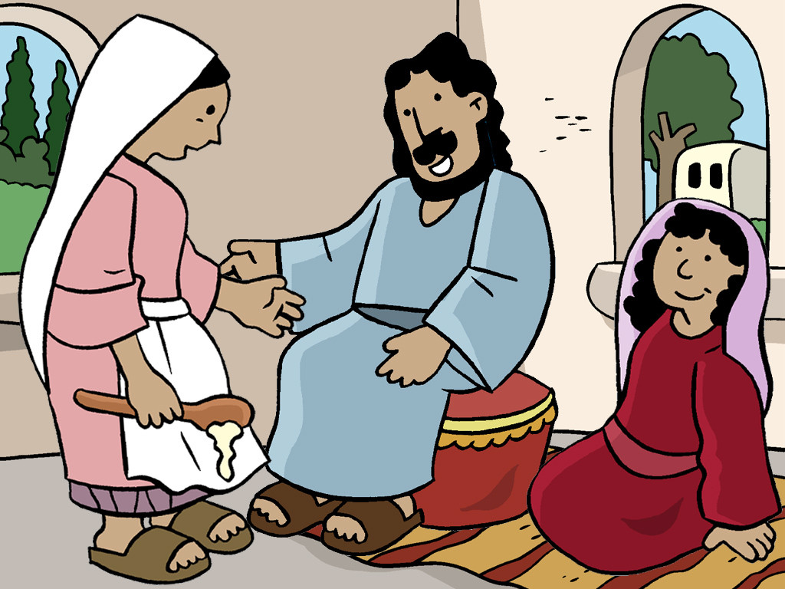
41
The Lord answered her, “Martha, Martha! You are worried and troubled over so many things,

Slide 10
42
but just one is needed. Mary has chosen the right thing, and it will not be taken away from her.”

Slide 11
Leader: The Gospel of the Lord.
All: Praise to You,
Lord Jesus Christ.

Slide 12
GOSPEL MESSAGE

Slide 13
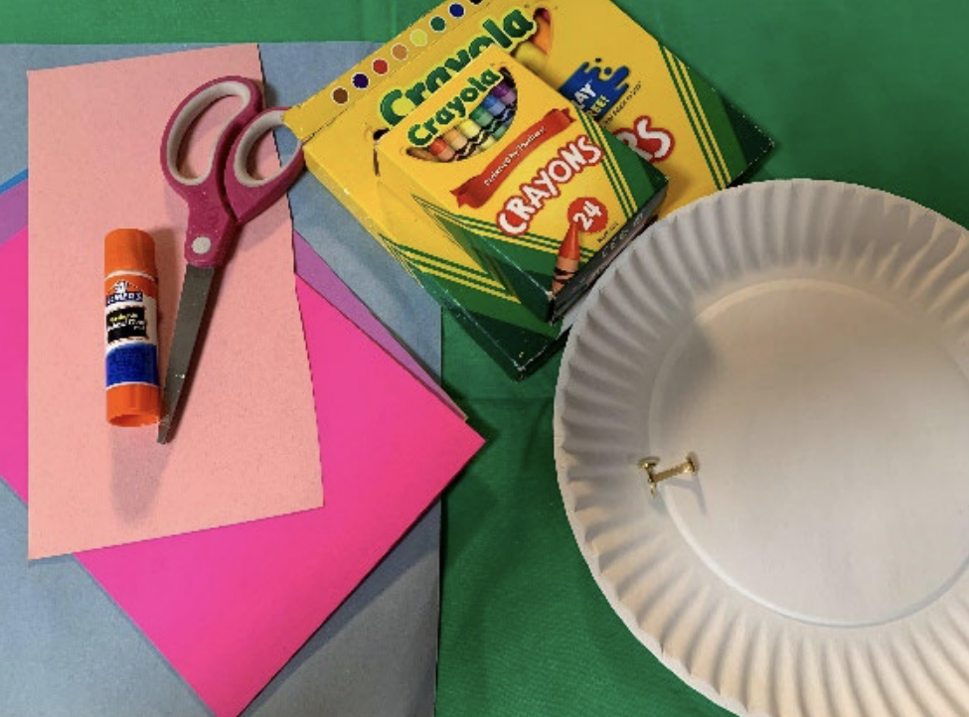
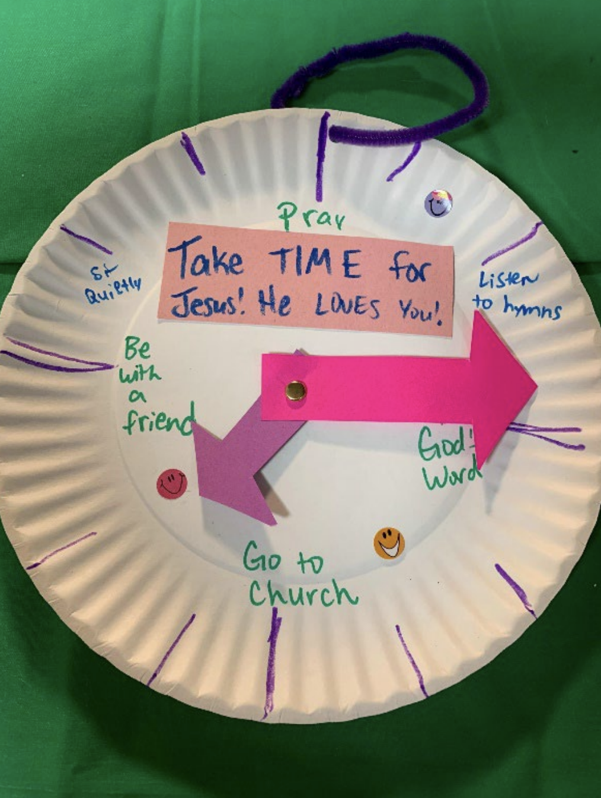
Activity:
Take Time for
Jesus Clock
Materials Needed:
Construction Paper or card paper
Paper plates
Brad fasteners
Glue or tape
String
Scissors
Decorative elements
Markers or crayons

Slide 14
1. Decorate the paper plate to resemble a clock, with markings around the
outside of it.
2. Add notes and captions to the clock, providing different ways to spend
time with Jesus and serve Him. Add larger verses or captions to the plate.
3. Cut paper pieces into arrow shapes to look like the hands of a clock.
4. Carefully attach the arrows onto the plate with a brad fastener so that
they can move like clock hands would do.
5. If desired, attach a hanger or magnet to display the clock.

Slide 15
Closing Prayer
Dear God,
Thank You for the words of the Bible. Thank You for making us part of your family. Help us to slow down and breathe - and rest in Your presence. Thank You for Your love
We love you Jesus. Thank you for always being there at our side.
In Jesus name, Amen!

Slide 16
LIVE THE WORD KIDS
16th Sunday in Ordinary Time | Year C

