Slide 1
LIVE THE WORD KIDS
15th Sunday in Ordinary Time | Year C

Slide 2
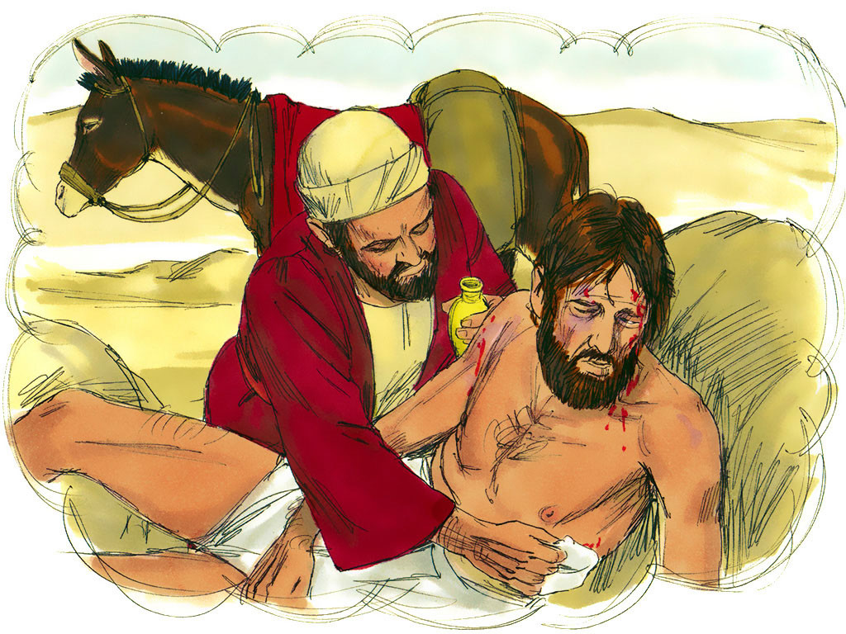
The Parable of the Good Samaritan
Luke 10:25-37

Slide 3
Notes for the Facilitator ONLY:
Main Lesson: Treat others the way you want to be treated.
In the parable the Good Samaritan, Jesus teaches Christians to love their neighbors as they would love themselves. The story is about a man who is robbed and left hurt on the side of the road. Both a priest and a Levite pass by the man, leaving him suffering and without help. A Samaritan passes by, and then stops and helps the man. Jesus urges Christians to show love by helping those in need. By telling this parable of a Samaritan who helped a stranger, Jesus made it plain that any person who is in need is our neighbor.
Important Key Points:
We should show mercy everyone.
We should love our neighbors.
We should reflect God’s love and mercy to others.

Slide 4
The Parable of the Good Samaritan
Luke 10:25-37

Slide 5
Leader: A reading from
the Holy Gospel
according to Luke.
All: Glory to You, Oh Lord.

Slide 6
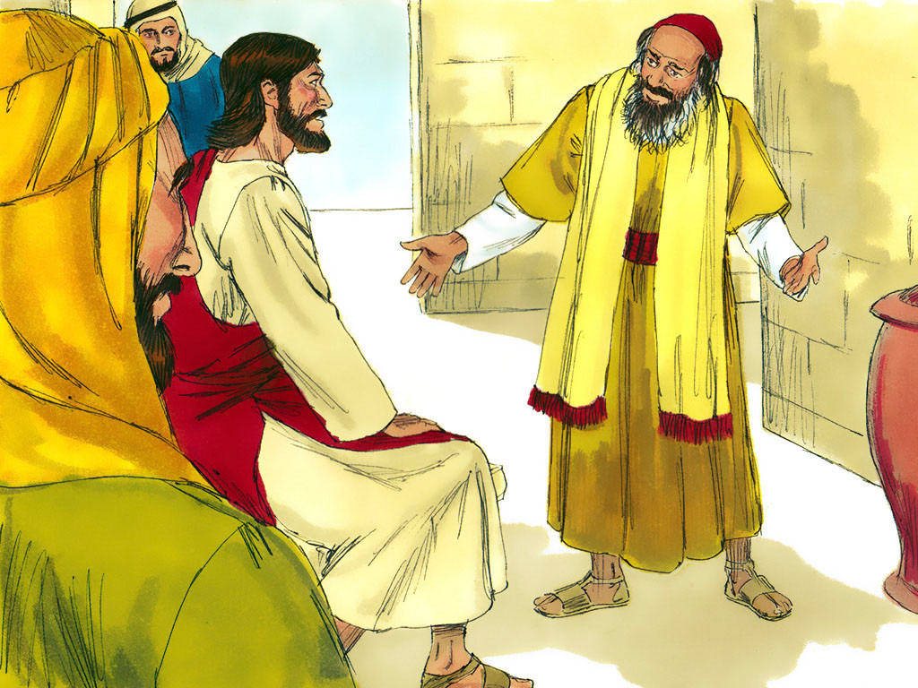
25
A teacher of the Law came up and tried to trap Jesus. “Teacher,” he asked, “what must I do to receive eternal life?”

Slide 7
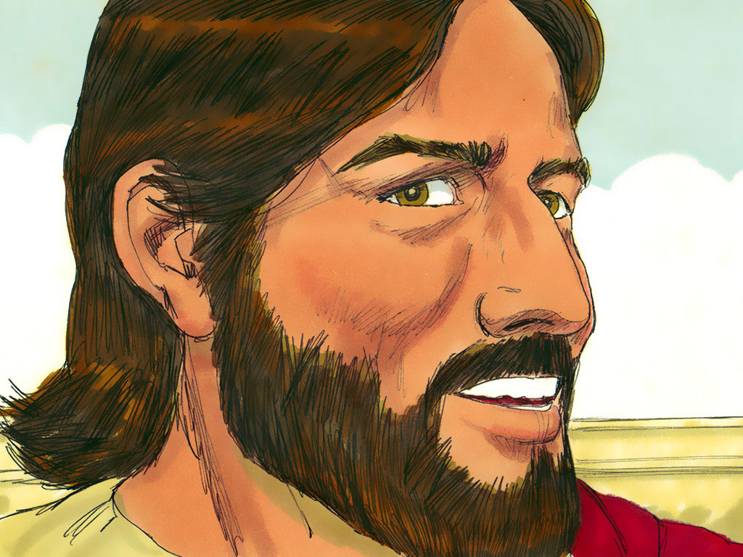
26
Jesus answered him, “What do the Scriptures say? How do you interpret them?”

Slide 8
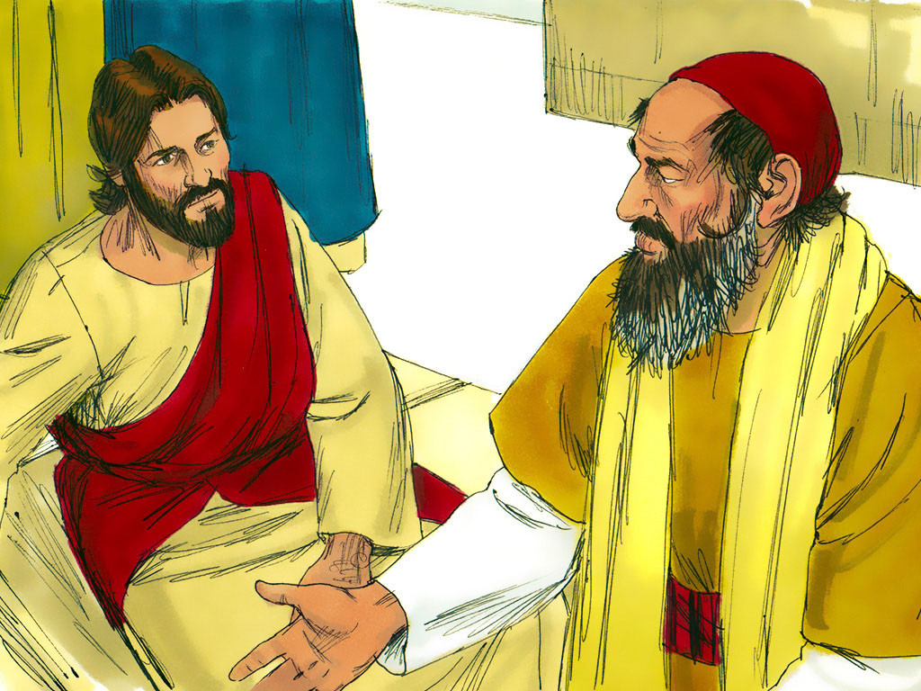
27
The man answered, “‘Love the Lord your God with all your heart, with all your soul, with all your strength, and with all your mind’; and ‘Love your neighbor as you love yourself.’”

Slide 9
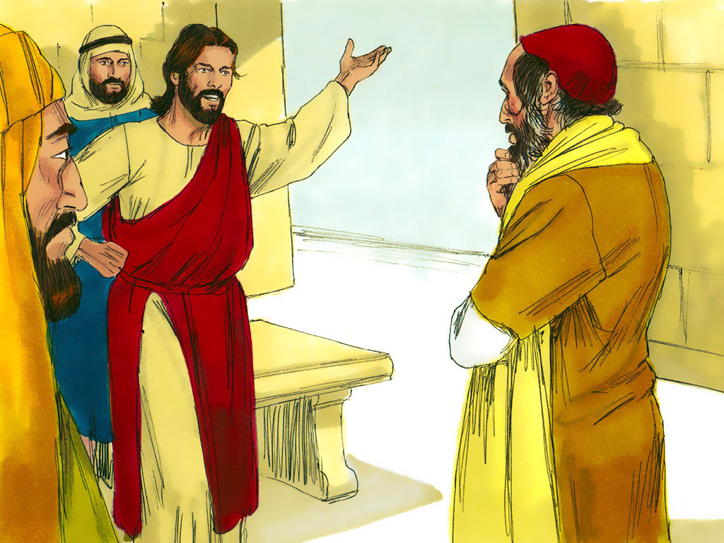
28
“You are right,” Jesus replied; “do this and you will live.”

Slide 10
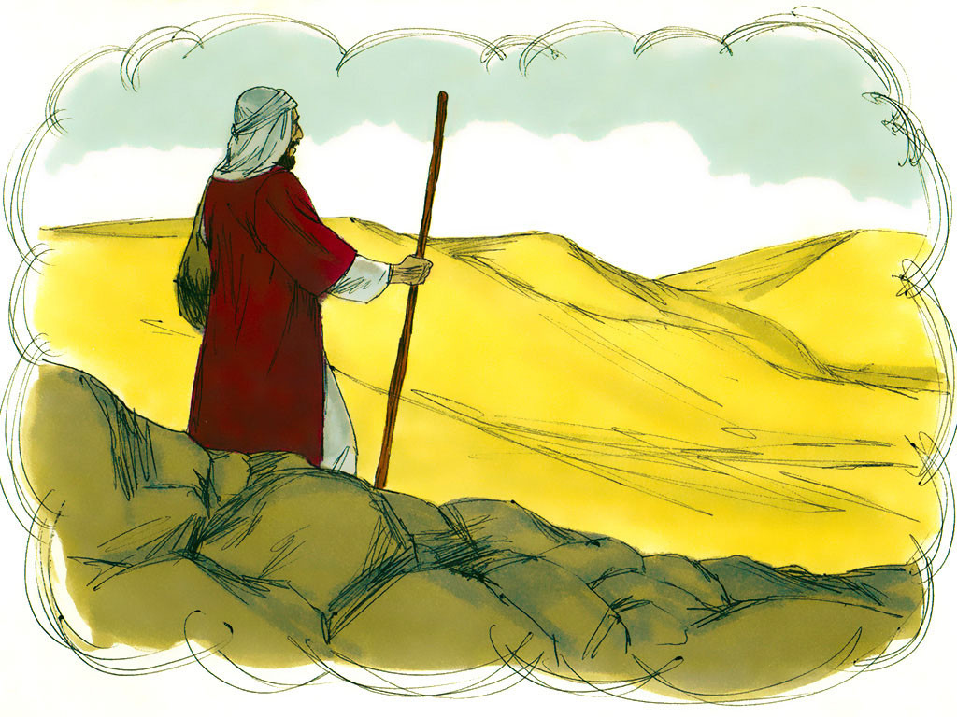
29
It so happened that a priest was going down that road; but when he saw the man, he walked on by on the other side.

Slide 11
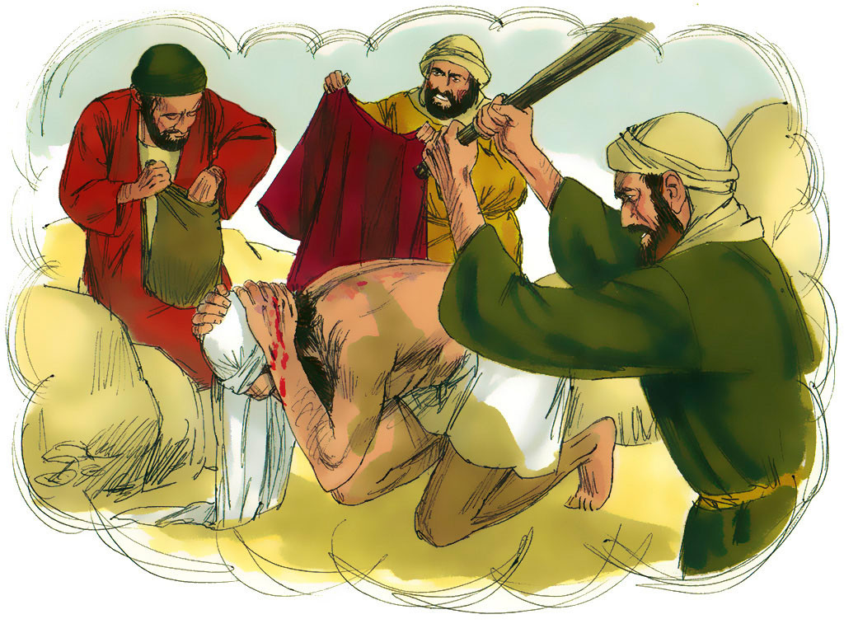
30
Jesus answered, “There was once a man who was going down from Jerusalem to Jericho when robbers attacked him, stripped him, and beat him up, leaving him half dead.

Slide 12
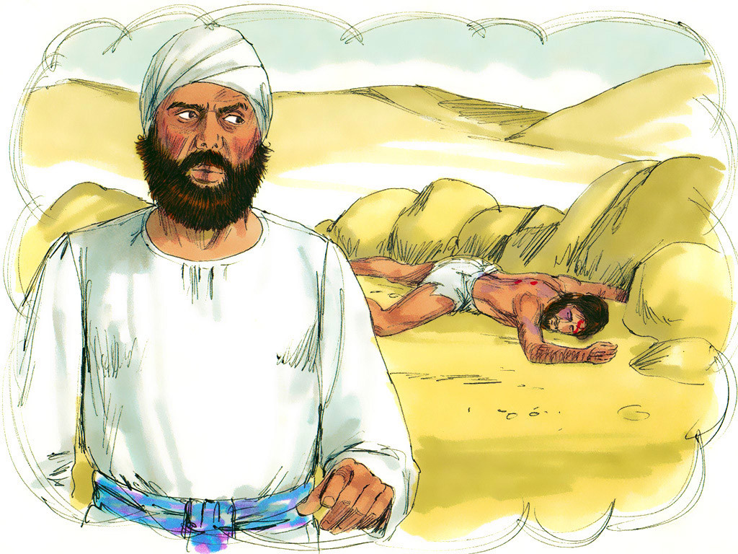
31
It so happened that a priest was going down that road; but when he saw the man, he walked on by on the other side.

Slide 13
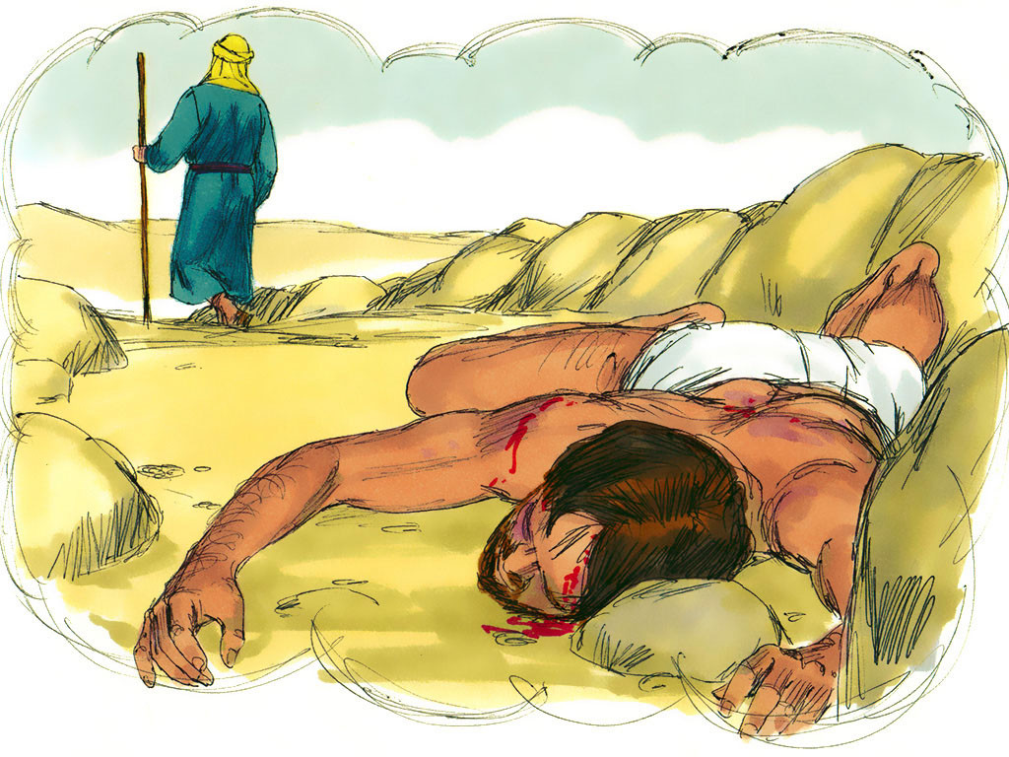
32
In the same way a Levite also came there, went over and looked at the man, and then walked on by on the other side.

Slide 14
33
But a Samaritan who was traveling that way came upon the man, and when he saw him, his heart was filled with pity.

Slide 15
34
He went over to him, poured oil and wine on his wounds and bandaged them; then he put the man on his own animal and took him to an inn, where he took care of him.

Slide 16
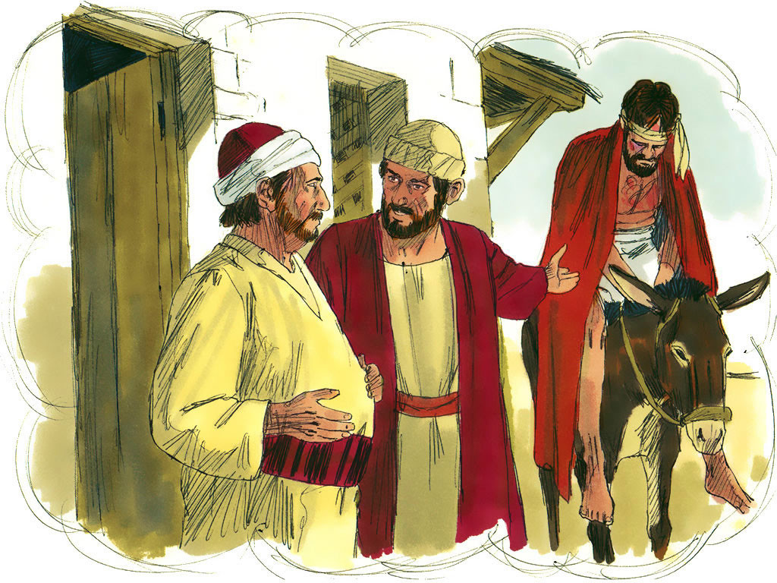
35
The next day he took out two silver coins and gave them to the innkeeper. ‘Take care of him,’ he told the innkeeper, ‘and when I come back this way, I will pay you whatever else you spend on him.’”

Slide 17
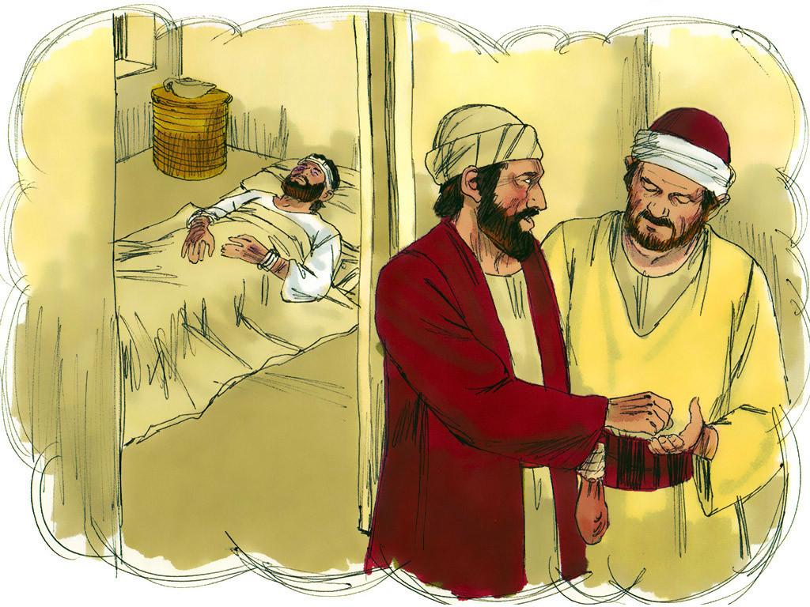
36
And Jesus concluded, “In your opinion, which one of these three acted like a neighbor toward the man attacked by the robbers?”

Slide 18
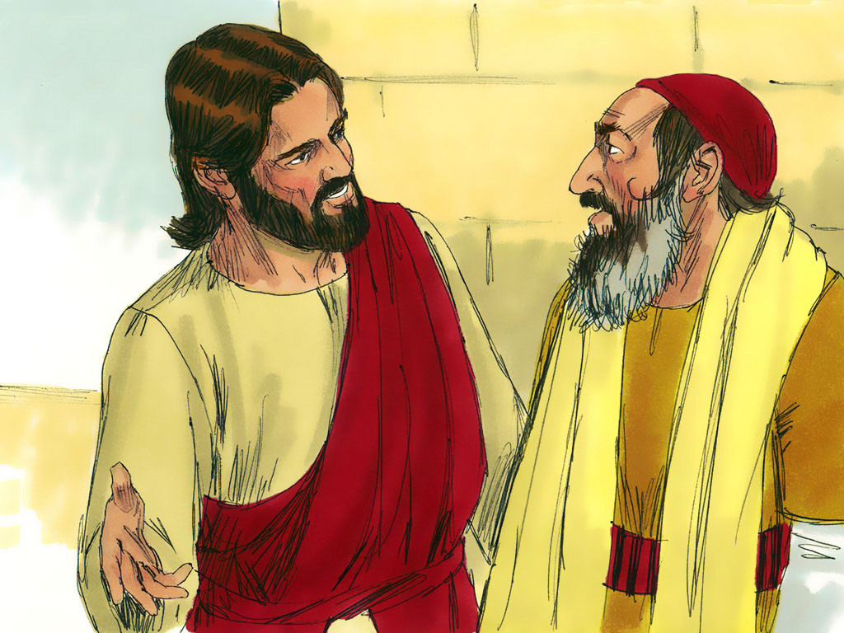
37
The teacher of the Law answered, “The one who was kind to him.”
Jesus replied, “You go, then, and do the same.”

Slide 19
Leader: The Gospel of the Lord.
All: Praise to You,
Lord Jesus Christ.

Slide 20
GOSPEL MESSAGE

Slide 21
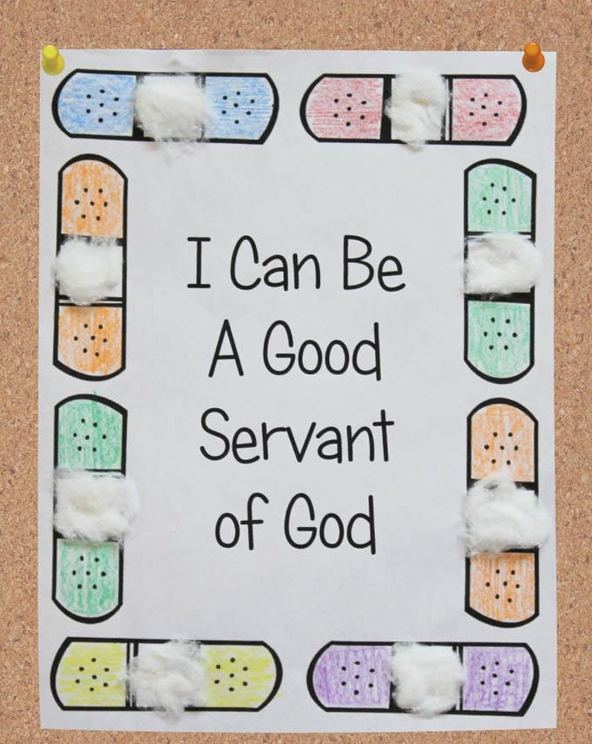
Activity:
Good Samaritan Bandaid
Materials Needed:
Bond Paper, Pencil, Pen, Marker, Crayons, Cotton Balls, and Glue

Slide 22
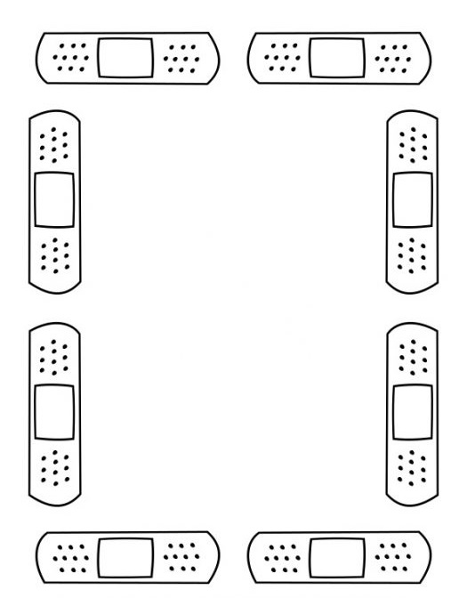
Procedure:
1. Draw an outline of band-aids (adhesive bandages) surrounding the paper.
2. Write your Gospel Message in the center
3. Color your 'bandaid border'
4. Tear a piece of the cotton ball and glue to the center of the bandaid image. (Repeat with the other bandaids)

Slide 23
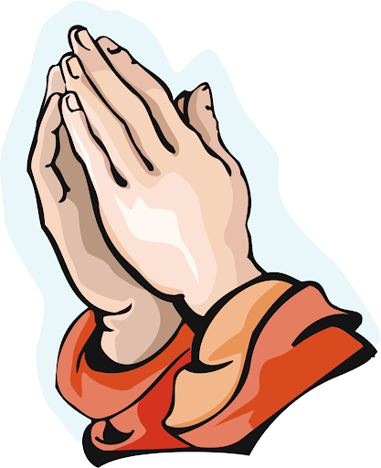
Closing Prayer
Dear God,
Thank you for caring for us and loving us no matter what. Help us to share your love and grace and to care for all of your people even those who are harder to love. Thank you for your love. We love you!
In Jesus name, Amen!

Slide 24
LIVE THE WORD KIDS
15th Sunday in Ordinary Time | Year C

