Slide 1
LIVE THE WORD KIDS
14th Sunday in Ordinary Time | Year C

Slide 2
GOSPEL REFLECTION
In this Sunday’s Gospel, Jesus sends out 72 of his disciples and tells them what they need to take with them on their journey. What did Jesus tell them they should take with them on their journey? (no money, no sack, no sandals; nothing). Jesus is telling his disciples and all of us that the only thing we really need is God’s grace. Although the world tells us that we need many things in order to be happy, Jesus is telling us that all we need for the journey is his grace and the knowledge that we are doing his work.
This week’s Gospel reminded us to trust in the Lord’s providence and protection fully. Let us not cling to worldly safety nets but, like the apostles, set out and proclaim the Gospel with total faith that the Lord will provide.

Slide 3
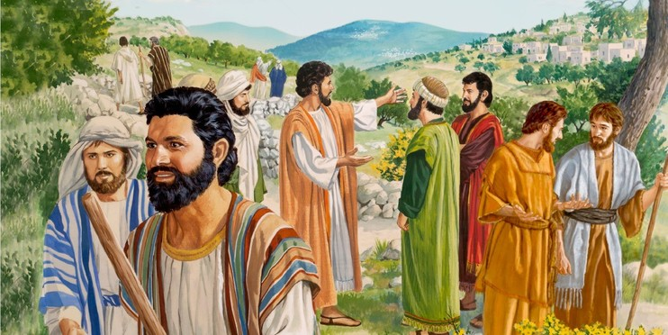
Jesus Sends Out the Seventy-Two
Luke 10:1-12, 17-20

Slide 4
Leader: A reading from
the Holy Gospel
according to Luke.
All: Glory to You, Oh Lord.

Slide 5
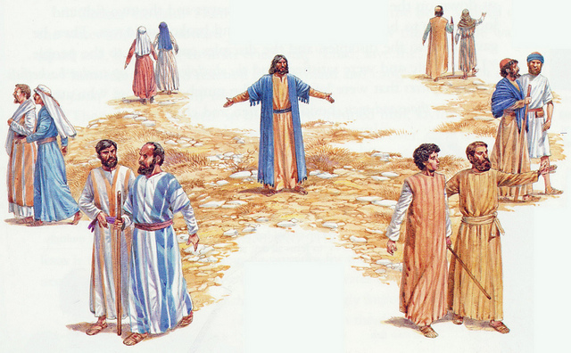
1
After this the Lord appointed seventy-two others whom he sent ahead of him in pairs to every town and place he intended to visit.

Slide 6
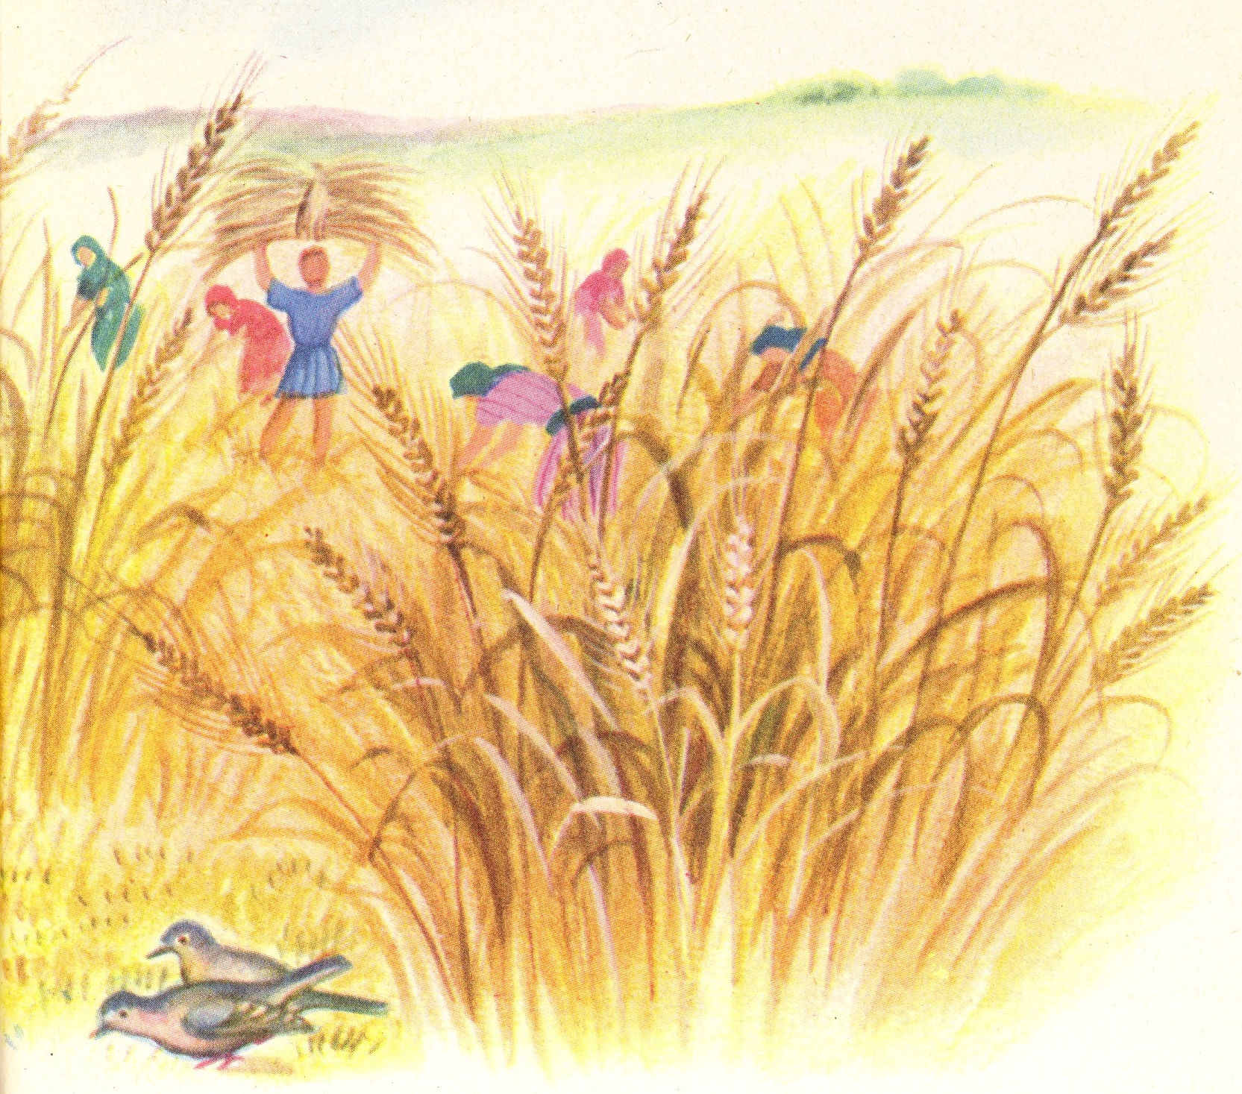
2
He said to them, “The harvest is abundant but the laborers are few; so ask the master of the harvest to send out laborers for his harvest.

Slide 7
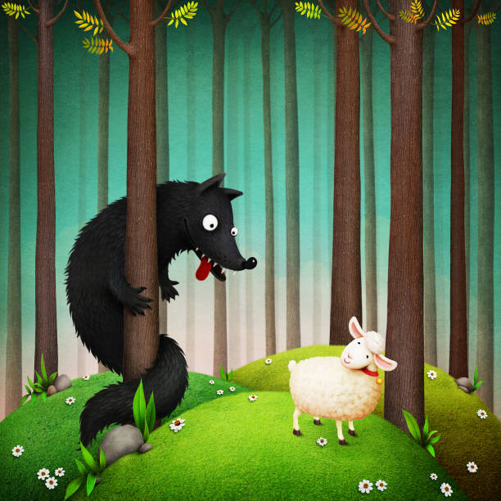
3
Go on your way; behold, I am sending you like lambs among wolves.

Slide 8
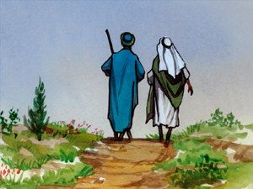
4
Carry no money bag, no sack, no sandals; and greet no one along the way.

Slide 9
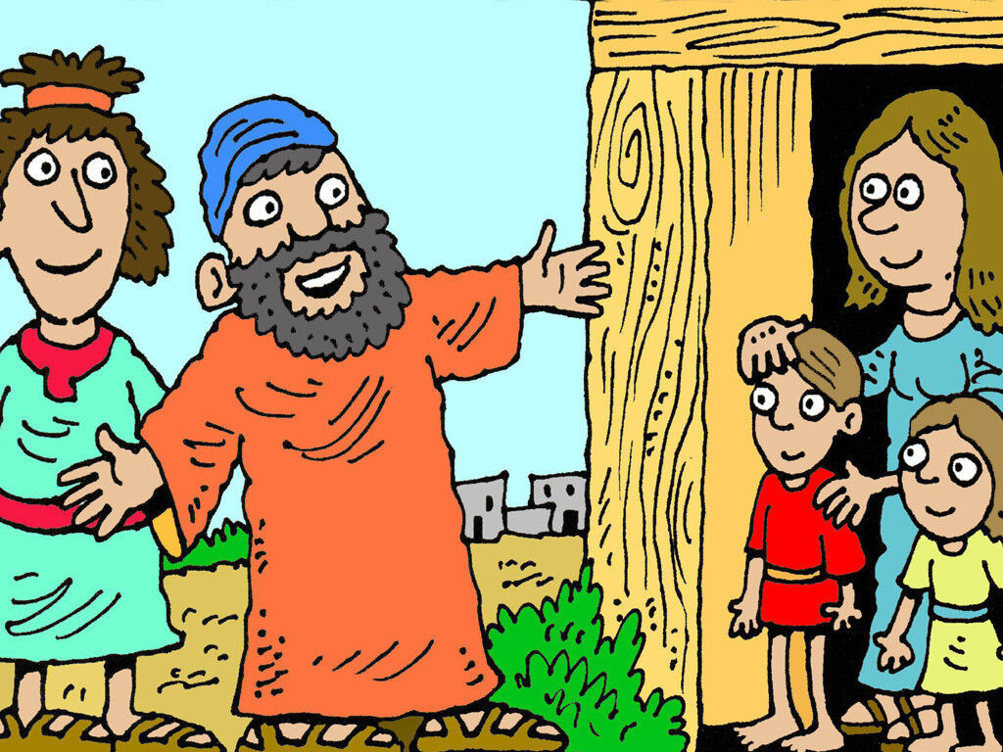
5
Into whatever house you enter, first say,
‘Peace to this household.

Slide 10
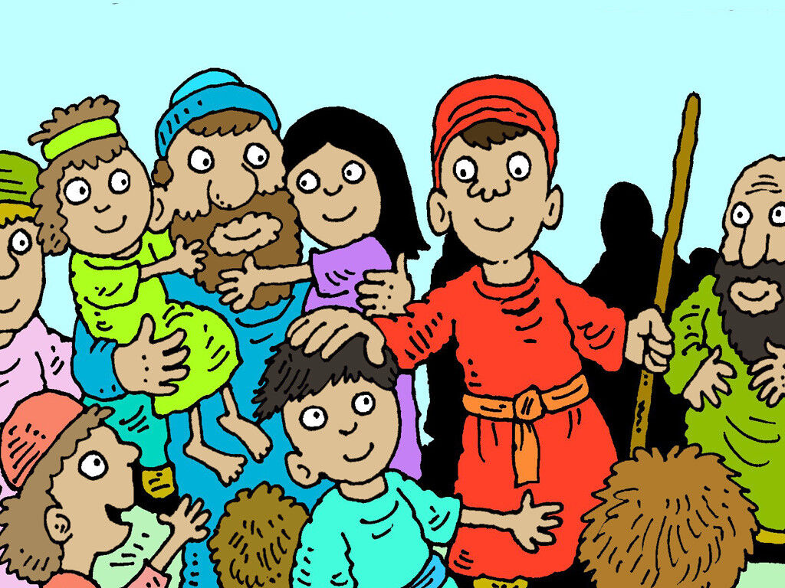
6
If a peaceful person lives there, your peace will rest on him; but if not, it will return to you.

Slide 11
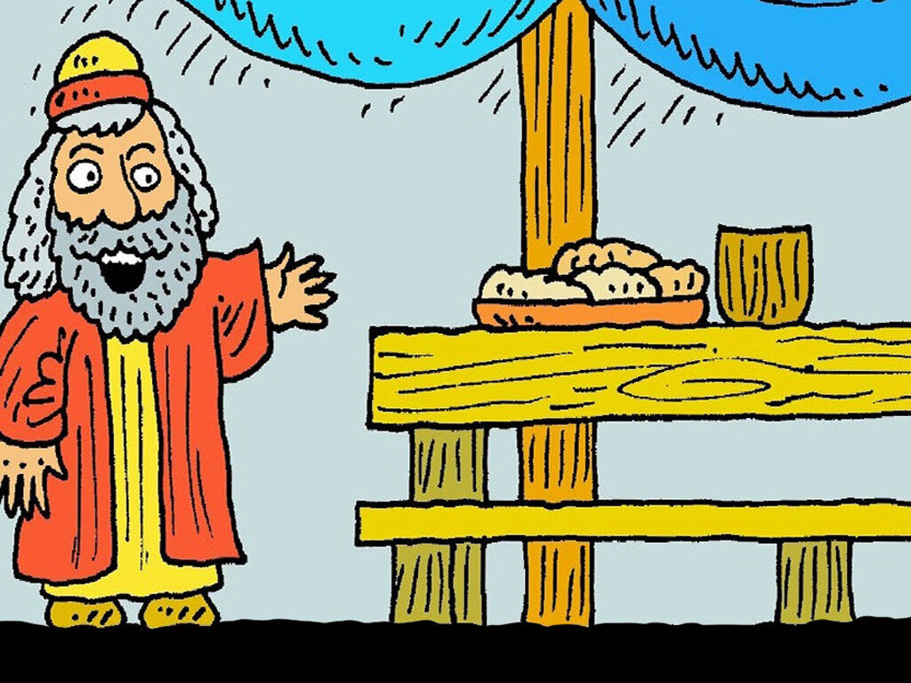
7
Stay in the same house and eat and drink what is offered to you, for the laborer deserves his payment. Do not move about from one house to another.

Slide 12
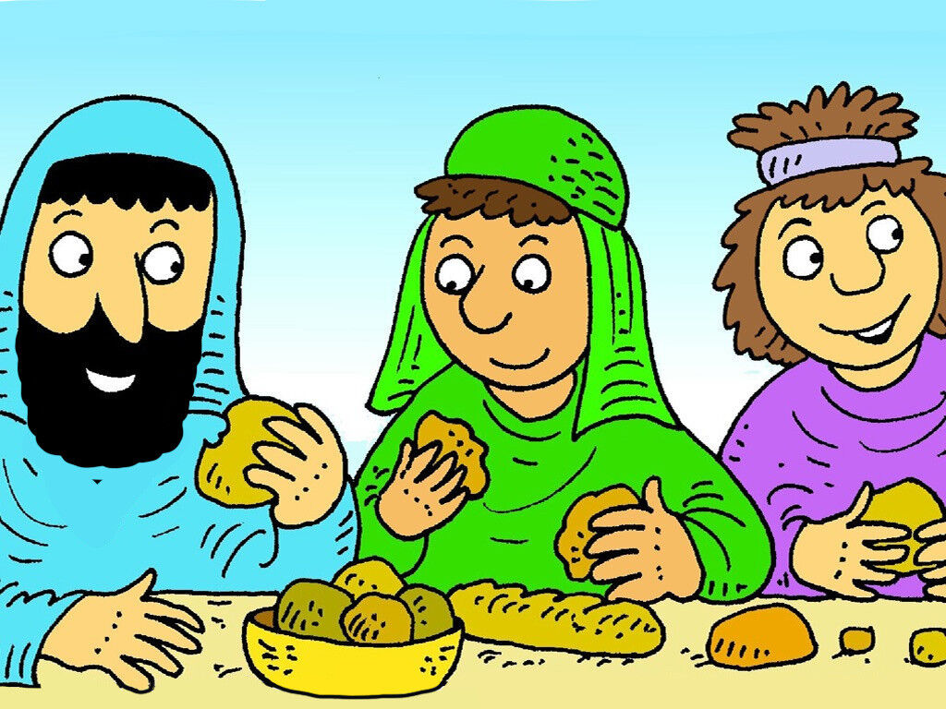
8
Whatever town you enter and they welcome you, eat what is set before you,

Slide 13
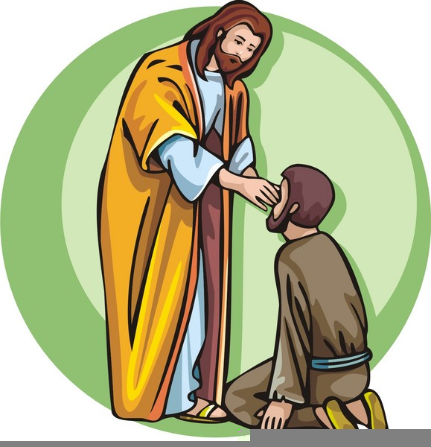
9
cure the sick in it and say to them, ‘The kingdom of God is at hand for you.’

Slide 14
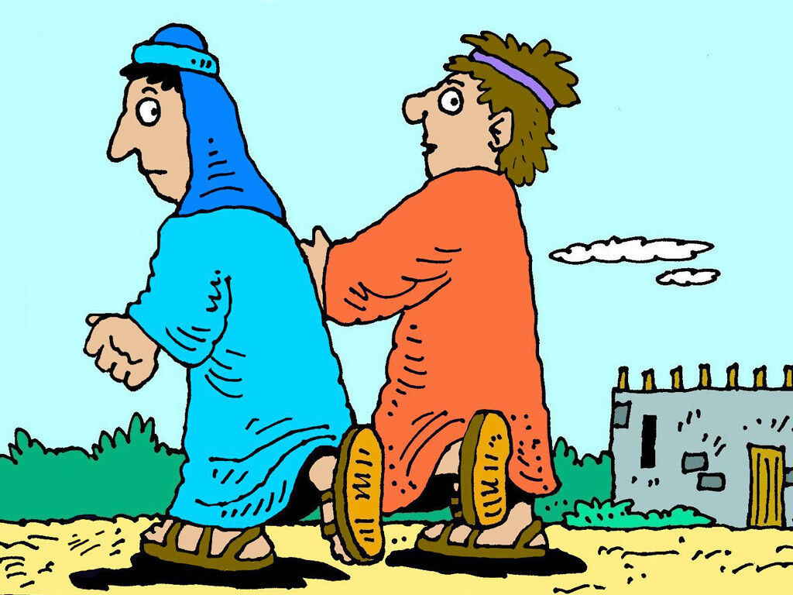
10
Whatever town you enter and they do not receive you, go out into the streets and say,

Slide 15
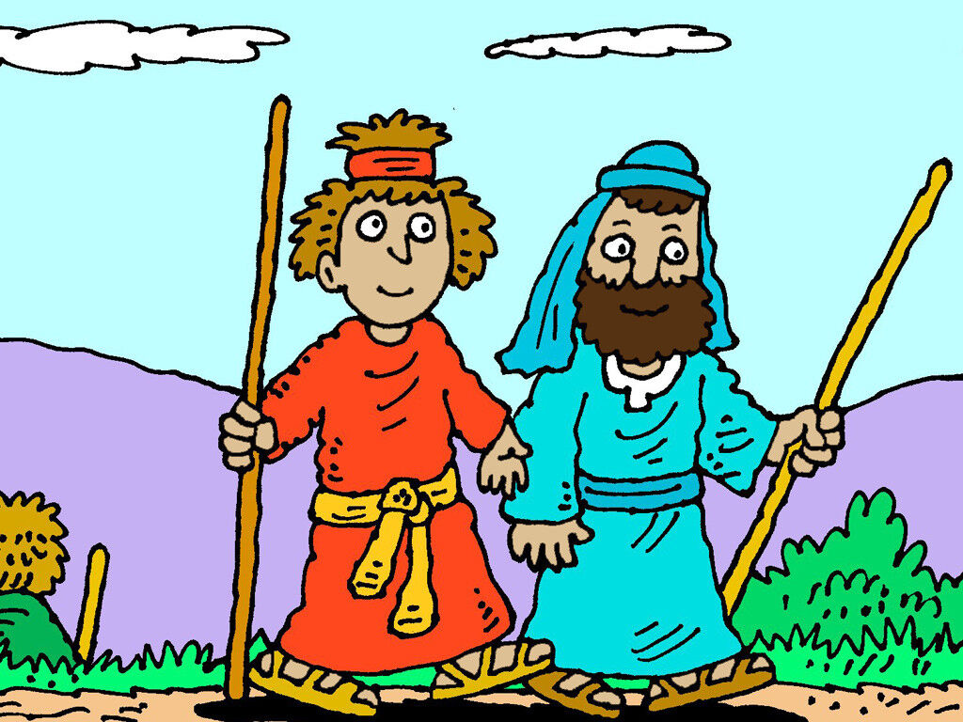
11
‘The dust of your town that clings to our feet, even that we shake off against you.’ Yet know this: the kingdom of God is at hand.

Slide 16
12
I tell you, it will be more tolerable for Sodom on that day than for that town.

Slide 17
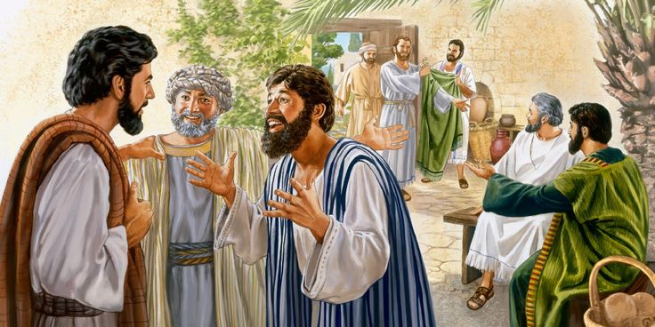
17
The seventy-two returned rejoicing, and said,
“Lord, even the demons are subject to us because of your name.”

Slide 18
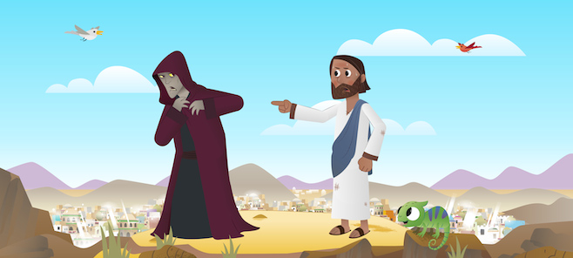
18
Jesus said,
“I have observed Satan fall like lightning from the sky.

Slide 19
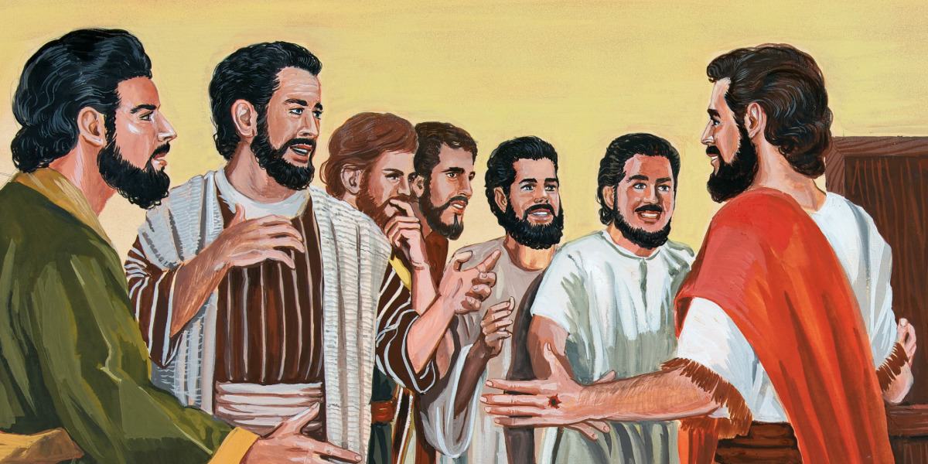
19
Behold, I have given you the power ‘to tread upon serpents’ and scorpions and upon the full force of the enemy and nothing will harm you.

Slide 20
20
Nevertheless, do not rejoice because the spirits are subject to you, but rejoice because your names are written in heaven.”

Slide 21
Leader: The Gospel of the Lord.
All: Praise to You,
Lord Jesus Christ.

Slide 22
GOSPEL MESSAGE

Slide 23
Activity:
Following Jesus Craft
Colored Paper / Bond Paper
Scissor
Coloring Materials
Glue
Marker/Pen

Slide 24
1. Using your bond paper, cut out the world, hands and heart.
2. Glue hands onto side of world.
3. Fold heart and glue down centre. Fix into middle of world.
4. Write this phrase on the center of the heart:
“Jesus loves me and I will share Him to the world.”

Slide 25
Closing Prayer
Dear God, Thank you for making us part of your family.Thank you for our citizenship in Heaven. Help us understand how special that is
Please give us courage to share the good news to those around us. Thank you, Lord, for everything.
In Jesus' name we pray. Amen.
Amen.

Slide 26
LIVE THE WORD KIDS
14th Sunday in Ordinary Time | Year C

