Slide 1
LIVE THE WORD KIDS
1st Sunday in Ordinary Time | Cycle C

Slide 2
GOSPEL REFLECTION
Today we celebrate the feast of the Baptism of the Lord. In today's Gospel, as in the other Gospel accounts of Jesus' baptism, we hear John the Baptist address the confusion of the people who thought that John might be the Messiah. In response, John contrasts the baptism that he performs with the Baptism that Jesus will inaugurate. John the Baptist says that he has baptized with water, but that someone will come and baptize with the Holy Spirit. The type of baptism that John performed was not yet a Christian Baptism; it was a preparation for Christian Baptism through which sins are forgiven and the gift of the Holy Spirit is received.
The baptism of Jesus is considered a manifestation of God in Jesus, another “epiphany.” On this, the last day of the Christmas season, our Gospel reveals to us Jesus' relation to God: the son of Mary and Joseph is also God's own Son. In Luke's Gospel, all three members of the Trinity are manifested here: God the Father in the voice, the Holy Spirit descending, and Jesus the Son. At the beginning of his Gospel, Luke is communicating to us important information about the identity of Jesus. In the verses that follow, Luke lists the genealogy of Jesus, tracing Jesus' ancestry back to the first person, Adam, who is also identified as the son of God. We, the children of Adam and Eve, are again made children of God through Baptism.
https://www.loyolapress.com/catholic-resources/liturgical-year/sunday-connection/baptism-of-the-lord-cycle-c-sunday-connection/

Slide 3
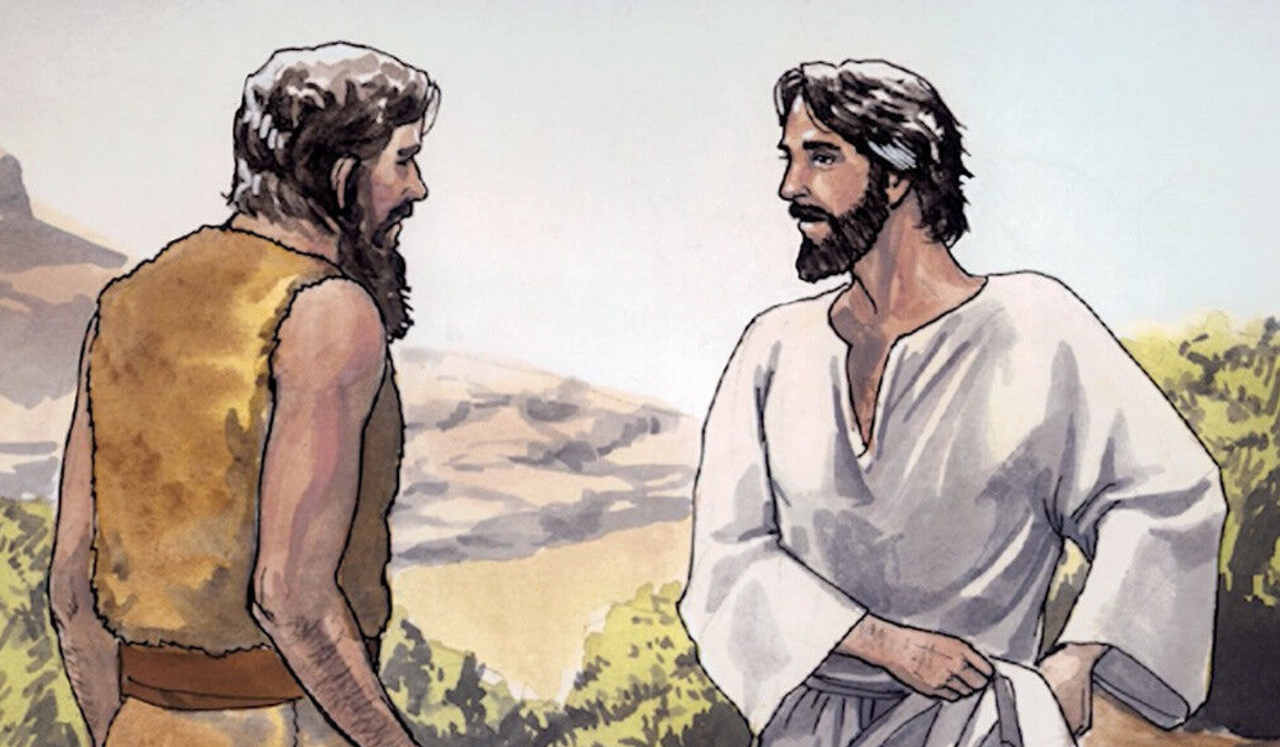
Baptism of Jesus
Luke 3: 15-16 21-22

Slide 4
Leader: A reading from
the Holy Gospel
according to Luke.
All: Glory to You, Oh Lord.

Slide 5
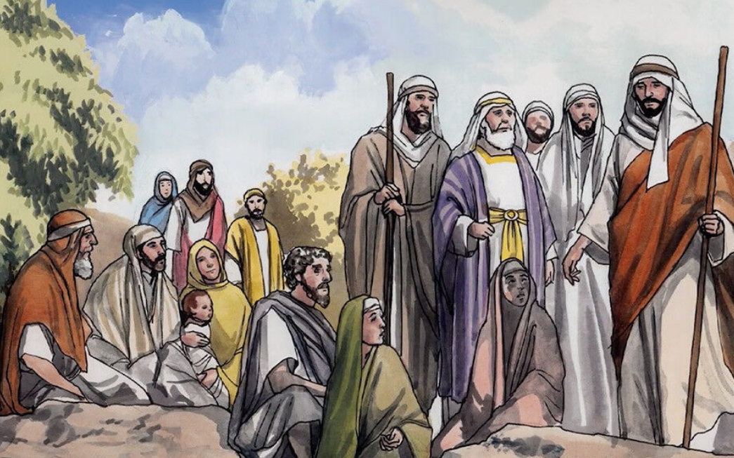
15
The people were waiting expectantly and were all wondering in their hearts if John might possibly be the Messiah
Notes:
The expectation was that the time had arrived for the messiah to come and redeem Israel. This event was awaited expectantly

Slide 6
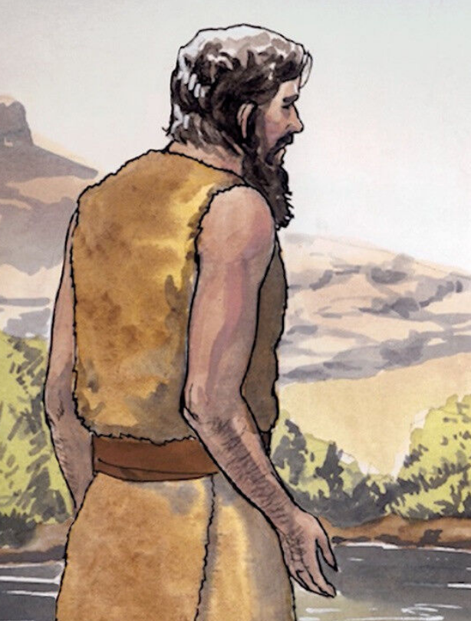
16
John answered them all, “I baptize you with water. But one who is more powerful than I will come, the straps of whose sandals I am not worthy to untie. He will baptize you with the Holy Spirit and fire.

Slide 7
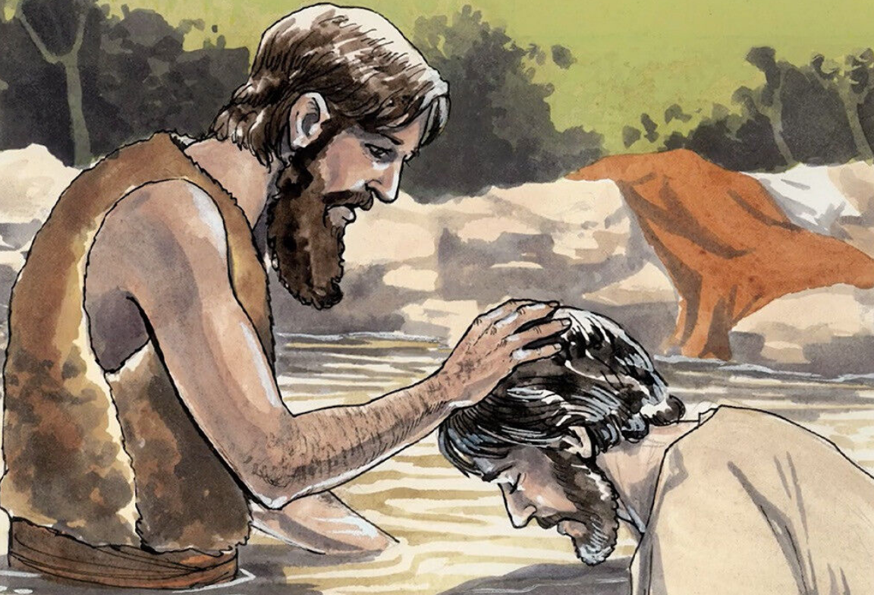
21
When all the people were being baptized, Jesus was baptized too. And as he was praying, heaven was opened
Notes:
This concludes the Baptist’s apostolate by showing the fulfillment of the mission confided to John before his birth “to prepare a perfect people for the Lord (Luke 1:17). Men have been led to their final moment of world salvation through the baptism administered by John; they are ready to become the messianic, eschatological people of God (Acts 15:14)
The imagery of heavens opening frequently implies a vision of heavenly secrets in apocalyptic writing (Ezekiel 1:1). Jesus baptism, therefore, answers that prayer and envisages a whole community advancing to the new and most joyful promised land. Jesus’ baptism, however, remains more of a promise to be fulfilled at Pentecost when the heavens will open again and the Spirit will descend upon the community (Acts 2).

Slide 8
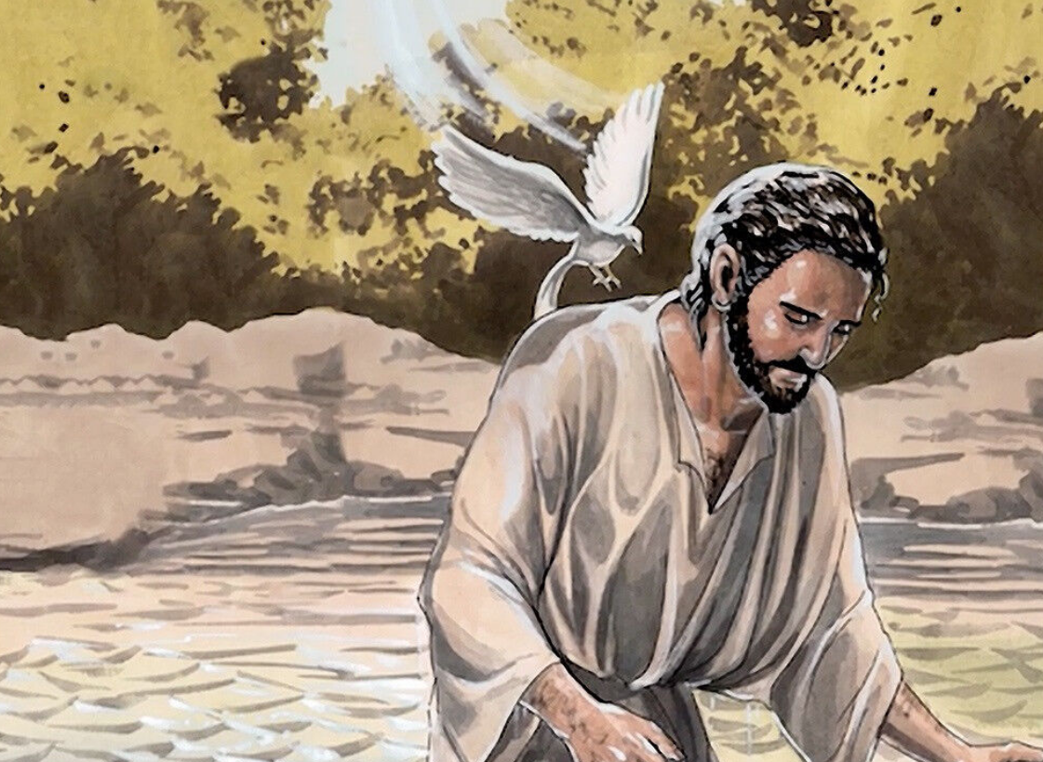
22
and the Holy Spirit descended on him in bodily form like a dove. And a voice came from heaven: “You are my Son, whom I love; with you I am well pleased.”

Slide 9
Leader: The Gospel of the Lord.
All: Praise to You,
Lord Jesus Christ.

Slide 10
GOSPEL MESSAGE

Slide 11
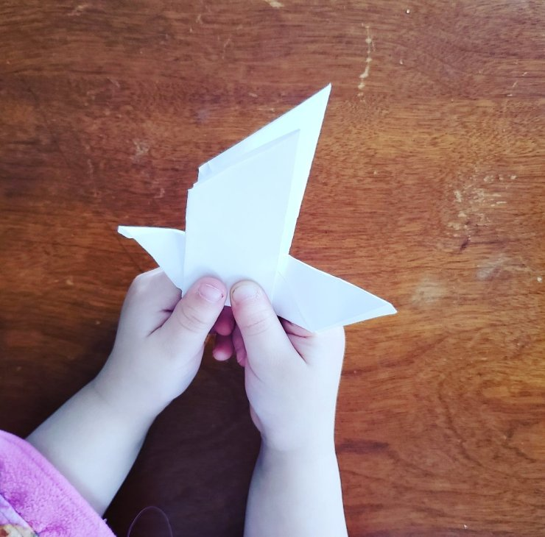
Activity:
DOVE ORIGAMI
Materials: 1. Paper
Notes:
The dove is the symbol of the Holy Spirit. When Christ was baptized by John the Baptist, a dove descended on him, according Matthew 3:16 and Mark 1:10. It also symbolizes God's grace. Let this dove be a reminder that God also sent the Holy Spirit to be with us each ands everyday.

Slide 12
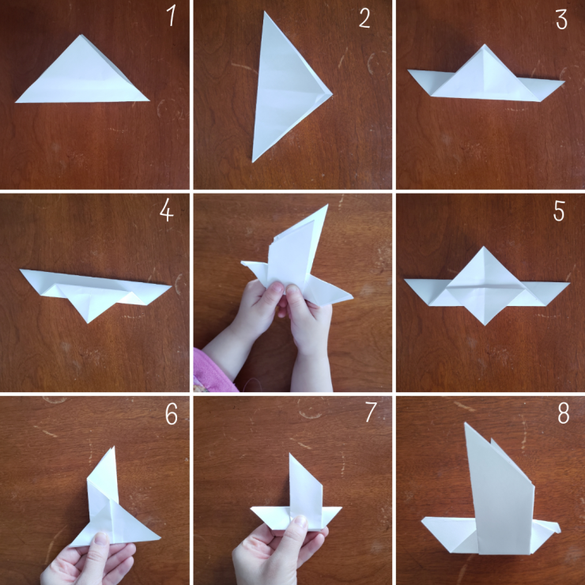
Instruction:
Fold paper upward diagonally, then open back up.
Fold diagonally in the other direction.
Fold triangle in half so that the point overlaps the longest side.
Fold the point back over so it, again over laps the opposite side.
Open the triangle to make a diamond.
Fold figure in half.
Fold wings down and flip shape over.
Fold down beak.

Slide 13
Closing Prayer
Dear God,
Thank you for sending us your son Jesus to save us and for sending us the Holy Spirit to help and us guide us every day.
In Jesus’ name, we pray. Amen.

Slide 14
LIVE THE WORD KIDS
1st Sunday in Ordinary Time | Cycle C

