Slide 1
LIVE THE WORD KIDS
4th Sunday in Ordinary Time | Cycle C

Slide 2
GOSPEL REFLECTION
On this Fourth Sunday in Ordinary Time we are invited to refl ect on the courage of Jesus in the fulfi llment of his apostolic ministry. In his native town of Nazareth, his audience became unfriendly. But instead of courting popularity and praises, Jesus remained faithful to his mission throughout his life. We, too, should be faithful to God’s call, even as we are constantly challenged by an environment and a culture that seeks the spectacular and exalts pleasure in all its forms.
Source: Sambuhay

Slide 3
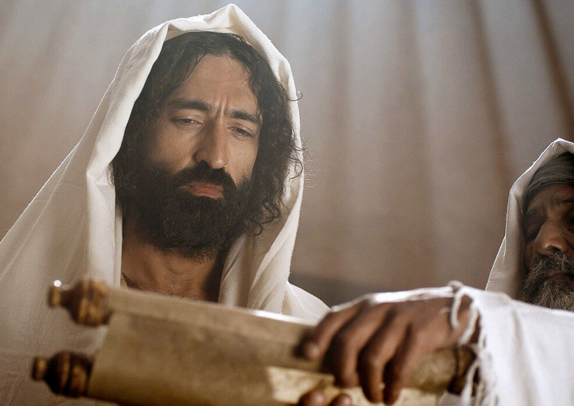
Jesus’ Public Ministry
Lk 4:21-30

Slide 4
Leader: A reading from
the Holy Gospel
according to Luke.
All: Glory to You, Oh Lord.

Slide 5
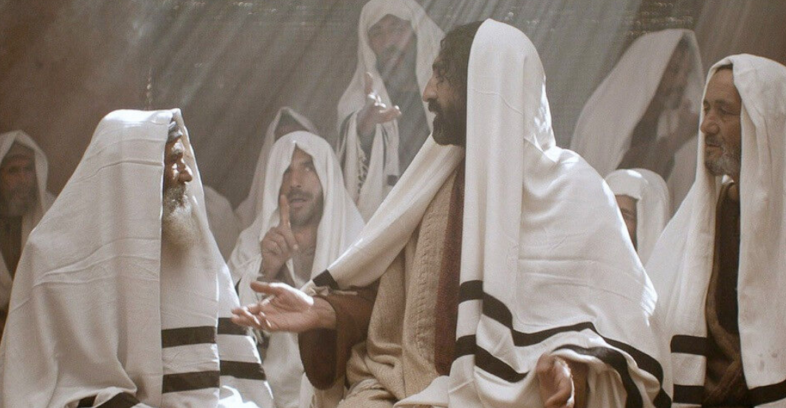
21
He said to them, “Today this scripture passage is fulfilled in your hearing.”
Notes:
Last week’s Gospel reading was from the beginning of Jesus’ public ministry when He went to His home town, Nazareth, and in the synagogue read from the scroll of Isaiah. Today’s reading continues this event in His life.
Luke’s theme is fulfillment of promise. The waiting is over; the Messiah has arrived.

Slide 6
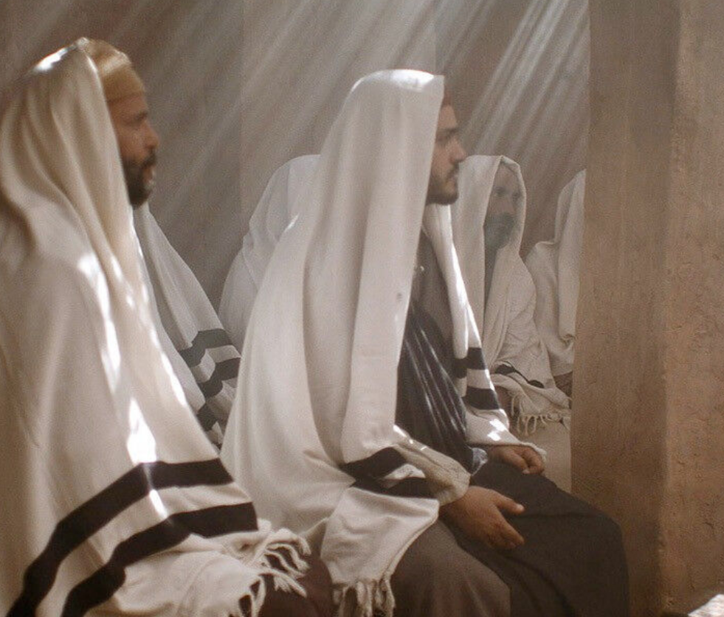
22
And all spoke highly of him and were amazed at the gracious words that came from his mouth. They also asked, “Isn’t this the son of Joseph?”
Notes:
Luke has recorded the virginal conception of Jesus (Luke 1:26-38), but Mary is the wife of Joseph and the normal reaction attributes Jesus to Joseph. The hearers, probably relatives, know Jesus as the son of Joseph and have watched Him grow up and think of Him only as human.

Slide 7
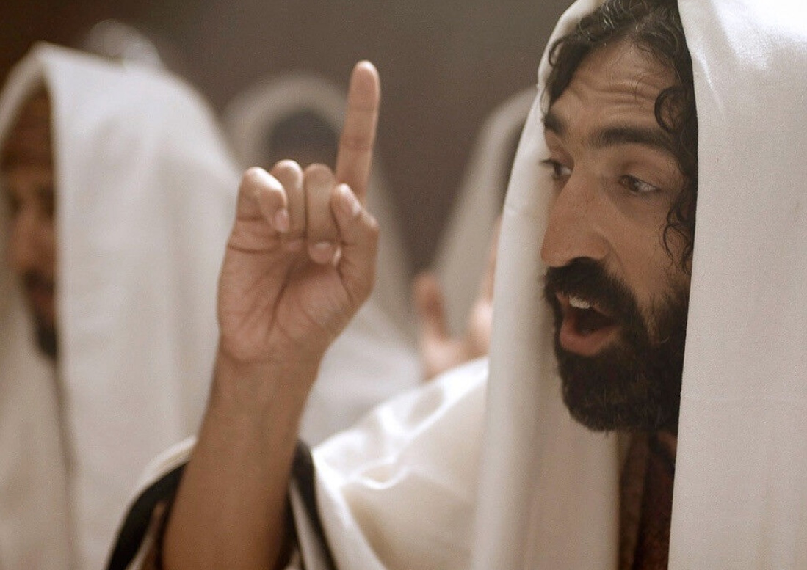
23
He said to them, “Surely you will quote me this proverb, ‘Physician, cure yourself,’ and say, ‘Do here in your native place the things that we heard were done in Capernaum.’”

Slide 8
24
And he said, “Amen, I say to you, no prophet is accepted in his own native place.

Slide 9
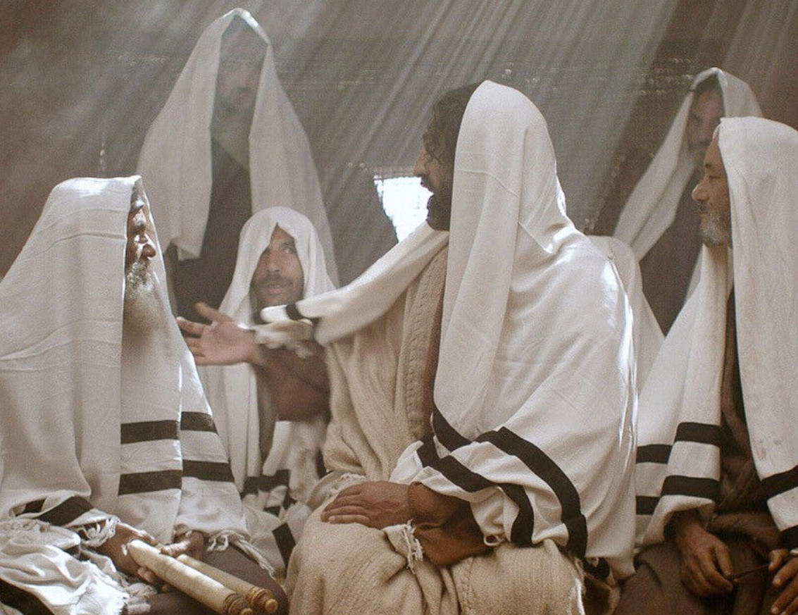
25
Indeed, I tell you, there were many widows in Israel in the days of Elijah when the sky was closed for three and a half years and a severe famine spread over the entire land.
Notes:
This is the beginning of Jesus’ public ministry. Just prior to this He was baptized (Luke 3:21-22) and was tempted in the desert (Luke 4:1-13). The Holy Spirit descended on Him at His baptism (Luke 3:22) and He was full of and led by the Holy Spirit when He went into the desert (Luke 4:1). His encounter with the devil has not diminished the power of the Holy Spirit. Jesus was a teacher. He had the authority to address people about God and God’s plan.

Slide 10
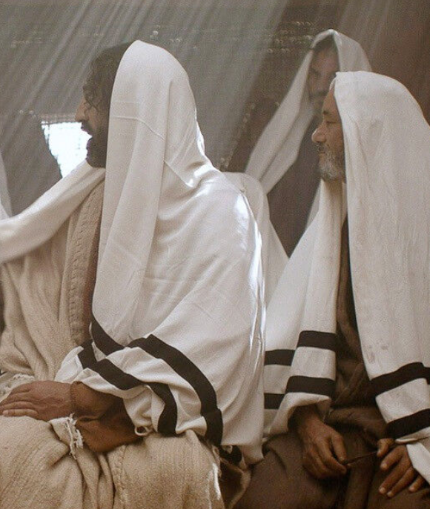
26
It was to none of these that Elijah was sent, but only to a widow in Zarephath in the land of Sidon.

Slide 11
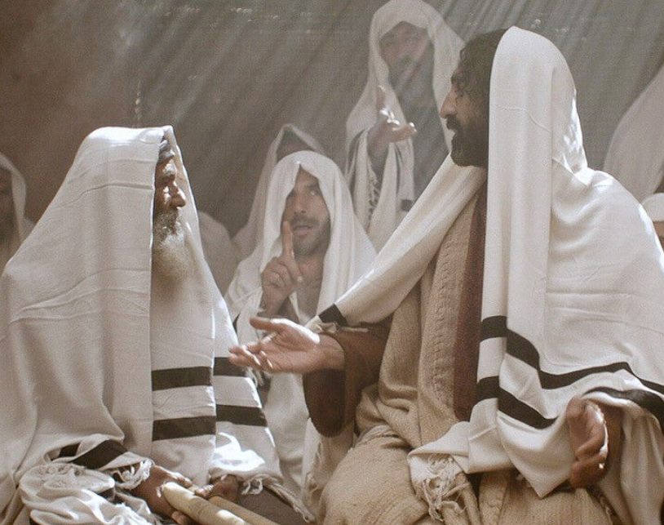
27
Again, there were many lepers in Israel during the time of Elisha the prophet; yet not one of them was cleansed, but only Naaman the Syrian.”
Notes:
It seems that the Sabbath synagogue service in the first century consisted of the singing of a psalm, the recitation of the Shema and the 18 benedictions, a reading from the Torah, a reading from the Prophets, a sermon on the meaning of the readings, a blessing by the president, and the priestly blessing of Numbers 6:24-27.

Slide 12
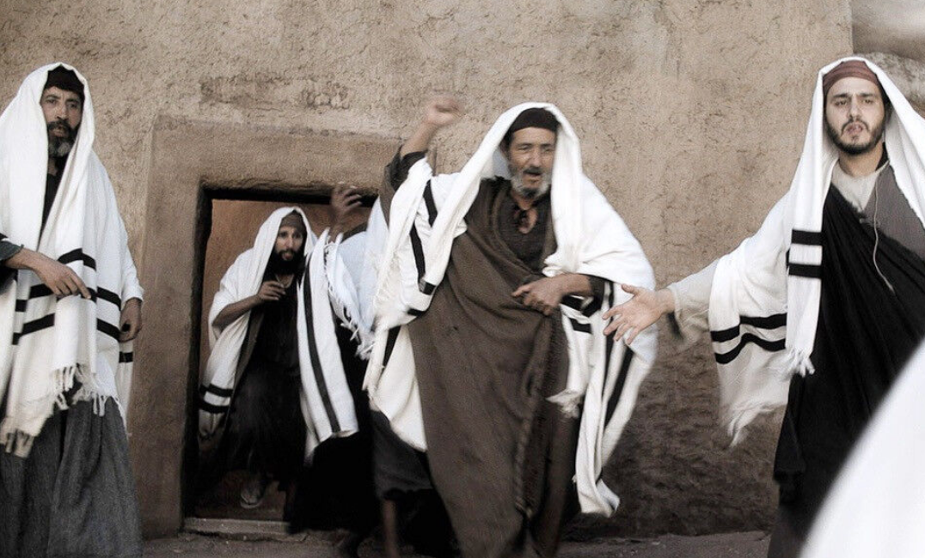
28
When the people in the synagogue heard this, they were all filled with fury

Slide 13
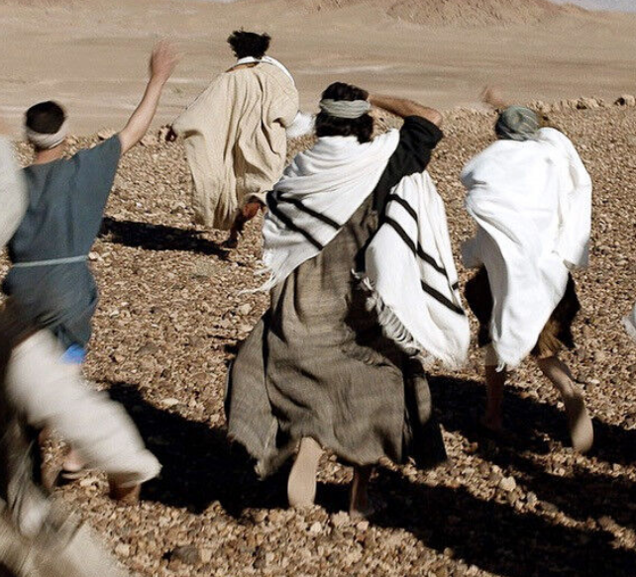
29
They rose up, drove him out of the town, and led him to the brow of the hill on which their town had been built, to hurl him down headlong.

Slide 14
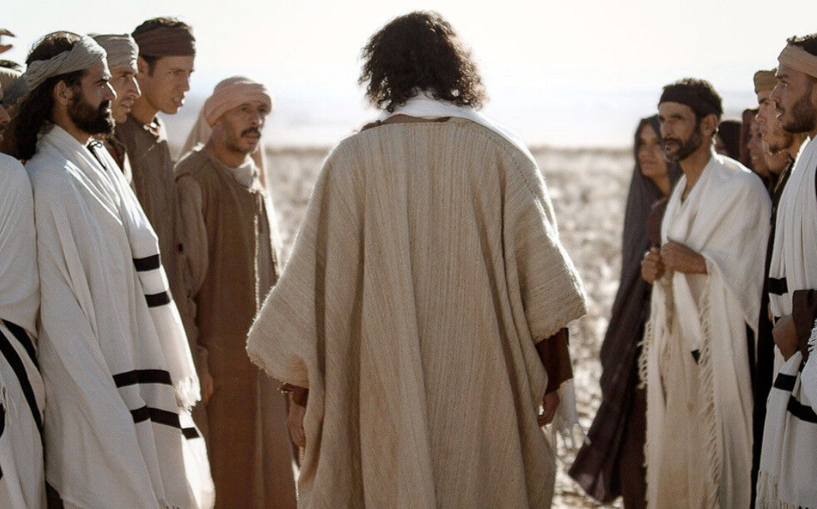
30
But he passed through the midst of them and went away.
Notes:
Jesus doesn’t flee but walks away majestically, leaving the crowd paralyzed. As on other occasions men do Him no harm; it was by God’s decree that He died on the cross (see John 18:32; John 3:14; Matthew 20:19) when His hour had come.

Slide 15
Leader: The Gospel of the Lord.
All: Praise to You,
Lord Jesus Christ.

Slide 16
GOSPEL MESSAGE

Slide 17
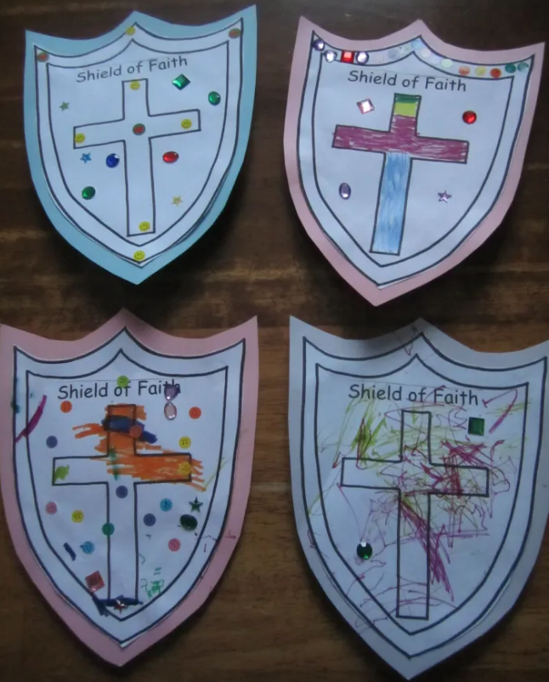
Activity:
Shield of faith
Materials: 1. Colored Papers
2. Scissors
3. Glue
4. Color pens
5. Design materials (stickers, washi tape)
Notes:
In our gospel, we saw how the people reacts to Jesus’ words because of their lack of faith. As MFC Kids, we learned how important our faith is to Jesus thus we will declare, we believe in Jesus!

Slide 18
Instructions:
Draw the shield shape and then cut it out.
Draw a cross at the center.
Write Shield of Faith at the top of the cross.
Write I believe in Jesus at the bottom of the cross.
Finish up your artwork by putting some color and design.

Slide 19
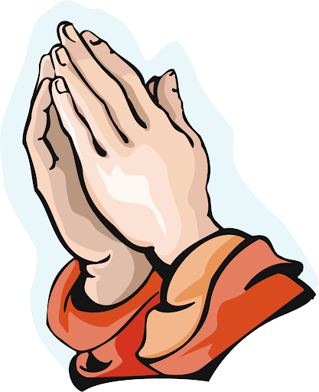
Closing Prayer
Act of Faith
O my God, I firmly believe that you are one God in three divine Persons, Father, Son, and Holy Spirit. I believe that your divine Son became man and died for our sins, and that he will come to judge the living and the dead. I believe these and all the truths which the holy Catholic Church teaches, because you have revealed them, who can neither deceive nor be deceived.
Amen.

Slide 20
LIVE THE WORD KIDS
4th Sunday in Ordinary Time | Cycle C

