Slide 1
LIVE THE WORD KIDS
3rd Sunday in Ordinary Time | Cycle C

Slide 2
GOSPEL REFLECTION
Luke is the only Gospel writer to give his book a preface or prologue (1:1-4). This prologue is really a summary of what the Gospel contains and helps us to realize that Jesus’ message of salvation, the Gospel, was preached before it came to be written down.
As Jesus stands in the synagogue, he reads from the scroll handed to him; it contains the words of the prophet Isaiah. At this early moment in his ministry, Jesus announces his mission in continuity with Israel's prophetic tradition. This reading from Isaiah defines Jesus' ministry. We will find more evidence of this as we continue to read from Luke's Gospel throughout the year. Jesus' ministry will include bringing glad tidings to the poor, liberty to captives, healing to the sick, freedom to the oppressed, and proclaiming a year acceptable to the Lord.
In Jesus, something new begins. Jesus not only announces God's salvation, he brings this salvation about in his person. Jesus is Yahweh's Anointed One, filled with the Spirit of God. The Kingdom of God is now at hand. It is made present in Jesus, in his life, death, and Resurrection. Jesus will send the Holy Spirit so that the Kingdom of God can be fulfilled.
Source: Sambuhay and Loyola press

Slide 3
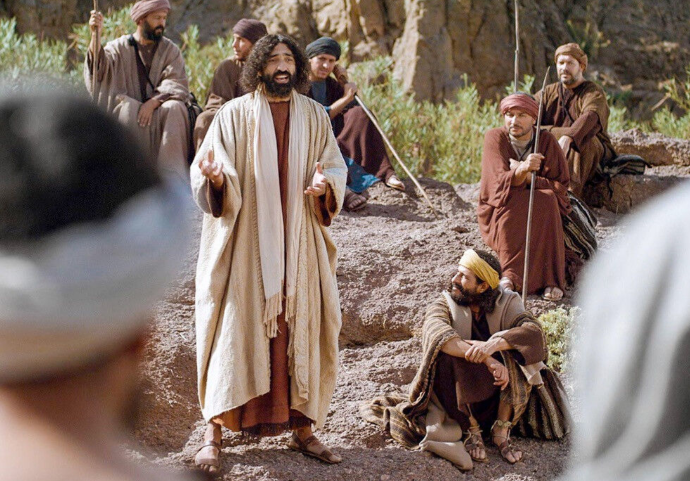
The Ministry in Galilee
Luke 1:1-4, 4:14-21

Slide 4
Leader: A reading from
the Holy Gospel
according to Luke.
All: Glory to You, Oh Lord.

Slide 5
1
Since many have undertaken to compile a narrative of the events that have been
fulfilled among us,
Notes:
Luke’s purpose is not merely to record history, he narrates events that are interpreted as having been brought to fulfillment by God for human salvation.

Slide 6
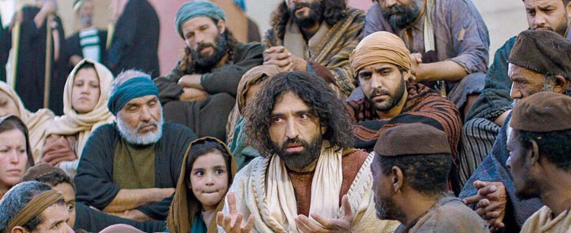
2
Just as those who were eyewitnesses from the beginning and ministers of the word have handed them down to us,
Notes:
Seeing isn’t sufficient for Saint Luke, these sources have not only seen, they have acted upon their faith and now proclaim the Word.

Slide 7
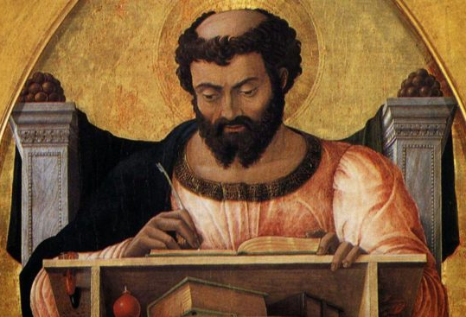
3
I too have decided, after investigating everything accurately anew, to write it down
in an orderly sequence for you, most excellent Theophilus,
Notes:
The name Theophilus means “beloved of God”. Who this person is in unknown. Luke wrote this gospel and Acts to him – the only times he is mentioned in the Bible (Luke 1:3; Acts 1:1). Theophilus could be a generic “all Christians”.

Slide 8
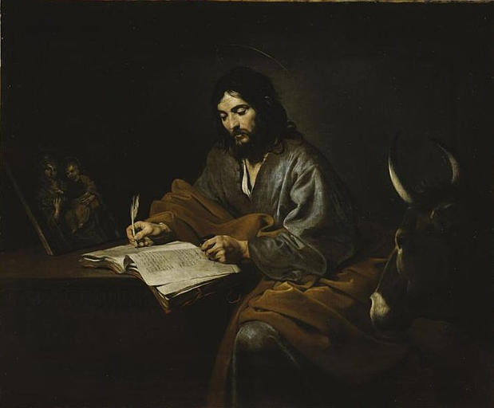
4
so that you may realize the certainty of the teachings you have received.

Slide 9
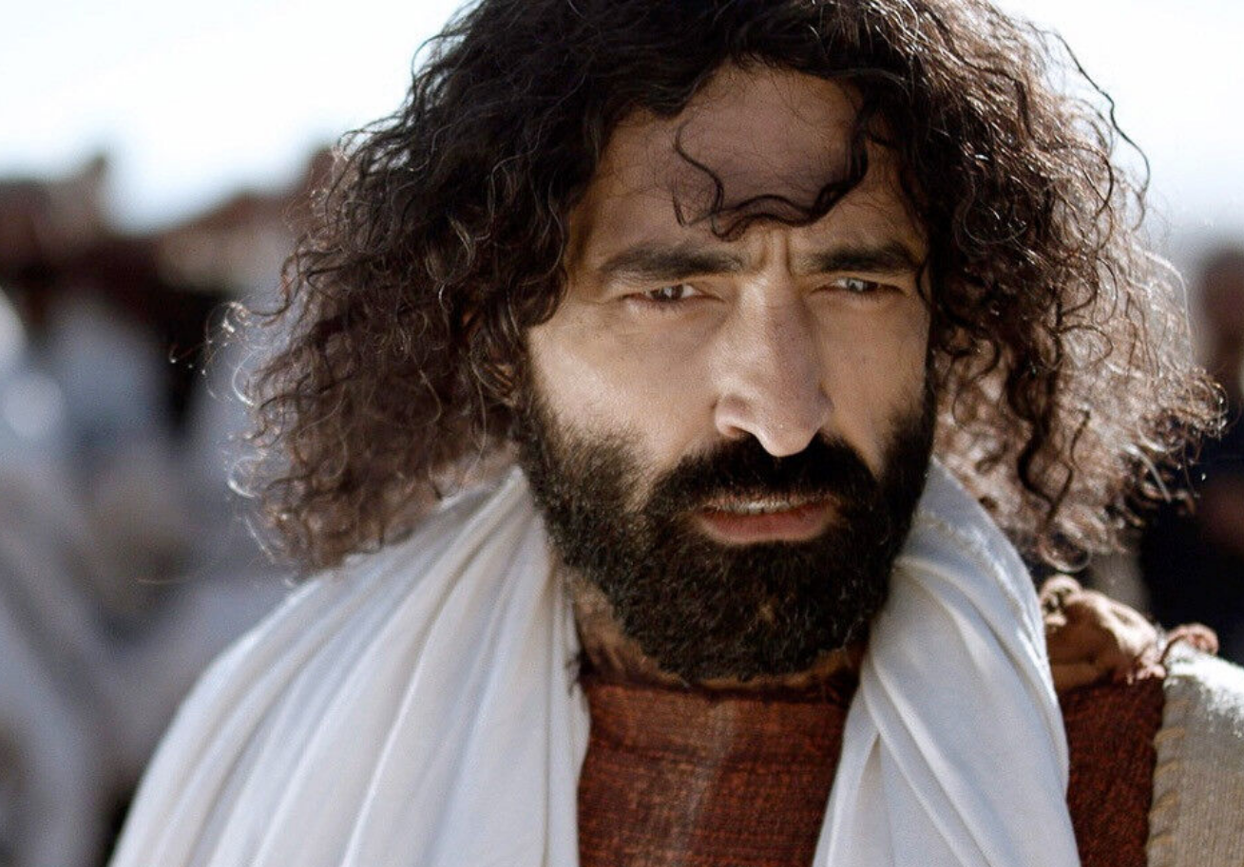
14
Jesus returned to Galilee in the power of the Spirit, and news of him spread throughout the whole region.
Notes:
This is the beginning of Jesus’ public ministry. Just prior to this He was baptized (Luke 3:21-22) and was tempted in the desert (Luke 4:1-13). The Holy Spirit descended on Him at His baptism (Luke 3:22) and He was full of and led by the Holy Spirit when He went into the desert (Luke 4:1). His encounter with the devil has not diminished the power of the Holy Spirit. Jesus was a teacher. He had the authority to address people about God and God’s plan.

Slide 10
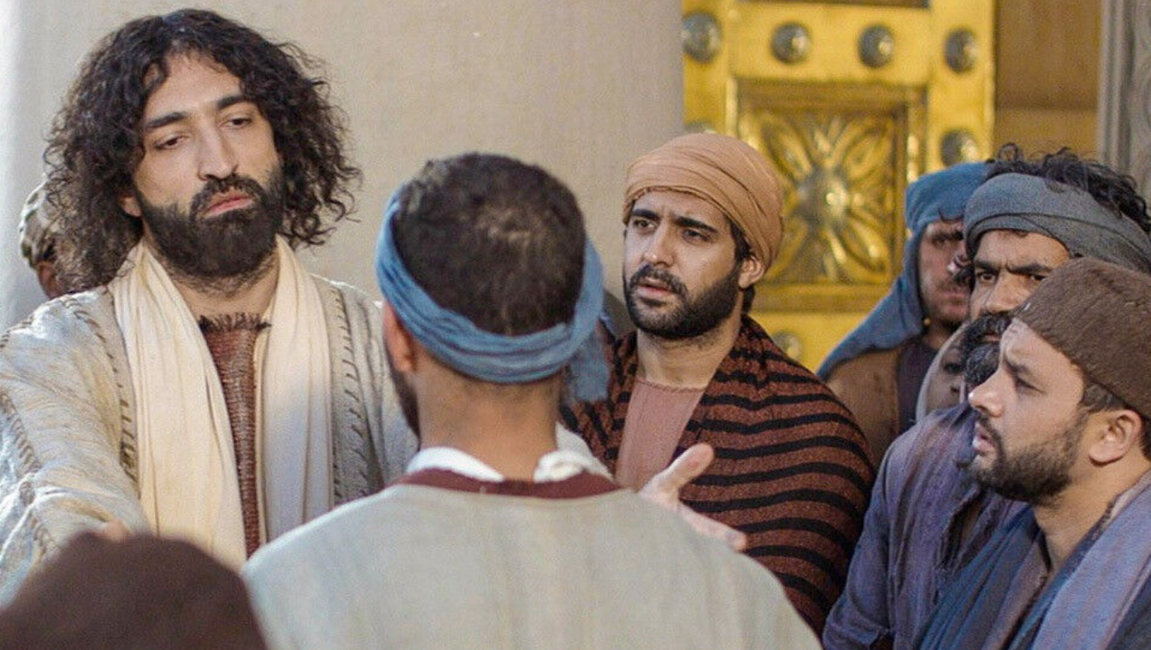
15
He taught in their synagogues and was praised by all.
Notes:
He was teaching openly in the Jewish place of worship and instruction. Jesus stands in continuity with God’s promises of old. Jesus starts His public ministry where His hearers think that they know Him and His origins.

Slide 11
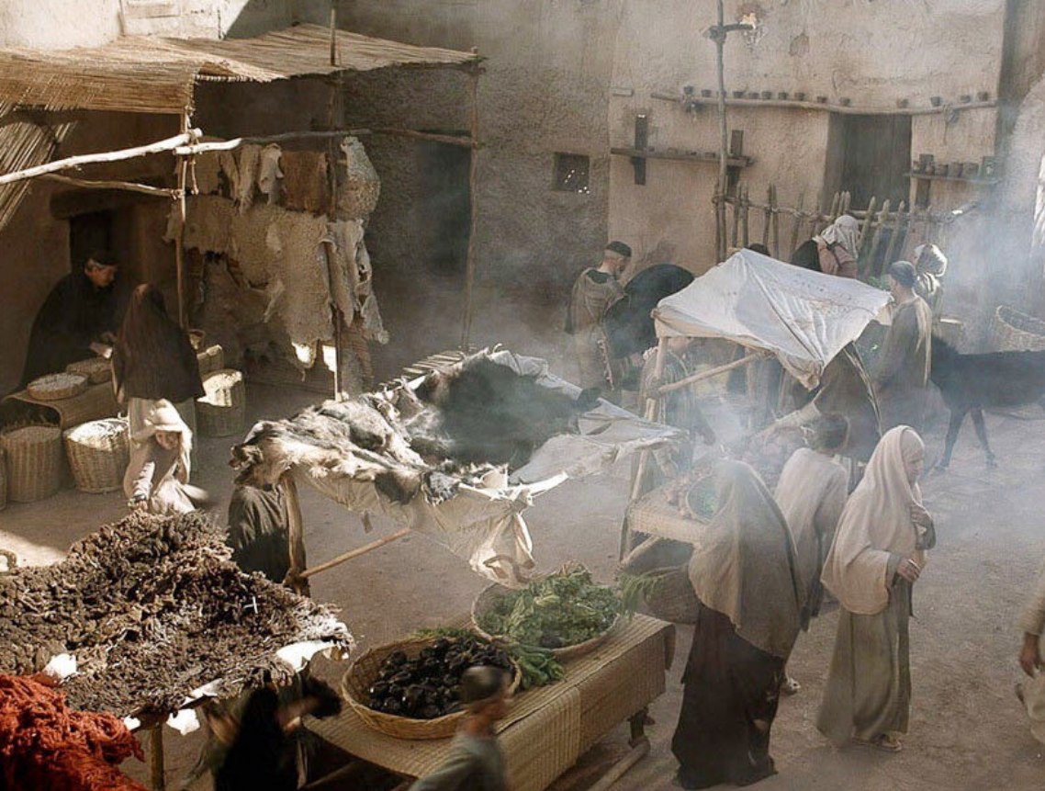
16
He came to Nazareth, where he had grown up, and went according to his custom into the synagogue on the sabbath day. He stood up to read
Notes:
It seems that the Sabbath synagogue service in the first century consisted of the singing of a psalm, the recitation of the Shema and the 18 benedictions, a reading from the Torah, a reading from the Prophets, a sermon on the meaning of the readings, a blessing by the president, and the priestly blessing of Numbers 6:24-27.

Slide 12
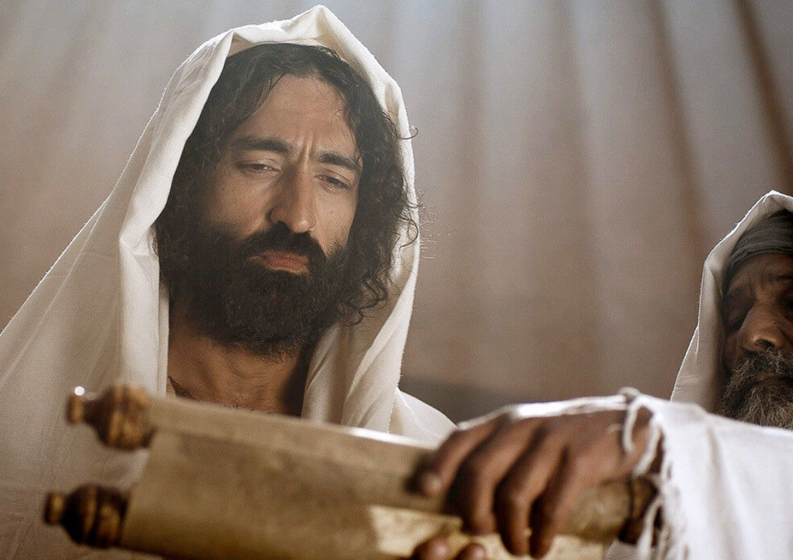
17
and was handed a scroll of the prophet Isaiah. He unrolled the scroll and found the passage where it was written

Slide 13
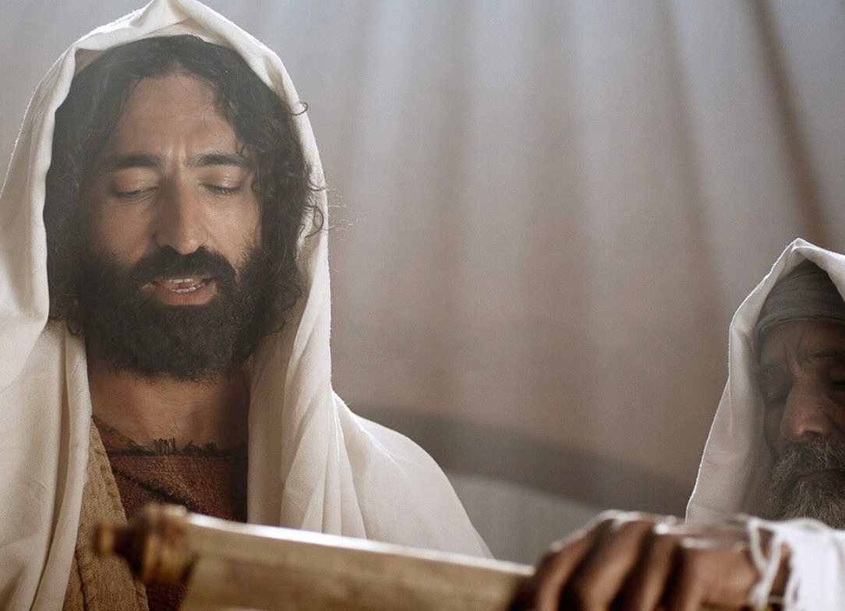
18
“The Spirit of the Lord is upon me, because he has anointed me to bring glad idings to the poor. He has sent me to proclaim liberty to captives and recovery of sight to the blind, to let the oppressed go free,
Notes:
The blessings God will send the people through the Messiah. “The poor” refers not so much to a social condition as to a very religious attitude of indigence and humility toward God; those who instead of relying on their possessions and merits, trust in God’s goodness and mercy. Likewise, “release” is seen to be a spiritual sense - freedom from the blindness and oppression of sin. This passage is also in line with Jesus’ special concern for those most in need. “Similarly, the Church encompasses with all her love all those who are afflicted by human misery and she recognizes in those who are poor and who suffer the image of her poor and suffering Founder. She does all in her power to receive their need and in them she strives to serve Christ” (Vatican II, Lumen Gentium 8)

Slide 14
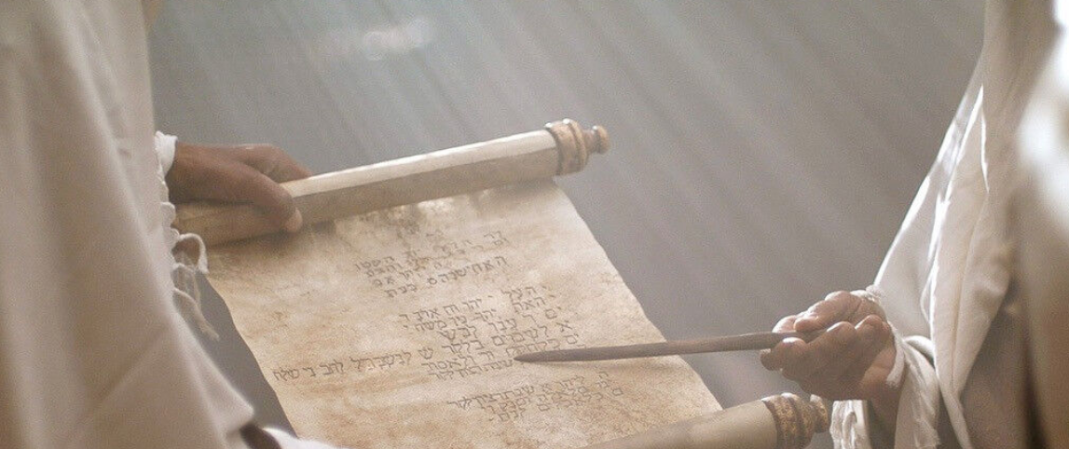
and to proclaim a year acceptable to the Lord.”
19

Slide 15
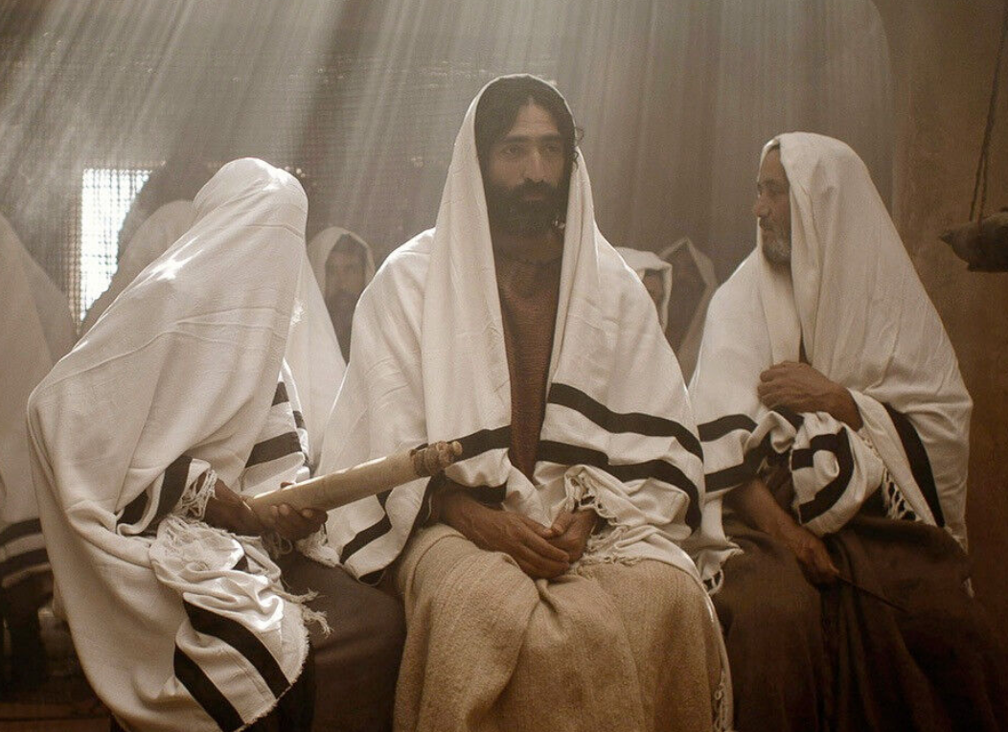
20
Rolling up the scroll, he handed it back to the attendant and sat down, and the eyes
of all in the synagogue looked intently at him.

Slide 16
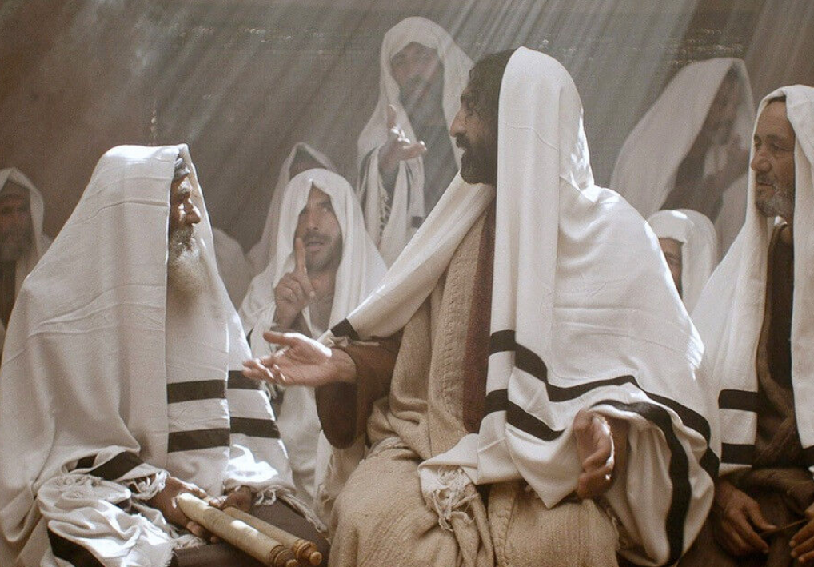
21
He said to them, “Today this
scripture passage is fulfilled in your hearing.”
Notes:
The fulfillment of the promise is Luke’s theme. The waiting is over, the Messiah has arrived.

Slide 17
Leader: The Gospel of the Lord.
All: Praise to You,
Lord Jesus Christ.

Slide 18
GOSPEL MESSAGE

Slide 19
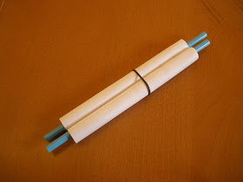
Activity:
The word of God
Materials: 1. Colored Papers
2. Straw or Popsicle stick
3. Glue
Notes:
In our gospel reading, we have learned that what was written in the scriptures were fulfilled. Thus, our activity would be a reminder for us that the words of God are true and all that is written in the bible is about His great love for us.

Slide 20
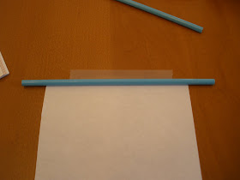
Instruction:
1. Cut a regular piece of copy paper in half lengthwise.
2. Taped each end to one of the straws or popsicle stick.

Slide 21
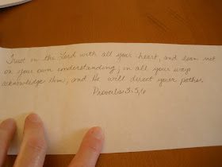
Instruction:
3. Write in the paper “God loves me and He has plans for me.”
4. Roll up both ends halfway. Hold it and twirl the straws to tighten it a little.

Slide 22
Closing Prayer
Dear God,
Thank you for being faithful to your words and love for us. Thank you for giving us the bible that helps us to discover Your love and Your promise to us.
May Your words bear fruit in us as we, and more people, receive God’s Word in our hearts in the Holy Eucharist and allow it to transform our lives.
In Jesus name, we pray.
Amen.

Slide 23
LIVE THE WORD KIDS
3rd Sunday in Ordinary Time | Cycle C

