Slide 1
LIVE THE WORD KIDS
2nd Sunday in Ordinary Time | Cycle C

Slide 2
GOSPEL REFLECTION
Gazing at the image of theSto. Niño, we are touched tosee his hand holding the globe. While we may look at it as awork of art, the image of the Child Jesus holding the world is loaded with meanings related to our readings today and to our experiences in this disruption. In fact, seen with the COVID pandemic as backdrop, the image declares that the Child Jesus will always hold us in
his hands.
The Gospel is Luke’s narrative of the Boy Jesus in the temple. It is a story filled “with great anxiety” as Joseph and Mary look for Jesus (Lk 2:48). When they find him, Jesus explains that he “must be” in his Father’s house (Lk 2:49). The emotional reunion, filled with relief, shows us that God held the Holy Family in his hand, accompanied them in difficult times, and showed them the right path. The celebration of the Sto. Niño assures us that everything in this world is in God’s hands. To him we plead, “Jesus, Son of David, have mercy on us.” To him we acclaim, “Viva!” and “Pit Senyor!” To him we pray, “Jesus, please hold us tightly in your hands.” Amen.
Source: Sambuhay

Slide 3
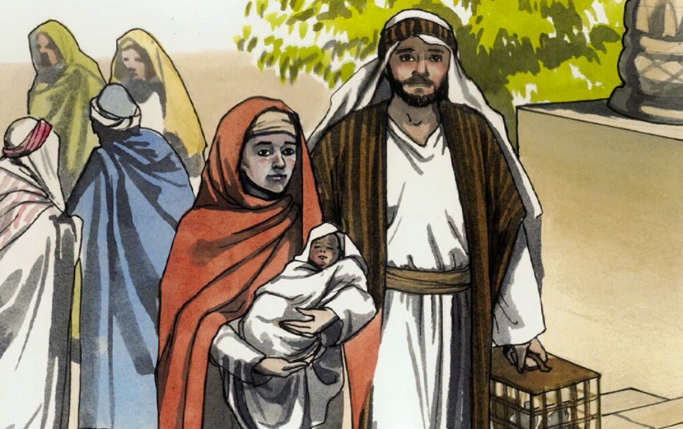
Feast of Sto. Niño
Luke 2:41-52

Slide 4
Leader: A reading from
the Holy Gospel
according to Matthew.
All: Glory to You, Oh Lord.

Slide 5
41
Every year Jesus’ parents went to Jerusalem for the Festival of the Passover.

Slide 6
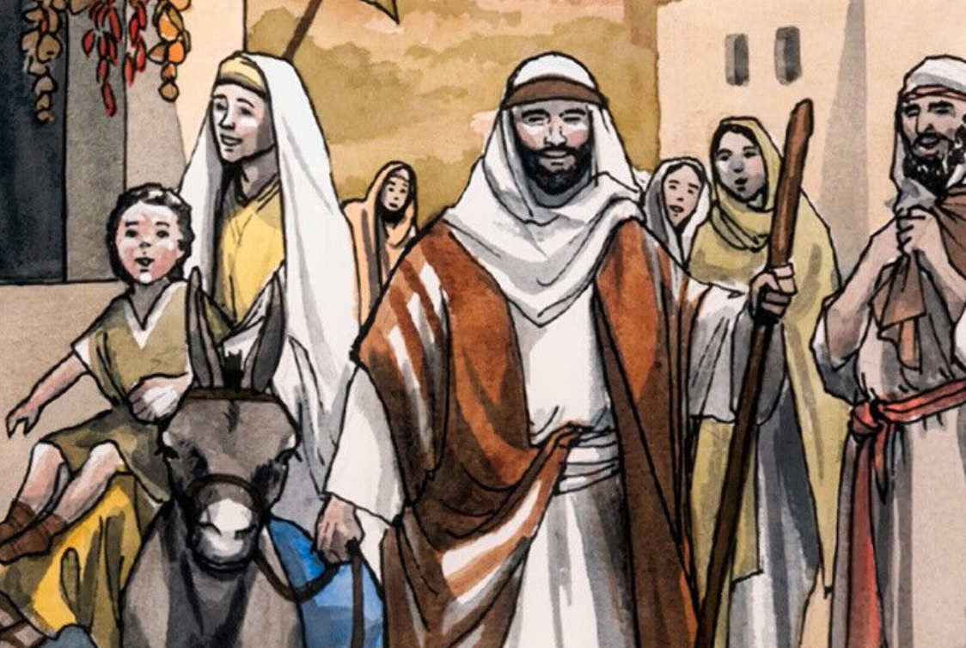
42
When he was twelve years old, they went up to the festival, according to the custom.

Slide 7
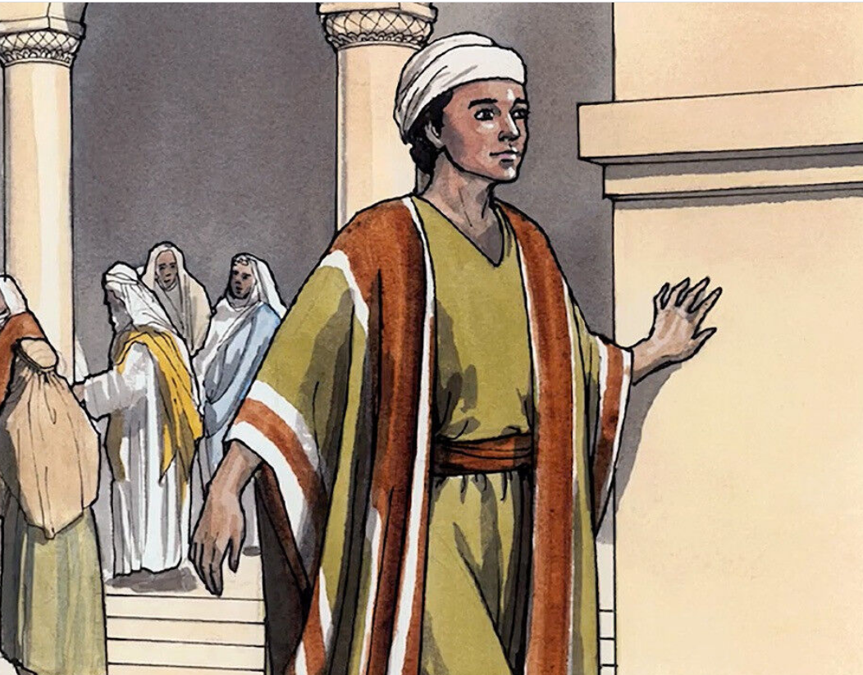
43
After the festival was over, while his parents were returning home, the boy Jesus stayed behind in Jerusalem, but they were unaware of it.

Slide 8
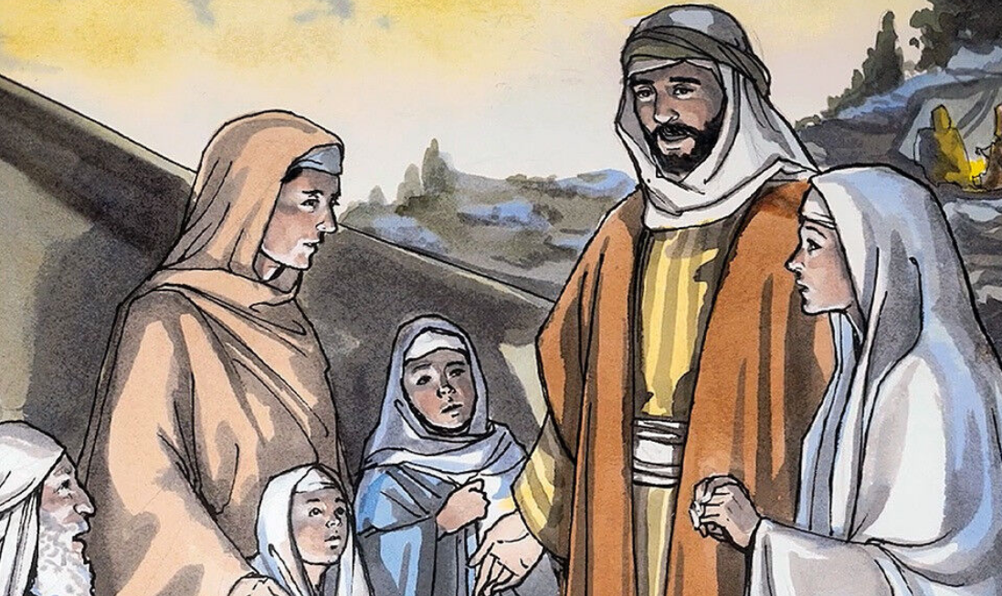
44
Thinking he was in their company, they traveled on for a day. Then they began looking for him among their relatives and friends.

Slide 9
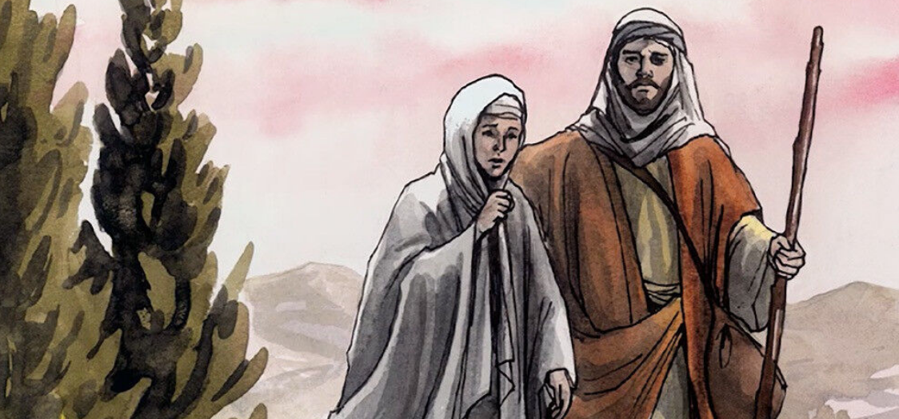
45
When they did not find him, they went back to Jerusalem to look for him.

Slide 10
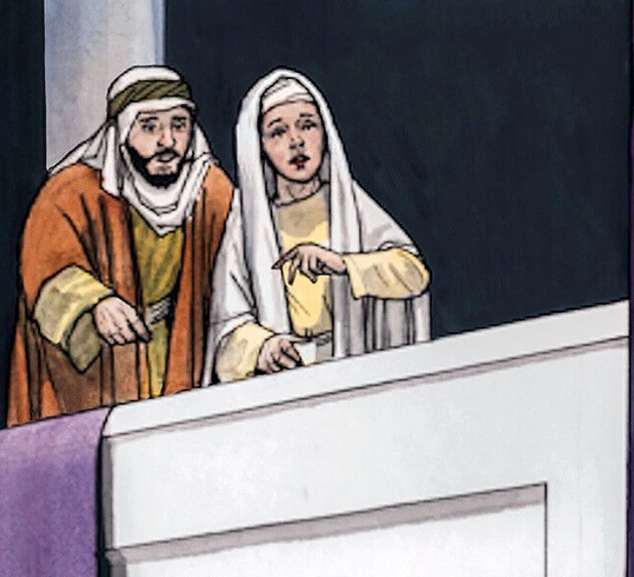
46
After three days they found him in the temple courts, sitting among the teachers, listening to them and asking them questions

Slide 11
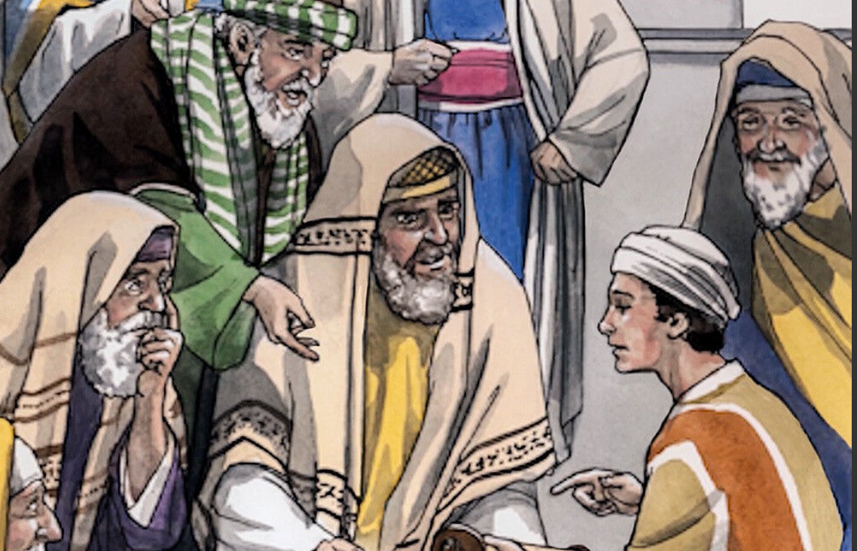
Everyone who heard him was amazed at his understanding and his answers.
47

Slide 12
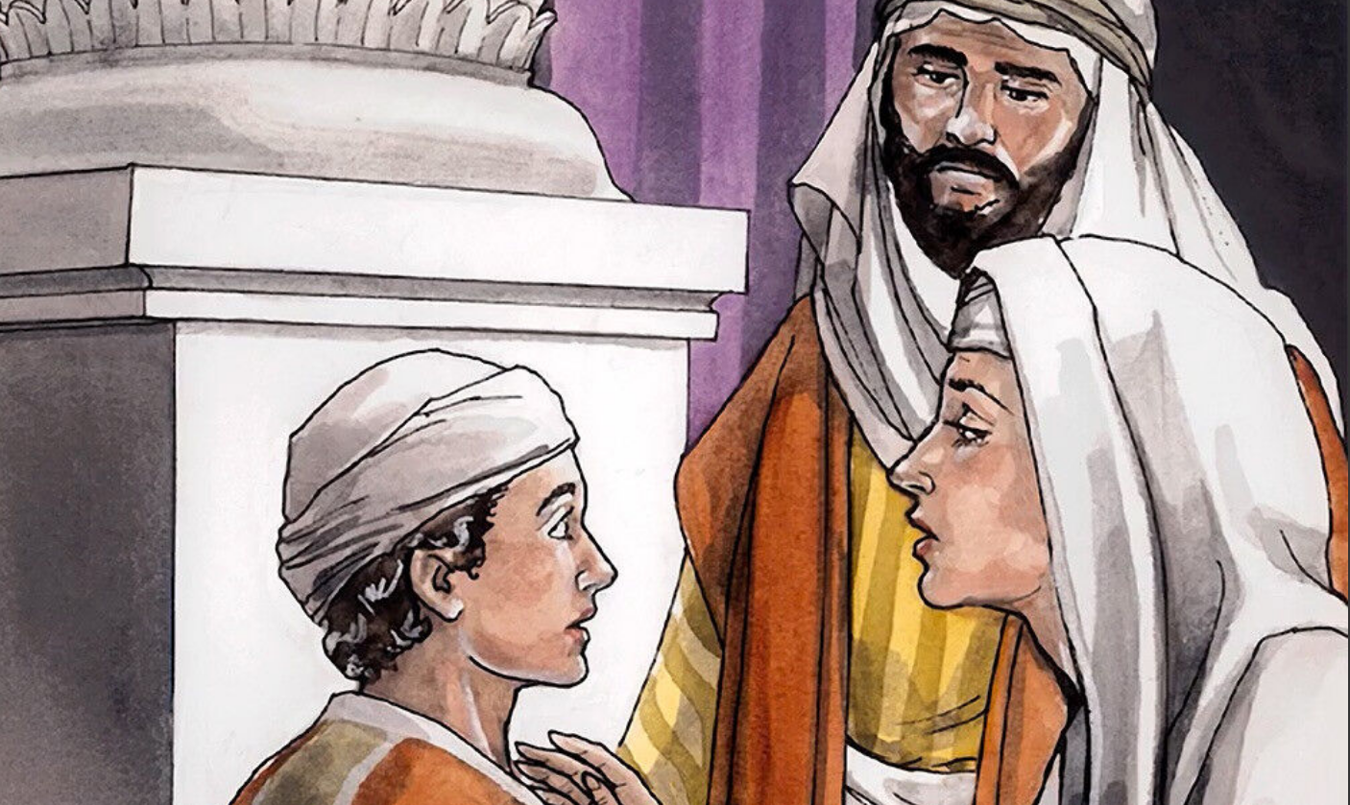
48
When his parents saw him, they were astonished. His mother said to him, “Son, why have you treated us like this? Your father and I have been anxiously searching for you.”

Slide 13
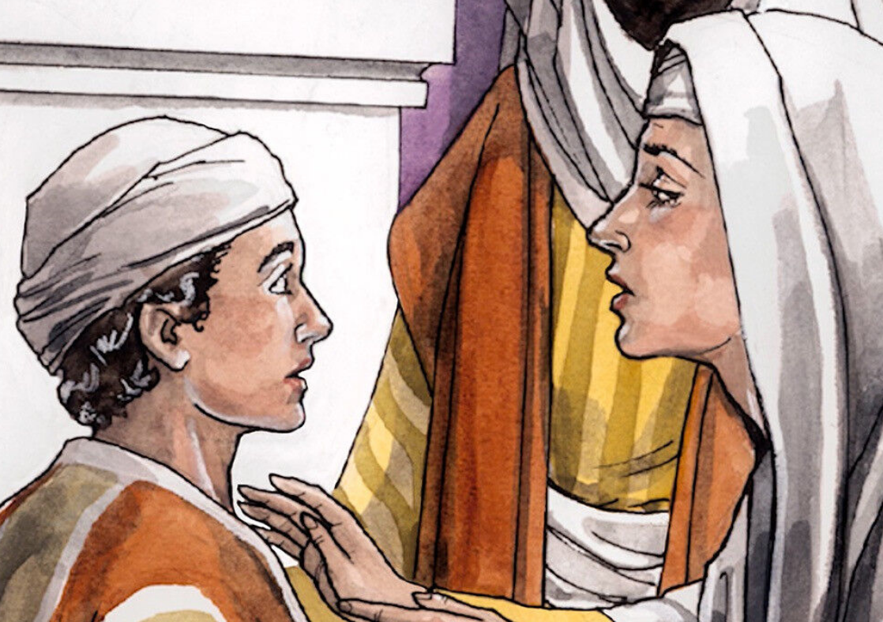
49
“Why were you searching for me?” he asked. “Didn’t you know I had to be in my Father’s house?

Slide 14
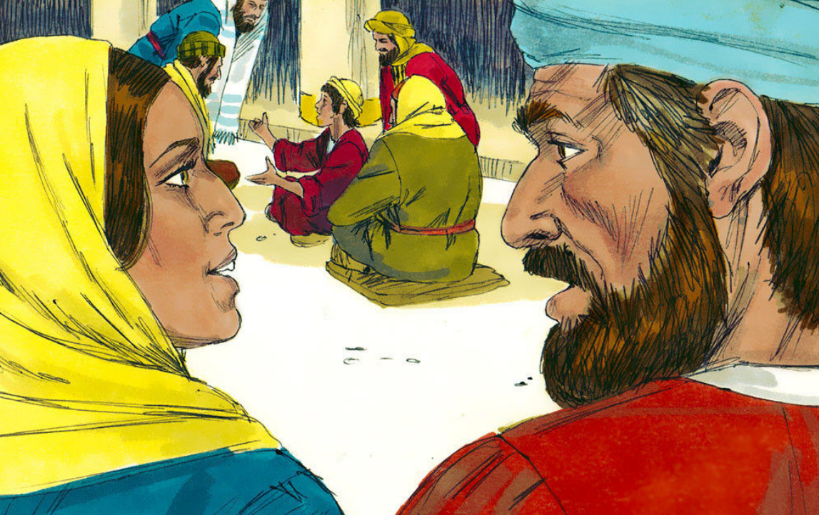
But they did not understand what he was saying to them.
50

Slide 15
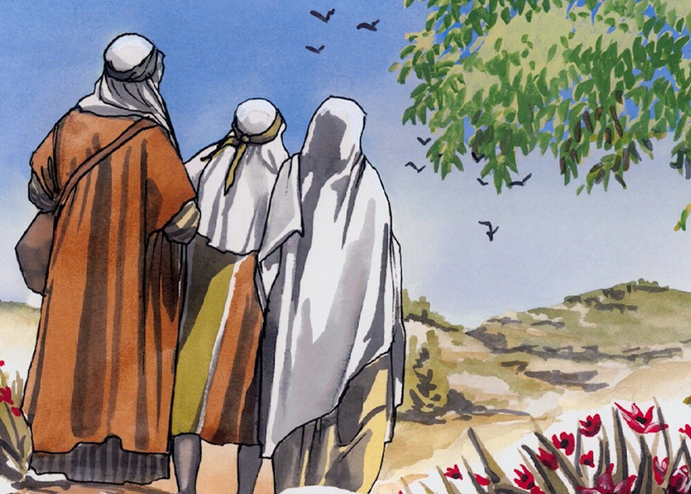
51
Then he went down to Nazareth with them and was obedient to them. But his mother treasured all these things in her heart.

Slide 16
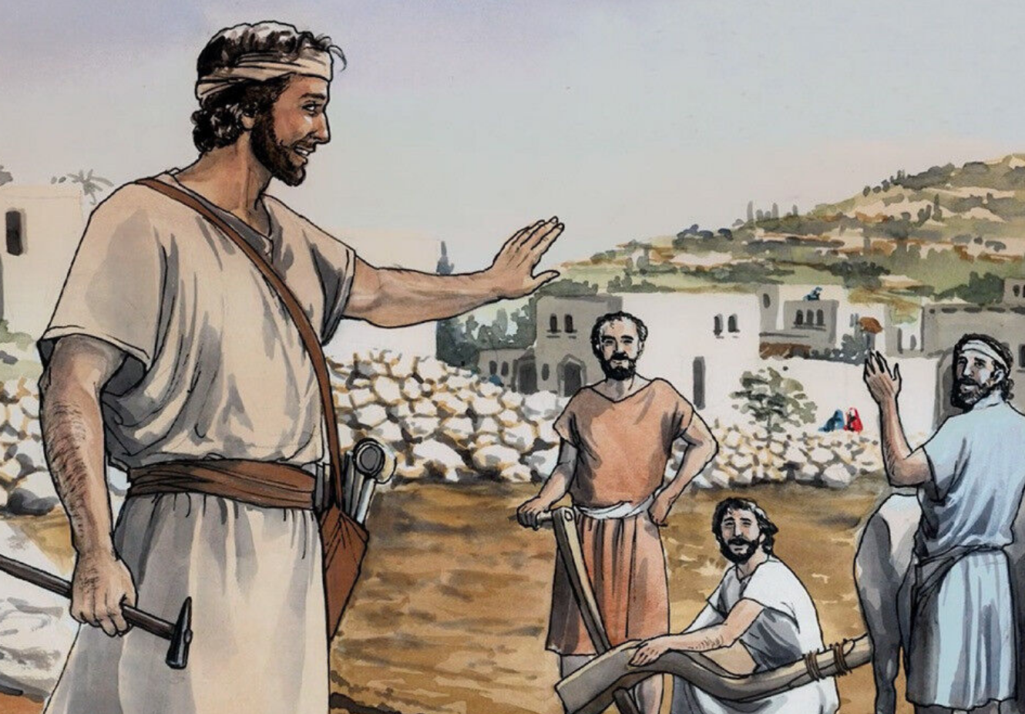
52
And Jesus grew in wisdom and stature, and in favor with God and man.

Slide 17
Leader: The Gospel of the Lord.
All: Praise to You,
Lord Jesus Christ.

Slide 18
GOSPEL MESSAGE

Slide 19
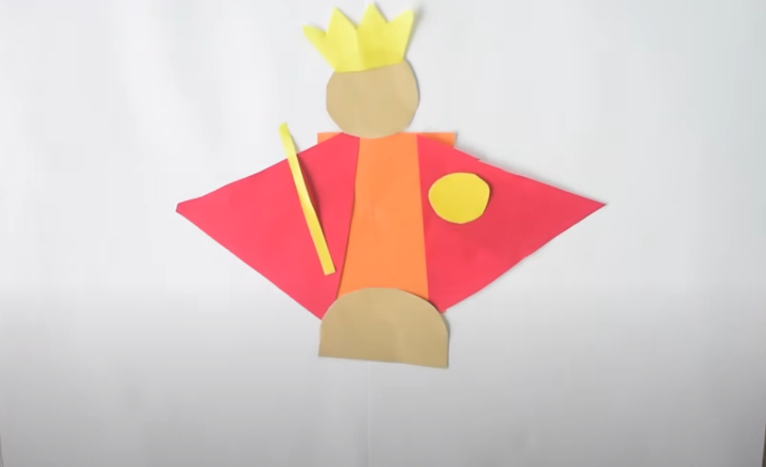
Activity:
Viva Pit Senyor
Materials: 1. Colored Papers
2. White bond paper
3. Scissors
4. Glue
Notes:
The dove is the symbol of the Holy Spirit. When Christ was baptized by John the Baptist, a dove descended on him, according Matthew 3:16 and Mark 1:10. It also symbolizes God's grace. Let this dove be a reminder that God also sent the Holy Spirit to be with us each ands everyday.

Slide 20
Instruction:
Cut out two (2) triangle shape using red colored paper.
In any colored paper, cut out a rectangle shape.
In a brown or flesh colored paper, cut out one (1) circle shape and one (1) half circle piece.
Cut a crown shape, a circle, a slim rectangle in yellow colored paper.
Glue them together using the pattern shown in the picture.
Write Viva Pit Señor! and add some design on the Sto. Niño’s clothing!
Viva Pit Señor!
Notes:
The devotion to the Sto. Niño in the Philippines is as old as the history of Christianity in the country. The image of Sto. Niño was given to Queen Juana by Ferdinand Magellan after she was baptized with her husband, King Humabon, in Cebu in 1521. Eventually, Magellan died after the battle of Mactan. After which, there was no continuity in the spreading of the new religion to the natives of Cebu.
Forty-four years later, the Spaniards returned with Miguel Lopez de Legazpi as head of the expedition and found an image of the Sto. Niño.A feast day then was dedicated to the finding of the image of Sto. Niño on April 28, 1565. Since then, people celebrate the feast of the child Jesus in honor of His Most Holy name. One particular tradition of the fiesta is the out loud cry of the phrases- “VIVA PIT SEÑOR!” and “VIVA SEÑOR SANTO NIÑO!”
‘VIVA SEÑOR SANTO NIÑO!’ is ‘Hail, Lord Holy Child!’ which is referred to Jesus Christ.

Slide 21
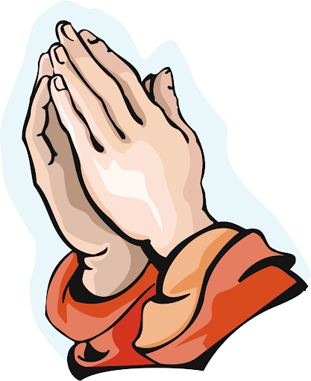
Closing Prayer
O Señor Sto. Niño, who shed Your blessings on whoever invokes Your name, look kindly on us who kneel humbly before Your holy Image, and hear our prayers. We commend to Your mercy the many poor and needy people who trust in Your Divine Heart. Lay Your all-powerful hand upon them and help them in their needs.
Lay Your hand upon the sick, to cure them and sanctify their suffering; upon those in distress, to console them; upon sinners, to draw them into the light of your divine grace; upon all those who, stricken with grief and suffering, turn trustingly to You for loving help.
Lay Your hand also upon all of us and give us Your blessing. O little King, grant the treasures of Your divine mercy to all the world, and keep us now and always in the grace of your love! Amen..
O Señor Sto. Niño, have mercy on us!

Slide 22
LIVE THE WORD KIDS
2nd Sunday in Ordinary Time | Cycle C

