Slide 1
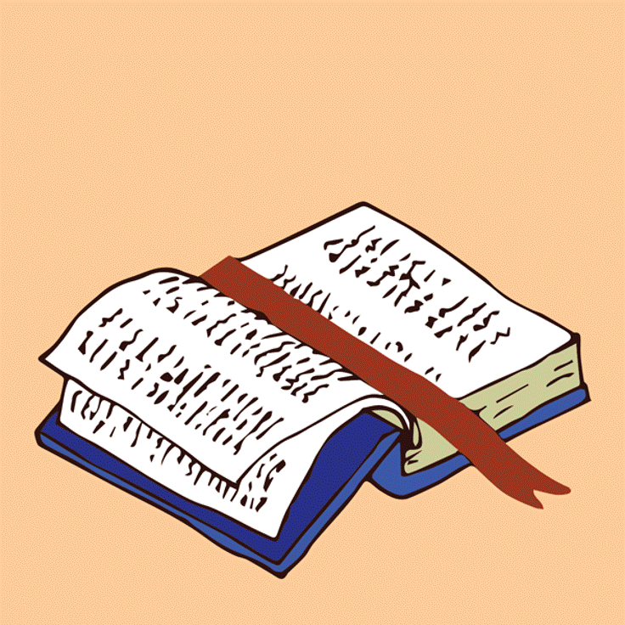
LIVE THE WORD KIDS
8th Sunday in Ordinary Time | Cycle C

Slide 2
GOSPEL REFLECTION
This Sunday’s liturgy invites us to be humble, be concerned about correcting our defects and aiming at what really matters in life: to BECOME the sort of person God calls us to be. This means that we must be people who have fully assimilated the values of the Kingdom and constantly endeavor to be “disciples” who reproduce in ourselves, as close as possible, the traits of the Master. In a world full of superficiality, pretenses, and hypocrisy, – all forms of moral blindness – if we really want to help and guide those who are
affected by such blindness, we must rid ourselves of the many specks or logs that impair our moral vision and may even blind us completely. The best way to help our brothers and sisters blinded by sin is for us
to become morally sound “trees” that bear abundant fruits of an authentic Christian life.
Reminder: Check last week’s activity if they were able to accomplish their LTW Love Challenge
Source: Sambuhay

Slide 3
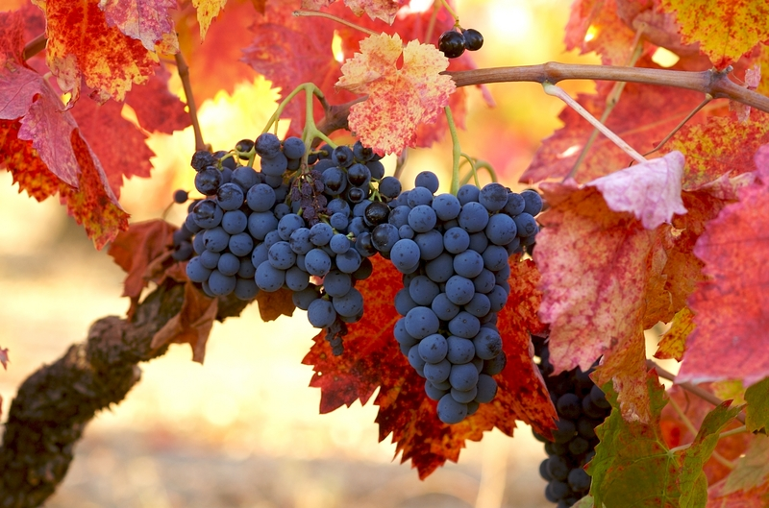
A tree known by its fruit
Luke 6:39-45
Notes:
As we continue reading from Jesus’ “Sermon on the Plain,” in this series of sayings he reminds us of the importance of being humble, and of the need that we get rid of our own moral defects if we want to help others to get rid of their own.

Slide 4
Leader: A reading from
the Holy Gospel
according to Luke.
All: Glory to You, Oh Lord.

Slide 5
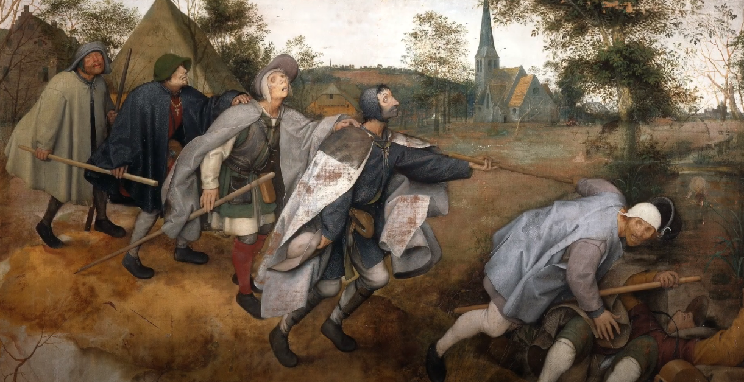
39
And he told them a parable, “Can a blind person guide a blind person? Will not both fall into a pit?
Notes:
Parables are wise sayings or fictitious short stories. The parables are a development of a literary form which has its roots in Old Testament and rabbinic literature.
The purpose of the parable is to bring the listener to concede a point which he does not perceive as applicable to himself. In addition the parable whets the curiosity and attracts attention; the listener is trapped because of his desire to hear how the story comes out.
Luke addresses not false teachers but the disciples; who are blind until they have their eyes opened by Jesus’ teaching (the sermon on the plain which we have heard for the past two weeks). Once they have learned to apply the teaching, they will be able to teach others.

Slide 6
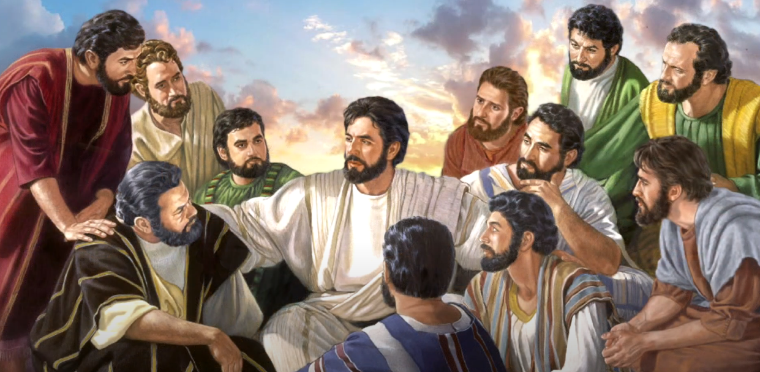
40
No disciple is superior to the teacher; but when fully trained, every disciple will be like his teacher.

Slide 7
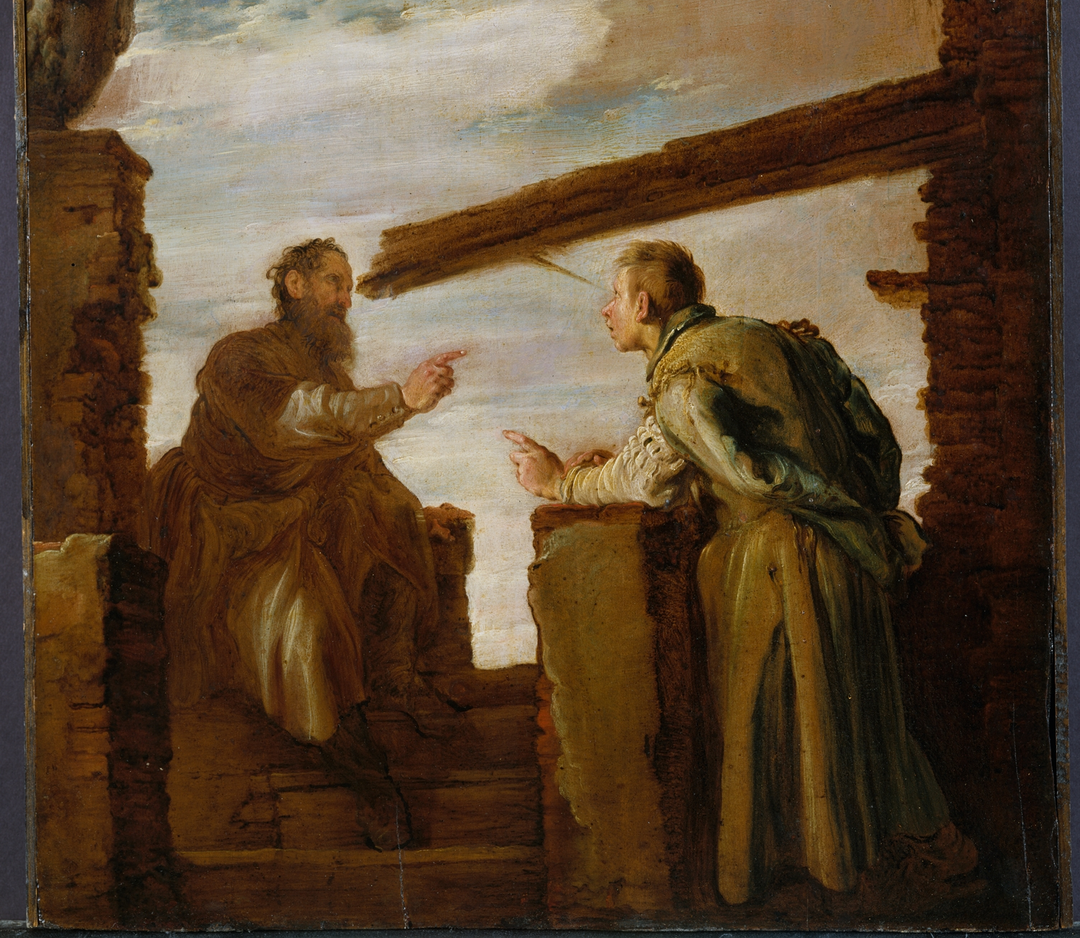
41
Why do you notice the splinter in your brother’s eye, but do not perceive the wooden beam in your own?
Notes:
This is an admonition to those who see their lapses as being minute in comparison to the gross failures of others. This is obviously hyperbole (an exaggeration used as a figure of speech “this book weighs a ton”), but it gets the point across.

Slide 8
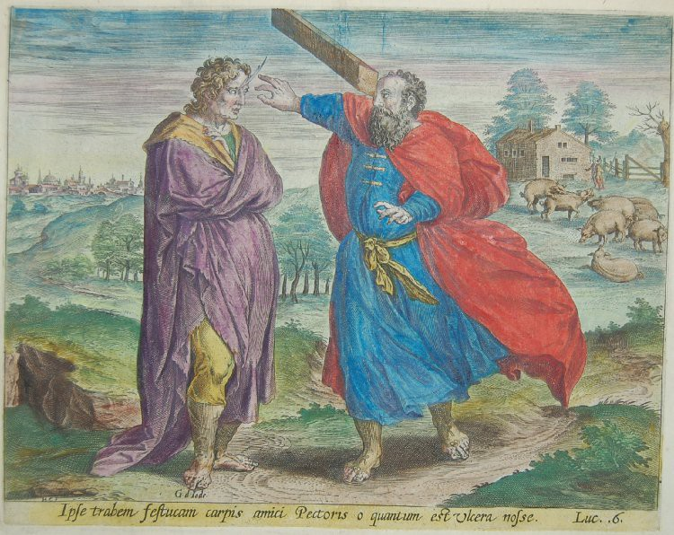
42
How can you say to your brother, ‘Brother, let me remove that splinter in your eye,’ when you do not even notice the wooden beam in your own eye? You hypocrite! Remove the wooden beam from your eye first; then you will see clearly to remove the splinter in your brother’s eye.
Notes:
The word hypocrite originally meant actor. Here, the meaning is a person pitifully deceived 5 by their own condition. They are called to exercise self-criticism.

Slide 9
43
“A good tree does not bear rotten fruit, nor does a rotten tree bear good fruit.
Notes:
To distinguish the good tree from the bad tree we need to look at the fruit the tree produces (deeds) and not at its foliage (words). There is no lack of people here on earth who, on being approached, turn out to be nothing but large, shiny, glossy leaves. Meanwhile, many souls are looking at us hoping to satisfy their hunger, which is a hunger for God. We must not forget that we have all the resources we need.

Slide 10
44
For every tree is known by its own fruit. For people do not pick figs from thornbushes, nor do they gather grapes from brambles.

Slide 11
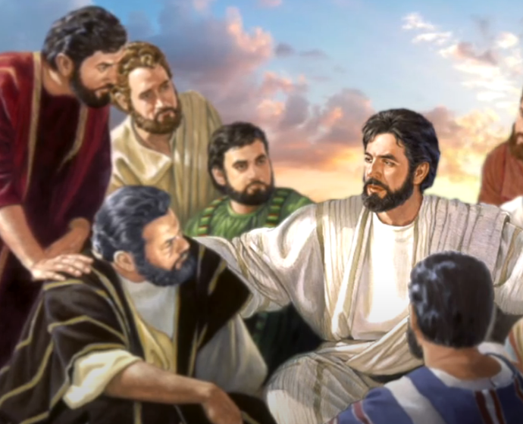
45
A good person out of the store of goodness in his heart produces good, but an evil person out of a store of evil produces evil; for from the fullness of the heart the mouth speaks.
Notes:
Effective compliance with the teaching of the sermon on the plain can come only from a heart that has been converted to the gracious God proclaimed in Jesus’ kingdom ministry .

Slide 12
Leader: The Gospel of the Lord.
All: Praise to You,
Lord Jesus Christ.

Slide 13
GOSPEL MESSAGE

Slide 14
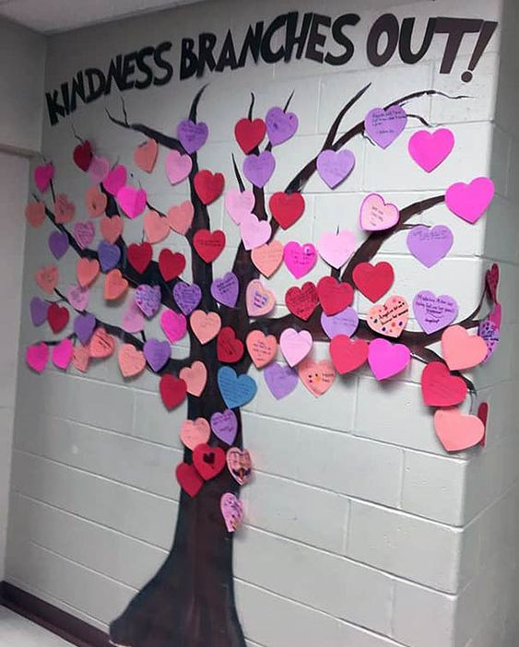
Activity:
Kindness Tree
Materials: 1. Colored Papers
2. Colors
3. Tape or Glue
4. Scissors
Notes:
We are reminded that a good tree bears a good fruit and since we all came from God and God is good, we know that we are good and can do good things. This activity will help us list down the things that we can do so we could be a good tree bearing good deeds. While doing these as well, we could be an example to our family, friends and the community.

Slide 15
Instruction:
Trace or draw leaves and flowers on colored paper and cut them out. Make sure the leaves and flowers are big enough to write a few words or a sentence.
Cut out a tree trunk shape and branches and tape them to a paper. You can also draw a tree directly on your colored papers.
Write acts of kindness that you can do in each flowers and leaves. Then paste it on your tree on your paper.
Kindness Tree will “bloom” whenever they
Accomplish the tasks they have written

Slide 16
Instruction:
Sample Acts of Kindness
Write a letter to a friend
Call a family member
Water the plants
Sweep the floor
Donate things to people in need
Practice a new hobby
Read a book
Pray the Holy Rosary with your family
Invite other friends or relative to attend LTW
Give compliments
Play with your siblings

Slide 17
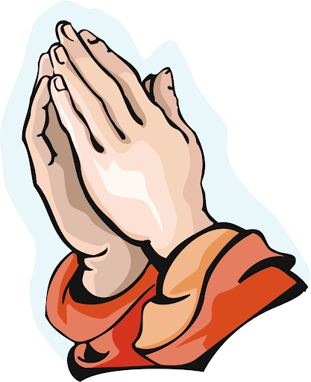
Closing Prayer
Dear God,
Thank you for all those who are sharing kindness in our communities. Thank you for their acts of kindness, generosity and love. Help me to be kind through my words, actions and attitude. Please show me if one of my family members (or friends) needs me to be extra kind to them today. Thank you, God, for inspiring us to be kind through your love for the world.
In Jesus name, we pray.
Amen.

Slide 18
LIVE THE WORD KIDS
8th Sunday in Ordinary Time | Cycle C

