Slide 1
LIVE THE WORD KIDS
7th Sunday in Ordinary Time | Cycle C

Slide 2
GOSPEL REFLECTION
The theme – LOVE – is both attractive and challenging. In a world characterized by aggressiveness and violence, the concept of Godlike love may seem unrealistic and incapable of solving the problems of justice, stability, and order. Other solutions may appear to be more “effective.” But, in the long run, the real solution can be found only in a love that is patterned after God’s love for us, for “God knows best”. Such a love is the only way to go beyond the present deficiencies and injustices, and build the Kingdom established by Christ. This is the “new order” characterized by authentic solidarity, compassion, forgiveness, and self-giving – all “family names” of the sublime reality we call “LOVE.”
Source: Sambuhay

Slide 3
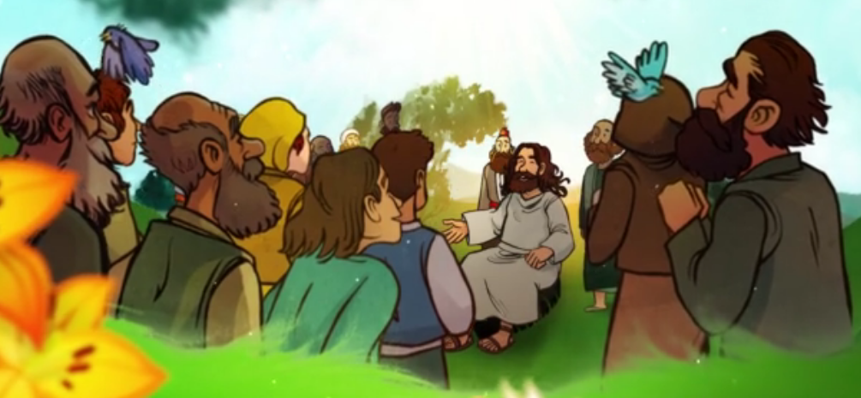
Love your enemies
Luke 6:27-38
Notes:
We continue reading from Jesus’ “Sermon on the Plain.” Today Jesus continues his “inaugural discourse” by proclaiming the climax of his teaching: love of neighbor without boundaries and without conditions. Last week we began Jesus’ Sermon on the Plain and we heard the four blessings (beatitudes) and the four curses (woes). The final woe was “Woe to you when all speak well of you. Their fathers treated the false prophets in just this way.” We now hear Jesus tell us to love our enemy.

Slide 4
Leader: A reading from
the Holy Gospel
according to Luke.
All: Glory to You, Oh Lord.

Slide 5
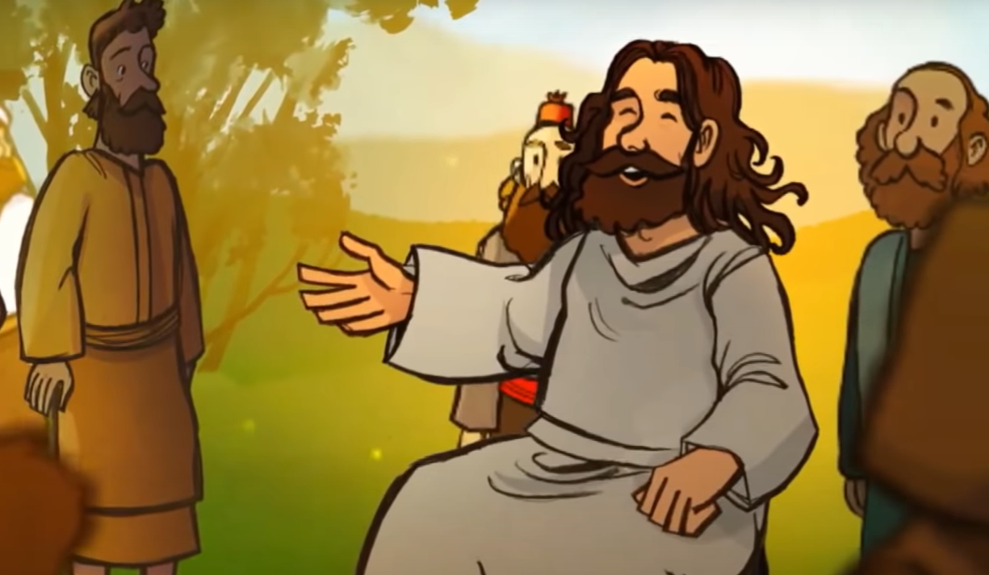
Jesus is speaking to would-be disciples.
27
“But to you who hear I say, love your enemies,
do good to those who hate you,
Notes:
Jesus is speaking to would-be disciples. This statement refers back to verse 22: “Blessed shall you be when men hate you, when they ostracize you and insult you and proscribe your name as evil.”

Slide 6
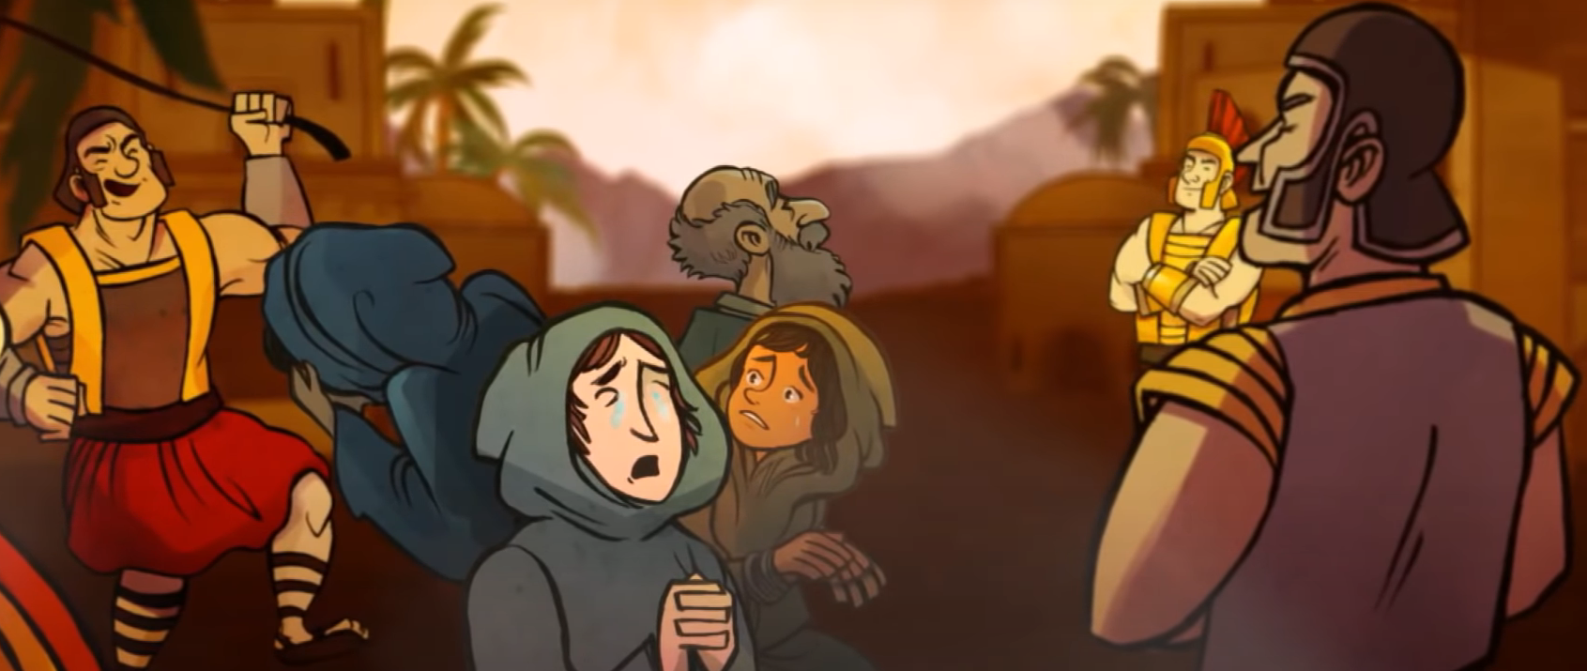
28
Bless those who curse you, pray for those who mistreat you.

Slide 7
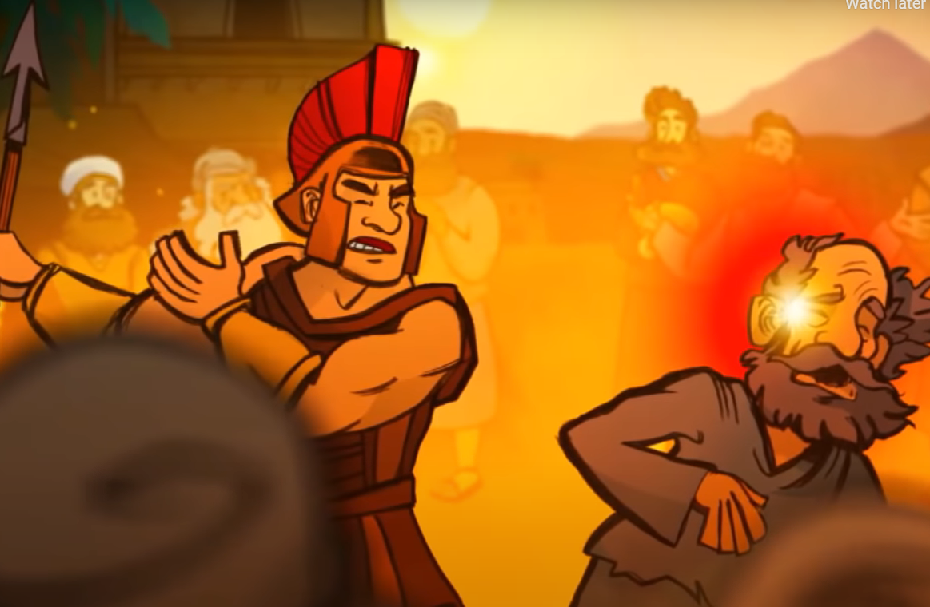
29
To the person who strikes you on one cheek, offer the other one as well, and from the person who takes your cloak, do not withhold even your tunic.
Notes:
The cloak (coat) is more valuable than the tunic (shirt). The cloak is used for sleeping outdoors. The cloak once had a special value as bond (Deuteronomy 24:10-13)

Slide 8
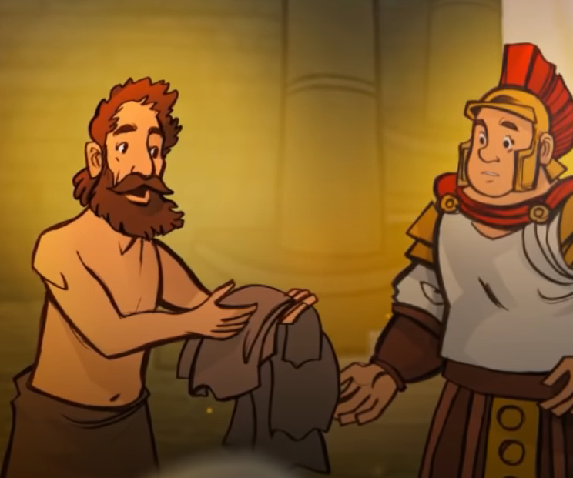
30
Give to everyone who asks of you, and from the one who takes what is yours do not demand it back.

Slide 9
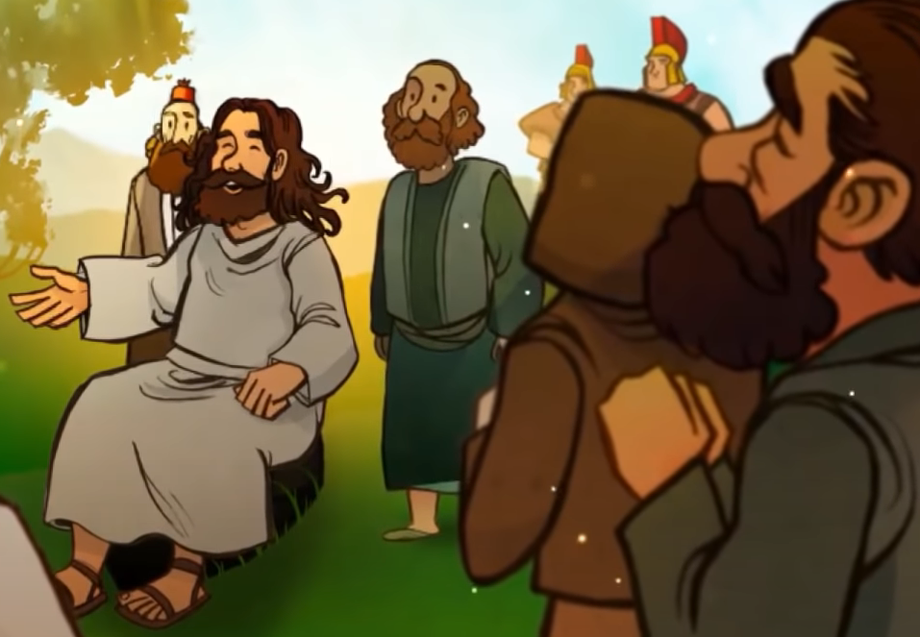
31
Do to others
as you would have them
do to you.
Notes:
The golden rule. Jesus does provide the supreme example of living this out and expects the same from His disciples.

Slide 10
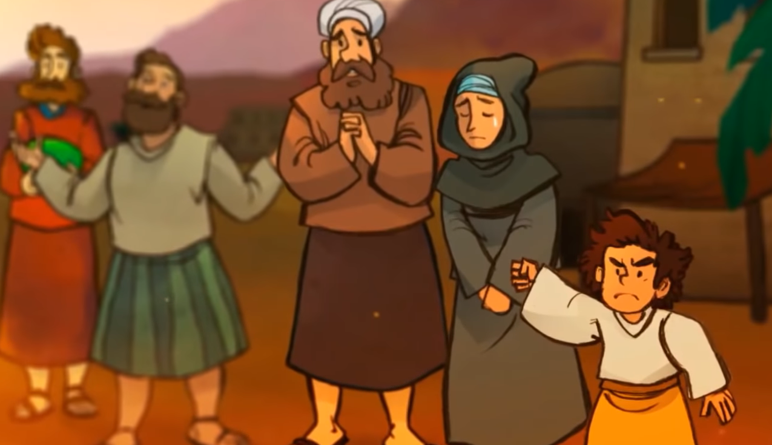
32
For if you love those who love you, what credit is that to you? Even sinners love those who love them.

Slide 11
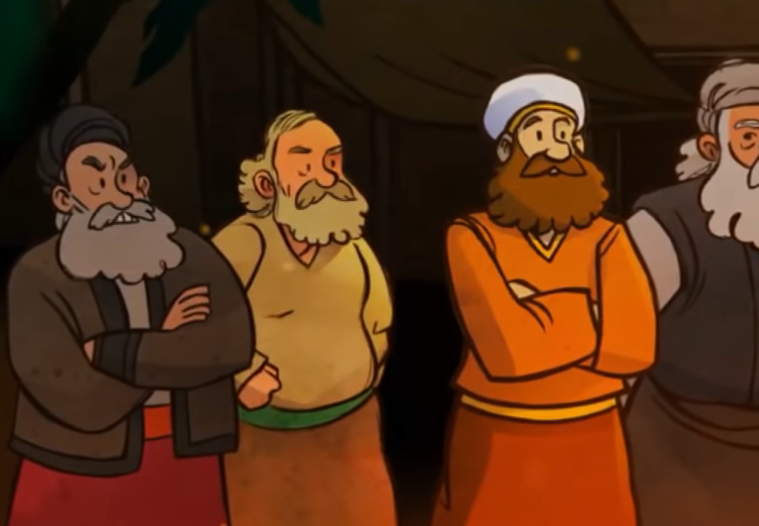
33
And if you do good to those who do good to you, what credit is that to you? Even sinners do the same.
Notes:
Be kind. This implies tenderness, liberality, amiability.

Slide 12
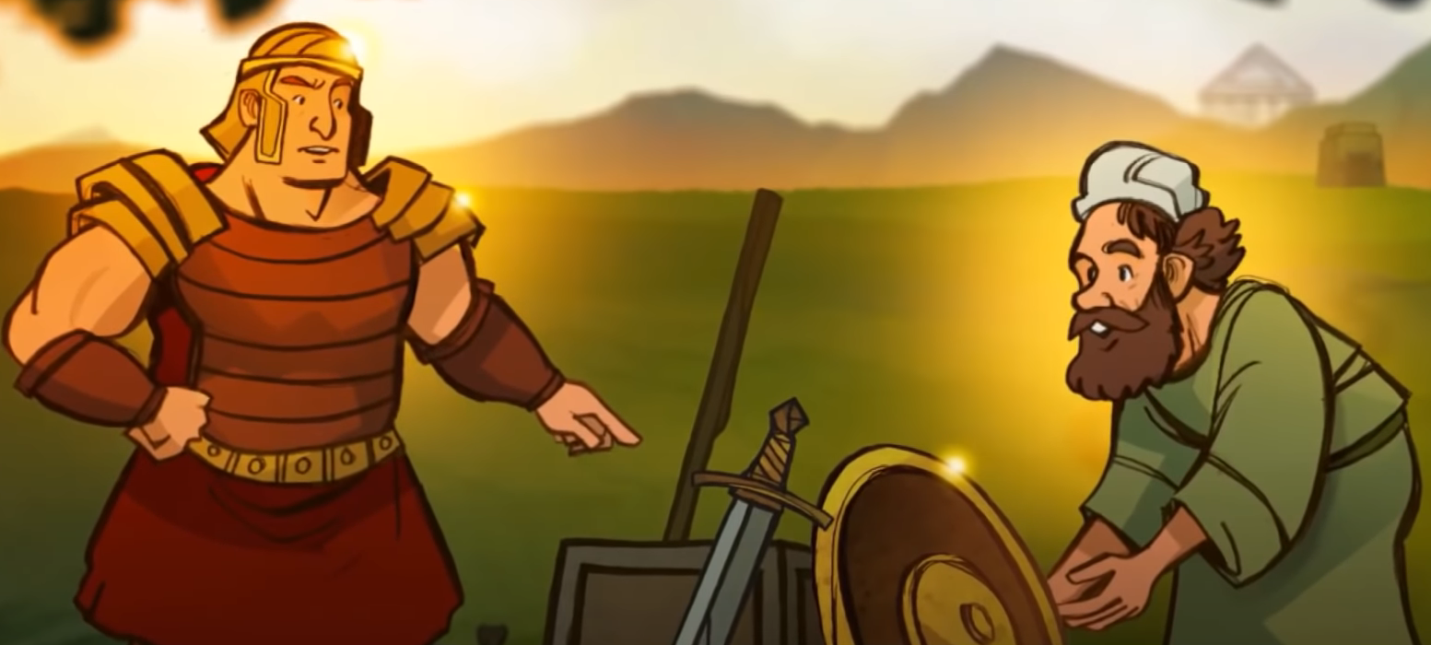
34
If you lend money to those from whom you expect repayment, what credit that to you? Even sinners lend to sinners, and get back the same amount.

Slide 13
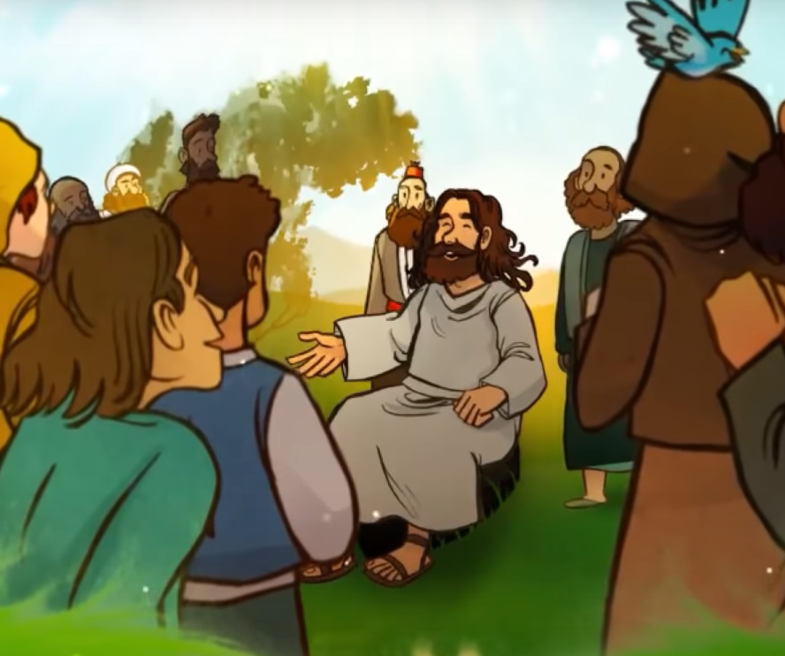
35
But rather, love your enemies and do good to them, and lend expecting nothing back; then your reward will be great and you will be children of the Most High, for he himself is kind to the ungrateful and the wicked.

Slide 14
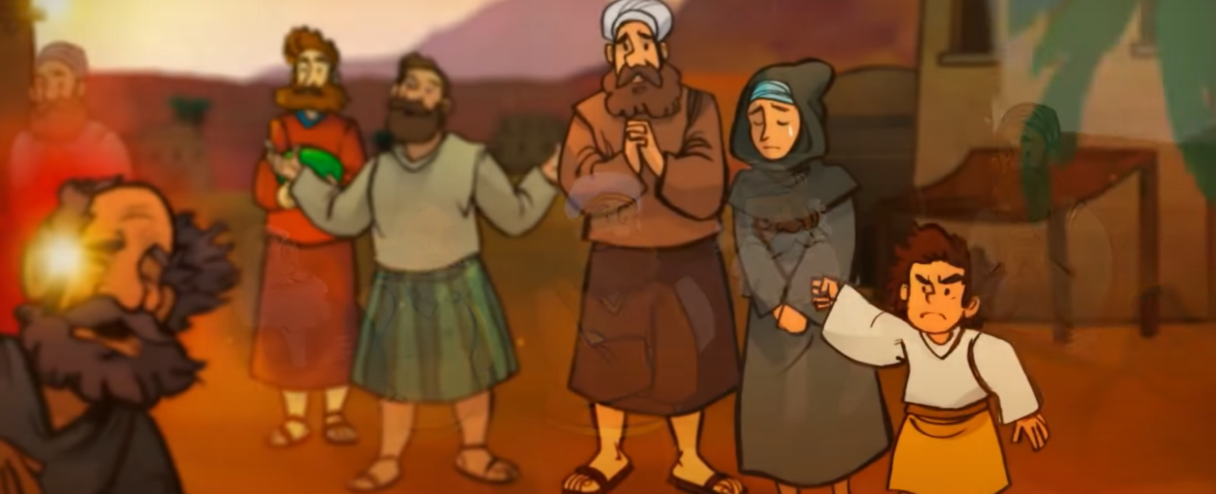
36
Be merciful, just as your Father is merciful.
Notes:
In the Old Testament, mercy is attributed to God, rarely to men, while perfection is a goal to be sought by man.

Slide 15
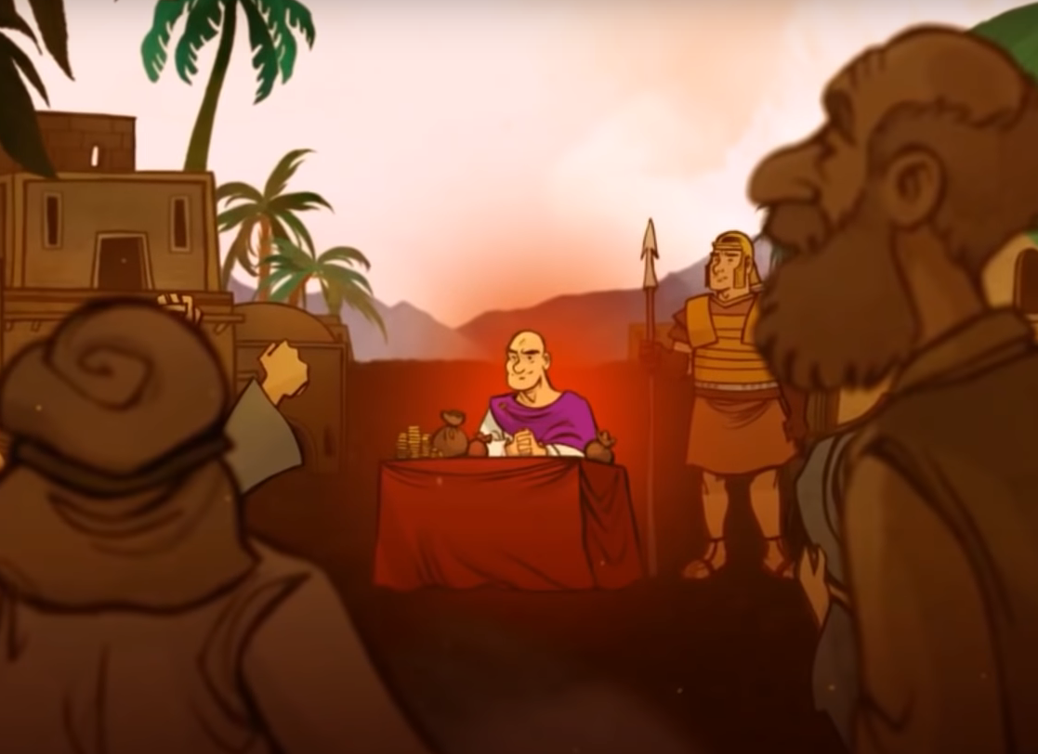
37
“Stop judging and you will not be judged. Stop condemning and you will not be condemned. Forgive and you will be forgiven.

Slide 16
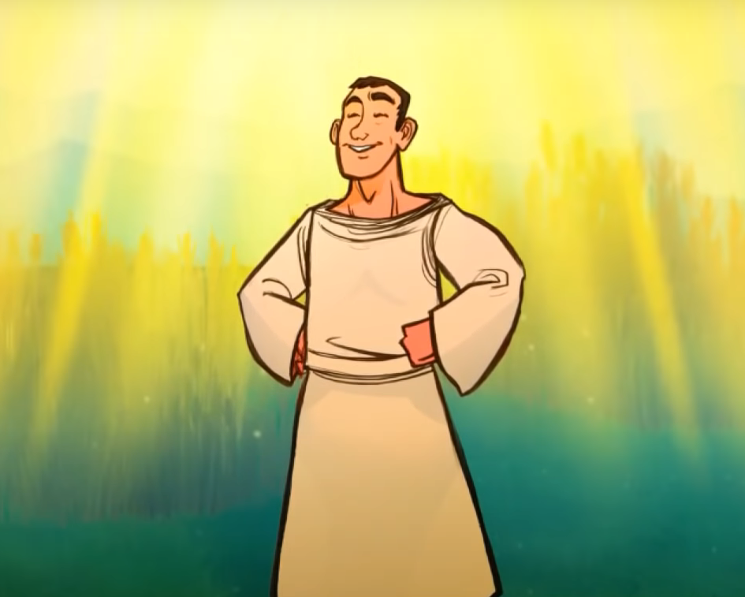
38
Give and gifts will be given to you; a good measure, packed together, shaken down, and overflowing, will be poured into your lap. For the measure with which you measure will in return be measured out to you.”
Notes:
The word “measure,” as it is used in Matthew, is a standard of judgment; but here in Luke, it is the capacity of one’s generosity

Slide 17
Leader: The Gospel of the Lord.
All: Praise to You,
Lord Jesus Christ.

Slide 18
GOSPEL MESSAGE

Slide 19
Activity:
Love Challenge
Materials: 1. Colored Papers
2. Colors/
3. Tape
4. Glue
Notes:
The gospel taught us to how truly love the people around us. Jesus is teaching us to love even to those people who are hard to love. Our activity for this week will help us to show love in ways we don’t usually show to the people around us.

Slide 20
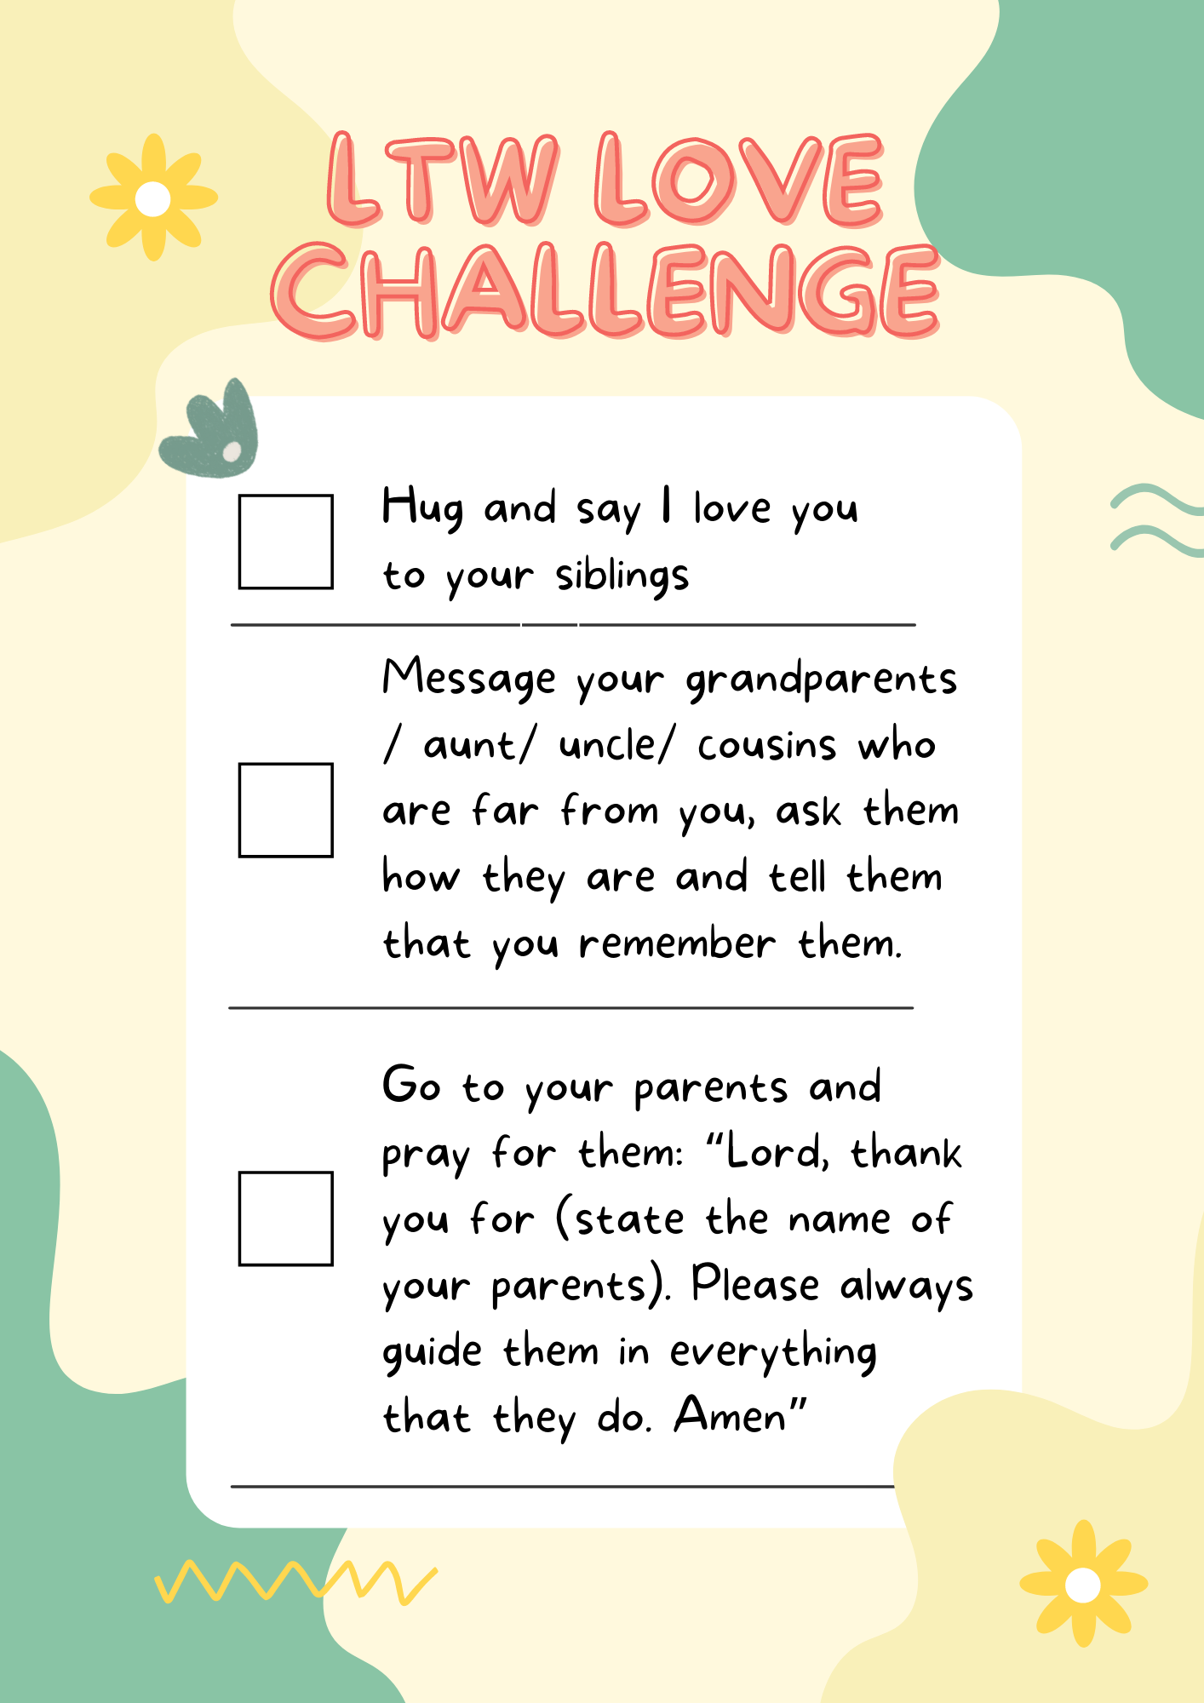
Instruction:
Write the following challenges on your clean paper and draw a box beside it:
Hug and say I love you to your siblings
Message your grandparents/ aunt/ uncle/ cousins who are far from you, ask them how they are and tell them that you remember them
Go to your parents and pray for them: “Lord, thank you for (state the name of your parents). Please always guide them in everything that they do. Amen”

Slide 21
Instruction:
2. You may put design on your love challebnge checklist.
3. You have the whole week to do it. Once you have done doing it, don’t forget to put a check on it.
4. Bring your accomplished checklist next LTW Kids!
5. Don’t forget to do these 3 challenges!

Slide 22
Closing Prayer
Dear God,
Father, it is easy to love those who love us. Help us to love our enemies so that they might know that we are Your children. Lord we pray that You may use us to let other people feel Your love.
In Jesus name, we pray.
Amen.

Slide 23
LIVE THE WORD KIDS
7th Sunday in Ordinary Time | Cycle C

