Slide 1
LIVE THE WORD KIDS
6th Sunday in Ordinary Time | Cycle C

Slide 2
GOSPEL REFLECTION
Today’s Liturgy of the Word invites us to refl ect on two fundamental choices: blessing or curse, life or death. We choose the best when we put our trust in the Lord and live according to this choice. Such is the message of the Beatitudes. The Lord should be our only Treasure, ur Friend, our Guide, and our fi nal Reward.
In this Eucharist, we will pray in a special manner for the grace to always stay close to the Lord Jesus and live by the light of his Beatitudes. We will also pray for those who are blinded by their passions and make choices that are destructive of their dignity and endanger their eternal salvation. May all of us see the light and live according to the teaching and example of Jesus.
Source: Sambuhay

Slide 3
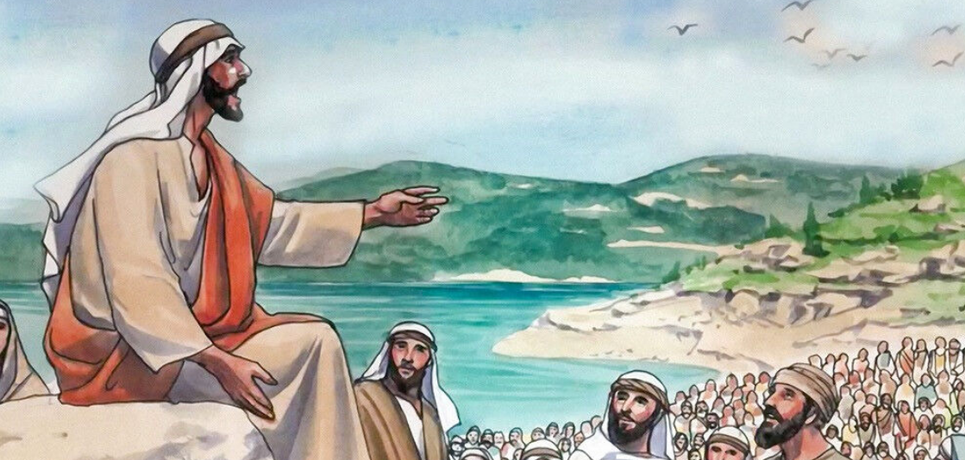
The Beatitudes
Luke 6:17.20-26
Notes:
Jesus is still at the beginning of his apostolic ministry and already fi nds himself surrounded by immense crowds. He has words of hope for all those who are poor, suffering or ill-treated. But he has also serious warnings against those who focus on earthly pleasures instead of pursuing higher values.

Slide 4
Leader: A reading from
the Holy Gospel
according to Luke.
All: Glory to You, Oh Lord.

Slide 5
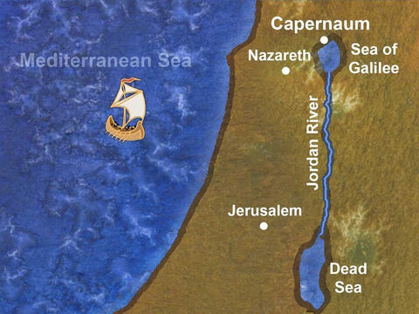
17
And he came down with them and stood on a stretch of level ground.
A great crowd of his disciples and a large number of the people from all Judea and Jerusalem and the coastal region of Tyre and Sidon
Notes:
Not just disciples, but many others as well. Judea and Jerusalem are by the Dead Sea, Tyre and Sidon are on the Mediterranean seacoast north of the Sea of Galilee. Apparently, these places are mentioned to show that Jesus had followers (and curious) from far and wide.

Slide 6
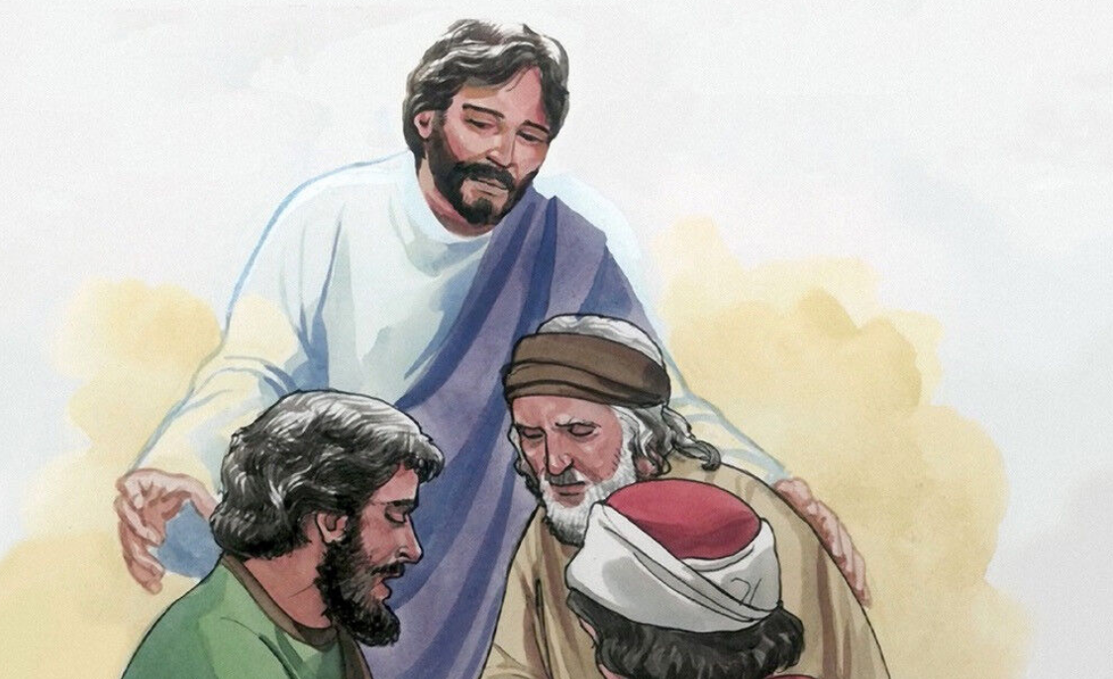
20
And raising his eyes toward his disciples he said:
“Blessed are you who are poor, for the kingdom of God is yours.
Notes:
Blessed are you: This is a form of joyful outburst or congratulation. It is different from the liturgical expression of blessing, praise or thanksgiving
Who are poor: The poor here are those who are the lowly ones and depend desperately upon Yahweh for help. While Matthew writes of “the poor in spirit... who hunger for justice,” Luke writes more simply of “you poor... who hunger... who are weeping.” Luke makes great demands and expects strong simplicity of the followers of Jesus.

Slide 7
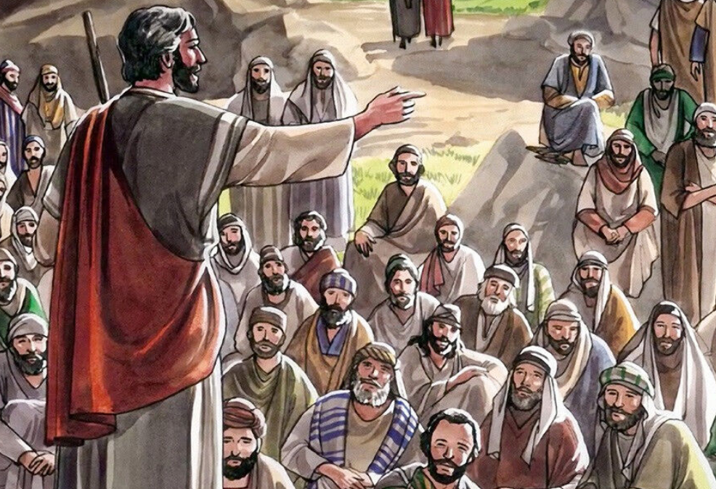
21
Blessed are you who are now hungry, for you will be satisfied.
Blessed are you who are now weeping, for you will laugh.
Notes:
Hungry: Famine for word of God
Weeping: Are concerned for their salvation

Slide 8
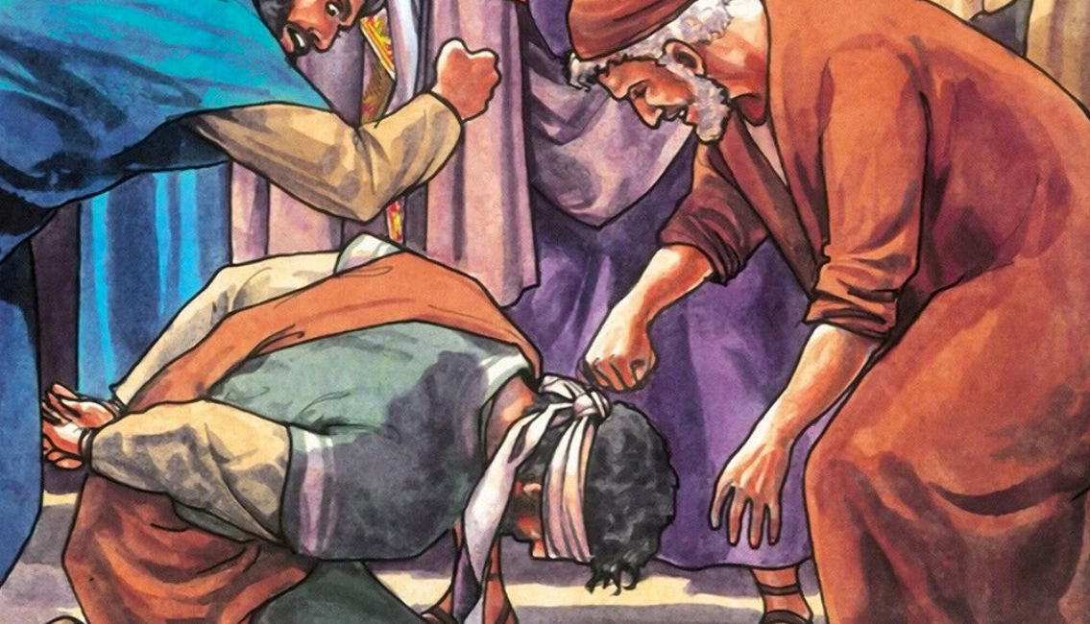
22
Blessed are you when people hate you, and when they exclude and insult you, and denounce your name as evil on account of the Son of Man.
Notes:
When you are persecuted because you are a follower of Jesus. Remember, persecution is a reward of discipleship.

Slide 9
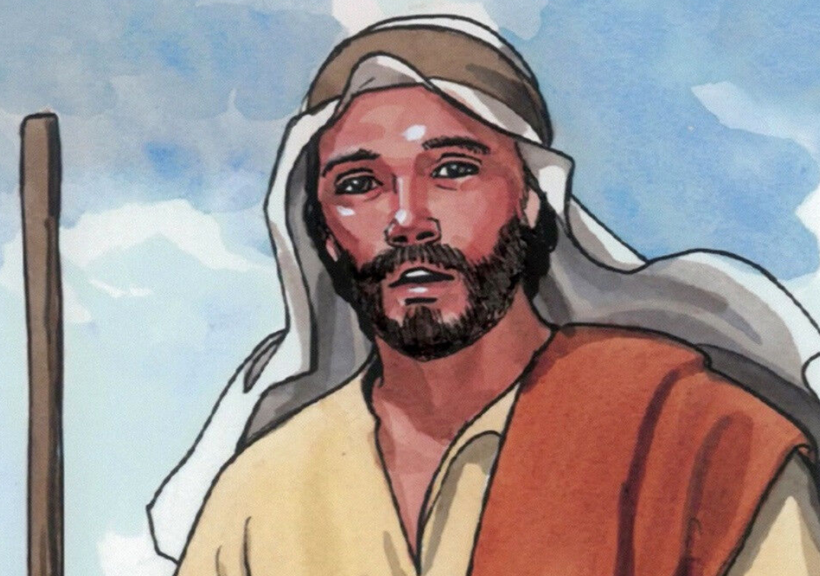
23
Rejoice and leap for joy on that day! Behold, your reward will be great in heaven. For their ancestors treated the prophets in the same way.

Slide 10
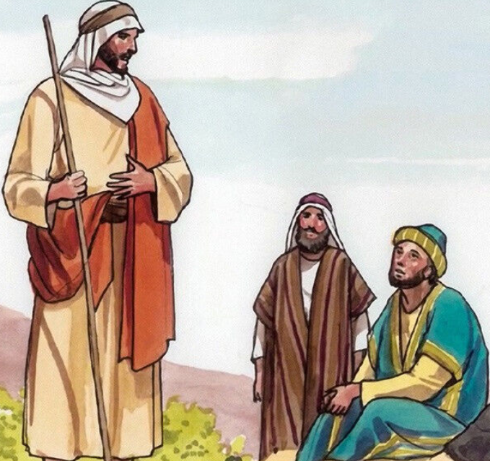
24
But woe to you ho are rich,
for you have received your consolation.
Notes:
Luke uses a technical term for someone who has undertaken a debt. Woe or bankruptcy upon each man who does not acknowledge that he owes every comfort to Jesus.

Slide 11
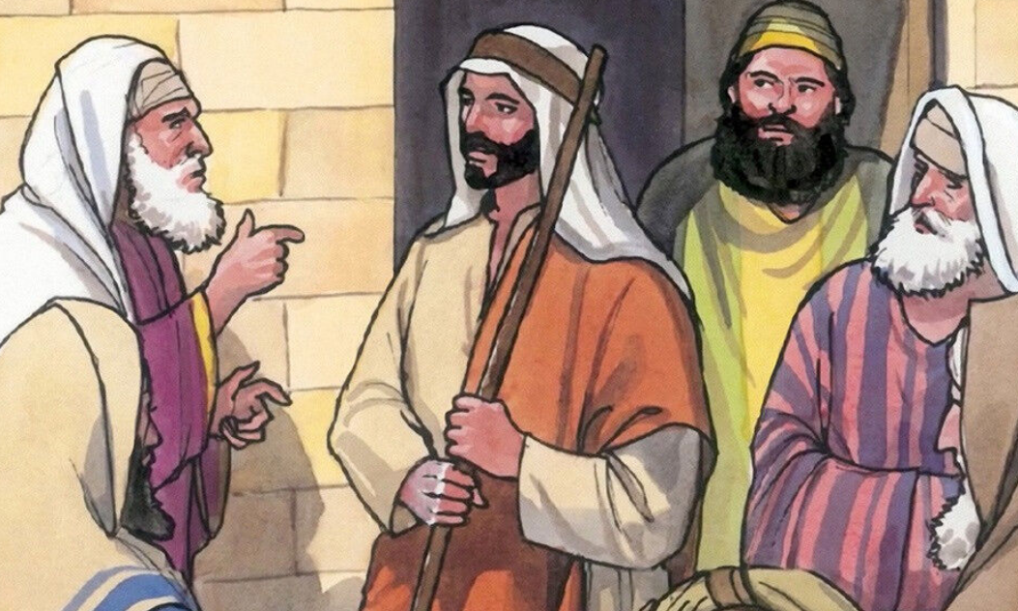
25
But woe to you who are filled now, for you will be hungry. Woe to you who laugh now, for you will grieve and weep.

Slide 12
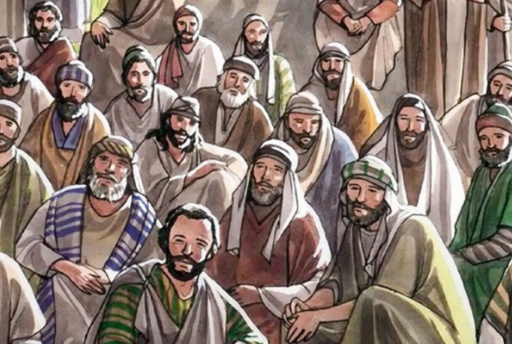
26
Woe to you when all speak well of you,
for their ancestors treated the false prophets in this way
Notes:
Notice here that Jesus is not addressing a social class but condemning four things:
Avarice and attachment to worldly things.
2) Excessive care of the body, gluttony.
3) Empty-headed joy and general self-indulgence.
4) Flattery and disordered desire for human glory.
These are four very common vices which the Christian needs to be on guard against.

Slide 13
Leader: The Gospel of the Lord.
All: Praise to You,
Lord Jesus Christ.

Slide 14
GOSPEL MESSAGE

Slide 15
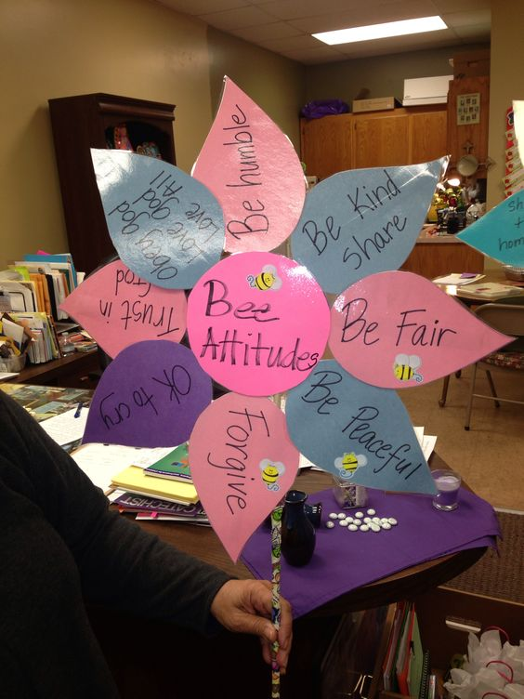
Activity:
Bee Attitudes
Materials: 1. Colored Papers
2. Straw or sticks
3. Tape
4. Glue
Notes:
The eight beatitudes which Saint Matthew gives (Matthew 5:3-12) are summed up in four by Saint Luke. Saint Luke also gives us four opposite woes (curses), to go with the beatitudes while Saint Matthew has none. These woes cast Jesus as a prophet because the prophet’s job was to pronounce the blessings and curses as he reminded the people of God’s covenant and the obligations involved in keeping it

Slide 16
Instruction:
Cut 8 petal shapes and 1 circle from your colored papers.
Write the following in attitudes per petal:
Be humble
Be kind and share
Be fair
Be peaceful
Firguve
It’s okay to cry
Trust in God
Obey God and Love God

Slide 17
Instruction:
3. Using tape or glue, put together the 8 petals and 1 circle to make a flower just like in the picture
4. Using a tape, put the stick at the back of the flower.

Slide 18
Closing Prayer
Dear God,
We thank You Lord for the guide that You’ve given us so we can be better persons. Thank you for Your love that longs for us to be with You in heaven someday. Help us to be kind, to be fair, to be peaceful, to forgive, to cry when there is need, to trust in You and to obey You always.
In Jesus name, we pray.
Amen.

Slide 19
LIVE THE WORD KIDS
6th Sunday in Ordinary Time | Cycle C

