Slide 1
LIVE THE WORD KIDS
5th Sunday in Ordinary Time | Cycle C

Slide 2
GOSPEL REFLECTION
The God who created the universe single-handedly and holds it in His hand does not save it single-handedly. He seeks the collaboration of all. But over and above this general
cooperation, He also chooses, calls and sends some individuals to be the heralds of His messages, and the special instruments of His love. We call these people “prophets” and “apostles.” Their lives are a mixture of ordinary weakness and exceptional strength, of
humiliating defeats and resounding victories. But in spite of such disconcerting contrasts, if they do their best, as Isaiah, Paul, and Peter did, “the world will be better for this” and good will triumph over evil.
On this 5th Sunday in Ordinary Time, we witness a miraculous catch of fish which symbolizes the mission of Jesus and his associates to save mankind from the forces of evil, symbolized by the stormy seas. In every generation and community of believers, Jesus, the Divine Fisherman, continues to invite people to share in his mission of saving mankind from the clutches of evil in all its forms. The response to Jesus’ invitation demands generosity and perseverance.
In this Eucharist, we will pray in a special manner that all those who are called to fulfi ll this
task may respond generously and persevere faithfully till the end of their life.
Source: Sambuhay

Slide 3
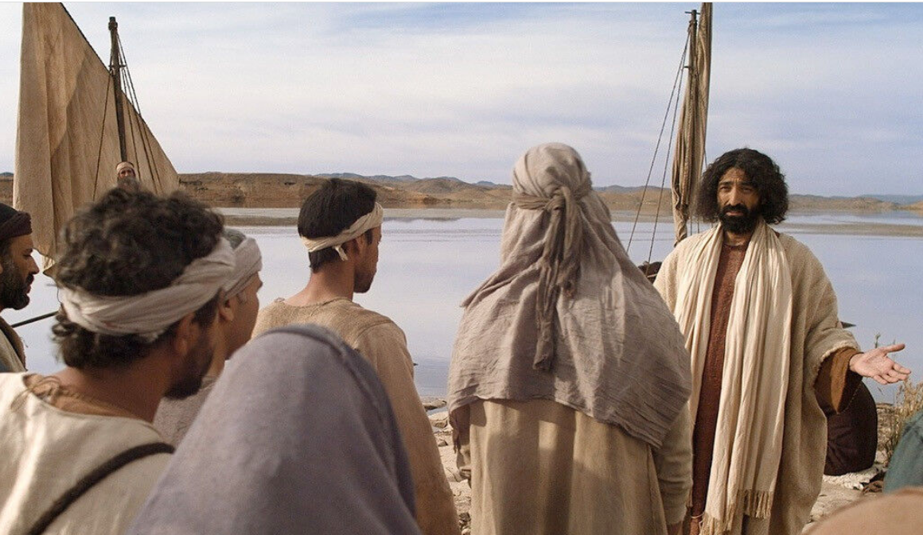
The Call of Simon the Fisherman
Luke 5:1-11

Slide 4
Leader: A reading from
the Holy Gospel
according to Luke.
All: Glory to You, Oh Lord.

Slide 5
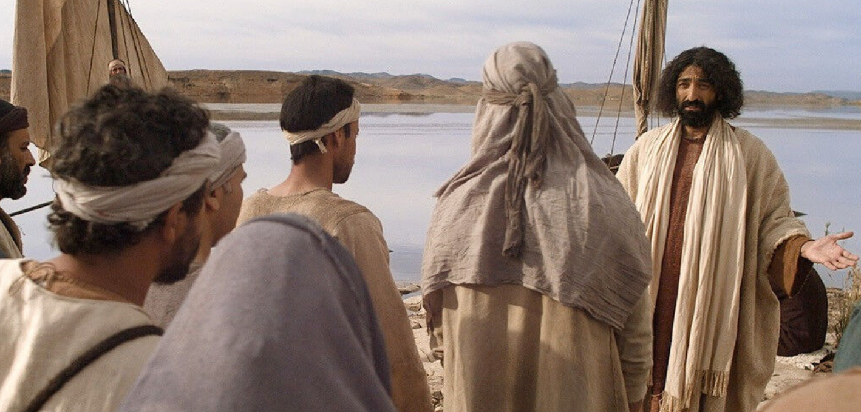
1
While the crowd was pressing in on Jesus and listening to the word of God, he was standing by the Lake of Gennesaret
Notes:
The phrase “word of God” is used 5 times in Luke and 13 times in Acts (Revised Standard Version) [5 times in Luke and 11 times in Acts in the New American Bible] and generally refers to the Christian message. By using this phrase of Jesus’ preaching, Luke “roots the community’s proclamation in the teaching of Jesus”. Lake of Gennesaret is The Sea of Galilee

Slide 6
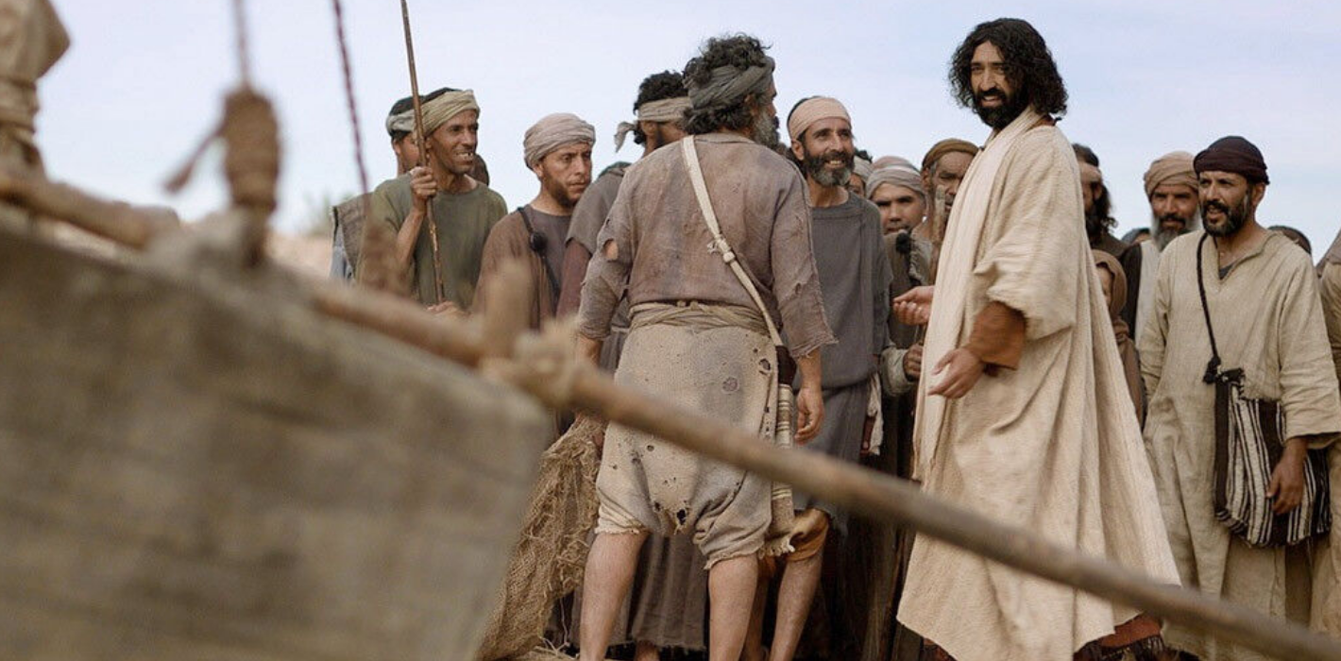
2
He saw two boats there alongside the lake; the fishermen had disembarked and were washing their nets.

Slide 7
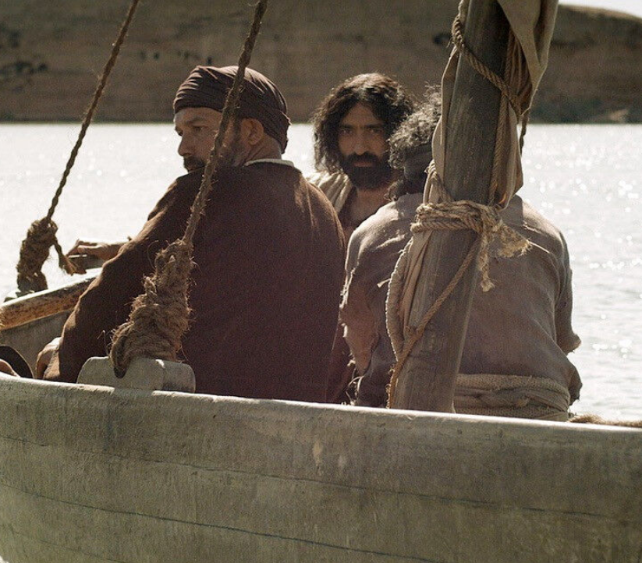
3
Getting into one of the boats, the one belonging to Simon, he asked him to put out a short distance from the shore. Then he sat down and taught the crowds from the boat.

Slide 8
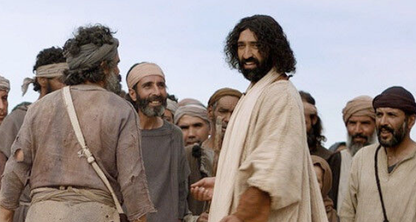
4
After he had finished speaking, he said to Simon, “Put out into deep water and lower your nets for a catch.”

Slide 9
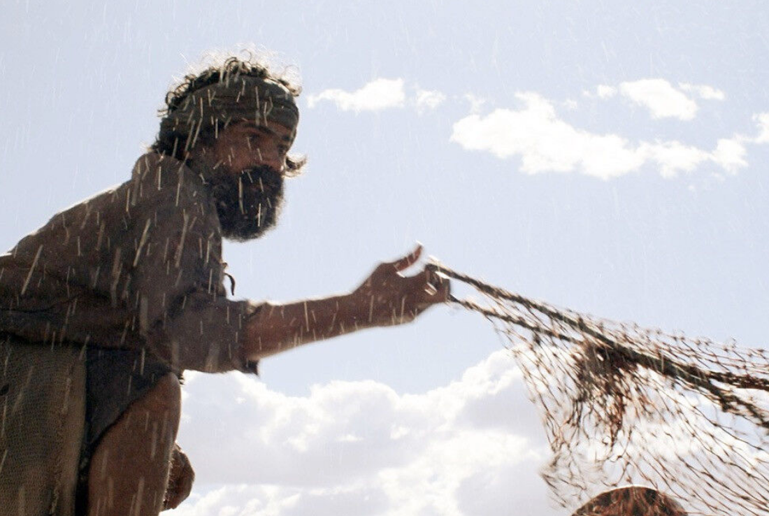
5
Simon said in reply, “Master, we have worked hard all night and have caught nothing, but at your command I will lower the nets.”
Notes:
Luke wrote for a primarily gentile audience. He uses “master” as a favorite title for Jesus rather than the Hebrew title of “rabbi”. Although they worked exhaustively throughout the night, Peter will let down the net because Jesus has asked him to. Nighttime was the normal time for fishing.

Slide 10
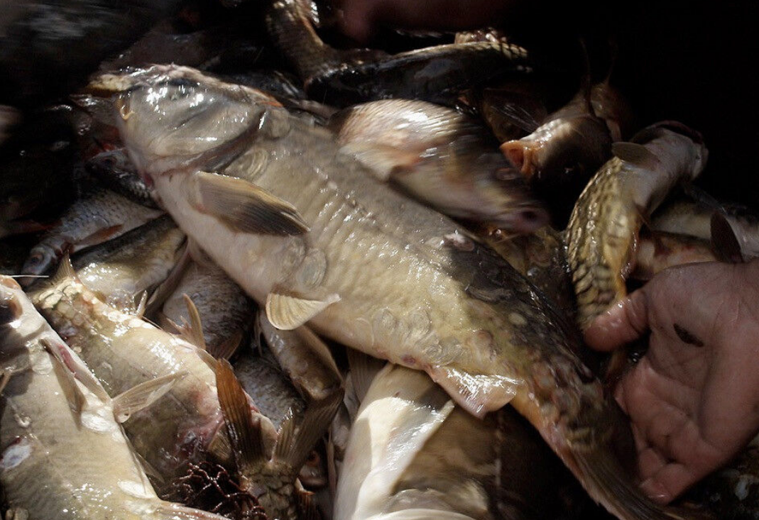
6
When they had done this, they caught a great number of fish and their nets were tearing.
Notes:
Fishing nets 2,000 years ago were not like they are today. They had no synthetics (nylon, rayon, etc.) but had only hemp, cotton, wool and other natural fibers to work with. The nets were weak by modern standards.

Slide 11
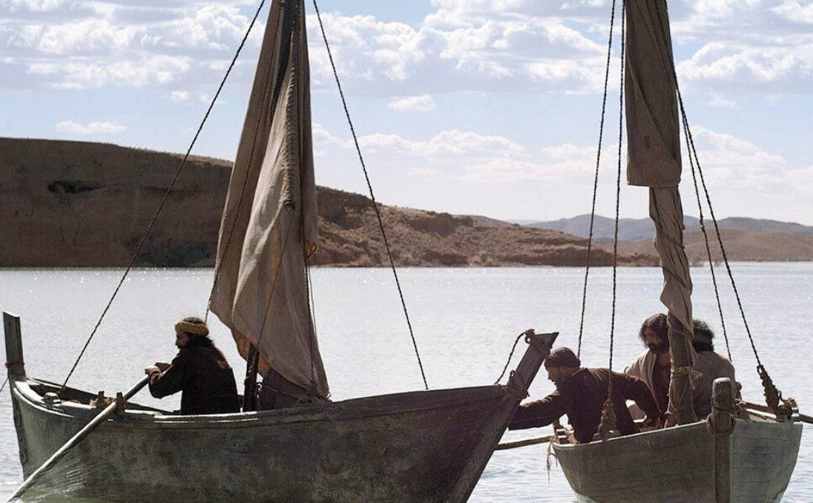
7
They signaled to their partners in the other boat to come to help them. They came and filled both boats so that they were in danger of sinking.
Notes:
Truly a miracle. First, because none were caught earlier; and second, because the weak nets could contain enough fish to almost swamp two boats

Slide 12
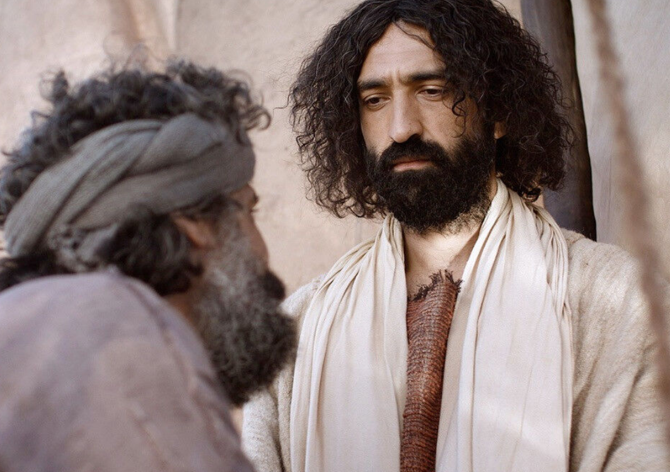
8
When Simon Peter saw this, he fell at the knees of Jesus and said, “Depart from me, Lord, for I am a sinful man.
Notes:
The change from “master” to “Lord” reflects Simon’s recognition of the presence of the divine. How many today would recognize the divine presence or would they simply try to strike up a business deal – “You tell me when and where to fish, and I’ll give you a share of 8 the profits.”

Slide 13
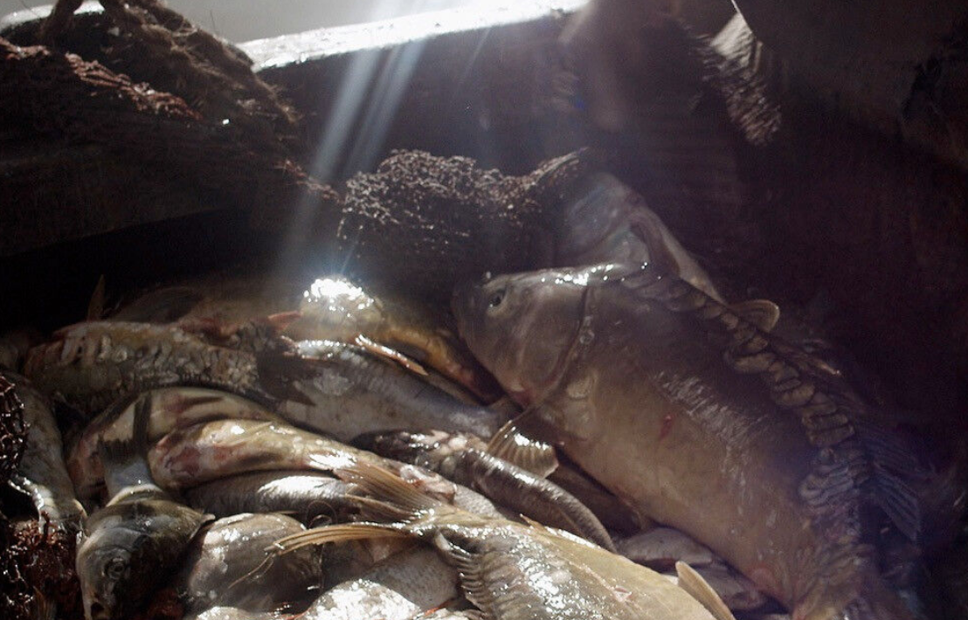
9
For astonishment at the catch of fish they had made seized him and all those with him,

Slide 14
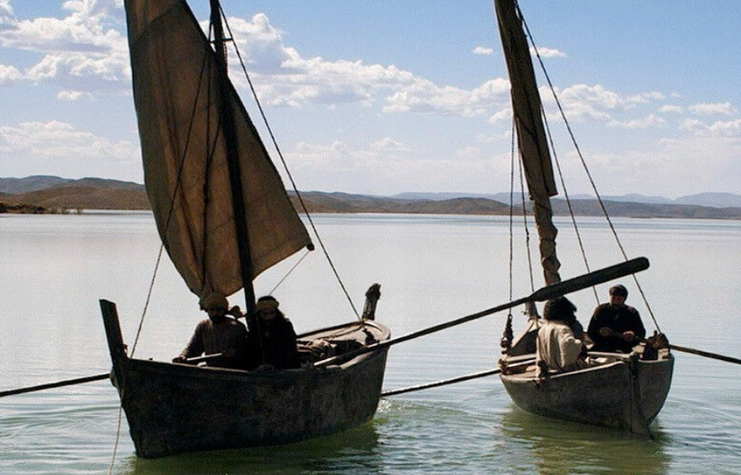
10
and likewise James and John, the sons of Zebedee, who were partners of Simon. Jesus said to Simon, “Do not be afraid; from now on you will be catching men.”

Slide 15
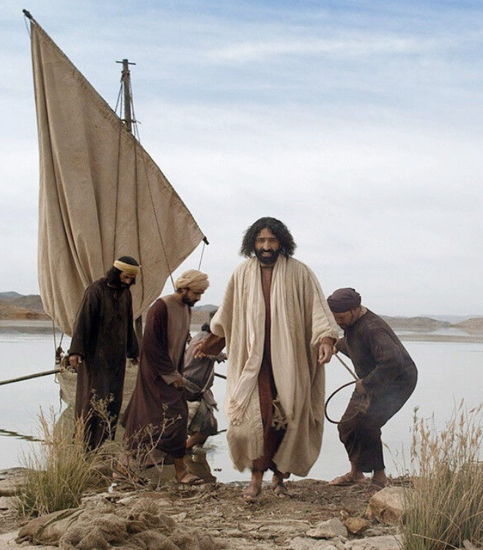
11
When they brought their boats to the shore, they left everything and followed him.
Notes:
Simon’s recognition that he was in the presence of the divine caused him great fear because he didn’t see himself as adequate. As he said, “I am a sinful man.” One doesn’t have to be sinless in order to approach Jesus, His mercy helps us to recognize our sinfulness and repent.
Followers are not members of the crowd but walk in His footsteps. They live the life which Jesus sets as the example.

Slide 16
Leader: The Gospel of the Lord.
All: Praise to You,
Lord Jesus Christ.

Slide 17
GOSPEL MESSAGE

Slide 18
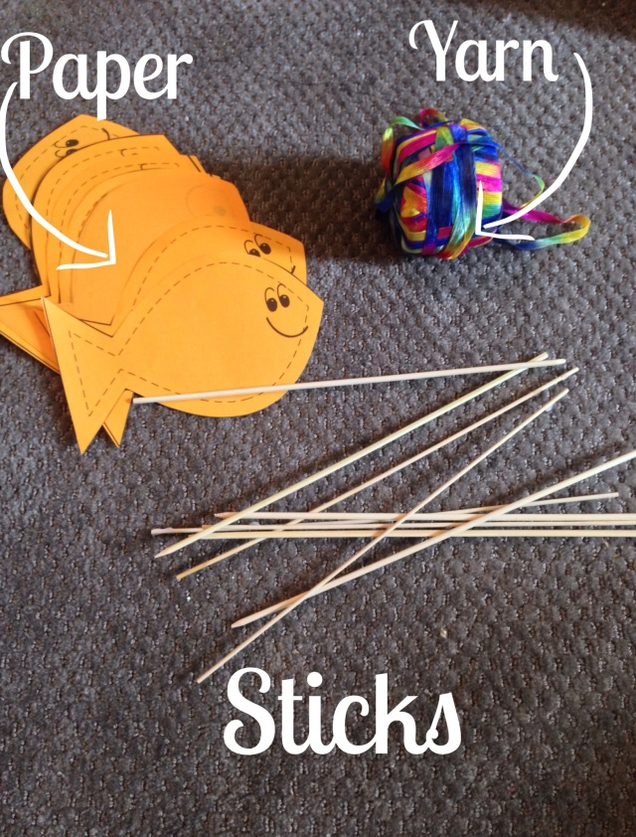
Activity:
I am a fisher of men
Materials: 1. Colored Papers
2. Straw or sticks
3. Yarn or thread
Notes:
In our gospel reading, we have learned how Jesus called His first disciples to become fishers of men to become evangelizers and follow him. Young as the kids are, they can also be fishers of men by inviting their friends and family to attend our LTW Kids and other MFC Kids Assembly.

Slide 19
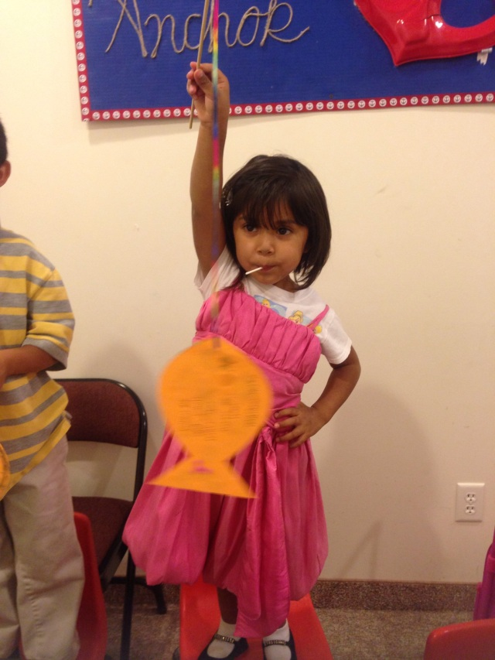
Instruction:
Cut a fish shape from your paper.
Write the name of your friends or family friends you want to invite in our activities
Put a small hole on a cut fish shape to tie the other side of the thread or yarn.
Tie the other side of the yarn on the stick or straw.
Don’t forget to invite those names you have written next LTE and MFC Kids Assembly!

Slide 20
Closing Prayer
Dear God,
Thank you for the gift of Your miracle. Thank You for giving us all the things we need even if we think that it is impossible. Thank You for also calling us to be like your first disciples to also become fishers of men. Lord we pray for (state the names from the activity), help us to invite them in our LTW Kids and other activities that would help them get to know You more.
In Jesus name, we pray.
Amen.

Slide 21
LIVE THE WORD KIDS
5th Sunday in Ordinary Time | Cycle C

