Slide 1
LIVE THE WORD KIDS
4th Sunday of Advent | Cycle A

Slide 2
GOSPEL REFLECTION
A central message of advent is in the last few lines of the gospel: ‘Emmanuel, a name which means “God-is-with-us”’.
This is the true and deepest meaning of the Christmas time; worth our preparation. The baby in the manger, the child in his mother’s womb, the outpouring of the Holy spirit on Mary, is ‘God-is-with-us.
Christmas offers the gift of faith; offers this gift with the very human realities of birth, joy, struggle, confusion and peace. Christmas is a gift given, and a gift to be shared, and sometimes a gift to be worked at.
In prayer we receive the peace and joy of the feast; in our kindness to others at Christmas we share his coming; and in our working in the world, or in the family and communities, for peace, reconciliation, forgiveness and other qualities of the message of the gospel, we bring Christmas alive.
In these ways God is with us; his birth was in the ordinary locality, not just in the temple, so it is great to see the crib in the street, the shop window and in the home.
We need this message very much in a world of war and terror; we need it too in the ordinary days of our lives. and we can be truly grateful that the real Christmas gift is wrapped in the human body and lasts forever, for this life and the next.
Jesus, Emmanuel, strengthen our faith.

Slide 3
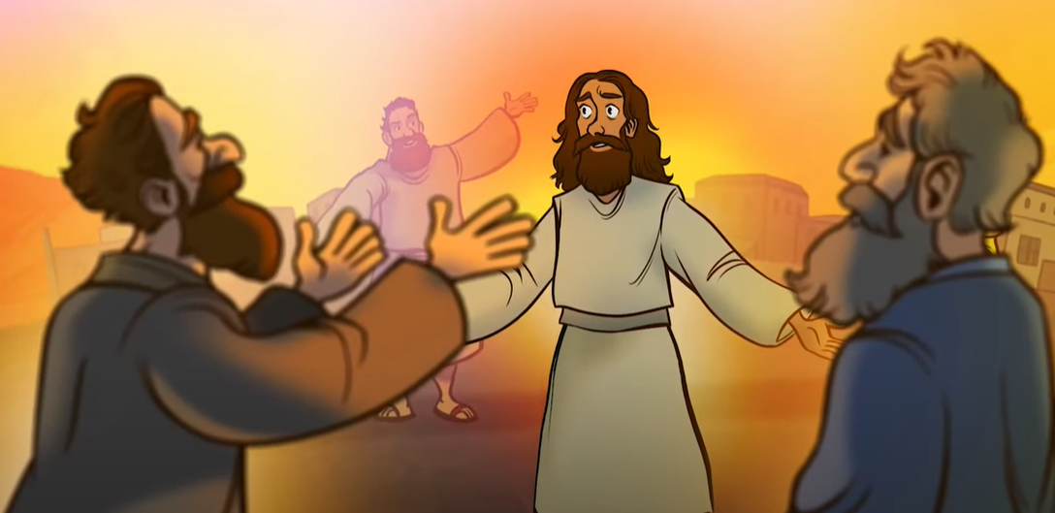
The Birth of Jesus Christ
Matthew 1:18-24

Slide 4
Leader: A reading from
the Holy Gospel
according to Matthew.
All: Glory to You, Oh Lord.

Slide 5
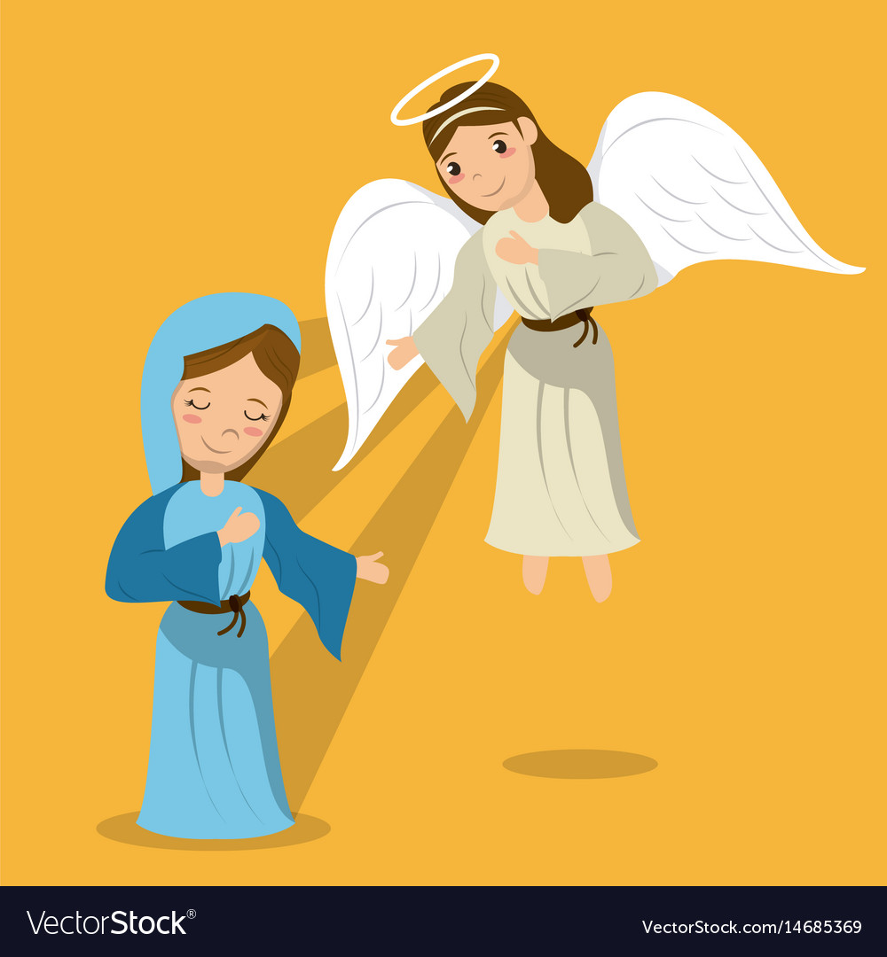
18
This was how the birth of Jesus Christ took place. His mother Mary was engaged to Joseph, but before they were married, she found out that she was going to have a baby by the Holy Spirit.

Slide 6
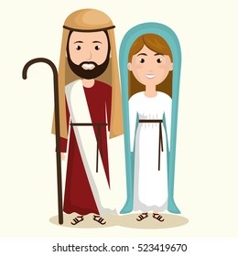
19
Joseph was a man who always did what was right, but he did not want to disgrace Mary publicly; so he made plans to break the engagement privately.

Slide 7
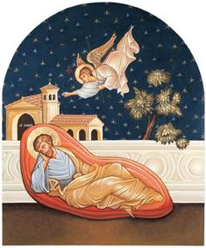
20
While he was thinking about this, an angel of the Lord appeared to him in a dream and said, “Joseph, descendant of David, do not be afraid to take Mary to be your wife. For it is by the Holy Spirit that she has conceived.

Slide 8
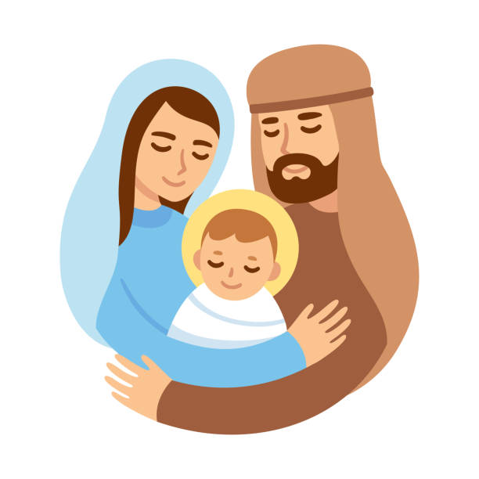
21
She will have a son, and you will name him Jesus—because he will save his people from their sins.”

Slide 9
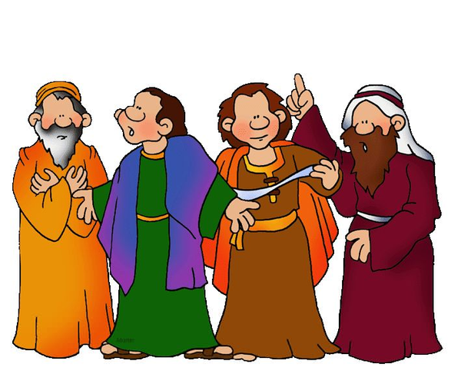
22
Now all this happened in order to make come true what the Lord had said through the prophet,

Slide 10
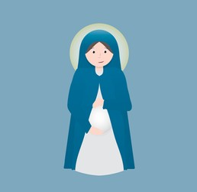
23
“A virgin will become pregnant and have a son, and he will be called Immanuel” (which means, “God is with us”).

Slide 11
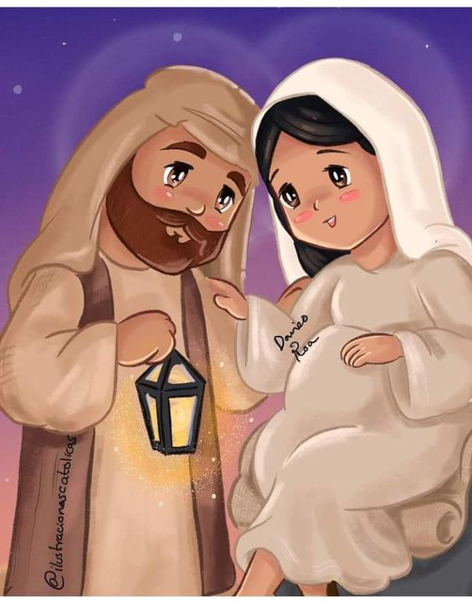
24
So when Joseph woke up, he married Mary, as the angel of the Lord had told him to.

Slide 12
Leader: The Gospel of the Lord.
All: Praise to You,
Lord Jesus Christ.

Slide 13
GOSPEL MESSAGE

Slide 14
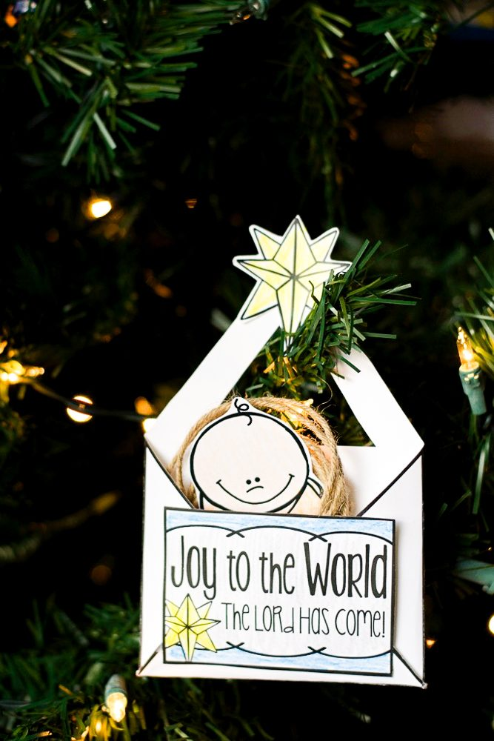
Activity:
The Greatest Gift
Materials: 1. Small white envelope
2. Colored Paper
3. Markers/Pens
4. Glue
5. Scissors
6. Crayons

Slide 15
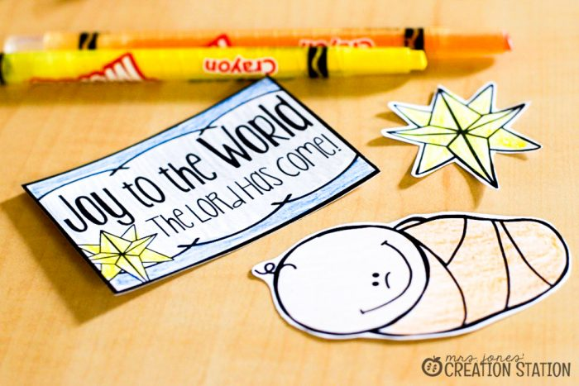
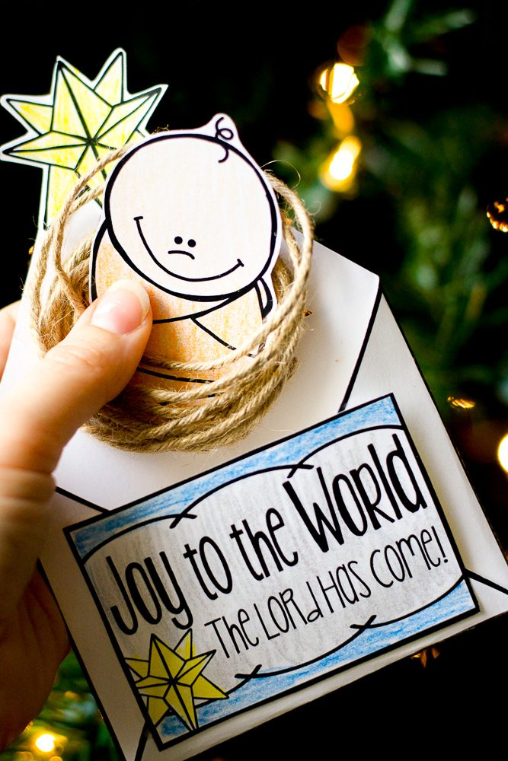
Instructions:
Make “Joy to the World the Lord has come” sign and glue it over the envelope.
Make a triangle-shape hole on the seal flap.
Make baby Jesus craft and place it inside the envelope.
The great thing about this craft is that it can also be used as an ornament to help us remember the Nativity story throughout the season!

Slide 16
Closing Prayer
Dear God,
Thank You for giving us the gift of Jesus, the greatest Christmas gift of all. Please help me to remember why we celebrate, even as we eat Christmas cookies and open presents. I am very thankful for the real reason for the season and, without Jesus, we wouldn’t have Christmas! I love You and thank You for giving us this day!
Amen.

Slide 17
LIVE THE WORD KIDS
4th Sunday of Advent | Cycle A

