Slide 1
LIVE THE WORD KIDS
3rd Sunday of Advent | Cycle A

Slide 2
GOSPEL REFLECTION
Biblical times, people looked for signs, too. In fact, they read Scriptural prophecies and looked for things that would help them know what was going on in their world and what was coming. But you know, even after Jesus came, they still did not always recognize Him. And some wanted to understand who He was.
One of the people who was asking about signs was John. Remember John? We talked about him a little bit ago. As it turned out, John got stuck in prison for some of those crazy things he preached about. John had been hearing about the works of Jesus, though, and he sent some friends to ask Jesus if He was the chosen one they had waited for. Jesus responded by describing the amazing wonders He had done.
There were miracles performed, sick and hurt people made well, and even dead people come back to life. It’s almost like Jesus is saying, “what more could you ask for?” He clearly wanted to express who He was. At the same time, though, Jesus was supportive of John and his ministry, telling people that John the Baptist had done great things and prepared the way for Jesus.
So this was how Jesus showed Himself, in a way, or how people recognized who He was. But is that the only way we know who Jesus is? We can certainly identify that He fulfilled some remarkable prophecies and promises of God. But we know who He is with even greater assurance. Who was Jesus? He is the son of God…and He is God!
He came to Earth to suffer and die for our sins, and what happened after that? He came back to life! We know what happened to Jesus, and we can be fully certain of who He was as divine. How many people do you know who can come back from the dead?! We have the best sign possible – the cross.

Slide 3
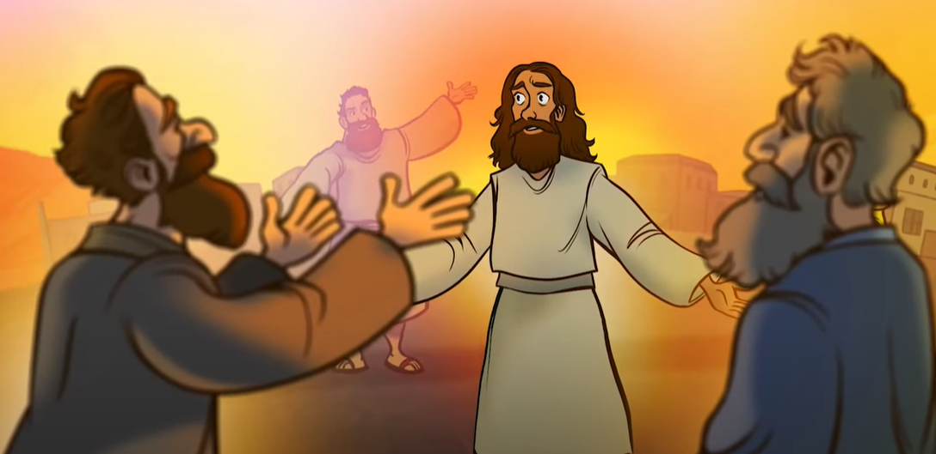
The Messengers from John the Baptist
Matthew 11: 2-11

Slide 4
Leader: A reading from
the Holy Gospel
according to Matthew.
All: Glory to You, Oh Lord.

Slide 5
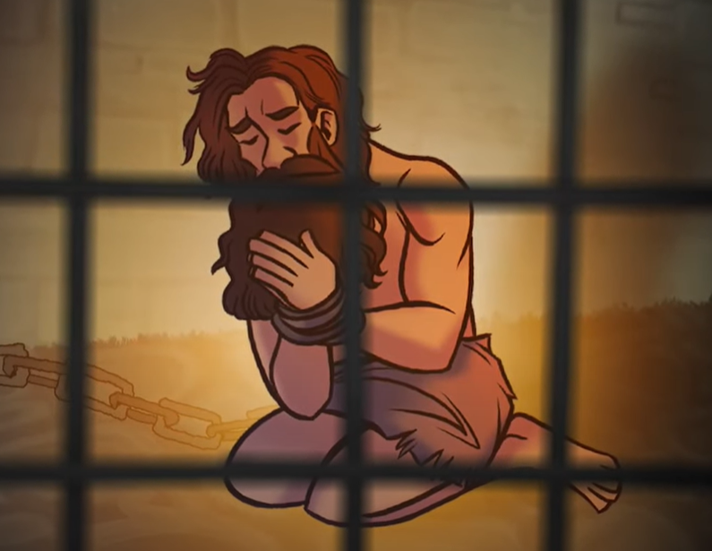
2
When John the Baptist heard in prison about the things that Christ was doing, he sent some of his disciples to him.

Slide 6
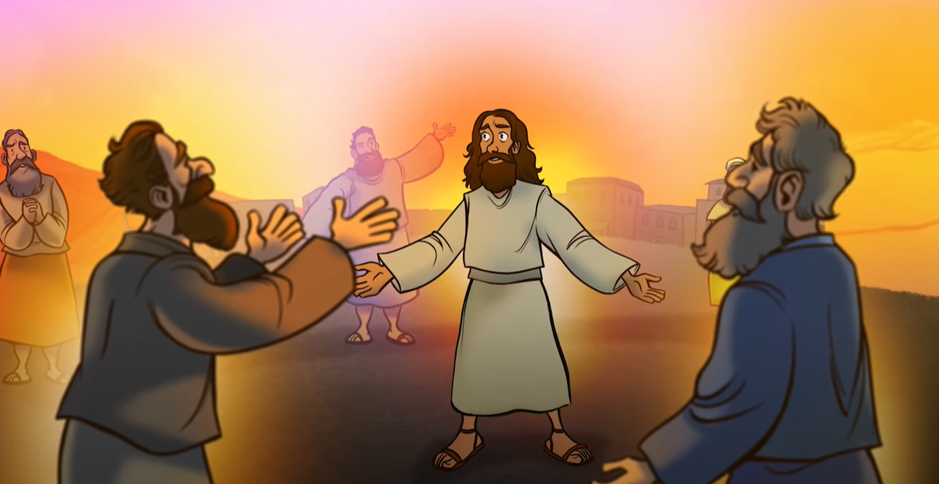
3
“Tell us,” they asked Jesus, “are you the one John said was going to come, or should we expect someone else?”
Notes:
John sent his disciples to Jesus so that they could shed their mistaken notions about the kind of Messiah to expect, and come to recognize Jesus.

Slide 7
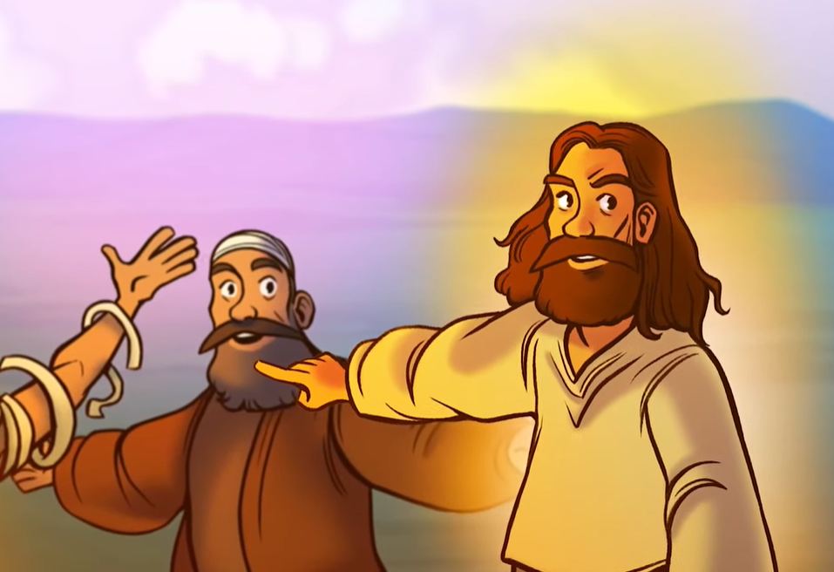
4
Jesus answered, “Go back and tell John what you are hearing and seeing

Slide 8
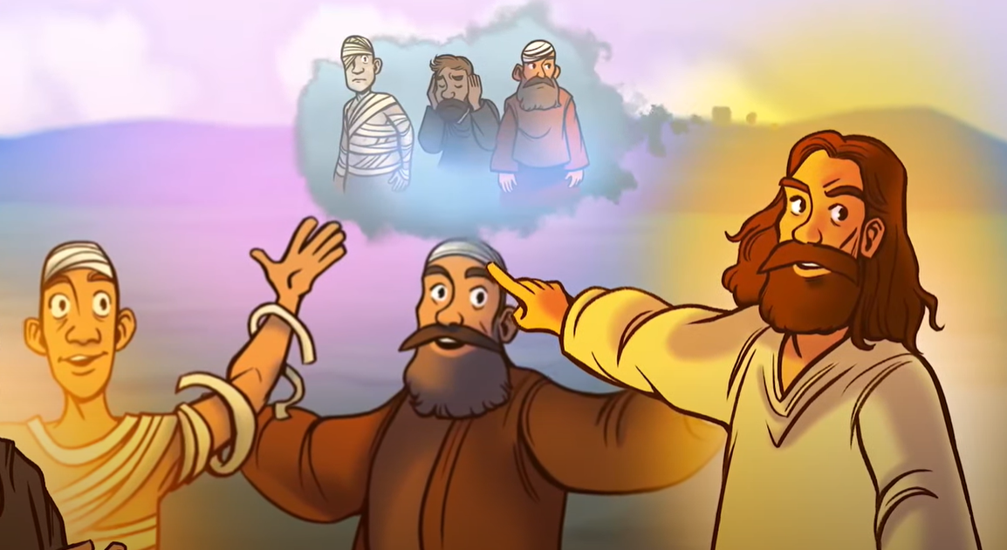
5
The blind can see, the lame can walk, those who suffer from dreaded skin diseases are made clean, the deaf hear, the dead are brought back to life, and the Good News is preached to the poor

Slide 9
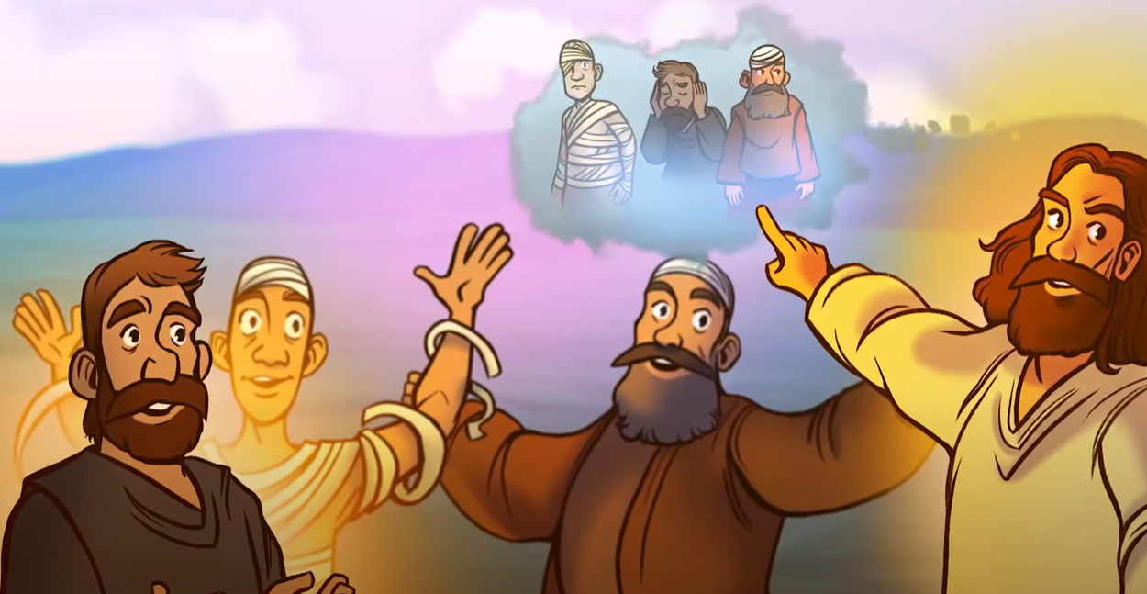
6
How happy are those who have no doubts about me!”

Slide 10
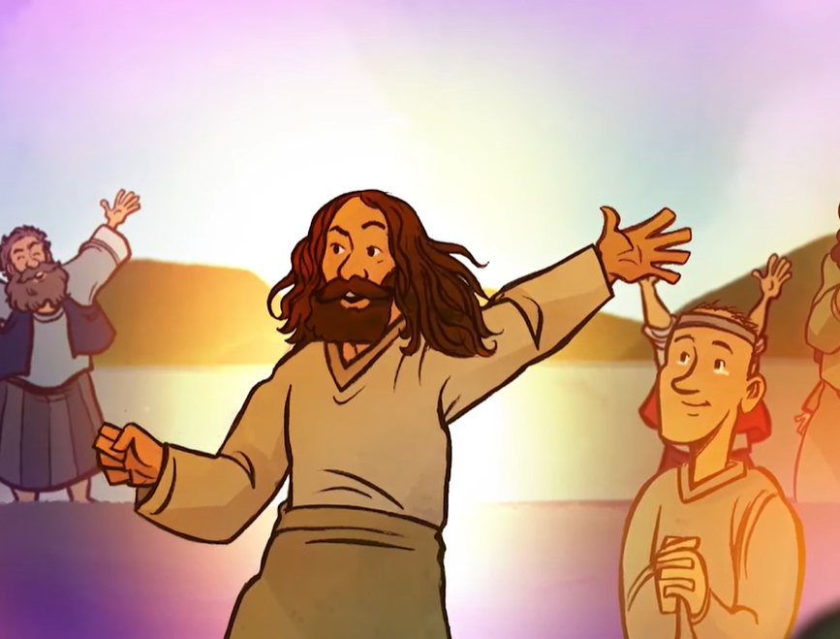
7
While John's disciples were leaving, Jesus spoke about him to the crowds: “When you went out to John in the desert, what did you expect to see? A blade of grass bending in the wind?

Slide 11
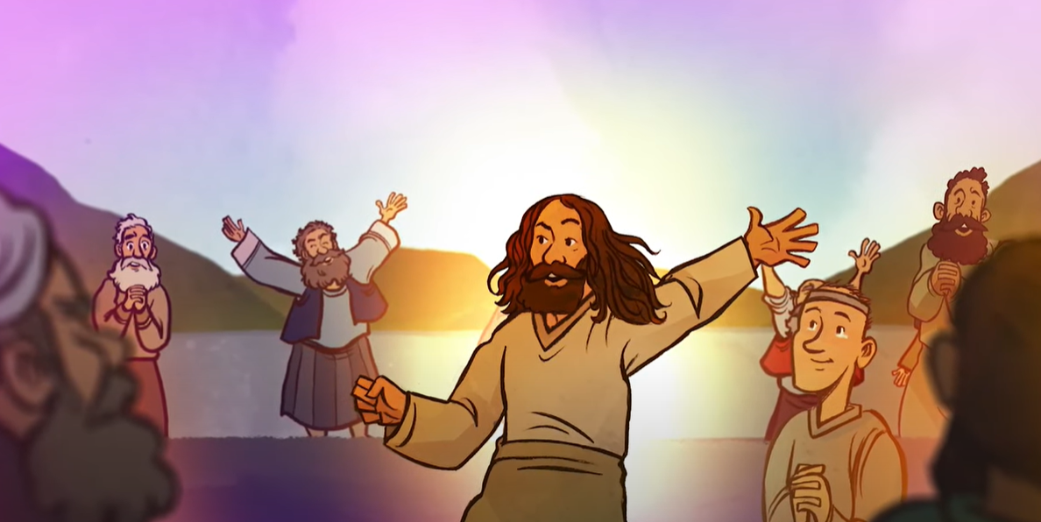
8
What did you go out to see? A man dressed up in fancy clothes? People who dress like that live in palaces!
Notes:
The common Jewish belief is that there has been no prophecy in Israel since the last of the Old Testament prophets, Malachi. The coming of a new prophet was eagerly awaited and Jesus agrees that John is a prophet, and much more

Slide 12
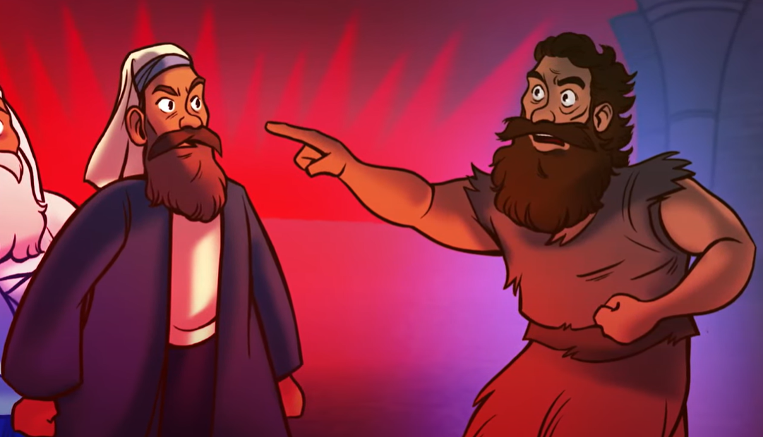
9
Tell me, what did you go out to see? A prophet?
Yes indeed, but you saw much more than a prophet.

Slide 13
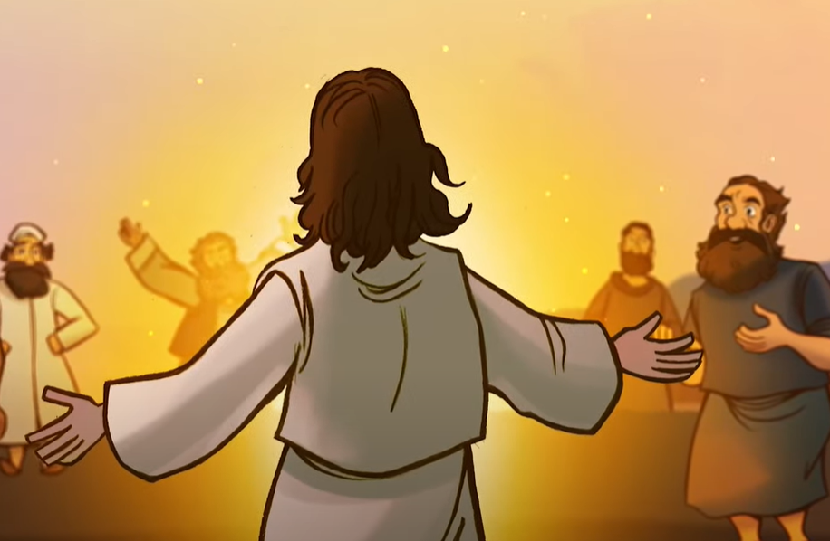
10
For John is the one of whom the scripture says: ‘God said, I will send my messenger ahead of you to open the way for you.’
Notes:
John is the long awaited precursor of the one who will bring in the new and final age.

Slide 14
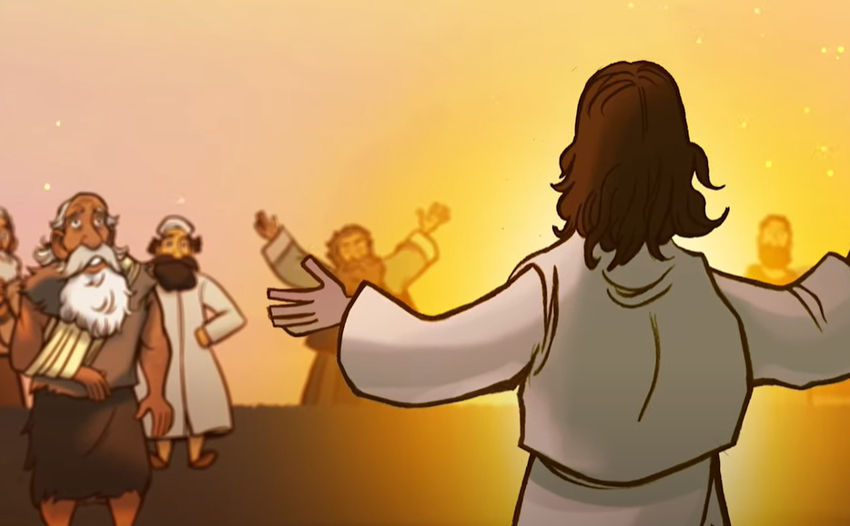
11
I assure you that John the Baptist is greater than anyone who has ever lived. But the one who is least in the Kingdom of heaven is greater than John.
Notes:
This makes John the Baptist the last and greatest of the prophets, even greater than Moses. John lived and worked before the messianic reign. Therefore, even the least in the messianic reign, who will have the light of the gospel and the communication of the power of faith, will accomplish greater works than John.

Slide 15
Leader: The Gospel of the Lord.
All: Praise to You,
Lord Jesus Christ.

Slide 16
GOSPEL MESSAGE

Slide 17
Activity:
God’s Messengers
Materials: 1. Colored Papers
2. Coloring Materials
3. Pen or Marker
4. Glue or tape
5. Art Decorations (optional)
Notes:
We have learned that Jesus is already giving signs and wonders to people in His time that He is the messiah. Now, that we know that He is God and He is our savior, it is our turn to make this message known to the world!

Slide 18
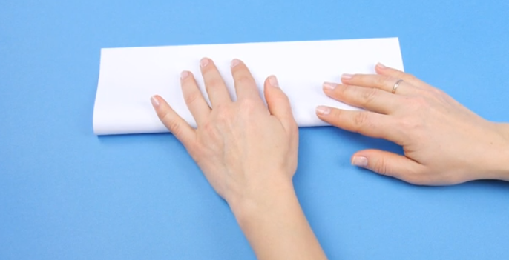
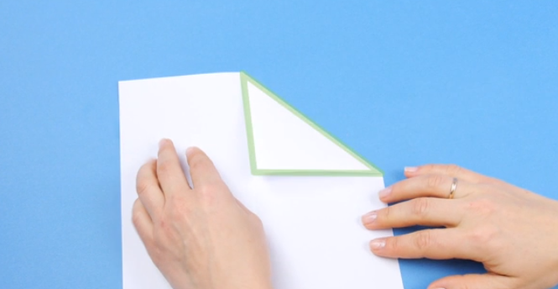
Instructions:
1. Fold the paper in half lengthwise. Match up the edges of the paper to ensure the fold is straight, and press down on the folded edge with your fingers to make a crease. Then, you can unfold the piece of paper, and it will have a crease in the middle.
2. Fold the top right corner along the center crease. When the edge of the top right corner is touching the center crease in a straight line, fold the corner down. This will make a triangle shape with the top right corner.
3. Fold the top left corner along the center crease. Fold the top left corner down as you did the right corner. Remember to smooth out the paper with your fingers to make a straight fold. You will now have two small triangles sitting on top of a rectangle.

Slide 19
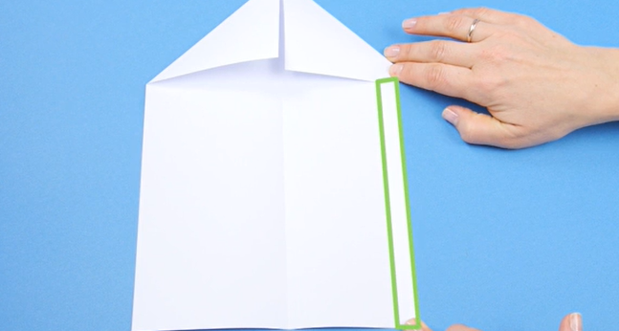
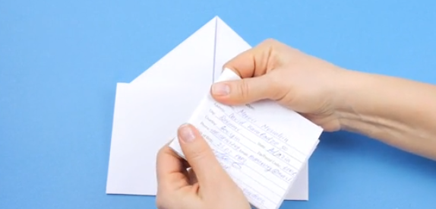
Instructions:
4. Fold one inch of the top and bottom edges toward the center crease. The measurement here does not have to be exact, so you can eyeball the fold. Both the top and bottom edges should be folded towards the center, leaving enough room in the center for a letter or card to fit, about one inch.
5. Fold the right edge of the paper along the bottom of the triangle. The edge of the folded triangle on the left-hand side of the paper should be parallel with the edge of the right hand side. The triangle itself will still be visible. Smooth out the fold with your fingers, then unfold it.
6. In another sheet of clean paper, write “Jesus is the Messiah!” and then fold your message so it fits into the envelope. Large cards may be too big for this method, but regular letter-sized paper will fit if folded in half or in thirds/

Slide 20
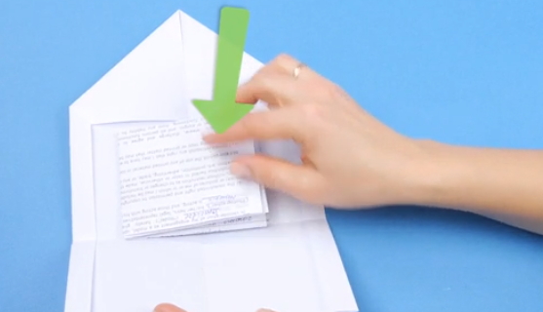
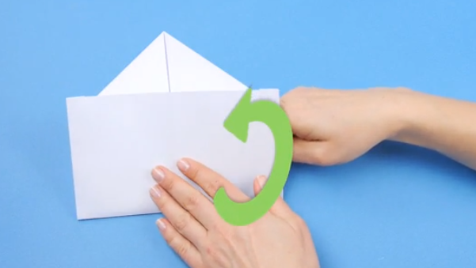
Instructions:
7. Insert your message. Your note can go between the horizontal creases of the envelope. Use the bottom flaps of the triangle and the two length-wise flaps at the side to keep the message in the envelope.
8. Close the envelope. Fold the right hand edge of the paper back up to the edge of the triangle, just like did a moment ago. Fold the triangle top towards the center of the rectangle. Now, you will notice the back of your envelope looks like those bought in stores.

Slide 21
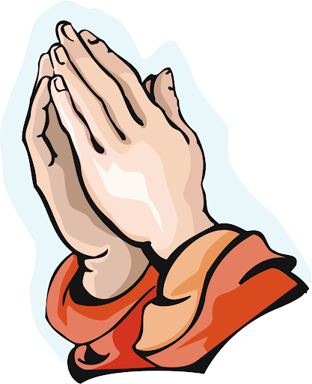
Closing Prayer
Dear God,
Thank you for coming into our lives. Thank you for giving your son Jesus to us here on earth. Lord, we pray that you always help us to recognize Jesus in everything that we see and to be like Him in everything that we do.
In Jesus name, we pray.
Amen.

Slide 22
LIVE THE WORD KIDS
3rd Sunday of Advent | Cycle A

