Slide 1
LIVE THE WORD KIDS
2nd Sunday of Advent | Cycle A

Slide 2
GOSPEL REFLECTION
Children (like adults) can be self-centered. It’s easy for them to want the attention and praise for everything they do. In this lesson you can see how John the Baptist had a mission of pointing others to Christ first and foremost. Like John, we can follow God’s plan and shine the light on Jesus. Our whole lives can reflect the love of God and give him the praise.

Slide 3
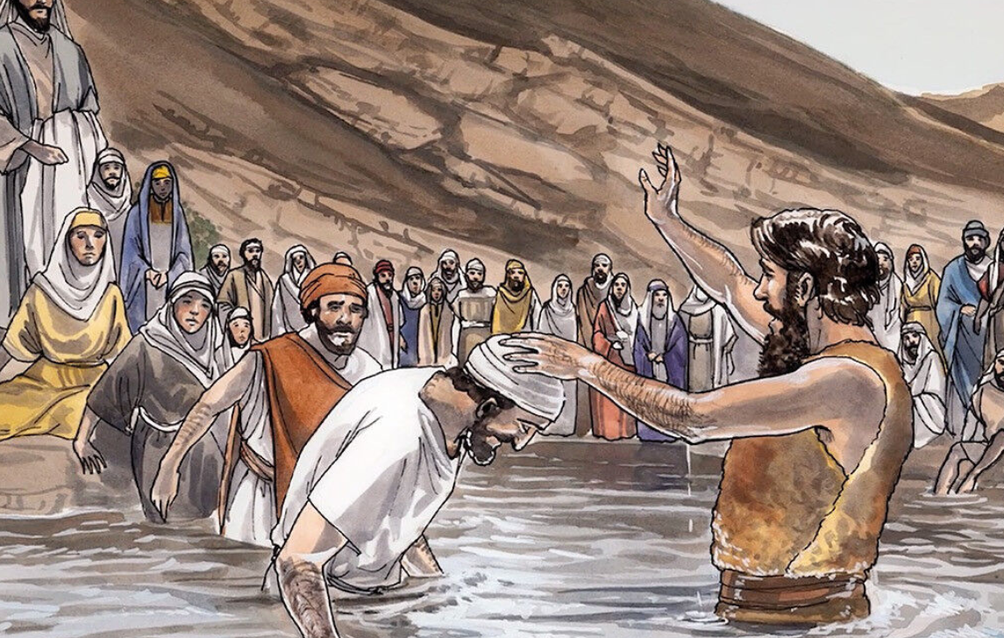
The Preaching of John the Baptist
Matthew 3:1-12

Slide 4
Leader: A reading from
the Holy Gospel
according to Matthew.
All: Glory to You, Oh Lord.

Slide 5
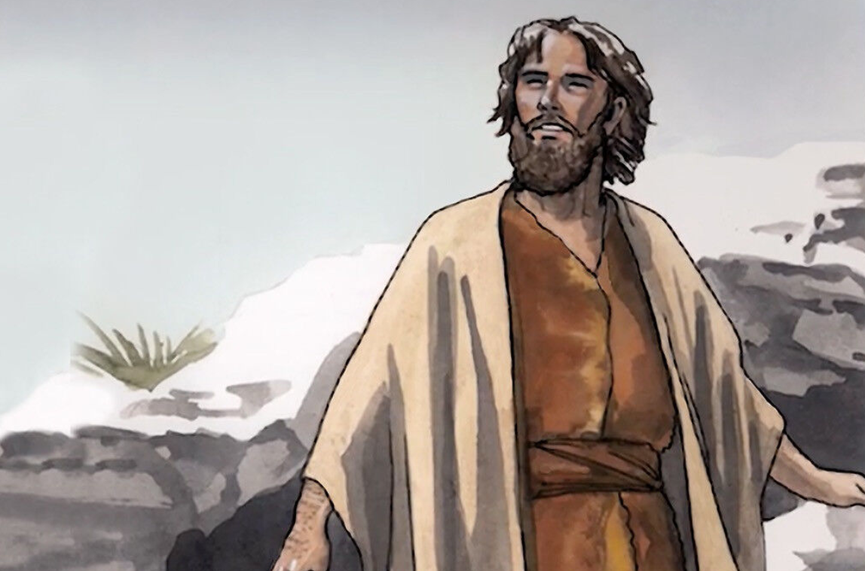
1
At that time John the Baptist came to the desert of Judea and started preaching

Slide 6
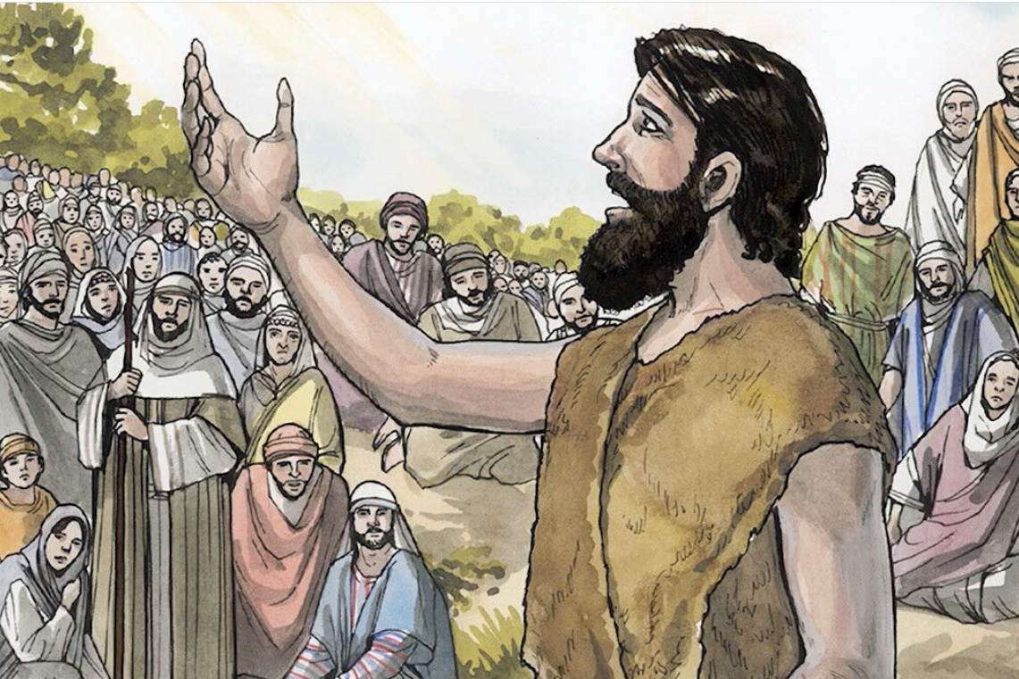
2
“Turn away from your sins,” he said, “because the Kingdom of heaven is near!”

Slide 7
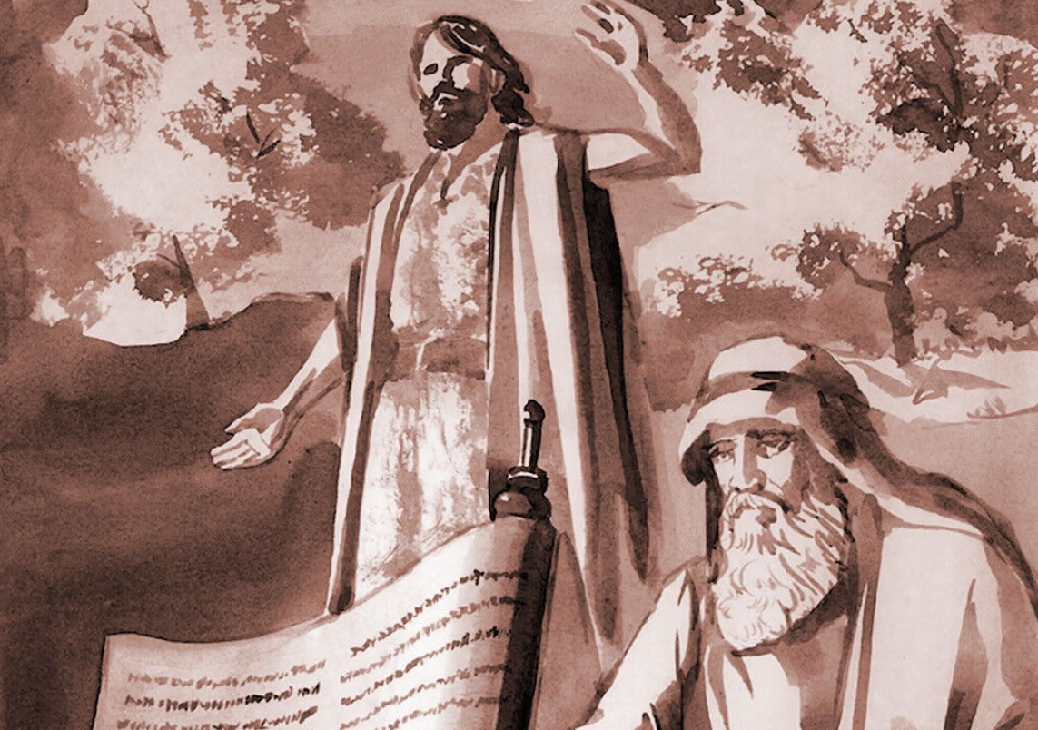
3
John was the man the prophet Isaiah was talking about when he said, “Someone is shouting in the desert, ‘Prepare a road for the Lord; make a straight path for him to travel!’”

Slide 8
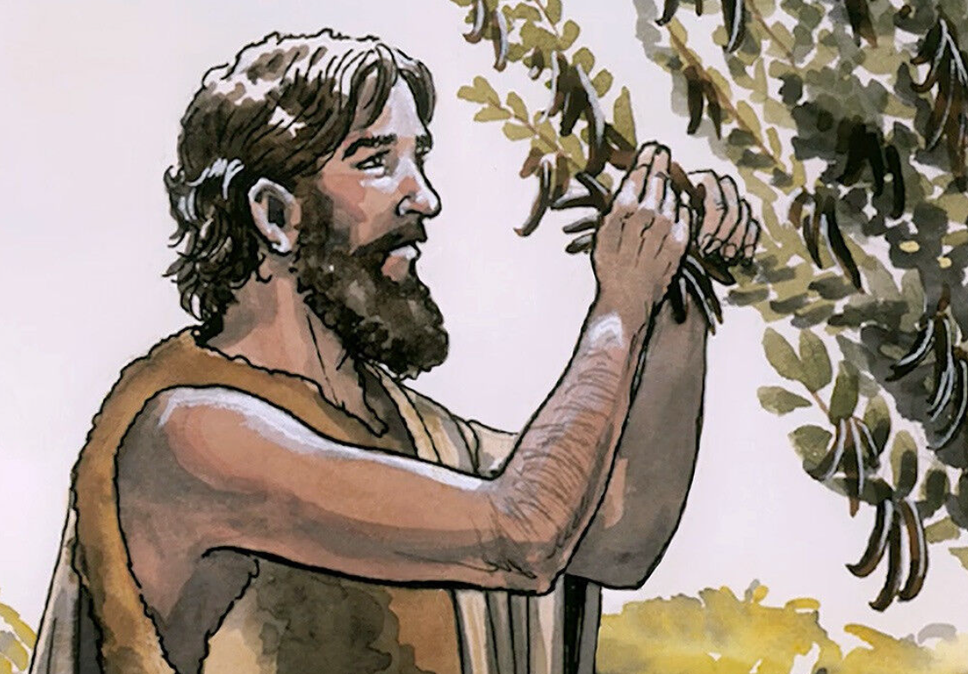
4
John's clothes were made of camel's hair; he wore a leather belt around his waist, and his food was locusts and wild honey.
Notes:
Wild food, the food of a nomad. The locust has been interpreted by some to be the fruit of the carob tree, and wild honey has also been interpreted by some to be the sweet substance secreted by insects on the local shrubs (we will hear of this more when we study about the manna in another lesson); it is hard to conceive of wild bees in the desert. During the Advent liturgy, John is placed before us as a model of mortification and penance. Just as John’s mission was to prepare the way for Jesus, a Christian’s entire life is a preparation for his meeting with Christ. Mortification and penance play a significant part in John’s life as they should in our own.

Slide 9
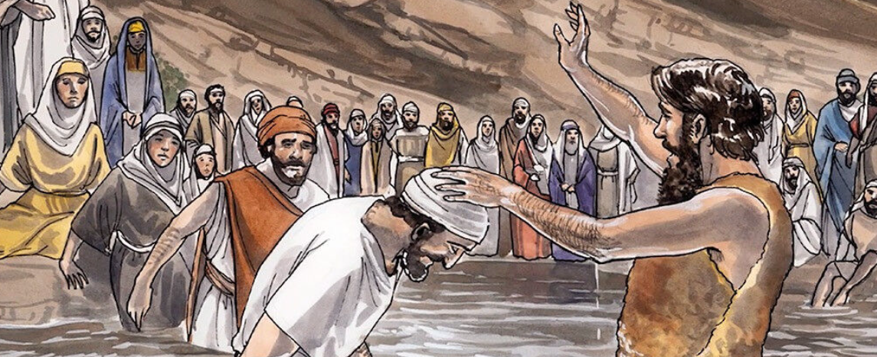
5
People came to him from Jerusalem, from the whole province of Judea, and from all over the country near the Jordan River.

Slide 10
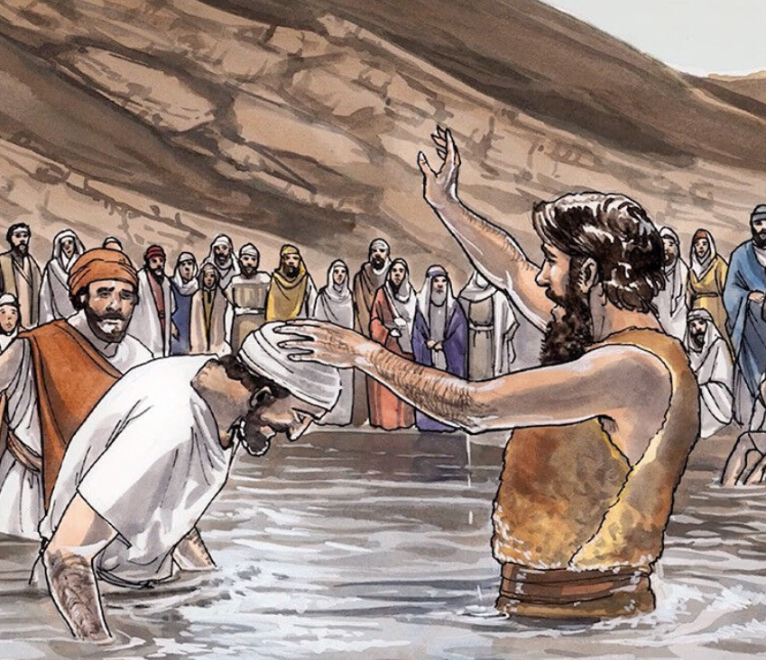
6
They confessed their sins, and he baptized them in the Jordan.
Notes:
The Greek word baptize means to dip or immerse ceremonially, perhaps also to pour. Here, baptism is a religious rite of cleansing or purification. Priests washed before performing sacred rites, Jews washed before entering the Temple and before eating. What is unique here is that the washing is not done by the penitent, but by John himself.

Slide 11
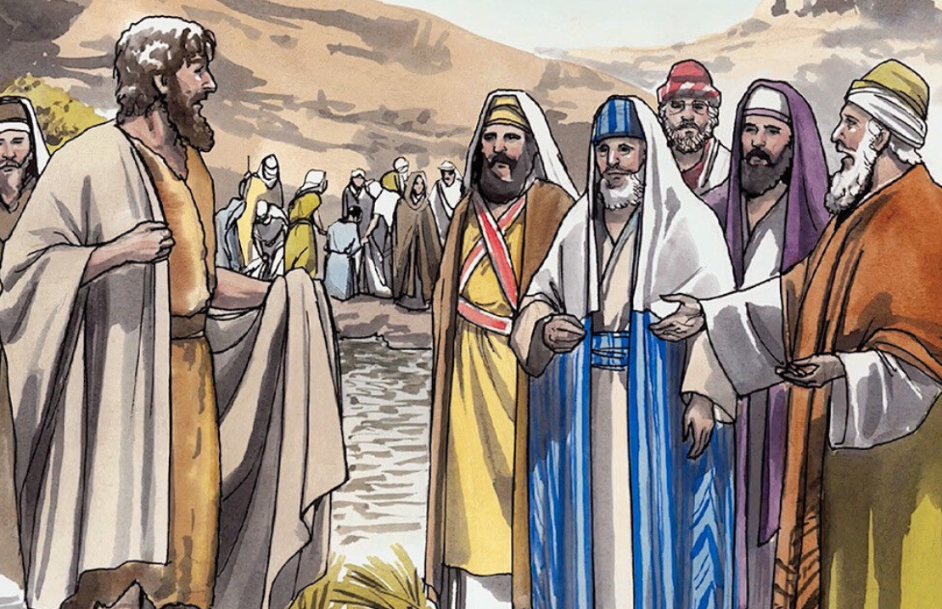
7
When John saw many Pharisees and Sadducees coming to him to be baptized, he said to them, “You snakes—who told you that you could escape from the punishment God is about to send?
Notes:
The Pharisees were the most important religious group in Jesus’ time. They kept the law of Moses rigorously and also the oral traditions which had built up around it. They gave as much importance to the traditions as they did to the law itself. The Sadducees, on the other hand, were a smaller religious group than the Pharisees, but they included many influential people, most of them from the main priestly 7 families. They accepted as Scripture only the written Law, the first five books of the Old Testament but, unlike the Pharisees, they rejected oral tradition and were opposed to teachings not found in the Pentateuch.

Slide 12
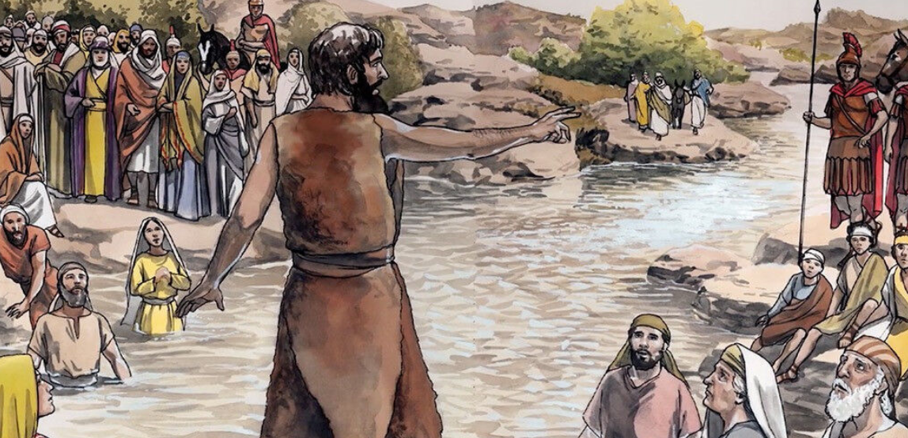
8
Do those things that will show that you have turned from your sins
Notes:
Good works that go beyond the good intentions of repentance is what he is asking for; a follow-through of their intentions.

Slide 13
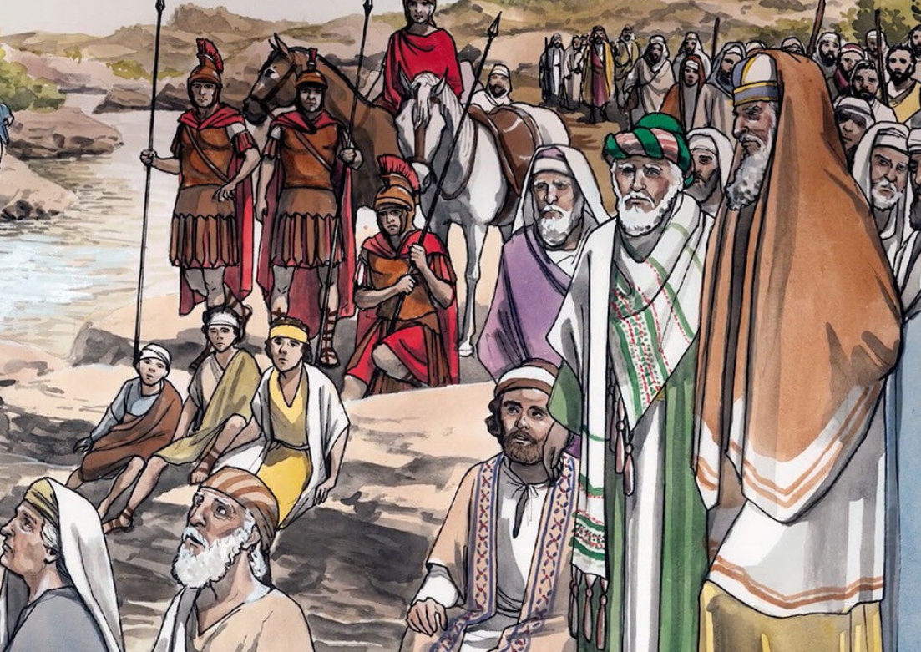
9
And don't think you can escape punishment by saying that Abraham is your ancestor. I tell you that God can take these rocks and make descendants for Abraham!

Slide 14
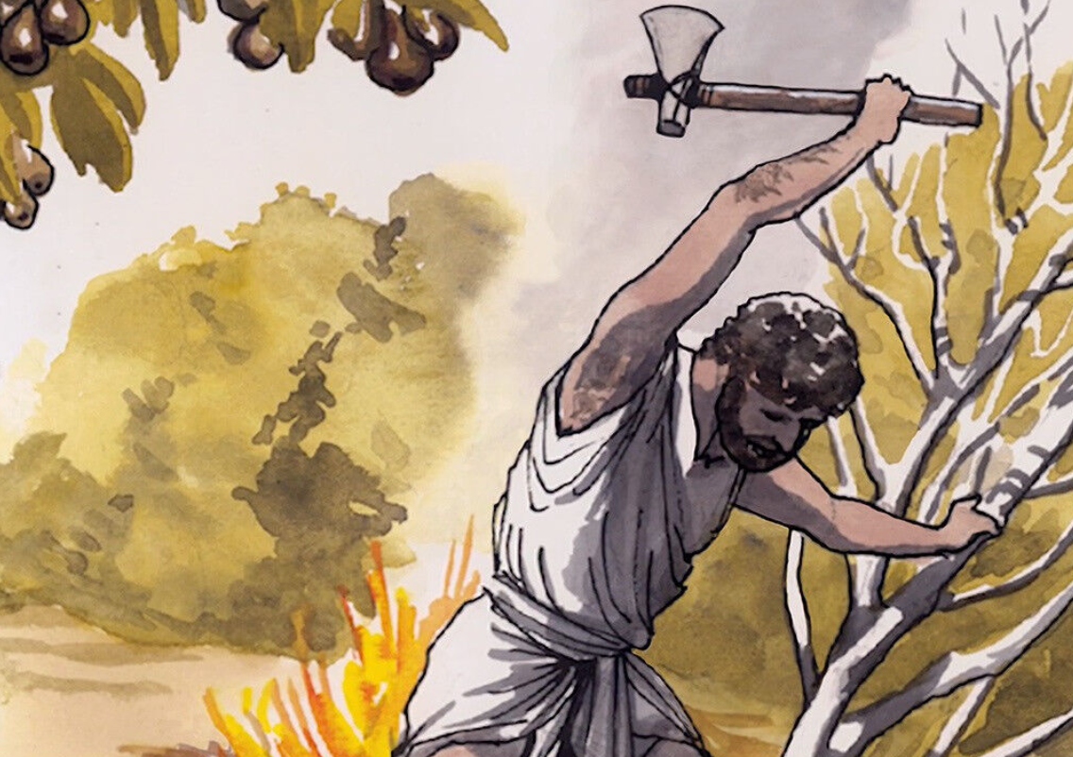
10
The ax is ready to cut down the trees at the roots; every tree that does not bear good fruit will be cut down and thrown in the fire.
Notes:
The situation is urgent.

Slide 15
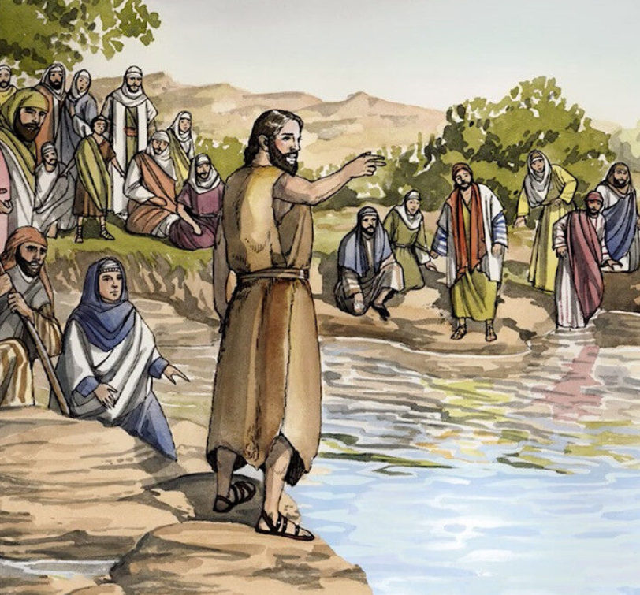
11
I baptize you with water to show that you have repented, but the one who will come after me will baptize you with the Holy Spirit and fire. He is much greater than I am; and I am not good enough even to carry his sandals.
Notes:
The situation is urgent.

Slide 16
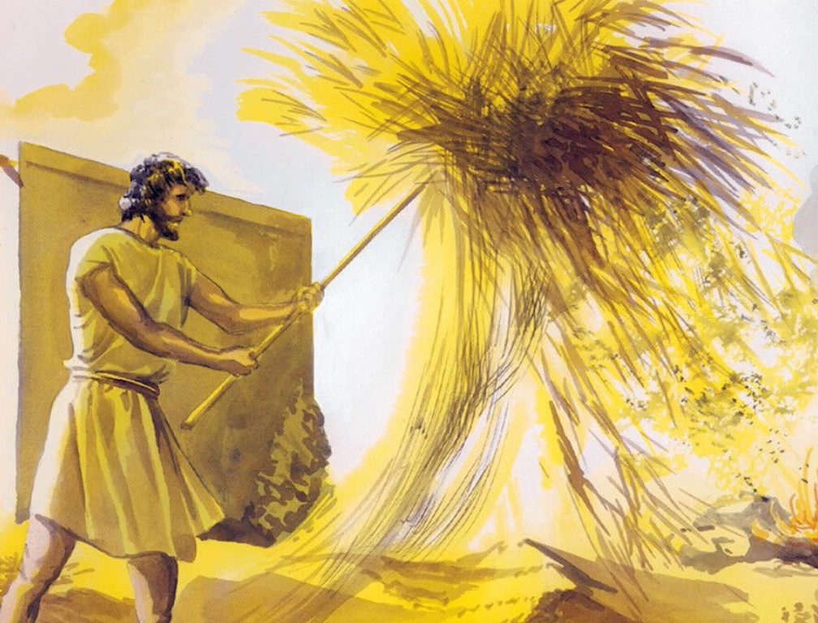
12
He has his winnowing shovel with him to thresh out all the grain. He will gather his wheat into his barn, but he will burn the chaff in a fire that never goes out.”
Notes:
The situation is urgent.

Slide 17
Leader: The Gospel of the Lord.
All: Praise to You,
Lord Jesus Christ.

Slide 18
GOSPEL MESSAGE

Slide 19
Activity (Poster making):
Repent and be baptized!
Materials: 1. Colored Papers
2. Coloring Materials
3. Pen or Marker
4. Art Decorations (optional)
Notes:
In our gospel reading, we have learned how John was used by God to prepare the coming of His son Jesus. We were reminded that as we await Jesus’ coming we must turn away from our sins and be baptized.

Slide 20
Instruction:
Write “ Repent and be baptized!” on any clean colored papers
Put designs and colors into your poster to finish your art work.

Slide 21
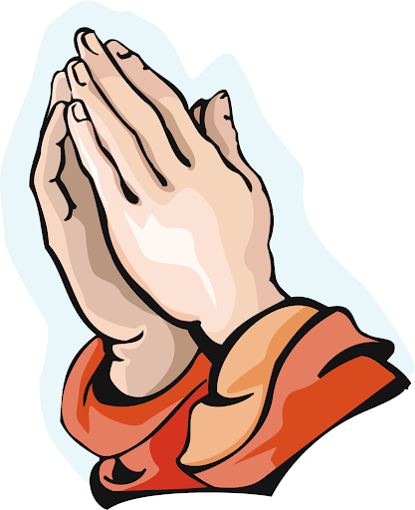
Closing Prayer
Dear God,
Thank you for reminding us today to always focus our eyes on You. Thank you for reminding us to turn away from sins so that we can be prepared to Your coming and be closer to You.
Help us Lord, to be good children and to live out the baptism that we have.
In Jesus name, we pray.
Amen.

Slide 22
LIVE THE WORD KIDS
2nd Sunday of Advent | Cycle A

