Slide 1
LIVE THE WORD KIDS
22nd Sunday in Ordinary Time | Year C

Slide 2
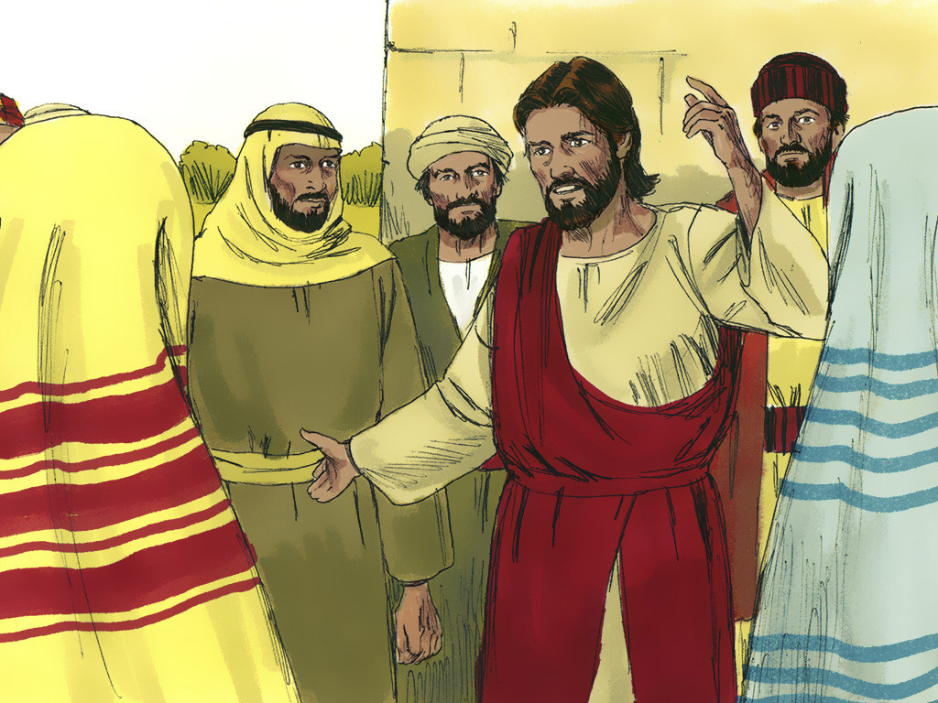
Jesus’ Parable about Humility & Hospitality
Luke 14:1, 7-14

Slide 3
NOTES FOR THE FACILITATOR ONLY:
Gospel Lesson:
In today’s Gospel, we see Jesus being invited to a meal by a chief Pharisee. There He notices how people claimed places of importance and thus self glorification. Looking at the crowd Jesus taught them by sharing with them a parable highlighting guests invited to a Wedding Banquet. The main theme of that parable and this passage is ‘humility’.
In Jewish community, Pharisees were known for their pride in tradition and the Law of Moses, but Jesus invited them to be humble. To be humble means to empty oneself of the problem of “I” that is our ego. This was the biggest problem with the Pharisees, they were full of themselves and boastful about their power and wealth. Thus their followers also followed in their footsteps. Therefore, Jesus is this passage, is helping the Pharisees see a kernel of truth in their everyday way of life. They are invited not to be roaming here and there, seeking a honorable place to sit. Sometimes people pay for status in society and become proud of this. We have such people still living among us.
Notes:
Don’t include this slide when you present this to the kids

Slide 4
NOTES FOR THE FACILITATOR ONLY:
Gospel Lesson:
A person who is always humble in nature, will be always sustained in God’s work and bring change in others life and encourage others also to work hard to established God’ Kingdom in the own life and in the world.
Benefits:
Humility is the gateway to all the virtues of God
Humility is the ladder that helps us to climb up and become closer to God
Humility keeps us grounded and balanced with a right attitude in the world.
Humility helps us to face the truth and accept our strength and weakness.
So, friends “Be humble or else we shall take a tumble in our life”
Notes:
Don’t include this slide when you present this to the kids

Slide 5
Jesus’ Parable about Humility & Hospitality
Luke 14:1, 7-14

Slide 6
Leader: A reading from
the Holy Gospel
according to Luke.
All: Glory to You, Oh Lord.

Slide 7
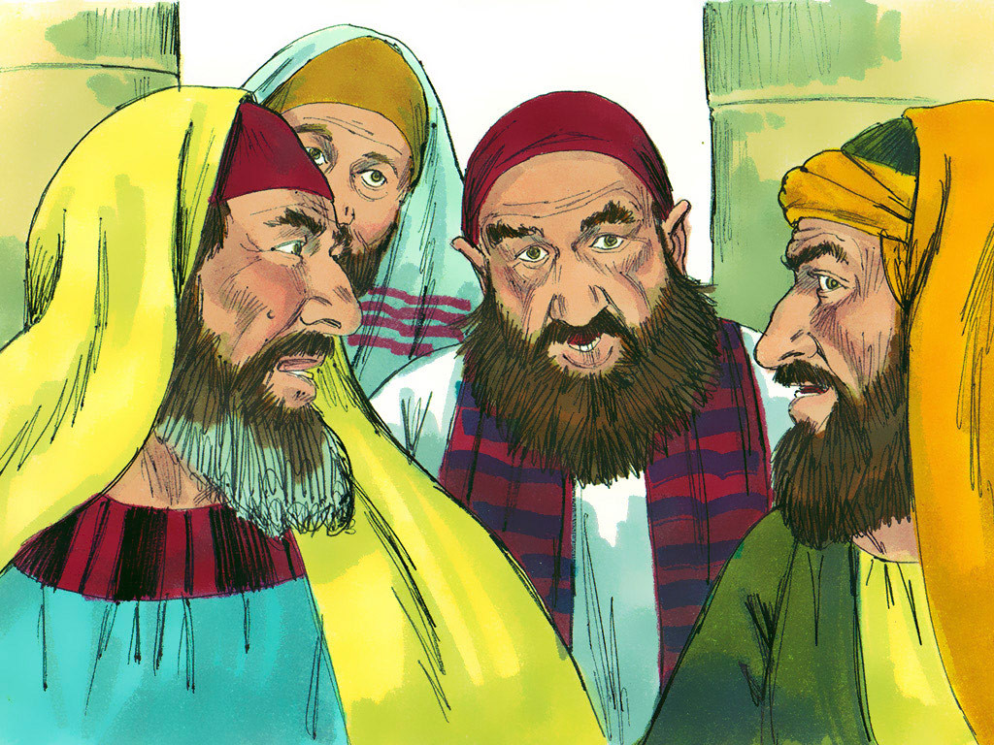
1
“One Sabbath Jesus went to eat a meal at the home of one of the leading Pharisees; and people were watching Jesus closely.

Slide 8
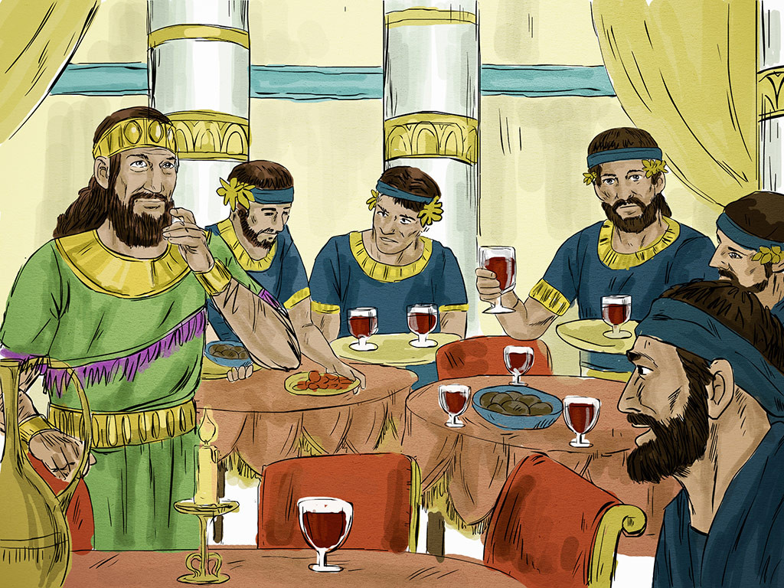
7
Jesus noticed how some of the guests were choosing the best places, so he told this parable to all of them:

Slide 9
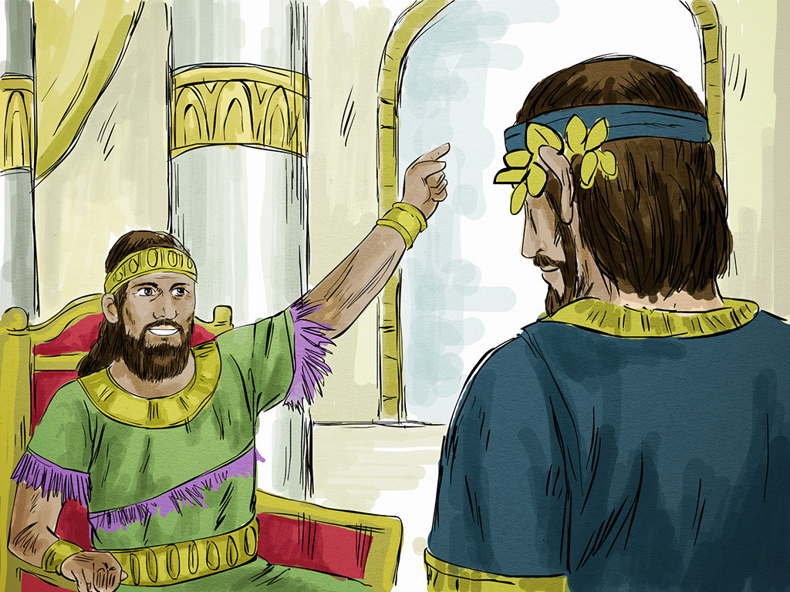
8
“When someone invites you to a wedding feast, do not sit down in the best place. It could happen that someone more important than you has been invited,

Slide 10
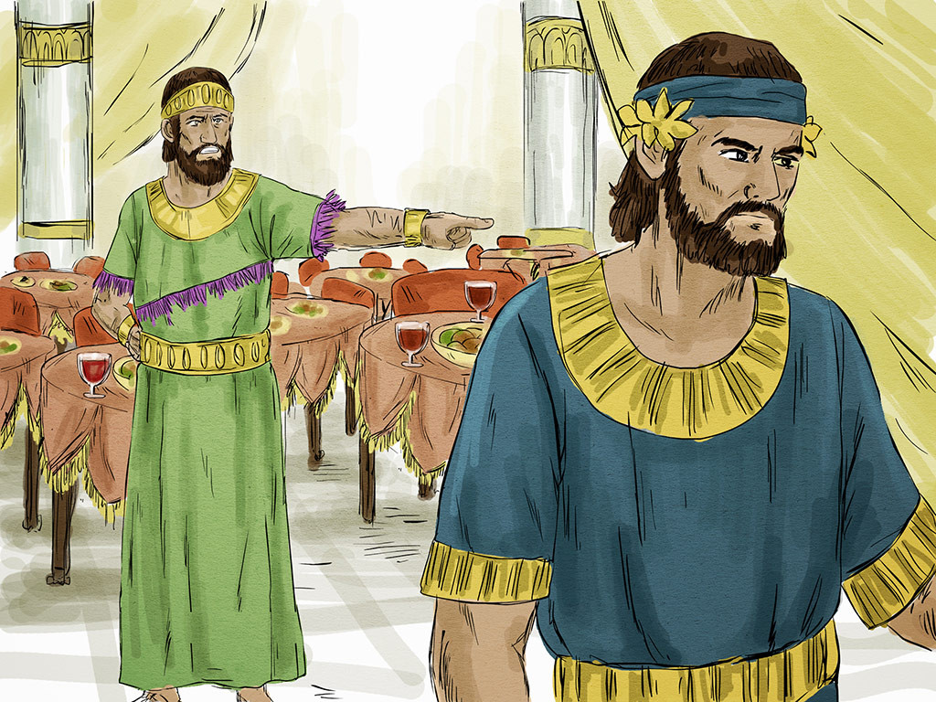
9
and your host, who invited both of you, would have to come and say to you, ‘Let him have this place.’ Then you would be embarrassed and have to sit in the lowest place.

Slide 11
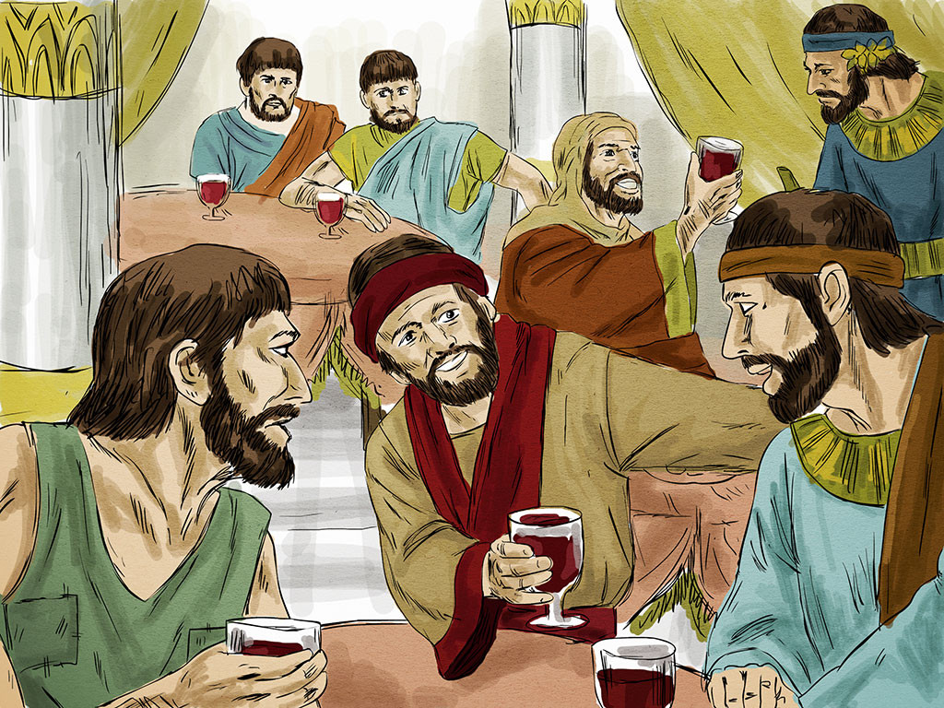
Instead, when you are invited, go and sit in the lowest place, so that your host will come to you and say, ‘Come on up, my friend, to a better place.’ This will bring you honor in the presence of all the other guests.
10

Slide 12
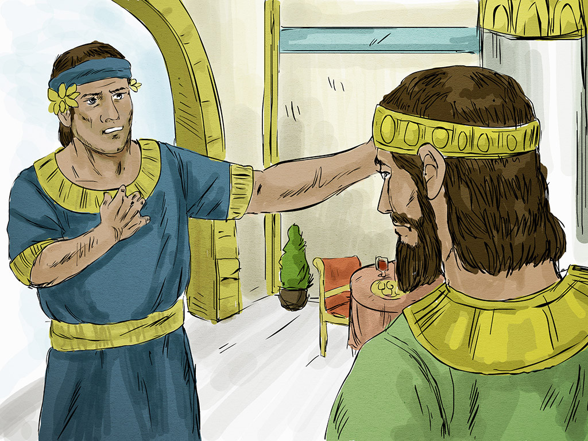
11
For those who make themselves great will be humbled, and those who humble themselves will be made great.”

Slide 13
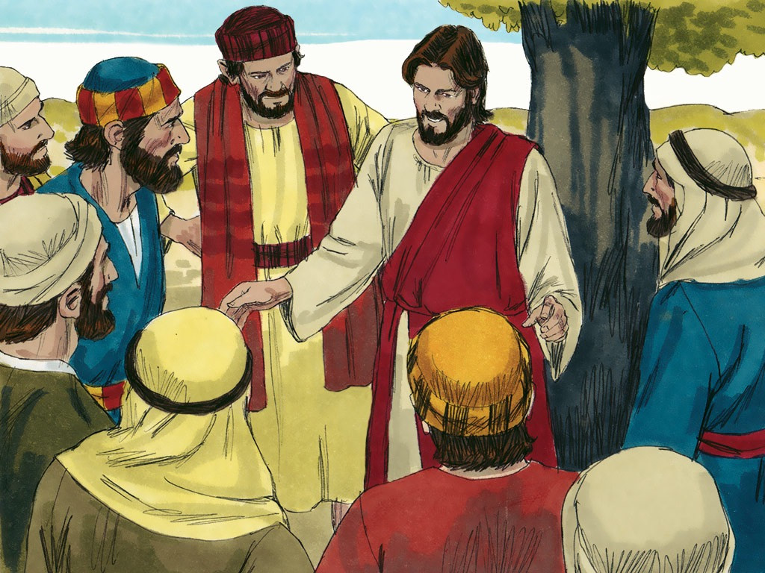
12
Then Jesus said to his host, “When you give a lunch or a dinner, do not invite your friends or your brothers or your relatives

Slide 14
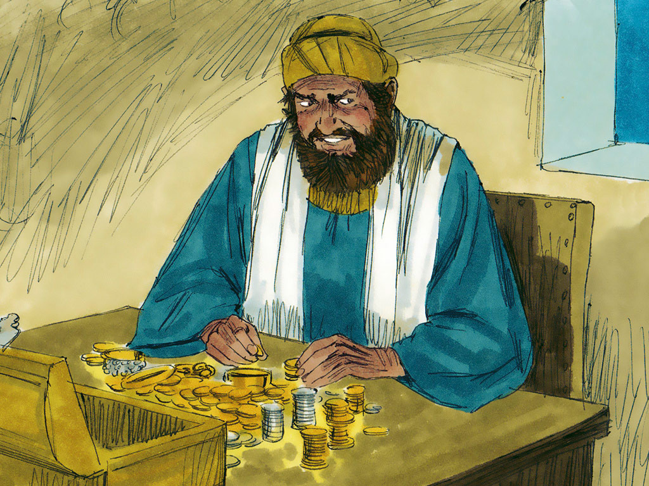
or your rich neighbors—for they will invite you back, and in this way you will be paid for what you did.

Slide 15
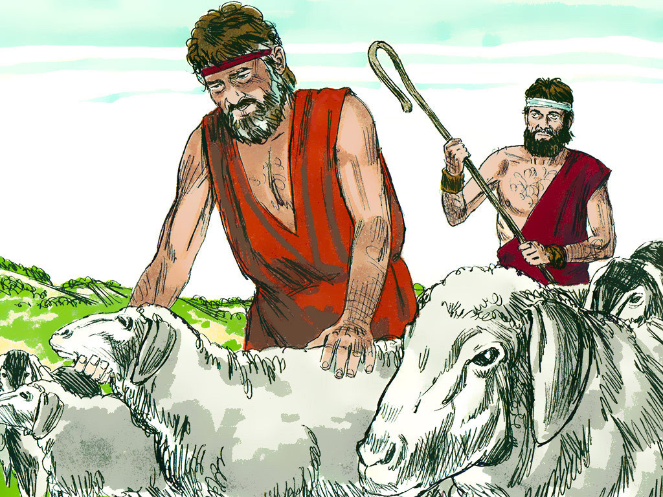
13
When you give a feast, invite the poor, the crippled, the lame, and the blind;

Slide 16
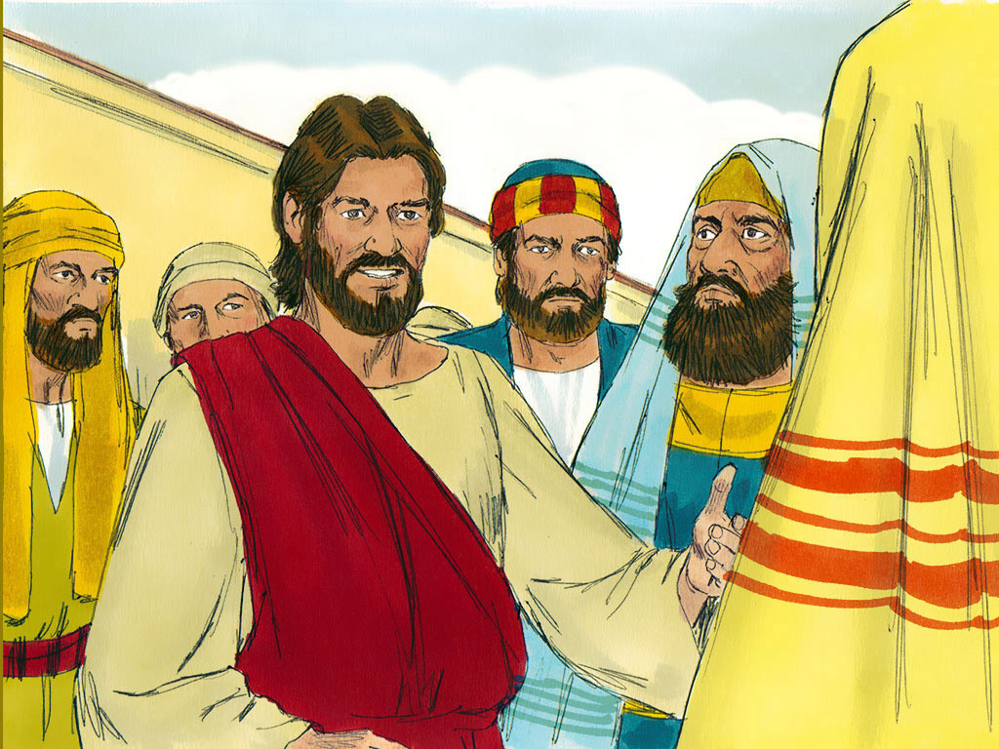
14
and you will be blessed, because they are not able to pay you back. God will repay you on the day the good people rise from death.”

Slide 17
Leader: The Gospel of the Lord.
All: Praise to You,
Lord Jesus Christ.

Slide 18
GOSPEL MESSAGE

Slide 19
Activity:
Humble Pie Recipe
Materials:
Construction Paper / Colored Paper /
Card stock
Crayons / Markers /
Any Coloring Materials
Scissors
Glue
Decorating Materials, bows, ribbons
PAPER BAG

Slide 20
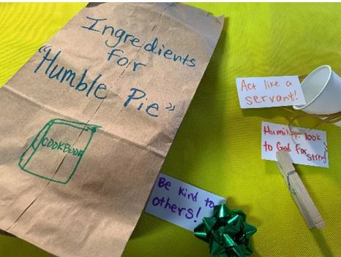
Procedure:
Decorate the paper bag to be a “recipe bag” or “ingredient bag”, making it plain but fun!
Decorate notecards or papers to nestle within the bag, including notes about “ingredients” needed to be humble and not proud. Add small tokens or decoration (bows, cups, etc.)
Place the “humble pie ingredients” inside the paper bag.
Seal the bag with ribbon or string. Add captions or verses.
Use your bag to recall what humility means, or use it as a prayer request receptacle!

Slide 21
Closing Prayer
Dear Lord,
Thank You for your wonderful message of humility. Thank You for always reminding us to be humble. May we glorify You in everything that we do. Amen.

Slide 22
LIVE THE WORD KIDS
22nd Sunday in Ordinary Time | Year C

