Slide 1
LIVE THE WORD KIDS
21st Sunday in Ordinary Time | Cycle C

Slide 2
NOTES FOR THE FACILITATOR ONLY:
Gospel Lesson:
Modern psychology gives great importance to “feeling good” and “loving one’s self” as a precondition to love others. But in today’s Gospel passage Jesus warns us that there is no easy way to be his disciples as he declares that the Kingdom of God can be “accessed” only through a “narrow gate.” Obviously, Jesus is not speaking of a material gate but of the “narrow gate” of daily faithfulness to one’s duties and the loyal observance of God’s law in all circumstances of life. That is what makes life challenging, but that is also the only way that leads to eternal happiness in heaven.
The possibility of belonging to the Kingdom of heaven is open to all, but subject to a basic condition: to live a life according to the teaching of Jesus. That is the “narrow gate” that leads to everlasting life.
Source: Sambuhay
Notes:
Don’t include this slide when you present this to the kids

Slide 3
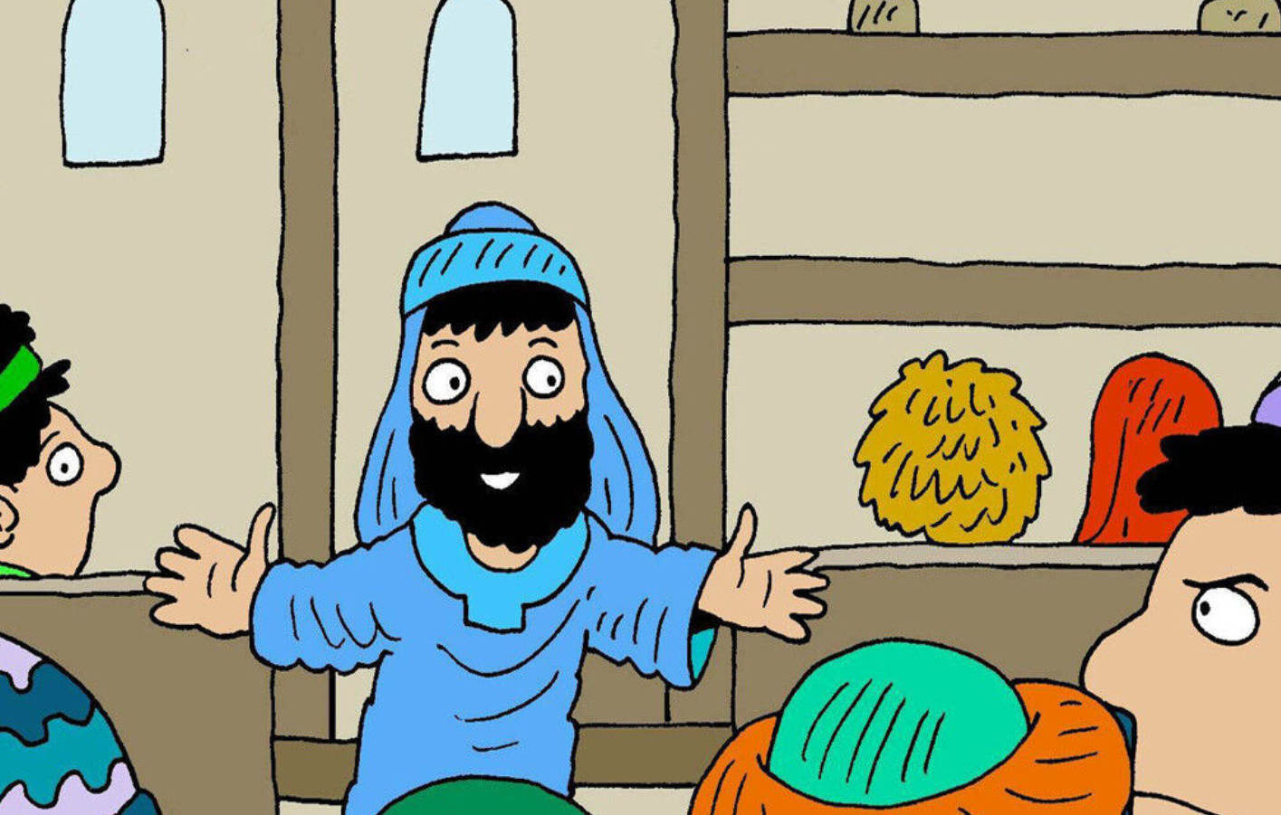
The Narrow Door
Luke 13:22-30

Slide 4
Leader: A reading from
the Holy Gospel
according to Luke.
All: Glory to You, Oh Lord.

Slide 5
22
Jesus went through towns and villages, teaching the people and making his way toward Jerusalem.

Slide 6
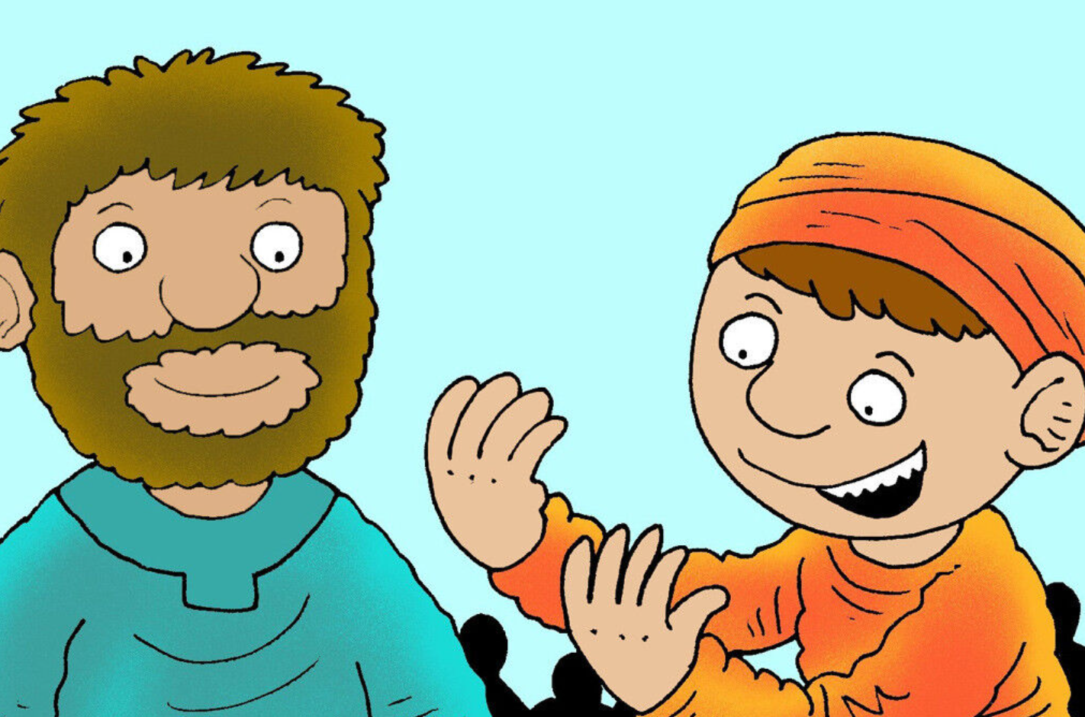
23
Someone asked him, “Sir, will just a few people be saved?” Jesus answered.
Notes:
Being saved in Catholic theology is the end result – seeing God face-to-face in heaven. It begins with faith and is the result of how that faith is lived out.

Slide 7
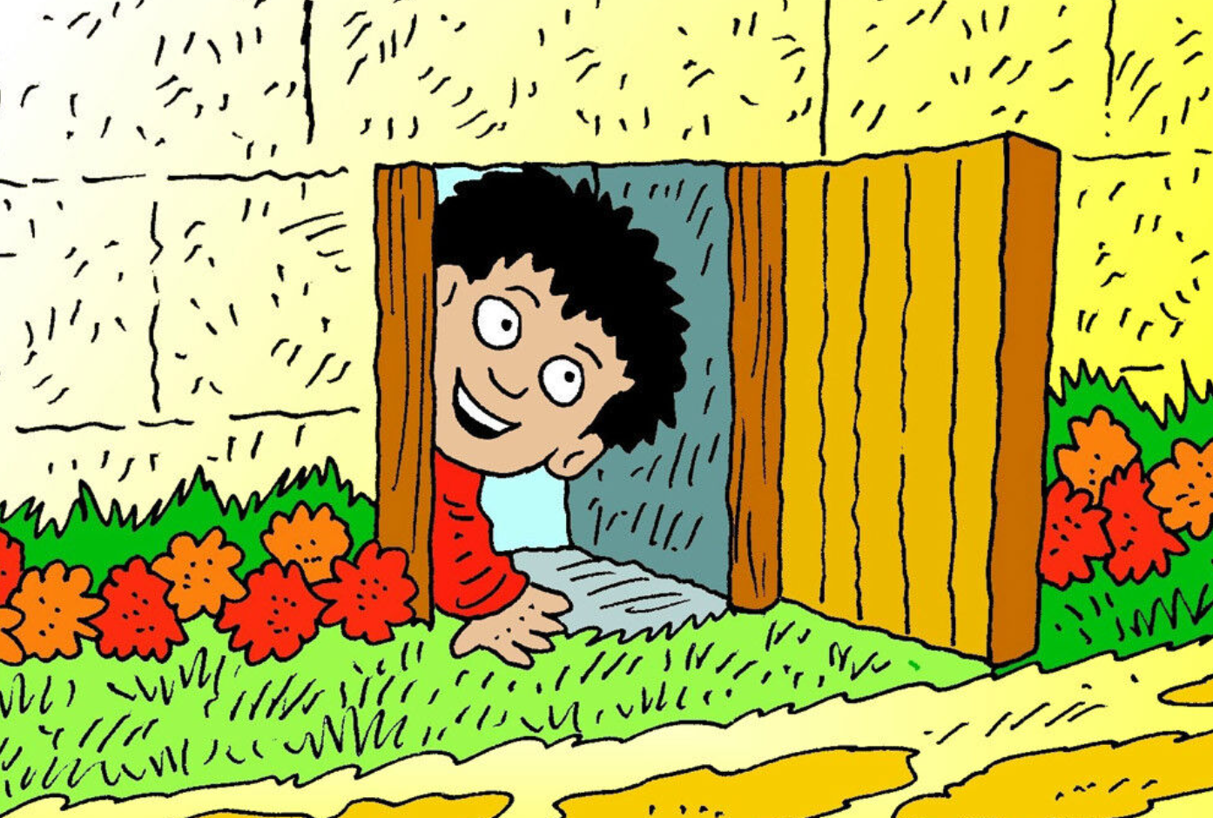
24
“Do your best to go in through the narrow door; because many people will surely try to go in but will not be able.
Notes:
The implied contrast is between large city gates through which throngs can pass at one time, and one where everything is in single file.

Slide 8
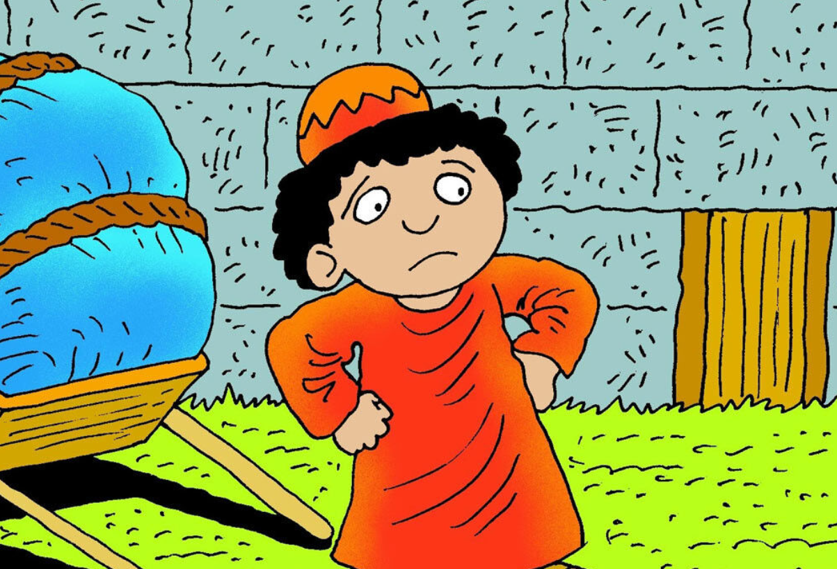
25
The master of the house will get up and close the door; then when you stand outside and begin to knock on the door and say, ‘Open the door for us, sir!’ he will answer you, ‘I don't know where you come from!’
Notes:
Many will seek entry too late, after the Kingdom has come; each one can and must strive now. Jesus must first recognize and love, and thus impart justifying faith.

Slide 9
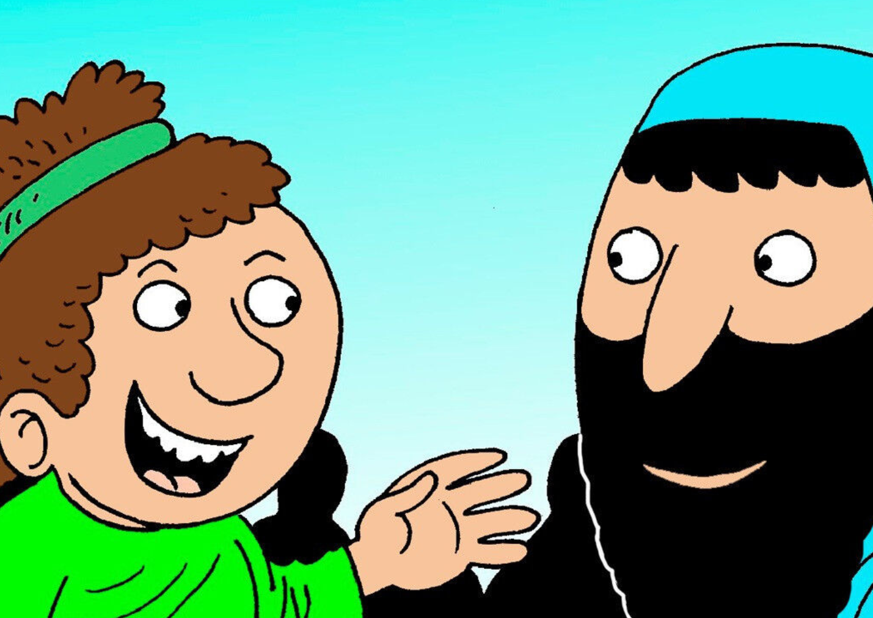
26
Then you will answer, ‘We ate and drank with you; you taught in our town!’
Notes:
Casual eating and drinking with Jesus is not enough; one must share in his life, as symbolized by His table fellowship with the lowly. One cannot simply boast that they are acquainted with Him and His message.

Slide 10
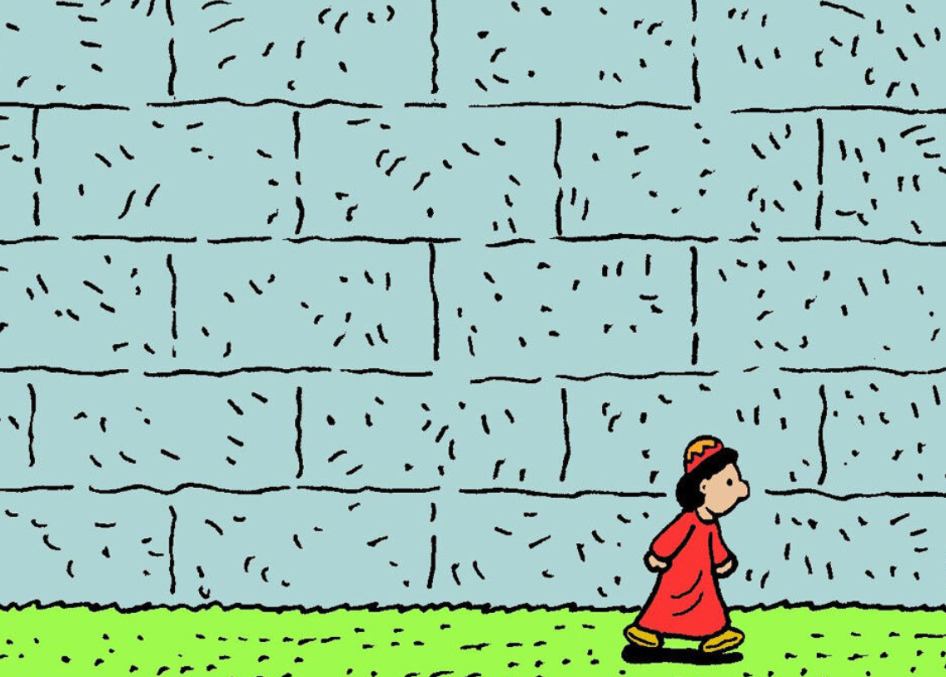
27
But he will say again, ‘I don't know where you come from. Get away from me, all you wicked people!’

Slide 11
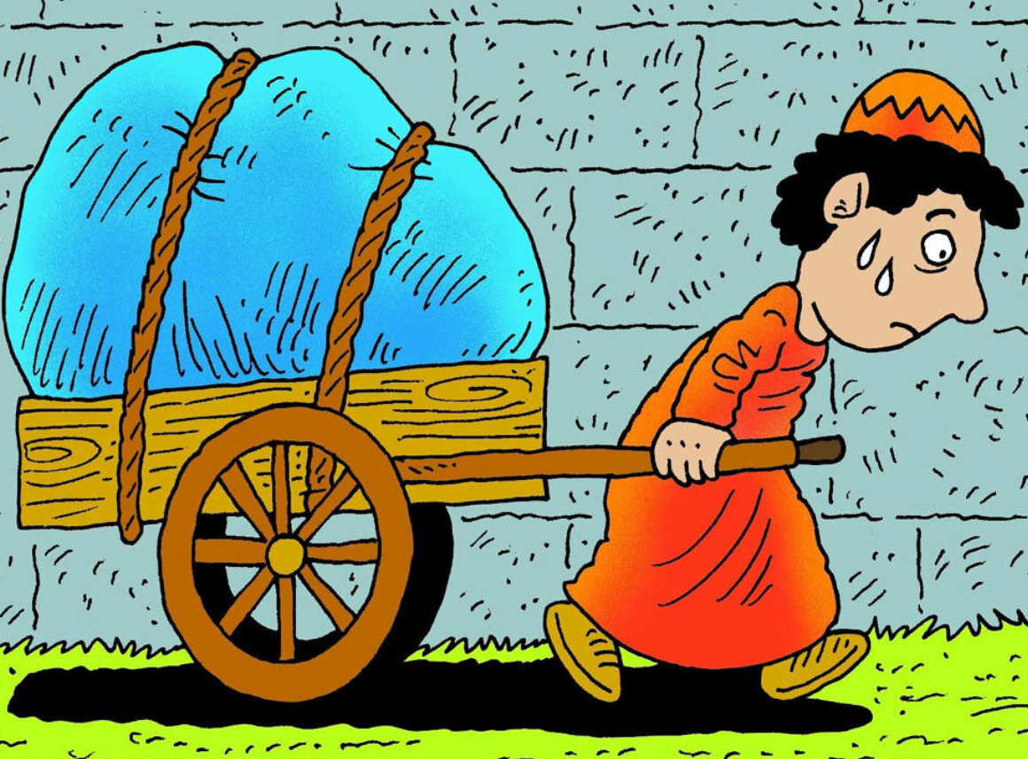
28
How you will cry and gnash your teeth when you see Abraham, Isaac, and Jacob, and all the prophets in the Kingdom of God, while you are thrown out!

Slide 12
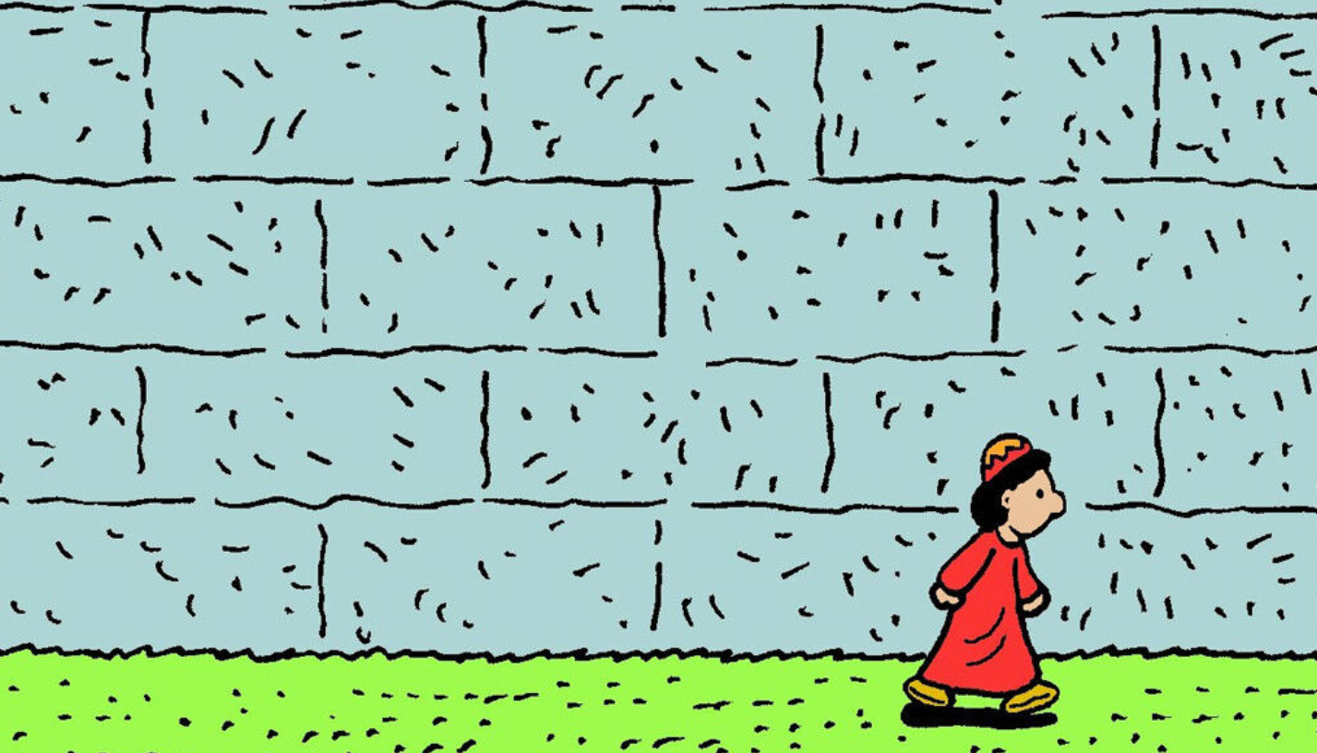
People will come from the east and the west, from the north and the south, and sit down at the feast in the Kingdom of God.
29

Slide 13
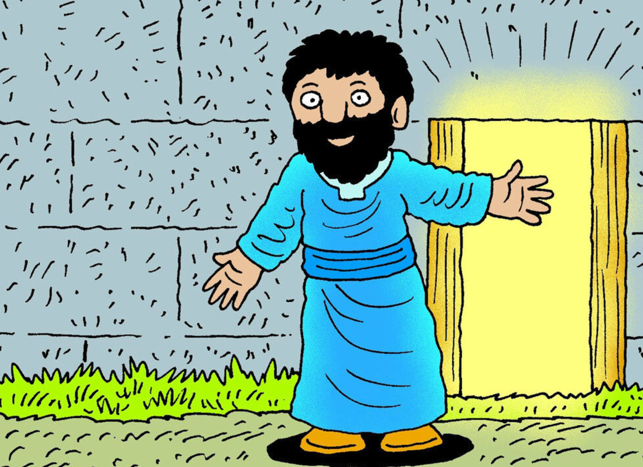
30
Then those who are now last will be first, and those who are now first will be last.”

Slide 14
Leader: The Gospel of the Lord.
All: Praise to You,
Lord Jesus Christ.

Slide 15
GOSPEL MESSAGE

Slide 16
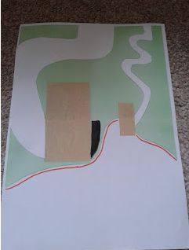
Activity:
The Narrow Gate
Materials: 1. Coloring Materials
2. White bond paper
3. Colored paper
4. Scissors
5. Glue
Notes:
For us to to be with God in heaven someday, we need to take the narrow door as young as we are. For us to do this, we need to be aware of the things that we can do to enter the narrow gate.

Slide 17
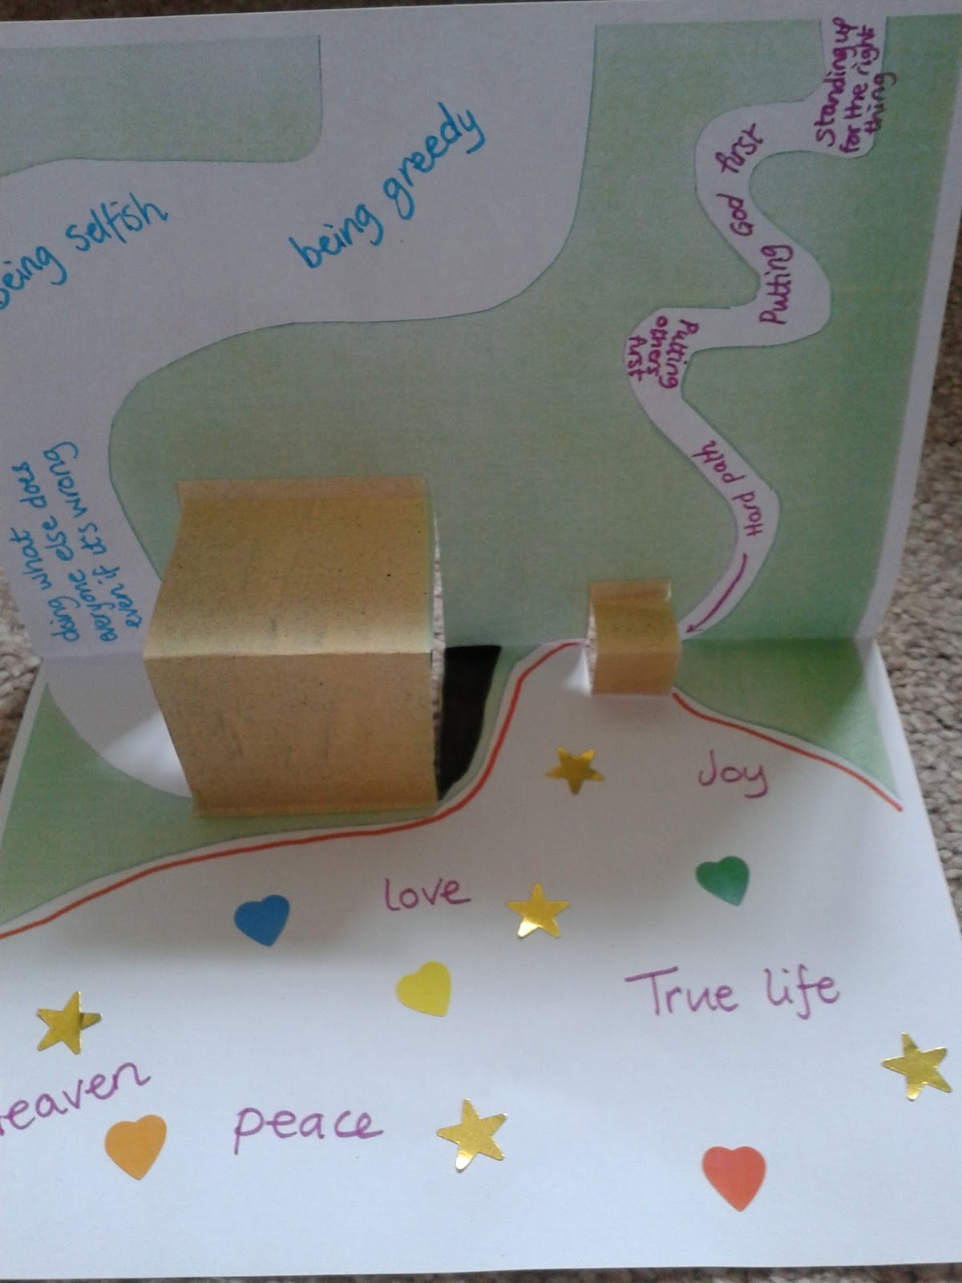
Instruction:
Fold the paper lengthwise.
Draw a wider path on the right side of the paper and a narrow path on the left side.
Cut out one big and small rectangles that would serve as the door to your paths.
Paste the cut out onto your drawing paper.
Write on the side of the wider path the things that you need to avoid so you can enter the narrow path.
Write the good things that you think you will receive once you enter the narrow path.

Slide 18
Closing Prayer
Dear God,
Thank You for showing us the way to Heaven. We pray that You’ll help us to follow You on the narrow road, even when other people are going down the wide road because we know what’s waiting for us in the end. Amen

Slide 19
LIVE THE WORD KIDS
21st Sunday in Ordinary Time | Cycle C

