Slide 1
LIVE THE WORD KIDS
20th Sunday in Ordinary Time | Year C

Slide 2
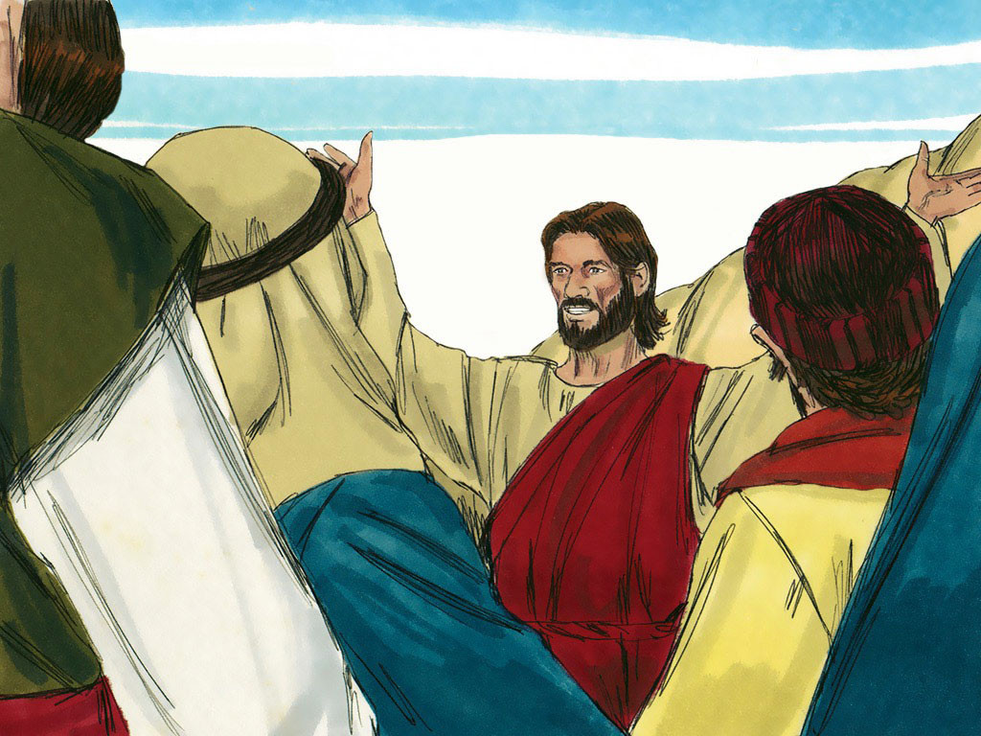
Jesus, the Cause of Division
Luke 12:49-53

Slide 3
NOTES FOR THE FACILITATOR ONLY:
Gospel Lesson:
1. The Spark That Must Become a Blaze: Jesus' intensity and passion break out in radical expression in today's Gospel. He yearns for a divine conflagration in the hearts of his disciples. Jesus endured a true baptism of immersion, steeped in the pain of Golgotha, precisely so that our own baptism would not be a mere ceremony. Rather he wanted our baptism to be a holy spark of divine life that, with care and formation, would become a growing flame of authentic Christian holiness. Indeed, let us fan that flame and never allow external pressures, or our own mediocrity, to extinguish it.
Notes:
Don’t include this slide when you present this to the kids

Slide 4
NOTES FOR THE FACILITATOR ONLY:
Gospel Lesson (cont.):
2. Peace, at Any Price? Jesus corrects a misperception in some of his listeners. Some no doubt expected him to usher in the messianic peace, when the lion would lie down with the lamb (see Isaiah 11:6-9). No, the time for that peace will be at history's end, when God's Kingdom is established in all its fullness. Till then, Christianity will often find itself in conflict with the powers of the world. We want to be considered nice people, yet our convictions will at times bring us conflict. May the spark of our soul be a strong-enough flame to accept those moments and avoid the cheap peace of acquiescing with the world.
Notes:
Don’t include this slide when you present this to the kids

Slide 5
NOTES FOR THE FACILITATOR ONLY:
Gospel Lesson (cont.):
3. Put Up Your Dukes? Should Catholics be people spoiling for a fight? Not if they want to be good Catholics! Those who love fighting and arguing may very well find themselves in divided households, but not for the reasons Jesus really means. Courtesy, gentleness, and the finer details of charity should characterize the person who wants to be like Christ. These kinds of people seek to unite, not divide. When they are dividers, it is because they have to be. They know when the point arrives that if they bend any further, they'll break where flexibility would degenerate into infidelity. There are tough, sad moments when being faithful to Christ means a head-on collision in a very important relationship, such as the ones Jesus mentions. But when it's a question of where our first loyalty lies, there is no debate. Christ must come first.
Notes:
Don’t include this slide when you present this to the kids

Slide 6
NOTES FOR THE FACILITATOR ONLY:
You may visit this link for an exegesis (a more detailed explanation on the text):
https://sermonwriter.com/biblical-commentary/new-testament-luke-1249-56/
Notes:
Don’t include this slide when you present this to the kids

Slide 7
Jesus, the Cause of Division
Luke 12:49-53

Slide 8
Leader: A reading from
the Holy Gospel
according to Luke.
All: Glory to You, Oh Lord.

Slide 9
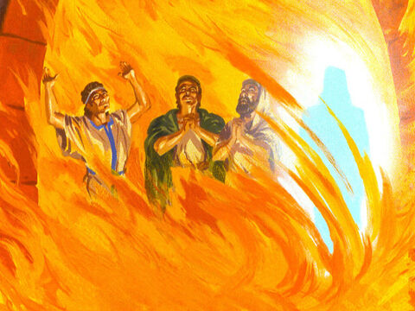
49
“I came to set the earth on fire, and how I wish it were already kindled!
Notes:
Fire is usually a figure of judgment (see Luke 3:16-17); here it seems to be the fire that will separate and purify those who are meant for the kingdom.

Slide 10
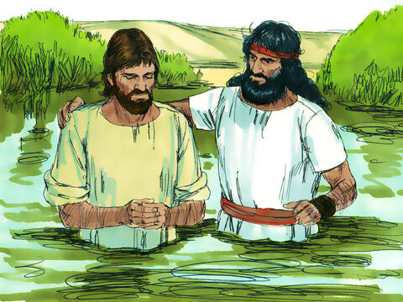
50
I have a baptism to receive, and how distressed I am until it is over!

Slide 11
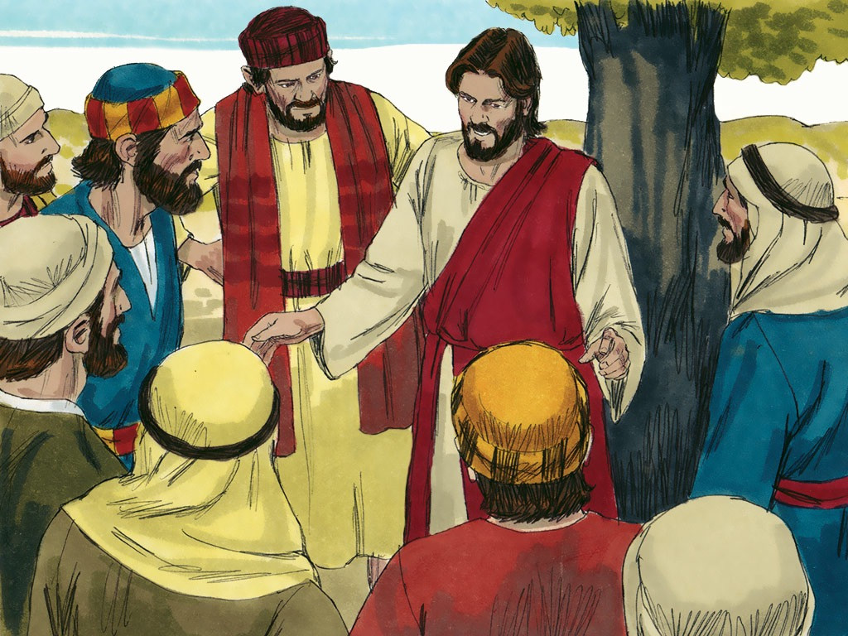
51
Do you suppose that I came to bring peace to the world? No, not peace, but division.
Notes:
Jesus will not tolerate peace at any cost. He will not bring the sobriety of the status quo, but the sword that will divide the eager from the contented. By resisting, through sin, the redeeming work of Christ, we become His opponents

Slide 12
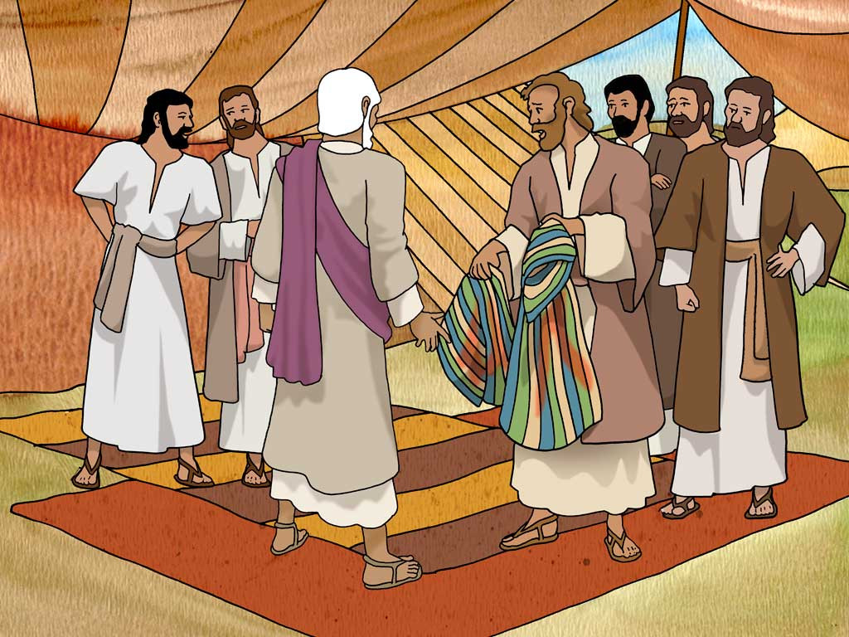
52
From now on a family of five will be divided, three against two and two against three.

Slide 13
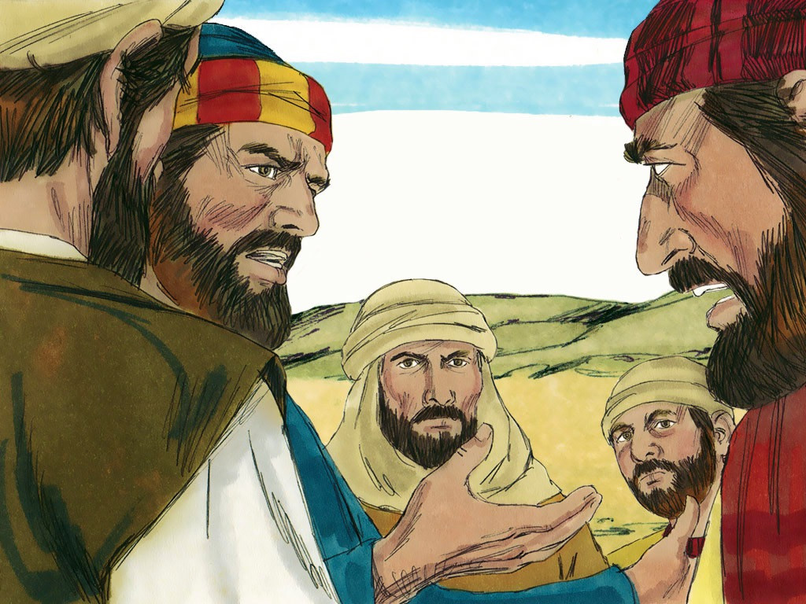
53
Fathers will be against their sons, and sons against their fathers;

Slide 14
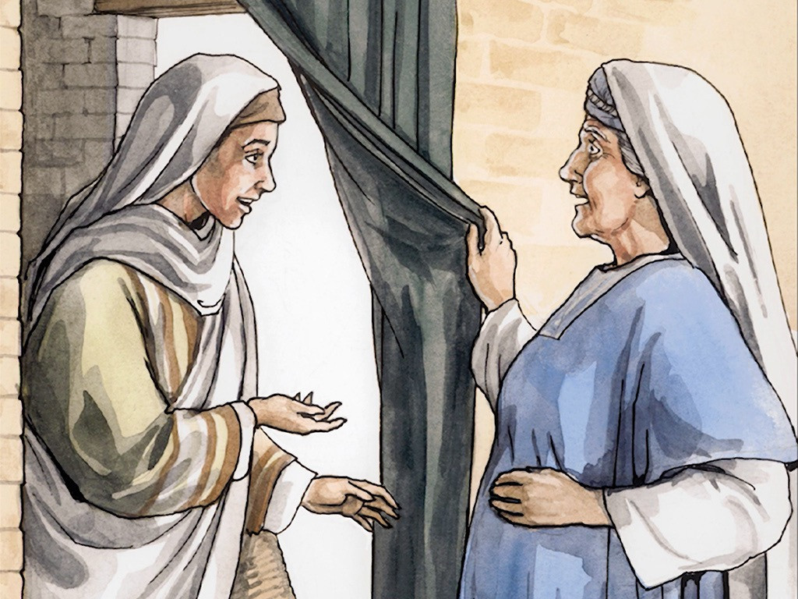
mothers will be against their daughters, and daughters against their mothers; mothers-in-law will be against their daughters-in-law, and daughters-in-law against their mothers-in-law.”

Slide 15
Leader: The Gospel of the Lord.
All: Praise to You,
Lord Jesus Christ.

Slide 16
GOSPEL MESSAGE

Slide 17
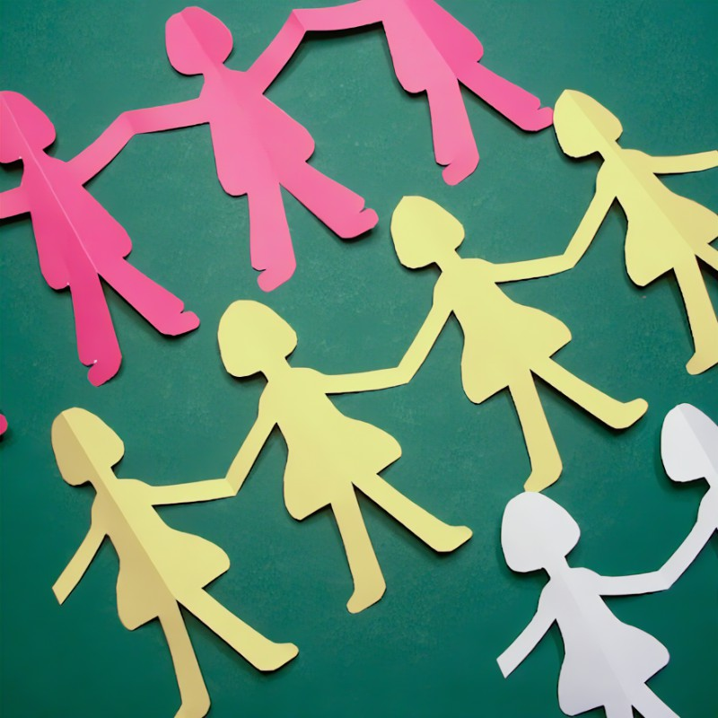
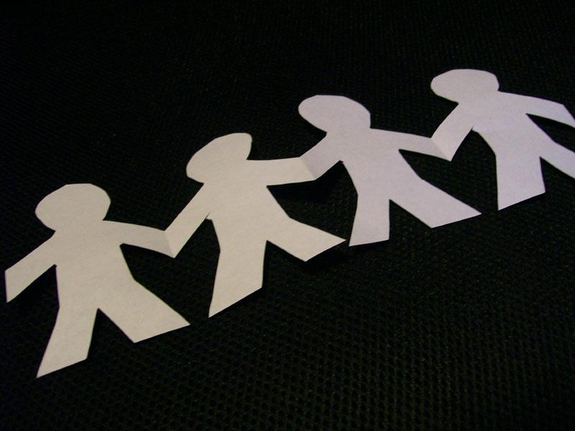
Activity:
ORIGAMI PAPER
DOLL CHAIN
Materials:
Bond Paper / Colored Paper / Any Specialty Paper
Crayons / Markers / Any Coloring Materials
Scissors
Glue & Accessories (optional)
Extra Stickers (optional)

Slide 18
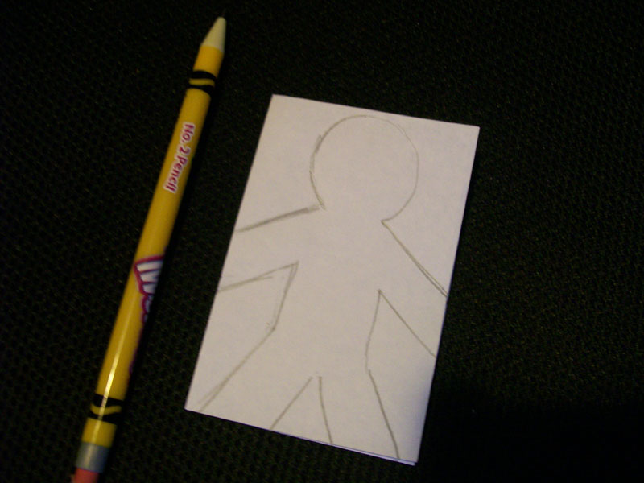
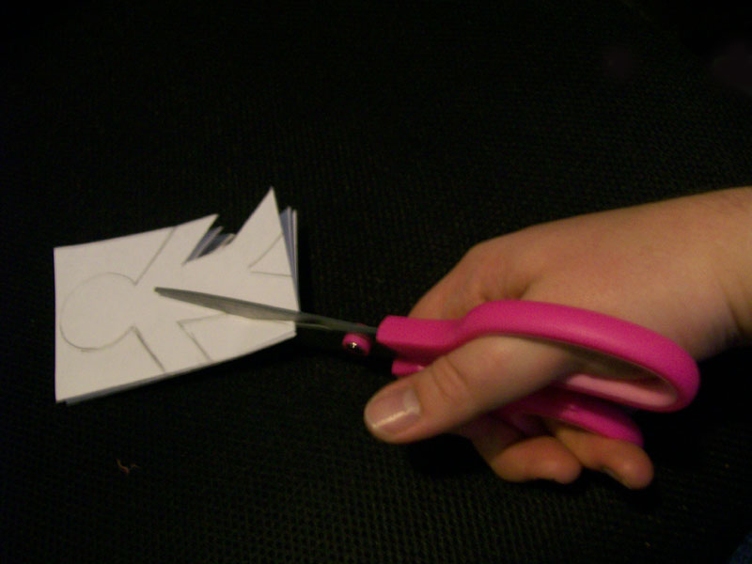
Procedure:
To begin making a paper doll chain, choose the paper you want. The length of your chain will depend on the length of the paper you pick.
Accordion fold your paper, making the folds as wide as you want your paper doll to be. Draw your design onto the top fold. The arms of the doll should reach all the way to the edges of the top fold. A basic doll shape is fine for beginners, or you can experiment with creative.
Carefully cut out the design you drew, taking your time to make sure your cuts are accurate and even. You'll be cutting through all the folds of paper at once.

Slide 19
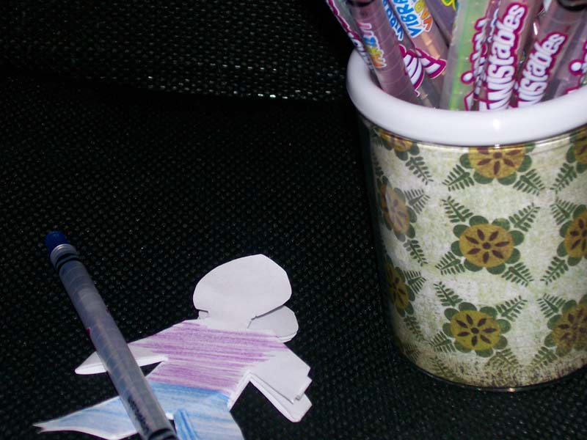
Remember that you shouldn't cut the ends of the arms or the feet because this will make the chain fall apart.
When you're done cutting, unfold the chain. The dolls will be holding hands with one another! If you have a partial doll on one end of the chain, simply cut the chain off before that doll begins.
Decorate the dolls as desired. You can use crayons, markers, paints, and other methods to add color. Glue on lace, sequins, wool, ribbon, decorative buttons, or whatever other supplies you have handy to give your paper doll chain a bit of personality.
WRITE IN EACH PERSON A GOOD CHRISTIAN CHARACTER

Slide 20
Closing Prayer
Dear Lord,
You are the center of my life. I thank you for my family and pray that I will never be a stumbling block for their faith. Give me the wisdom to know when to speak and when to remain silent. Help me, so that I will never compromise the Gospel. Amen.

Slide 21
LIVE THE WORD KIDS
20th Sunday in Ordinary Time | Year C

