Slide 1
LIVE THE WORD KIDS
19th Sunday in Ordinary Time | Year C

Slide 2
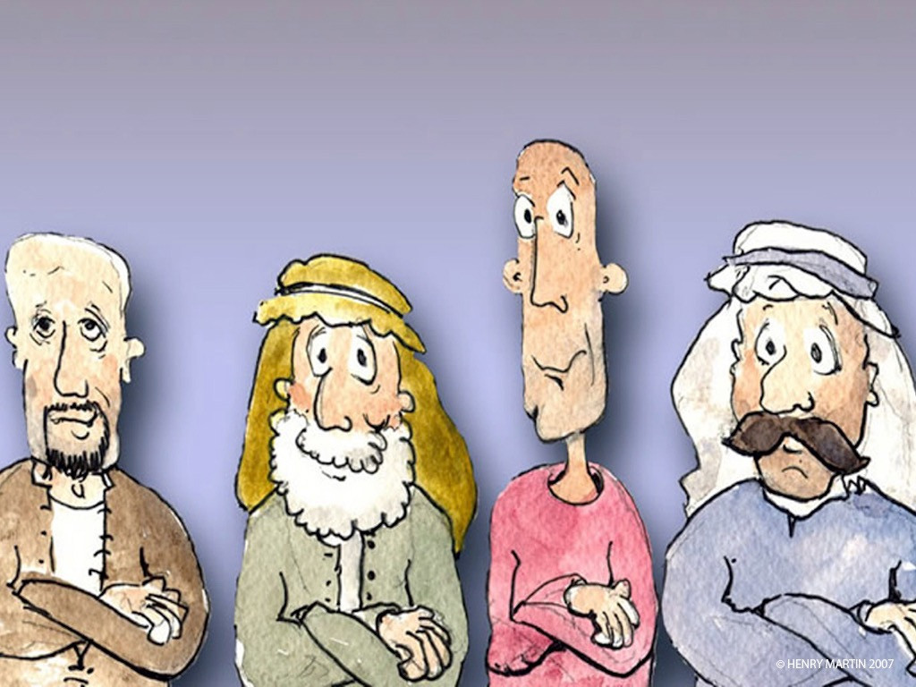
The Parable of Vigilant and Faithful Servants
Luke 12:35-40

Slide 3
NOTES FOR THE FACILITATOR ONLY:
Gospel Lesson:
Jesus' instructions on how to be ready for the coming judgment continue in the stories and sayings found in today's Gospel. We are not to be like the greedy rich man in last Sunday's Gospel who planned to store his great harvest in barns rather than share it. We are, rather, to share our wealth with those in need. The antidote for the anxiety brought on by the coming judgment is to relinquish our possessions and provide for the needs of others. Our treasure will be in heaven where it will not wear out or be destroyed.
The other major way to be ready for the coming judgment is to be watchful. In Luke's Gospel, Jesus tells a parable about watchfulness to begin making this point. We must be like servants waiting for the master's return from a wedding banquet, which, even now, can last for a few days in the Middle East. We must be watchful so that even if the master comes after midnight, we will be ready for him. This is what the coming of the Son of Man will be like.
Notes:
Don’t include this slide when you present this to the kids

Slide 4
NOTES FOR THE FACILITATOR ONLY:
Gospel Lesson (cont.):
Without answering Peter's question, Jesus responds with another parable about servants awaiting the return of their master. It begins with a question: “Who, then, is the faithful and prudent steward whom the master will put in charge of his servants to distribute the food allowance at the proper time?”
This parable adds to the theme of watchfulness; it explains how to wait and reminds us of the reward for the faithful follower at the heavenly banquet after the judgment…the parables reminds us that we should be found doing our jobs when the master arrives. If we are doing our jobs, our reward will be great. But if we relax, neglect our duties, and begin to act like the greedy rich man—eating, drinking, and making merry—we will not have a place in the kingdom. Watchfulness means living in such a consistently moral and obedient way that we are always ready to give an account to God of how we have lived.
Notes:
Don’t include this slide when you present this to the kids

Slide 5
The Parable of Vigilant and Faithful Servants
Luke 12:35-40

Slide 6
Leader: A reading from
the Holy Gospel
according to Luke.
All: Glory to You, Oh Lord.

Slide 7
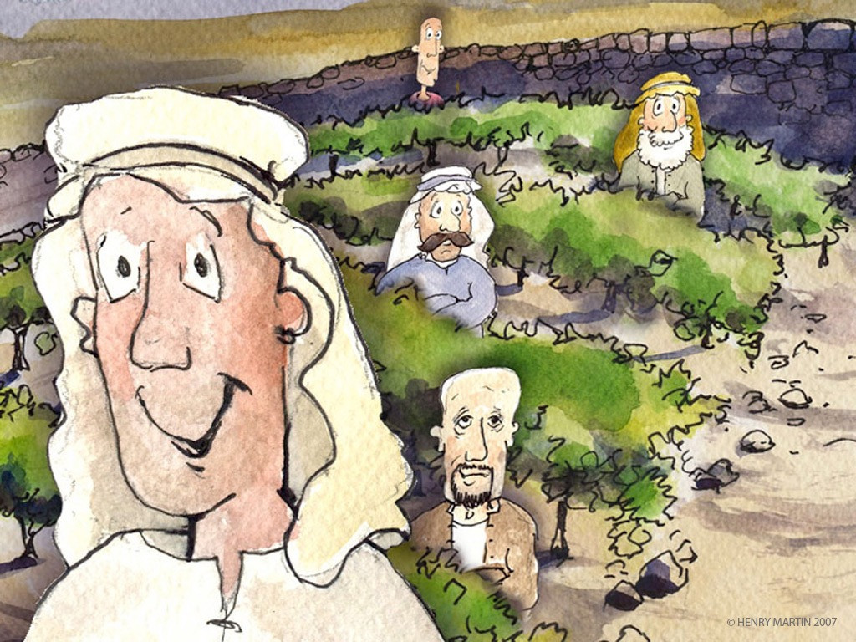
35
“Gird your loins and light your lamps
Notes:
Verse 35: Gird up one's loins means Prepare oneself for action.

Slide 8
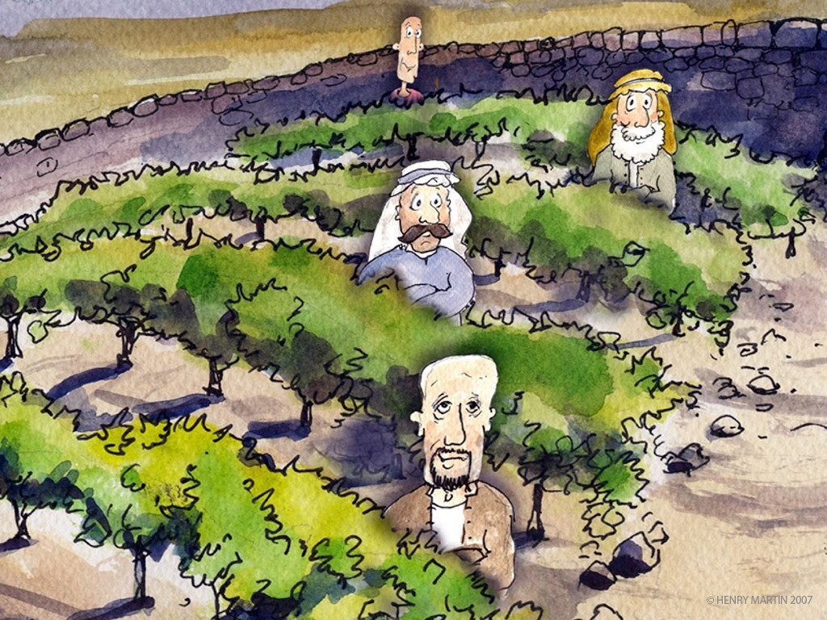
36
and be like servants who await their master’s return from a wedding, ready to open immediately when he comes and knocks.

Slide 9
37
Blessed are those servants whom the master finds vigilant on his arrival. Amen, I say to you, he will gird himself, have them recline at table, and proceed to wait on them.

Slide 10
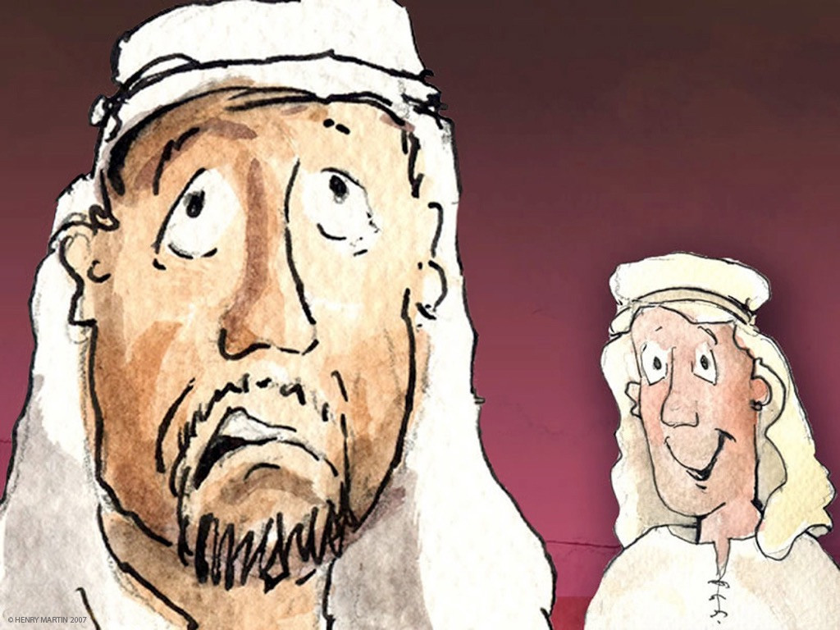
38
And should he come in the second or third watch and find them prepared in this way, blessed are those servants.

Slide 11
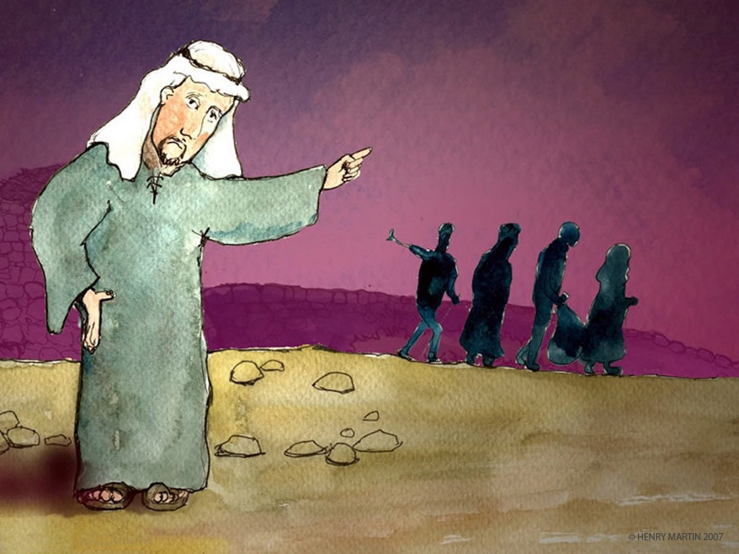
39
Be sure of this: if the master of the house had known the hour when the thief was coming, he would not have let his house be broken into.

Slide 12
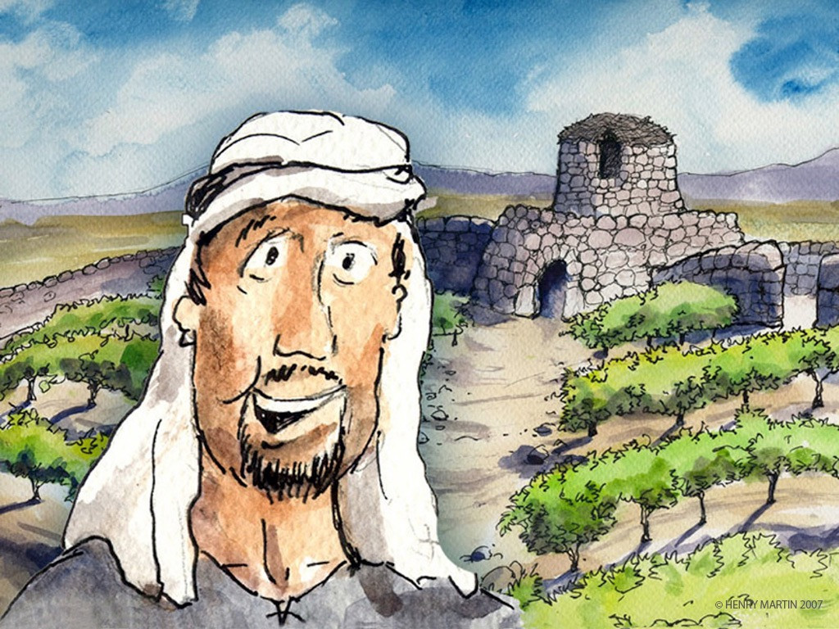
40
You also must be prepared, for at an hour you do not expect, the Son of Man will come.”

Slide 13
Leader: The Gospel of the Lord.
All: Praise to You,
Lord Jesus Christ.

Slide 14
GOSPEL MESSAGE

Slide 15
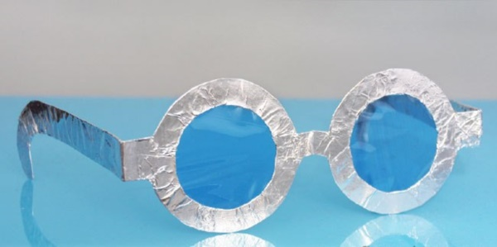
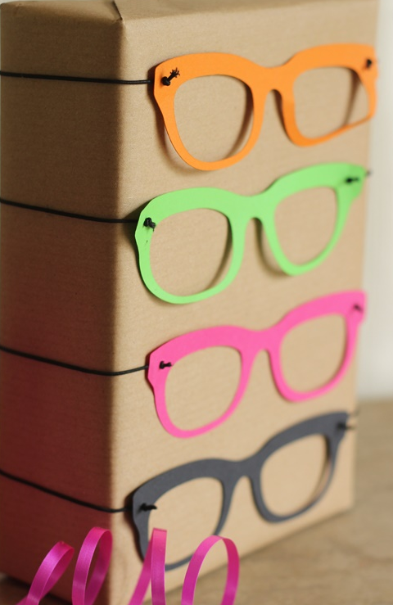
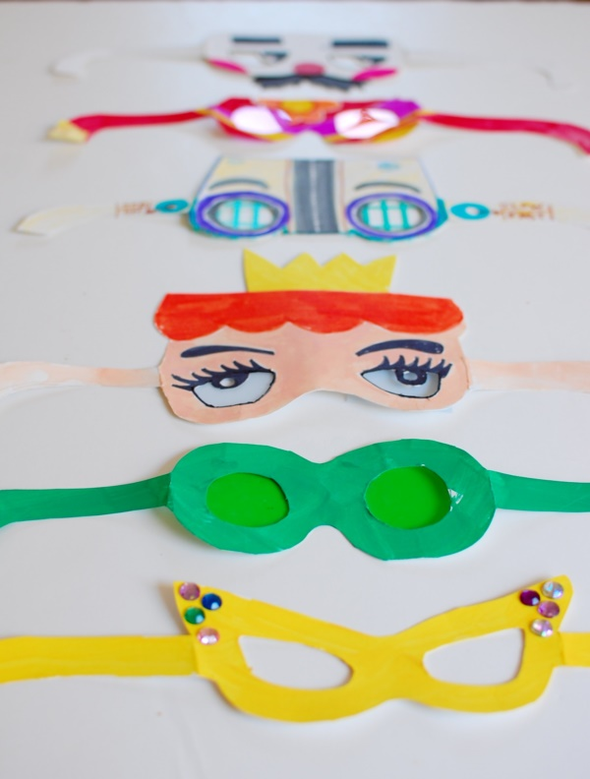
Activity:
Watchful Sunglasses
Materials:
Bond Paper / Colored Paper
Crayons/ Coloring Materials
Markers
Glue
Accessories
Extra Stickers
Cellophane paper (optional)

Slide 16
Procedure:
Step 1- Trace out the pair of sunglass onto a colored paper of your choice or you can also directly print a template as shown. The frame of the sunglasses is your choice you can experiment with different styles like aviator sunglasses etc.
Step 2- If you choose a plain white sheet, you can color it with your choice of color, you can choose either pencil colors or crayons.
Step 3- Now cut out the three template pieces carefully and neatly. Don’t forget to cut out the eye holes!
Step 4- Glue it all together. Fold the side tabs of the glasses towards the back. Now glue both the arms to the side tabs neatly.
Step 5- Now for the sunglass effect take the cellophane paper or transparency film, cut a pair to a size and shape that covers each eyehole of your sunglass and glue the lenses at the back of the frame.

Slide 17
Closing Prayer
Dear God,
Thank you for always blessing us in many ways. We pray that You always make us ready, especially for Your coming. May we become watchful and faithful
Amen.

Slide 18
LIVE THE WORD KIDS
19th Sunday in Ordinary Time | Year C

