Slide 1
LIVE THE WORD KIDS
2nd Sunday of Easter | Cycle C

Slide 2
USEFUL NOTES FOR THE FACILITATOR
(Don’t include this slide when you start your bible study with the kids)
The story of Thomas is an important one to emphasize how as Christians, we put our trust in Jesus despite the fact we cannot see Him physically.

Slide 3
Furthermore, In today’s Gospel, Jesus greets his disciples with the gift of peace. Jesus then commands his disciples to continue the work that he has begun; as Jesus was sent by God, so Jesus sends his disciples. He gives his disciples the gift of the Holy Spirit so that they will be able to accomplish this task.
Jesus’ words to his disciples also highlight the important connection between the forgiveness of sins and the gift of the Holy Spirit. With the grace of the Holy Spirit, we can share forgiveness and reconciliation with others.

Slide 4
LIVE THE WORD KIDS
2nd Sunday of Easter | Cycle C

Slide 5
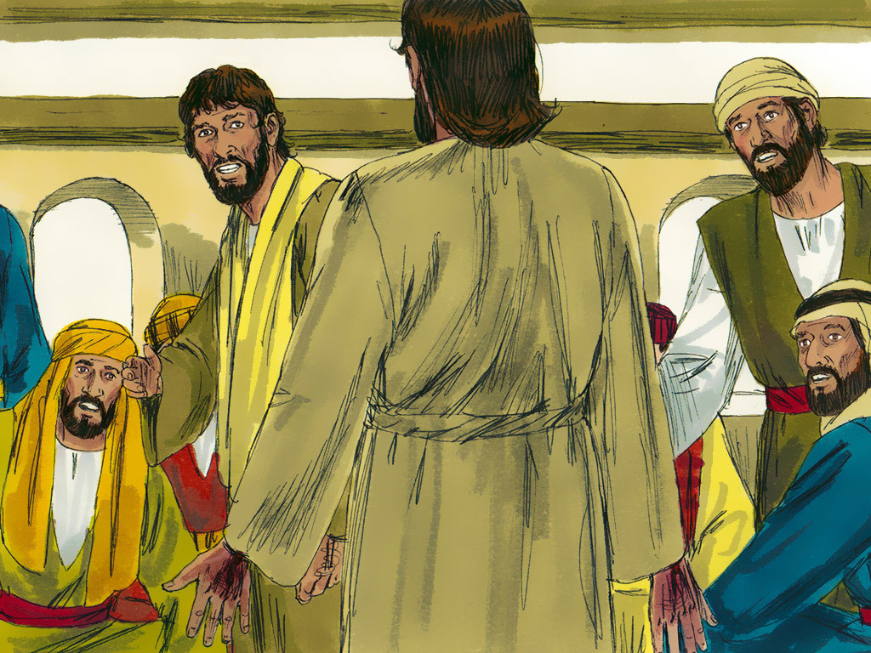
Jesus Appears to His Disciples
John 20:19-31

Slide 6
Leader: A reading from
the Holy Gospel
according to John.
All: Glory to You, Oh Lord.

Slide 7
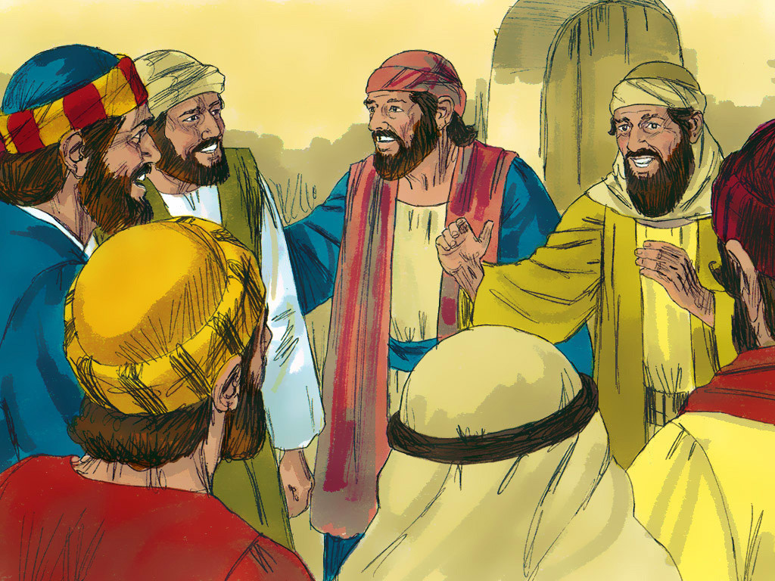
19
It was late that Sunday evening, and the disciples were gathered together behind locked doors, because they were afraid of the Jewish authorities. Then Jesus came and stood among them. “Peace be with you,” he said.

Slide 8
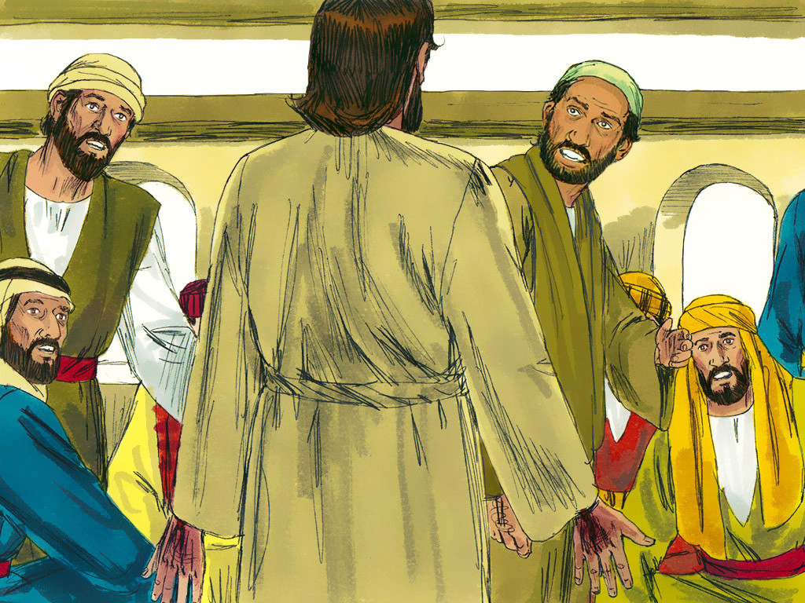
20
After saying this, he showed them his hands and his side. The disciples were filled with joy at seeing the Lord.

Slide 9
21
Jesus said to them again, “Peace be with you. As the Father sent me, so I send you.”

Slide 10
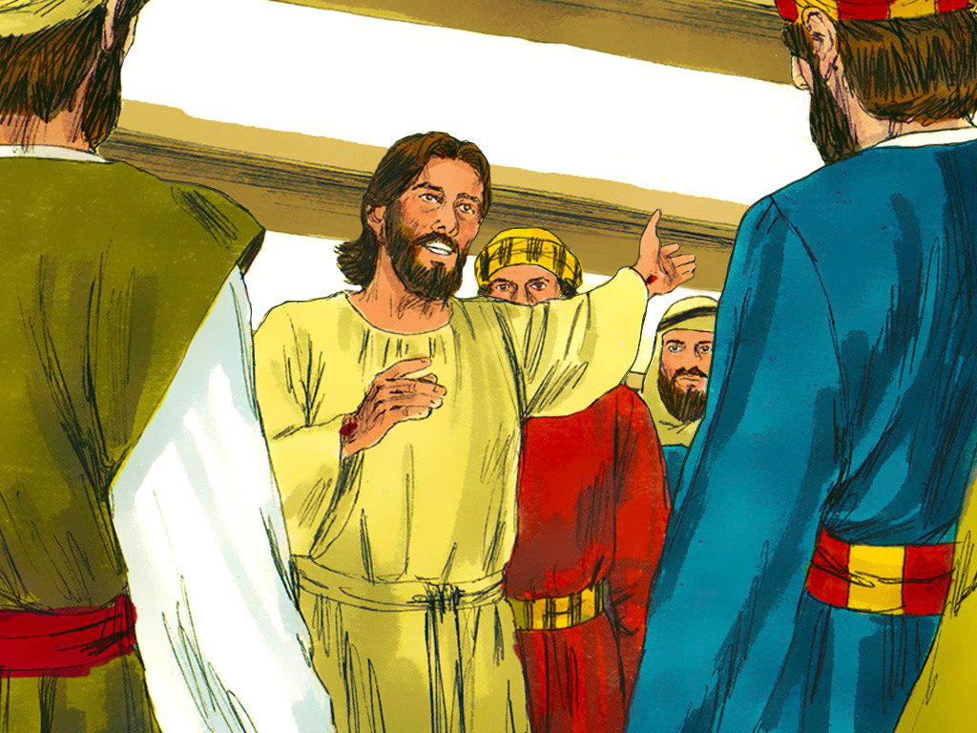
22
Then he breathed on them and said, “Receive the Holy Spirit.

Slide 11
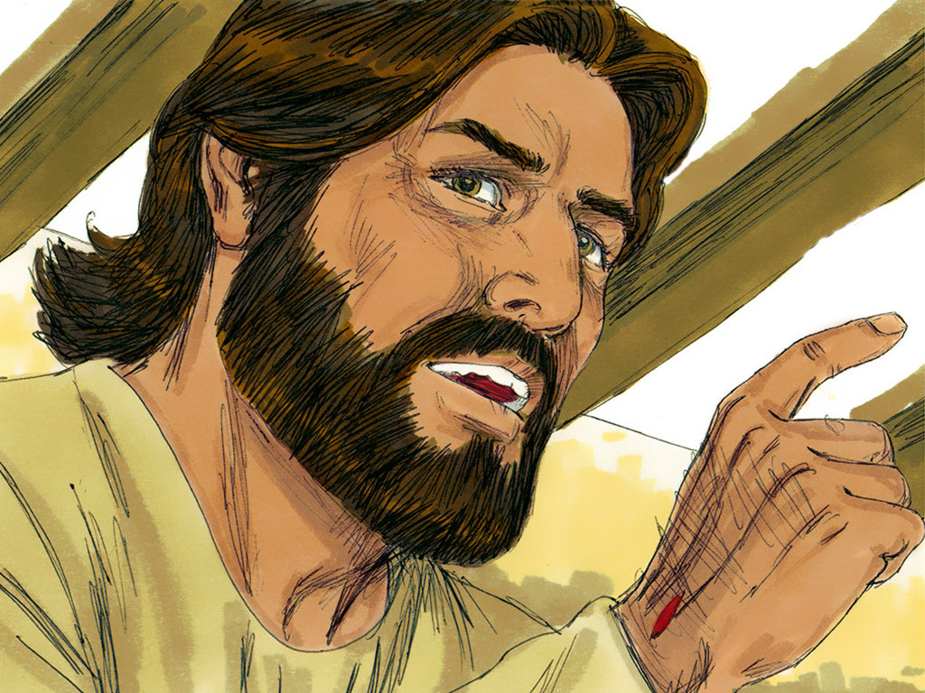
23
If you forgive people's sins, they are forgiven; if you do not forgive them, they are not forgiven.”

Slide 12
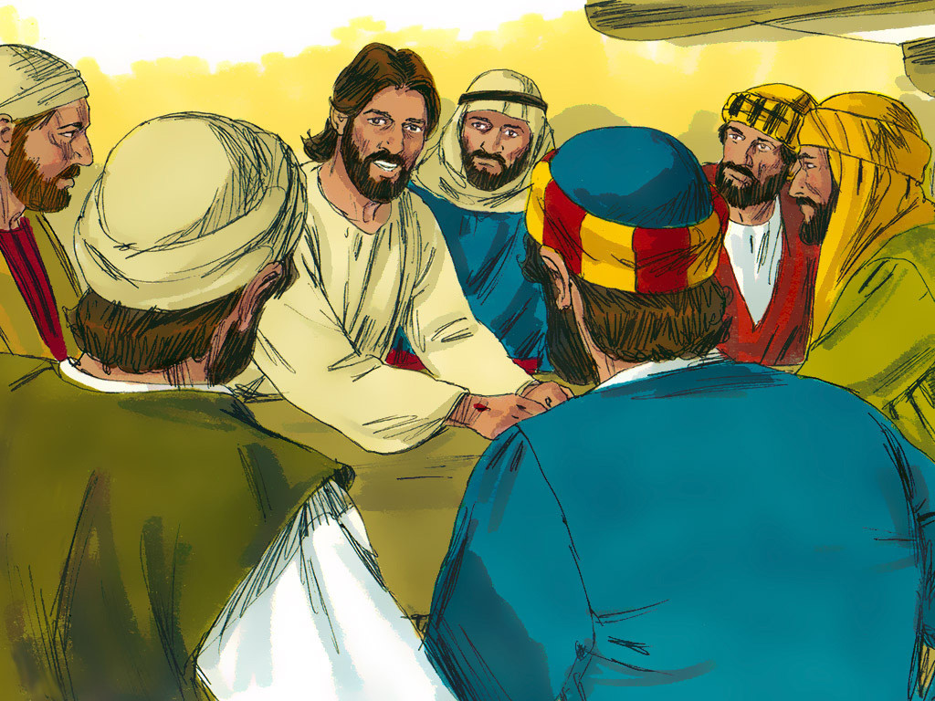
24
One of the twelve disciples, Thomas (called the Twin), was not with them when Jesus came.

Slide 13
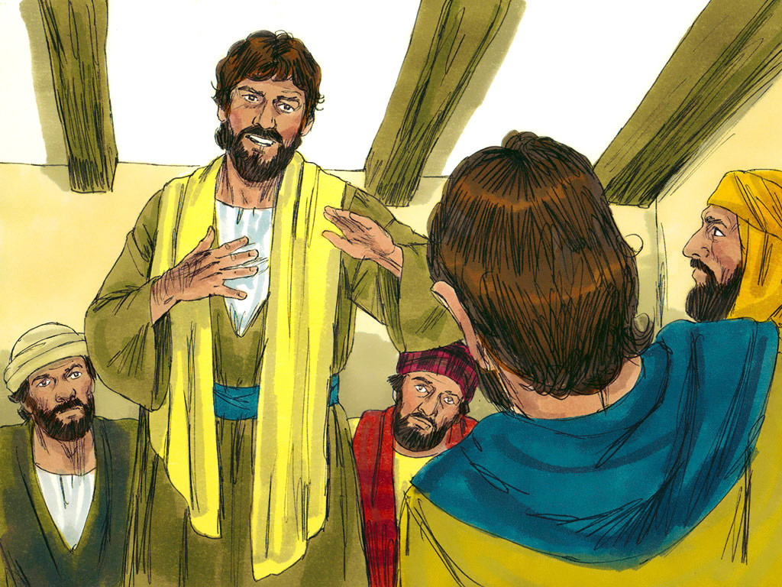
25
So the other disciples told him, “We have seen the Lord!”
Thomas said to them, “Unless I see the scars of the nails in his hands and put my finger on those scars and my hand in his side, I will not believe.”

Slide 14
26
A week later the disciples were together again indoors, and Thomas was with them. The doors were locked, but Jesus came and stood among them and said, “Peace be with you.”

Slide 15
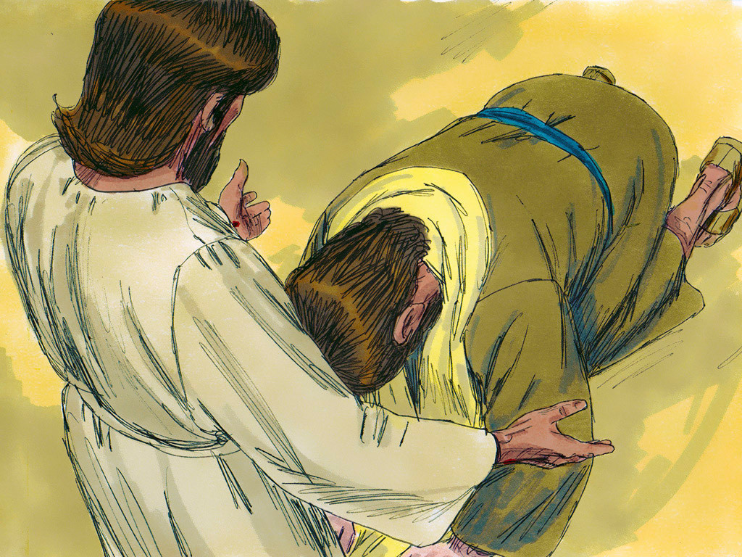
27
Then he said to Thomas, “Put your finger here, and look at my hands; then reach out your hand and put it in my side. Stop your doubting and believe!”

Slide 16
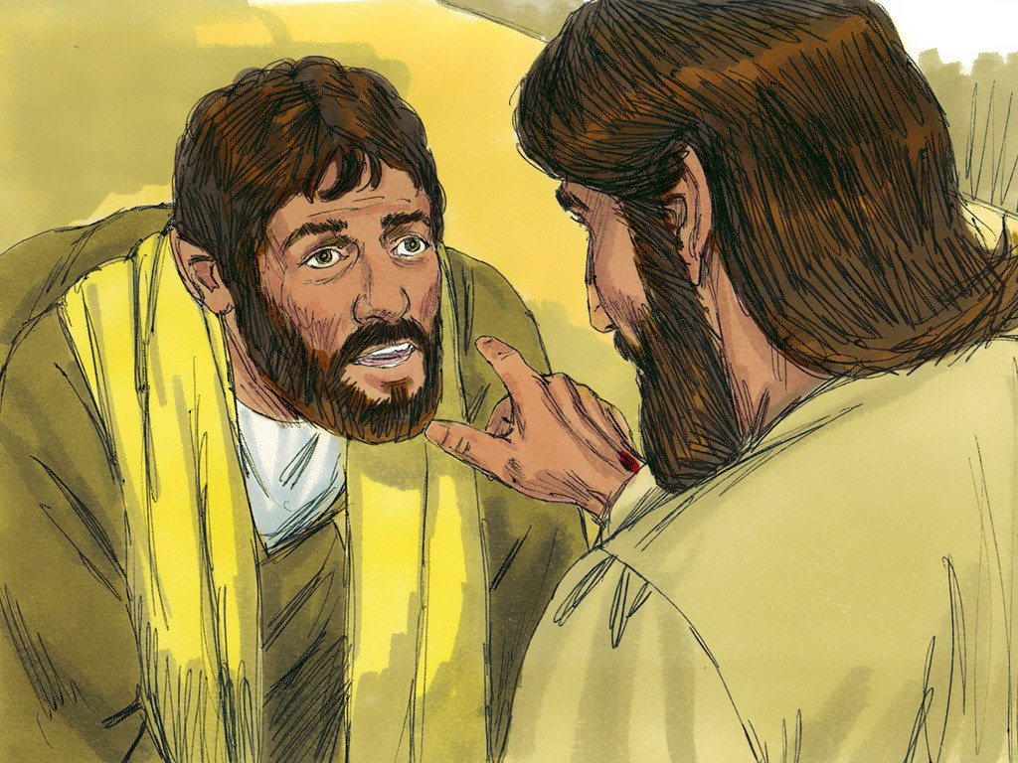
28
Thomas answered him, “My Lord and my God!”

Slide 17
29
Jesus said to him, “Do you believe because you see me? How happy are those who believe without seeing me!”

Slide 18
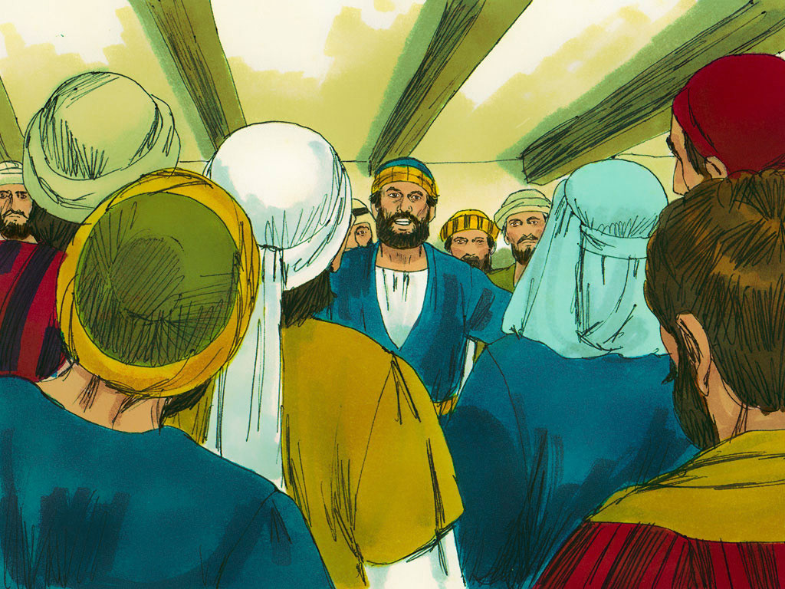
30
In his disciples' presence Jesus performed many other miracles which are not written down in this book.

Slide 19
31
But these have been written in order that you may believe that Jesus is the Messiah, the Son of God, and that through your faith in him you may have life.

Slide 20
Leader: The Gospel of the Lord.
All: Praise to You,
Lord Jesus Christ.

Slide 21
GOSPEL MESSAGE

Slide 22
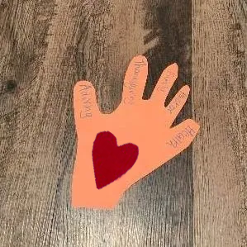
Activity:
I BELIEVE HAND
Construction Paper/Multipurpose Paper (2 different colors)
Scissors
Pen or Markers
Glue or tape

Slide 23
Activity:
I BELIEVE HAND
Trace a hand onto the paper
Glue another small “heart-shaped paper” in the center.
Cut the handout of the paper.
On each finger, write the name
of the person that you want to pray for.

Slide 24
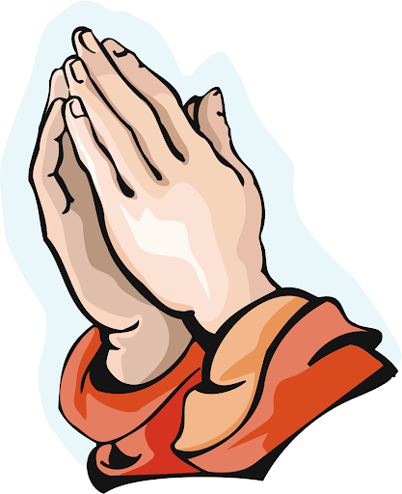
Closing Prayer
Dear God, Thank you for the life of Jesus, and thank you for your promises. We believe in you and trust you even when we can’t see you. Help us not to be afraid and to remember that you watch over us.
In Jesus’ name, we pray. Amen.

Slide 25
LIVE THE WORD KIDS
2nd Sunday of Easter | Cycle C

