Slide 1
LIVE THE WORD KIDS
6th Sunday of Lent | Cycle C

Slide 2
USEFUL NOTES FOR THE FACILITATOR
(Don’t include this slide when you start your bible study)
Jesus is completing His journey to Jerusalem; the place He knows that He must go for His passion. Our Mass this Sunday opens with Luke’s account of Jesus’ Messianic entry into the city.

Slide 3
Just a few days before He was crucified, Jesus rode a donkey into Jerusalem as the people waved palm branches and shouted "Hosanna! He who comes in the name of the Lord is the blessed One--the King of Israel!" We remember and celebrate this event on Palm Sunday. His triumphal entry into Jerusalem declared that Jesus is the King of kings.

Slide 4
LIVE THE WORD KIDS
6th Sunday of Lent | Cycle C

Slide 5
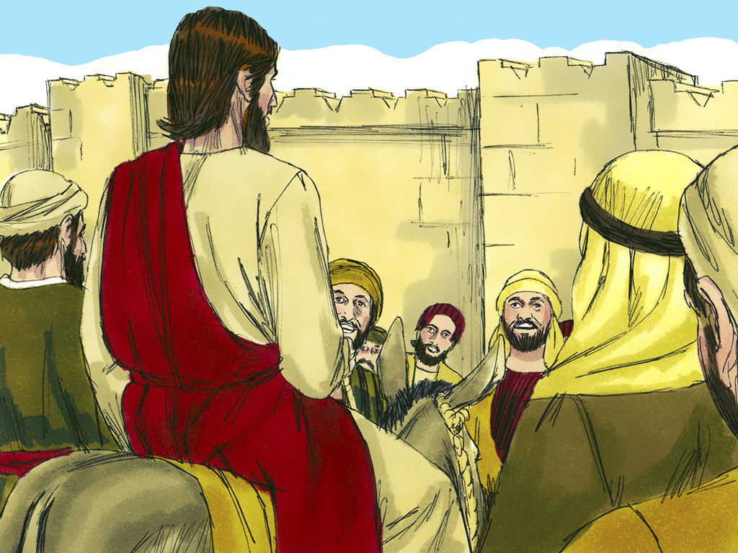
The Triumphant Approach to Jerusalem (Palm Sunday)
Luke 19:28-40

Slide 6
Leader: A reading from
the Holy Gospel
according to Luke.
All: Glory to You, Oh Lord.

Slide 7
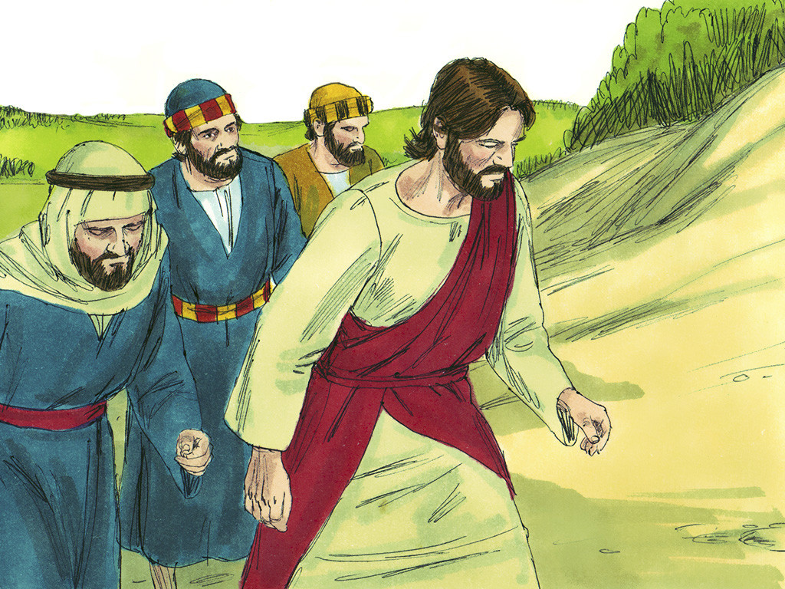
28
After Jesus said this, he went on in front of them toward Jerusalem.

Slide 8
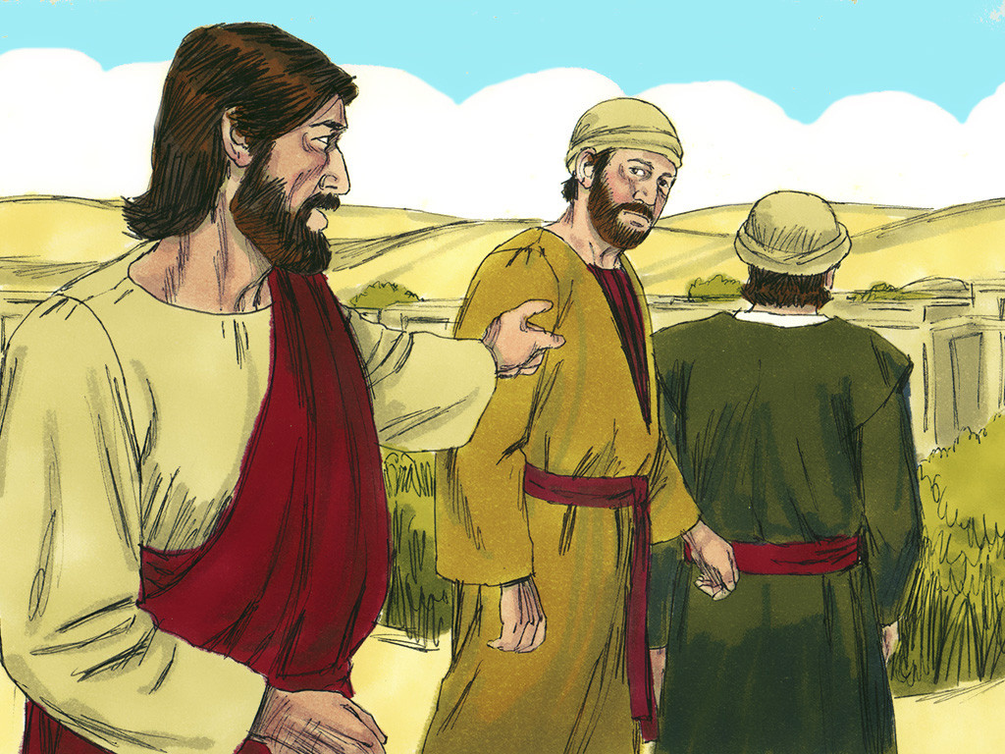
29
As he came near Bethphage and Bethany at the Mount of Olives, he sent two disciples ahead

Slide 9
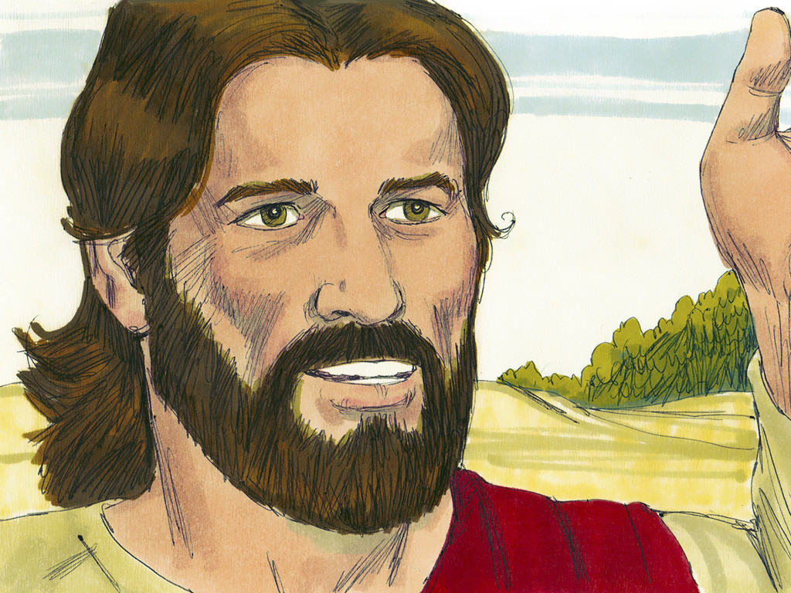
30
with these instructions: “Go to the village there ahead of you; as you go in, you will find a colt tied up that has never been ridden. Untie it and bring it here.

Slide 10
31
If someone asks you why you are untying it, tell him that the Master needs it.”

Slide 11
32
They went on their way and found everything just as Jesus had told them.

Slide 12
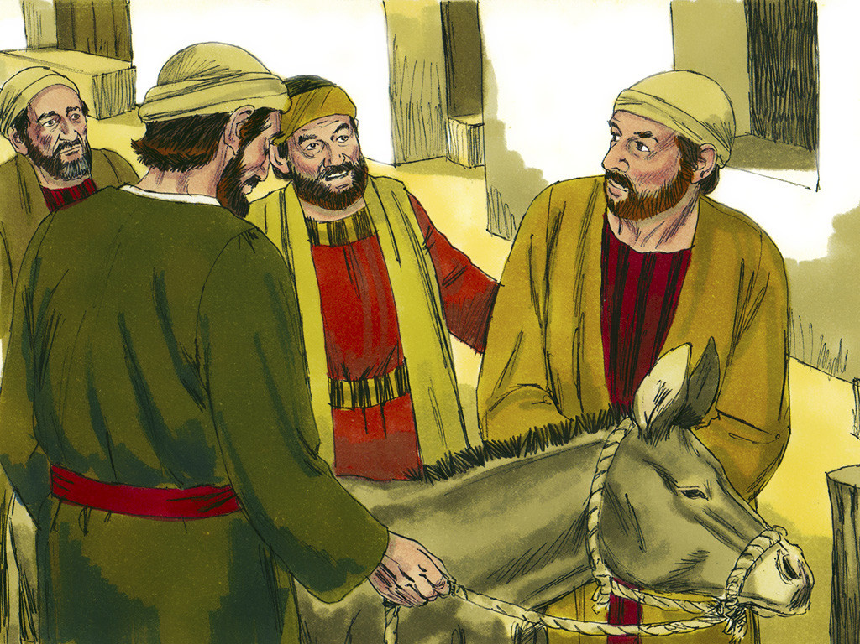
33
As they were untying the colt, its owners said to them, “Why are you untying it?”

Slide 13
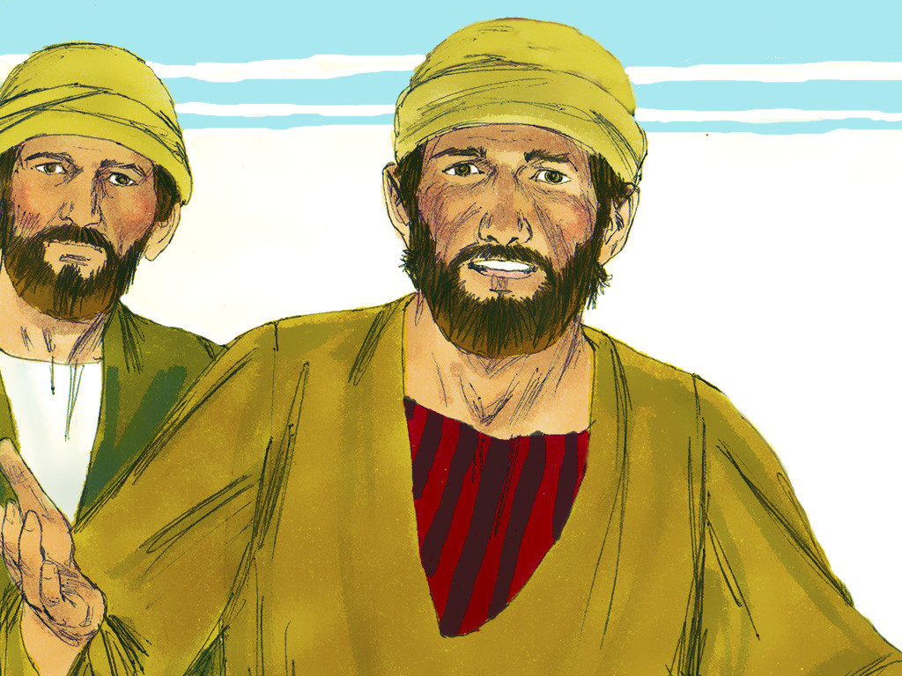
34
“The Master needs it,” they answered,

Slide 14
35
and they took the colt to Jesus. Then they threw their cloaks over the animal and helped Jesus get on.

Slide 15
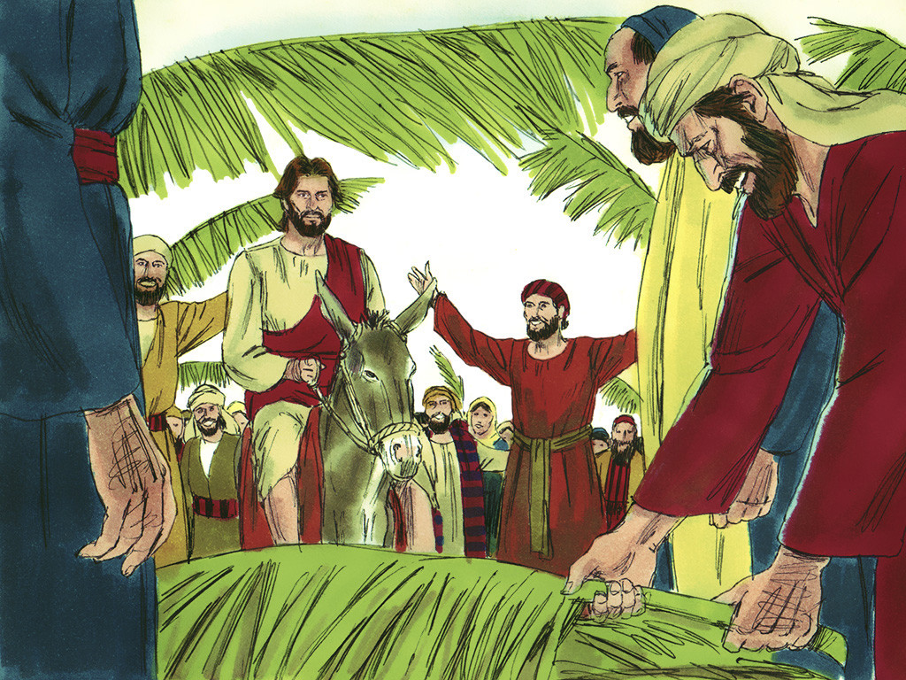
36
As he rode on, people spread their cloaks on the road.

Slide 16
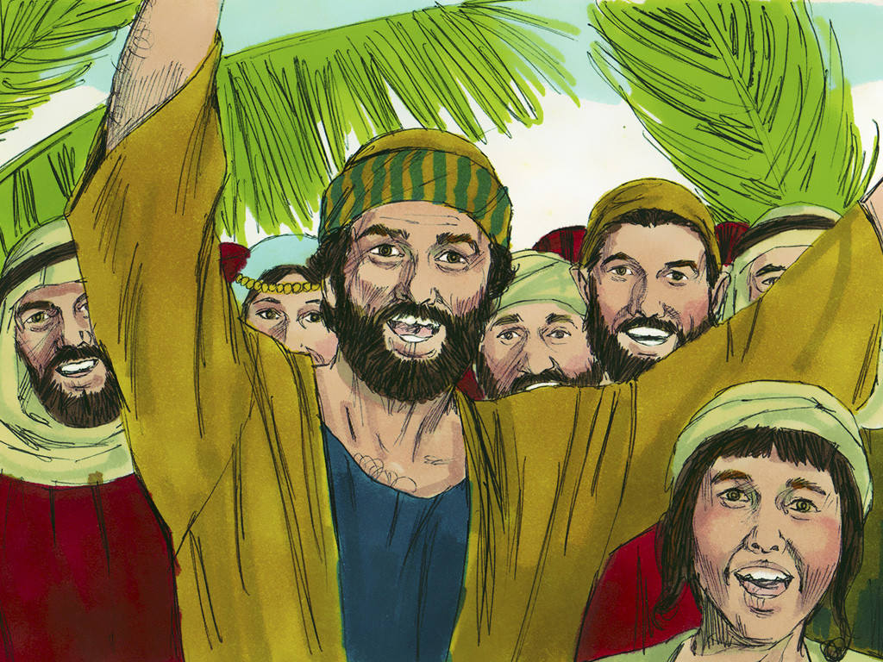
37
When he came near Jerusalem, at the place where the road went down the Mount of Olives, the large crowd of his disciples began to thank God and praise him in loud voices for all the great things that they had seen:

Slide 17
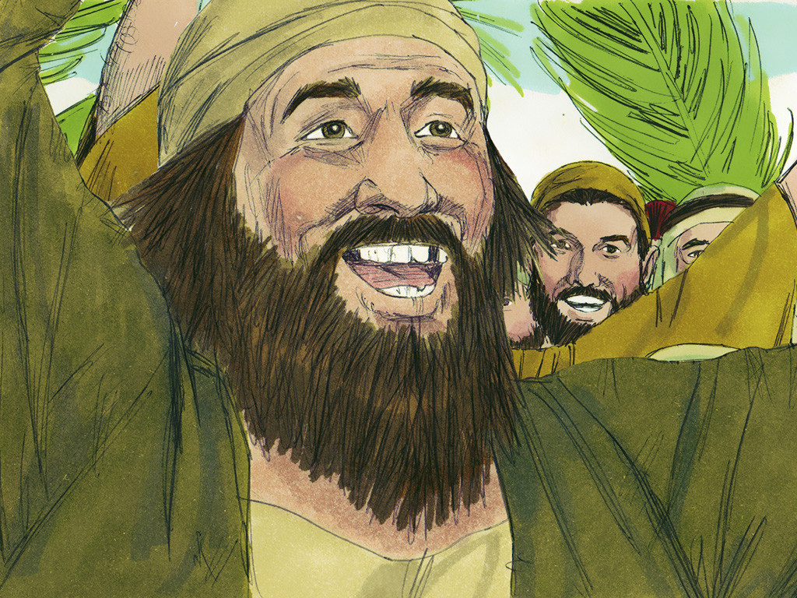
38
“God bless the king who comes in the name of the Lord! Peace in heaven and glory to God!”

Slide 18
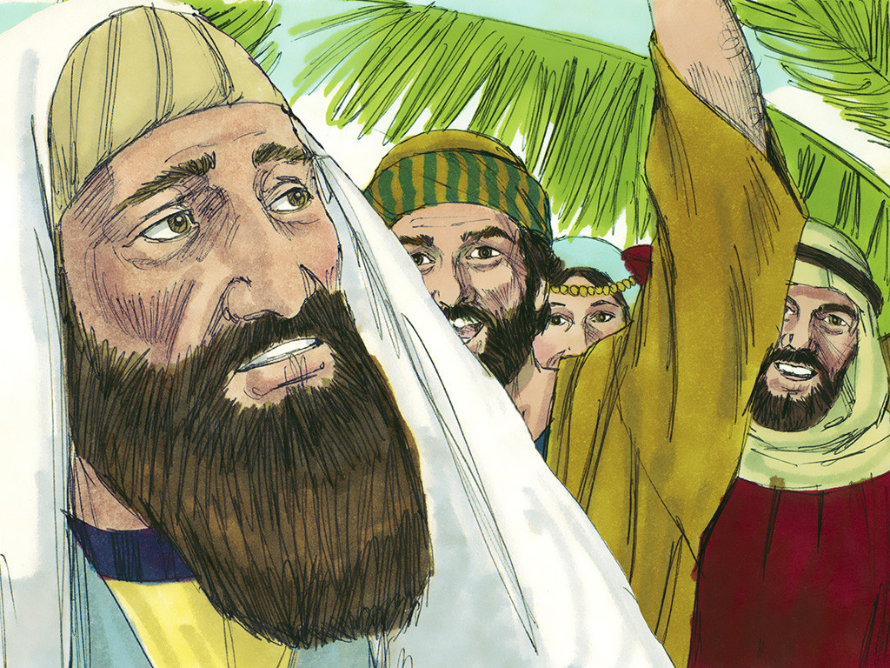
39
Then some of the Pharisees in the crowd spoke to Jesus. “Teacher,” they said, “command your disciples to be quiet!”

Slide 19
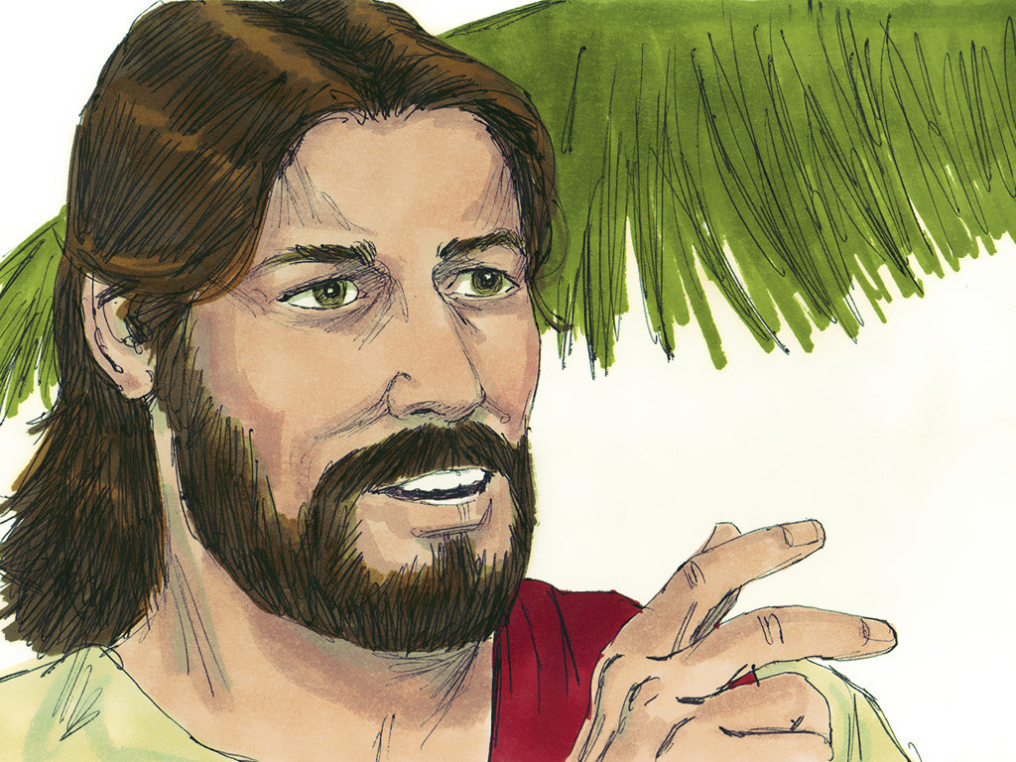
40
Jesus answered, “I tell you that if they keep quiet, the stones themselves will start shouting.”

Slide 20
Leader: The Gospel of the Lord.
All: Praise to You,
Lord Jesus Christ.

Slide 21
GOSPEL MESSAGE

Slide 22
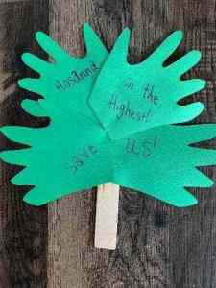
Activity:
Hand Palm Stick
Scissors
Construction paper (green)
Markers or decorating materials
Glue or tape
Toilet Paper tube or popsicle stick

Slide 23
Activity:
Hand Palm Stick
Trace handprints onto green paper.
Carefully cut the hands out of the paper.
Decorate the hands with words, phrases, or verses.
Glue the handprints onto the sides of the stick or tube.

Slide 24
Closing Prayer
Dear Jesus, Lord of our life, show us how to live. When we are afraid, angry, sad and rejected, taeach us to live deeply into difficult moments, that we might find meaning and purpose even in the moments which require a bit of pain as a child. We offer to you all our challenges and may we glorify you in all these things.
In Jesus’ name, we pray. Amen.

Slide 25
LIVE THE WORD KIDS
6th Sunday of Lent | Cycle C

