Slide 1
LIVE THE WORD KIDS
5th Sunday of Lent | Cycle C

Slide 2
USEFUL NOTES FOR THE FACILITATOR
(Don’t include this slide when you start your bible study)
This Gospel on Sunday is based on
John 8:1-11, the story of the Adulterous Woman talking to Jesus. This lesson shows how willing Christ is to forgive every sin, even the ones our culture considers unforgivable.

Slide 3
When dealing with adult subjects such as adultery you should be careful to explain the concept at a child’s level. Here are two ways to define adultery that helps children see the point while preserving their innocence. Many children will already know more but remember the point of the lesson is Jesus’ forgiveness more than the woman’s sin.
Adultery is when a person does not keep their marriage promises.
Adultery is when a person pretends that someone else is their husband/wife who is not.

Slide 4
LIVE THE WORD KIDS
5th Sunday of Lent | Cycle C

Slide 5
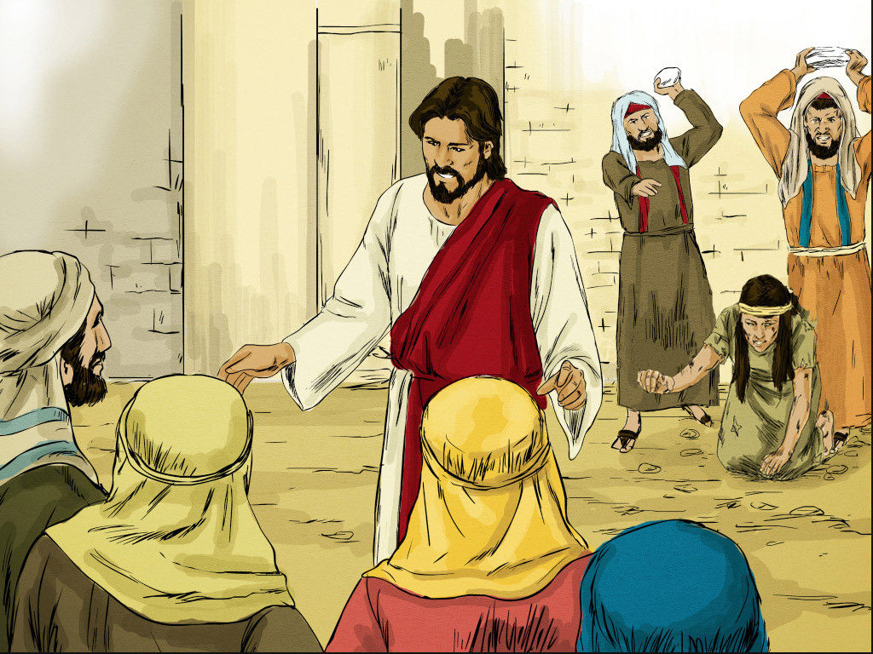
The Woman Caught in Adultery
John 8:1-11

Slide 6
Leader: A reading from
the Holy Gospel
according to John.
All: Glory to You, Oh Lord.

Slide 7
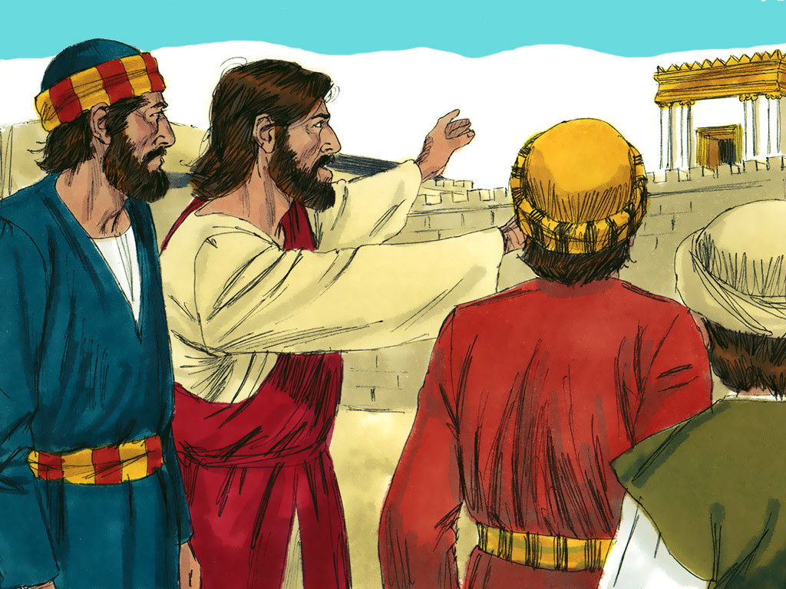
1
Then everyone went home, but Jesus went to the Mount of Olives.

Slide 8
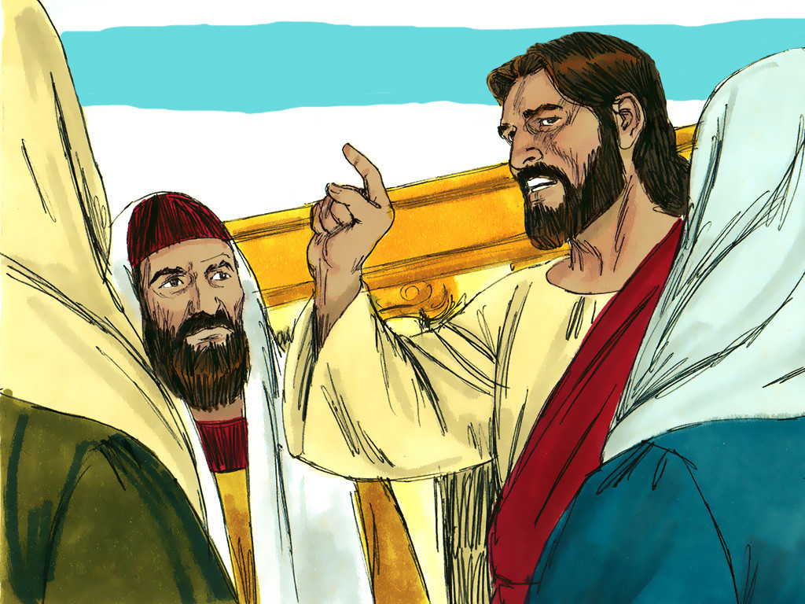
2
Early the next morning he went back to the Temple. All the people gathered around him, and he sat down and began to teach them.

Slide 9
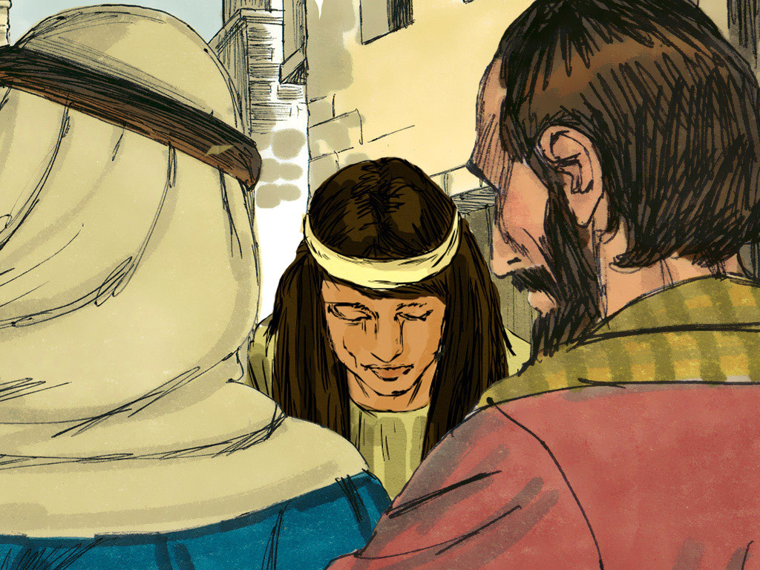
3
The teachers of the Law and the Pharisees brought in a woman who had been caught committing adultery, and they made her stand before them all.

Slide 10
4
“Teacher,” they said to Jesus, “this woman was caught in the very act of committing adultery.

Slide 11
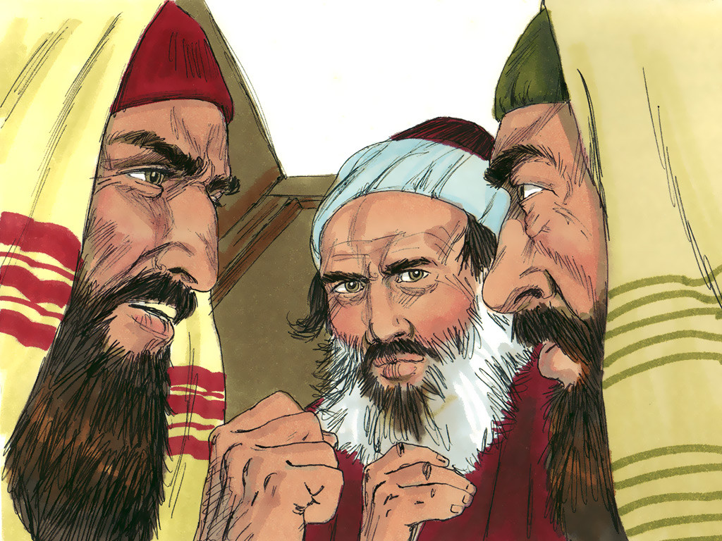
5
In our Law Moses commanded that such a woman must be stoned to death. Now, what do you say?”

Slide 12
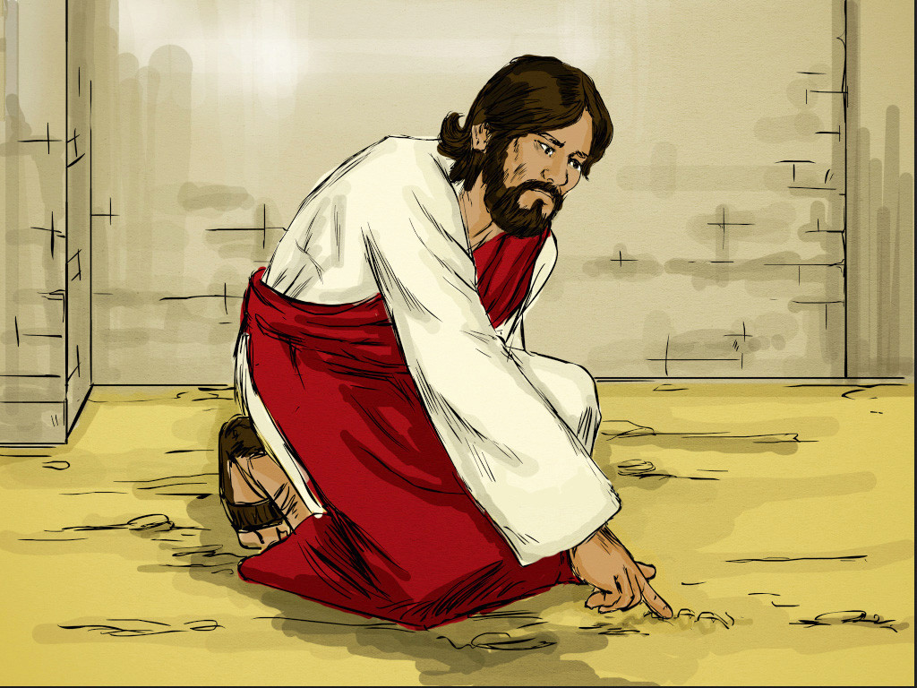
6
They said this to trap Jesus, so that they could accuse him. But he bent over and wrote on the ground with his finger.

Slide 13
7
As they stood there asking him questions, he straightened up and said to them, “Whichever one of you has committed no sin may throw the first stone at her.”

Slide 14
8
Then he bent over again and wrote on the ground.

Slide 15
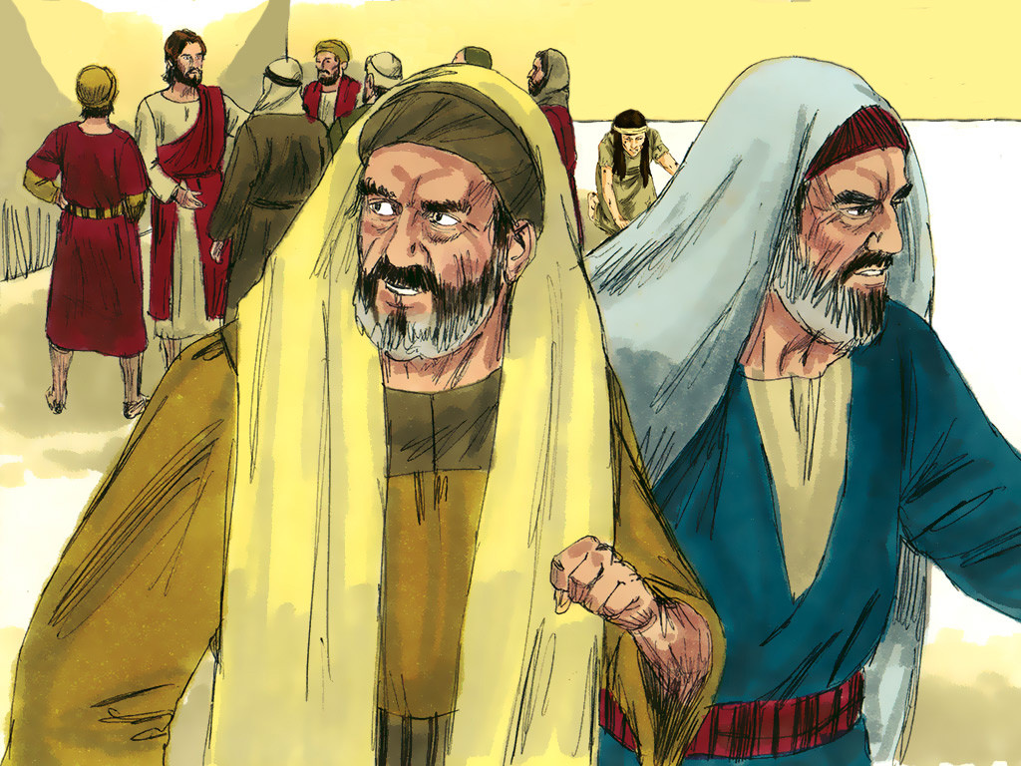
9
When they heard this, they all left, one by one, the older ones first. Jesus was left alone, with the woman still standing there.

Slide 16
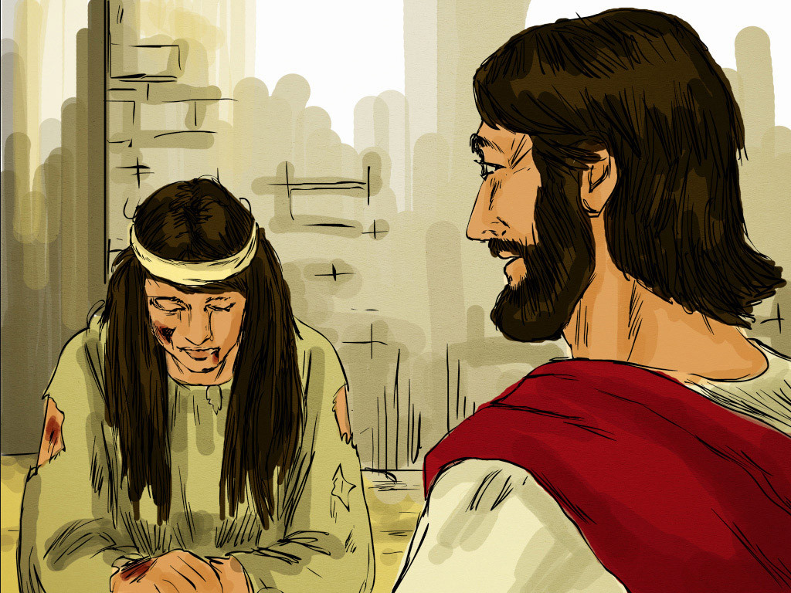
10
He straightened up and said to her, “Where are they? Is there no one left to condemn you?”

Slide 17
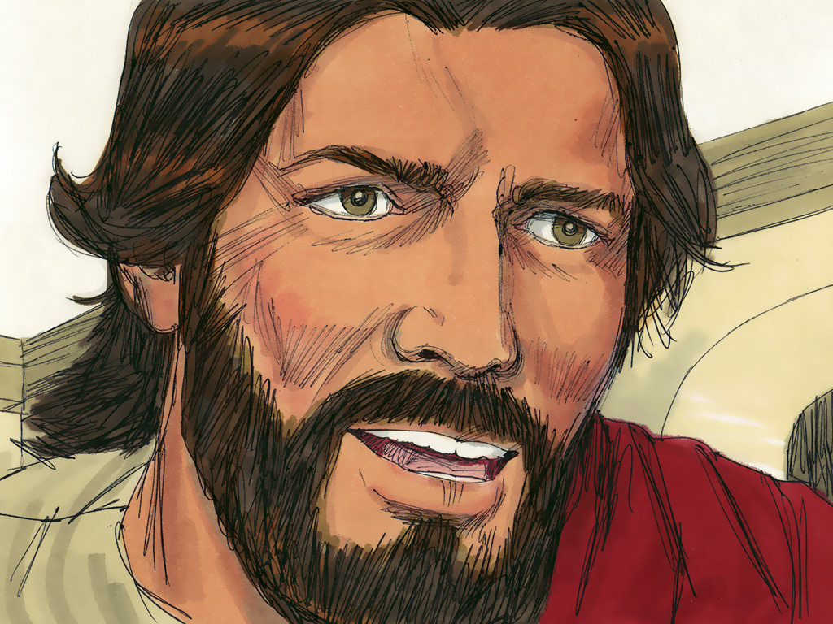
11
“No one, sir,” she answered. “Well, then,” Jesus said, “I do not condemn you either. Go, but do not sin again.”

Slide 18
Leader: The Gospel of the Lord.
All: Praise to You,
Lord Jesus Christ.

Slide 19
GOSPEL MESSAGE

Slide 20
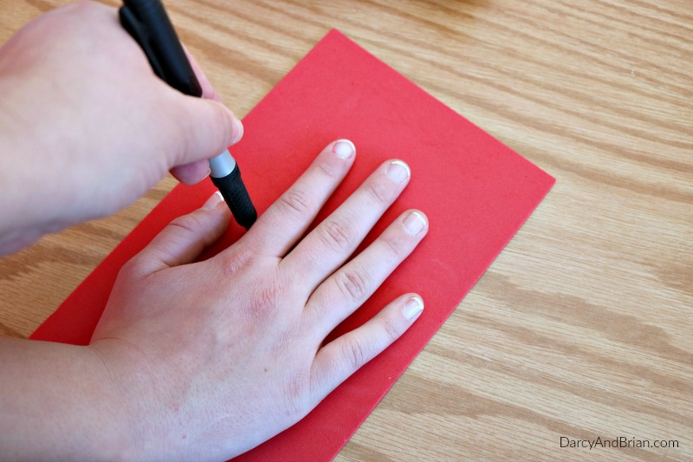
“A LESSON FOR ME”
(Hand Tracing Activity)

Slide 21
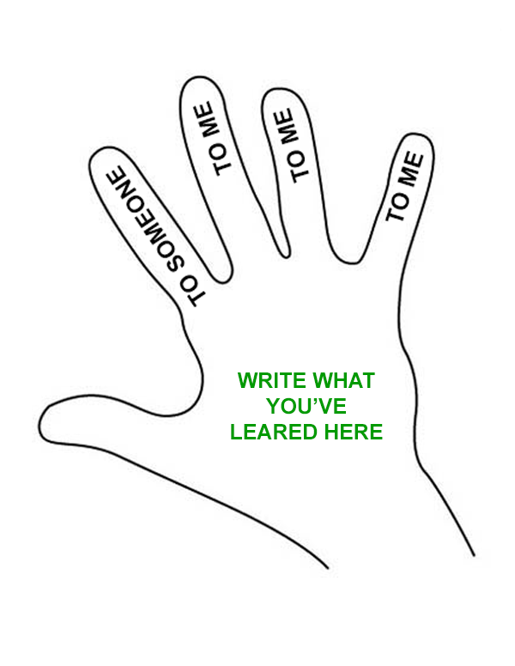
A LESSON FOR ME
(Hand Tracing Activity)
MATERIALS NEEDED:
Construction Paper or Bond Paper
Marker / Pen
Coloring Materials

Slide 22
A LESSON FOR ME
(Hand Tracing Activity)
Trace your hands on a piece of construction paper or bond paper.
Label the index finger - "TO SOMEONE".
Label the other 3 fingers not including the thumb - "TO ME".
Write (inside the palm part) what you've learned from the Gospel in our bible study today.
Take time and have fun coloring your traced hand while making sure that the lesson learned is still readable.

Slide 23
"Remember, when you point your finger at someone, there are three fingers pointing back at you.“
Try it, point your finger at someone and then look at your hand. Three fingers are pointing back at you!

Slide 24
Closing Prayer
Let’s pray the Act of Contrition
O my God, we are sorry for our sins because we have offended you. We know that we should love you above all things. Help us to do penance, to do better, and to avoid anything that might lead us to sin.
In Jesus’ name, we pray. Amen.

Slide 25
LIVE THE WORD KIDS
5th Sunday of Lent | Cycle C

