Slide 1
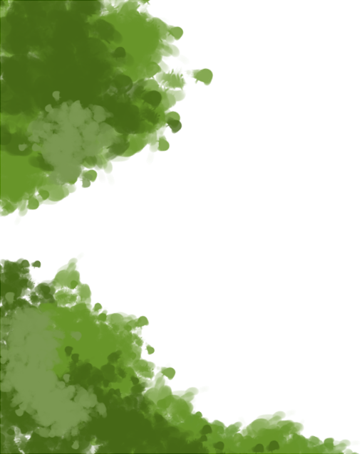




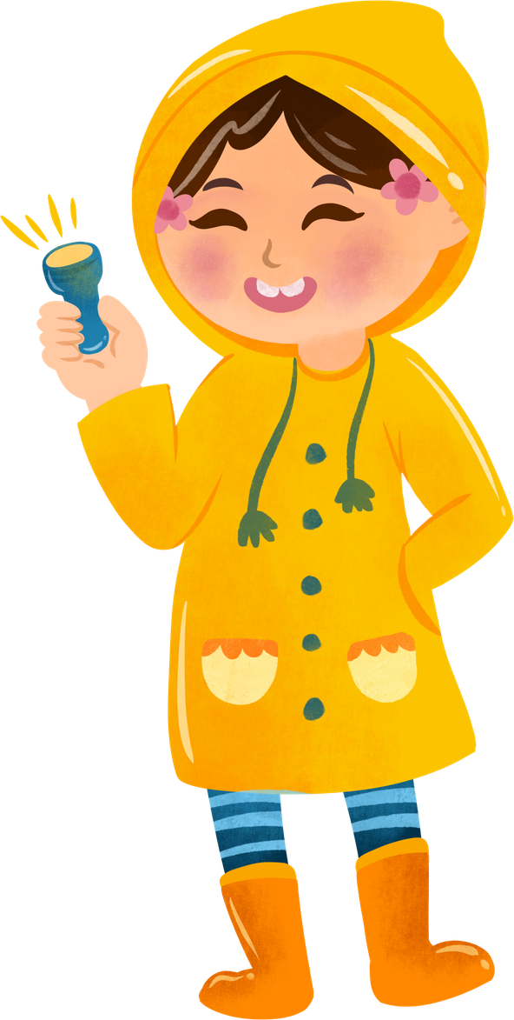
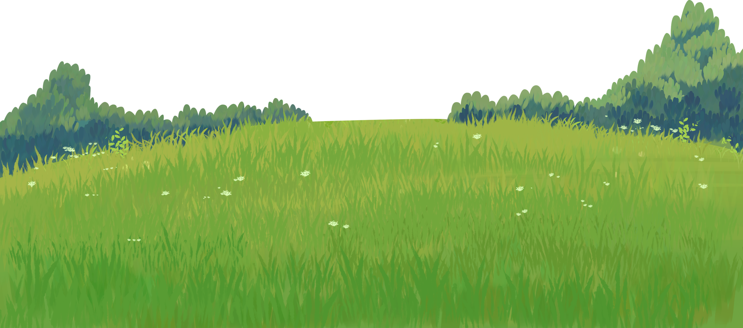
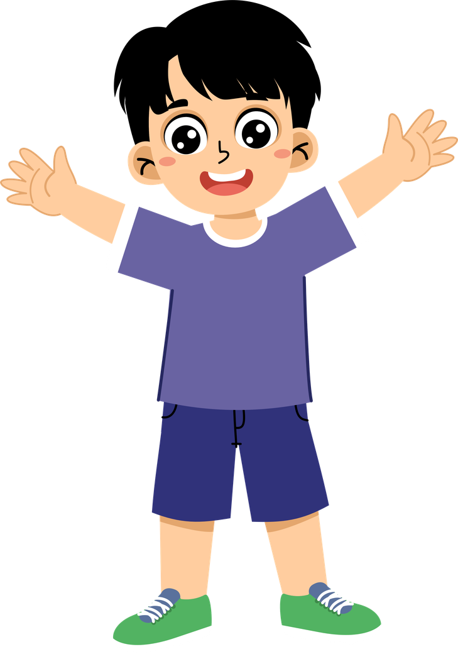
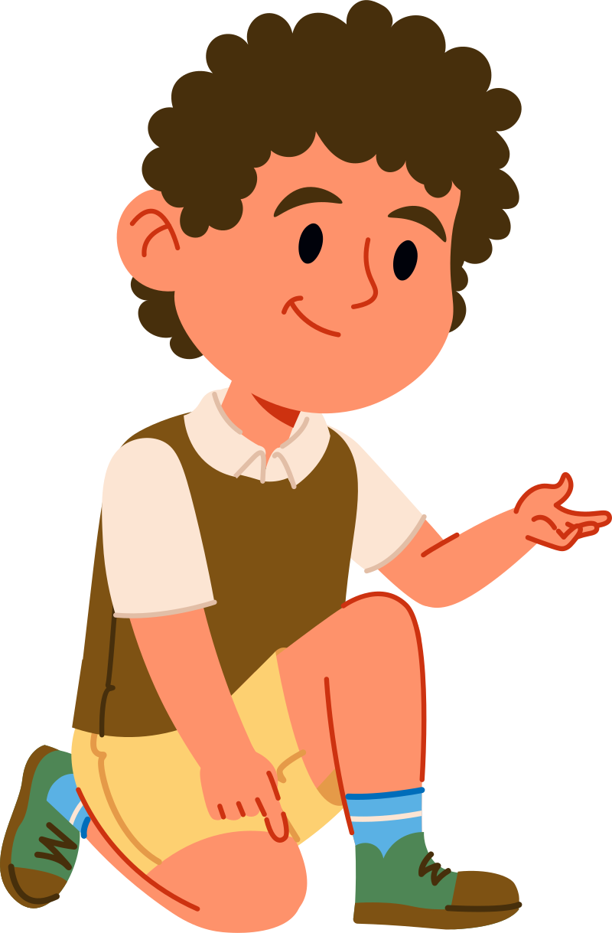
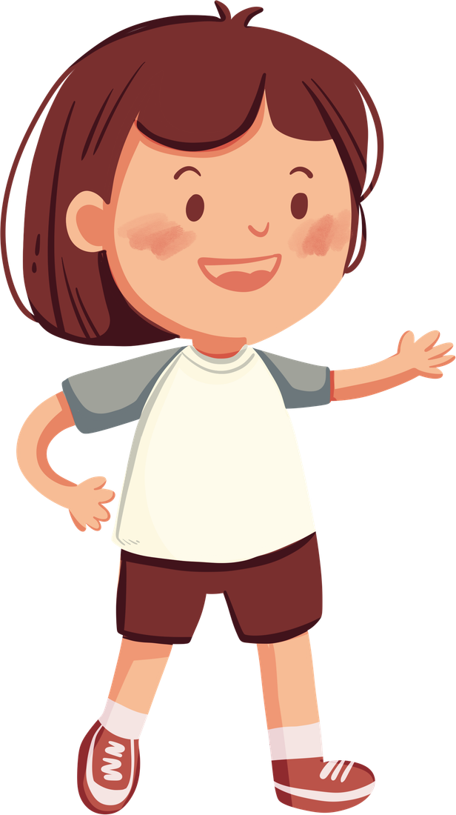

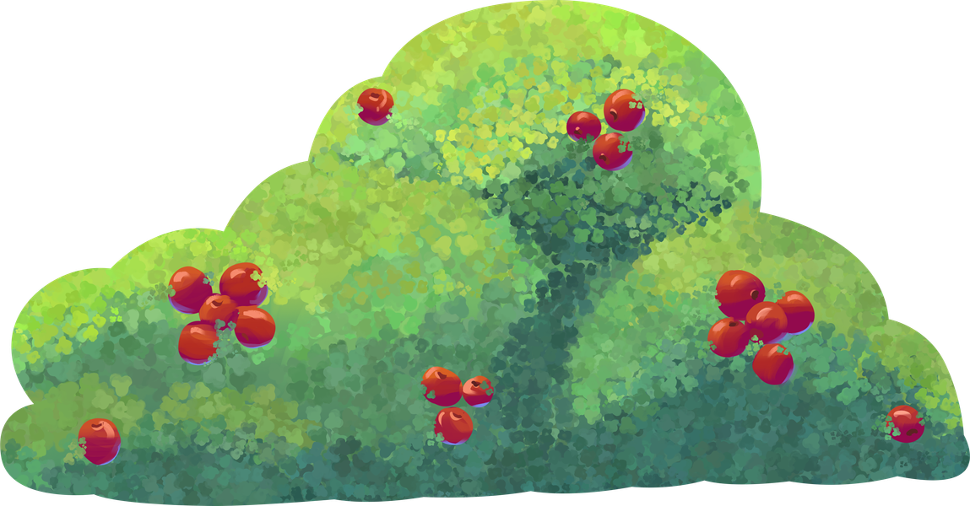
PEACE
STARTS WITH ME
JULY 2026

Slide 2
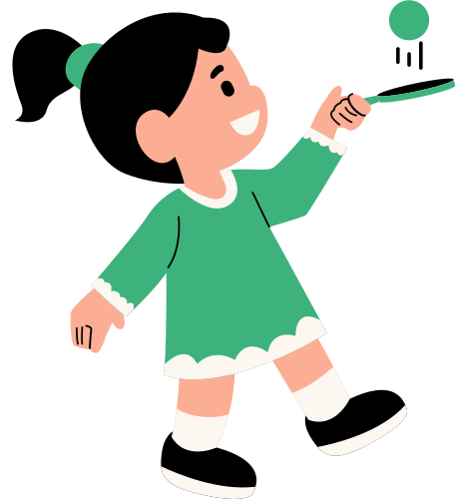
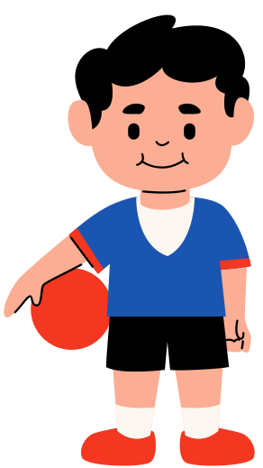
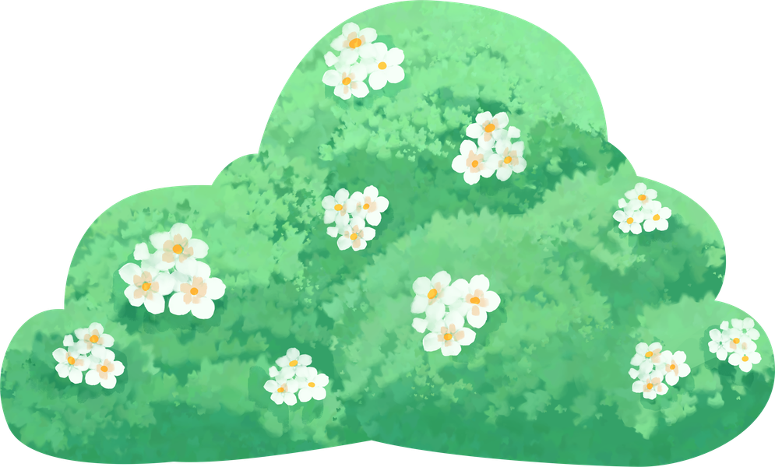
PEACE MAKER
OR
TROUBLE MAKER?

Slide 3
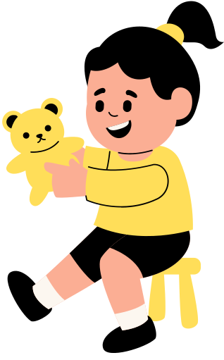

Sharing your toys.
Calling your classmate names.
Saying "I'm sorry."
Hitting your sibling because you're angry.
Helping two friends become friends again.
Gossiping about someone.
Waiting for your turn.
Shouting when someone makes a mistake.
Forgiving someone who hurt your feelings.
Saying hurtful words when you're angry.

Slide 4
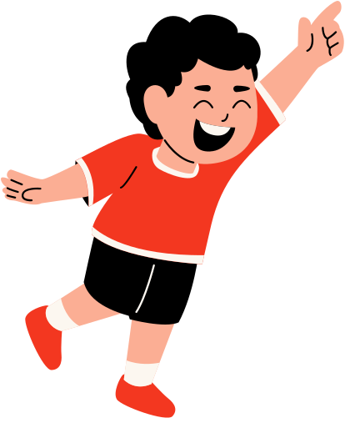
MATTHEW 5:9
Blessed are the peacemakers, for they shall be called children of God.

Slide 5

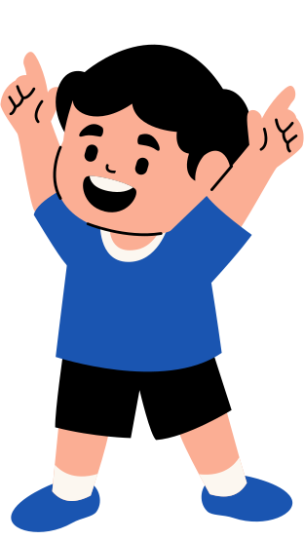
CHOOSE KIND WORDS INSTEAD OF HURTFUL WORDS

Slide 6
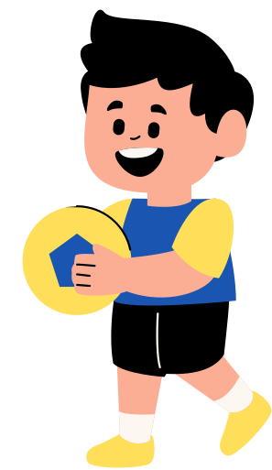
LEARN TO FORGIVE.

Slide 7
SAY "I'M SORRY."

Slide 8
HELP OTHERS BECOME FRIENDS AGAIN.

Slide 9
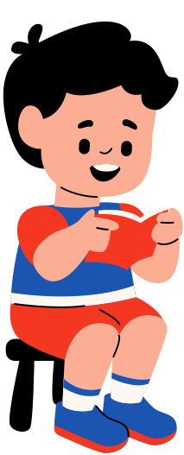
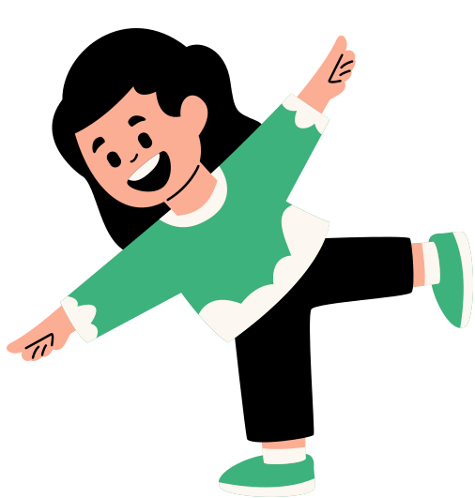
CLOSING PRAYER
Dear Jesus,
Thank You for loving us and teaching us how to live in peace. Help us to use kind words, forgive those who hurt us, and say sorry when we make mistakes. Teach us to stop fighting and become peacemakers in our homes, our schools, and our MFC Kids family. May our words and actions always bring love, joy, and peace to everyone we meet.
Amen.

Slide 10
PEACE
STARTS WITH ME
JULY 2026

