Slide 1




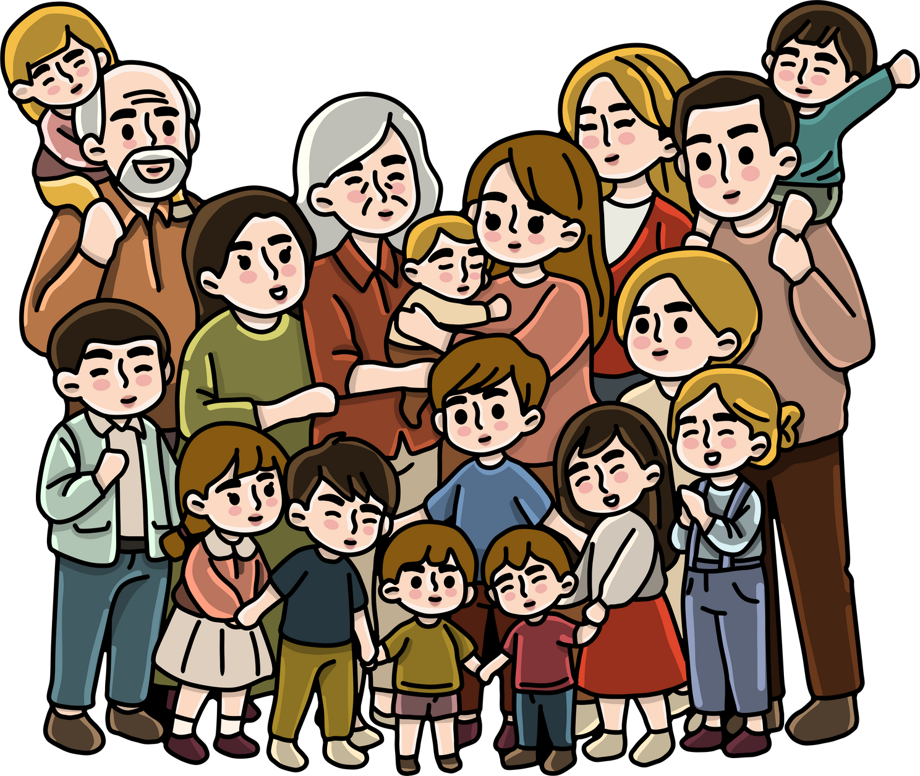


GOD’S GIFT: FAMILY AND LIFE
Live Life Kids

Slide 2

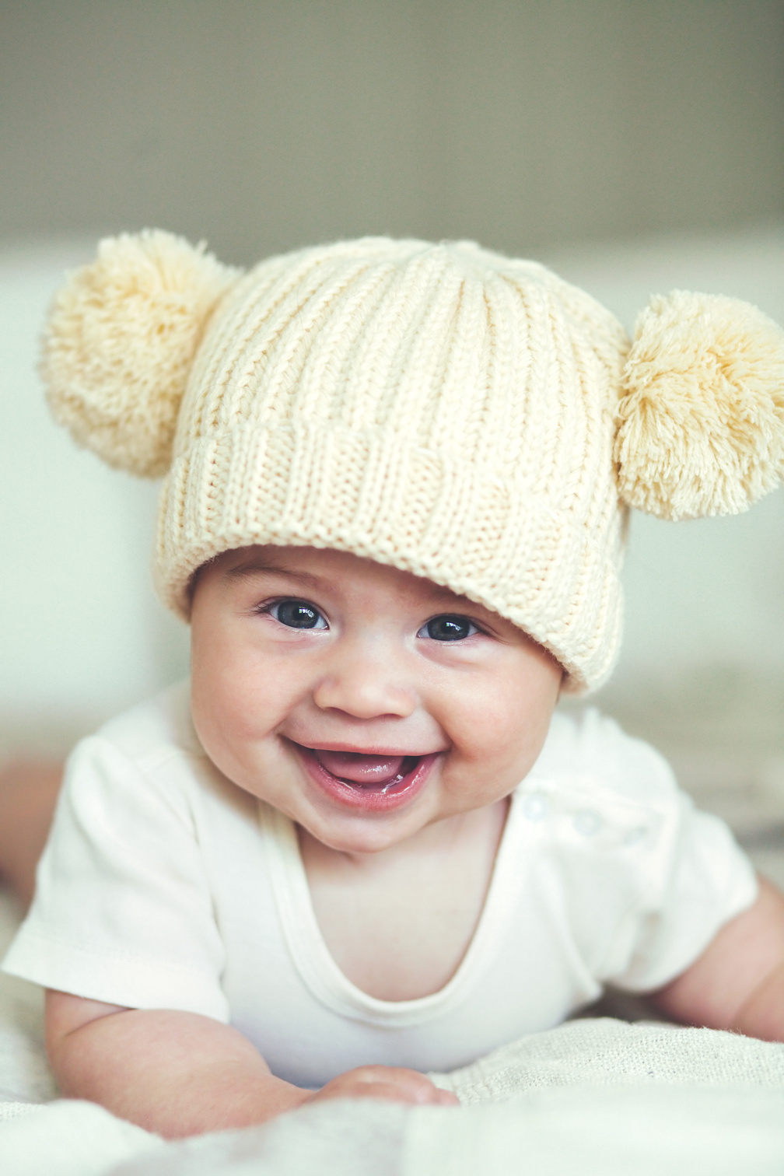



Life is a gift from God because He made each one of us with love. He made each of us special and gave us the chance to smile, play, learn, and love.

Slide 3

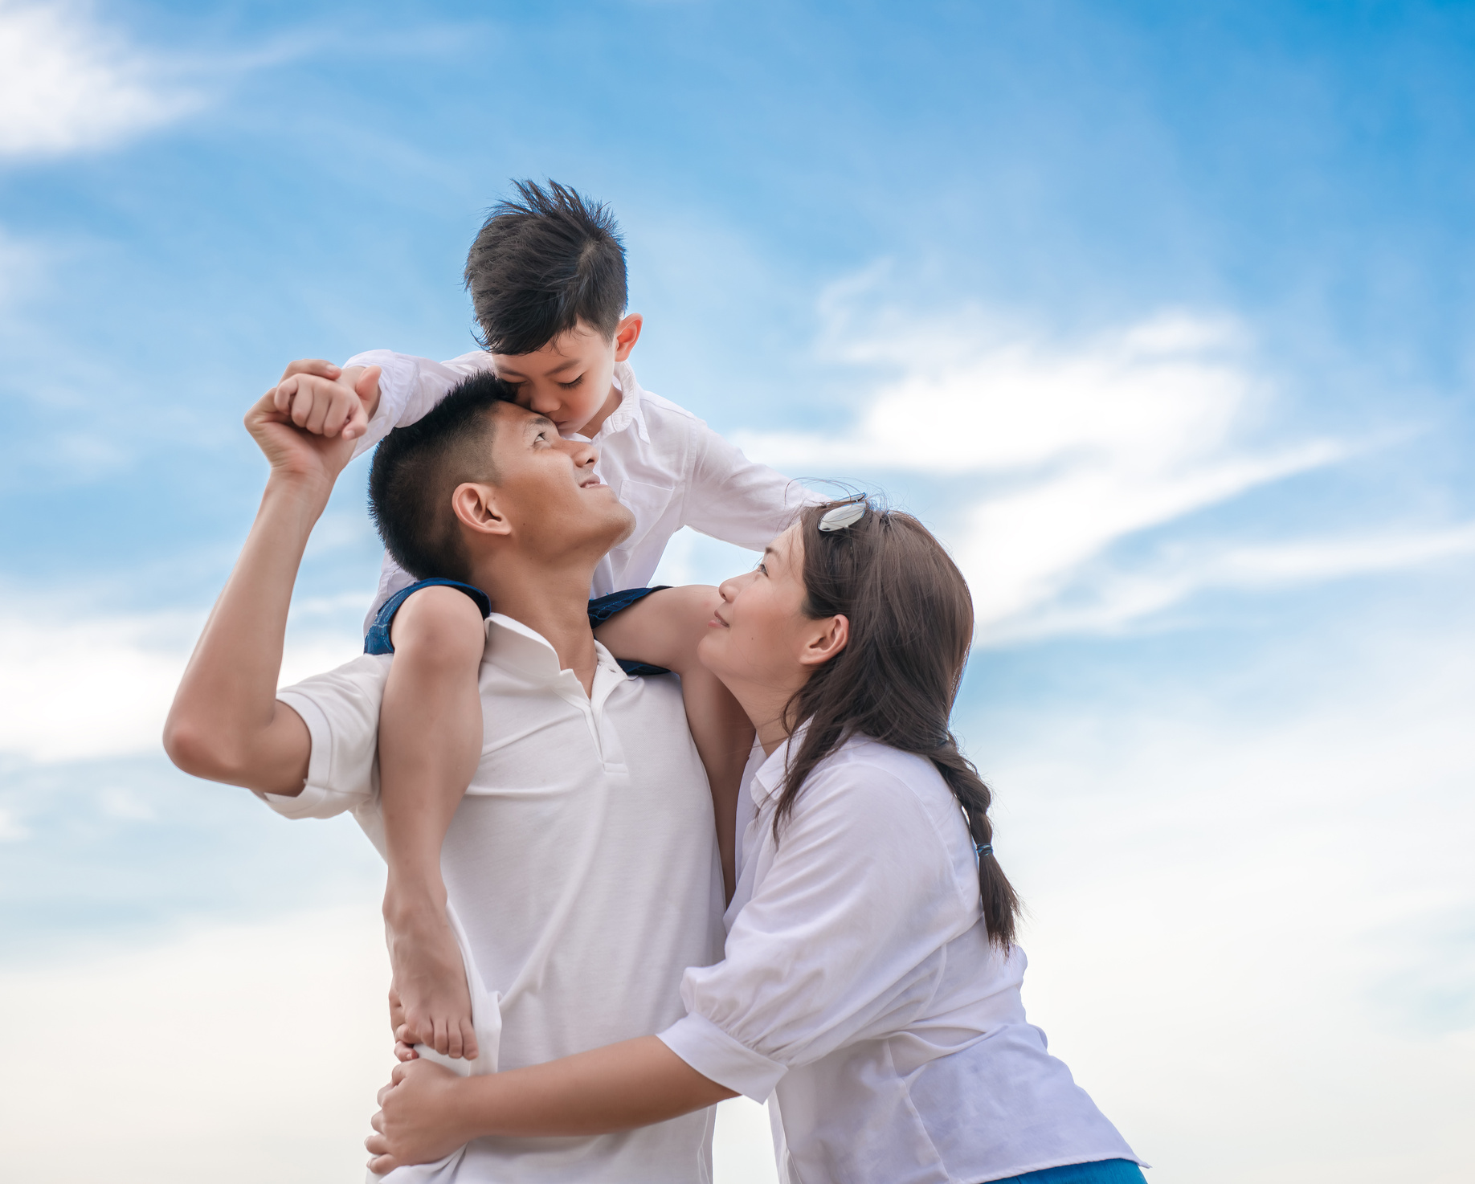



Our families are one of the most special gifts God has given us. They love us, care for us, and help us grow into the people God wants us to be. Our life is God's perfect gift, and He chose our parents to bring us into the world.

Slide 4



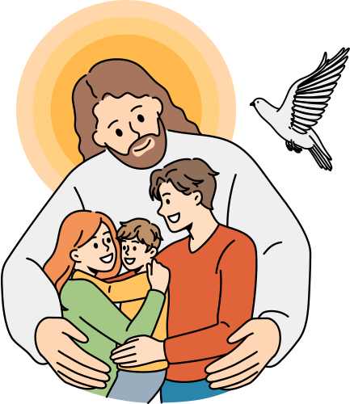


God is the perfect example of a Pro-Life Warrior, honoring life and those around Him.

Slide 5


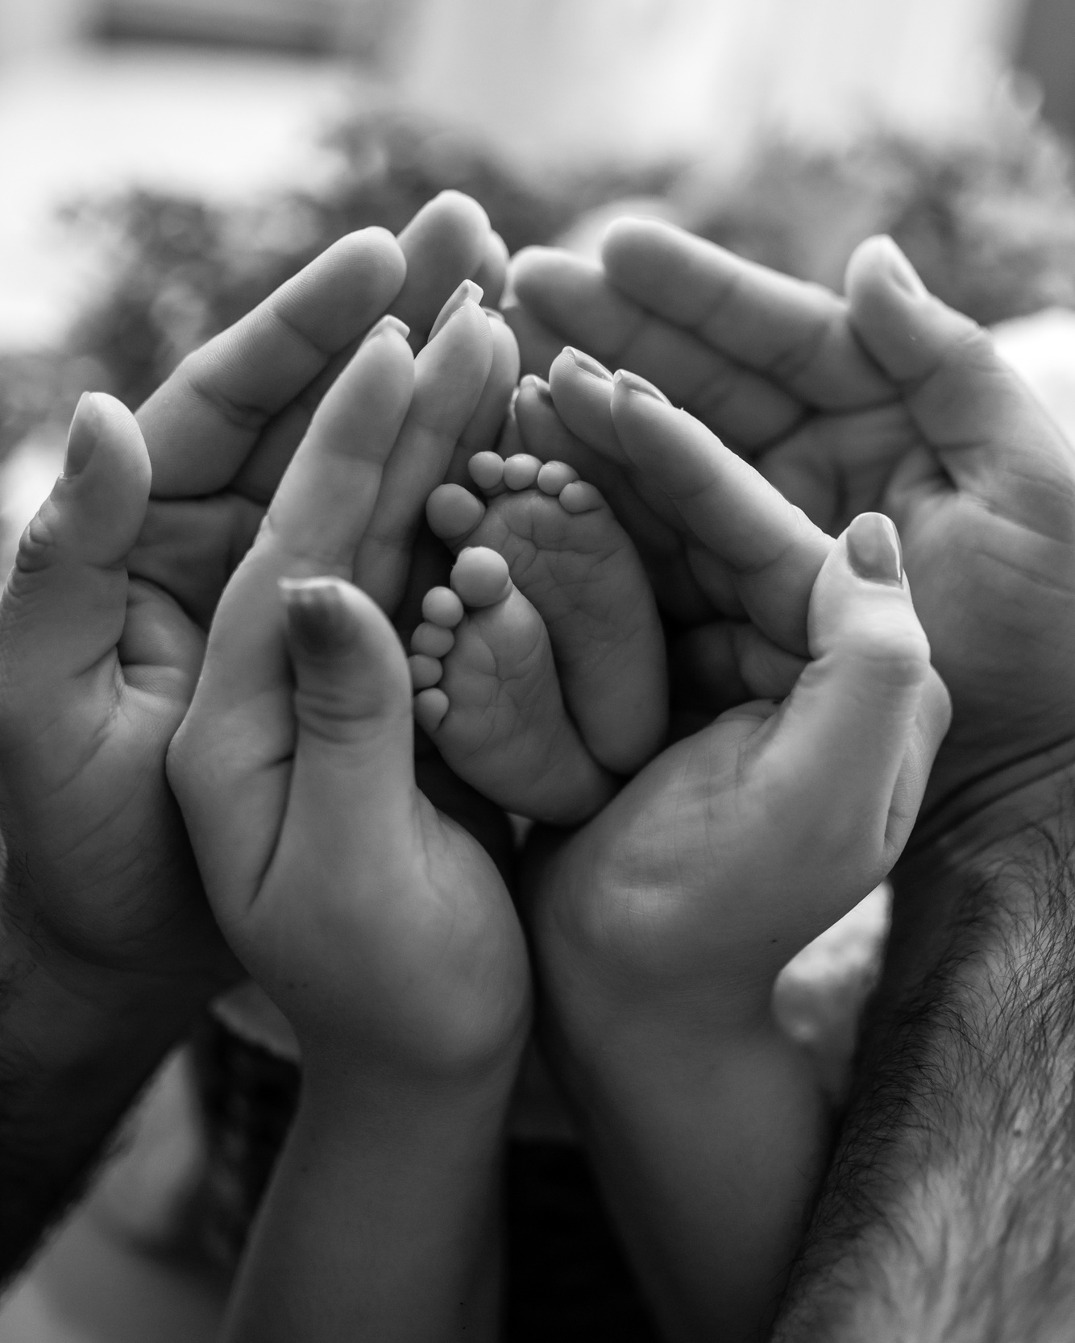



Being a Pro-Life Warrior means standing up for the value of every human life, especially babies who are still growing in their mother’s womb and cannot speak for themselves.

Slide 6
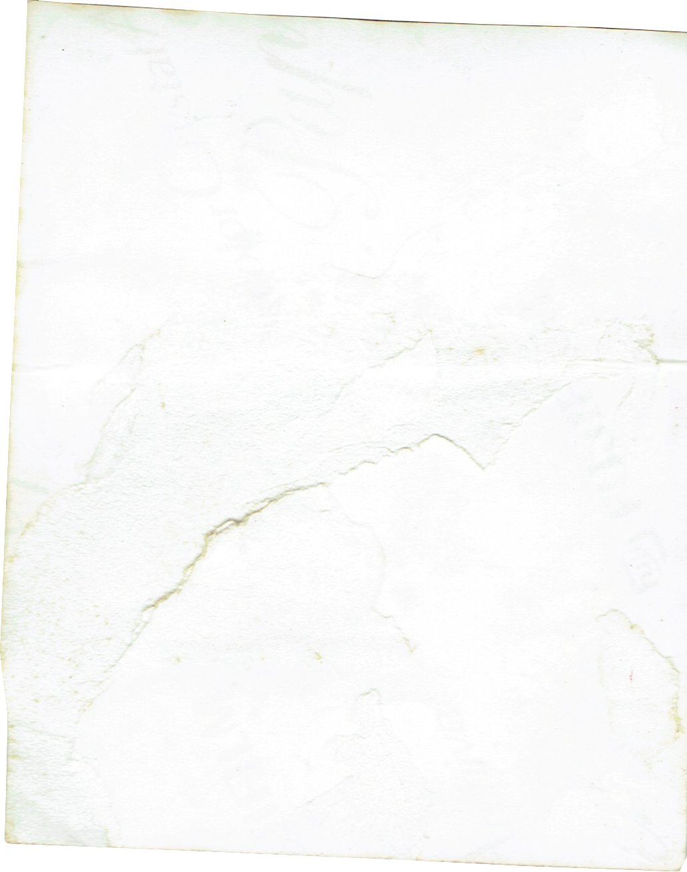



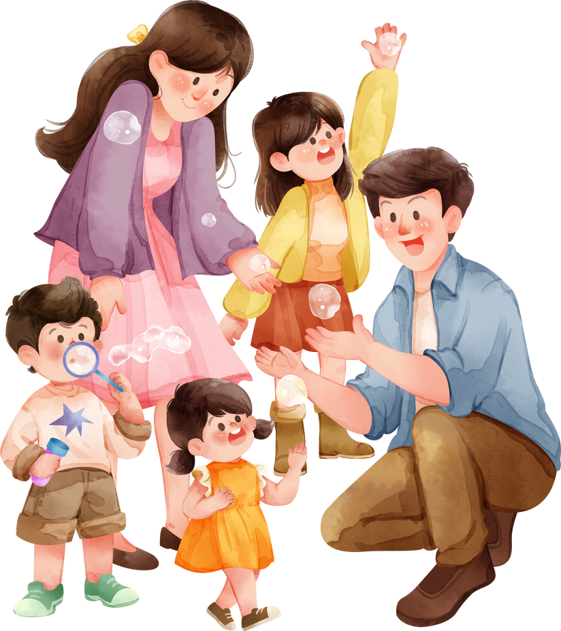

Respect and Listen to Your Parents

Slide 7

Help and Serve Others

Slide 8

Be a Kid Pro Life Warrior

Slide 9
GOD’S GIFT: FAMILY AND LIFE
Live Life Kids

