Slide 1

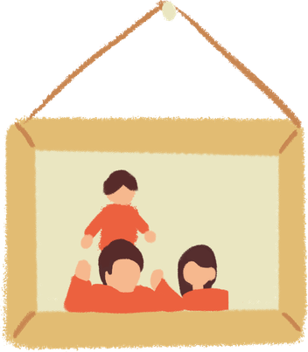

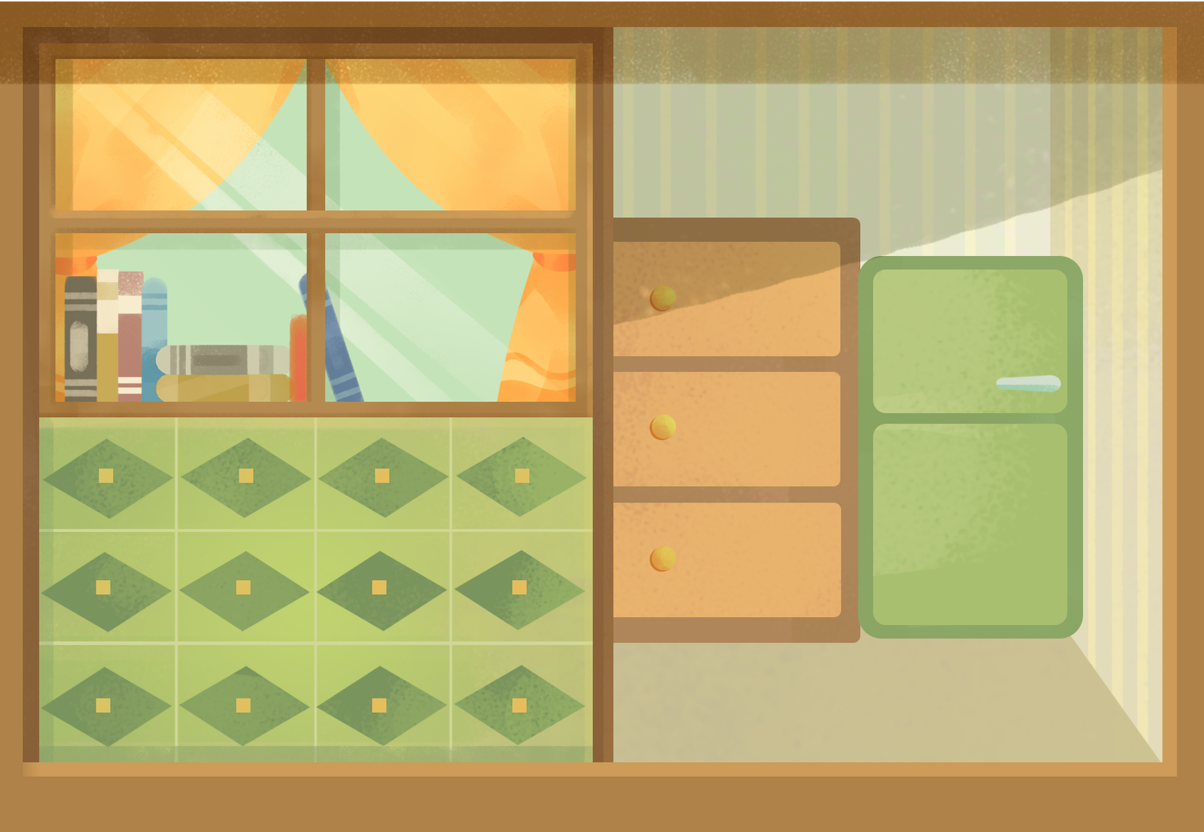
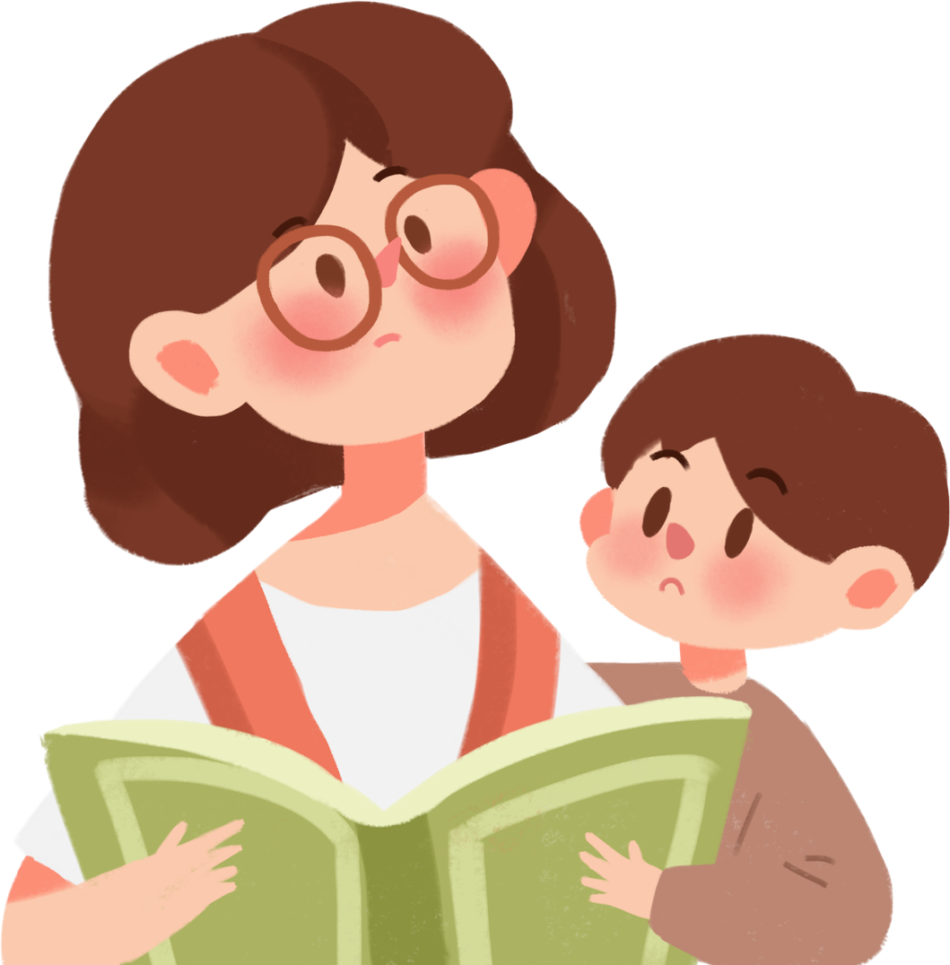





HONEST
HEART
August KAT

Slide 2
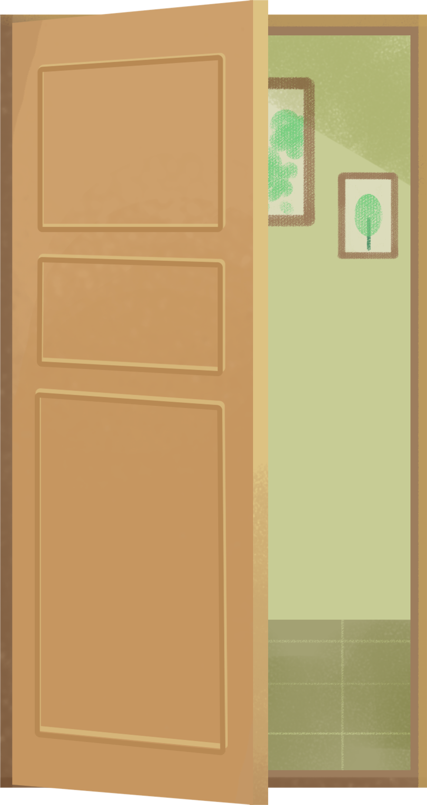



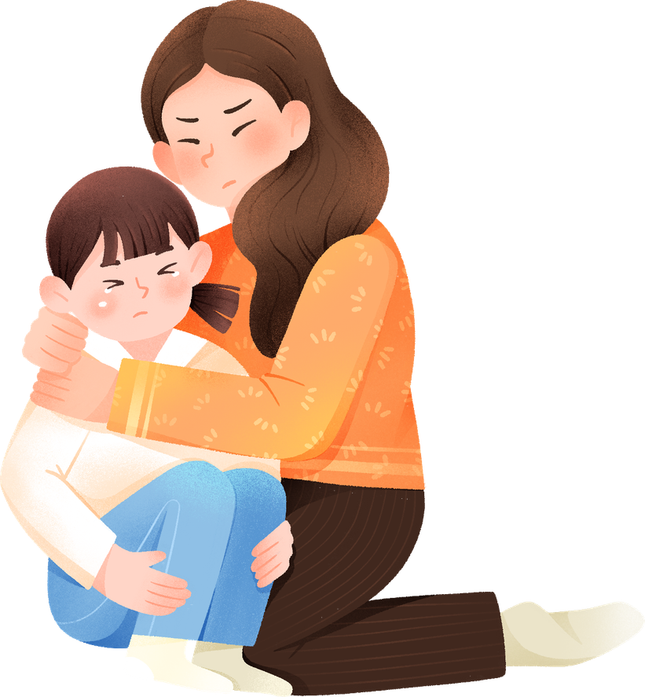



Sometimes we make mistakes, and it can be scary to admit what we did. But God looks beyond our actions—He looks at our hearts. He wants each of us to have a pure heart, a heart that loves the truth, chooses what is right, and is honest.

Slide 3


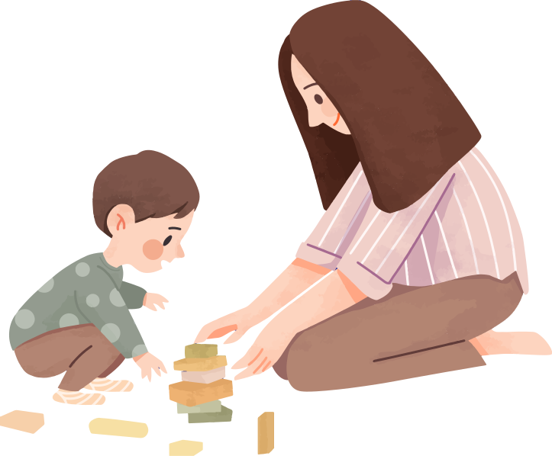
Being honest means telling the truth, admitting when we make mistakes, not cheating or taking things that do not belong to us, keeping our promises, and doing the right thing even when no one is watching. Every time we choose honesty, we show God's goodness in our lives and allow Him to shape our hearts to become more like His.

Slide 4



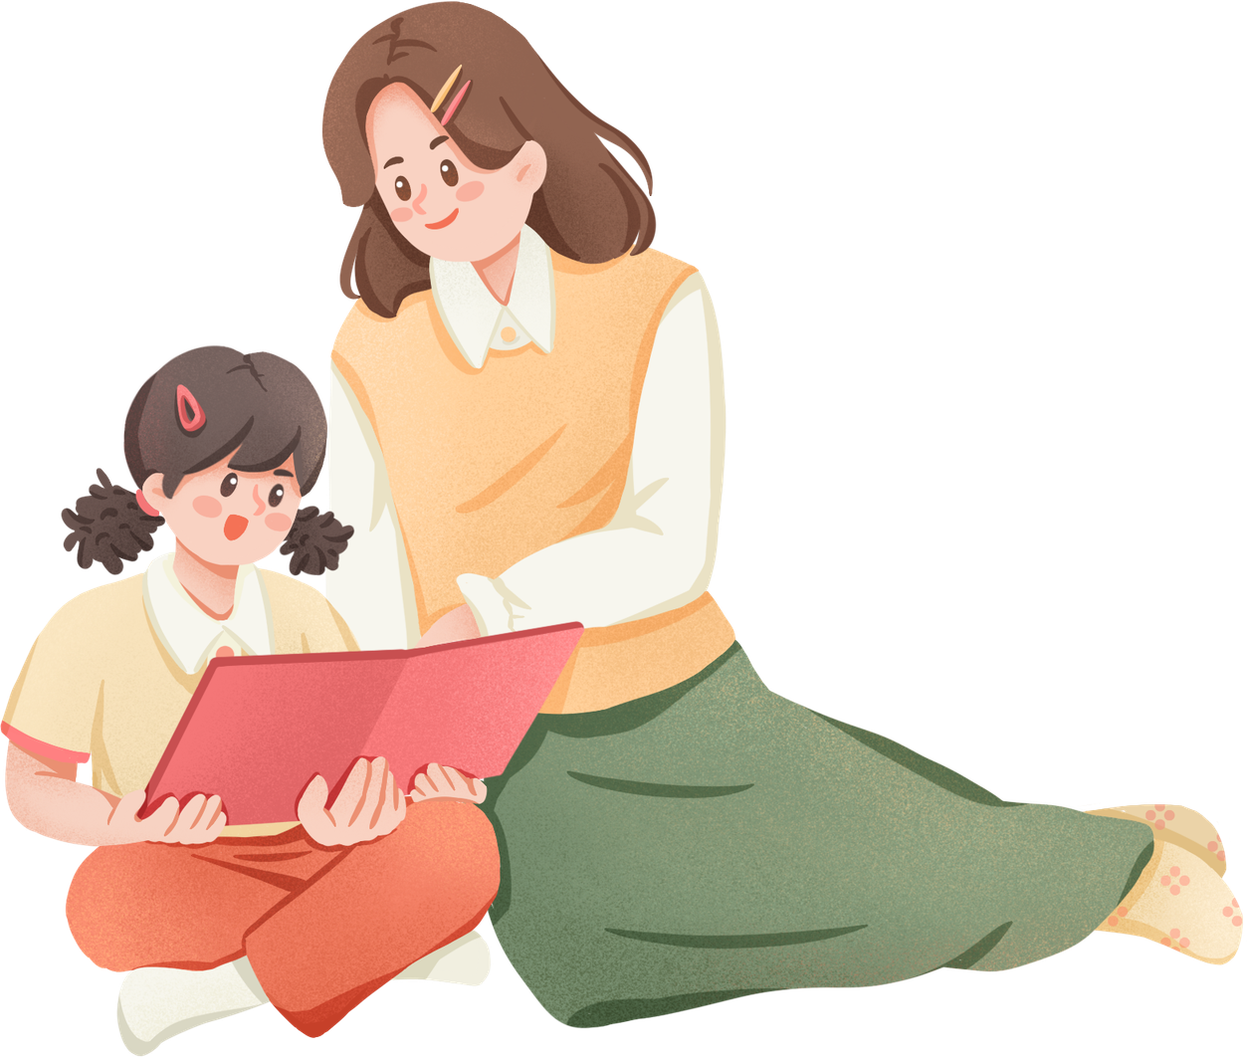

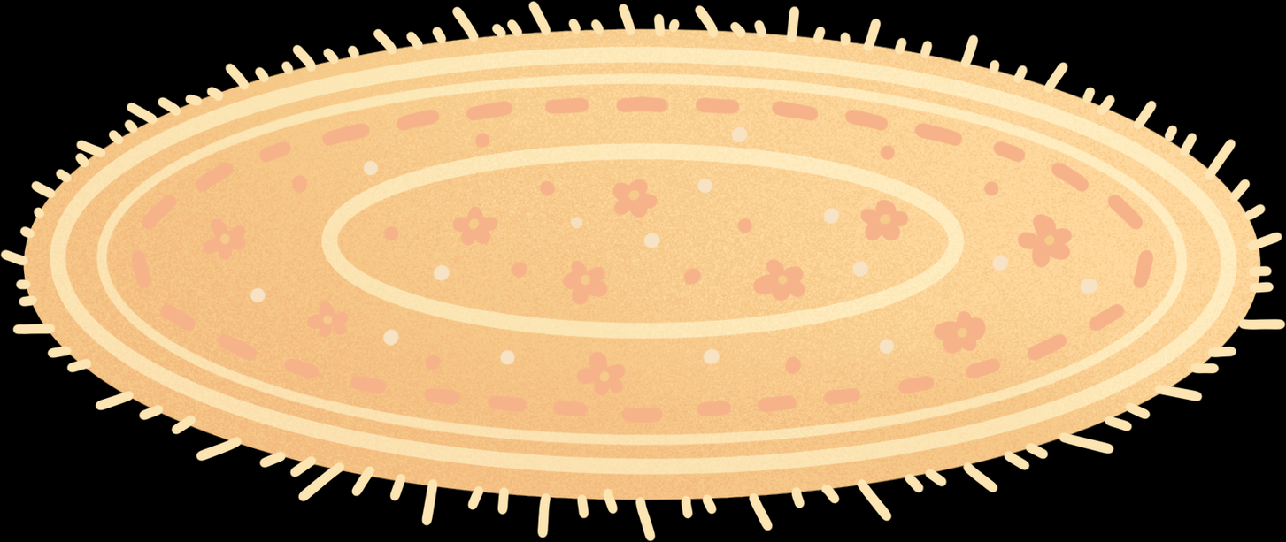
Blessed are the pure in heart, for they will see God.
Matthew 5:8

Slide 5



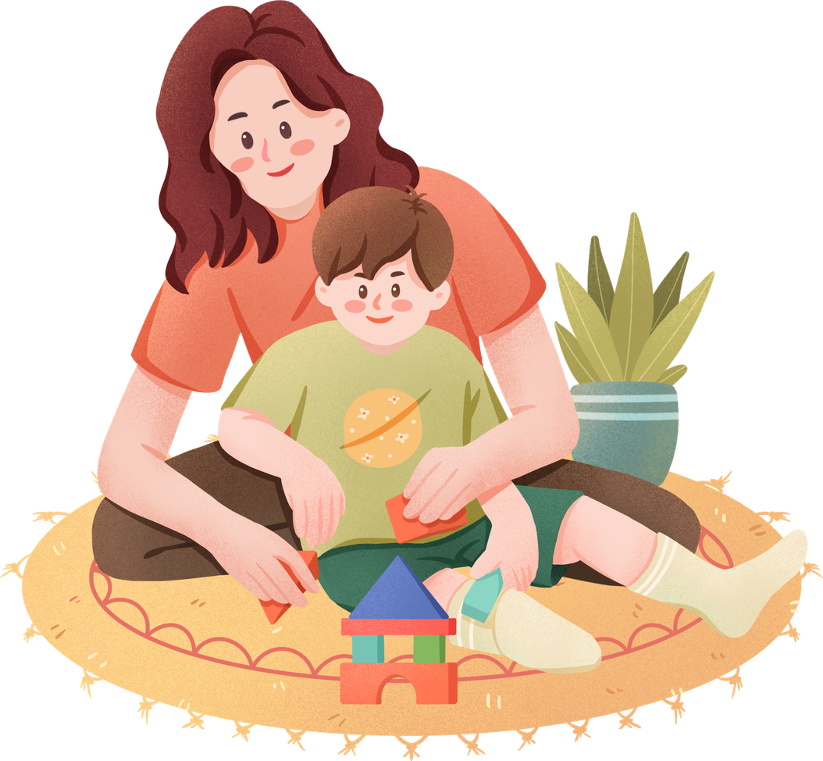
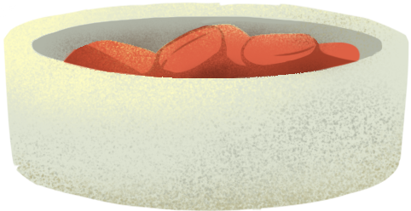
Honesty Pleases
God

Slide 6
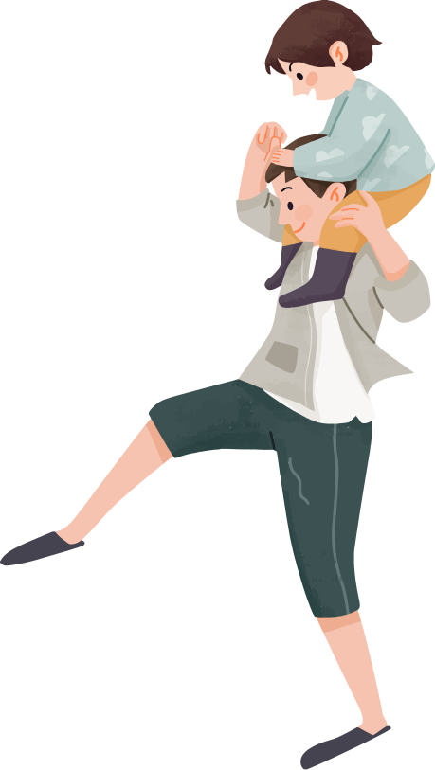

Honesty Builds
Trust

Slide 7
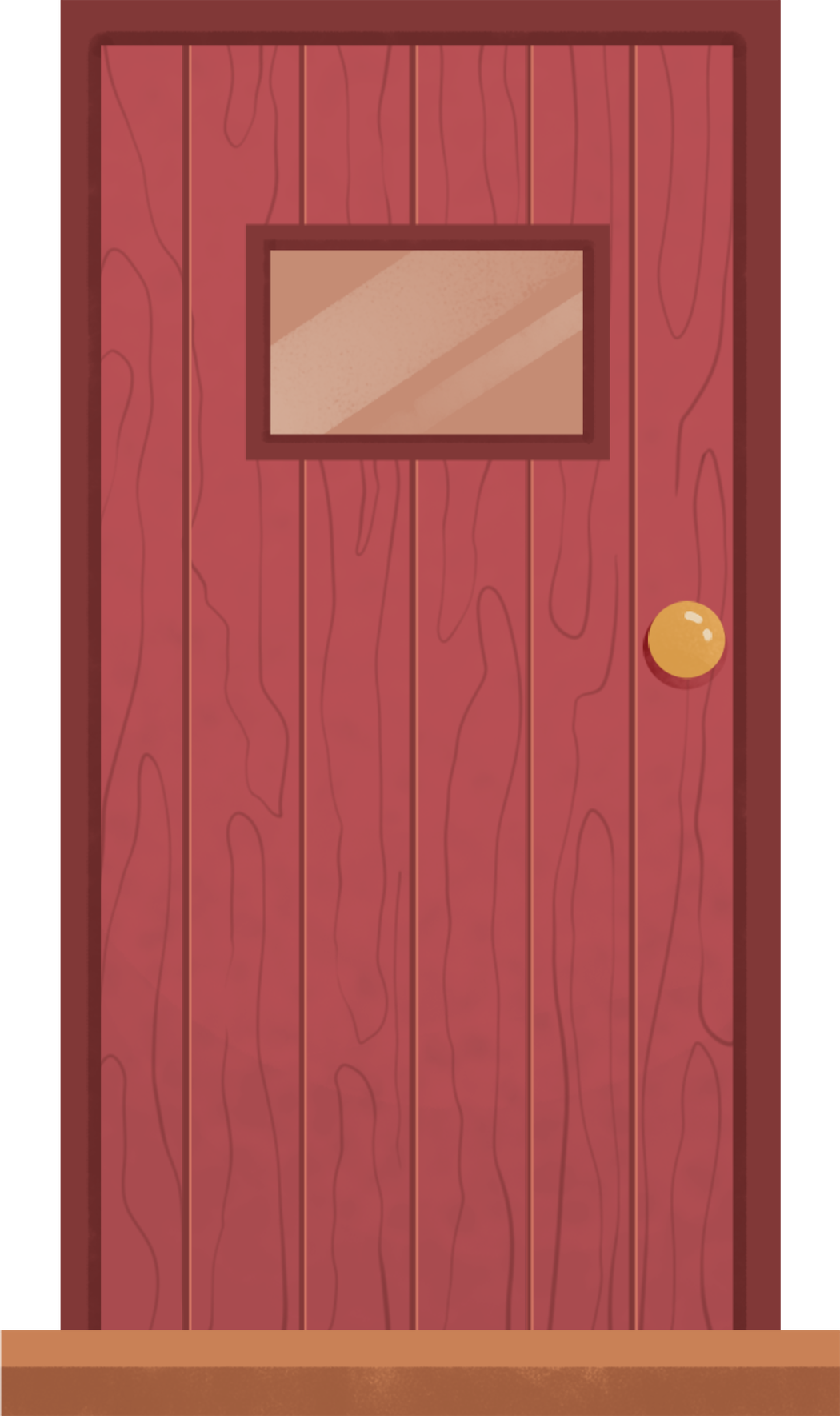
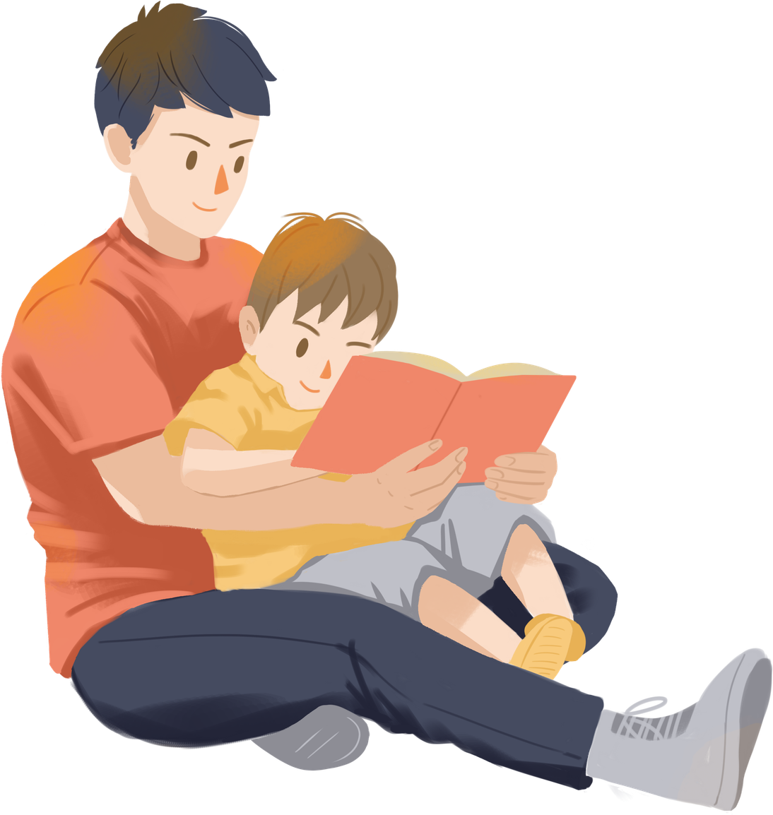
Honesty Gives Us Peace

Slide 8

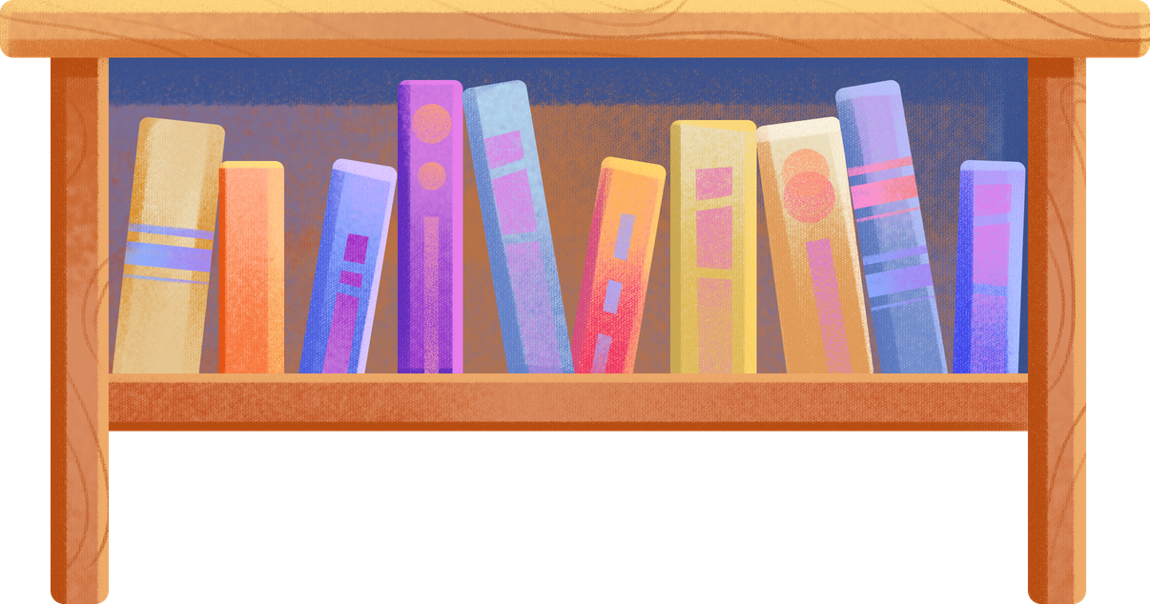
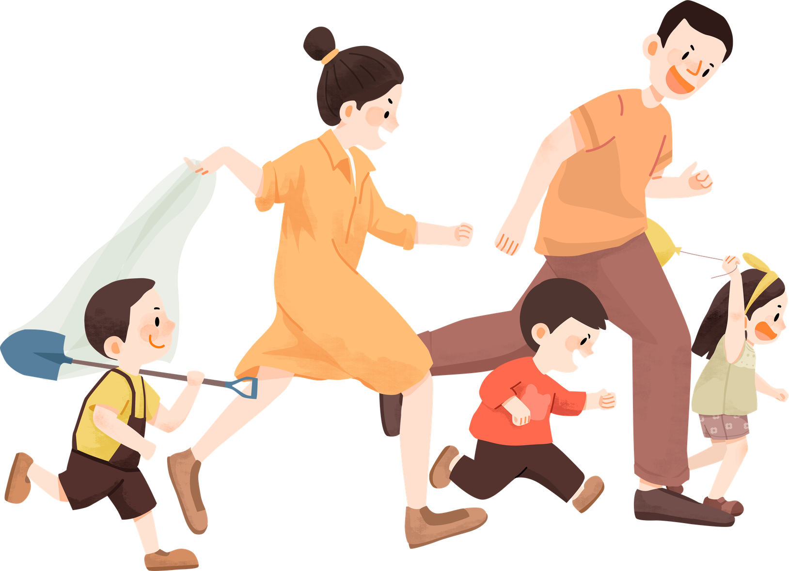

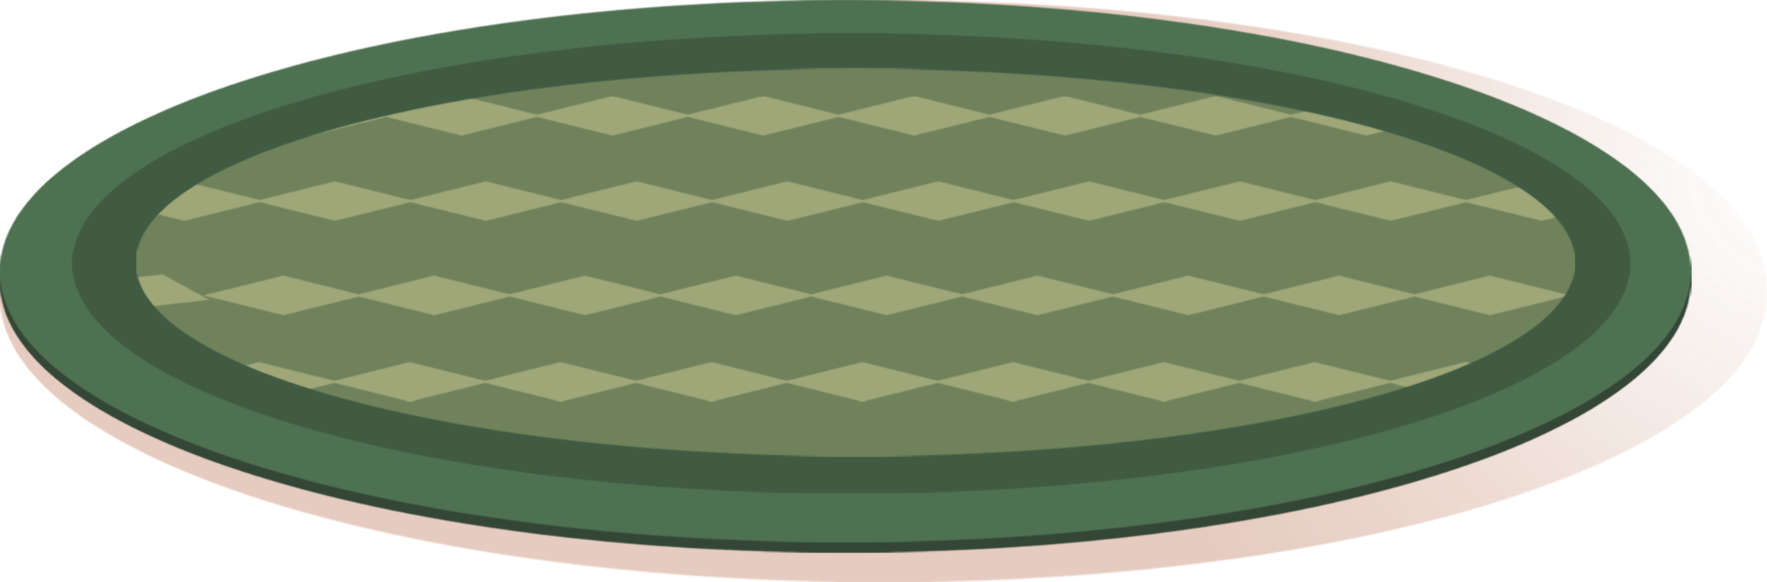
Honesty is a choice we make every day through our words and actions. Whether we are at home, at school, or with our friends, we can show honesty by telling the truth, taking responsibility for our mistakes, and doing what is right. Jesus showed us the perfect example of living truthfully, and when we follow Him, He helps us become children with pure hearts who honor God in everything we do.

Slide 9

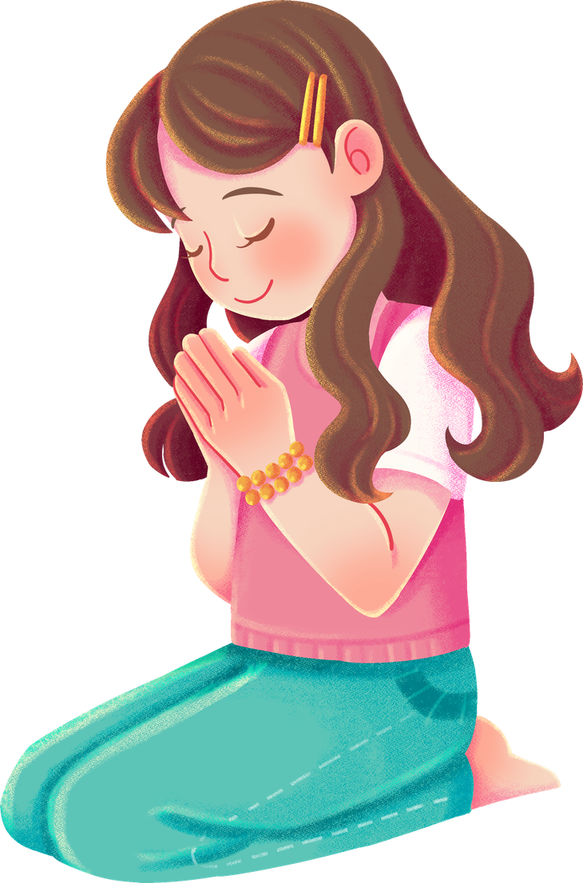
CLOSING PRAYER
Dear Jesus,
Thank You for loving us and teaching us to live with honest and pure hearts. Help us to always tell the truth, even when it is difficult. Give us courage to admit our mistakes and choose what is right. Make our hearts clean, kind, and full of Your love so that we may become more like You each day.
Amen.

