Slide 3
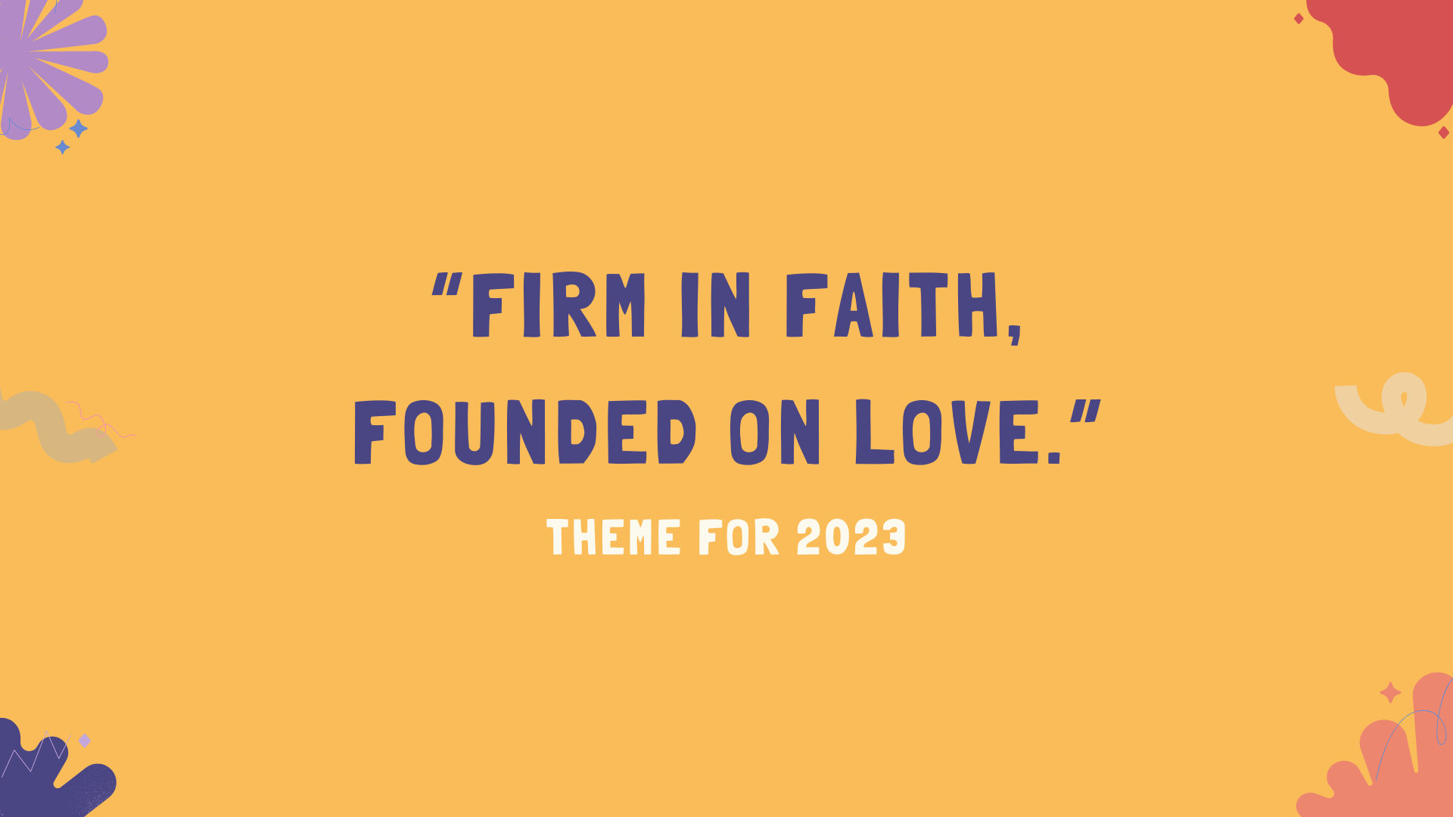

Slide 5
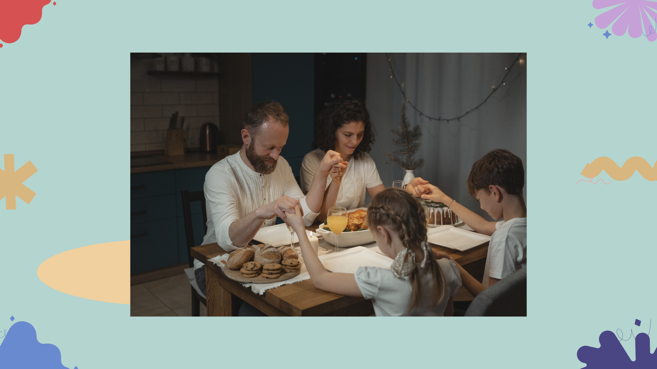

Slide 10
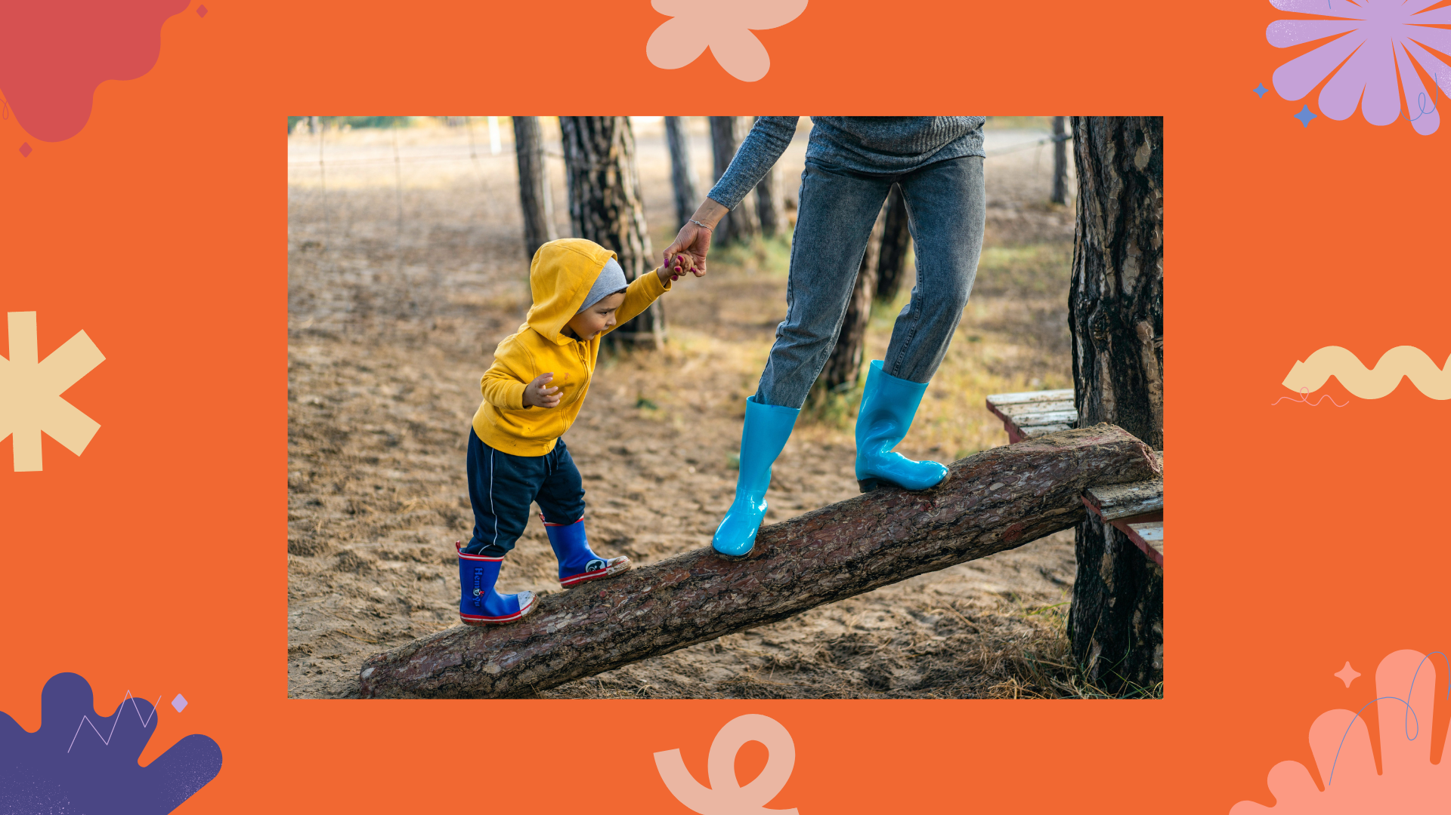

Slide 14
Let’s recite the
MFC Kids Promise

Slide 15
1. I will imitate Jesus.
• I will pray to God and read the Bible every day.
• I will make Jesus as my role model by obeying rules and doing good in school.
2. I will be a good family member.
• I will be a good son/daughter to my parents by obeying and respecting them.
• I will be a good sister/brother to my siblings through sharing and supporting them.

Slide 16
3. I will be an active member of MFC Kids
• I will always attend and participate in all MFC Kids activities.
• I will share my time, talents, and treasures to others especially to my brothers and sisters in MFC Kids
• I will love, respect and be loyal to my MFC Kids family.
4. I will tell others about Jesus.
• I will love my brothers and sisters, relatives, and friends by doing good deeds every day that will reflect God's love.
• I will serve in our Parish Church.
• I will love the poor by sharing what I have with them

Slide 18
ACTIVITY TIME

